Slide 1
Mises University--2020
The Minimum Wage
Dr. Mark Thornton
@DrMarkThornton
Notes:
Tuesday, July 16th 3:00-3:45 Wolfe Hall
Slides 1-14

Slide 2
Main Takeaways
2020 Record number of increases by states and local governments
Austrian versus Mainstream approaches
MWL increases did not satisfy advocates
Progressive origins of the MWL
Notes:
Method notes: Ceteris Paribus, holistic, realistic, mundane, not just P&Q

Slide 3
What is the Minimum Wage
Law that sets a “floor” on payments to labor
You can pay higher wages, but not lower
Federal MWL is $7.25 per hour
31 States have MWL higher than federal
Cites such as Seattle, San Francisco, Portland, Los Angeles, Kansas City, and DC have MWL higher than state levels
Notes:
Price floors can create surpluses (not a good thing). More available than can be efficiently used.

Slide 4
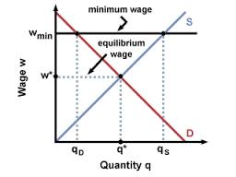
Conventional Analysis
Notes:
Method notes: Conventional-mainstream analysis hinges on two data points (Price & Quantity). You can measure them, but “jobs” are complex contractual arrangements involving dozens of things, not just wage rate. Mainstream hinges on measurement. Austrians do measure things, but that is not the important issue and can be misleading.

Slide 5
What Does the MWL Do?
On the one hand
On the other hand
“There’s just no evidence that raising the minimum wage costs jobs, at least when the starting point is as low as it is in modern America...” [this apparent defiance of the laws of supply and demand occurs because]“the market for labor isn’t like the market for, say, wheat, because workers are people.”
“Any Econ 101 student can tell you the answer: The higher wage reduces the quantity of labor demanded, and hence leads to unemployment. Clearly these advocates (of MWL) very much want to believe that the price of labor–unlike that of gasoline, or Manhattan apartments–can be set based on considerations of justice, not supply and demand, without unpleasant side effects…”

Slide 6


Who Said Those Things?

Slide 7
Seattle: A Tale of Two Studies
University of California-Berkeley
University of Washington
Food Service Industry
$11-$13 (18% increase)
Little/no change in wage-pay and employment in full service (i.e. high skill) (tip and benefit exemption) 1%+
Limited service increases less than expected by 4%
Hours worked decline by 13%
Not just food service but all industries with low wage workers
Reduced hours by 9%, increased wages by 3%, reduced monthly pay by $125
Increased high skill $19+/hr. jobs

Slide 8
Reconciliation
Both studies say the same thing--increase wage (price) decreases hours worked (quantity demanded) and reduces monthly pay.
Both studies find relative substitution of high skill for low skilled jobs.
Seattle was Bubblesville in 2016. More construction cranes than NYC and LA combined!

Slide 9
Austrian Perspective on MWL (Labor)
MWL causes some combination of the following:
Unemployment
  Fewer hours, Fewer jobs, Fewer employers (esp. small business)
Decrease job benefits
  For example, Health insurance, Vacation & Sick days, Clean uniforms, etc.
Decrease job desirability
  For example, Harder work, Less sanitary conditions, Less lighting, air conditioning, etc.

Slide 10
Continued (Capital)
Increased Demand for High Skilled Labor
Jobs are automated (partially or completely)
Notes:
Differences converge at older ages

Slide 11
Discrimination
Discrimination of minorities and inexperienced
Unemployment Rate – 2nd Quarter 2017
Total Unemployment = 4.2%
Total 16-17 = 16.4%
White 16-17 = 14.7%
Black 16-17 = 27.8%
Hispanic 16-17 = 19.0%

Slide 12
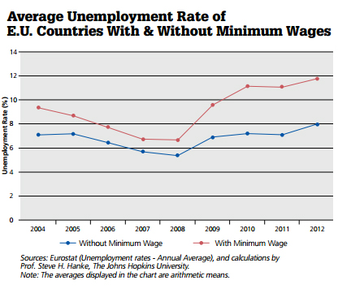
EU Employment 2004-2012
Notes:
Teen unemployment in 2012 was 20% and 28%

Slide 13
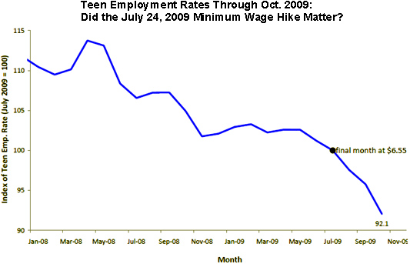
Teen Employment and the Last Hike in the Minimum Wage Law-2009
Notes:
Jan 08 to July 09 =10% decline in employment in 19 months
July 09 to Oct 09 = 8% decline in employment in 4 months

Slide 14
Conclusions
Wage rates determined market conditions, the relative scarcity of human and non-human resources.
There is no unemployment in a pure market economy.
Wage rate increases are driven by increases in capital (saving) and the extension and expansion of the structure of production.
Early job experience improves lifetime employment
MWL: Hurt their “intended” beneficiary

Slide 15
How do help the poor
Eliminate MWL and compulsory education
Job experience leads to higher wages
Eliminate monopoly grants by government
Lowers cost of living & increases opportunity
Eliminate taxes on labor
Higher wages & income, more jobs
Eliminate the “Welfare Trap”

Slide 16
Labor Misconceptions
Employers determine wage rates and working conditions
Malthusian trap—subsistence wages
Unions helps labor, Labor laws help labor
Nonsense! Under capitalism real wages have been rising, work week has fallen, child labor has fallen, and workplace safety has consistently improved-without government
“unemployment” 1888. Marshall--one page

Slide 17
Ludwig von Mises
“It is a distortion to say that factories carried off the housewives from nurseries and the kitchens and the children from their play. These women had nothing to cook with and to feed their children. These children were destitute and starving.” Human Action, Ch. 21
Mass production from the factories of the Industrial Revolution were produced to sell to the masses!

Slide 18
Labor versus Leisure
Labor is a factor of production
More labor = more production
  Limited by time (24 hrs/day)
  Limited by ability (skills)
  Limited by leisure (a desirable consumer good that must be foregone)
We work until the value or utility of the return from working is exceeded the disutility of giving up leisure whether producing goods for yourself or trading your labor to others.
MWL: Denies Low Productivity Workers
Notes:
How much will we work? Answered!

Slide 19
“Self Satisfaction” Counts
Some jobs provide direct satisfaction
Examples: Making wedding cakes and being an Austrian economist @MI—it’s a bonus! Except in the job market this bonus can reduce wages.
Some jobs are “displeasing.”
Examples: Embalmers, prison guards, miners, sanitation engineers (dirty and dangerous), but increases wages.
MWL: Employers make work less satisfying

Slide 20
Benefits and Taxes
Employers do not pay more than DMVP
Increased benefits decrease take home pay
Mandated benefits decrease take home pay
Increased taxes decrease take home pay
All 3 have contributed to stagnating wages (take home pay) and employment
MWL reduces side benefits

Slide 21
Wage
W=Payment for a unit of labor (hour, day, etc.)
Wages derived from DMVP
P=Product (what is produced)
V=Value (how much is a unit worth, Revenue)
M=Marginal (at the margin, declining)
D=Discounted (interest during time to market)
DMRP: How much value/revenue does the employee produce for the employer?

Slide 22
How much is labor worth?
I plant something on your farm for you that will not be available for sale for one year at $20.
If interest rates are 5%, the most I’m willing to pay you is $19.
If you were willing to accept my $15 offer, I would earn $4 profit and $1 in interest.
If your DMVP is $19 then other entrepreneurs would bid up your wages.
Therefore: Labor is paid close to what it is worth

Slide 23
Supply of Labor
Labor has alternative uses
Increasing marginal value of leisure
Supply of labor is upward sloping
Therefore: More labor will only be supplied at higher wage rates.

Slide 24
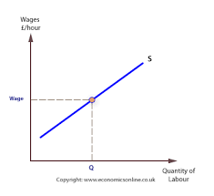
Supply of Labor

Slide 25
Demand for Labor
Based on DMVP (DMRP)
How much does the employee contribute?
Labor productivity is misleading
It is not so much that the productivity of labor increases, rather--
It is an increase in capital and an extension and expansion of the structure of production
This increases MPP, DMVP and wage rates

Slide 26
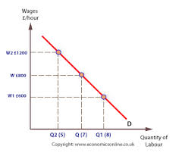
Demand for Labor

Slide 27
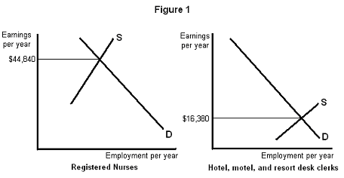
Supply and Demand determines Wage Rates

Slide 28
Minimum Wage and Unemployment
Notes:
How much unemployment = Qs - Qd

Slide 29
Minimum Wage Laws
“Effective” when set above market wage rates
Causes compulsory unemployment
Decreases “side benefits”
Worsens working conditions
Increases labor intensity
Hurts the marginal worker/teens/minorities
Increases the demand for high skilled workers
All opposite of the “intentions” of MWL

Slide 30
Pass MWL Increases to Customers?
Businesses cannot pass increases on to customers or they would have already increased their prices.
MWL increases Cost, but not revenue.
Therefore Profits are lower, or turn to losses.
Losses lead to reduced output or shutdown.
Shutdowns reduce Supply
Reduced Supply leads to higher Prices

Slide 31
Conclusions
Government interventions (taxes, mandated benefits) not necessary/harmful
Minimum wage => unemployment, worse working conditions
Discrimination caused by government intervention (when MWL Qs>Qd), Minority teen Unemployment 2X White teen
High skilled labor benefits from making manual labor uncompetitive

Slide 32
Welfare vs. Work
126 anti-poverty programs $1 T/year
Family of 4 = $17k (MS) to $49k (HI)
Welfare benefits not taxed
Welfare > Full time low skilled job in most states
Really no work requirements
Welfare rational in SR, Welfare Trap in LR
Poverty and lower economic growth

Slide 33
Labor-Related Questions
Should we “reform” the Minimum Wage Law?
Are people entitled to a “living wage”?
Do labor unions protect labor against capital?
What is causing the growing inequality of income and wealth?
Are women paid less than men?
Are there glass ceilings that prevent women and minority from reaching their potential?
What causes unemployment?
Slavery? Sweatshops? The End of Work?
Notes:
Important, ongoing issues of the times, always need to be refuted. The Austrian school needs some good “labor” economists.

Slide 34
Answers to Labor Related Questions
What is labor? Heterogeneous
What determines wage rate and hours?
What makes wage rates go up and down?
What do government interventions do for labor?
What causes unemployment?
What do labor unions do?

Slide 35
We stop working because:
The Marginal Utility of our Production decreases (the value of our marginal product)
The Marginal Utility of our Leisure increases
Eventually the utility of leisure lost outweighs the utility or return from labor
True with wage labor too.

Slide 36
Unemployment and Discrimination

