Slide 1
Richard Cantillon:
At the Louvre
Dr. Mark Thornton
Supporters Summit:
The End of the Dollar Era
October 12-14, 2023

Slide 2


Slide 3


Slide 4


Slide 5
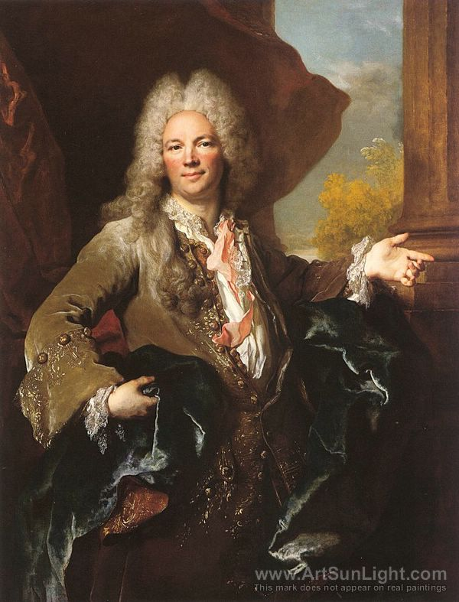

Slide 6
