Slide 1
Economic Inequality
Dr. Mark Thornton
Mises University
July 28, 2023
@DrMarkThornton

Slide 2
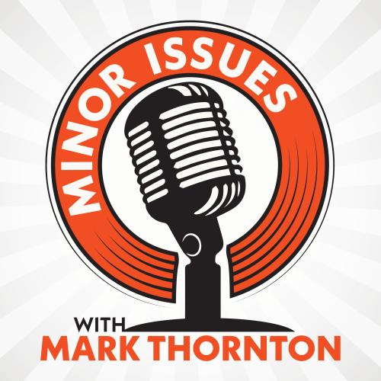
Minor Issues Podcast
@DrMarkThornton

Slide 3
Introduction
Austrians “love” economic inequality
Many types of “equality” and “inequality”
Socialists use coercion for “economic inequality”
That “voice” is filled with lies, distortions, and “the unseen”
Reality is your guide

Slide 4
Inequality as Reality
If men were like ants, there would be no interest in human freedom. If individual men, like ants, were uniform, interchangeable, devoid of specific personality traits of their own, then who would care whether they were free or not? Who, indeed, would care if they lived or died? The glory of the human race is the uniqueness of each individual, the fact that every person, though similar in many ways to others, possesses a completely individuated personality of his own. It is the fact of each person's uniqueness — the fact that no two people can be wholly interchangeable — that makes each and every man irreplaceable and that makes us care whether he lives or dies, whether he is happy or oppressed. And, finally, it is the fact that these unique personalities need freedom for their full development that constitutes one of the major arguments for a free society. MNR

Slide 5
Aspects of Human Inequality
Physical and Biological differences (e.g., sex and sex preference)
Tastes and preferences (e.g., good and services)
IQ, Interests, Talents, education, training, experiences
Tastes for labor vs. leisure (i.e., energetic vs. lazy)
Time preferences (i.e., now vs. later thinking, e.g., savers)
Risk taking preferences (e.g., entrepreneurs vs. wage labor)
  All of this can be distorted by government, but not “fixed”
  Reality is the perplexing brew of all these factors
Law of Comparative Advantage: We all have one!
Income distribution is the reality on the market

Slide 6
Dubious Types of Equality in Markets
Innate equality (at birth) – obviously wrong
Equality “by birth” – obviously wrong
Equality of opportunity – obviously wrong
Equality of result – obviously wrong
  Attempts fail
  Attempts harm
  Attempts backfire
  Attempts can destroy civilization
Economics recognizes reality and demonstrates its benefits for all!

Slide 7
Systems of Inequality
Natural Law—some equality & justice (basic)
Rule of Law—some equality & justice (legal)
Theocracy—caste system & injustice
Monarchy—caste system & injustice
Democracy—caste system & injustice
Dictatorship—caste system & injustice
Socialism & Progressivism—caste system & injustice
Capitalism or Anarcho-Capitalism and Law—some “equality”/justice

Slide 8
Human Development Requirements
Reality: “the diversity of Nature, which does not repeat itself but creates the universe in infinite, inexhaustible variety. ...” von Mises
Freedom—despotism of all sorts stymies humanity
Development →>> Subsistence (Industrial Revolution)
Division, specialization, and comparative advantage=productivity
↑Productivity → Wages > Subsistence; Wages – C = savings
Economic Growth → Savers-> Capitalists-> Entrepreneurs=>capitalism
Capitalists paid Interest to contribute savings/capital (stocks and bonds)
Entrepreneurs borrow and pay labor now for later revenues
Entrepreneurs bear uncertainty → $ Profit and Loss

Slide 9
Every Role is Harder than it looks
The global division of labor is amazing in terms of standards of living, population, life expectancy, equality of results and achievement. We all serve everyone else to our mutual benefit.
Capitalist families deprive themselves to acquire capital. Most consume all or most of what they produce. The return after risk of repayment, bankruptcy, fluctuation, inflation, and taxes is very low.
Entrepreneurs bear uncertainty of the market (consumers). We see the extreme success stories, but most fail even with “good” products. Bubbles make it look easy, but most of them fail too!!
Labor has to work more and invest in their education, training, and experience to ↑Wages (college, apprenticeship, minor leagues) @ Opp. Cost + saving for higher incomes

Slide 10
Incomes in the Free Market
Nature => subsistence & Malthusian Law of Population applies
Labor: Labor time Wages Paid now
Landlord: Resources Rents Paid now
Capitalist: Savings Interest Paid over time
Entrepreneur Risk/Uncertainty Profit/Loss After the fact
No profits until the others are paid and buyers are satisfied
Profit expectations can turn to real losses if buyers are not satisfied
Profits are the smallest component, but the driving force (wages, rents, interest)

Slide 11
Socialist Proposition: Efficiency and Equity
Mises and reality showed socialism was inefficient at best
Socialist (Heilbroner and Piketty) Equity and Ecology
  Equity—Redistribute wealth and income
  Welfare and Progressive Income Tax, etc.
  Ecology—Global warming, climate change
  Regulating everything to change the weather
  Involves technocratic control without real science or justice (includes Covidia)

Slide 12
What Biases Income Distribution
Government:
  Politicians and Bureaucrats gain, taxpayer and citizens lose
Government Monopolies:
  Rich monopolies gain, while the barred and consumers lose
Central Bank:
  Rich politicos gain, while labor and low incomes lose
Summary: Political Rich Class gains, productive and taxpayers lose

Slide 13
Government Statistics Biases the Debate
Does not count the total number of Welfare dollars given away*
Does not count the total number of Tax dollars taken*
Does not consider all the business failures and bankruptcies (where capitalists and entrepreneurs suffer)
Does not consider all the foregone economic potential:
  Rent seekers earn abnormally high incomes and competitors are “stymied.”
  Welfare recipients are almost all capable to earning more income.
  Taxpayers are widely discouraged from maximizing their free market incomes.
Incomes and the “economic pie” could be much larger (PPF)***

Slide 14
The Myth of American Inequality:
How Government Biases Policy Debate
Gramm, Ekelund, and Early, Forthcoming 2022
Looked at government statistics from 1967 to 2017
Recalculated these statistics to include:
  All forms of welfare benefits (income redistribution); many missing from stats.
  All forms of taxation (income redistribution); many missing from the stats.
  This greatly increased the consumable income of low-income quintile households.
  This greatly reduced the consumable income from high-income quintiles.
This turned all the reported stats on their heads.
Things are better or the same, not worse over the last 50 years!

Slide 15
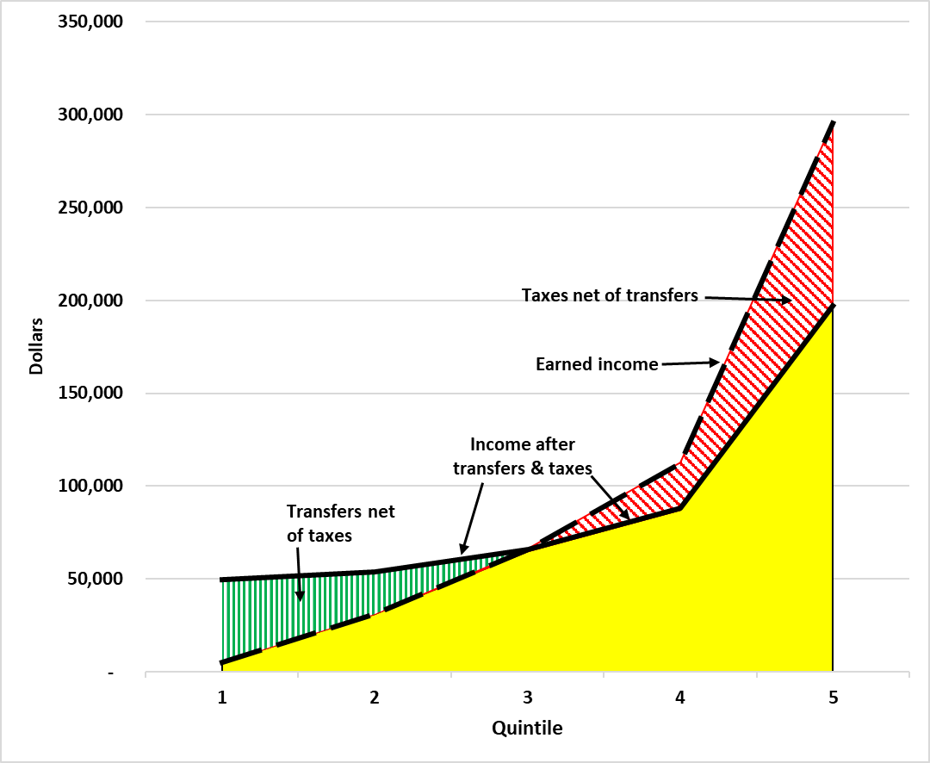
Gramm, Ekelund, and Early, forthcoming 2022
Notes:
Earned income 60:1---Reported 16.7:1----Recalculated 4:1 by quintile (20% of households)

Slide 16
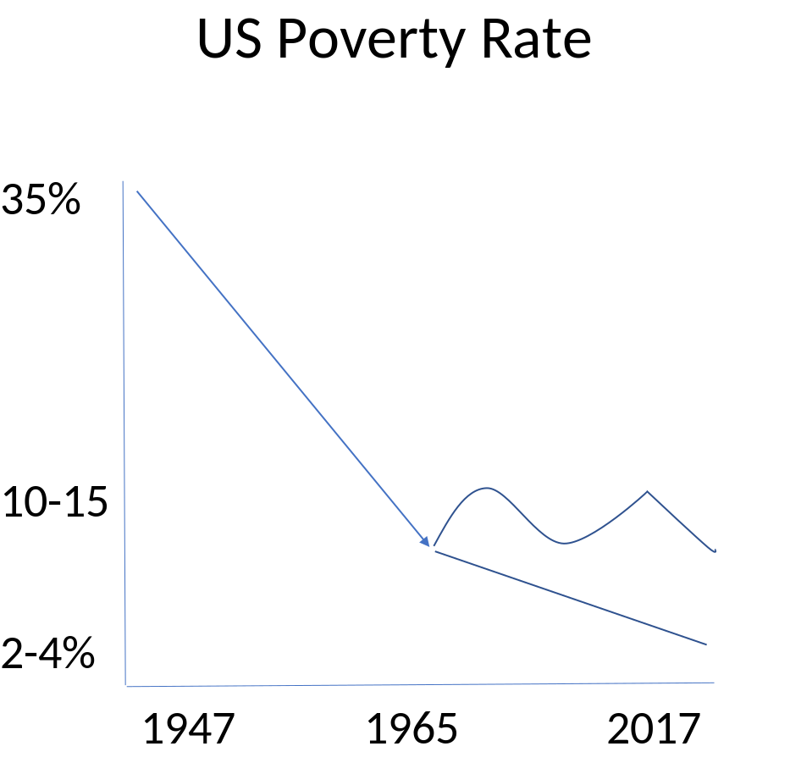
Official Poverty: 1947-2017
Notes:
Gini coefficient goes lower instead of much higher. USA goes from “most unequal” to middle of the pack OECD.

Slide 17
The Equality – Depopulation Connection
Disasters Create Equality
Black Death: Labor gained versus Landowners and Capitalists
Post WWII America:
  WWI and WWII
  Spanish Flu
  Great Depression
Disasters depopulate (labor wages increase) and land and capital are relatively abundant → increases economic equality

Slide 18
Takeaways
You have been misled by Piketty et al, the media, the government
Inequality (of all sorts) is a good thing in the free market and people have more equality of various sorts in a market society (paradox)
Economic equality is a disastrous government policy that leads to economic ruin for all, including the poor and workers.
Government monopolies (rent seeking) protectionism for the wealthy.

Slide 19
Thank You!
@DrMarkThornton
https://mises.org/library/minor-issues

Slide 20
References
Murray Rothbard, “Freedom, Inequality, Primitivism, and the Division of Labor,” Rothbard, 1970.
Murray Rothbard, “Egalitarianism as a Revolt Against Nature (and other essays)”
Murray Rothbard, Egalitarianism and the Elites, Review of Austrian Economics, 1995.
Joseph Salerno, "Ludwig von Mises as Social Rationalist,“ Review of Austrian Economics 4 (1990): 26–54.
Ludwig von Mises, Economic Calculation in the Socialist Commonwealth 1990 edition, plus Salerno, "Postscript,"
Gramm, Ekelund, Early, The Myth of American Inequality: How Government Biases Policy Debate, forthcoming.

