Slide 1
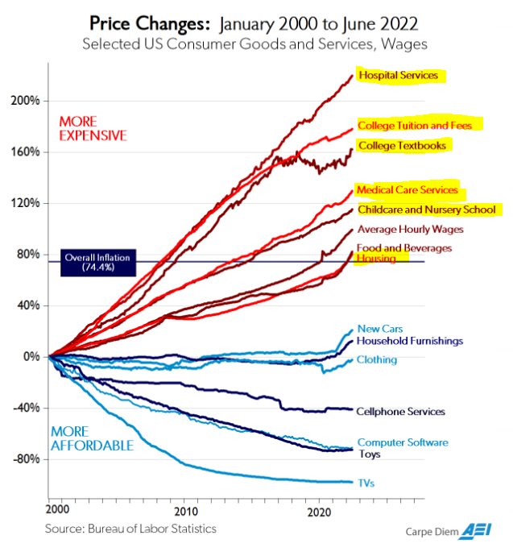

Higher Education In Crisis
Timothy D. Terrell
Mises University 2023
@timothyterrell
terrelltd@wofford.edu

Slide 2
Crisis 1: INEFFECTIVE TEACHING
Crisis 2: The Enrollment Cliff
Crisis 3: Stifled Academic Discourse
Crisis 4: Government IS DRIVING UP TUITION

Slide 3
Crisis 1: INEFFECTIVE TEACHING

Slide 4
What Does College Do?
Transfer skills (“human capital”)?
Signal work ethic or disposition toward higher-order thinking?
Provide a consumption good for higher-income individuals?

Slide 5
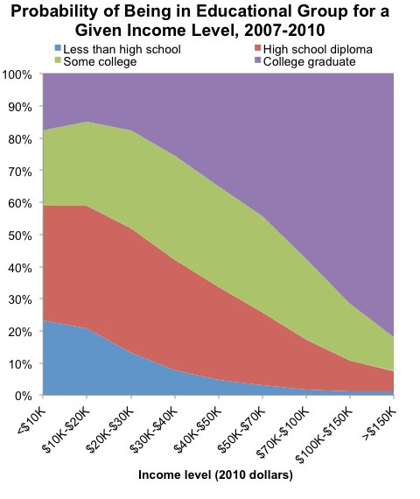

Slide 6
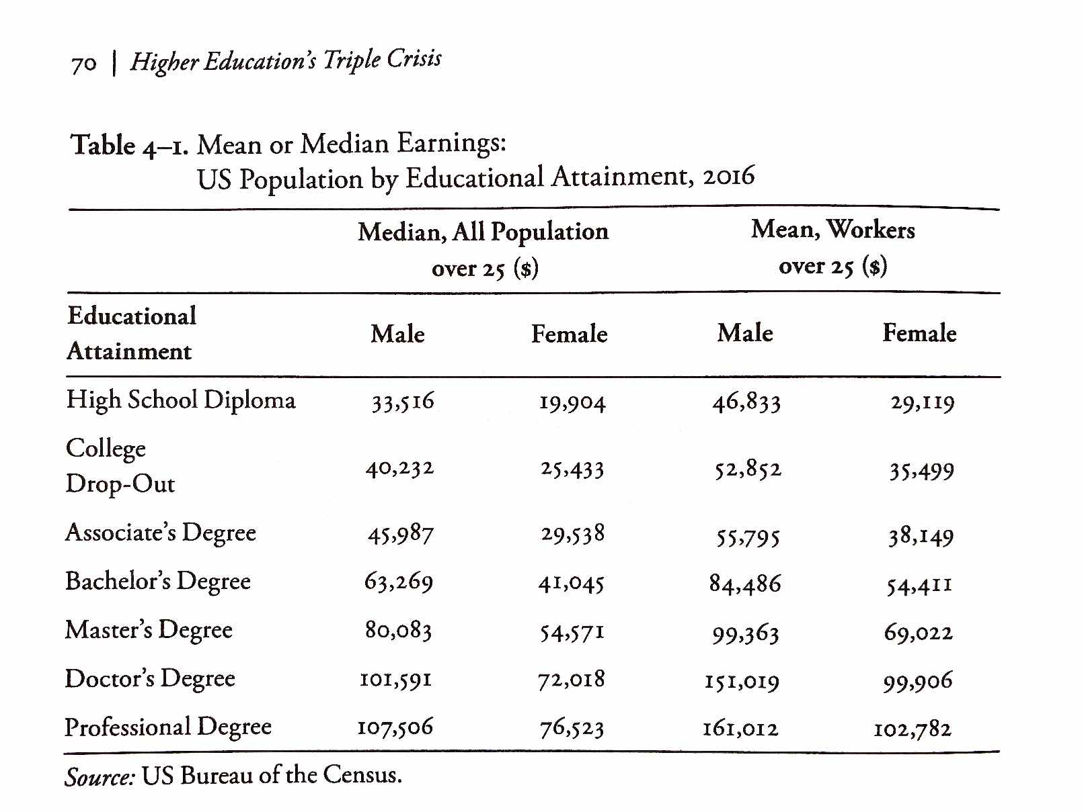
From Richard Vedder, Restoring the Promise, p. 70.

Slide 7
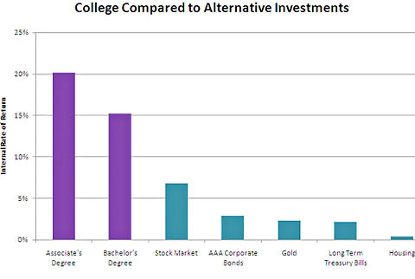

Slide 8
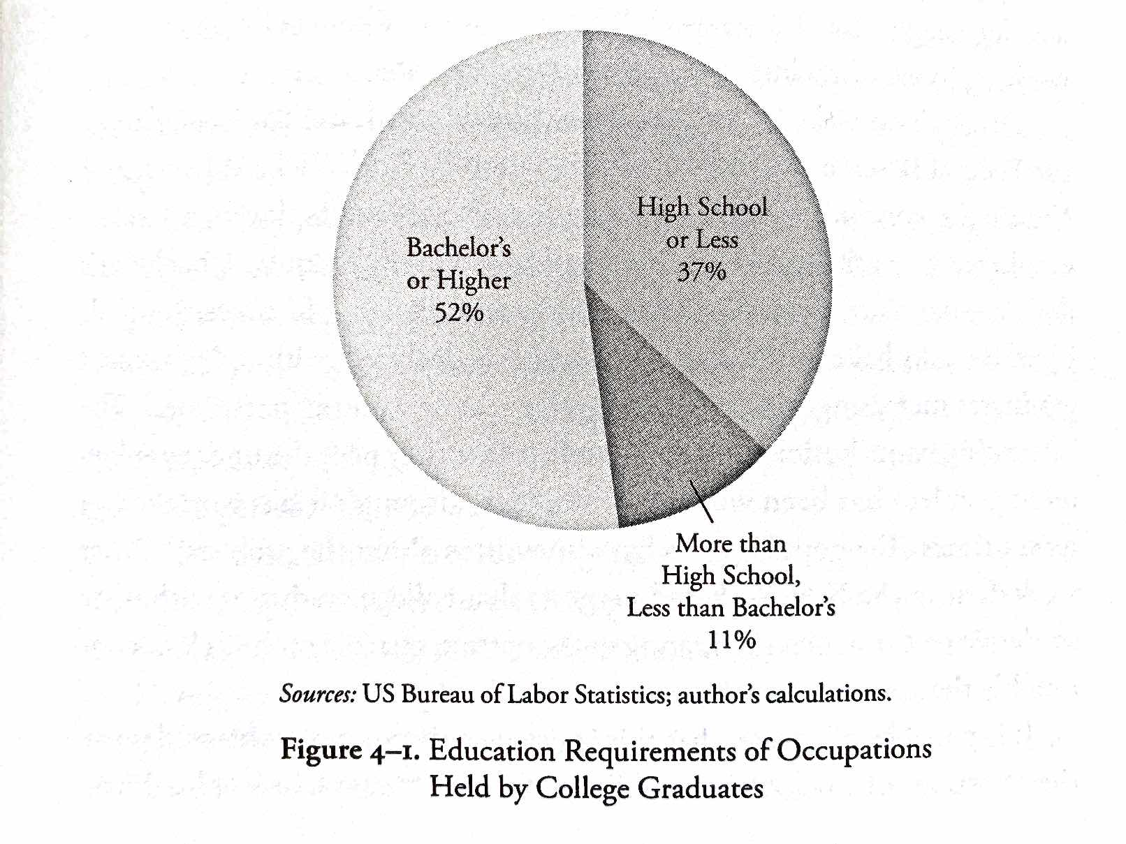
From Richard Vedder, Restoring the Promise, p. 71.

Slide 9
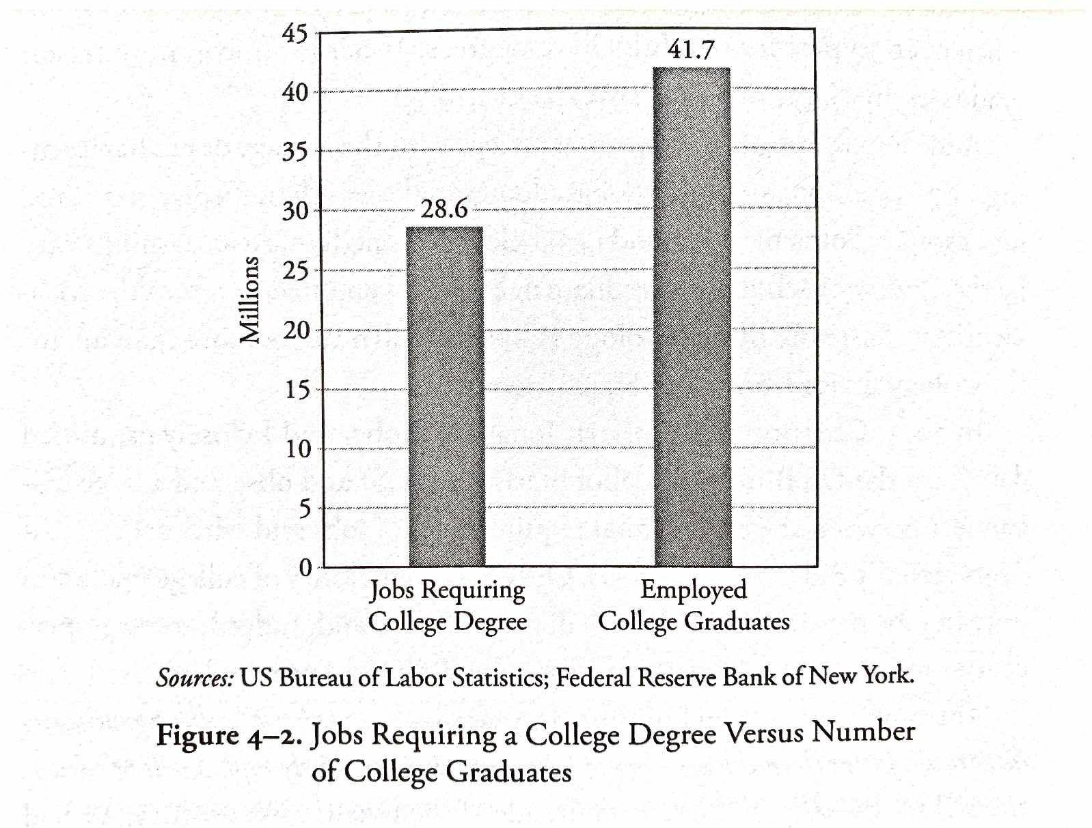
From Richard Vedder, Restoring the Promise, p. 72.

Slide 10
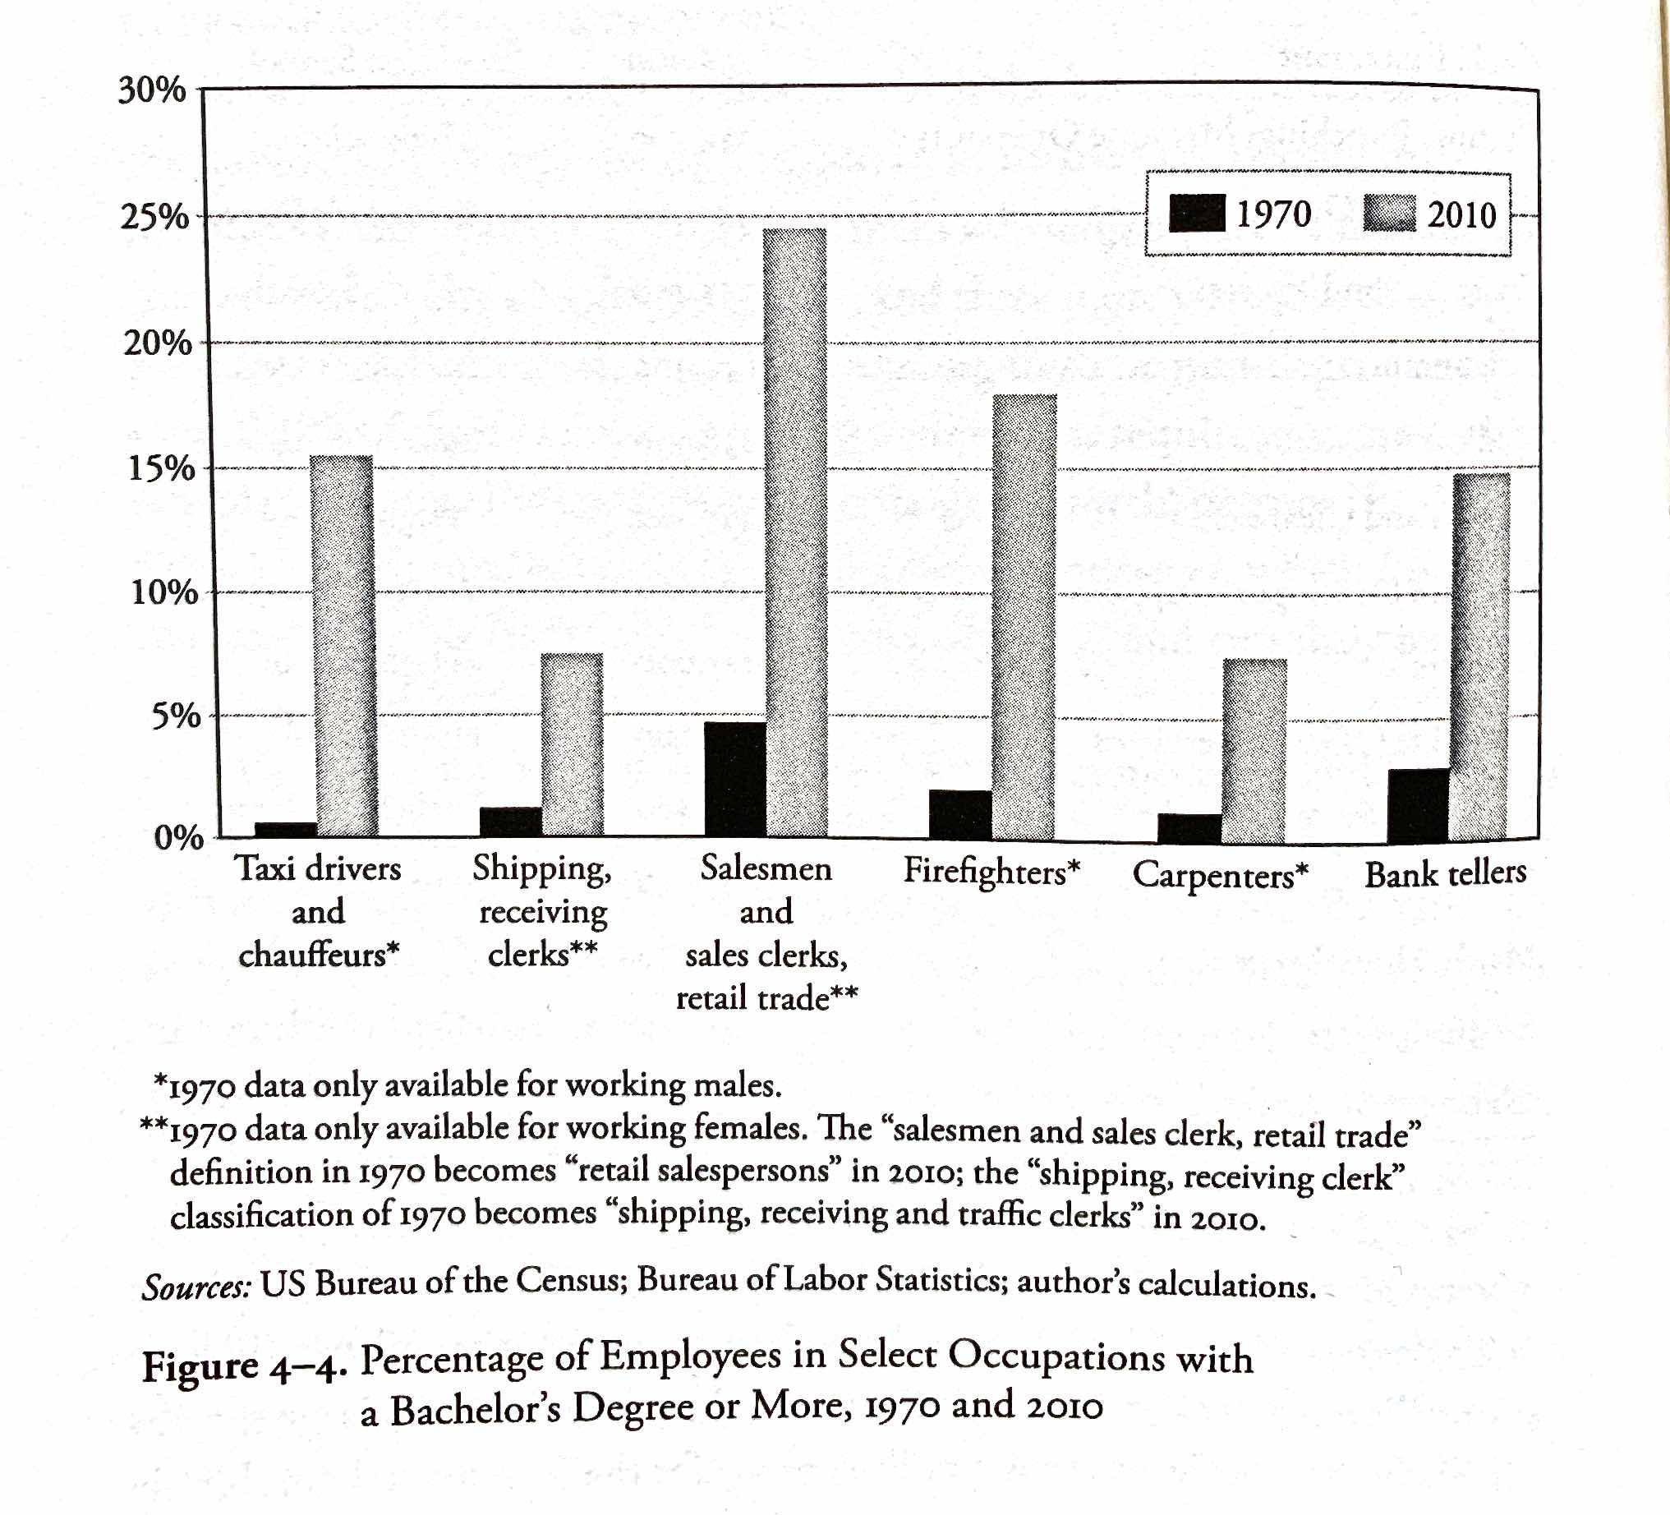
From Richard Vedder, Restoring the Promise, p. 76.

Slide 11
Higher Education as Signaling
Filter for motivation, perseverance, intelligence (MPI)
Pass
Certified MPI
To filter
Population
Fail/dropout
Uncertified MPI
+
Not MPI
Bypass filter

Slide 12
Higher Education as Signaling
$
Taxes
Filter for motivation, perseverance, intelligence
(less effective)
Pass
Certified MPI
Subsidies
Population
To filter
Fail/dropout
Uncertified MPI
+
Not MPI
Bypass filter

Slide 13
Higher Education as Signaling
“[O]nce workers have been ranked, giving everyone extra years of education is socially wasteful. Furthermore, since the status quo is supported by hundreds of billions of dollars of subsidies, we’re probably underusing alternative certification methods like apprenticeships, testing, boot camps, and so on.”
“Signaling… explains why students are far more concerned about grades than actual learning. They want ‘easy A’s’—not professors who teach lots of job skills. Signaling explains why cheating pays—a successful cheater profits by impersonating a good student. And signaling explains why students readily forget course material the day after the final exam. Once you’ve got the good signal on your transcript, you can usually safely forget whatever you learned.”
    -- Bryan Caplan
http://blog.press.princeton.edu/2018/01/23/bryan-caplan-on-the-case-against-education/

Slide 14
Higher Education as Signaling
“Above all, we need far less education. And the cleanest way to get far less education is to sharply cut government education spending. …[E]mployers will no longer expect you to have the education you can no longer afford. In other words, spending cuts will cause credential deflation. You’ll once again be able to get low- and middle-skill jobs with a high school degree—or less.”
“[T]here’s little sign that education causes much enlightenment or civic understanding. Even at top schools, most students are intellectually and culturally apathetic, and most professors are uninspiring.”
    -- Bryan Caplan
http://blog.press.princeton.edu/2018/01/23/bryan-caplan-on-the-case-against-education/

Slide 15
Plagiarism and Incentives
Administrators are incentivized to accept applicants who may have little experience in writing.
Administrators have little incentive to vigorously prosecute plagiarism.
Increasing online formats foster an environment where cheating is low-cost. AI is exacerbating this problem.
Faculty (and GTAs) have little incentive to create work for themselves by following a bureaucratized academic dishonesty process.

Slide 16
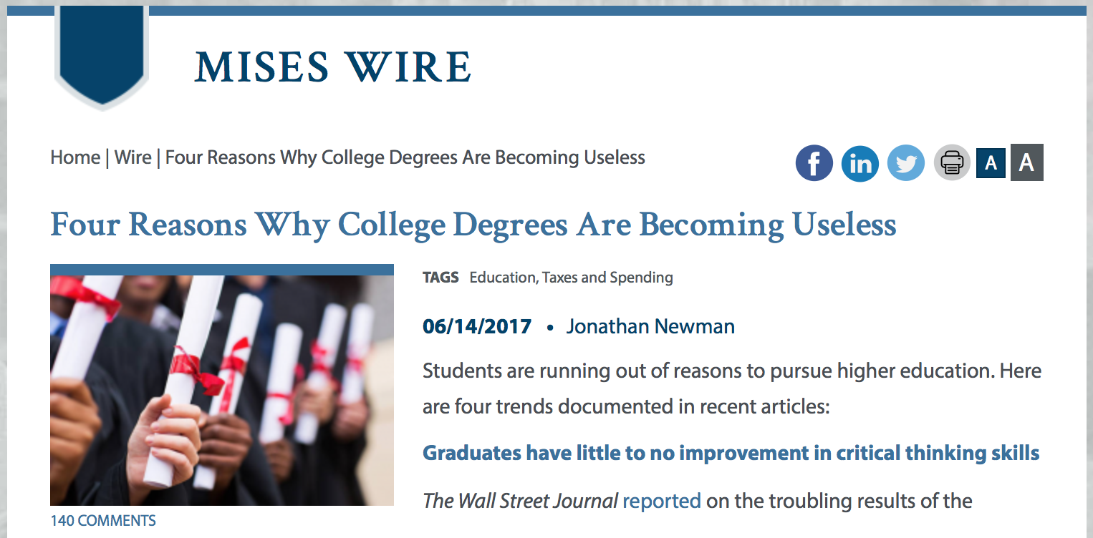

Slide 17
Does College Deliver?
“At some of the most prestigious flagship universities, test results indicate the average graduate shows little or no improvement in critical thinking over four years.”
Jonathan Newman, “Four Reasons Why College Degrees are Becoming Useless,” https://mises.org/wire/four-reasons-why-college-degrees-are-becoming-useless

Slide 18
Grade Inflation
“[Arthur Levine] found in a national survey that 41 percent of students had grade point averages of A-minus or higher in 2009, compared to just 7 percent in 1969.”*
Denning, Eide, Mumford, Patterson, and Warnick (2022): The increase in graduation rates over the last three decades is driven by grade inflation. (“Why Have College Completion Rates Increased?” American Economic Journal: Applied Economics 14, no. 3 [July] https://www.aeaweb.org/research/college-completion-grade-inflation-us)
*Marcella Bombardieri, “Harvard, Other Schools Still Fighting Grade Inflation,” https://www.bostonglobe.com/metro/2013/12/05/with-its-most-common-grade-harvard-earns-disapproval-but-has-company/kCeheDYfuDjSRcM1sVljfK/story.html

Slide 19
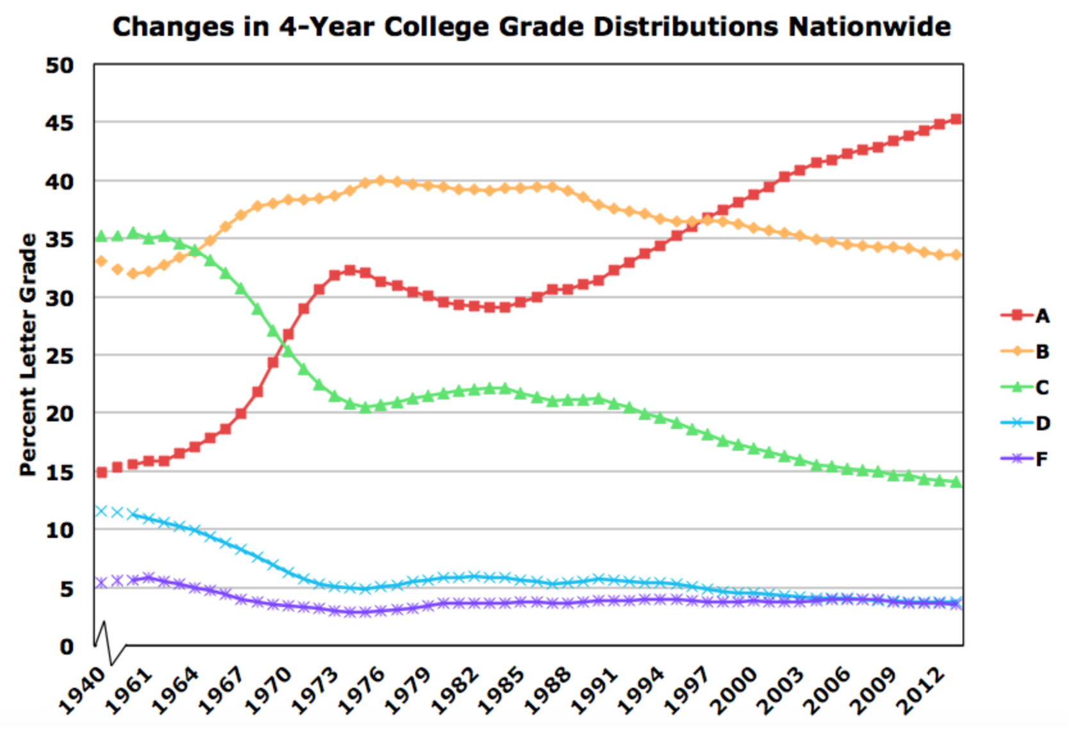
Source: gradeinflation.com

Slide 20
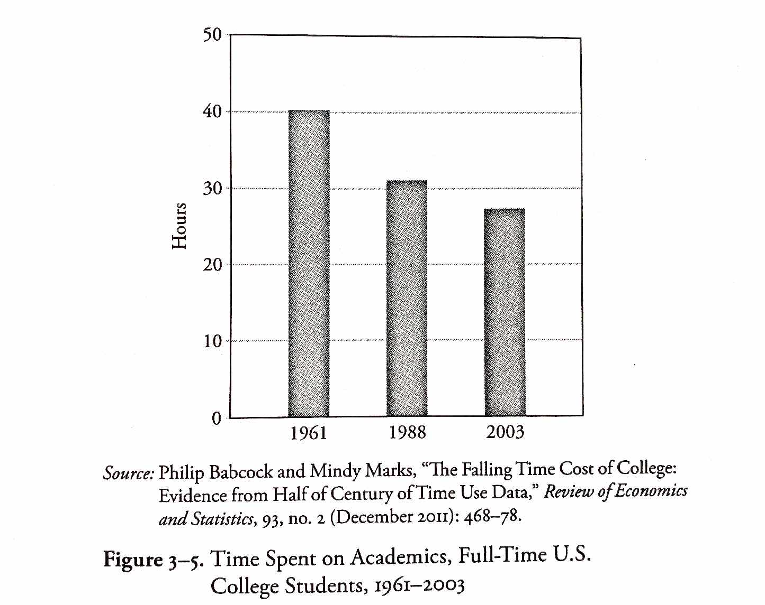
From Richard Vedder, Restoring the Promise, p. 57.

Slide 21
Crisis 2: The Enrollment Cliff

Slide 22
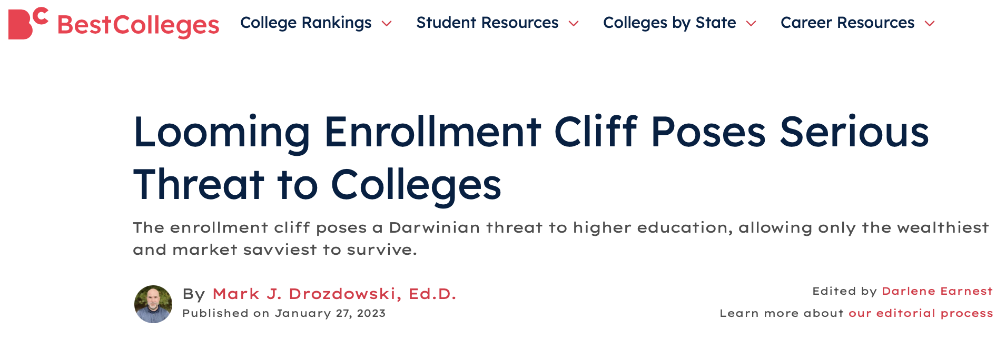
https://www.bestcolleges.com/news/analysis/looming-enrollment-cliff-poses-serious-threat-to-colleges/

Slide 23
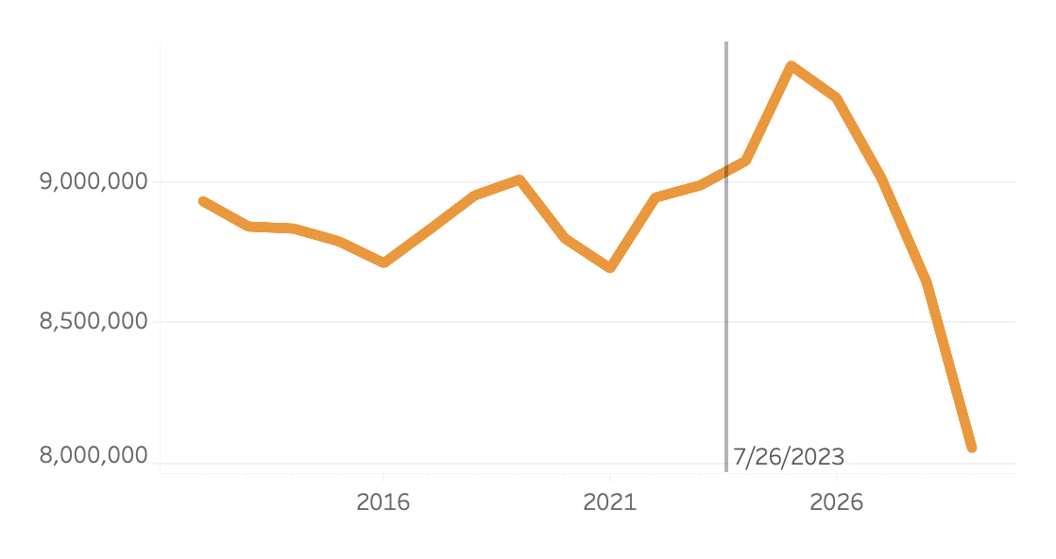
Number of 18-year-olds
Source: Higher Education Demand Index (Grawe 2016)
https://www.cupahr.org/issue/dept/interactive-enrollment-cliff/

Slide 24
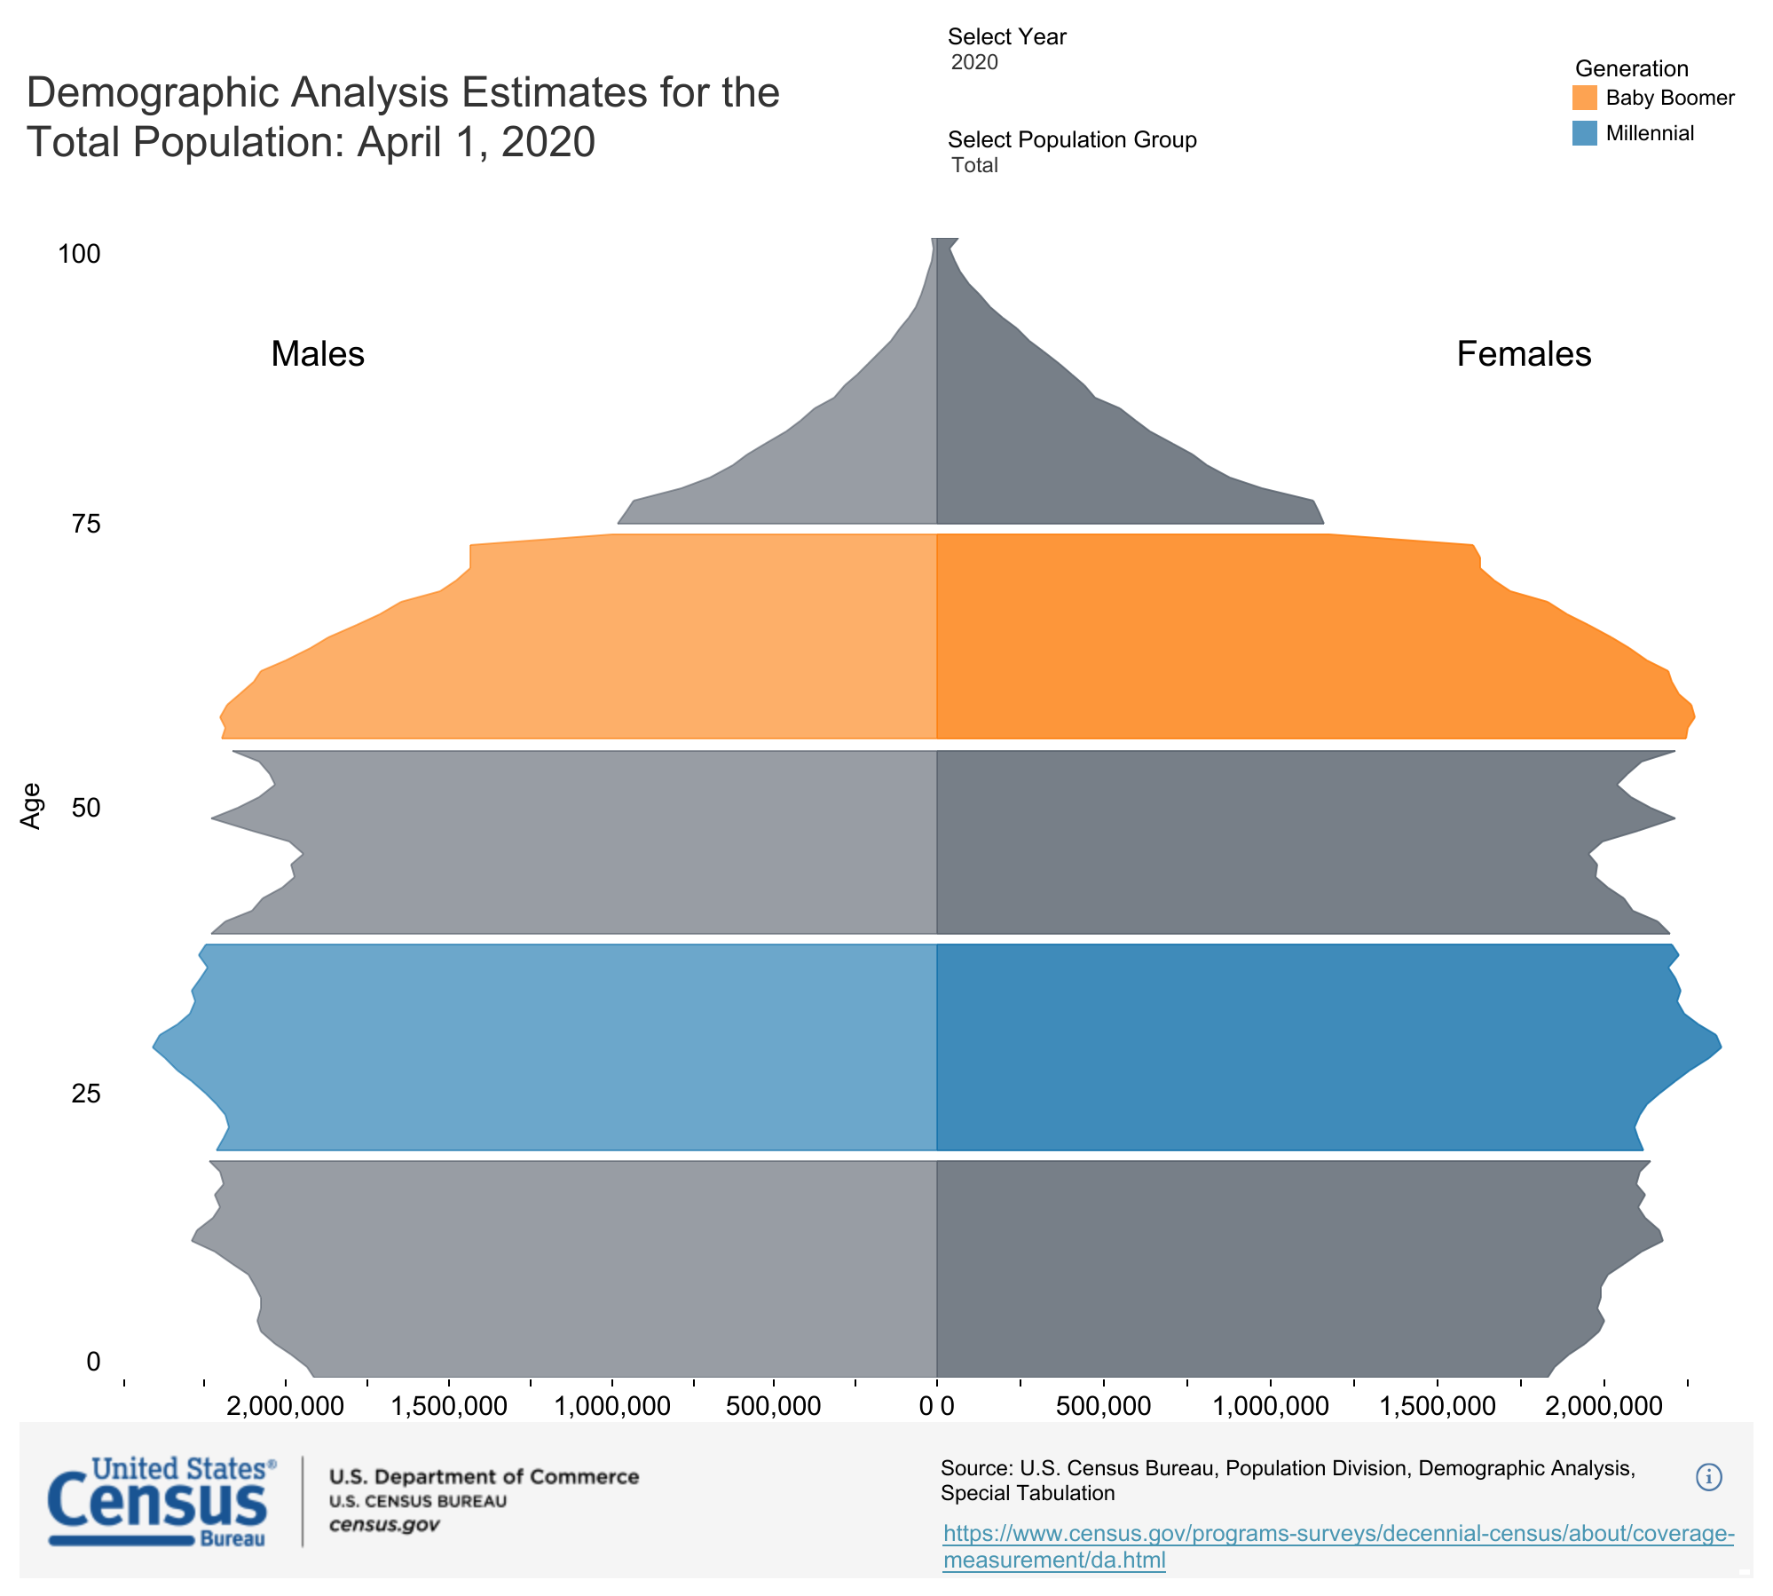
Effects of the “Enrollment Cliff”
“Regional

Slide 25
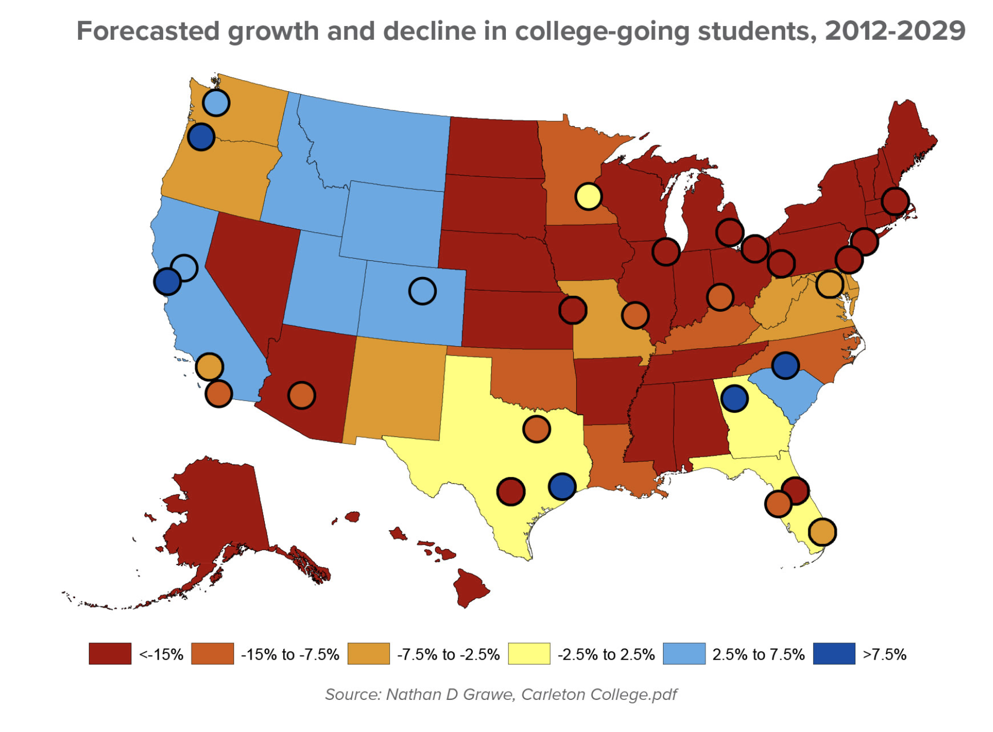
Source: Missy Kline, “The Looming Higher Ed Enrollment Cliff” (2019)
https://www.cupahr.org/issue/feature/higher-ed-enrollment-cliff/
Notes:
While not all colleges and universities will see a decline in student enrollment, many of those that do will be hit hard. In a recent article in The Hechinger Report, columnist Jill Barshay writes that elite institutions will likely fare much better than regional four-year colleges and universities, which are expected to be impacted the most. According to the article, which cites research by economist and Carleton College professor Nathan Grawe, regional bachelor’s institutions are expected to lose more than 11 percent of their students by 2029, while demand for elite institutions may be up to 14 percent higher in 2029 than it was in 2012.
Why the contrast? As Grawe explains to Barshay in the article, “elite colleges are less affected by the birth dearth because they’re a small, niche market of fewer than 200,000 students.” He also cites the boom in the Asian-American population, which, he says, has a “high attachment to higher education, and elite higher education in particular.”
In addition to institution type, location will have some bearing on the impact of the declining college-age population. Citing Grawe’s research, Barshay writes in the article, “the Northeast, where a disproportionate share of the nation’s colleges and universities are located, is expected to be the hardest hit. By contrast, mountain states, where there are fewer students and fewer colleges … may see slight increases in student demand,” as could institutions in the Southwest due to high rates of immigration over the past several years — although immigration has slowed considerably as of late.

Slide 26
Crisis 3: Stifled ACADEMIC Discourse

Slide 27
Stifled Academic Discourse
“Shouting matches have invaded campuses across the country”
  “At Evergreen State College in Washington, student protests have hijacked classrooms and administration. Protestors took over the administration offices last month, and have disrupted classes as well. It has come to the point where enrollment has fallen so dramatically that government funding is now on the line.”
  “The chaos at Evergreen resulted in ‘anonymous threats of mass murder, resulting in the campus being closed for three days.’”
Jonathan Newman, “Four Reasons Why College Degrees are Becoming Useless,” https://mises.org/wire/four-reasons-why-college-degrees-are-becoming-useless

Slide 28
Stifled Academic Discourse
2017 study of college students: “Some students say shouting down speakers and using violence is sometimes acceptable”
  “Many colleges struggle when inviting controversial figures to speak on campus. Ninety percent of college students say it is never acceptable to use violence to prevent someone from speaking, but 10 percent say it is sometimes acceptable. A majority (62 percent) also say shouting down speakers is never acceptable, although 37 percent believe it is sometimes acceptable.” (medium.com)
  “Students have become more likely to think the climate on their campus prevents people from speaking their mind because others might take offense.” (knightfoundation.org)
Gallup-Knight Foundation survey of U.S. college students, https://www.knightfoundation.org/reports/free-expression-on-campus-what-college-students-think-about-first-amendment-issues and https://medium.com/informed-and-engaged/8-ways-college-student-views-on-free-speech-are-evolving-963334babe40

Slide 29
Stifled Academic Discourse
2017 study of 1,500 U.S. citizen undergraduates at 4-year colleges and universities:
  “fewer than half of the respondents believe that the First Amendment protects hate speech.”
  “A public university invites a very controversial speaker to an on-campus event. The speaker is known for making offensive and hurtful statements. A student group opposed to the speaker uses violence to prevent the speaker from speaking. Do you agree or disagree that the student group’s actions are acceptable?”
  “19% of the respondents stated that they agreed with the student group’s actions….”
Eugene Volokh, “Freedom of Expression on Campus: An Overview of Some Recent Surveys,” Washington Post, Oct. 23, 2017. https://www.washingtonpost.com/news/volokh-conspiracy/wp/2017/10/23/freedom-of-expression-on-campus-an-overview-of-some-recent-surveys/?utm_term=.baea637297f6
Image: https://www.newyorker.com/magazine/2016/05/30/the-new-activism-of-liberal-arts-colleges

Slide 30
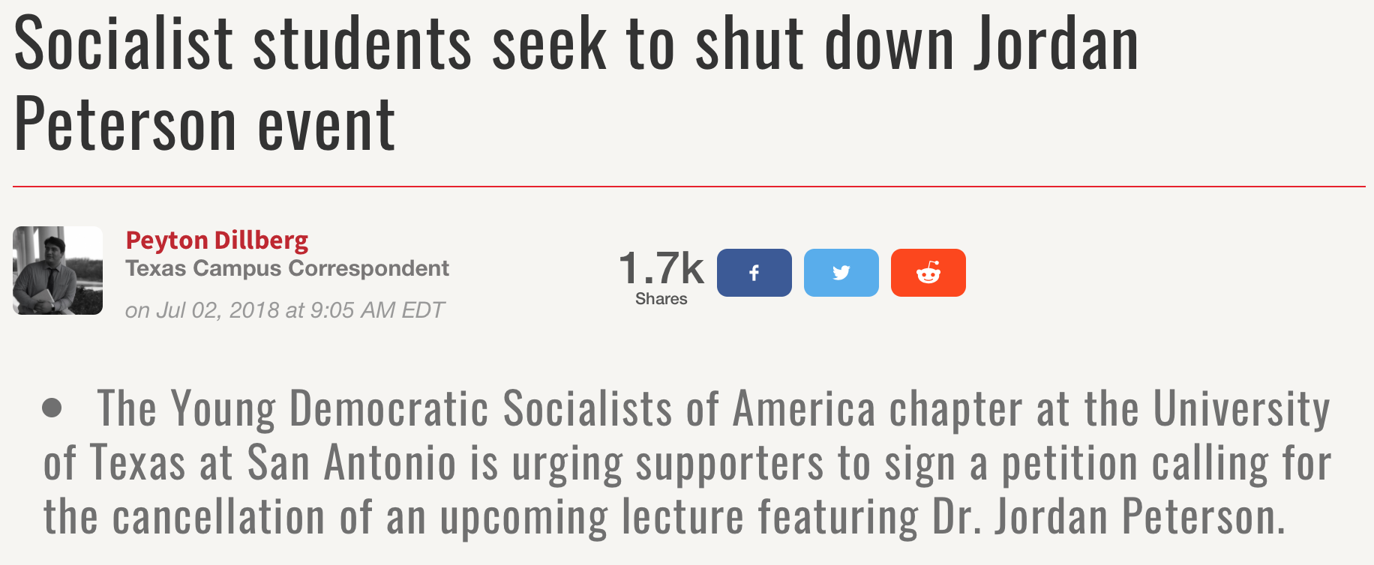
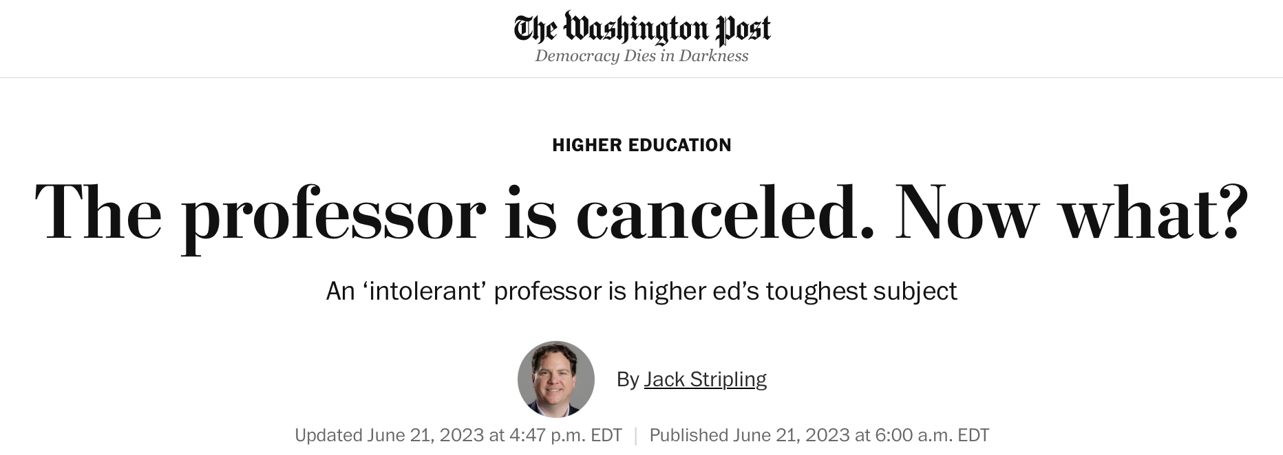
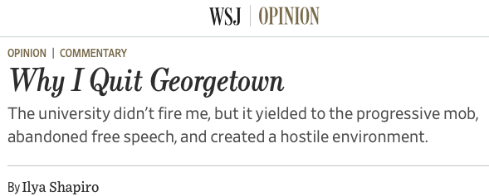
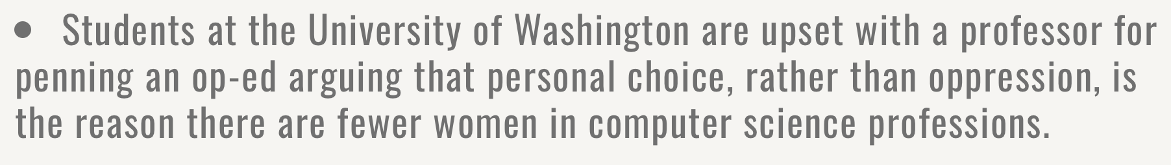
https://www.washingtonpost.com/education/2023/06/21/college-professors-fired-cancel-culture/

Slide 31
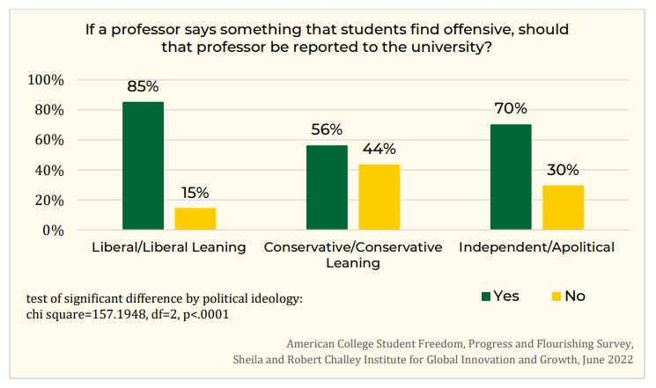
Stifled Academic Discourse

Slide 32
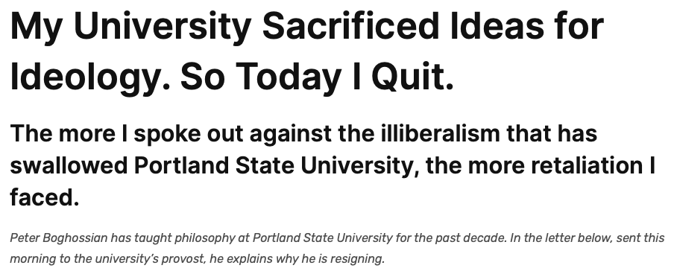
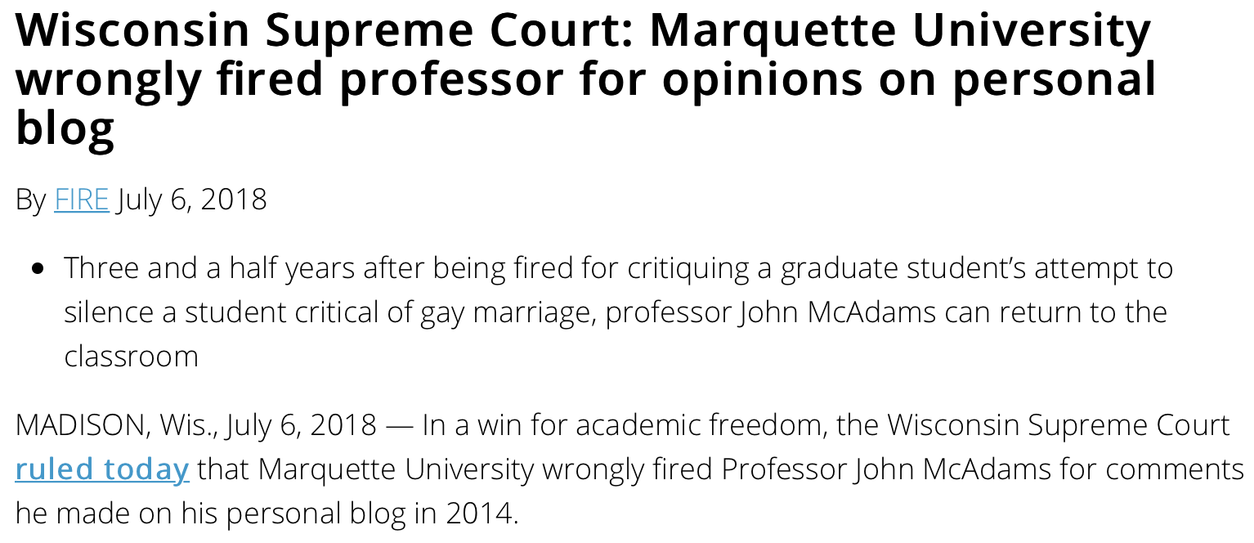
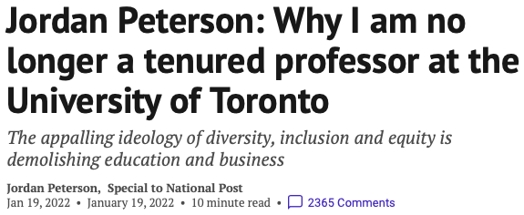
Bureaucracy and the University
University bureaucracies wield fearsome power over faculty, cheered on by many students who apparently regard shutting down academic discourse as a victory.
Even baseless and absurd accusations against faculty can lead to long investigations lacking in due process—creating job security for university bureaucrats but stress and often self-censorship on the part of faculty.
  E.g., Peter Boghossian, Jordan Peterson, Ilya Shapiro
Notes:
From Peter Boghossian’s resignation letter to Portland State University: And it became increasingly clear to me that the incidents of illiberalism I had witnessed over the years were not just isolated events, but part of an institution-wide problem.
The more I spoke out about these issues, the more retaliation I faced.
Early in the 2016-17 academic year, a former student complained about me and the university initiated a Title IX investigation. (Title IX investigations are a part of federal law designed to protect “people from discrimination based on sex in education programs or activities that receive federal financial assistance.”) My accuser, a white male, made a slew of baseless accusations against me, which university confidentiality rules unfortunately prohibit me from discussing further. What I can share is that students of mine who were interviewed during the process told me the Title IX investigator asked them if they knew anything about me beating my wife and children. This horrifying accusation soon became a widespread rumor.
With Title IX investigations there is no due process, so I didn’t have access to the particular accusations, the ability to confront my accuser, and I had no opportunity to defend myself. Finally, the results of the investigation were revealed in December 2017. Here are the last two sentences of the report: “Global Diversity & Inclusion finds there is insufficient evidence that Boghossian violated PSU’s Prohibited Discrimination & Harassment policy. GDI recommends Boghossian receive coaching.”
Not only was there no apology for the false accusations, but the investigator also told me that in the future I was not allowed to render my opinion about “protected classes” or teach in such a way that my opinion about protected classes could be known — a bizarre conclusion to absurd charges. Universities can enforce ideological conformity just through the threat of these investigations.

Slide 33
Crisis 4: Government IS DRIVING UP TUITION

Slide 34
Student Loan Debt
$1.75 trillion in total student loan debt*
$28,950 average debt per borrower*
92% federal; remainder is private*
60% of student loan debt is held by those in the top 40% of household income.**
* Source: https://www.forbes.com/advisor/student-loans/average-student-loan-statistics/
** Source: https://www.sofi.com/learn/content/average-student-loan-debt-by-career/

Slide 35
Tuition and Costs
Jonathan Newman, “Busting the ‘Free College’ Myth,” https://mises.org/wire/busting-free-college-myth

Slide 36
https://www.zerohedge.com/news/2014-04-06/ongoing-inflation-higher-education-bubble

Slide 38
For-Profit Education
“[A] market has natural mechanisms for punishing credit abusers, mechanisms that decrease the likelihood that these individuals will be the beneficiaries of credit in future transactions. Unfortunately, much to the dismay of the American taxpayer, such mechanisms are not intrinsic in FFA, where everyone enjoys equal status regardless of their ability to satisfy debt-related obligations.

Slide 39
For-Profit Education
“Only in rare instances, such as prior default on student loans, will government restrict access to this ubiquitous program. While some may champion FFA by arguing the merits of readily accessible education, they fail to heed the lessons taught to us by Henry Hazlitt in his masterpiece Economics in One Lesson. In particular, advocates conveniently overlook the unintended consequences of systematically extending credit to undeserving debtors: higher prices and default.”
-- A.G. Smith, “The Bubble in For-Profit Schooling,” https://mises.org/library/bubble-profit-schooling

Slide 40
Federal Aid and Student Costs
The “Bennett Hypothesis”
“[I]ncreases in financial aid in recent years have enabled colleges and universities blithely to raise their tuitions.”
-- William Bennett, former secretary of education, 1987

Slide 41
Federal Aid and Student Costs
“A prominent question in public debate is whether Pell grants tend to be appropriated by universities through increases in tuition—consistent with what is known as the Bennett hypothesis. Based on a panel of 1554 colleges and universities from 1989 to 1996, we find little evidence of the Bennett hypothesis for in-state tuition for public universities. For private universities, though, increases in Pell grants appear to be matched nearly one for one by increases in list (and net) tuition. Results for out-of-state tuition for public universities are similar to those for private universities, suggesting that they behave more like private ones in setting out-of-state tuition.”
  Larry Singell, Joe Stone, 2007. “For Whom the Pell Tolls: The Response of University Tuition to Federal Grants-in-Aid,” Economics of Education Review 26, no. 3: 285–295.
https://eric.ed.gov/?id=EJ762744

Slide 42
Federal Aid and Student Costs
“…intended cost reductions of tax-based federal student aid are substantially offset by institutional price increases for a sample of 4-year colleges and universities. Contrary to the goal of policymakers, I find that tax-based aid crowds out institutional aid roughly dollar-for-dollar.”
  Nicholas Turner, 2012. “Who Benefits from Student Aid? The Economic Incidence of Tax-Based Federal Student Aid,” Economics of Education Review 31, no. 4: 463–481.

Slide 43
Federal Aid and Student Costs
“We find that the Title IV institutions [eligible to participate in federal student aid programs] charge tuition that is about 78 percent higher than that charged by comparable institutions whose students cannot apply for federal financial aid.”
  Stephanie Riegg Cellini, Claudia Goldin, 2013. “Does Federal Student Aid Raise Tuition? New Evidence on For-Profit Colleges,” NBER Working Paper No. 17827
https://www.sciencedirect.com/science/article/pii/S0272775711001968
http://www.nber.org/papers/w17827

Slide 44
Federal Aid and Student Costs
“We study the link between the student credit expansion of the past fifteen years and the contemporaneous rise in college tuition. …We find a pass-through effect on tuition of changes in subsidized loan maximums of about 60 cents on the dollar, and smaller but positive effects for unsubsidized federal loans. The subsidized loan effect is most pronounced for more expensive degrees, those offered by private institutions, and for two-year or vocational programs.”
  David O. Lucca, Taylor Nadauld, and Karen Shen, 2017. “Credit Supply and the Rise in College Tuition: Evidence from the Expansion in Federal Student Aid Programs,” FRBNY Staff Report.
https://www.newyorkfed.org/research/staff_reports/sr733.html

Slide 45
Federal Aid and Student Costs
“The demand-side shocks [e.g., expanded subsidized student loan availability] cause tuition to jump by 91%. With all other changes except the demand-side shocks, tuition only increases by 14%.”
  Grey Gordon and Aaron Hedlund, 2017. “Accounting for the Rise in College Tuition,” Chapter forthcoming in Charles R. Hulten and Valerie A. Ramey, eds., Education, Skills, and Technical Change: Implications for Future US GDP Growth, University of Chicago Press, NBER Book Series Studies in Income and Wealth.
http://www.nber.org/chapters/c13711.pdf

Slide 46
Where Does the Money Go?
Dormitory improvements, campus amenities, and administration, for the most part.
  Princeton spent $136 million on a student dormitory ”with leaded glass windows and a cavernous oak dining hall…. The dorm’s cost approached $300,000 per bed.”
  Since 2000, NYU ”has provided $90 million in loans, many of them zero-interest and forgivable, to administrators and faculty to buy houses and summer homes on Fire Island and the Hamptons.”
  Lavish perqs for senior higher education administrators
Richard Vedder, 2013, http://www.wsj.com/articles/SB10001424127887324619504579029282438522674

Slide 47
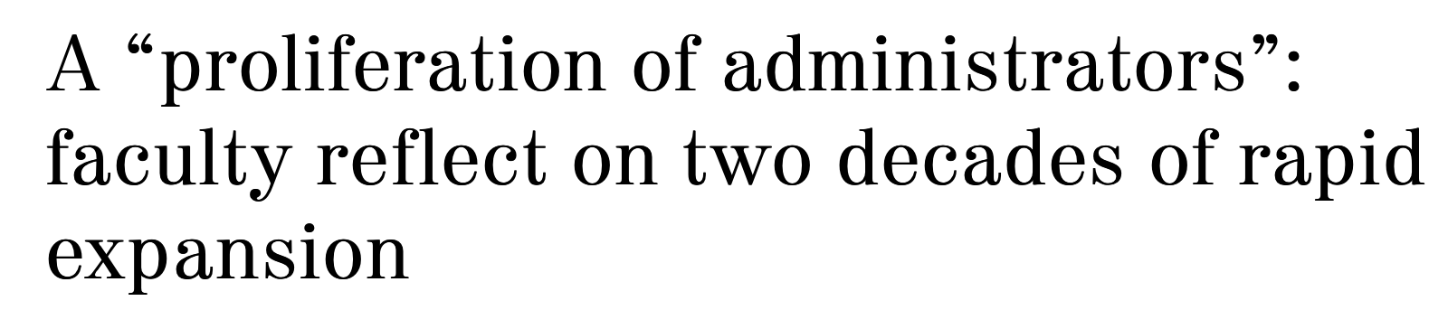
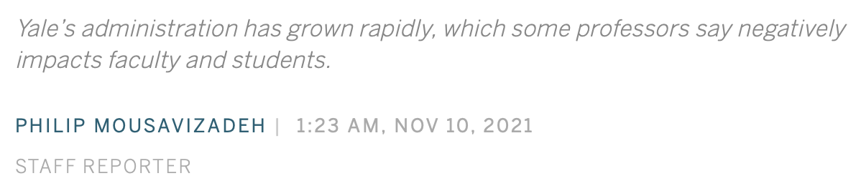
https://yaledailynews.com/blog/2021/11/10/reluctance-on-the-part-of-its-leadership-to-lead-yales-administration-increases-by-nearly-50-percent/
Notes:
Over the last two decades, the number of managerial and professional staff that Yale employs has risen three times faster than the undergraduate student body, according to University financial reports. The group’s 44.7 percent expansion since 2003 has had detrimental effects on faculty, students and tuition, according to eight faculty members.
The report further details that, according to data from the Mercatus Center at George Mason University, “the number of federal requirements placed on colleges and universities grew by 56 percent between 1997 and 2012.”
However, Paul Campos, a professor of law at the University of Colorado and an expert in the economics of higher education, said that the burden imposed by government regulations is “overblown” and that it fails to adequately explain the significant growth in administrators. He suggested that the main driver has been the desire of administrators to accumulate power and influence within their institutions.
Professor of political science James Scott agreed with Campos, adding that while all Ivy League schools are subject to similar levels of government regulation, Yale still leads the group in manager to student ratio.
“One [cause] is the tremendous increase in revenue generated by these universities that more or less has to be spent,” Campos said. “This means that as revenues go up, there has to be found ways to spend them. And one of the most natural ways to increase spending is to increase administration, the size of it and the compensation of the top administrators in particular.”

Slide 48
Additional Reading
Bombardieri, Marcella. 2013. “Harvard, Other Schools Still Fighting Grade Inflation,” https://www.bostonglobe.com/metro/2013/12/05/with-its-most-common-grade-harvard-earns-disapproval-but-has-company/kCeheDYfuDjSRcM1sVljfK/story.html
Cellini, Stephanie Riegg, Claudia Goldin, 2013. “Does Federal Student Aid Raise Tuition? New Evidence on For-Profit Colleges,” NBER Working Paper No. 17827
Denning, Eide, Mumford, Patterson, and Warnick, 2022. “Why Have College Completion Rates Increased?” American Economic Journal: Applied Economics 14, no. 3 (July) https://www.aeaweb.org/research/college-completion-grade-inflation-us)
French, Doug. “No End in Sight for Higher-Education Malinvestment,” https://mises.org/library/no-end-sight-higher-education-malinvestment
Gordon, Grey, and Aaron Hedlund, 2017. “Accounting for the Rise in College Tuition,” Chapter forthcoming in Charles R. Hulten and Valerie A. Ramey, eds., Education, Skills, and Technical Change: Implications for Future US GDP Growth, University of Chicago Press, NBER Book Series Studies in Income and Wealth.
Lindsay, Tom. 2019. “The ‘Other’ College Scandal: Grade Inflation Has Turned Transcripts into Monopoly Money,” Forbes, https://www.forbes.com/sites/tomlindsay/2019/03/30/the-other-college-scandal-grade-inflation-has-turned-transcripts-into-monopoly-money/?sh=682598754182
Lucca, David O., Taylor Nadauld, and Karen Shen, 2017. “Credit Supply and the Rise in College Tuition: Evidence from the Expansion in Federal Student Aid Programs,” FRBNY Staff Report.
Newman, Jonathan. 2017. “Four Reasons Why College Degrees are Becoming Useless,” https://mises.org/wire/four-reasons-why-college-degrees-are-becoming-useless
Singell, Larry, Joe Stone, 2007. “For Whom the Pell Tolls: The Response of University Tuition to Federal Grants-in-Aid,” Economics of Education Review 26, no. 3: 285–295.
Turner, Nicholas. 2012. “Who Benefits from Student Aid? The Economic Incidence of Tax-Based Federal Student Aid,” Economics of Education Review 31, no. 4: 463–481.
Vedder, Richard. 2013, http://www.wsj.com/articles/SB10001424127887324619504579029282438522674
Vedder, Richard. 2019. Restoring the Promise, p. 57.
Volokh, Eugene. 2017. “Freedom of Expression on Campus: An Overview of Some Recent Surveys,” Washington Post, Oct. 23. https://www.washingtonpost.com/news/volokh-conspiracy/wp/2017/10/23/freedom-of-expression-on-campus-an-overview-of-some-recent-surveys/?utm_term=.baea637297f6

