Slide 1

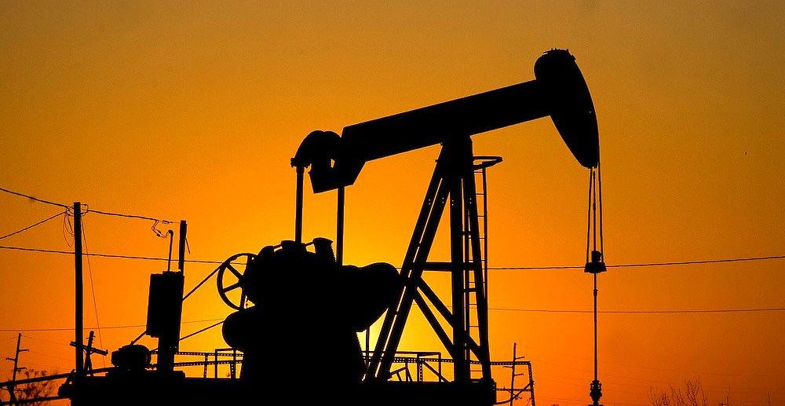


Energy Economics
This Photo by Unknown Author is licensed under CC BY-SA-NC
@timothyterrell
timothyterrell.net
Timothy D. Terrell
Mises University 2023
Notes:
Interest in environmental issues as one of the toughest set of issues for free market economists to deal with

Slide 2
Where We’re Going
Subjectivity, Calculation, Efficiency, and the Environment
  Some principles for understanding environmental issues
Government and Energy
  Can government steer energy use decisions to improve outcomes?

Slide 3
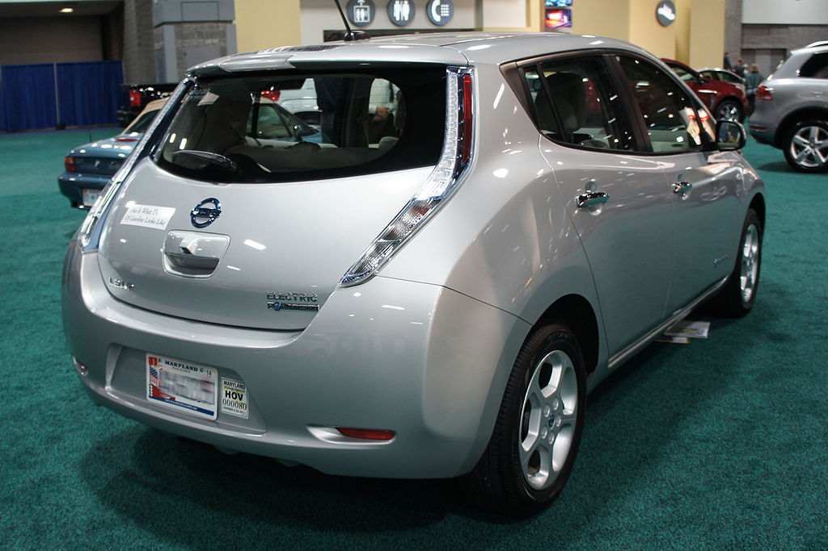

What Is Efficiency?
This Photo by Unknown Author is licensed under CC BY-SA
This Photo by Unknown Author is licensed under CC BY-SA-NC

Slide 4
What Is Efficiency?
Economy and catallaxy
  Catallactics is the study of monetary exchanges. In a catallaxy, there is no overall hierarchy of goals. There are only the separate objectives of the individuals.
  Economic efficiency is compatible with Austrian economic theory but must be restricted to determining whether individual means are consistent with individual goals.
  Catallactic efficiency: the institutional setting promotes economic efficiency, e.g., property rights are protected so individual plans can be accomplished. No interpersonal comparisons of ends.
Notes:
Catallactics is the study of monetary exchanges. In a catallaxy, there is no overall hierarchy of goals. There are only the separate objectives of the individuals.
Economic efficiency is compatible with Austrian economic theory insofar as it applies to the assessments of whether the means chosen by individuals are consistent with the accomplishment of ends chosen by those individuals. To the Austrian, it cannot engage in interpersonal comparisons of the values of the ends.
Catallactic efficiency occurs when economic efficiency is promoted by an institutional setting that ensures that property rights are secure, which in turn promotes the discovery and use of information for the accomplishment of individual plans. Catallactic efficiency takes into account the fact that we cannot judge the individual ends being pursued by participants in the market.
By studying the ideal institutional setting in which individuals can make economically efficient decisions, we can improve economic outcomes without trying to judge the value of some ends over others.

Slide 5

Institutional Settings
Haiti Dominican Republic
Economic Freedom Index
(rank): 103 62
“Protection of Property
Rights” (rating) 2.79 4.82
Economic Freedom Index at https://www.fraserinstitute.org/sites/default/files/economic-freedom-of-the-world-2018.pdf

Slide 6
What Is Efficiency?
Efficiency is an “individual goal-seeking problem, not a value-maximization problem” -- Roy Cordato
  From the Austrian perspective, efficiency is attained when legal institutions allow individuals to pursue their ends.
  Conflicts will arise over the use of scarce goods—but the Austrian does not try to assess the value of alternative uses. Costs are subjective, and can’t be measured or added up across individuals.

Slide 7

What Is Efficiency?
“…we cannot decide on public policy, tort law, rights, or liabilities on the basis of efficiencies or minimizing of costs.”
-- Murray Rothbard, in Mario Rizzo, Time, Uncertainty, and Disequilibrium
Notes:
[READ] In a chapter in Mario Rizzo’s book Time, Uncertainty, and Disequilibrium (1979), Rothbard says,
…we cannot decide on public policy, tort law, rights, or liabilities on the basis of efficiencies or minimizing of costs. But if not costs or efficiency, then what? The answer is that only ethical principles can serve as criteria for our decisions. Efficiency can never serve as the basis for ethics; on the contrary, ethics must be the guide and touchstone for any consideration of efficiency.
…Economists will have to get used to the idea that not all of life can be encompassed by our own discipline. A painful lesson no doubt, but compensated by the knowledge that it may be good for our souls to realize our own limits—and, just perhaps, to learn about ethics and about justice. [Rothbard, Logic of Action 2, p. 273]
No measure of pollution that uses pollution concentrations will account for varying subjective valuations of individuals. This undermines target pollution concentrations as a policy goal.
Using pollution concentrations to measure environmental quality is also problematic if we do not take into account human adaptability to the environment. For example, people will trade off air quality against other goods.
Government policy that favors one type of energy over another inevitably makes interpersonal comparisons of ends.

Slide 8
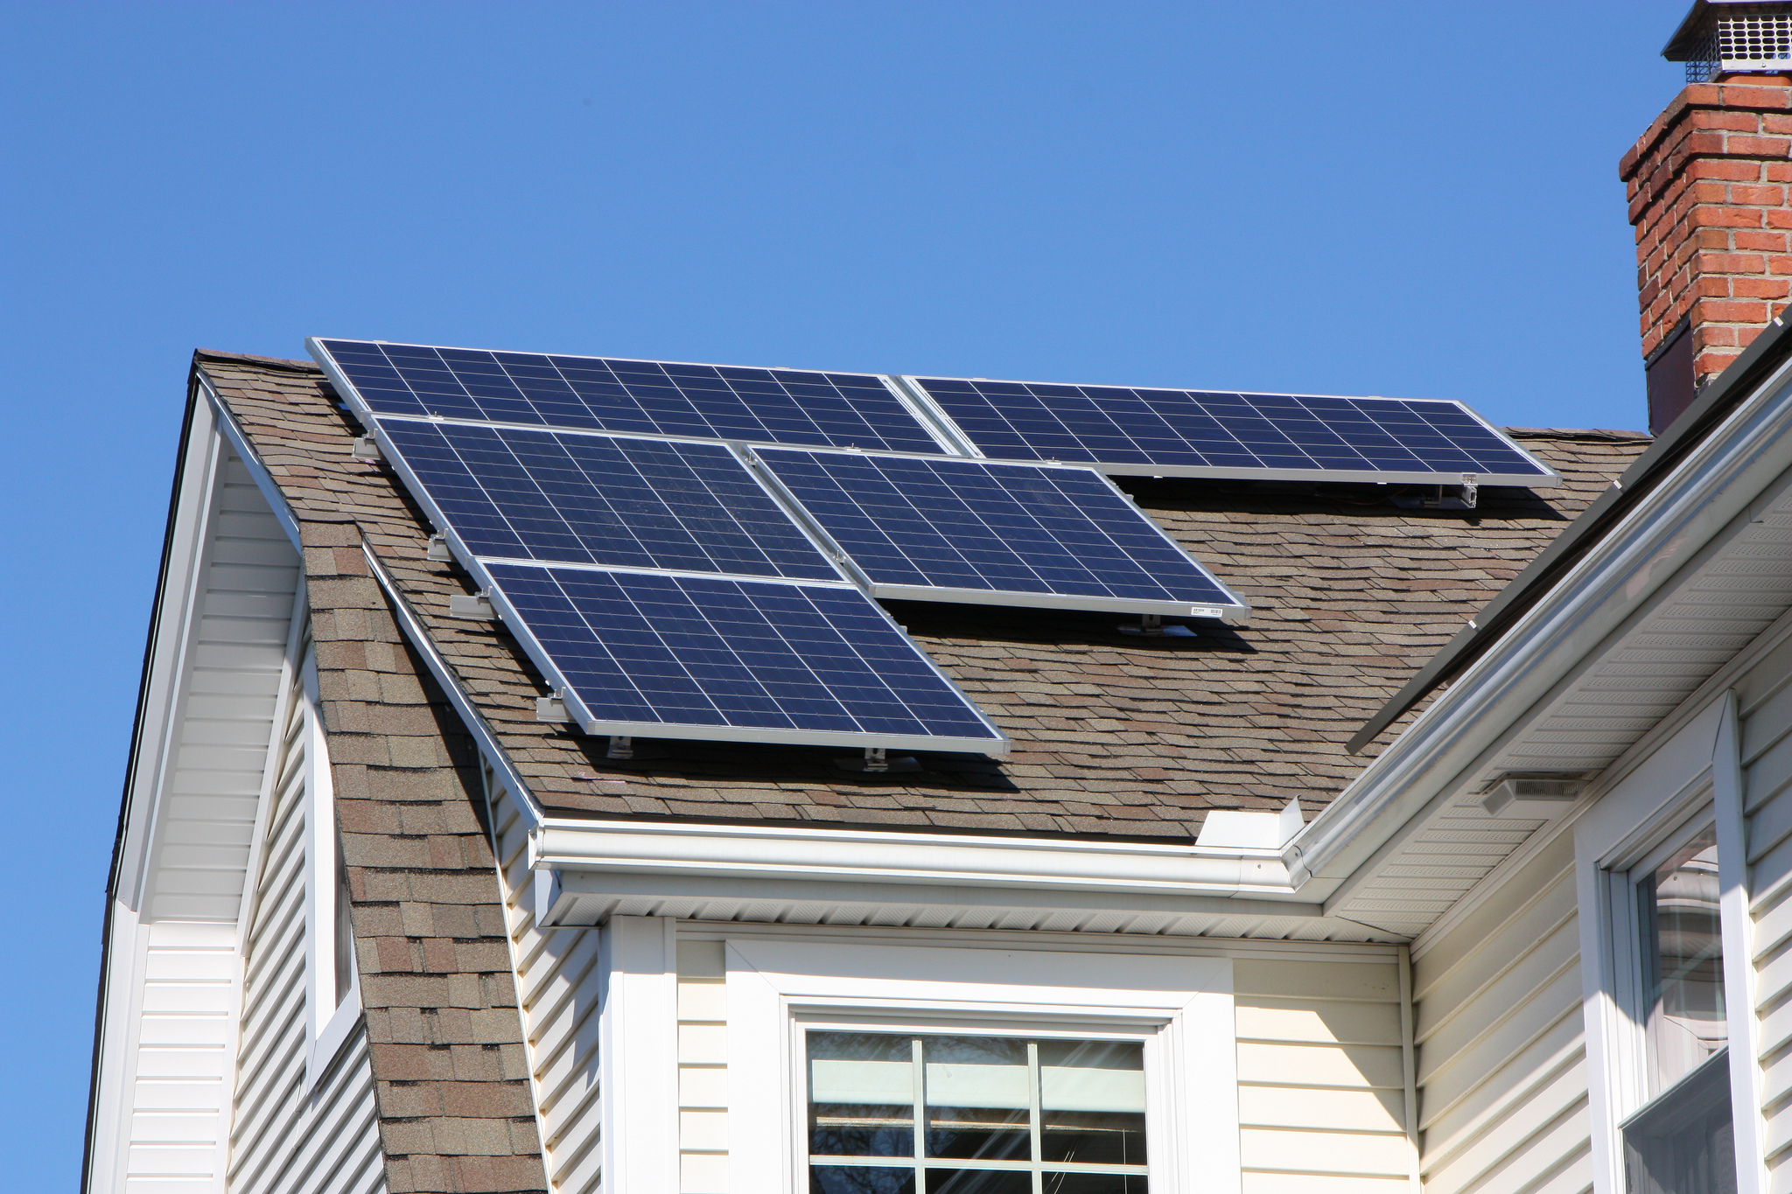
What Really Matters?
No measure of pollution that uses pollution concentrations will account for varying subjective valuations of individuals. This undermines target pollution concentrations as a policy goal.
Using pollution concentrations to measure environmental quality is also problematic if we do not take into account human adaptability to the environment. For example, people will trade off air quality against other goods.
Government policy that favors one type of energy over another inevitably makes interpersonal comparisons of ends.
This Photo by Unknown Author is licensed under CC BY

Slide 9
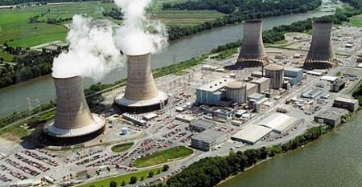
Knowledge and Incentives
This Photo by Unknown Author is licensed under CC BY-ND

Slide 10
Knowledge and Incentives
Problem 1: Knowledge
  Art Carden:
    “The information needed to know whether a particular regulation ‘works’ quite literally does not exist, and the key difference between firms and governments is that firms … have market tests for their decisions. Governments do not.”
    – “What Should Austrian Economists Do?...” in QJAE vol. 17, no. 2.
Problem 2: Incentives
  Elected officials and their associated bureaucrats aren’t selfless, publicly-interested beings any more than we assume the rest of humanity to be.
  Political incentives may discourage a long-term view that leads to ideal conservation or resource extraction.

Slide 11
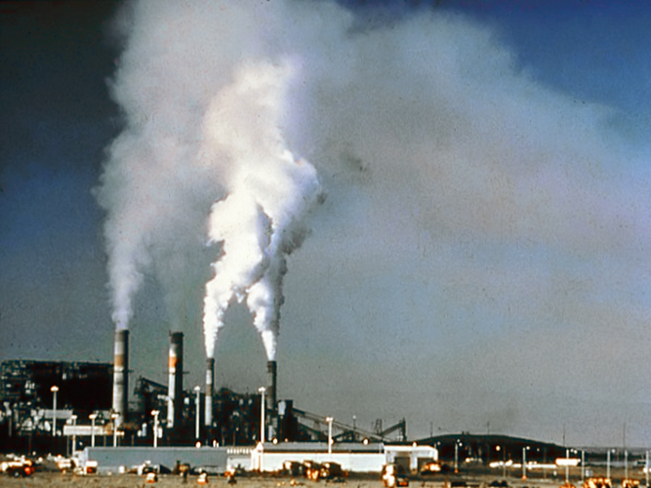
Tradable Permits
In March, 1993, the Environmental Protection Agency held its first auction of sulfur dioxide permits. They sold 275,000 permits, each allowing a polluter to emit a ton of sulfur dioxide. Permits cost an average of $76.36 each, or $21 million total.
Notes:
One coal-burning electric utility stopped construction on a $350 million scrubber and bought some permits that would allow it to save money. Other electric utilities that can reduce their SO₂ emissions at a lower cost (less than $76/ton) would reduce their emissions. [Barnaby J. Feder, “Sold: $21 Million of Air Pollution,” New York Times, March 30, 1993]

Slide 12
Calculation Problem
What does “overuse” of resources mean? In the context of pollution, “overuse” of air as a dumping ground for effluent
Assumes that we know the optimal rate of use for a whole society

Slide 13
Knowledge Problem
MPC, MSC, MPB
MSC
Deadweight loss (DWL)
MPC
Overproduction
MPB
Q*
Q^{M}
Qty. of output

Slide 14
Knowledge Problem
MPC, MSC, MPB
MSC
MPC
Tax?
MPB
Q*
Q^{M}
Qty. of output

Slide 15
Knowledge Problem
MPC, MSC, MPB
MSC
MPC
MPB
Q tradable permits?
Q*
Q^{M}
Qty. of output

Slide 16
Knowledge Problem
MPC, MSC, MPB
MSC_{est}
From any regained DWL, subtract:
DWL from “overshoot”
Costs of bureaucracy and enforcement
Costs of waste from political lobbying by, e.g., purveyors of alternative energy tech.
MSC
Overshooting tax on negative externality
DWL_{T}
DWL
MPC
MPB
Q^{T}
Q*
Q^{M}
Qty. of output

Slide 17
Incentives
While rulers of government own “public” property, their ownership is not secure in the long run, since they may always be defeated in an election or deposed. Hence government officials will tend to regard themselves as only transitory owners of “public” resources. While a private owner, secure in his property and its capital value, may plan the use of his resource over a long period of time in the future, the government official must exploit ”his” property as quickly as he can, since he has no security of tenure.
-- Murray Rothbard, Man, Economy, and State (1993 printing, Mises Institute), p. 828.

Slide 18
Incentives
In some cases, government could over-use a resource it owns or promote over-use indirectly via a tragedy of the commons.
In other cases, government will push under-usage of a resource, if use becomes unpopular with powerful interest groups.
  Ideological motivations
  Disadvantaging a competing product

Slide 19
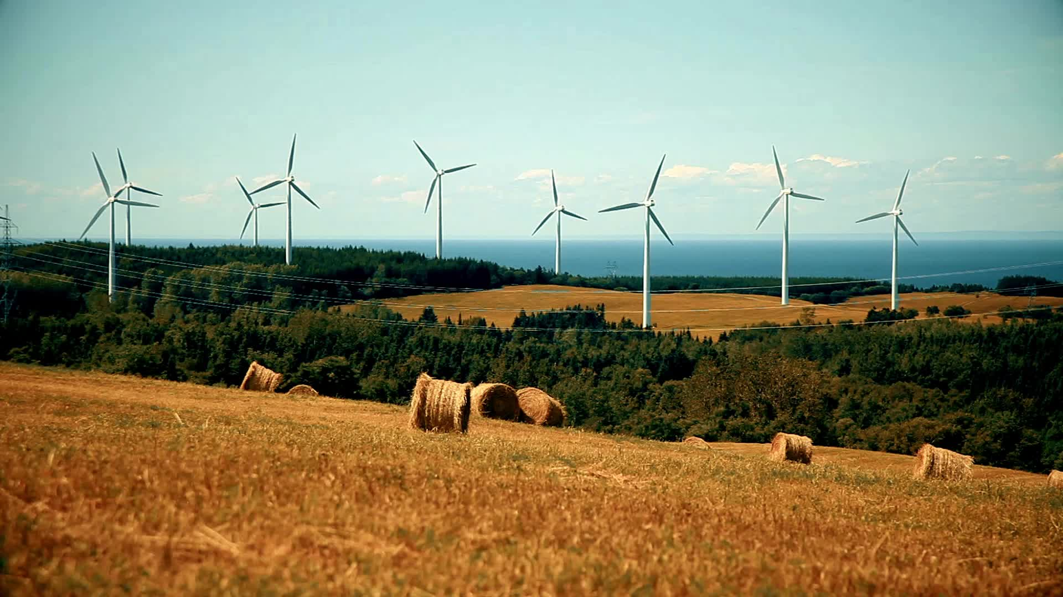
Alternative & Renewable Energy

Slide 20
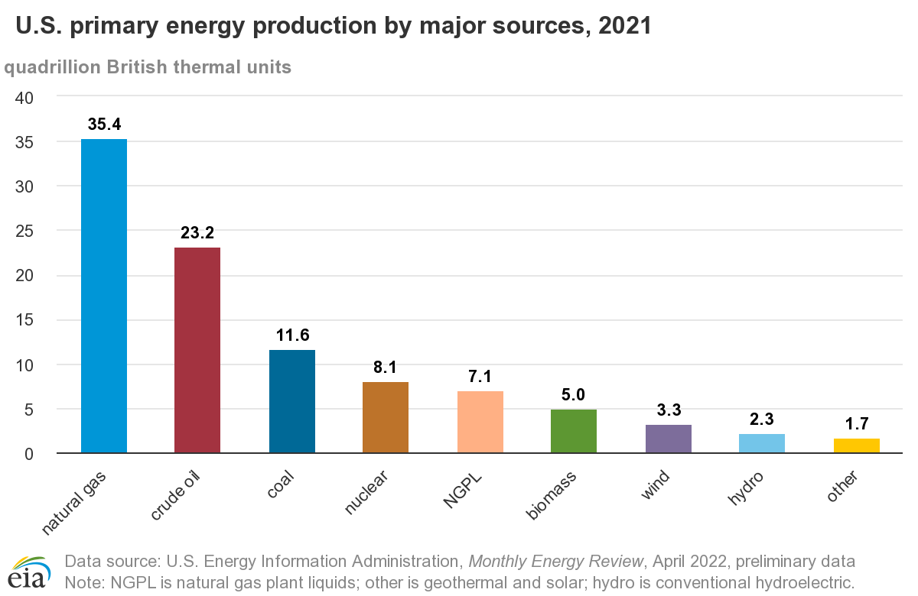
2015: 26
2015: 18
2015: 20
2015: 8
2015: 4
2015: 5
2015: 2*
2015: 2
*includes wind, solar, geothermal
Notes:
Coal is still a major energy source in the US and in some other countries that can ill-afford transitions to expensive alternatives. Many livelihoods depend on inexpensive energy.

Slide 21
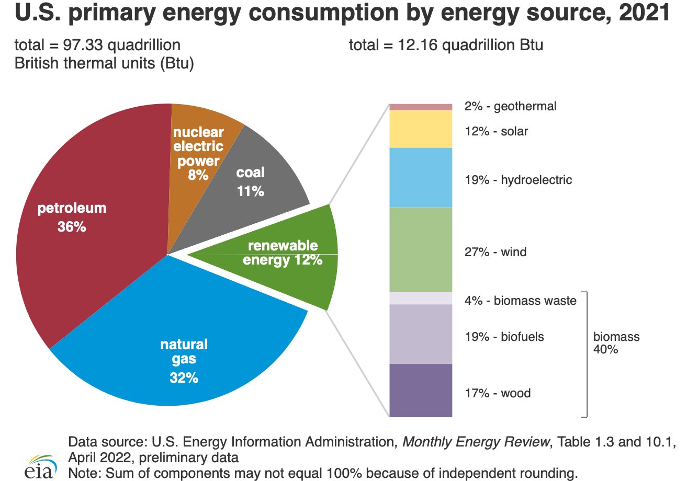

Slide 22
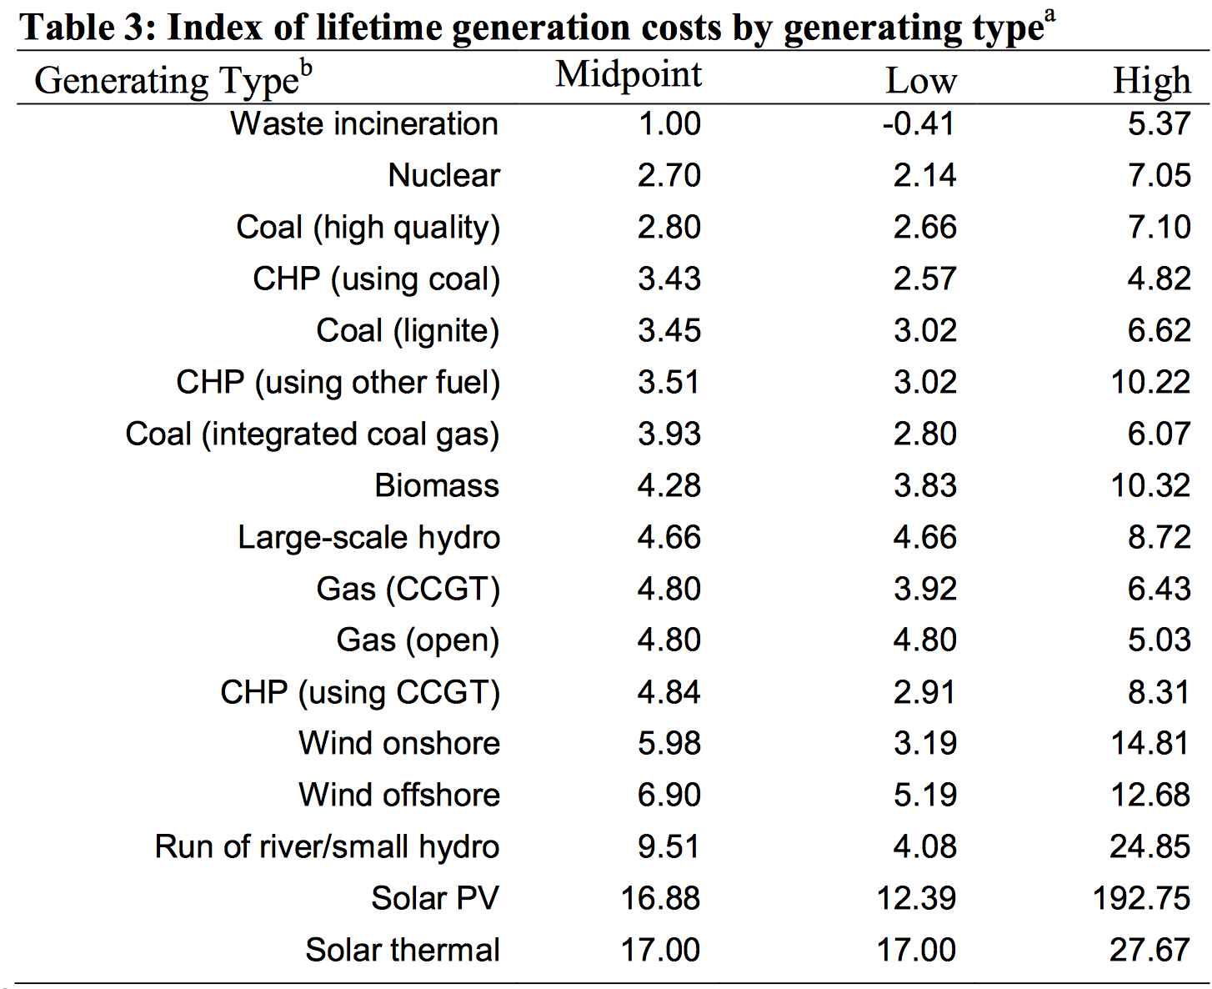
Source: http://www.cornwallalliance.org/wp-content/uploads/2014/04/a-renewed-call-to-truth-prudence-and-protection-of-the-poor.pdf, p. 66. CHP = Combined Heat and Power; CCGT = Combined Cycle Gas Turbine
“…we cannot decide on public policy, tort law, rights, or liabilities on the basis of efficiencies or minimizing of costs.”
-- Murray Rothbard
Notes:
Sources of energy most favored by many environmental groups also tend to be very expensive, slowing growth. The poor and vulnerable need economic growth to enhance their lives, including avoiding the worst of environmental risks.

Slide 23
Government Energy Choices
Regulatory limits on electricity and LPG → indoor air pollution
  “Around three billion people cook and heat their homes using open fires and simple stoves burning biomass (wood, animal dung and crop waste) and coal.”
  “over 4 million people die prematurely from illness attributable to the household air pollution from cooking with solid fuels.” This is c. 45x the number dying from natural catastrophes.
  ”the lack of access to electricity for at least 1.2 billion people (many of whom then use kerosene lamps for lighting) creates other health risks, e.g., burns, injuries and poisonings from fuel ingestion, as well as constraining other opportunities for health and development, e.g. studying or engaging in small crafts and trades, which require adequate lighting.” Most of the victims are women and young children.
Source: http://www.who.int/mediacentre/factsheets/fs292/en/

Slide 24
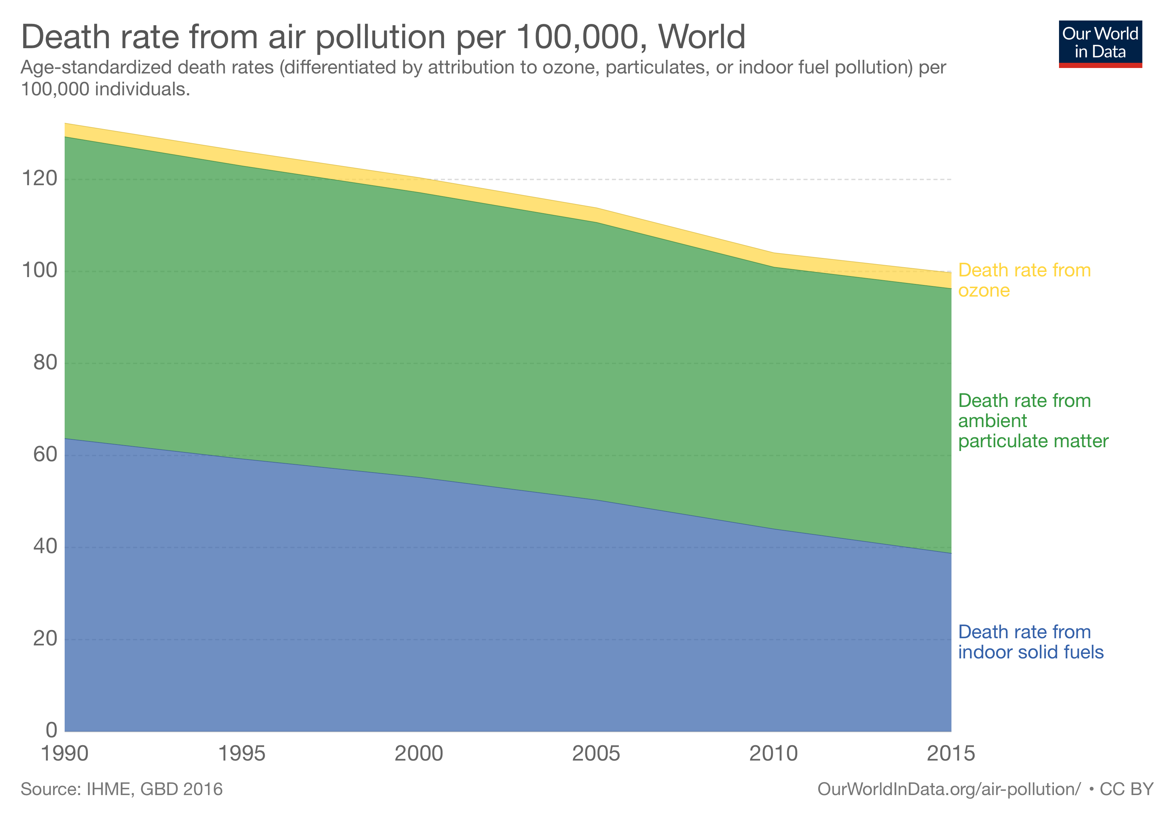
One way to assess the impact of environmental quality is to look at deaths from environmental hazards.
  “Age-standardized death rate” adjusts for population size and age demographics
  (https://ourworldindata.org/air-pollution)

Slide 25
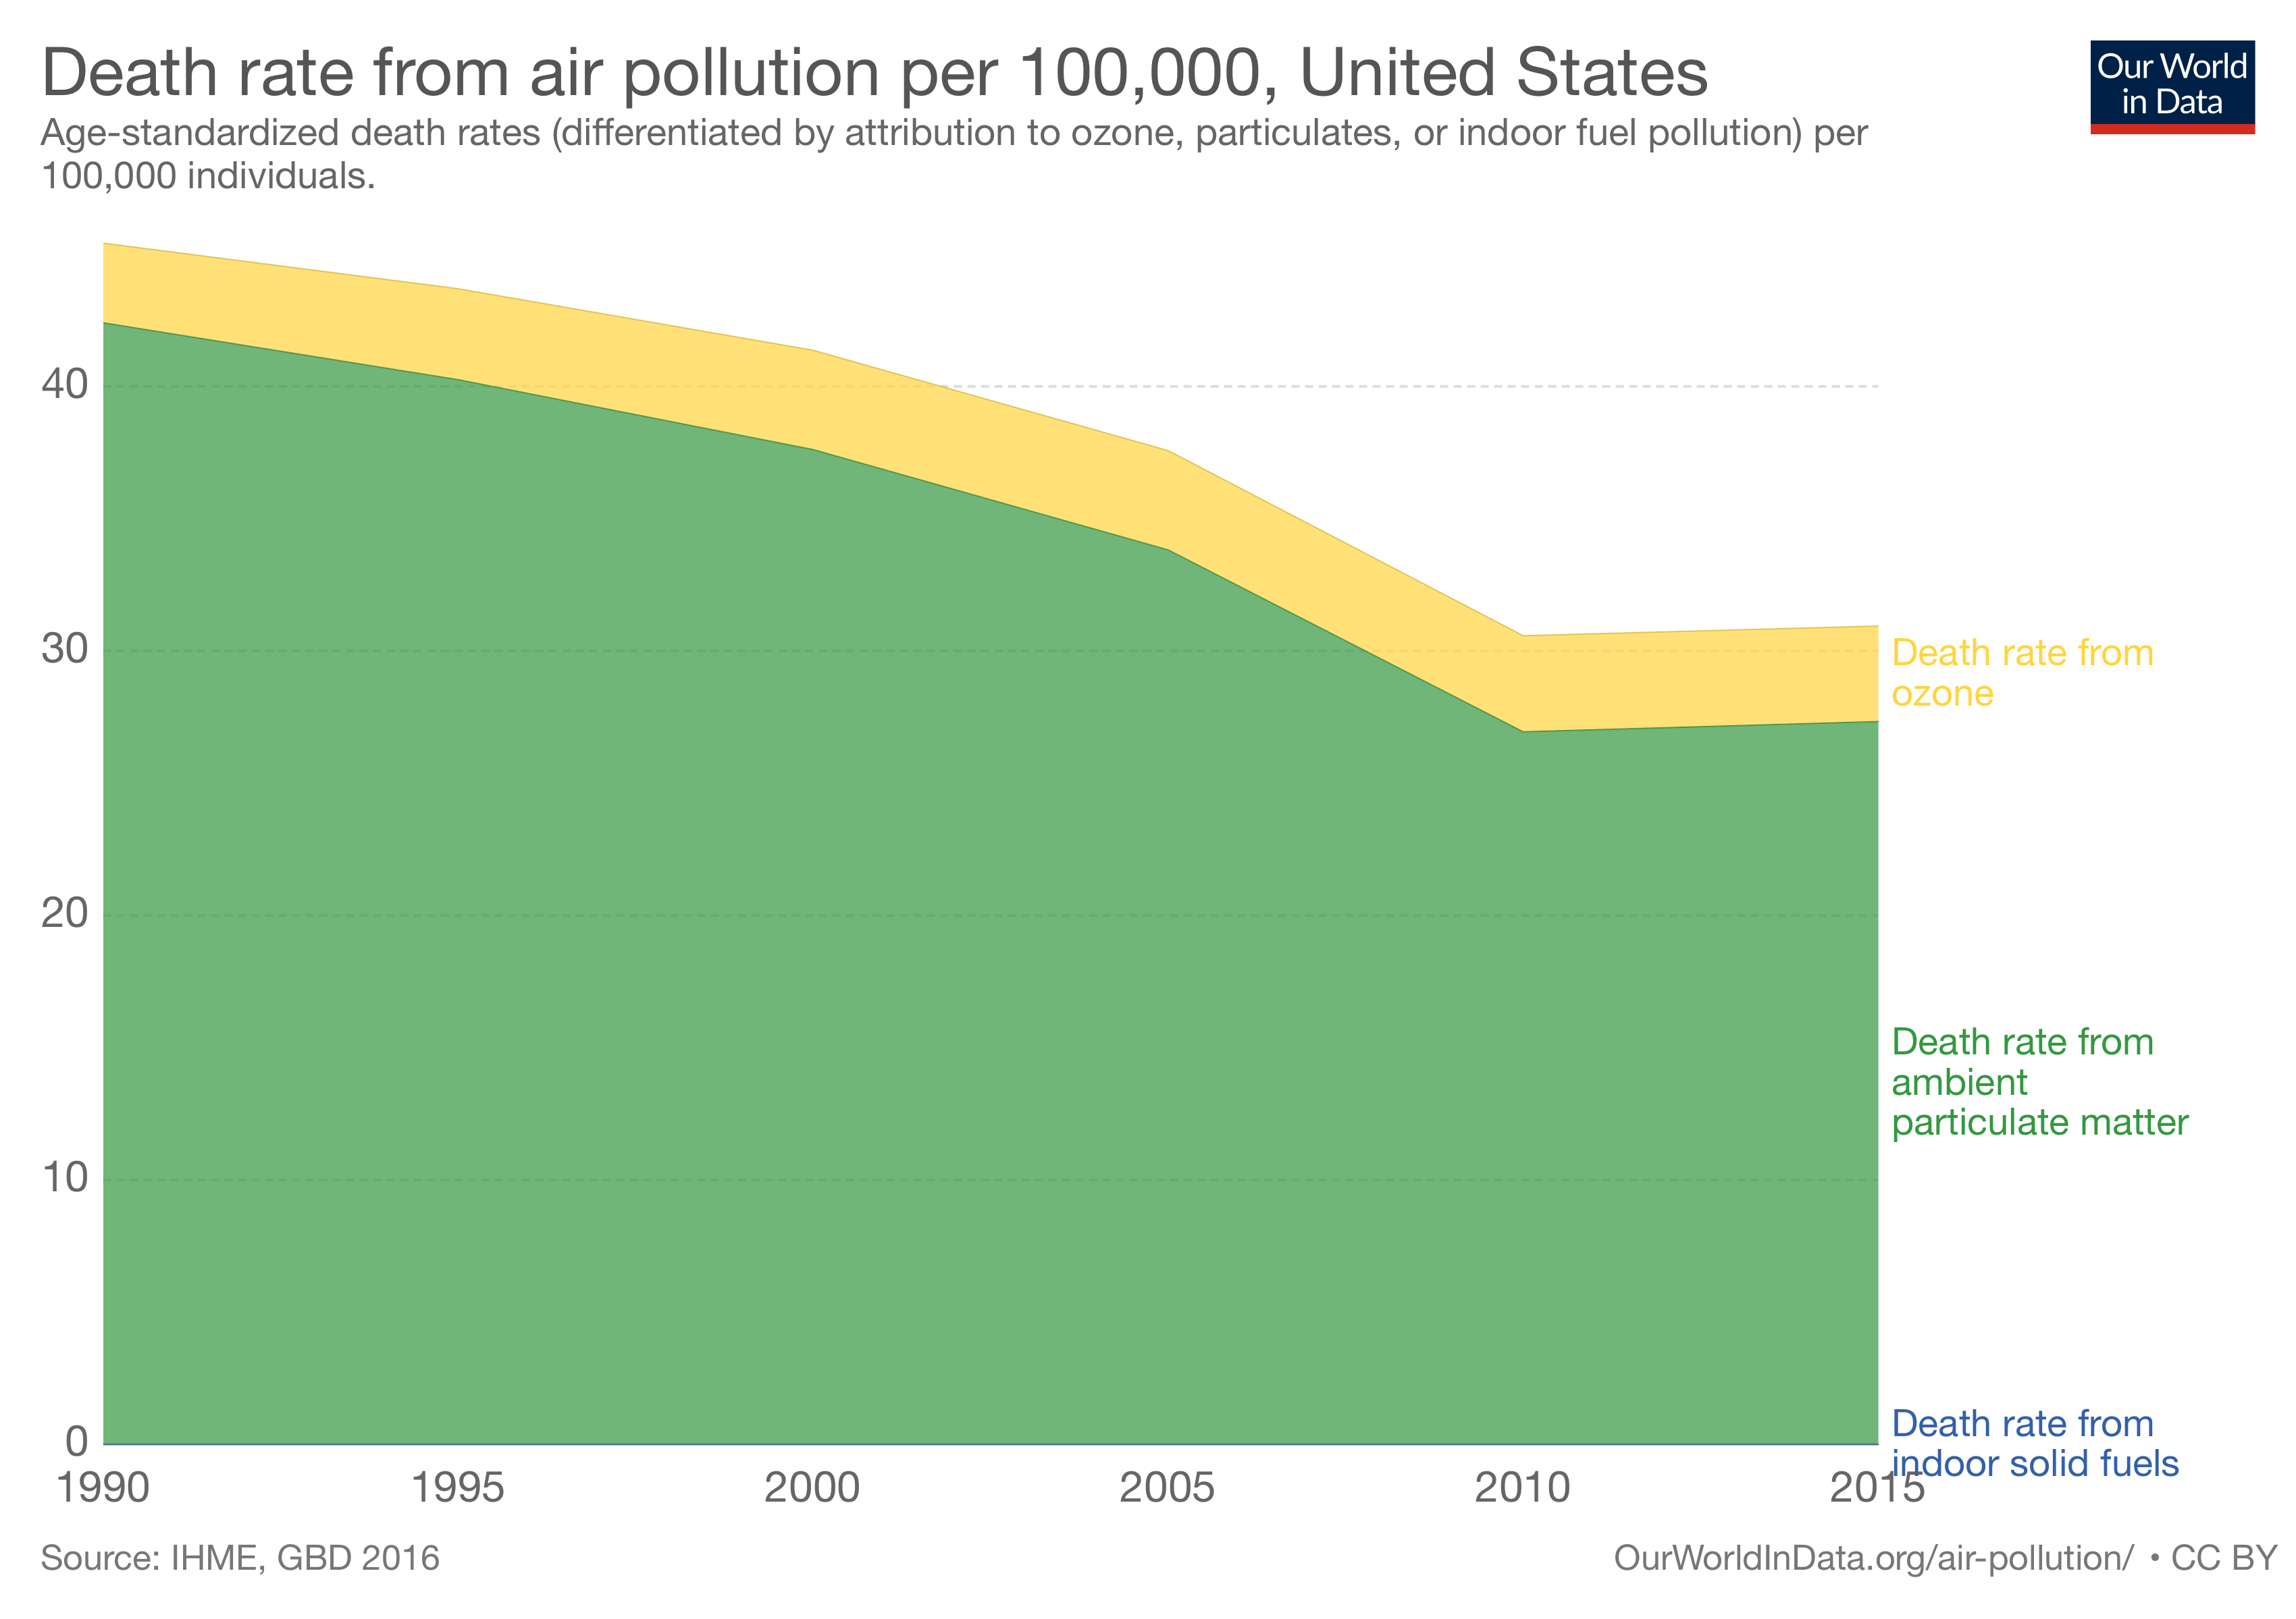

Slide 26
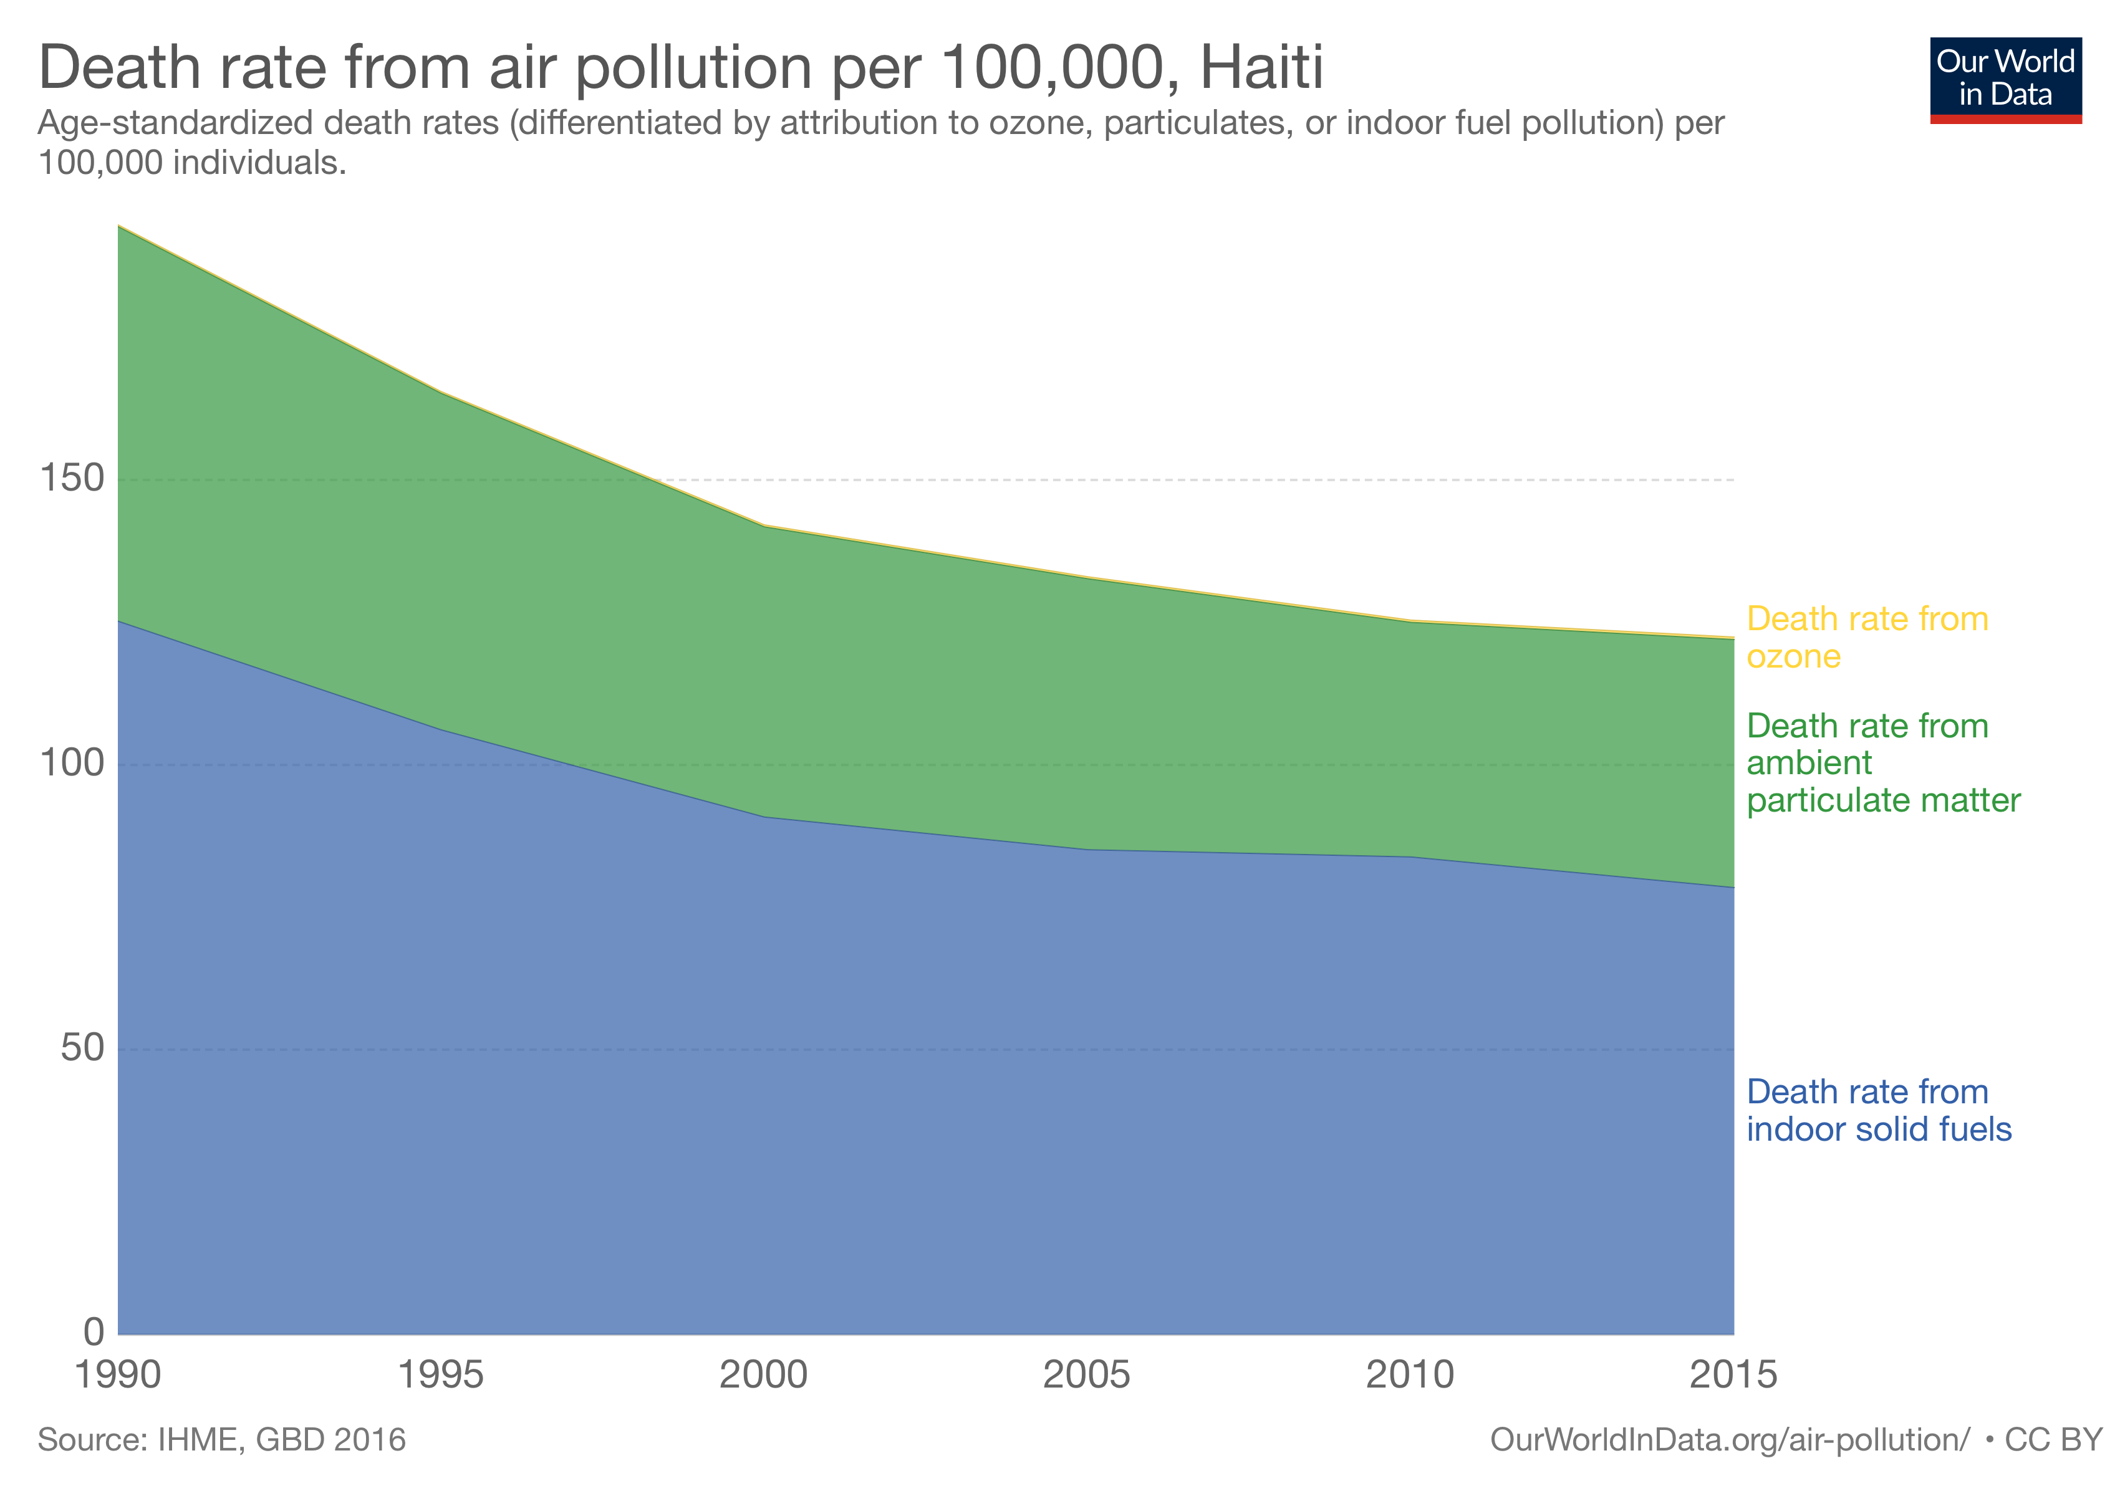

Slide 27
Government Energy Choices
Indoor air pollution indicator from Environmental Performance Index, 2006 – SEDAC (NASA)
Source: https://ourworldindata.org/indoor-air-pollution/

Slide 28
Government Energy Choices
Share of population without access to modern fuels (i.e., electricity, liquid fuels, and gaseous fuels such as LPG, natural gas, and kerosene) in developing countries, 2007 – UNDP & WHO (2009)
Source: https://ourworldindata.org/indoor-air-pollution/

Slide 29
Government Energy Choices
“As development finance institutions try to balance climate concerns against the need to spur equitable development and increase energy security, the United Kingdom, the United States, and the European Union have all taken aggressive steps to limit fossil fuel investments in developing and emerging economies.

Slide 30
Government Energy Choices
“Such policies often do not distinguish between different kinds of fossil fuels, nor do they consider the vital role some of these fuels play in powering the growth of developing economies, especially in sub-Saharan Africa.”
-- Yemi Osinbajo, Vice President of Nigeria
Notes:
Former Indian chief economic adviser Arvind Subramanian has called this anti-fossil fuel push “carbon imperialism,” and Indian Prime Minister Narendra Modi has complained of a new colonialism, in which the developed countries of the world, having used fossil fuels to achieve prosperity, now promote energy policies that would deny growth to countries like his own.

Slide 31
Government Energy Choices
“In the midst of fertilizer shortages caused by the war in Ukraine and a growing food crisis, the EU has refused financial investment to help Ghana and other cash-strapped African countries boost domestic [fertilizer] production or develop their fossil energy sources because doing so would be ‘inconsistent with their energy and environmental policies.’
“Formerly a net exporter of electricity, Ghana has experienced complete power blackouts that have left millions living in the Ashanti region without water as well… including irrigation needed to grow food.”
-- Larry Bell
    https://cornwallalliance.org/2022/07/green-energy-policies-no-help-to-the-most-desperate/

Slide 32
Risk Trade-Offs
You can’t just do one thing.
Back away from one risk, into another:
Lower income = lost life (Lutter & Morrall: $10-$50 million?)
OSHA regulations: 1.5 lives lost for every life saved
EPA formaldehyde standard: 25:1
MC
Safety
Notes:
To the extent that regulation reduces disposable income, it damages health. Disposable income is used partially to increase personal health and safety. In developing nations, higher incomes may be used to purchase adequate food and clean water, obtain medical care, and perhaps provide for an education that allows the individual to avoid dangerous employment. In industrialized nations, higher incomes mean that people can buy safer cars, choose more healthful foods, move away from crime-ridden neighborhoods, and install smoke detectors in their homes. Taxing $7.6 million away from citizens so an EPA regulation can extend one human life by one year means there is less money available for individuals to take any one of thousands of steps to extend and better their lives.
Testimony I gave to the Energy And Power Subcommittee of the Energy And Commerce Committee, U.S. House Of Representatives in Feb. 2012
“A 2009 EPA-funded study analyzing 40 species of freshwater fish at 137 sites in the western U.S. found that while 56 percent of the fish had quantities of mercury above what has been considered a “safe” threshold, 97.5 percent of the fish had enough selenium to counteract the effects of the mercury. All but one of the fish in the 468-fish sample that had an insufficient ratio of selenium to mercury were pikeminnows (also called squawfish), which are commonly considered a “trash” fish and are not normally consumed as food.
“…erring on the side of caution can be a serious error indeed. Alarmism about mercury in fish could discourage people from consuming this valuable but inexpensive source of protein, which can make up an important part of good maternal nutrition and aid cardiac and brain function in adults. Unwarranted concern about mercury could cause Americans to back into a more threatening problem from the loss of nutrition.”
Spencer A. Peterson, Nicholas V. C. Ralston, David V. Peck, John Van Sickle, J. David Robertson, Vickie L. Spate, and J. Steven Morris, “How Might Selenium Moderate the Toxic Effects of Mercury in Stream Fish of the Western U.S.?” Environmental Science and Technology 43, no. 10 (2009): 3919–3925.
G. Myers, P. Davidson, C. Cox, C. Shamlaye, D. Palumbo, E. Cimichiari, J. Sloane-Reeves, G. Wilding, L. Huang, and T. Clarkson, Statement by the University of Rochester Research Team Studying the Developmental Effects of Methylmercury before the U.S. Senate Committee on the Environment and Public Works, July 29, 2003. Available at http://epw.senate.gov/hearing_statements.cfm?id=212851.
If we look at the cost per premature death averted (from Office of Management and Budget data), we can see the enormous imbalance in costs, under regulation:
Aircraft cabin fire protection $100,000
Auto fuel-system integrity standard $400,000
Trenching and excavating standard $1,500,000
Asbestos ban $110,700,000
Hazardous waste disposal ban $4,190,400,000
Proposed solid waste standards $19,107,000,000
Atrazine drinking water standard $92,069,700,000
(The maximum allowable amount of atrazine in drinking water is 3 parts per billion─equivalent to half an aspirin dissolved in a 16,000 gallon railroad tank car.)
Doctors for Disaster Preparedness Newsletter, vol. 10, no. 1 (Jan. 1993).

Slide 33
Risk Trade-Offs
Regulations on mercury emissions from coal-fired power plants in the US:
  Concern is for bioaccumulation of mercury in maternal blood, affecting fetus brain development.
  Freshwater, farm-raised fish have low methylmercury levels. The connection from US power plants to fetal health is tenuous.
  Perspective: Yellowstone National Park produces more natural mercury emissions than all eight of Wyoming’s coal-fired power plants. Forest fires in the US emit roughly the same amount of mercury as all US power plants.
  Excessive concern about mercury in fish could cause people to back into a more serious problem from the loss of nutrition.
Notes:
To the extent that regulation reduces disposable income, it damages health. Disposable income is used partially to increase personal health and safety. In developing nations, higher incomes may be used to purchase adequate food and clean water, obtain medical care, and perhaps provide for an education that allows the individual to avoid dangerous employment. In industrialized nations, higher incomes mean that people can buy safer cars, choose more healthful foods, move away from crime-ridden neighborhoods, and install smoke detectors in their homes. Taxing $7.6 million away from citizens so an EPA regulation can extend one human life by one year means there is less money available for individuals to take any one of thousands of steps to extend and better their lives.
Testimony I gave to the Energy And Power Subcommittee of the Energy And Commerce Committee, U.S. House Of Representatives in Feb. 2012
“A 2009 EPA-funded study analyzing 40 species of freshwater fish at 137 sites in the western U.S. found that while 56 percent of the fish had quantities of mercury above what has been considered a “safe” threshold, 97.5 percent of the fish had enough selenium to counteract the effects of the mercury. All but one of the fish in the 468-fish sample that had an insufficient ratio of selenium to mercury were pikeminnows (also called squawfish), which are commonly considered a “trash” fish and are not normally consumed as food.
“…erring on the side of caution can be a serious error indeed. Alarmism about mercury in fish could discourage people from consuming this valuable but inexpensive source of protein, which can make up an important part of good maternal nutrition and aid cardiac and brain function in adults. Unwarranted concern about mercury could cause Americans to back into a more threatening problem from the loss of nutrition.”
Spencer A. Peterson, Nicholas V. C. Ralston, David V. Peck, John Van Sickle, J. David Robertson, Vickie L. Spate, and J. Steven Morris, “How Might Selenium Moderate the Toxic Effects of Mercury in Stream Fish of the Western U.S.?” Environmental Science and Technology 43, no. 10 (2009): 3919–3925.
G. Myers, P. Davidson, C. Cox, C. Shamlaye, D. Palumbo, E. Cimichiari, J. Sloane-Reeves, G. Wilding, L. Huang, and T. Clarkson, Statement by the University of Rochester Research Team Studying the Developmental Effects of Methylmercury before the U.S. Senate Committee on the Environment and Public Works, July 29, 2003. Available at http://epw.senate.gov/hearing_statements.cfm?id=212851.
If we look at the cost per premature death averted (from Office of Management and Budget data), we can see the enormous imbalance in costs, under regulation:
Aircraft cabin fire protection $100,000
Auto fuel-system integrity standard $400,000
Trenching and excavating standard $1,500,000
Asbestos ban $110,700,000
Hazardous waste disposal ban $4,190,400,000
Proposed solid waste standards $19,107,000,000
Atrazine drinking water standard $92,069,700,000
(The maximum allowable amount of atrazine in drinking water is 3 parts per billion─equivalent to half an aspirin dissolved in a 16,000 gallon railroad tank car.)
Doctors for Disaster Preparedness Newsletter, vol. 10, no. 1 (Jan. 1993).

Slide 34
Energy and Growth
Image: https://wattsupwiththat.com/2013/04/10/a-new-high-resolution-look-at-north-korea-where-it-is-earth-hour-every-night/

Slide 35
Further Reading
Bell, Larry. 2022. “Green Energy Policies No Help to the Most Desperate.” Cornwall Alliance, July 26. https://cornwallalliance.org/2022/07/green-energy-policies-no-help-to-the-most-desperate/
Block, Walter. Free Market Environmentalism
Brandly, Mark. 2016. “Including the Ocean Floor, the Feds Own Much More Land than You Think,” https://mises.org/library/including-ocean-floor-feds-own-much-more-land-you-think
Carden, Art. 2013. “Economic Calculation in the Environmentalist Commonwealth,” QJAE vol. 16, no. 1.
Carden, Art. 2014. “What Should Austrian Economists Do? On Dolan on the Austrian Paradigm in Environmental Economics,” QJAE vol. 17, no. 2.
Cordato, Roy. 2004. “Toward an Austrian Theory of Environmental Economics,” QJAE vol. 7, no. 1.
Cordato, Roy. 2007. Efficiency and Externalities in an Open-Ended Universe. Auburn, AL: Mises Institute
McCaffrey, Matthew. 2012. “Five Erroneous Ways to Argue about Resource Economics,” QJAE vol. 15, no. 1.
Rothbard, Murray. “Law, Property Rights, and Air Pollution” https://mises.org/library/law-property-rights-and-air-pollution
Terrell, Timothy, 2007. “Sprawl vs. Coastal Beauty,” The Freeman: Ideas on Liberty. https://fee.org/articles/sprawl-versus-coastal-beauty/

Slide 36
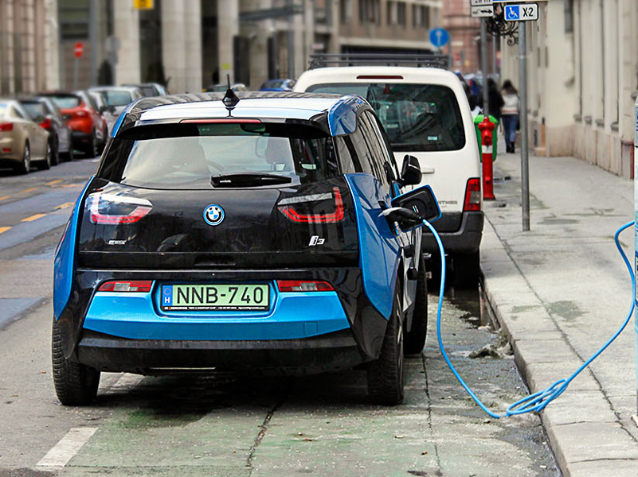
Electric Vehicles
“California has banned the sale of new gas-powered cars by 2035, and other states are following.” – WSJ, “The False ‘Green Jobs’ Promise,” July 21, 2022
GM is planning to produce only EVs by 2035.
Conventional vehicles are increasingly used to cross-subsidize EVs that are pushed with government policy and largely marketed to affluent customers.
EV companies are “rapidly burning through cash” and are facing higher production costs – WSJ, “The Electric-Vehicle Unicorn Crash,” May 19, 2022
This Photo by Unknown Author is licensed under CC BY
Notes:
Federal EV incentives effectively target luxury EVs, which don’t replace the high-mileage gas vehicles that are driven by lower-income households. https://today.law.harvard.edu/current-electric-vehicles-subsidies-fail-to-reduce-overall-emissions-says-harvard-law-study/

Slide 37

“Green Jobs”
Counting “jobs” is not a good measure of policy success.
Even so, “jobs” may not be materializing as advertised.
“The United Auto Workers union estimates that increasing EV manufacturing could result in the loss of 35,000 union jobs because it requires fewer parts”
– WSJ, “The False ‘Green Jobs’ Promise,” July 21, 2022

Slide 38

Tragedy of the Commons
If livestock are placed on a common pasture, where no one is an owner, herders gain all the benefits of the grass their animals eat, but suffer only part of the costs.

Slide 39
The Tragedy of the Commons
Rancher Al
1 cow
2 cows
Al: 5
Bob: 5
Al: 6
Bob: 3
1 cow
Rancher Bob
Al: 3
Bob: 6
Al: 4
Bob: 4
2 cows
Adapted from Baland and Platteau (1996, p. 29)

Slide 40

The Tragedy of the Commons
Menger: “When all members of society compete for a given quantity of goods that is insufficient… a practical solution to this conflict of interest is… only conceivable if the [goods] pass into the possession of some of the economizing individuals, and if these individuals are protected by society in their possession to the exclusion of all other individuals.”

Slide 41
The Tragedy of the Commons
Rancher Al
1 cow
2 cows
Al: 5
Bob: 5
Al: 6
Bob: 3
1 cow
Rancher Bob
Al: 3
Bob: 6
Al: 4
Bob: 4
2 cows
Adapted from Baland and Platteau (1996, p. 29)

Slide 42
Capitalism Destroying the Environment?
z

Slide 43
Deepwater Horizon Oil Spill
Image: https://phys.org/news/2018-04-deepwater-horizonthe-impact-america-largest.html
On April 20, 2010, a deep water oil well in the Gulf of Mexico, BP’s “Deepwater Horizon,” had a blowout on a well about 1 mile deep, about 41 miles off the Louisiana coast. Eleven oil rig workers were killed, and over a period of almost 3 months, about 210 million gallons of oil were leaked. Oil appeared on the coasts of every state along the Gulf.
Notes:
Michael Novak Mises Daily article from June 23, 2010
…the government specifically passed laws that gave the oil companies incentives to drill far offshore—that is, in deeper water where risk is presumably higher. In addition to the higher risk of accidents, the cost of solving any problems are necessarily greater in five thousand feet of water than in, say, 250 feet of water.

Slide 44
Deepwater Horizon Oil Spill
Matthew Novak:
  …the government specifically passed laws that gave the oil companies incentives to drill far offshore—that is, in deeper water where risk is presumably higher.
  In addition to the higher risk of accidents, the cost of solving any problems are necessarily greater in 5000 feet of water than in, say, 250 feet of water.
  Mises Daily, June 23, 2010
  http://mises.org/daily/4488
Notes:
Michael Novak Mises Daily article from June 23, 2010
…the government specifically passed laws that gave the oil companies incentives to drill far offshore—that is, in deeper water where risk is presumably higher. In addition to the higher risk of accidents, the cost of solving any problems are necessarily greater in five thousand feet of water than in, say, 250 feet of water.

Slide 45
Image: SwordPress, at https://www.awesomestories.com/asset/view/Location-of-Oil-Rigs-in-the-Gulf-of-Mexico/1

Slide 46
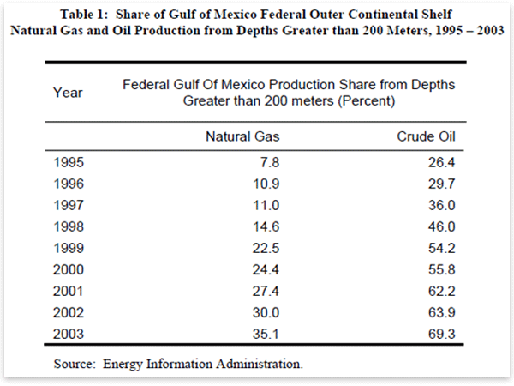
BP Oil Spill
Matthew J. Novak, Mises Daily June 23, 2010: http://mises.org/daily/4488
Notes:
There was something like a five-times increase in the amount of oil they could pump royalty-free in deep water. From 1995 to 2003, there was something like a 250 percent increase in the percentage of oil coming from deep water regions of the Gulf.

Slide 47
Deepwater Horizon Oil Spill
Other factors:
  “Tragedy of the commons”
  Bureaucratic rights assignment (no market prices)
Federal cap on liability at $75 million
Notes:
William Shughart in Human Events, July 21, 2010 http://www.independent.org/newsroom/article.asp?id=2831
Shughart mentions a tragedy of the commons problem:
…existing regulatory rules that assign “ownership” of crude oil deposits underneath the U.S. outer continental shelf to the federal government.
Rights are auctioned off periodically by the Minerals Management Service.
Since they cannot benefit personally from the decisions they make… the bureaucrats in charge of the auctions have no incentive to consider the values of the alternatives foregone, such as recreational uses, commercial fishing, exploiting other mineral deposits or simply maintaining a pristine ocean environment, when exploration rights are awarded.
…leases are auctioned willy-nilly, frequently ignoring safety concerns in the process in order to maximize governmental revenue rather than to ensure that the natural resources on the outer continental shelf are allocated efficiently.
The federal cap on liability at $75 million also plays a role:
Shughart, in New Republic July 21, 2010 http://www.independent.org/newsroom/article.asp?id=2832
A second contributor to the disaster is the federal law limiting liability for damages caused by offshore oil spills. Although the $75 million limit can be waived in cases of proven gross negligence (and likely will be in this case), BP probably would have been far more cautious from the beginning if it knew that a major blowout could cost the company billions rather than millions. Even in 2009, with energy prices sharply down from the recession, BP reported a $14 billion profit. The slim prospect of a $75 million liability “hit” may not have even raised an eyebrow.

Slide 48
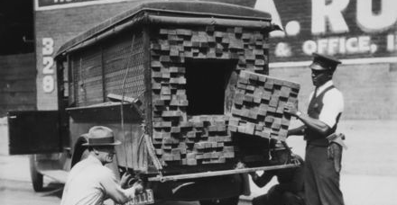
Bootleggers and Baptists
z
This Photo by Unknown Author is licensed under CC BY-SA-NC

Slide 49
Shell
Lower coal market share = higher natural gas market share.
June 1998: Shell “flipped” on global warming.
Shell executive: the company would be “promoting the development of the gas industry particularly in countries with large coal reserves such as India and China.”

Slide 50
Incandescent Light Bulb “Ban”
GE spent $47 million in 2007 lobbying for an incandescent light bulb ban, cap-and-trade carbon regulations, and other regulations
CFL, LED bulbs offered a higher profit margin
Philips began campaigning in 2006 to encourage a ban on incandescents by 2015.

Slide 51
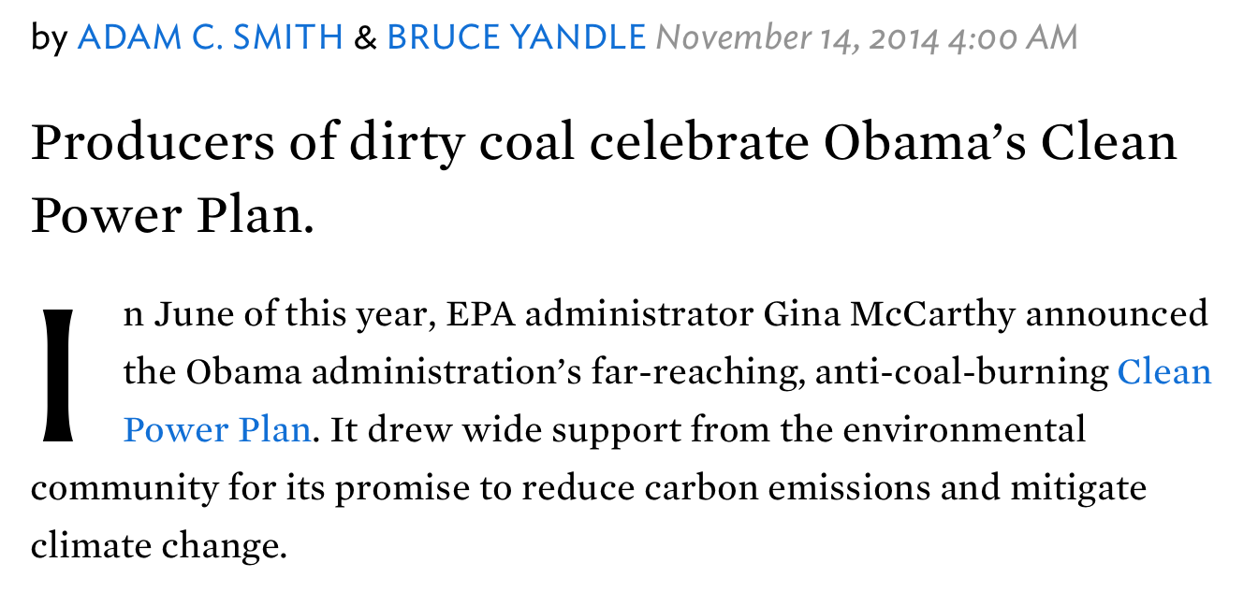
      http://www.nationalreview.com/article/392613/bootleggers-and-baptists-agree-energy-adam-c-smith-bruce-yandle
Notes:
“…dirty-coal producers in Obama’s home state of Illinois are chief among the bootleggers laughing all the way to the bank as they ship trainloads of coal to generators far and wide. The Obama administration’s Clean Power Plan has made lots of people happy — environmentalists, producers of clean-power technologies, and producers of dirty coal.”

