Slide 1

Markets and Medical Care
Timothy D. Terrell
Mises University 2022
@timothyterrell
terrelltd@wofford.edu
Notes:
Dear Dr. Terrell,I am taking your "Economics of Medical Care" course through the Mises Institute. Thank you for doing it! I appreciate you putting this course together. A couple of comments.
CPT codes are owned by the AMA and largely code the visit or procedure performed by the physician. For example a 99213 is a is a mid-level follow-up office visit. a 44950 is a routine appendectomy. They were first published in 1966.
ICD-10-CM codes are diagnostic codes and were originally developed by the WHO as tools for primarily infectious diseases and for epidemiology purposes, not for coding as it relates to medical billing:
https://www.who.int/classifications/icd/en/HistoryOfICD.pdf
These codes go back to the 1920's. However, with the most recent revision to ICD-10, the number of codes dramatically expanded from about 15,000 to about 60,000.
Even prior to the 1990's, physicians were required to put a CPT 4 code (what they did) and an ICD code (why they did it/patient diagnosis) on the HCFA 1500 billing forms for all insurances.
DRG (diagnosis-related groups) were developed by the insurance industry and CMS to change payment on the hospital inpatient side from a fee-for-service billed charges to one of a global payment for the entire hospitalization based on the diagnosis (and perhaps co-diagnoses). For CMS (Medicare) this went into effect in 1983.
In 1992, CMS wanted to value physician work by attaching "resource based-relative value units" (RVU's) to the CPT 4 codes. These codes have three components: Physician work; Facility overhead; and Malpractice. These values are modified annual (sometimes more, sometimes less) and come out in the Federal Register.
I think the explosion in healthcare administration started with the DRG implementation and then expanded more with the RB-RVS system in 1992. Hospitals (where most of the money goes) really had to learn how to work within ("game") the DRG system in order to get paid. Hospital coding became a huge industry.
There are additional coding systems such as SNOMED for diagnoses (this came out of the pathology side of medicine) and LOINC (laboratory terminology used in EMRs).
I hope that helps a little.
Thanks again for your course.
Alan R. Ertle, MD, MPH, MBA
Bend, Oregon
medinfoco@aol.com

Slide 2
Four Principles for Reforming Medical Care
Allow free pricing
1
Eliminate occupational licensure
2
Dismantle barriers to innovation
3
Put patients in charge of care
4

Slide 3
1. Allow free pricing
Keeping prices below the equilibrium tends to mean shortages, and reduces the incentives toward innovative solutions.
Low prices means that those who could make do with less won’t—so goods run out for those with great need.
The expectation that prices will be capped by government discourages stockpiling for emergencies.
Notes:
Allowing prices to rise—even dramatically—after a crisis does not rule out charitable efforts.

Slide 4
The Great Toilet Paper/Hand Sanitizer/N95 Shortages of 2020
Price
S₂
S₁
D₂
D₁
Q₁
Quantity
SHORTAGE

Slide 5
2. Eliminate occupational licensure
Occupational licensure limits competition and ossifies the status quo.
Under pandemic conditions,
  those who may be skilled but let their licensure lapse can’t easily re-enter,
  skilled people who are able to perform a function legally restricted to another group are unable to alleviate labor shortages, and not-quite-finished students are unable to put their training to full use.

Slide 6
Medical Licensure
“Competition resulted not only in a proliferation of medical personnel but in the growth of heterodox theories arising in opposition to standard medical therapeutics.”
Hamowy points out that by the 1870s, mainstream medicine had reduced its dependence on bloodletting, arsenic, etc., and added botanical drugs along the lines suggested by an alternative school of thought, eclecticism.
License to practice medicine in Connecticut, 1824. Source: http://doc1.med.yale.edu/historical/bicentennial/1810/midcentury.html
Ronald Hamowy, “The Early Development of Medical Licensing Laws in the United States, 1875-1900,” Journal of Libertarian Studies, vol. 3, no. 1 (1979)

Slide 7
Medical Licensure
Ronald Hamowy: “Competition resulted not only in a proliferation of medical personnel but in the growth of heterodox theories arising in opposition to standard medical therapeutics.”
Hamowy points out that by the 1870s, mainstream medicine had reduced its dependence on bloodletting, arsenic, etc., and added botanical drugs along the lines suggested by an alternative school of thought, eclecticism.
In the late 1800s, the US had the highest number of physicians, per capita, in the world.
In 1904, the AMA began a concerted effort to reduce the number of medical students, claiming that this would increase medical quality.
In 1910, Abraham Flexner published a report for the Carnegie Foundation on US and Canadian medical education.
The report suggested closure of most medical schools (155 to 31), homogenization of education in medical schools, approval of any new medical school by the state government, and additional state licensure regulation.

Slide 8
Medical Licensure
The AMA controls medical schools, state by state, through an accrediting body, the Liaison Committee on Medical Education. Licenses are granted only to graduates of these schools.
Prices of medical care shot up.
Schools of alternative medicine were almost all closed.
Changes arising from the Flexner report also led to fewer women and African Americans in medical education.
See Dr. Michel Accad, http://alertandoriented.com/an-economic-history-of-the-american-health-care-system-part-1/

Slide 9
Crisis and Licensure
Even before COVID, licensure contributed to higher costs.
HHS’s Alex Azar waived some rules that had limited federal compensation to physicians who were licensed in the state where they provided services, allowing them to “have an equivalent license from another state.”
Many states loosened or lifted occupational licenses. Some states have extended these temporary provisions.
Notes:
The COVID-19 pandemic has made the adverse consequences of occupational licensure painfully clear. In a time of crisis, these state requirements on medical education and training, and limits on the range of services different clinicians may provide, have stifled the medical system’s ability to respond. In tacit acknowledgement of licensing’s costs, some states have temporarily suspended some medical licensing rules. Even in normal circumstances, blocking potential new doctors, nurses, and other medical professionals drives up labor costs, an important factor in overall medical expenditures. A 2018 study in the Journal of the American Medical Association linked labor costs to the relatively high medical care spending in the US, saying that “prices of labor and goods, including pharmaceuticals, and administrative costs appeared to be the major drivers of the difference in overall cost between the United States and other high-income countries.” Removal of license-based barriers to entry might lower cost and improve access to skilled medical professionals. This does not mean that patients would be unable to discern the qualifications of those treating them. Professional certification could provide assurances of competence without creating artificial scarcity.
Medical facilities, too, are made more expensive by rules limiting expansion. Most states require hospitals and nursing homes to get permission to add beds through certificate-of-need (CON) laws—permission that can be denied for nothing more than posing a financial threat to existing facilities. Clearly, CON laws protect incumbent hospitals and long-term care providers from competition, and in so doing limit expansion of access. Pressure from the COVID-19 pandemic did result in a loosening of the restrictions in most of the states that have CON laws, but rapidly expanding hospital capacity in the face of a pandemic is difficult, and there is every possibility that the restrictions will be re-imposed once the crisis passes.
Papanicolas, Irene, Liana R. Woskie, and Ashish K. Jha. 2018. “Health Care Spending in the United States and Other High-Income Countries,” JAMA 319, no. 10: 1024–39.

Slide 10
3. Dismantle barriers to innovation
The FDA creates barriers to entry for new drugs, which reduces competition for existing treatments.
The FDA doesn’t know the patients’ willingness to accept risk.
Costs can discourage new drugs (“drug loss”), costing lives.
Delays (“drug lag”) can also cost lives as those who could be helped may die while waiting.

Slide 11
Deadly “Drug Lag”
Septra:
  Five-year delay in introducing the antibiotic Septra to the US market
  Estimate by Nobel laureate George Hitchings that this delay cost 80,000 lives in the US.
Beta blockers:
  Lag in FDA approval may have cost 250,000 lives in the US.
Miller, Benjamin, and North, The Economics of Public Issues, 18th ed. (2014), pp. 6, 7.

Slide 12
Drug Suppression
”Costs include patient harm from delayed access as well as research and development (R&D) opportunities foregone by drug developers whose capital is consumed by fulfilling the demands of FDA clinical trials. According to [Mary] Ruwart, at least half of pharmaceutical innovations get shelved because the cost to take a drug through the regulatory testing process makes those drugs uneconomic for drug developers to pursue.
”Even with very conservative assumptions, Ruwart found the years of life lost due to FDA clinical demands is in the millions.”
Bartley J. Madden, Free to Choose Medicine, 3rd ed. (2018), p. 6.

Slide 13
Information Suppression
“New drugs do consumers no good if they do not know about them. Advertising restrictions imposed by the FDA, therefore, prop up the profits of incumbent drug marketers at the expense of newcomers in the industry and of consumers.”
-- Tom DiLorenzo
http://mises.org/daily/3793

Slide 14

Information Suppression
“In the early 1980s, several reports in medical journals indicated that the B vitamin, folic acid, taken early in pregnancy could prevent a number of birth defect. … Folic acid would have to go through the expensive drug development process if the manufacturers wished to advertise its benefits to young women.
“… Had U.S. folic acid manufacturers been permitted to advertise … [we] might have seen an increase in supplementation in the United States—and a decline in birth defects. Instead, approximately 10,000 American babies were born with deformities more horrific than thalidomide.”
--Mary Ruwart, Death by Regulation: How We Were Robbed of a Golden Age of Health and How We Can Reclaim It, quoted in Bartley J. Madden, Free to Choose Medicine, 3rd ed., 2018, p. 6.
This Photo by Unknown Author is licensed under CC BY-SA

Slide 15
The FDA and COVID-19
“The federal government… botched the process for creating and administering coronavirus tests. Because SARS-CoV-2 is a new variant, a new test was needed to track its spread. German researchers developed one in mid-January, but the CDC decided not to use it, instead pressing ahead with the development of a separate test. When that test was released in late January, it proved faulty, and the FDA prevented private laboratories from developing tests of their own.”
-- Charles Silver and David A. Hyman, National Review Online, April 14, 2020

Slide 16
The FDA and COVID-19
“The CDC also distributed its few test kits equally to labs across the country, without regard to the size of local populations. The result was a dramatic shortage of valid tests in populous areas, which created the false impression that the number of cases in the U.S. was low. In early March, facilities in the U.S. had administered 3,099 tests. By comparison, South Korea, a much smaller country whose epidemic started the same day as ours, had administered 188,000.”
-- Charles Silver and David A. Hyman, National Review Online, April 14, 2020

Slide 17
Patents
US CDC survey: “of the ten most important medical discoveries of the twentieth century, none of them had anything to do with patents.”
      -- Nathan Nicolaisen, Mises Daily, 12/31/2013, https://mises.org/library/advancing-pharmaceutical-and-medical-technology-does-not-depend-patents

Slide 18
Patents
“Expanding the scope of research beyond pharmaceutical drugs, a survey of R&D labs and company managers revealed that between 23 and 35 percent believe a patent is an effective way of getting a return on investment. At the same time, 51 percent believe trade secrets to be an effective way of ensuring returns.”
      -- Nathan Nicolaisen, Mises Daily, 12/31/2013, https://mises.org/library/advancing-pharmaceutical-and-medical-technology-does-not-depend-patents

Slide 19

Private Prevention of Epidemics
Jeffrey Hammer (1993): “For some antimalarial operations, such as mosquito control, the service provided is a pure public good—if the public did not provide it, it would not get done at all.”
Byron Carson (2020):
  Disease prevention presents free rider problems.
  “…when individuals tied the collective good of prevention with a private good, and when individuals can form organizations like associations or firms,” private provision of mosquito control and malaria prevention is encouraged.
This Photo by Unknown Author is licensed under CC BY-SA

Slide 20
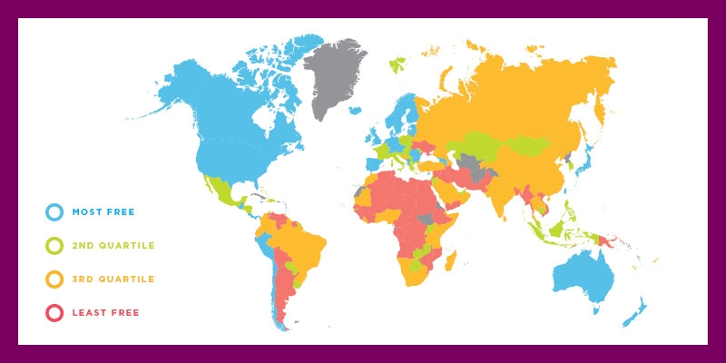
Economic Freedom and Pandemics
Candela and Geloso (2021): “A society that is relatively free economically offers economic actors greater flexibility to adapt to pandemics. We argue that societies that are more economically free will be more robust to the impact from pandemics, illustrated by shorter time for economic recovery.”

Slide 21
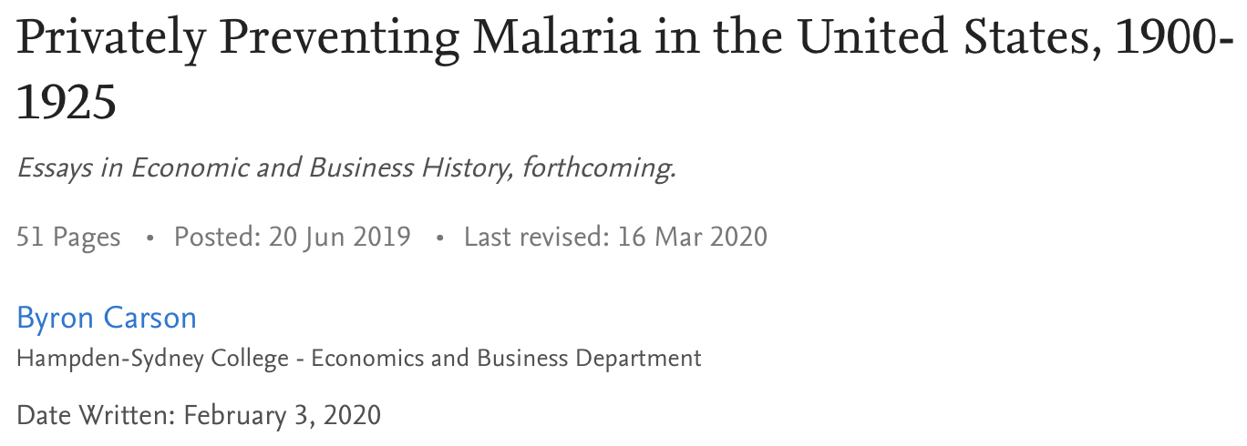

Slide 22
4. Put patients, not government, in charge of care
Third party payers (government or private insurance) create moral hazard effects that lead to regulation and rationing.

Slide 23
Clarifying Terms
Socialized medicine: government actually operates the hospitals, and medical staff are government employees.
  e.g. VA system
  UK (NHS) and Spanish system are examples
Universal coverage: Everyone has medical insurance, typically provided by the government. Hospitals and medical staff may be private in a universal coverage system.
  e.g., Canadian system
  Can universal coverage exist in a fully voluntary society?
Single-payer system: May be found with universal coverage, but universal need not be single-payer. Universal could be a blend of private insurance for some and government-paid for others.
Notes:
Medicare really isn’t single-payer since patients pay some part out of pocket, and many people buy private supplemental insurance. Private insurance companies can manage care in Medicare.

Slide 24
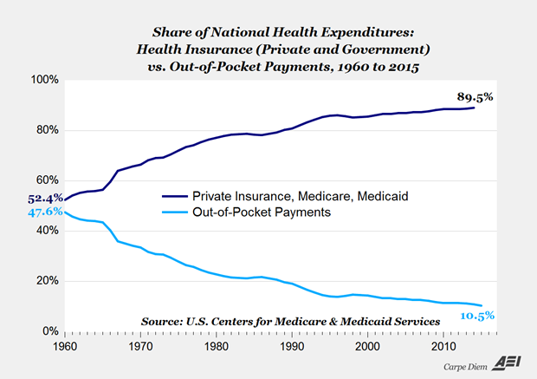
Source: Mark Perry, https://fee.org/articles/if-cosmetic-surgery-has-a-working-market-why-can-t-medical-care/

Slide 25
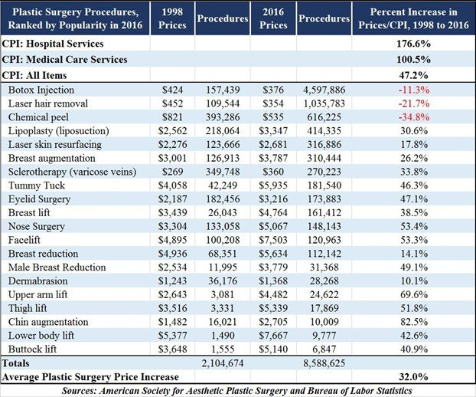
Source: Mark Perry, https://fee.org/articles/if-cosmetic-surgery-has-a-working-market-why-can-t-medical-care/

Slide 26
Rising Costs
Foy, Sciamanna, Kozak, and Filippone: “Studies have found that a fully insured population spends about 40-50 percent more than a population with a large deductible and their status is not measurably improved by the additional services (Manning et al. 1987).

Slide 27
Rising Costs
“This idea has been recently reaffirmed by a landmark analysis of the Oregon Experiment where Baicker et al. (2013) found that Medicaid coverage generated no significant improvements in health outcomes in the first two years, despite increased use of prescription drugs, office visits, preventive care services including mammograms, and annual spending per individual (by insurance plan) in excess of $1,100.

Slide 28
Rising Costs
“…[T]echnological change has indeed increased health care costs in many cases without significantly improving health outcomes. This has occurred because medical insurance in its current state discourages individuals from economizing health care decisions and incentivizes the adoption and overconsumption of services with progressively diminishing returns on investment.”
Foy, Sciamanna, Kozak, and Filippone, “The Medical Care Cost Ratchet,” Cato Journal vol. 34, no. 1 (Winter 2014). https://pdfs.semanticscholar.org/38e1/efdd0dc26681e10b16141538c3310603b0e2.pdf

Slide 29
Government-run
Image: https://freopp.org/bringing-private-health-insurance-into-the-21st-century-d1df138f1f0c

Slide 30
ACA
“Patient Protection and Affordable Care Act” or “Obamacare”
Main components:
  Insurers must cover all applicants, without regard to medical history, setting premiums based mostly on geographic location (“community rating”) and age, and not on gender and most pre-existing conditions.
  Everyone must obtain health insurance, except those who are deemed unable to afford coverage and those religious groups that have obtained waivers. Subsidies and state-based exchanges are to assist in finding health insurance.
  Employers with 50 or more employees must provide coverage for employees working ≥30 hours a week, or face penalties.
  Health insurance policies must cover certain services (“essential health benefits”) and not have any cap on annual or lifetime benefits for an individual.

Slide 31
ACA
All must be required to get insurance, lest adverse selection result in the healthiest opting out
If insurance companies must insure everyone, even those who are very expensive to cover, they must be required to cover certain things and not refuse to cover pre-existing conditions.
Insurance would therefore be expensive, so subsidies were built in.

Slide 32
ACA
Unintended consequences:
  Premiums rose (and are projected to rise substantially in 2022-23)
  People chose to pay the penalty rather than sign up for insurance
  Insurers pulled out of the exchanges, limiting options
  Employers limited the number of ≥ 30-hour employees to stay under the 50-employee mark.

Slide 33
ACA
“On average, premiums in the individual market have doubled since the ACA went into effect.”
“These high premiums are not accompanied by low deductibles; indeed, the median deductible for a benchmark Silver plan in 2019 was $4,375.”
“In 2010, the CBO projected that 24 million Americans would enroll in the exchanges in 2019; the actual figure was closer to 9 million.” [In 2022, 14.5 million people signed up for Marketplace plans.]
-- Avik Roy, 2019 https://freopp.org/bringing-private-health-insurance-into- the-21st-century-d1df138f1f0c

Slide 34
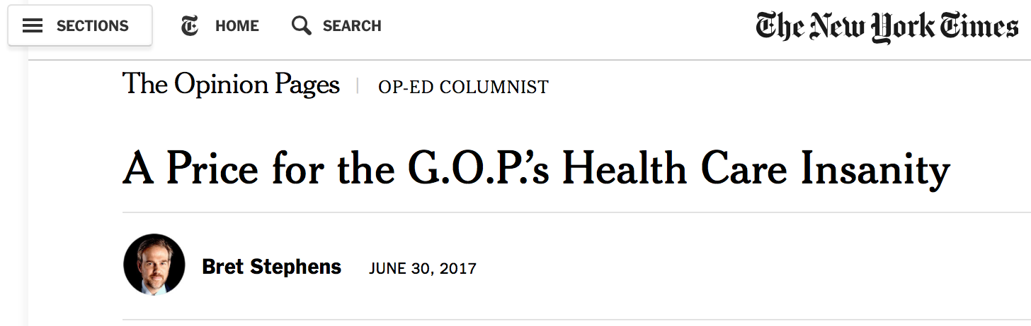
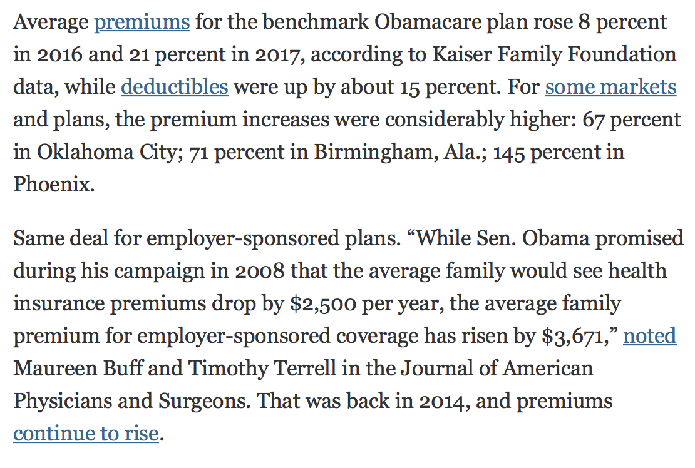
ACA
https://www.nytimes.com/2017/06/30/opinion/congress-health-savings-accounts.html
aapsonline.org

Slide 35
ACA
Conflation of medical care usage and health improvement
  Medical care has iatrogenic effects
  Health is related to many factors apart from medical care
  Resources devoted to medical care came from somewhere else—and that “somewhere else” may have had more powerful effects on health

Slide 36
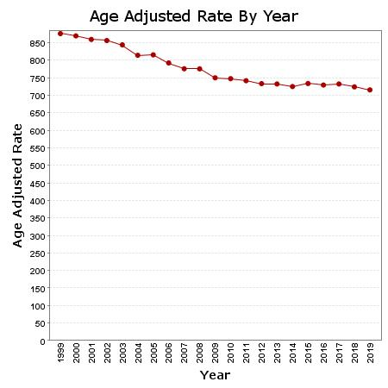
U.S. Age-Adjusted Mortality Rates per 100,000 (Annual)
Centers for Disease Control and Prevention, National Center for Health Statistics. Multiple Cause of Death on CDC WONDER Online Database. Accessed at http://wonder.cdc.gov/mcd-icd10.html on Jul 19, 2021.
Full expansion of insurance coverage under ACA: 2014
Notes:
Murphy: “And yet, we see the opposite. Although the ACA passed in 2010, the full expansion of insurance coverage didn’t kick in until 2014. So the relevant metric is to see what happened to (age-adjusted) mortality rates before and after 2014.”

Slide 37
ACA
Oregon health insurance experiment:
  In 2008, Oregon expanded its Medicaid service by lottery. About 10,000 residents of the state were enrolled, and their medical service usage and health were compared to lottery “losers.”
  Health care service usage increased, but there was “no statistically significant impact on physical health measures.”
  Financial strain for the lottery “winners” decreased, as we might expect.
  Winners had lower rates of depression
Notes:
Ben Domenech, managing editor of Health Care News and fellow of the Heartland Institute, commentated that the moderate changes in depression found in the study from Medicaid could have been exceeded by having all of the patients adopt a pet, which significantly lowers depression and reduces the risk of heart disease, and also would have been far cheaper. He concluded, "So... you actually care about people being healthier and not just feeling less depressed, is to end Medicaid and simply give people the monetary value of the program to purchase a private health plan."^{[11]}

Slide 38
Pre-Existing Conditions
Image: modernsurvivalblog.com
Notes:
Requiring an insurance company to take on certain payments without increasing premiums accordingly is forcing the insurance company to make a simple transfer—it is not insurance but a mandated payment.
Insurance companies would then have to raise premiums on others who do not have the pre-existing conditions.
These others now face not only the premium for covering risk, but an additional amount to be transferred to others in the insurance pool.
This will make insurance less attractive for those without pre-existing conditions, possibly inducing the healthiest to drop out. We are back to adverse selection, and therefore the mandate—which creates a forced transfer (“healthy tax”)

Slide 39
Pre-Existing Conditions
In a free market, how would pre-existing conditions be handled?
  Insuring insurability (e.g., guaranteed renewability).
    ”Under the individual insurance that existed before Obamacare, beneficiaries… could buy guaranteed-renewable health insurance. If they developed a condition while insured, they could still buy health insurance at a premium that applied to the whole pool they were in when they originally bought insurance.” (David Henderson, https://fee.org/articles/why-pre-existing-conditions-should-be-left-to-the-market/)
  Parents could buy ”insurability” insurance for their children, even unborn children.
  Charity

Slide 40
Medicare for All (M4A)
First-dollar coverage (no copays or deductibles)
Dental, vision, hearing—all covered
Payments to providers cut by >40% relative to private insurance payments
Image: https://thehill.com/homenews/senate/428430-bernie-sanders-to-deliver-his-own-state-of-the-union-response

Slide 41
Medicare for All (M4A)
“M4A would add approximately $32.6 trillion to federal budget commitments during the first 10 years of its implementation (2022–2031).” https://www.mercatus.org/publications/federal-fiscal-policy/costs-national-single-payer-healthcare-system
Increases in federal medical care expenses would be about 10.7% of GDP in 2022, 12.7% in 2031, and higher thereafter.
Charles Blahous: “A doubling all currently projected federal and corporate income tax collections would be insufficient to finance the added federal costs of the plan.”

Slide 42
Medicare for All (M4A)
Under M4A, insurance companies would still be around, managing the system, as with Medicare Advantage and Medicaid managed-care contractors.
Cuts to medical providers of 40% would mean that many doctors would exit. Access to medical care would suffer.
M4A would outlaw private insurance that duplicates benefits offered by the government. Private insurance is common in Europe.

Slide 43
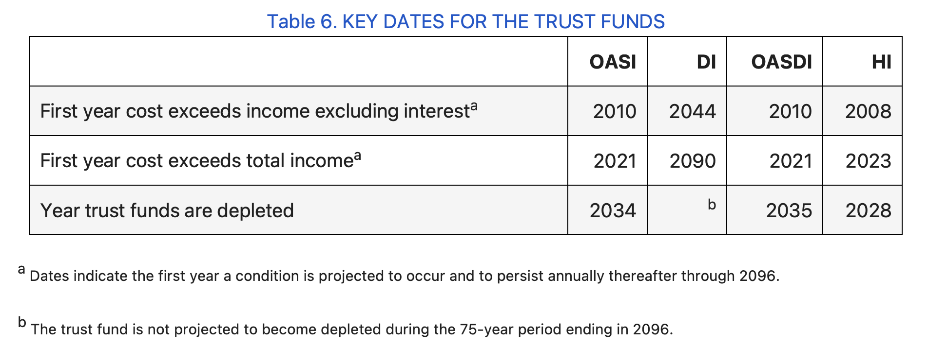
Financial Trouble Ahead
Source: 2022 Annual Report of the Social Security and Medicare Boards of Trustees:
https://www.ssa.gov/oact/TRSUM/
OASI: Old Age and Survivor’s Insurance
DI: Disability Insurance
OASDI: combined OASI and DI
HI: Hospital Insurance (Medicare Part A)

Slide 44
Financial Trouble Ahead
“In addition to notoriously underestimated cost projections, Medicare underpayments to hospitals must be addressed. Hospitals receive 88 cents on the dollar from Medicare and 90 cents on the dollar from Medicaid for their expenditures on these patients…. Currently hospitals make up the shortfall with higher payments from private insurance—which will no longer exist [under M4A]. Slashing oft maligned CEO salaries would be a drop in the bucket. Hospital workers—unionized or otherwise—would not accept pay cuts.”
-- Marilyn Singleton, M.D., J.D.

Slide 45
Comparing Medical care Systems
Medical Expenditures and International Comparisons

Slide 46
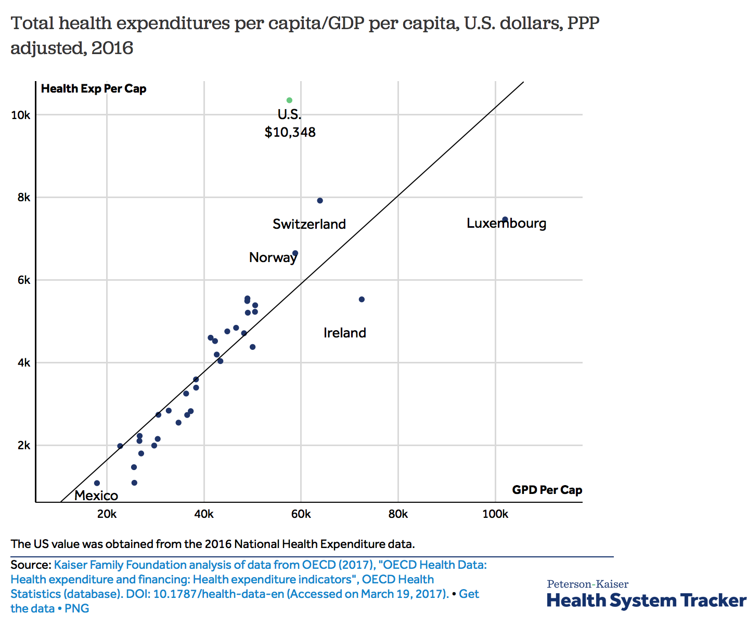
https://www.healthsystemtracker.org/chart-collection/health-spending-u-s-compare-countries/#item-since-1980-gap-widened-u-s-health-spending-countries

Slide 47
Comparing Systems
  Cancer incidence rates (age standardized, 2021)
  US: 362.2
  UK: 319.9
  Germany: 313.2
  France: 341.9
  Cancer 5-year mortality rates (age standardized, 2021)
  US: 86.3
  UK: 100.5
  Germany: 102.3
  France: 107.9
    From https://www.medicalnewstoday.com/articles/cancer-rates-by-country#highest-cancer-rates , 2021

Slide 48
Comparing Systems
  Stroke 30-day survival rates (2020), of 37 OECD countries
  US: #6 (95.9%)
  UK: #30 (91.6%)
  Germany: #14 (93.8%)
  France: #19 (92.9%)
  Canada: #20 (92.8%)
    Statista: https://www.statista.com/statistics/236551/deaths-resulting-from-strokes-in-selected-countries-by-gender/, 2020

Slide 49
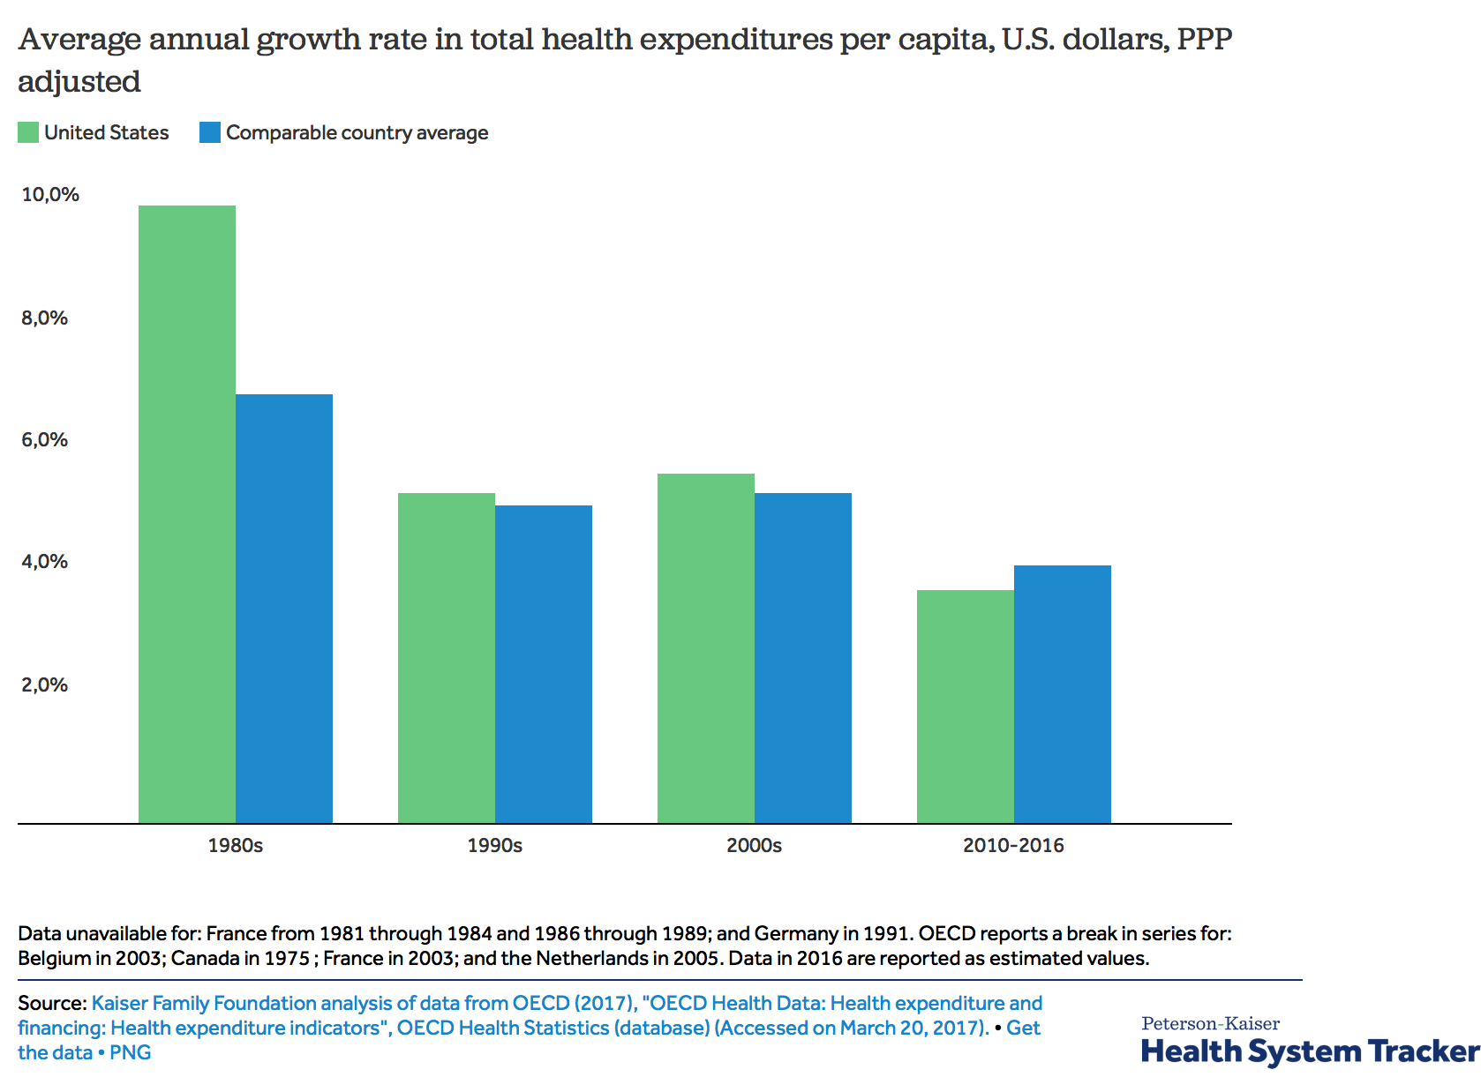
2015-19 average annual growth rates:
OECD38: +2.7%
US: +2.2%
https://www.healthsystemtracker.org/chart-collection/health-spending-u-s-compare-countries/#item-since-1980-gap-widened-u-s-health-spending-countries

Slide 50
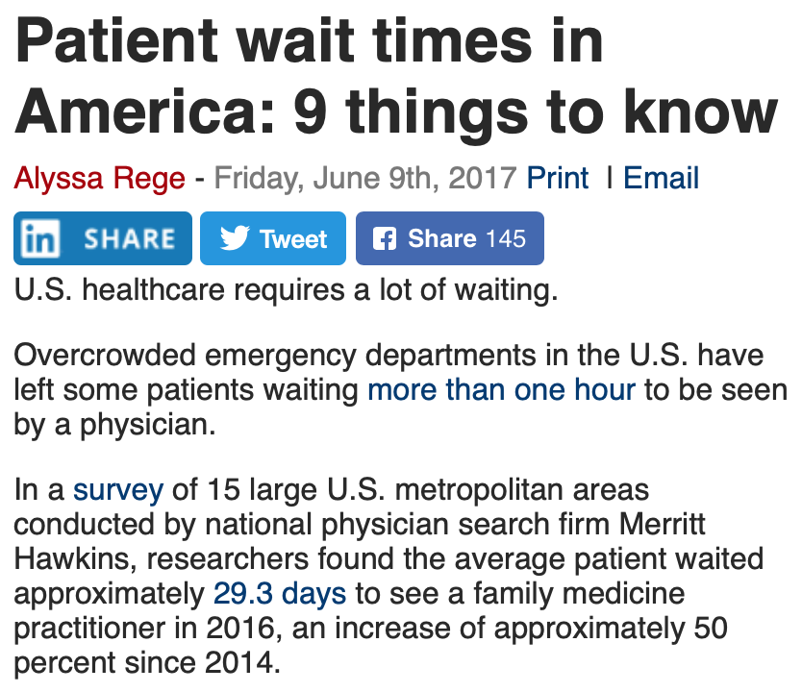
Wait Times
Wait times in the US have been increasing.
Wait times in the US tend to be shorter where the revenue to the provider is greater.
Wait times also vary tremendously from city to city, depending on the availability of different kinds of specialists.
  -- New York Times, July 6, 2014
beckershospitalreview.com

Slide 51
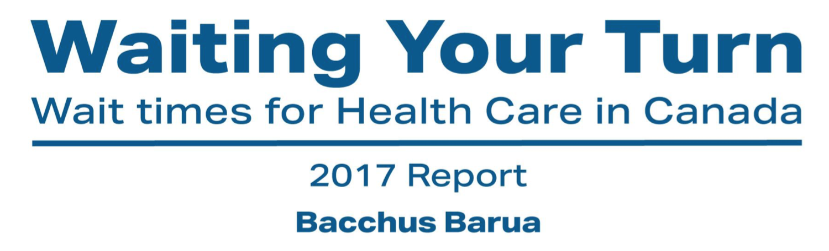
However, wait times have also increased in recent years in countries that have a less market-oriented system than the US, such as Canada.
The Fraser Institute’s 2017 report, by Bacchus Barua, shows that wait times for “medically necessary treatment” increased since 2016, and the median waiting time was the longest that survey had ever recorded. (https://www.fraserinstitute.org/sites/default/files/waiting-your-turn-2017.pdf)

Slide 52

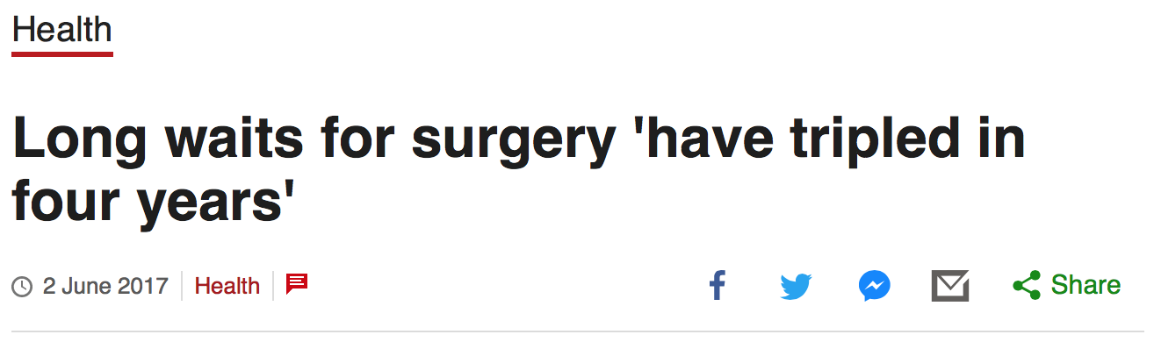
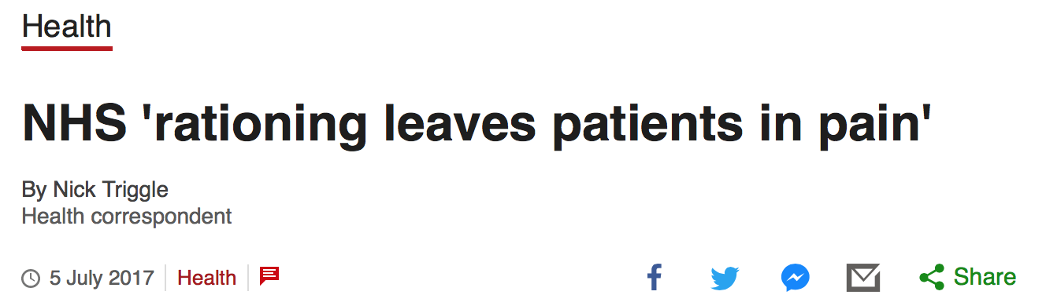
Comparing Systems

Slide 53
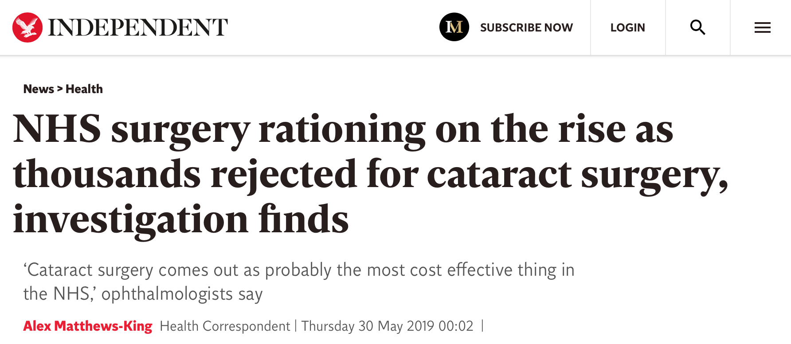

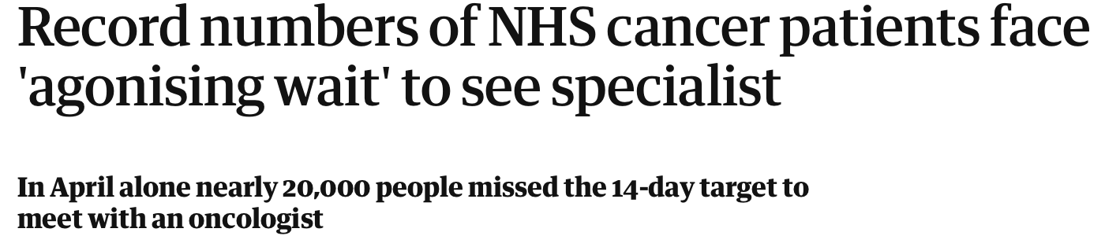



Slide 54
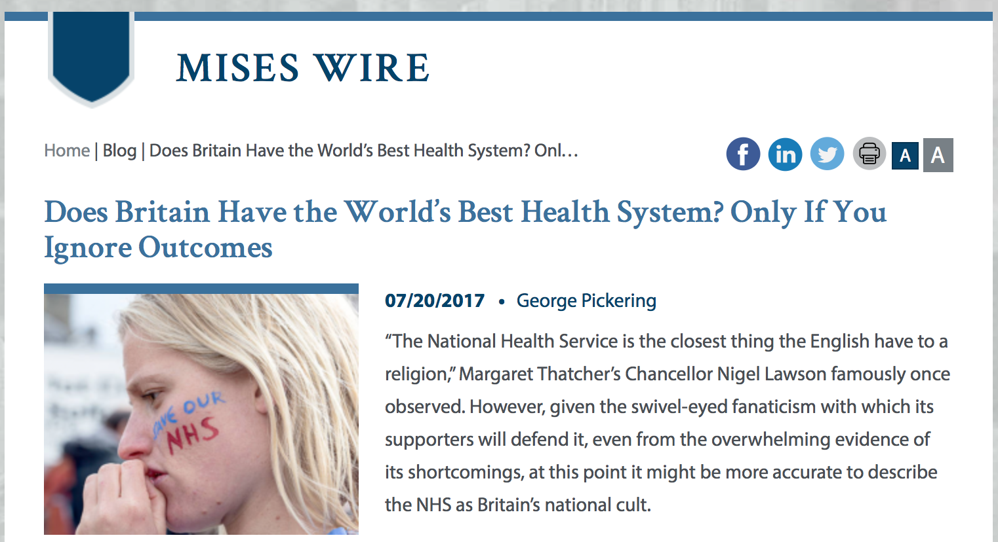
Comparing Systems

Slide 55
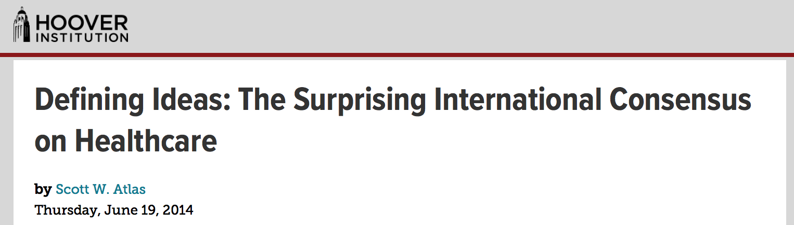
Convergence
“The paradox is that America has been doubling down on government authority over health care with the Affordable Care Act, just as more and more European governments, including Denmark, England, Finland, Ireland, Italy, the Netherlands, Norway, Spain, and Sweden, have been forced by public outcry to address the unconscionable waits for care by introducing new laws.”
--Scott Atlas, https://www.hoover.org/research/surprising-international-consensus-healthcare (6/19/14)

Slide 56
Convergence
”[T]he Swedish government has aggressively introduced private market forces into health care to improve access, quality, and choices. Although once entirely public, over a quarter of Swedish primary care clinics are now run by the private sector. Sweden’s municipality governments have increased spending on private care contracts by 50% in the past decade.”
--Scott Atlas, https://www.hoover.org/research/surprising-international-consensus-healthcare (6/19/14)

Slide 57
Britain
About 6 million British citizens “now buy private health insurance, including almost two-thirds of those earning more than $78,700. More than 50,000 Brits travel out of the country per year and spend $250 million to receive medical care due to lack of access.”
    --Scott Atlas, https://www.hoover.org/research/surprising-international-consensus-healthcare (6/19/14)

Slide 58

Concluding Thoughts
  Third-party payment, patents, and regulation raise costs and wait times.
  US medical provision is far from a free market, and is a mixed bag of government and markets—as are most developed countries.
  Flagship programs have serious fiscal problems ahead.
  The ACA and M4A are not moves in the right direction.

Slide 59
Additional Reading
Candela, Rosolino, and Vincent Geloso. 2021. “Economic Freedom, Pandemics, and Robust Political Economy.” Southern Economic Journal 87, no. 4: 1250–66. https://doi.org/10.1002/soej.12489
Carson, Byron. 2020. “Privately Preventing Malaria in the United States, 1900-1925.” Essays in Economic and Business History, 38, no. 1: 142–92., Available at SSRN: https://ssrn.com/abstract=3389134 or http://dx.doi.org/10.2139/ssrn.3389134
Hamowy, Ronald. 1979. “The Early Development of Medical Licensing Laws in the United States, 1875-1900,” Journal of Libertarian Studies, vol. 3, no. 1 (1979)
Terrell, Timothy D. 2021. “The False Promise of Free Medical Care.” In Freedom or Free Stuff… It’s Your Choice, ed. Rafael Acevedo. Miami: Econintech.

