Slide 1
Government Land Ownership and Management
Timothy D. Terrell
Mises University 2021
@timothyterrell
terrelltd@wofford.edu

Slide 2
Environmental Issues
Resource Use
  Land use, deforestation, oil reserves, fisheries, recycling
Externalities (spillover effects)
  Smoking, paper mills, fireworks, litter, water pollution
Core issue for both: property rights

Slide 3
Where We’re Going
Subjectivity, Calculation, Efficiency, and the Environment
  Some principles for understanding environmental issues
Government and Land Management
  Are land use problems the result of capitalism run amok?

Slide 4
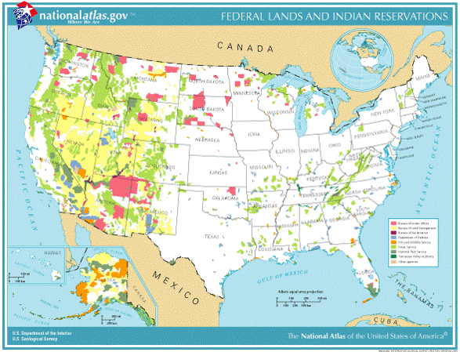
Source: Mark Brandly, https://mises.org/library/including-ocean-floor-feds-own-much-more-land-you-think

Slide 5
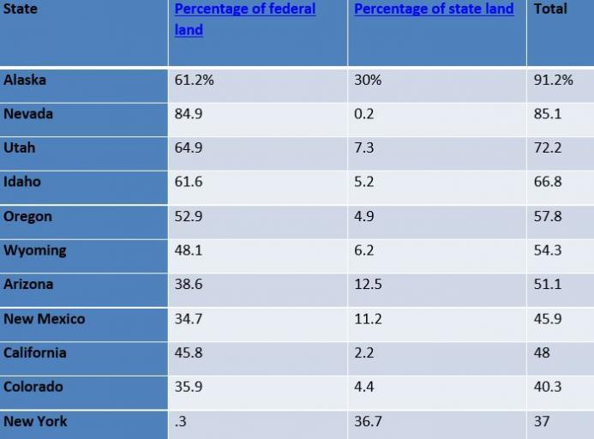
Source: Mark Brandly, https://mises.org/library/including-ocean-floor-feds-own-much-more-land-you-think

Slide 6
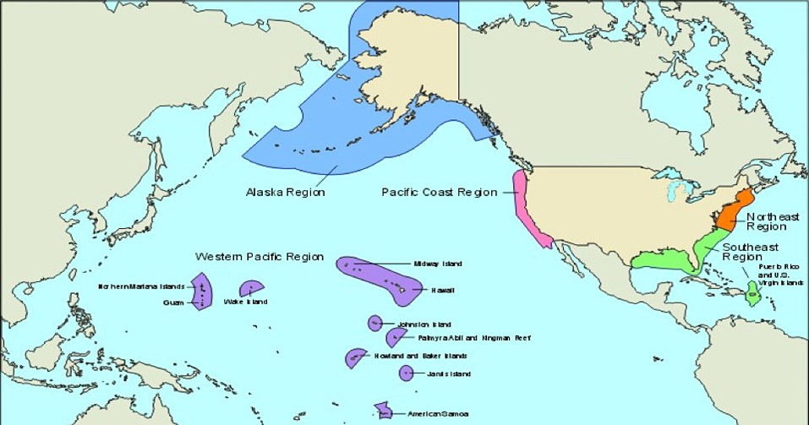
Source: Mark Brandly, https://mises.org/library/including-ocean-floor-feds-own-much-more-land-you-think

Slide 7
Economic Calculation Problems
“The government ownership of lands leads to several economic problems. Government officials can use their control of the natural resources to reward politically favored industries and punish their political enemies. Second, government restrictions on the use of resources on government lands limits economic growth. Third, and this is Mises’s point regarding socialism, land socialism will create economic calculation problems.”

Slide 8
Economic Calculation Problems
“The first calculation issue here is the government’s decisions regarding the use of this land and the resources on and under the land. Since the government owns the land, we see no prices for these resources. The government has no way to economize on these resources in the sense that government officials, even if they wanted to, could not efficiently allocate these resources. They make these allocation decisions based on political considerations, so they end up allowing the private sector to access the wrong resources, wrong in the sense that if we were allowed to have private ownership of these resources, we would choose to use the resources much differently, and more efficiently.”

Slide 9
Economic Calculation Problems
“The second issue is that the economic calculation of private businesses is distorted by government control of the resources, because government ownership distorts the prices of the resources. If the prices were based on the private ownership of land and resources, for instance, we would see a different array of energy prices. The prices we see for resources do not accurately reflect the underlying realities of resource availability. Even though we are engaged in calculation when we allocate these resources, we are not economizing on the resources in the sense that Mises described.”
Mark Brandly, “Including the Ocean Floor, the Feds Own Much More Land than You Think,”
https://mises.org/library/including-ocean-floor-feds-own-much-more-land-you-think

Slide 10
Market vs. Government Failure
Allegations of market failure:
  Underproduction or overproduction of products creating externalities (side effects of behavior that confer benefits or impose costs on others)
  Underproduction of public goods (nonexclusive, nonrival)
  Inefficiencies from market power (e.g., monopoly, monopsony)
Problems with externalities and “public goods” usually arise where property rights are poorly defined or protected.
Merely to show that the market has failed to arrive at some ideal standard—if this could be done—is not enough. The second step is to show that the possible government intervention would produce results that are superior. It may be the case that the government intervention is actually worse than the initial market failure.

Slide 11
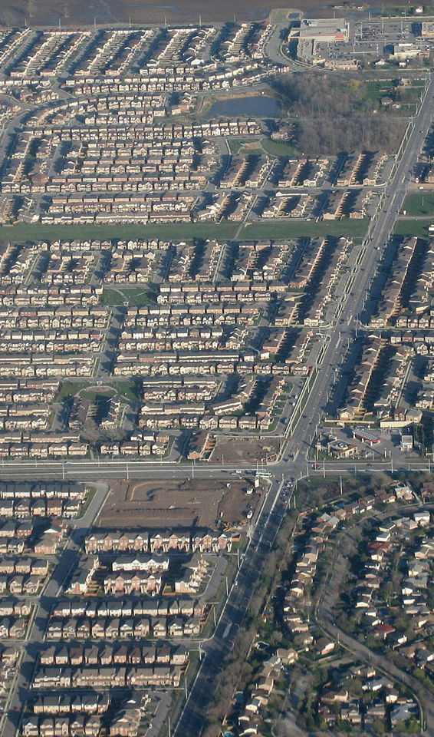
“It’s a bad idea to turn the whole future of a region over only to people with money to make.”
-- John Lane, professor emeritus (English) at Wofford College

Slide 12
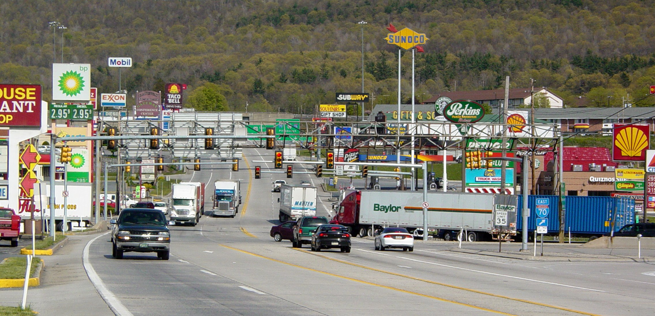
Image: https://upload.wikimedia.org/wikipedia/commons/d/d6/Breezewood%2C_Pennsylvania.jpg
What land use is best? How do we know?
Will government bring us closer to what we want with land restrictions and environmental preserves?
Ironically, restrictions can lead to the very problems they are intended to prevent.

Slide 13
What Do “We” Want?
“To know whether… [a market] process is optimal, we would need to know the very information whose discovery is the object of that process… [I]f we could independently ascertain the information, the… process would be superfluous.”
-- Gerald O’Driscoll and Mario Rizzo, 1985, The Economics of Time and Ignorance, p. 110.

Slide 14
What Do “We” Want?
“…The whole of the so-called ‘welfare economics,’ which pretends to base its arguments on the inter-personal comparisons of ascertainable utilities, lacks all scientific foundation. The fact that most of us believe that they can judge which of the several needs of two or more known persons are more important, does not prove either that there is any objective basis for this, nor [sic] that we can form such a conceptions [sic] about people whom we do not know individually. The idea of basing coercive actions by government on such fantasies is clearly an absurdity.”
-- Friedrich Hayek, 1979, Law, Legislation, and Liberty, vol. 3, pp. 201–02. Quoted in Cordato (2007), pp. 24, 25.

Slide 15
What Do “We” Want?
Economy and catallaxy
  Catallactics is the study of monetary exchanges. In a catallaxy, there is no overall hierarchy of goals. There are only the separate objectives of the individuals.
  Economic efficiency is compatible with Austrian economic theory insofar as it applies to the assessments of whether the means chosen by individuals are consistent with the accomplishment of ends chosen by those individuals. To the Austrian, it cannot engage in interpersonal comparisons of the values of the ends.
  Catallactic efficiency occurs when economic efficiency is promoted by an institutional setting that ensures that property rights are secure, which in turn promotes the discovery and use of information for the accomplishment of individual plans. Catallactic efficiency takes into account the fact that we cannot judge the individual ends being pursued by participants in the market.

Slide 16
What Do “We” Want?
By studying the ideal institutional setting in which individuals can make economically efficient decisions, we can improve economic outcomes without trying to judge the value of some ends over others.
  “No meaningful means ends framework is even possible without the ability to access and control physical resources. Beyond this, the role of this institutional setting is to allow the exchange process, through the price system, to disseminate as much information concerning appropriate exchange opportunities as possible.”
--Roy Cordato, Efficiency and Externalities in an Open-Ended Universe, p. 65.

Slide 17
Efficiency vs. Ethics
Efficiency is an “individual goal-seeking problem, not a value-maximization problem” (Roy Cordato)
  From the Austrian perspective, efficiency is attained when legal institutions allow individuals to pursue their ends.
  Conflicts will arise over the use of scarce goods—but the Austrian does not try to assess the value of alternative uses. Costs are subjective, and can’t be measured

Slide 18
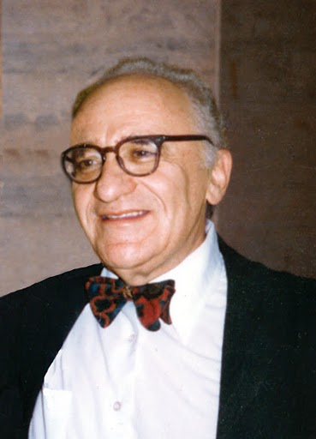
Efficiency vs. Ethics
“…we cannot decide on public policy, tort law, rights, or liabilities on the basis of efficiencies or minimizing of costs.”
-- Murray Rothbard, in Mario Rizzo, Time, Uncertainty, and Disequilibrium
http://picasaweb.google.com/MisesInstitute/RothbardImages#5400723609019072930

Slide 19
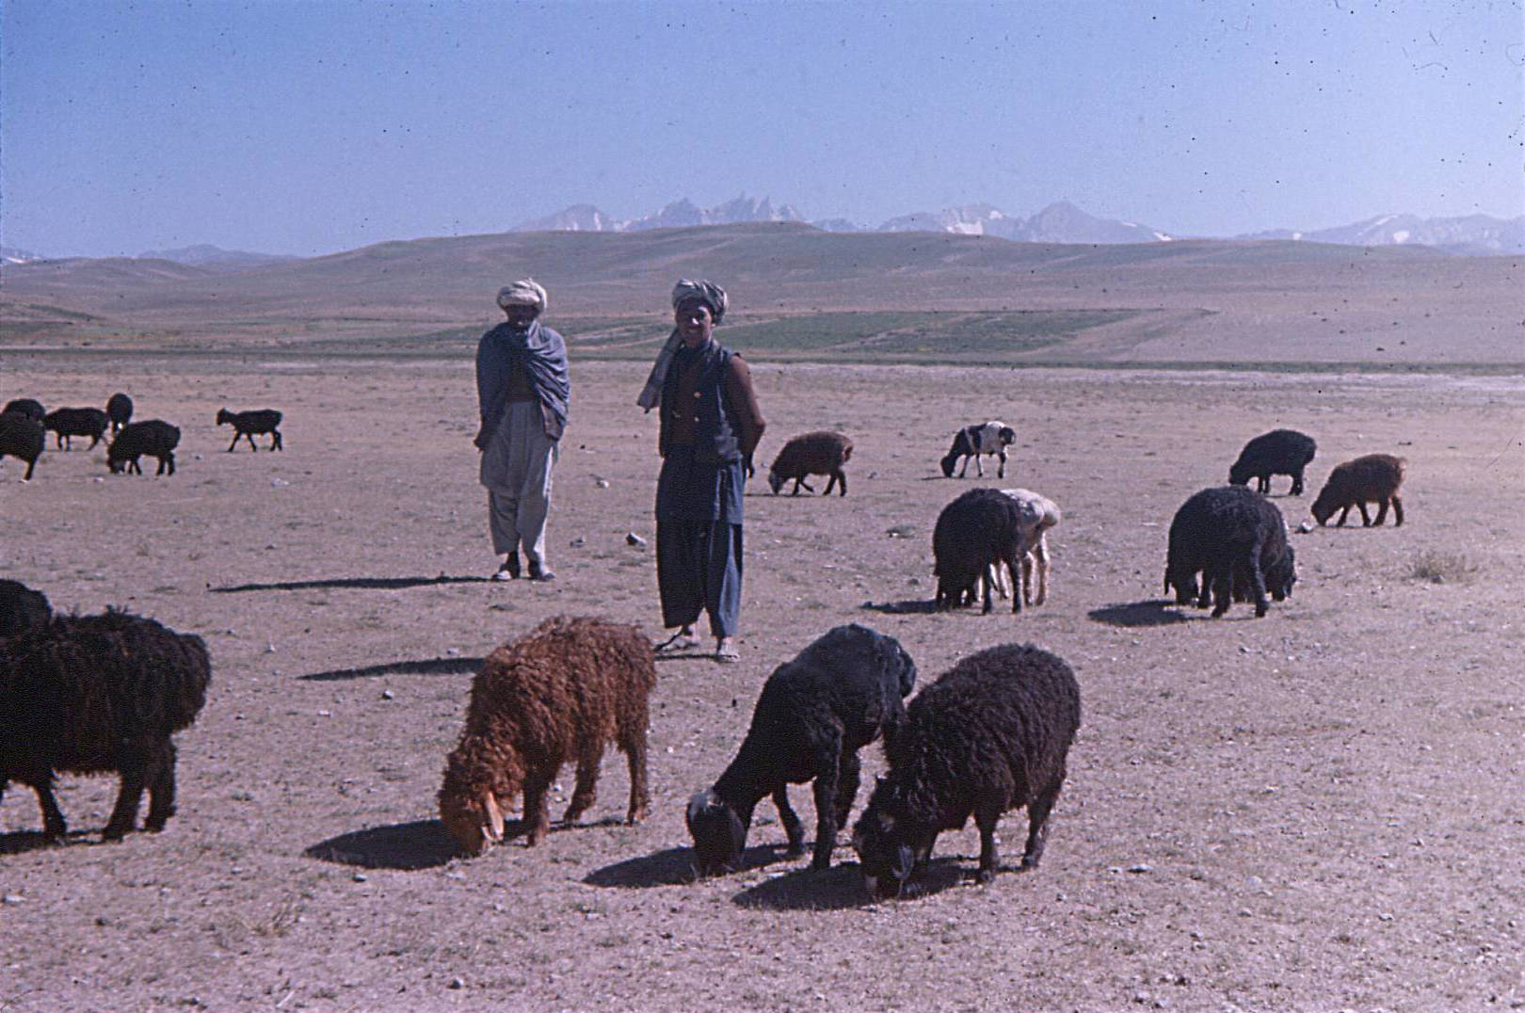
Tragedy of the Commons
If livestock are placed on a common pasture, where no one is an owner, herders gain all the benefits of the grass their animals eat, but suffer only part of the costs.

Slide 20
The Tragedy of the Commons
Rancher Al
1 cow
2 cows
Al: 5
Bob: 5
Al: 6
Bob: 3
1 cow
Rancher Bob
Al: 3
Bob: 6
Al: 4
Bob: 4
2 cows
Adapted from Baland and Platteau (1996, p. 29)

Slide 21

The Tragedy of the Commons
Menger: “When all members of society compete for a given quantity of goods that is insufficient… a practical solution to this conflict of interest is… only conceivable if the [goods] pass into the possession of some of the economizing individuals, and if these individuals are protected by society in their possession to the exclusion of all other individuals.”

Slide 22
The Tragedy of the Commons
Rancher Al
1 cow
2 cows
Al: 5
Bob: 5
Al: 6
Bob: 3
1 cow
Rancher Bob
Al: 3
Bob: 6
Al: 4
Bob: 4
2 cows
Adapted from Baland and Platteau (1996, p. 29)

Slide 23
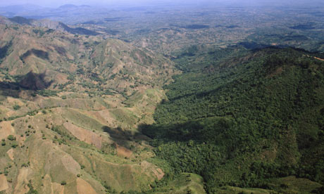
Haiti Dominican Republic
Economic Freedom Index
(rank): 103 62
“Protection of Property
Rights” (rating) 2.79 4.82
Economic Freedom Index at https://www.fraserinstitute.org/sites/default/files/economic-freedom-of-the-world-2018.pdf

Slide 24
Property Rights
Murray Rothbard (1973)
“If a private firm owned Lake Erie… then anyone dumping garbage in the lake would be promptly sued in the courts for their aggression against private property and would be forced by the courts to pay damages and to cease and desist from any further aggression.

Slide 25
Property Rights
“Thus, only private property rights will insure an end to pollution — invasion of resources. Only because the rivers are unowned is there no owner to rise up and defend his precious resource from attack. If, in contrast, anyone should dump garbage or pollutants into a lake which is privately owned (as are many smaller lakes), he would not be permitted to do so for very long — the owner would come roaring to its defense.”
Murray Rothbard, in For a New Liberty (https://mises.org/library/libertarian-manifesto-pollution)
Walter Block and Peter Nelson, Water Capitalism: The Case for Privatizing Oceans, Rivers, Lakes, and Aquifers (2015)

Slide 26
About All That Plastic….
“[A]bout 90 percent of all the plastic that reaches the world's oceans gets flushed through just 10 rivers: The Yangtze, the Indus, Yellow River, Hai River, the Nile, the Ganges, Pearl River, Amur River, the Niger, and the Mekong (in that order).”
https://www.dw.com/en/almost-all-plastic-in-the-ocean-comes-from-just-10-rivers/a-41581484?fbclid=IwAR2I7_TmAi_DwihdTU1M9IJf6IAQx6gadw_sm3Zma2XWbkMEZmBEWGFlUyA

Slide 27
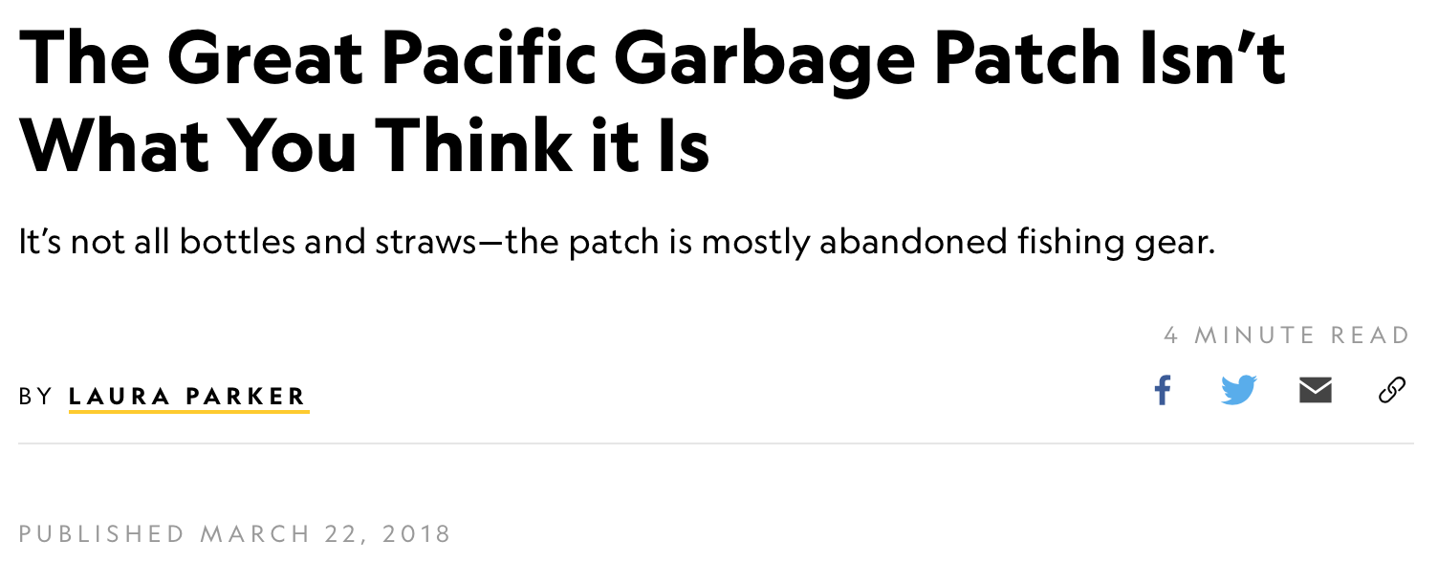
“…fishing nets account for 46 percent of the trash, with the majority of the rest composed of other fishing industry gear, including ropes, oyster spacers, eel traps, crates, and baskets. Scientists estimate that 20 percent of the debris is from the 2011 Japanese tsunami.” https://news.nationalgeographic.com/2018/03/great-pacific-garbage-patch-plastics-environment/

Slide 28
Political Considerations
Problem 1: Knowledge
  Art Carden:
    “The information needed to know whether a particular regulation ‘works’ quite literally does not exist, and the key difference between firms and governments is that firms … have market tests for their decisions. Governments do not.”
    – “What Should Austrian Economists Do?...” in QJAE vol. 17, no. 2.
Problem 2: Incentives
  Elected officials and their associated bureaucrats aren’t selfless, publicly-interested beings any more than we assume the rest of humanity to be.
  Political incentives may discourage a long-term view that leads to ideal conservation or resource extraction.

Slide 29
Political Considerations
While rulers of government own “public” property, their ownership is not secure in the long run, since they may always be defeated in an election or deposed. Hence government officials will tend to regard themselves as only transitory owners of “public” resources. While a private owner, secure in his property and its capital value, may plan the use of his resource over a long period of time in the future, the government official must exploit ”his” property as quickly as he can, since he has no security of tenure.

Slide 30
Political Considerations
And even the most securely entrenched civil servant must concentrate on present use, because government officials cannot usually sell the capitalized value of their property, as private owners can. In short, except in the case of the “private property” of a hereditary monarch, government officials own the current use of resources, but not their capital value. But if a resource itself [p. 829] cannot be owned, but only its current use, there will rapidly ensue an uneconomic exhaustion of the resource, since it will be to no one’s benefit to conserve

Slide 31
Political Considerations
it over a period of time, and yet to each owner’s advantage to use it up quickly. It is particularly curious, then, that almost all writers parrot the notion that private owners, possessing time preference, must take the “short view” in using their resources, while only government officials are properly equipped to exercise the ”long view.” The truth is precisely the reverse. The private individual, secure in his capital ownership, can afford to take the long view because of his interest in maintaining the capital value of his resource.

Slide 32
Political Considerations
It is the government official who must take and run, who must exploit the property quickly while he is still in command.
-- Murray Rothbard, Man, Economy, and State (1993 printing, Mises Institute), pp. 828, 829.

Slide 33
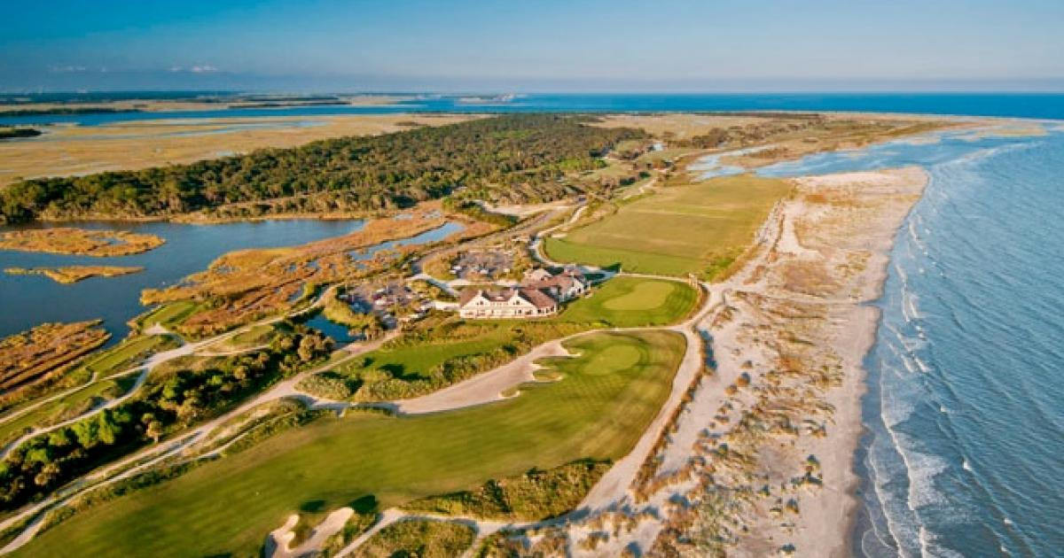
Development Restrictions
Because people often value natural landscapes, private developers sometimes try to preserve these landscapes to increase the profitability of their developments.
This tends to be expensive, however, because it typically means foregoing the use of some land.
Kiawah Island, from realestatescorrecard.com

Slide 34
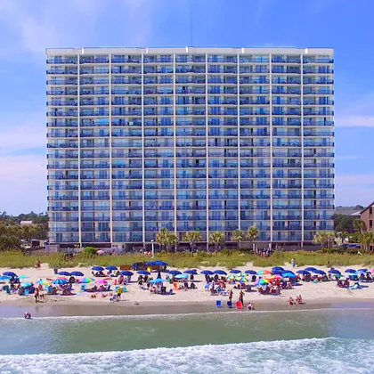
Development Restrictions
Trade-off between access and affordability
Prohibiting development on government-owned land reduces supply, increasing the price for users of other land.
  Housing availability ⬇︎
  Cost of visiting environmental amenities ⬆︎
  Desirable land becomes even more inaccessible, apart from high-income groups
  Opportunity cost of leaving remaining land undeveloped rises—conversion to development is shifted rather than reduced.
Image: https://www.condo-world.com

Slide 35


Development Restrictions
Coastal Zone A
Price
Supply before restrictions
$$P_{1990}^{M}$$
D₁₉₉₀
$$Q_{1990}^{M}$$
Quantity of developed land

Slide 36

Development Restrictions
Coastal Zone A
Price
Supply after restrictions
Supply before restrictions
$$P_{1990}^{M}$$
D₂₀₃₀
D₁₉₉₀
$$Q_{1990}^{M}$$
$$Q_{}^{G}$$
Quantity of developed land

Slide 37




Development Restrictions
Coastal Zone A
Price
Supply after restrictions
Supply before restrictions
$$P_{2030}^{G}$$
$$P_{2030}^{M}$$
$$P_{1990}^{M}$$
Population growth, affluence, etc.
D₂₀₃₀
D₁₉₉₀
$$Q_{1990}^{M}$$
$$Q_{2030}^{G}$$
$$Q_{2030}^{M}$$
Quantity of developed land

Slide 38



Development Restrictions
Coastal Zone B
Price
S
$$P_{2030}^{G}$$
$$P_{2030}^{M}$$
Higher price of substitute property
$$P_{1990}^{M}$$
Population growth, affluence, etc.
$$D_{2030}^{G}$$
$$D_{2030}^{M}$$
$$D_{1990}^{M}$$
$$Q_{1990}^{M}$$
$$Q_{2030}^{M}$$
$$Q_{2030}^{G}$$
Quantity of developed land

Slide 39
Zoning
Zoning is a form of central planning—allegedly to reduce negative externalities and encourage positive externalities at the local level.
In the early 1900s, some municipalities actually compensated owners for losses imposed by zoning regulation, approaching an eminent domain principle.
In 1926, in the Supreme Court decision Euclid v. Ambler, compensation to landowners for zoning-induced losses was held to be not normally necessary.

Slide 40
Zoning
Common zoning regulations:
  Subdivision regulations, which impose design and infrastructure requirements on builders
  Historic preservation ordinances, which restrict the modification of old buildings
  Special district controls that restrict the conversion of wetlands, agricultural land, or other areas to more intensive uses.
  Growth controls, which attempt to retard overall community development rather than just guiding it to a particular area (usually by withholding building permits or water/sewer service).

Slide 41
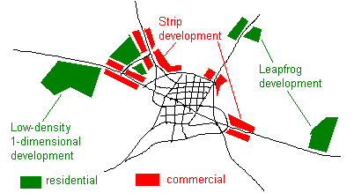
Urban Sprawl
Leapfrog development (“noncontiguous development patterns”)
Strip or ribbon development (linear pattern along arterial roadways)
Low-density, 1-dimensional development (e.g., large residential subdivisions on large parcels)

Slide 42
Urban Sprawl
Objections:
  Lost open space and natural habitats
  Increased air pollution from more traffic
  Increased driving time
  Reduced water quality
  Abandoned urban communities
  Unsightly

Slide 43
Urban Sprawl
Strip development may reduce overall traffic, since people may not have to go all the way into the urban area.
People like low-density residences
Getting away from the city center may reduce regulatory and tax burdens, and reduce other problems, like parking.

Slide 44
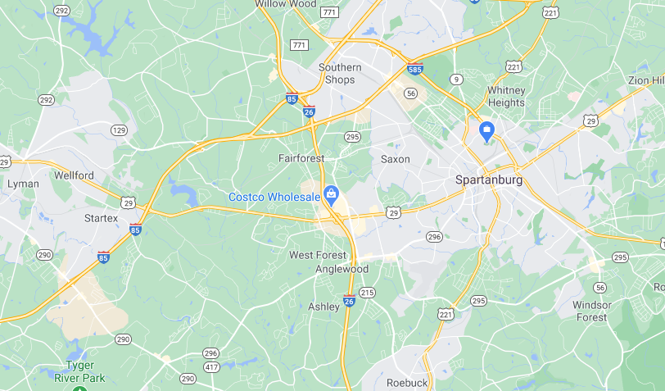

Slide 45
Urban Sprawl
“If left to its own devices, development will occur in a decentralized manner, which will usually lead different types of activities to be conveniently located in relation to one another. Decentralized growth will provide nodes of development. People can live close to the node where they work, allowing a more efficient pattern of two-way traffic as people travel between nodes. Decentralized development keeps commuting distances short but allows the amenities of suburban living for those who want them.
”…Urban sprawl can produce more efficient land-use patterns and enhance people’s quality of life. Nobody forces people to live in single-family detached homes. Developers build them because that is where people want to live.”
-- Randall Holcombe, PERC Reports, Feb. 1999, pp. 5, 8.

Slide 46
Urban Sprawl
Some economists have suggested that zoning to try to prevent “premature and unnecessary conversion of open space land” and “discourage noncontiguous development patterns….[i.e. leapfrogging]” (as the California Open Space Land Act describes sprawl) can actually increase the spread of urban areas into undeveloped areas. A geographical study of Olmstead County, Minnesota (which surrounds Rochester) found that its farmland preservation zoning caused scattered rather than concentrated development. Legal restrictions on growth in one area (say, a county) can lead developers to other, more distant, locations.

Slide 47
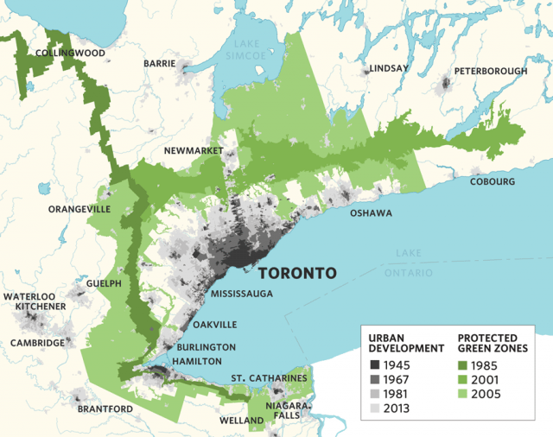

Slide 48
Urban Sprawl
A law in Los Angeles County (which controls the nonurbanized land) prevented undeveloped, noncontiguous areas from being zoned for urban densities. The areas were instead zoned for low-density housing (single-family dwellings).
Developers of high-density housing went “forum shopping” in towns that are even more remote from existing urbanized areas than the unincorporated parts of the county. Zoning, in short, exacerbated the leapfrogging “problem.” Zoning frustrations in the suburbs seem to lead developers further out, not back to the central cities.

Slide 49
Love Canal
Love Canal was a 3,000 foot long trench from a failed canal project from the 1800s) on the outskirts of Niagara Falls, New York. In the 1920s it was turned into a dumping ground for toxic waste. The clay soil and the clay cover placed over the waste protected against leakage.
Privately owned companies—but also the US Army and the city government—dumped toxic waste into the canal.*
In 1953, the city government, warned by then-owner Hooker Chemical of what had been buried in the canal, paid $1 for the property to build a school, under threat of eminent domain.
Image: https://www.wired.com/2011/11/1121love-canal-birth-defects/
*See https://reason.com/1981/02/01/love-canal/

Slide 50
Love Canal
Eric Zuesse* pointed out that Hooker took great pains to point out to the local government that the land had been filled with chemical waste products, and escorted school board officials to the property and made eight test borings in their presence to confirm the presence of chemicals. Borings over the site turned up chemicals; on the sides of the canal, there were none.
*See https://reason.com/1981/02/01/love-canal/

Slide 51
Love Canal
Hooker Chemical placed an explicit warning in the deed that the land had been filled with chemical waste, and tried to have additional special provisions placed in the deed, e.g., requiring that the land ”be used for park purposes only.” When the school board tried to sell land to a developer in 1957, Hooker Chemical objected.
*See https://reason.com/1981/02/01/love-canal/

Slide 52
Love Canal
Rick Stroup:
  Only when the waste site was taken over by local government... was the site mistreated in ways that led to chemical leakage. The government decision makers lacked personal or corporate liability for their decisions. They built a school on part of the site, removed part of the protective clay cap to use as fill dirt for another school site, and sold off the remaining part of the Love Canal site to a developer without warning him of the dangers as Hooker had warned them. The local government also punched holes in the impermeable clay walls to build water lines and a highway. This allowed the toxic wastes to escape when rainwater, no longer kept out by the partially removed clay cap, washed them through the gaps created in the walls.
Image: https://grist.org/justice/love-canal-the-toxic-suburb-that-helped-launch-the-modern-environmental-movement/
https://www.econlib.org/library/Enc/FreeMarketEnvironmentalism.html

Slide 53
Love Canal
People living near the canal complained for decades about odors and foul-smelling substances emanating from the soil. The city government’s response was to cover up the offending toxins with more soil. In 1976, the city finally hired a private firm to investigate, and toxic residues were found in homes and storm drains. The city responded only by installing window fans in a few homes.*
In 1978 the New York State Department of Health got involved and limited evacuations were begun. A homeowners’ association was founded to combat government recalcitrance.*
*http://chej.org/wp-content/uploads/Love-Canal-Factpack-PUB-001.pdf

Slide 54
Love Canal
The Love Canal episode led to Senator Al Gore’s 1980 CERCLA law (”Superfund”) which required firms to pay for cleanup of toxic waste sites, even if they were only “potentially responsible.” Hooker Chemical was hit with massive lawsuits.*
*https://www.econlib.org/library/Enc/FreeMarketEnvironmentalism.html

Slide 55
Deepwater Horizon Oil Spill
On April 20, 2010, a deep water oil well in the Gulf of Mexico, BP’s “Deepwater Horizon,” had a blowout on a well about 1 mile deep, about 41 miles off the Louisiana coast. Eleven oil rig workers were killed, and over a period of almost 3 months, about 210 million gallons of oil were leaked. Oil appeared on the coasts of every state along the Gulf.
Image: https://phys.org/news/2018-04-deepwater-horizonthe-impact-america-largest.html

Slide 56
Deepwater Horizon Oil Spill
Matthew Novak:
  …the government specifically passed laws that gave the oil companies incentives to drill far offshore—that is, in deeper water where risk is presumably higher.
  In addition to the higher risk of accidents, the cost of solving any problems are necessarily greater in 5000 feet of water than in, say, 250 feet of water.
  Mises Daily, June 23, 2010
  http://mises.org/daily/4488

Slide 57
Image: SwordPress, at https://www.awesomestories.com/asset/view/Location-of-Oil-Rigs-in-the-Gulf-of-Mexico/1

Slide 58
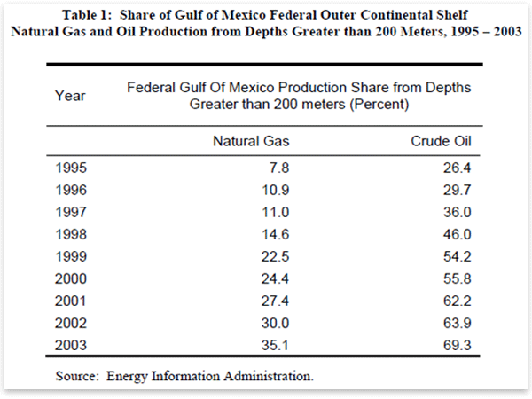
BP Oil Spill
Matthew J. Novak, Mises Daily June 23, 2010: http://mises.org/daily/4488

Slide 59
Deepwater Horizon Oil Spill
Other factors:
  “Tragedy of the commons”
  Bureaucratic rights assignment (no market prices)
Federal cap on liability at $75 million

Slide 60
Final Comments
Environmental problems are real, but the common view that capitalism destroys the environment while government saves it is problematic.
  Bad incentives
  Socialist calculation problem
  ”Poster child” environmental crises are often linked to government intervention, rather than the lack thereof
Property rights are key.

Slide 61
Further Reading
Block, Walter. Free Market Environmentalism
Block, Walter. 2014. “Comment on Dolan on Austrian Economics and Environmentalism,” QJAE vol. 17, no. 2.
Block, Walter, and Peter Nelson. 2015. Water Capitalism: The Case for Privatizing Oceans, Rivers, Lakes, and Aquifers.
Carden, Art. 2013. “Economic Calculation in the Environmentalist Commonwealth,” QJAE vol. 16, no. 1.
Carden, Art. 2014. “What Should Austrian Economists Do? On Dolan on the Austrian Paradigm in Environmental Economics,” QJAE vol. 17, no. 2.
Cordato, Roy. 2004. “Toward an Austrian Theory of Environmental Economics,” QJAE vol. 7, no. 1.
Cordato, Roy. 2007. Efficiency and Externalities in an Open-Ended Universe. Auburn, AL: Mises Institute
Dolan, Ed. 2014. “The Austrian Paradigm in Environmental Economics,” QJAE vol. 17, no. 2.
Dolan, Ed. 2015. “Austrian Environmental Economics Redux,” QJAE vol. 18, no. 1.
McCaffrey, Matthew. 2012. “Five Erroneous Ways to Argue about Resource Economics,” QJAE vol. 15, no. 1.
Rothbard, Murray. “Law, Property Rights, and Air Pollution” https://mises.org/library/law-property-rights-and-air-pollution
Terrell, Timothy, 2007. “Sprawl vs. Coastal Beauty,” The Freeman: Ideas on Liberty. https://fee.org/articles/sprawl-versus-coastal-beauty/

