Slide 1
Higher Education In Crisis
Timothy D. Terrell
Mises University 2021
@timothyterrell
terrelltd@wofford.edu

Slide 2
Crisis 1: College Doesn’t Do What It Advertises
Crisis 2: Government Subsidies are Backfiring
Crisis 3: Politicized Academic Discourse

Slide 3
Crisis 1: College Doesn’t Do What It Advertises

Slide 4
What Does College Do?
Transfer skills (“human capital”)?
Signal work ethic or disposition toward higher-order thinking?
Provide a consumption good for higher-income individuals?

Slide 5
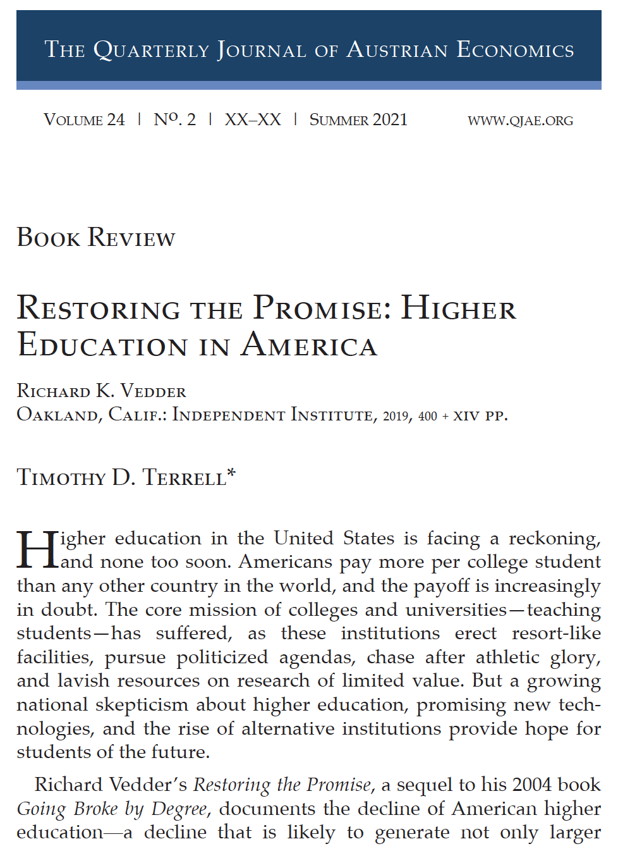
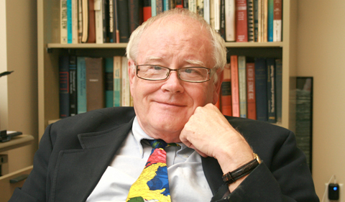

Slide 6
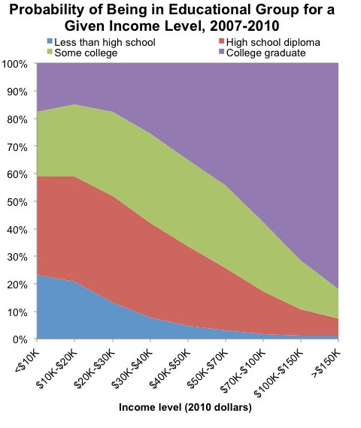

Slide 7
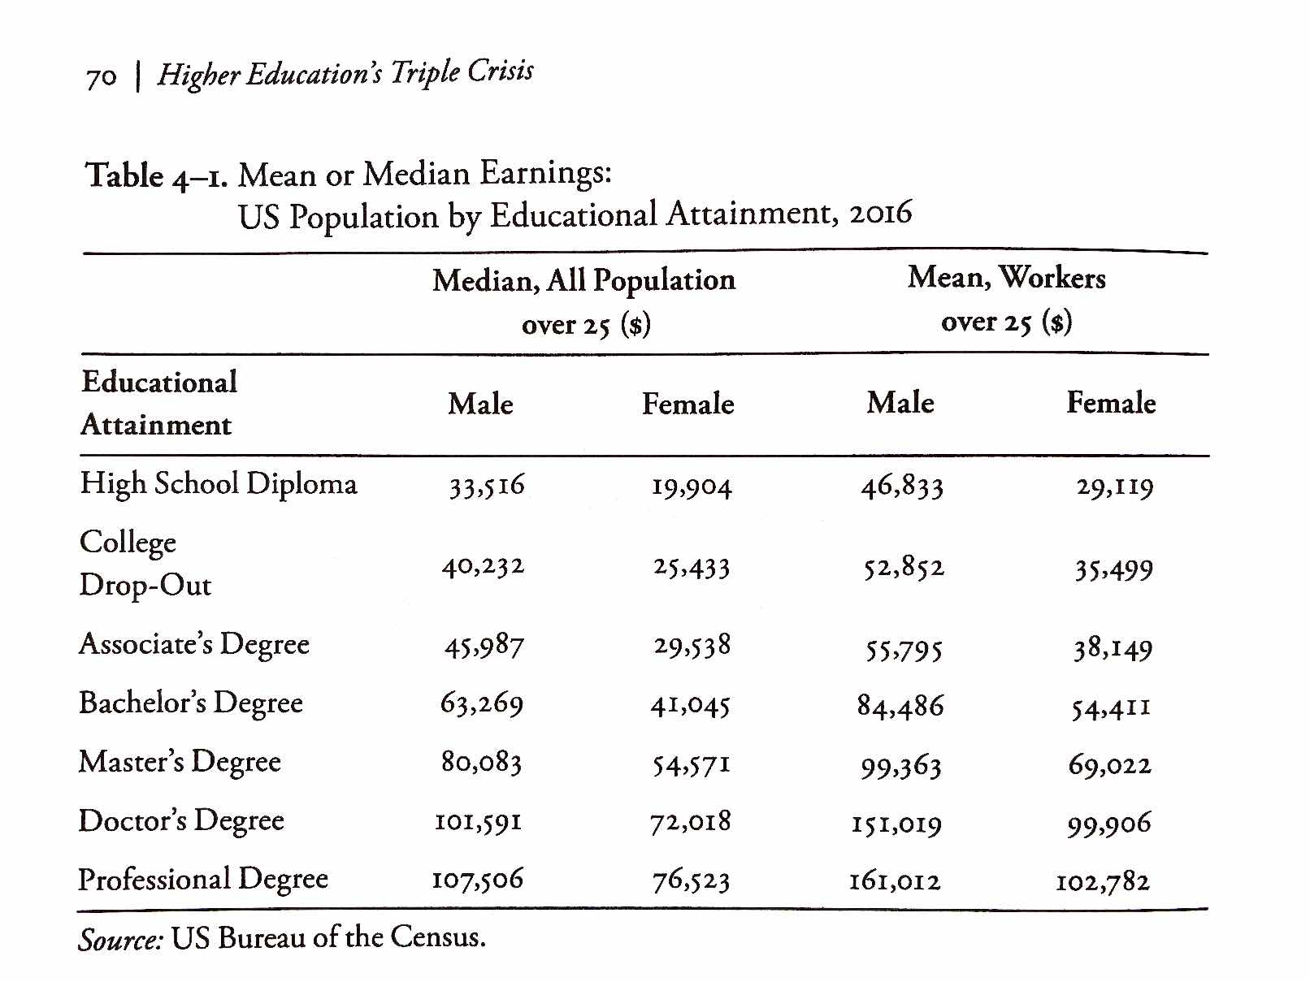
From Richard Vedder, Restoring the Promise, p. 70.

Slide 8
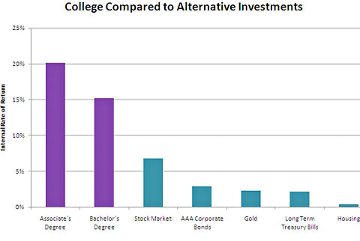

Slide 9
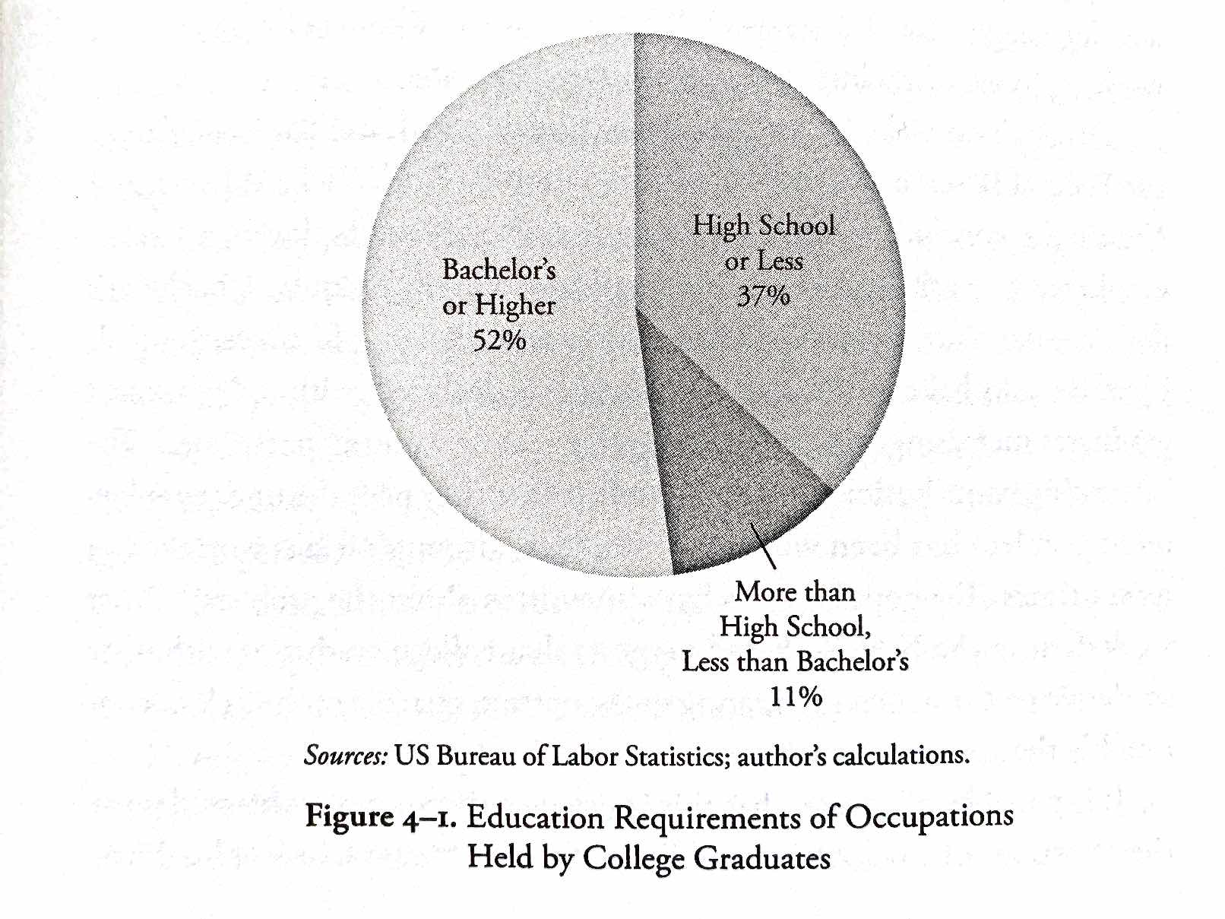
From Richard Vedder, Restoring the Promise, p. 71.

Slide 10
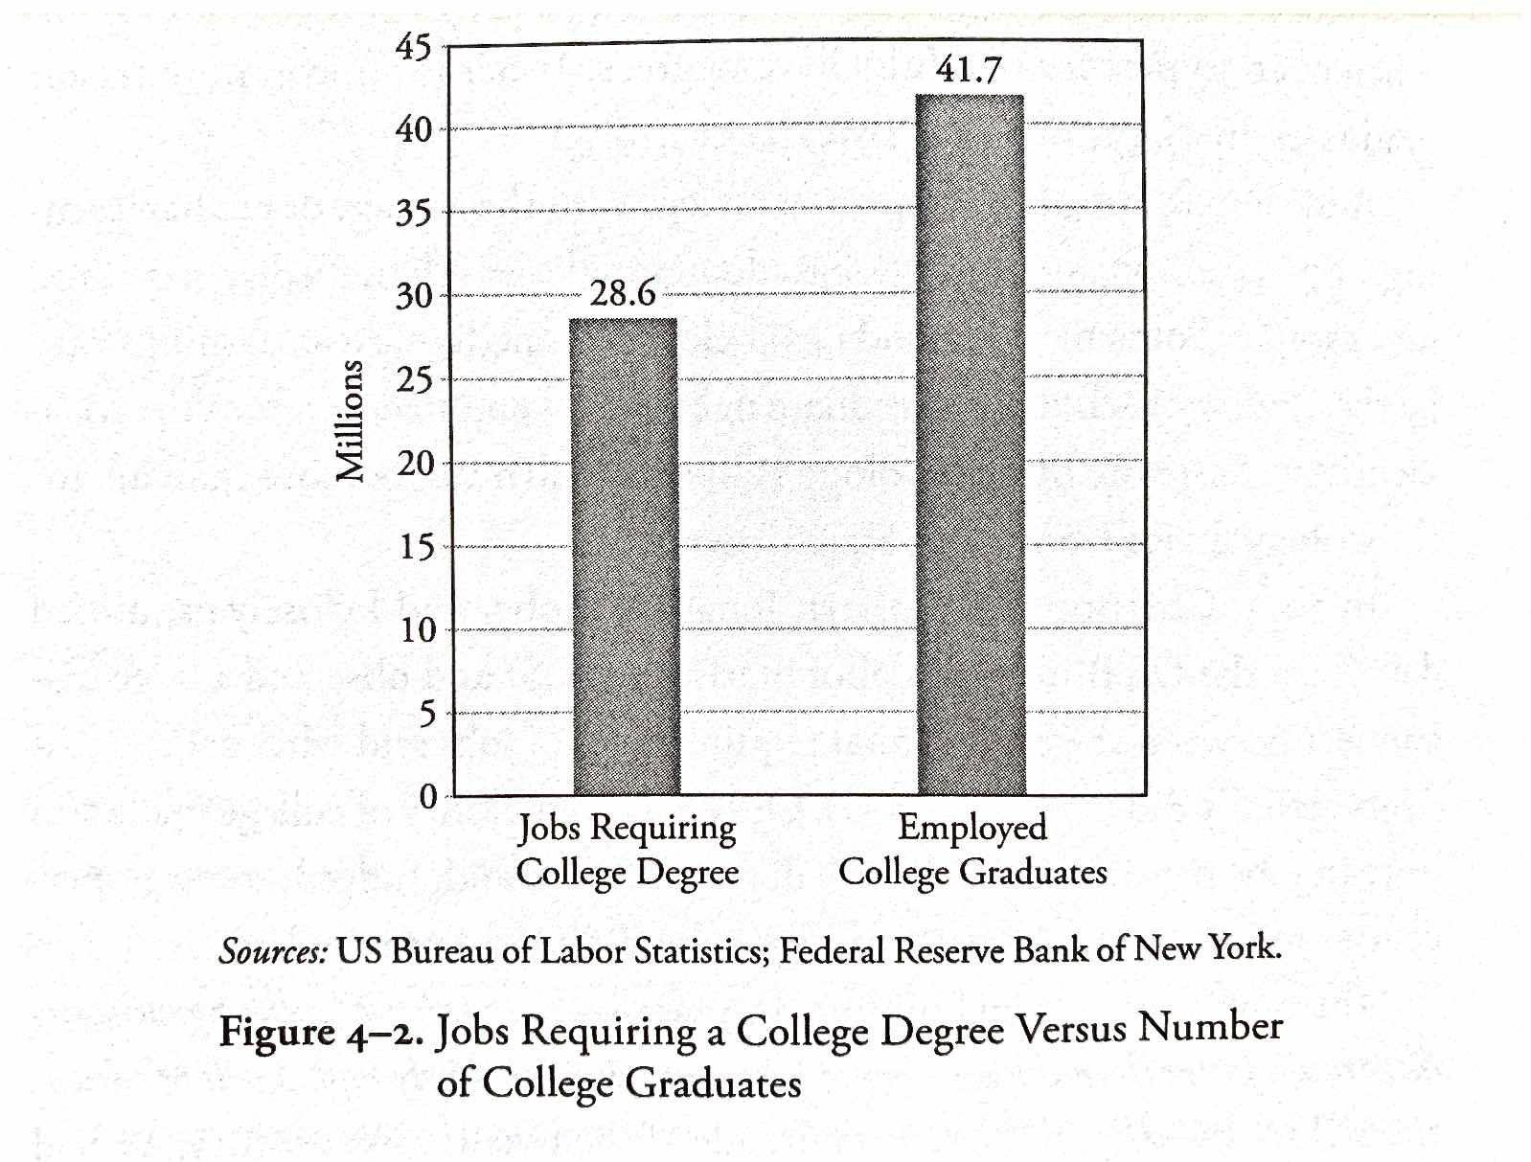
From Richard Vedder, Restoring the Promise, p. 72.

Slide 11
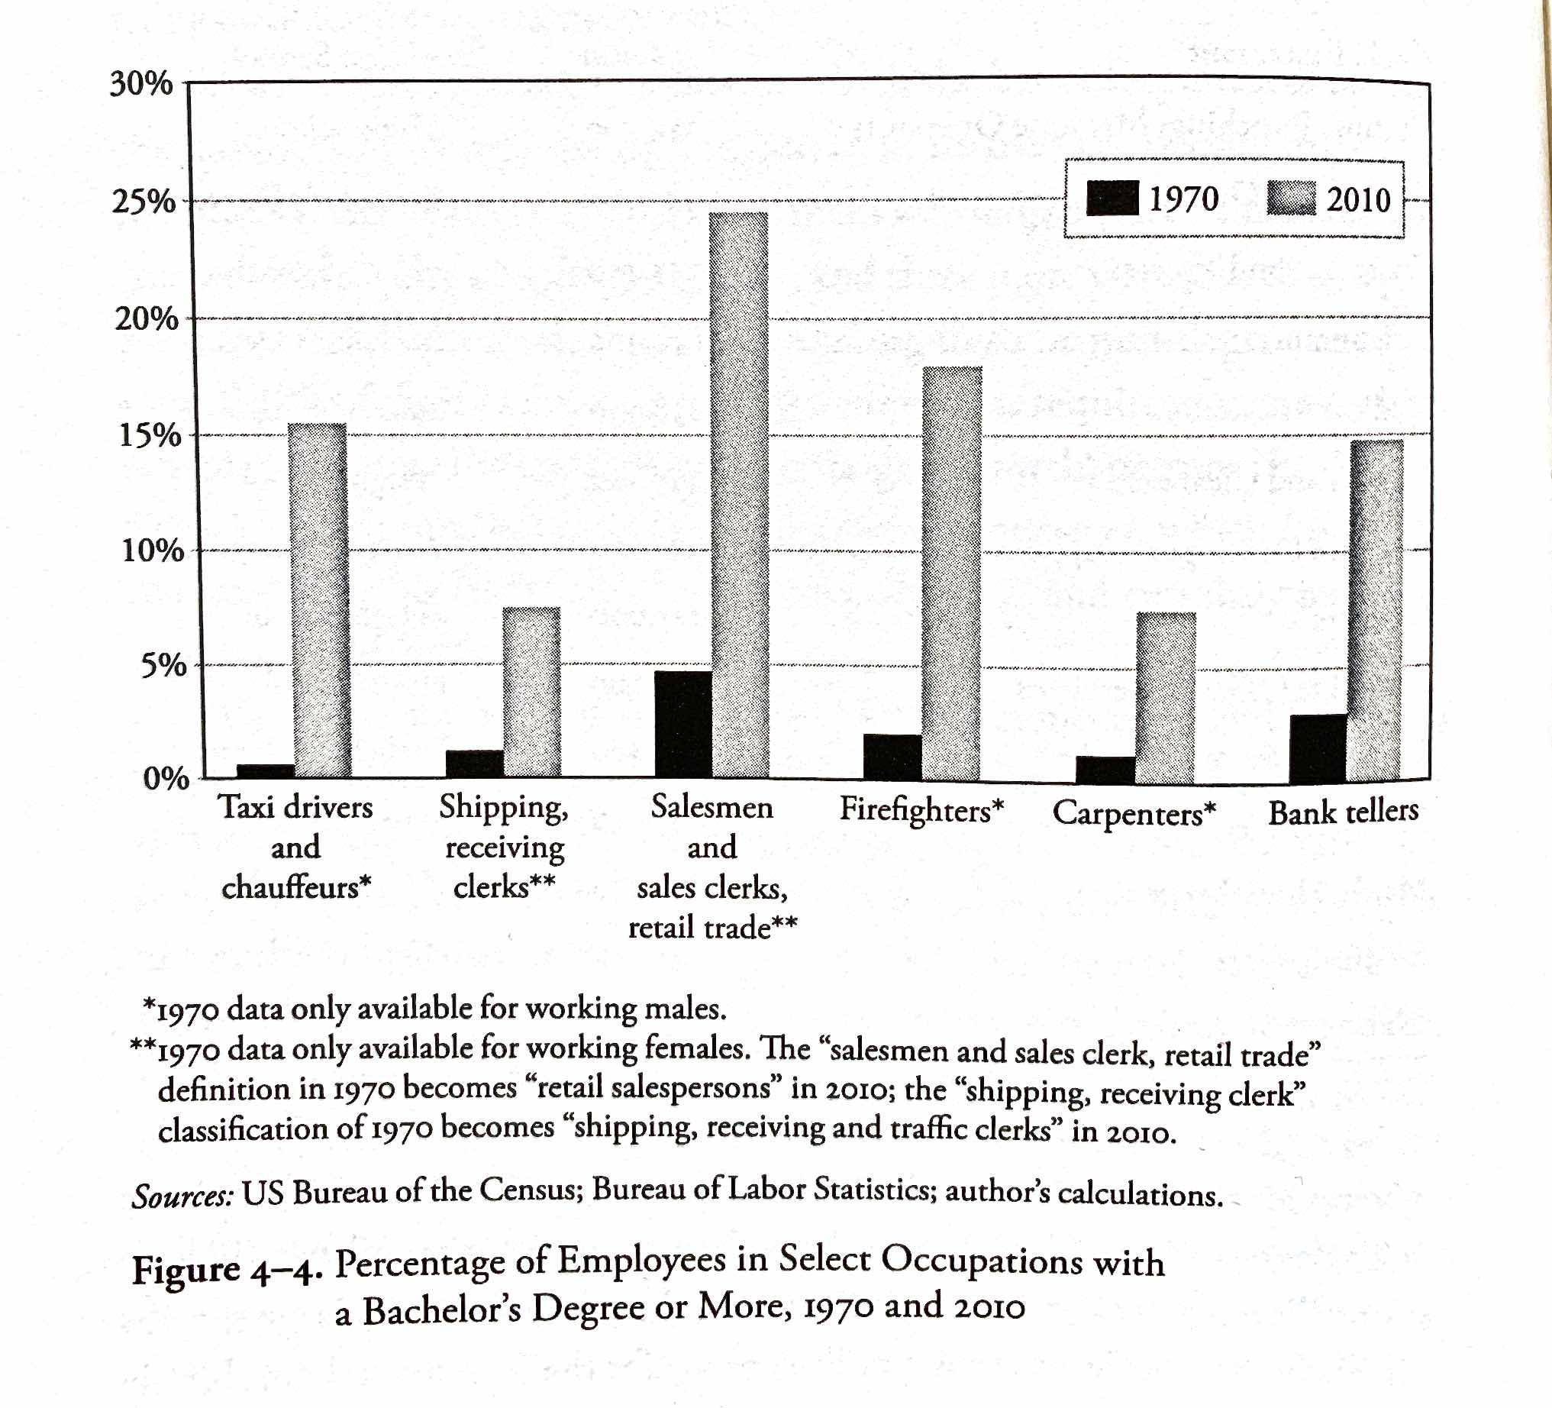
From Richard Vedder, Restoring the Promise, p. 76.

Slide 12
Higher Education as Signaling
Filter for motivation, perseverance, intelligence
Certified motivated, persevering, intelligent
Pass
To filter
Population
Uncertified motivated, persevering, intelligent
+
Unmotivated, undisciplined, unintelligent
Fail/dropout
Bypass filter

Slide 13
Higher Education as Signaling
$
Taxes
Filter for motivation, perseverance, intelligence
(less effective)
Certified motivated, persevering, intelligent
Pass
Subsidies
Population
To filter
Uncertified motivated, persevering, intelligent
+
Unmotivated, undisciplined, unintelligent
Fail/dropout
Bypass filter

Slide 14
Higher Education as Signaling
“[O]nce workers have been ranked, giving everyone extra years of education is socially wasteful. Furthermore, since the status quo is supported by hundreds of billions of dollars of subsidies, we’re probably underusing alternative certification methods like apprenticeships, testing, boot camps, and so on.”
“Signaling… explains why students are far more concerned about grades than actual learning. They want ‘easy A’s’—not professors who teach lots of job skills. Signaling explains why cheating pays—a successful cheater profits by impersonating a good student. And signaling explains why students readily forget course material the day after the final exam. Once you’ve got the good signal on your transcript, you can usually safely forget whatever you learned.”
    -- Bryan Caplan
http://blog.press.princeton.edu/2018/01/23/bryan-caplan-on-the-case-against-education/

Slide 15
Higher Education as Signaling
“Above all, we need far less education. And the cleanest way to get far less education is to sharply cut government education spending. …[E]mployers will no longer expect you to have the education you can no longer afford. In other words, spending cuts will cause credential deflation. You’ll once again be able to get low- and middle-skill jobs with a high school degree—or less.”
“[T]here’s little sign that education causes much enlightenment or civic understanding. Even at top schools, most students are intellectually and culturally apathetic, and most professors are uninspiring.”
    -- Bryan Caplan
http://blog.press.princeton.edu/2018/01/23/bryan-caplan-on-the-case-against-education/

Slide 16
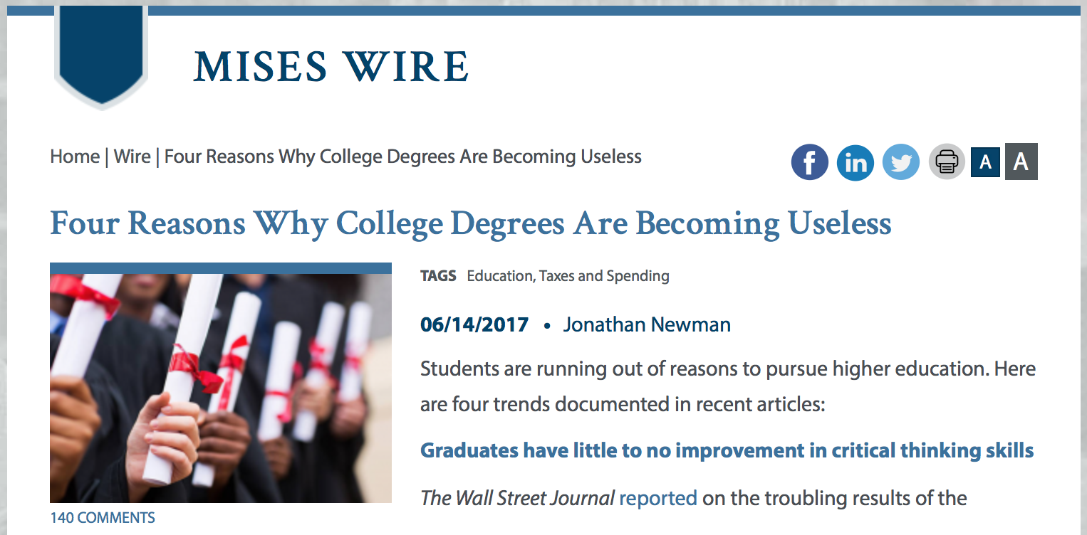

Slide 17
Does College Deliver?
“Graduates have little to no improvement in critical thinking skills”
  “At some of the most prestigious flagship universities, test results indicate the average graduate shows little or no improvement in critical thinking over four years.”
  “[E]mployers are beginning to discount the degree signal as well. Google, for example, doesn’t care if potential hires have a college degree. They look past academic credentials for other characteristics that predict job performance.”
Jonathan Newman, “Four Reasons Why College Degrees are Becoming Useless,” https://mises.org/wire/four-reasons-why-college-degrees-are-becoming-useless

Slide 18
Does College Deliver?
Grade Inflation
  “At Yale College, where 62 percent of grades are in the A range, proposals to curb grade inflation are in doubt following student protests and faculty concern.”
  “[Arthur Levine] found in a national survey that 41 percent of students had grade point averages of A-minus or higher in 2009, compared to just 7 percent in 1969.”
Marcella Bombardieri, “Harvard, Other Schools Still Fighting Grade Inflation,” https://www.bostonglobe.com/metro/2013/12/05/with-its-most-common-grade-harvard-earns-disapproval-but-has-company/kCeheDYfuDjSRcM1sVljfK/story.html

Slide 19
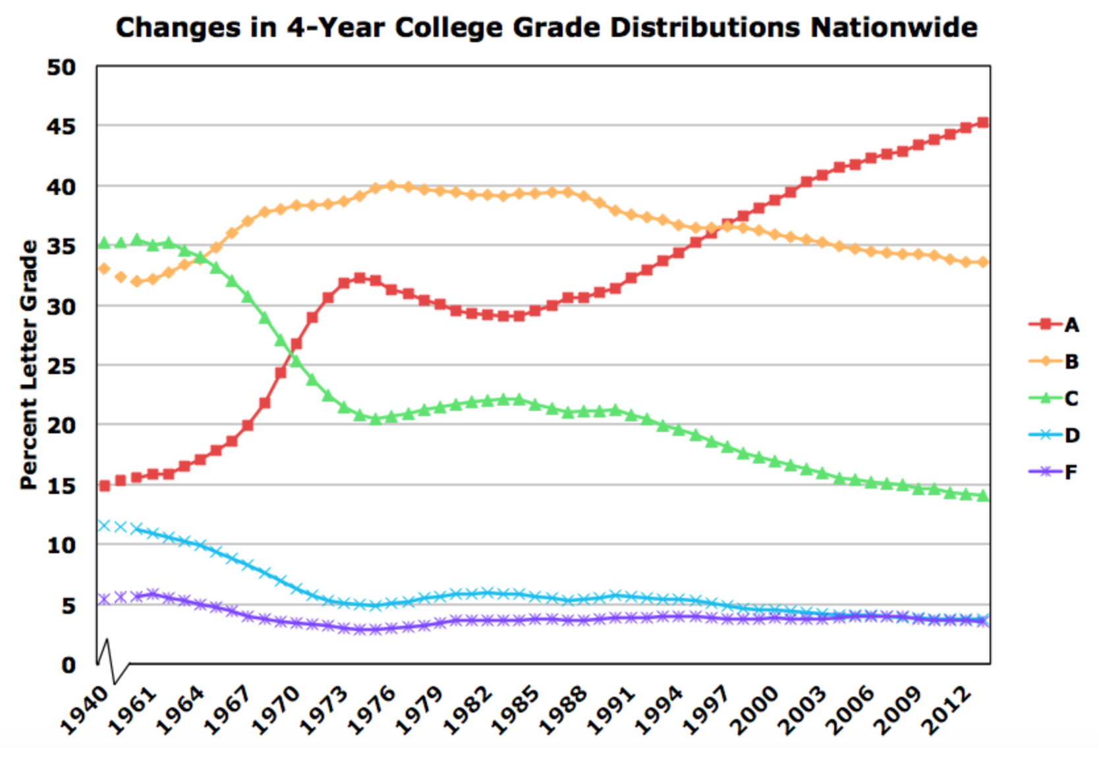
Source: gradeinflation.com

Slide 20
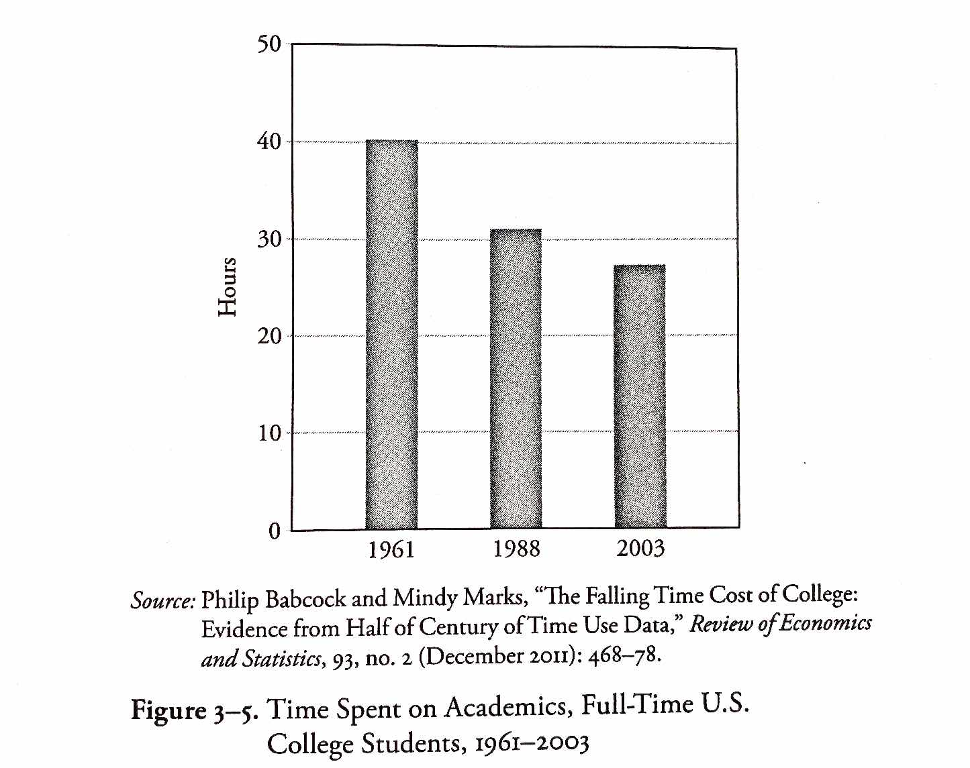
From Richard Vedder, Restoring the Promise, p. 57.

Slide 21
Crisis 2: Government Subsidies Are Backfiring

Slide 22



Tuition and Costs
“Tuition is increasing, but future earnings are decreasing”
  “According to Bloomberg, college tuition and fees have increased 1,120 percent since records began in 1978, and the rate of increase in college costs has been ‘four times faster than the increase in the consumer price index.’” – Doug French
  Total student loans are at $1.8 trillion (July ‘21) and climbing.
Jonathan Newman, “Four Reasons Why College Degrees are Becoming Useless,” https://mises.org/wire/four-reasons-why-college-degrees-are-becoming-useless
Doug French, “No End in Sight for Higher-Education Malinvestment,” https://mises.org/library/no-end-sight-higher-education-malinvestment
Debt clock: http://finaid.org/loans/studentloandebtclock.phtml

Slide 23
Tuition and Costs
Jonathan Newman, “Busting the ‘Free College’ Myth,” https://mises.org/wire/busting-free-college-myth

Slide 24
https://www.zerohedge.com/news/2014-04-06/ongoing-inflation-higher-education-bubble

Slide 26
For-Profit Education
“[A] market has natural mechanisms for punishing credit abusers, mechanisms that decrease the likelihood that these individuals will be the beneficiaries of credit in future transactions. Unfortunately, much to the dismay of the American taxpayer, such mechanisms are not intrinsic in FFA, where everyone enjoys equal status regardless of their ability to satisfy debt-related obligations.

Slide 27
For-Profit Education
“Only in rare instances, such as prior default on student loans, will government restrict access to this ubiquitous program. While some may champion FFA by arguing the merits of readily accessible education, they fail to heed the lessons taught to us by Henry Hazlitt in his masterpiece Economics in One Lesson. In particular, advocates conveniently overlook the unintended consequences of systematically extending credit to undeserving debtors: higher prices and default.”
-- A.G. Smith, “The Bubble in For-Profit Schooling,” https://mises.org/library/bubble-profit-schooling

Slide 28
Federal Aid and Student Costs
“[I]ncreases in financial aid in recent years have enabled colleges and universities blithely to raise their tuitions.”
-- William Bennett, former secretary of education, 1987

Slide 29
Federal Aid and Student Costs
Larry Singell, Joe Stone, 2007. “For Whom the Pell Tolls: The Response of University Tuition to Federal Grants-in-Aid,” Economics of Education Review 26, no. 3: 285–295.
  “A prominent question in public debate is whether Pell grants tend to be appropriated by universities through increases in tuition—consistent with what is known as the Bennett hypothesis. Based on a panel of 1554 colleges and universities from 1989 to 1996, we find little evidence of the Bennett hypothesis for in-state tuition for public universities. For private universities, though, increases in Pell grants appear to be matched nearly one for one by increases in list (and net) tuition. Results for out-of-state tuition for public universities are similar to those for private universities, suggesting that they behave more like private ones in setting out-of-state tuition.”
https://eric.ed.gov/?id=EJ762744

Slide 30
Federal Aid and Student Costs
Nicholas Turner, 2012. “Who Benefits from Student Aid? The Economic Incidence of Tax-Based Federal Student Aid,” Economics of Education Review 31, no. 4: 463–481.
  “…intended cost reductions of tax-based federal student aid are substantially offset by institutional price increases for a sample of 4-year colleges and universities. Contrary to the goal of policymakers, I find that tax-based aid crowds out institutional aid roughly dollar-for-dollar.”

Slide 31
Federal Aid and Student Costs
Stephanie Riegg Cellini, Claudia Goldin, 2013. “Does Federal Student Aid Raise Tuition? New Evidence on For-Profit Colleges,” NBER Working Paper No. 17827
  “We find that the Title IV institutions [eligible to participate in federal student aid programs] charge tuition that is about 78 percent higher than that charged by comparable institutions whose students cannot apply for federal financial aid.”
https://www.sciencedirect.com/science/article/pii/S0272775711001968
http://www.nber.org/papers/w17827

Slide 32
Federal Aid and Student Costs
David O. Lucca, Taylor Nadauld, and Karen Shen, 2017. “Credit Supply and the Rise in College Tuition: Evidence from the Expansion in Federal Student Aid Programs,” FRBNY Staff Report.
  “We study the link between the student credit expansion of the past fifteen years and the contemporaneous rise in college tuition. …We find a pass-through effect on tuition of changes in subsidized loan maximums of about 60 cents on the dollar, and smaller but positive effects for unsubsidized federal loans. The subsidized loan effect is most pronounced for more expensive degrees, those offered by private institutions, and for two-year or vocational programs.”
https://www.newyorkfed.org/research/staff_reports/sr733.html

Slide 33
Federal Aid and Student Costs
Grey Gordon and Aaron Hedlund, 2017. “Accounting for the Rise in College Tuition,” Chapter forthcoming in Charles R. Hulten and Valerie A. Ramey, eds., Education, Skills, and Technical Change: Implications for Future US GDP Growth, University of Chicago Press, NBER Book Series Studies in Income and Wealth.
  “The demand-side shocks [e.g., expanded subsidized student loan availability] cause tuition to jump by 91%. With all other changes except the demand-side shocks, tuition only increases by 14%.”
http://www.nber.org/chapters/c13711.pdf

Slide 34
Where Does the Money Go?
Dormitory improvements, campus amenities, and administration, for the most part.
  Princeton spent $136 million on a student dormitory ”with leaded glass windows and a cavernous oak dining hall…. The dorm’s cost approached $300,000 per bed.”
  Since 2000, NYU ”has provided $90 million in loans, many of them zero-interest and forgivable, to administrators and faculty to buy houses and summer homes on Fire Island and the Hamptons.”
Richard Vedder, 2013, http://www.wsj.com/articles/SB10001424127887324619504579029282438522674

Slide 35
Where Does the Money Go?
  “Former Ohio State President Gordon Gee… earned nearly $2 million in compensation last year while living in a 9,630 square-foot Tudor mansion on a 1.3 acre estate. The Columbus Camelot includes $673,000 in art décor and a $532 shower curtain in a guest bathroom. Ohio State also paid roughly $23,000 per month for Mr. Gee’s soirees and half a million for him to travel the country on a private jet.”
  ”Colleges have also used the gusher of taxpayer dollars to hire more administrators to manage their bloated bureaucracies…. The University of California system employs 2,358 administrative staff in just its president’s office.”
Richard Vedder, 2013, http://www.wsj.com/articles/SB10001424127887324619504579029282438522674

Slide 36
Where Does the Money Go?
  Vedder: “Thirty percent of the adult population has college degrees…. The Department of Labor tells us that only 20% or so of jobs require college degrees. We have 115,520 janitors in the United States with bachelor’s degrees or more. Why are we encouraging more kids to go to college?”
  ”’In housing, we had artificially low interest rates. The government encouraged people with low qualifications to buy a house. Today, we have low interest rates on student loans. The government is encouraging kids to go to school who are unqualified just as it encouraged people to buy a home who are unqualified.’”
  “…ultimately, the way to improve college affordability is for the government to disinvest in higher ed and wean students from subsidies.”
Richard Vedder, 2013, http://www.wsj.com/articles/SB10001424127887324619504579029282438522674

Slide 37
For-Profit Education
In 1897, more than 92% of college students were enrolled at for-profit institutions. (https://affordableschools.net/for-profit-universities/)
Image: http://www.processhistory.org/angulo-for-profit-colleges/

Slide 38
For-Profit Education
  “’One thing about the for-profits is that they are laser-like devoted to instruction.’”
  “’The Obama administration has been beating up on [for-profits] pretty hard for the past two to three years,’ Mr. Vedder says. ‘It’s true that drop-out rates are disproportionately higher at the for-profits, but it’s also true that the for-profits are reaching the exact audience that Obama wants to reach’—low-income minorities, many of whom are the first in their family to attend college.
  ”Today, only about 7% of recent college grads come from the bottom-income quartile compared with 12% in 1970 when federal aid was scarce.”
Richard Vedder, 2013, http://www.wsj.com/articles/SB10001424127887324619504579029282438522674

Slide 39
Crisis 3: Politicized Academic Discourse

Slide 40
Politicized Academic Discourse
“Shouting matches have invaded campuses across the country”
  “At Evergreen State College in Washington, student protests have hijacked classrooms and administration Protestors took over the administration offices last month, and have disrupted classes as well. It has come to the point where enrollment has fallen so dramatically that government funding is now on the line.”
  “The chaos at Evergreen resulted in ‘anonymous threats of mass murder, resulting in the campus being closed for three days.’”
Jonathan Newman, “Four Reasons Why College Degrees are Becoming Useless,” https://mises.org/wire/four-reasons-why-college-degrees-are-becoming-useless

Slide 41
Politicized Academic Discourse
2017 study of college students: “Some students say shouting down speakers and using violence is sometimes acceptable”
  “Many colleges struggle when inviting controversial figures to speak on campus. Ninety percent of college students say it is never acceptable to use violence to prevent someone from speaking, but 10 percent say it is sometimes acceptable. A majority (62 percent) also say shouting down speakers is never acceptable, although 37 percent believe it is sometimes acceptable.” (medium.com)
  “Students have become more likely to think the climate on their campus prevents people from speaking their mind because others might take offense.” (knightfoundation.org)
Gallup-Knight Foundation survey of U.S. college students, https://www.knightfoundation.org/reports/free-expression-on-campus-what-college-students-think-about-first-amendment-issues and https://medium.com/informed-and-engaged/8-ways-college-student-views-on-free-speech-are-evolving-963334babe40

Slide 42
Politicized Academic Discourse
2017 study of 1,500 U.S. citizen undergraduates at 4-year colleges and universities:
  “fewer than half of the respondents believe that the First Amendment protects hate speech.”
  “A public university invites a very controversial speaker to an on-campus event. The speaker is known for making offensive and hurtful statements. A student group opposed to the speaker uses violence to prevent the speaker from speaking. Do you agree or disagree that the student group’s actions are acceptable?”
  “19% of the respondents stated that they agreed with the student group’s actions….”
Eugene Volokh, “Freedom of Expression on Campus: An Overview of Some Recent Surveys,” Washington Post, Oct. 23, 2017. https://www.washingtonpost.com/news/volokh-conspiracy/wp/2017/10/23/freedom-of-expression-on-campus-an-overview-of-some-recent-surveys/?utm_term=.baea637297f6

Slide 43
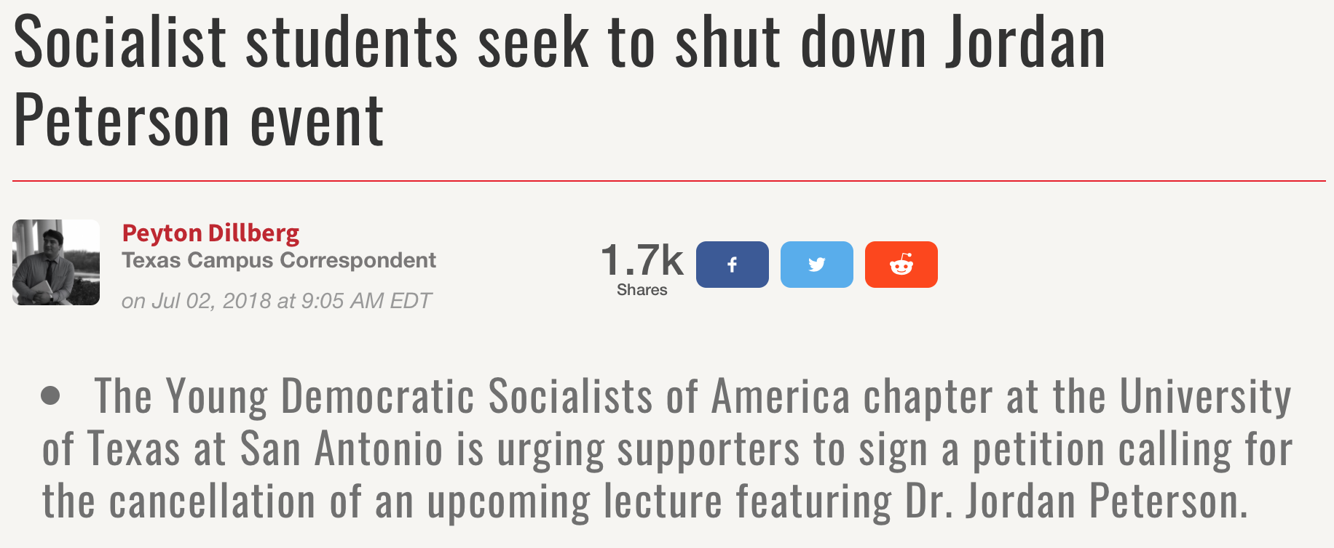
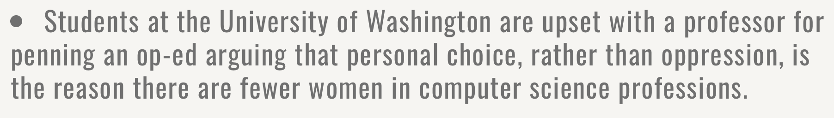
https://www.campusreform.org/?ID=11082
https://www.newyorker.com/magazine/2016/05/30/the-new-activism-of-liberal-arts-colleges

Slide 44
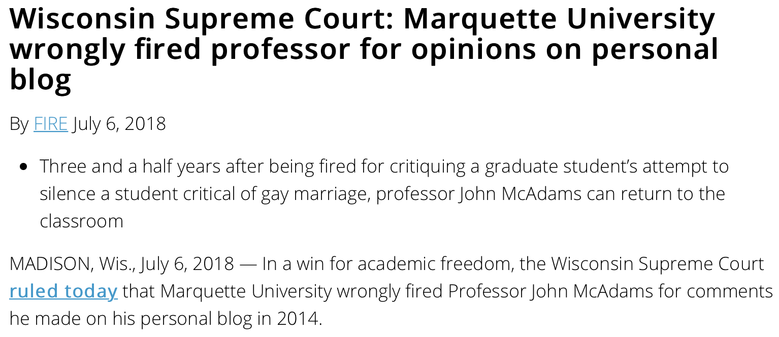
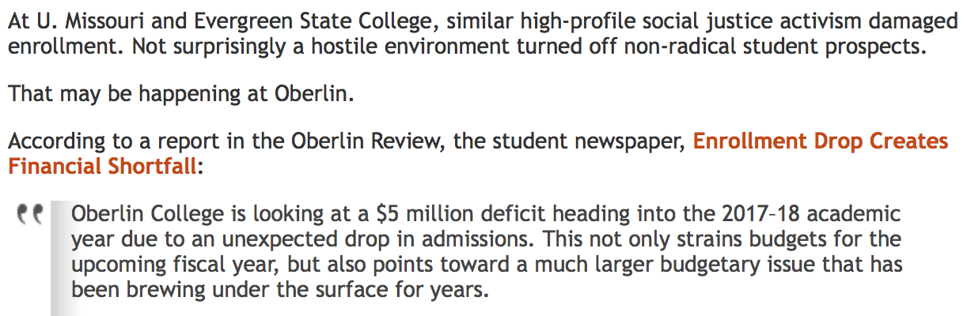
https://legalinsurrection.com/2017/09/radical-fallout-oberlin-college-enrollment-drops-causing-financial-problems/

Slide 45
Free Speech Policies
“Based on FIRE’s observations, institutions that adopt free speech policy statements tend to have more active discourse surrounding freedom of expression on campus. Importantly, many of these initiatives are driven by the administration, sending a signal to the entire university community that freedom of speech is not merely tolerated, but encouraged.”
https://www.thefire.org/five-years-of-the-chicago-statement-what-have-we-learned- part-1/

Slide 46
Free Speech Policies
“Since its initial release in 2015, the number of colleges that have adopted a free speech policy statement has swelled to 78 institutions as of this writing. Campuses that have continued to have challenging but worthwhile conversations about free expression embody the very best in higher education. Following the dictates of the Chicago Statement, these institutions demonstrate their commitment to “free and open inquiry in all matters” on a daily basis and manifest the guarantee that “all members of the University community [have] the broadest possible latitude to speak, write, listen, challenge, and learn.”
https://www.thefire.org/five-years-of-the-chicago-statement-what-have-we-learned-part-2/

Slide 47
About Free Speech
“Take, for example, the ‘human right’ of free speech. Freedom of speech is supposed to mean the right of everyone to say whatever he likes. But the neglected question is: Where? Where does a man have this right? He certainly does not have it on property on which he is trespassing. In short, he has this right only either on his own property or on the property of someone who has agreed, as a gift or in a rental contract, to allow him on the premises. In fact, then, there is no such thing as a separate ‘right to free speech’; there is only a man's property right: the right to do as he wills with his own or to make voluntary agreements with other property owners.”
Murray Rothbard, Ethics of Liberty, ch. 15.

Slide 48
About Free Speech
“In short, a person does not have a ‘right to freedom of speech’; what he does have is the right to hire a hall and address the people who enter the premises. He does not have a ‘right to freedom of the press’; what he does have is the right to write or publish a pamphlet, and to sell that pamphlet to those who are willing to buy it (or to give it away to those who are willing to accept it). Thus, what he has in each of these cases is property rights, including the right of free contract and transfer which form a part of such rights of ownership. There is no extra ‘right of free speech’ or free press beyond the property rights that a person may have in any given case.
Murray Rothbard, Ethics of Liberty, ch. 15.

Slide 49
About Free Speech
“Furthermore, couching the analysis in terms of a ‘right to free speech’ instead of property rights leads to confusion and the weakening of the very concept of rights. The most famous example is Justice Holmes's contention that no one has the right to shout "Fire" falsely in a crowded theater, and therefore that the right to freedom of speech cannot be absolute, but must be weakened and tempered by considerations of ‘public policy.’ And yet, if we analyze the problem in terms of property rights we will see that no weakening of the absoluteness of rights is necessary.
Murray Rothbard, Ethics of Liberty, ch. 15.

Slide 50
About Free Speech
“For, logically, the shouter is either a patron or the theater owner. If he is the theater owner, he is violating the property rights of the patrons in quiet enjoyment of the performance, for which he took their money in the first place. If he is another patron, then he is violating both the property right of the patrons to watching the performance and the property right of the owner, for he is violating the terms of his being there. For those terms surely include not violating the owner's property by disrupting the performance he is putting on. In either case, he may be prosecuted as a violator of property rights; therefore, when we concentrate on the property rights involved, we see that the Holmes case implies no need for the law to weaken the absolute nature of rights.”
Murray Rothbard, Ethics of Liberty, ch. 15.

Slide 51
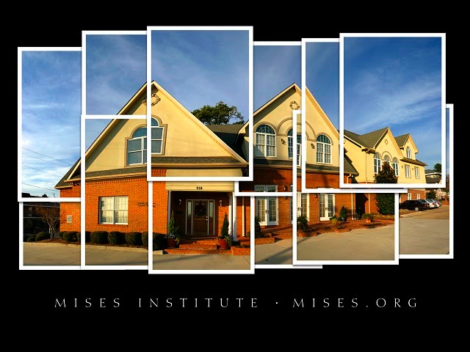
Questions

