Slide 1
Calculation and Socialism
Mises University 2020
Joseph T. Salerno

Slide 2
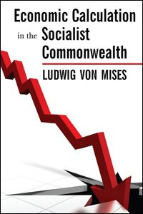
Mises’s Article
Ludwig von Mises, Economic Calculation in a Socialist Commonwealth (1920):
  destroyed the intellectual foundations of the case for socialist central planning;
  was a revolutionary breakthrough In economic theory which demonstrated the nature and function of the price system.

Slide 3
Scientific Vs. Utopian Socialism
UTOPIAN SOCIALISTS
Charles Fourier (1772-1837)
Henri Saint-Simon (1760-1825)
Robert Owen (1771-1858)
“SCIENTIFIC” SOCIALISTS
Karl Marx (1818-83)
Friedrich Engels (1820 -1895)

Slide 4
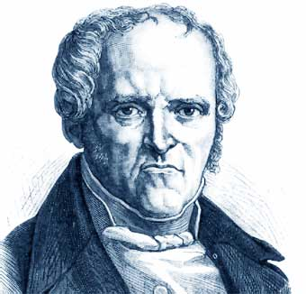
CHARLES FOURIER

Slide 5
The Phalanstère
Garden cities modeled after a grand hotel containing 1,500-1600 residents and based on the phalanx an ancient Greek military formation
Each resident would be able to purchase accommodations according to his/her individual tastes and income
All residents would be a stockholder in the city
Collective production
All would share meals in a communal kitchen
Dirty work would be shared

Slide 6
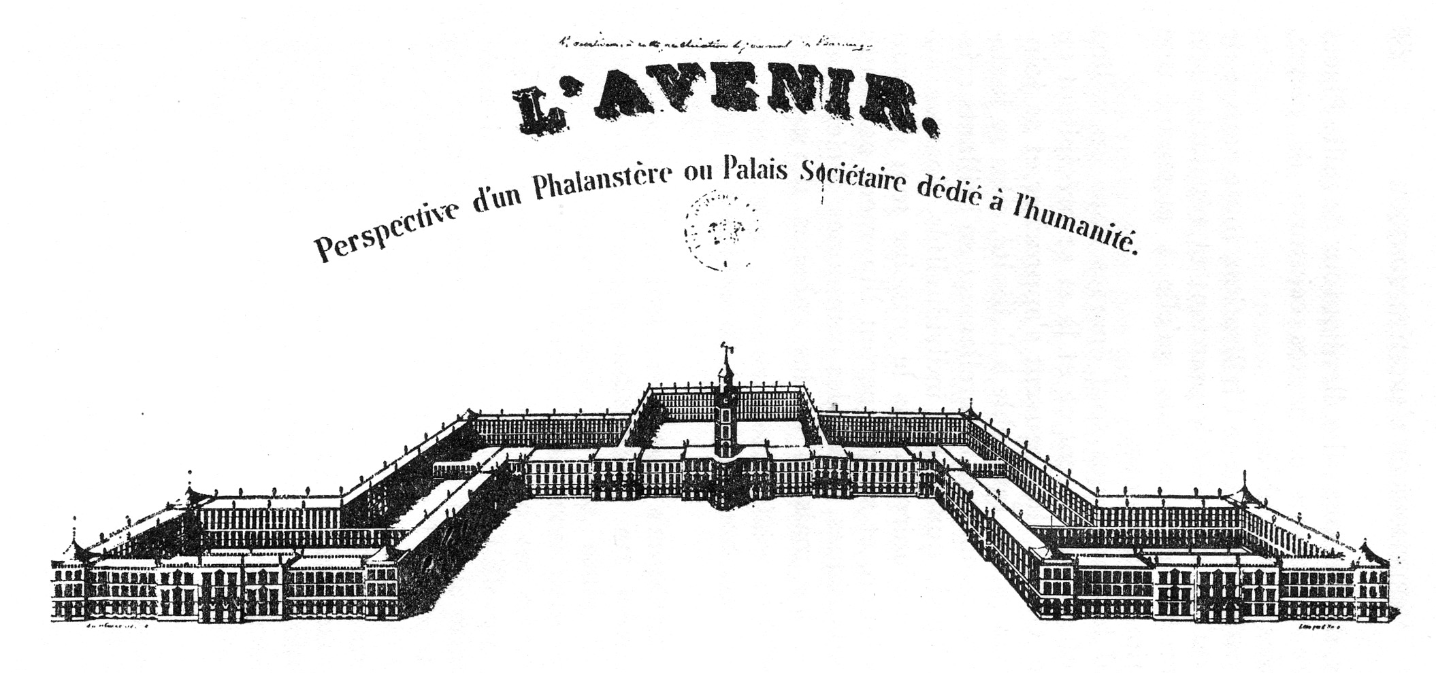
Sketch of the Phalanstère

Slide 7
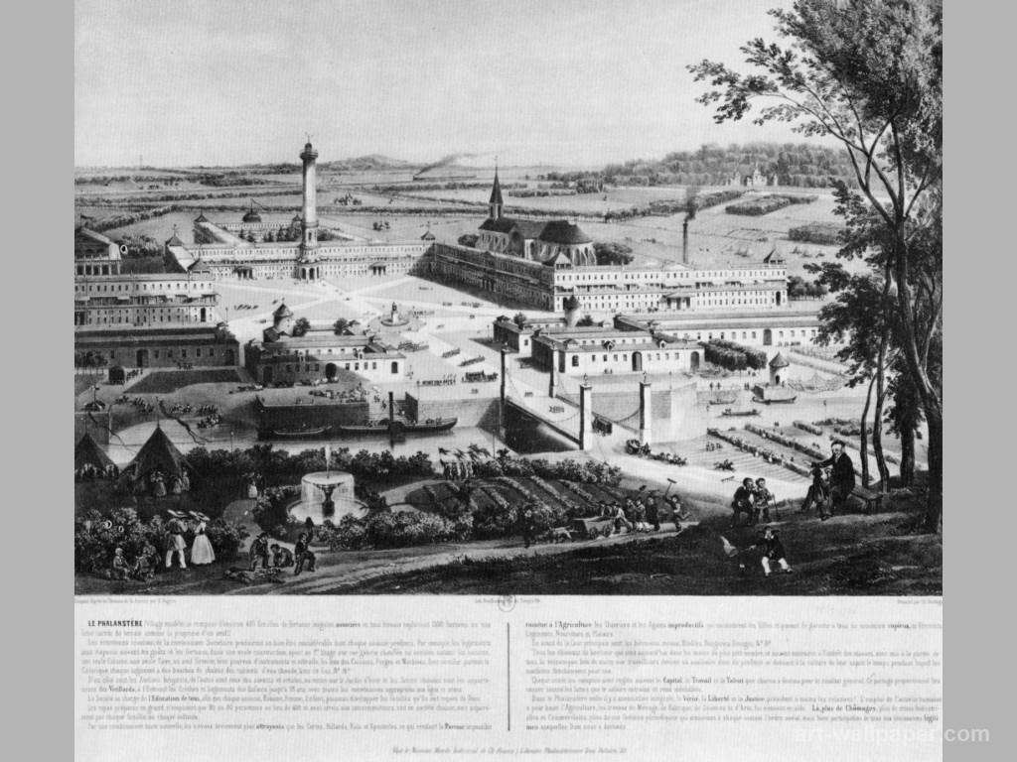
Model of the Phalanstère

Slide 8
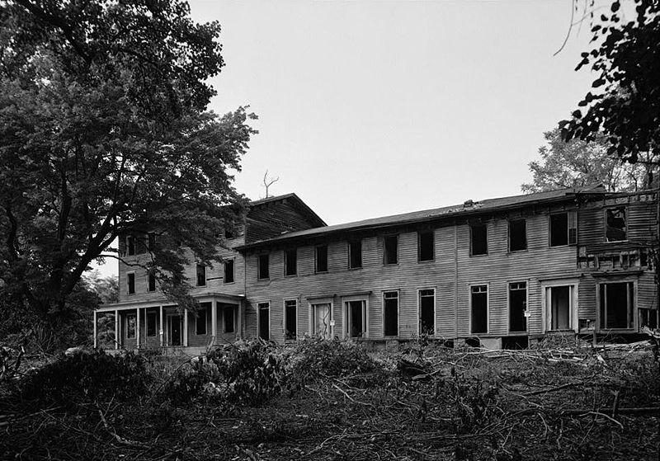
Abandoned Phalanstère (Monmouth, NJ)

Slide 9
Fourier’s Ramblings—1
19th century France was allegedly in the 5th stage of advancement, having passed through: 1. confusion; 2. savagery; 3. patriarchism; and 4. barbarity. After passing through two more stages it would approach the upward slope of harmony—the final stage of utter bliss—which would last for 8,000 years. Then however history would reverse itself, and society would regress through each stage back to the beginning.
(Robert B. Ekelund, Jr. and Robert F. Hebert, A History of Economic Theory and Method, 5th ed., pp. 159-60)

Slide 10
Fourier’s Ramblings—2
Fourier detailed the changes accompanying “harmony”:
six new moons would replace the one in existence.
a halo, showering gentle dew would circle the north pole.
the seas would turn to Kool-Aid.
all violent or repulsive beasts would be replaced by their opposites [and] would be commonplace and serviceable to mankind. Anti-lions would offer themselves to humans to be ridden and roasted anti-chickens would fly into human mouths.
The human lifespan in the harmonic stage would stretch to 144 years and 5/6 of this time would be devoted to the unrestrained pursuit of sexual love. [Free love a part of almost all Utopian schemes]

Slide 11
Response of the Classical Economists
The incentive problem: “Who will take out the garbage under socialism?” The price system provides the needed incentives through the profit and loss mechanism (supply and demand) to supply the right goods in the right amounts (“invisible” hand)
Socialist answer: “The New Socialist Man” would work for the community welfare and not monetary profit.
Both sides implicitly assumed that if the incentive problem could be solved socialism would be as productive as capitalism.

Slide 12
Marx’s Brilliant Polemical Ploy
Marx realized the harm that the crazy scribblings of the Utopian Socialists did to the socialist cause.
He devised the doctrine of “Scientific Socialism” to counter them:
  The “inexorable laws of history” dictated that socialism would replace capitalism just as capitalism had replaced feudalism and feudalism had replaced classical slave societies.
  Therefore it was unscientific to speculate about what a future socialist society would look like or to try to speed up its arrival.
Marx’s writings, therefore, were mainly a critique of capitalism and its “contradictions.” (Das Kapital)

Slide 13
Mises’s Impossibility Thesis
In a developed industrial economy with complicated production processes and many different kinds of capital goods, the rational allocation of resources is impossible without economic calculation using actual market prices. A socialist economy is impossible because it cannot generate prices for capital goods and natural resources.

Slide 14
Mises’s Argument
  Socialism abolishes private property in capital goods and natural resources.
  Since the socialist State is sole owner of the material factors of production, they can no longer be exchanged.
  Without exchange there can be no market prices.
  Under socialism, therefore, the State cannot calculate the costs of production for the goods its produces.
  Without calculation of profit and loss, socialist planners cannot know the most valuable uses of scarce resources and therefore a socialist economy is impossible

Slide 15
The Essence of Socialism
“The essential mark of socialism is that one will alone acts. It is immaterial whose will it is. . . . The main thing is that the employment of all factors of production is directed by one agency only. One will alone chooses, decides, directs, acts, gives orders. The distinctive mark of socialism is the oneness and indivisibility of the will directing all production activities within the whole social system. (Ludwig von Mises, Human Action, pp. 691-92)

Slide 16
The Preconditions of Economic Calculation
private property in all stages of goods, including capital goods of every kind.
freedom to exchange all kinds of goods and services.
sound money—i.e., a money whose value is independent of political influence, such as gold.
Socialism abolishes all three of these preconditions and therefore nullifies economic calculation.

Slide 17

Production Function for a Car
P tons steel + Q hrs. machine time + R hrs. unskilled labor
+ S hrs engineering labor + T sq. ft. factory space
+ U kilowatt hrs. electricity + V gallons paint + . . . = Chevy SS

Slide 18
Economic Calculation
How can we calculate the cost of producing this car under socialism?
In the market economy all resources ( steel, engineering services, electricity) are exchanged and have market prices, so firms can calculate costs of anything. Assume that average cost of car is $50,000. Firms forecast future price ($55,000 or $48,000) and make decision to produce or not accordingly.
Also, calculation allows firms to determine what technology is least costly: more labor and less equipment or more computerized robotics and less labor. Titanium, steel or fiber glass bumper?

Slide 19
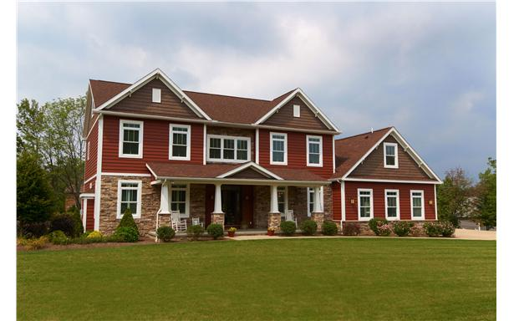
Calculation and Home Building in Montana

Slide 20

687 Miles

Slide 21
Direct Valuation in Crusoe Economy
Crusoe’s Scale of Value for Allocating Labor (3 hour units)
1st 2 fish
2nd 3 lbs. wild mushrooms
3rd 8 coconuts
4th 1 sack berries
Quick Quiz: What is the cost of producing a rabbit that requires 6 hours to hunt and catch? Can Crusoe allocate his labor rationally without calculation using cardinal numbers?

Slide 22
Production in the Former USSR
Gross output planning—GOSPLAN
Problems
  Difficult to specify qualities and varieties of product.
  Cases of agriculture, women’s clothing, construction, chandeliers etc.

Slide 23

Soviet Nail Cartoon

Slide 24
Social Appraisement Process
The process by which the market economy driven by entrepreneurs determines the money prices of all resources to be used in economic calculation of costs of production.

Slide 25
How Social Appraisement Works
Future Prices of Consumer Goods
↑
(1. appraises future prices based on present consumer prices and forecasted changes in S and D)
ENTREPRENEURS
(2. bids based on anticipated future consumer prices)
↓
Current Structure of Resource Prices

Slide 26
The Intellectual Division of Labor
Everyone is involved in generating the price structure—consumers, capitalists, entrepreneurs, and laborers—through their valuations, choices and exchanges.
Prices are a genuine social phenomenon—everyone contributes a little bit to the formation of the price structure but it exists beyond the individual human will and mind.
The price structure allows entrepreneurs to compute money costs of any conceivable production process and compare costs to anticipated prices of the product.

Slide 27
Socialist Response to Mises 1
Naïve Marxist Responses, 1920s
  Calculation in Kind (adding apples and oranges)
  Calculating with Labor Hours
  Assuming a Stationary Economy

Slide 28
Socialist Responses to Mises 2
Sophisticated Neoclassical Responses
  The Trial and Error Method
  Market Socialism (Oscar Lange, Abba Lerner)
  Mathematical Solution (Enrico Barone, H.D. Dickinson)

Slide 29
Austrian Replies: F. A. Hayek and Lionel Robbins
Impracticality of acquiring the necessary knowledge and solving equations in the pre-computer age
Impracticality of changing prices in a timely manner and the loss of knowledge in prices.

Slide 30
Austrian Replies: Mises
The market economy is an entrepreneurial and not a managerial process in which the creation and destruction of firms and production processes are a regular occurrence
It is impossible to allocate capital without real market prices and stock, bond and commodities markets.
Equilibrium prices yielded by mathematical equations are useless for a dynamic economy because they do not take into account change in tastes, technology etc; profits and losses; and changes in the kinds of capital goods needed.

