Slide 1
Cronyism: Liberty versus Power in Early America, 1607-1849
Dr. Patrick Newman
2021 Mises University

Slide 2
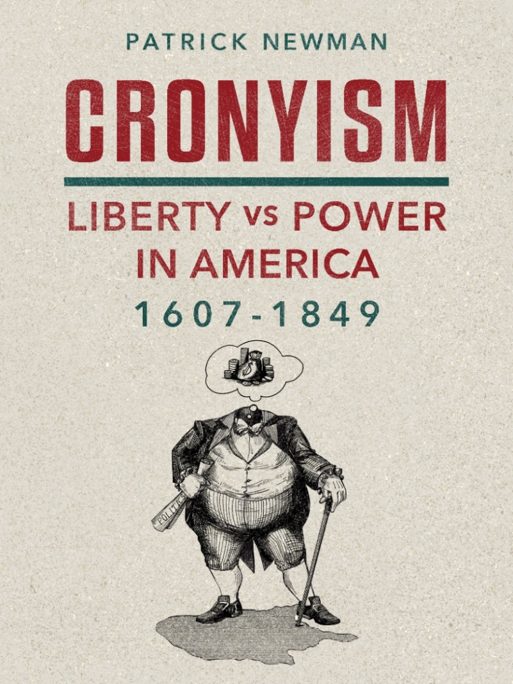
What’s this presentation about, and why should I care?
Forthcoming book (October 2021)
  Cronyism: special-interest policies that enrich insiders at the public’s expense.
    My narrative briefly covers Rothbard’s Conceived in Liberty series and then extensively covers the period after

Slide 3
Okay, so what’s the thesis?
  Cronyism increased in a jagged fashion. It went up, then slightly declined before increasing again (rinse and repeat)
  The Liberty versus Power theory explains why:
    History is a clash between liberty and power
    Power corrupts (increases the tendency to cronyism)
    Reform is difficult because power corrupts
    The proximate driver of cronyism was the desire to build an American Empire
      an Empire of Power versus an Empire of Liberty

Slide 4
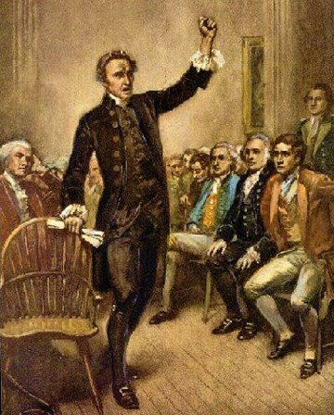
Part I: The Road to Empire, 1607-1790
  Chapter 1: The Path to American Independence
    The Old Orders of Europe
    Salutary Neglect versus the Grand Design
    Revolution!
      Patrick Henry: “Give me liberty, or give me death!”

Slide 5
Part I: The Road to Empire, 1607-1790
  Chapter 2: The American Revolutionary War: The Triumph of Liberty
    The Declaration of Independence versus the Articles of Confederation
    Robert Morris and the Bank of North America
    The Proposed Federal Tariff

Slide 6
Part I: The Road to Empire, 1607-1790
  Chapter 3: The U.S. Constitution: The Triumph of Power
      Debt holders, bankers, manufacturers and shippers, transportation companies, land speculators and merchants, military officials
      Federalists Robert Morris, Alexander Hamilton, and James Madison versus Antifederalists George Clinton and Patrick Henry
        Henry: The Constitution will “convert this country into a powerful and mighty empire.”

Slide 7
Part II: The Hamiltonian Era, 1790-1801
  Chapter 4: Prime Minister Hamilton: The Fiscal Program
    The Funding Act
    The Bank of the United States
    Protective Tariffs

Slide 8
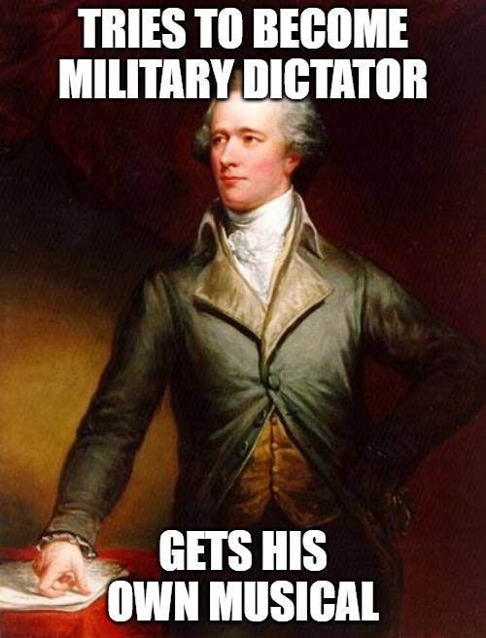
Part II: The Hamiltonian Era, 1790-1801
  Chapter 5: Prime Minister Hamilton: The Imperial Program
    The Whiskey Rebellion
    Inspector General Alexander Hamilton
      Hamilton: When it comes to the “riches of Mexico and Peru,” “the command in this case would very naturally fall upon me.”

Slide 9
Part II: The Hamiltonian Era, 1790-1801
  Chapter 6: The Jeffersonian Revolution and the Defeat of Hamilton
    The Republican Party
      Federalist: “We hear, incessantly, from the old foes of the Constitution, ‘this is unconstitutional, and that is’.”
    The Revolution of 1800
    The Judiciary Act of 1801 and Chief Justice John Marshall

Slide 10
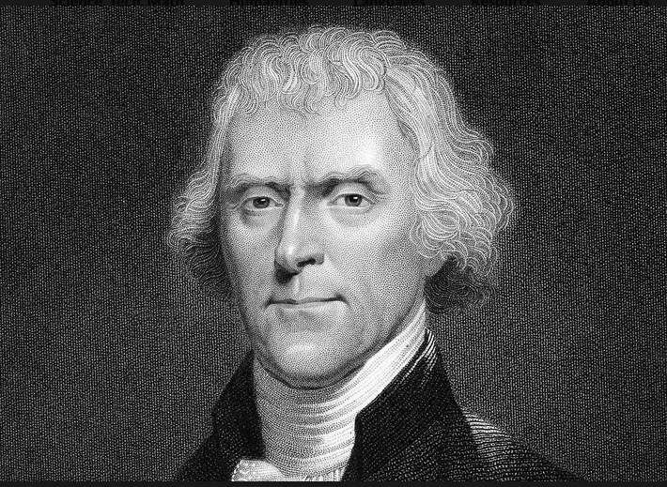
Part III: The Failed Jeffersonian Revolution, 1801-1817
  Chapter 7: President Jefferson: The Supremacy of Moderation
    Old Republicans (John Randolph and John Taylor) versus the moderates (James Madison)
    Jefferson is in the middle

Slide 11
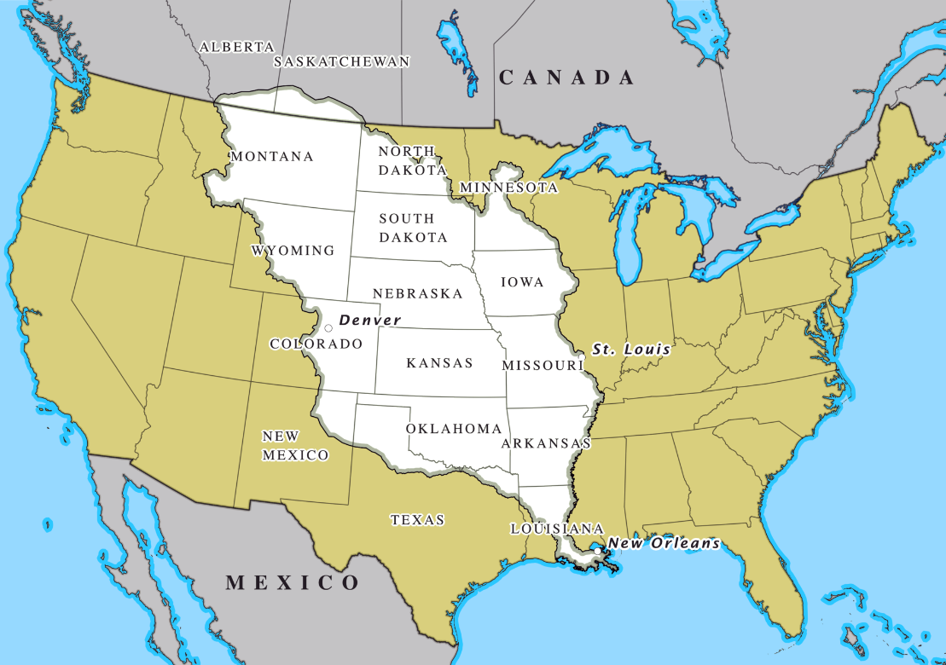
Part III: The Failed Jeffersonian Revolution, 1801-1817
  Chapter 8: President Jefferson: The Corruption of Land
    The Louisiana Purchase → Canada and Florida
John Randolph: the Louisiana Purchase was “the greatest course that ever befell us.”

Slide 12
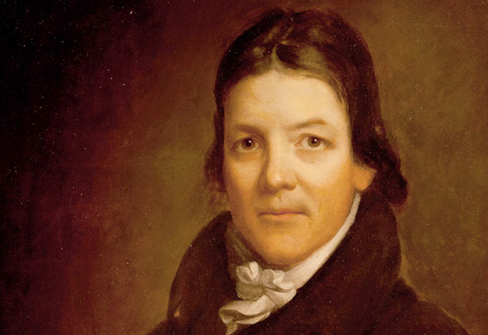
Part III: The Failed Jeffersonian Revolution, 1801-1817
  Chapter 9: President Madison: The Empire of Power
    The War of 1812 a (failed) land grab!
    Second Bank of the United States and the Tariff of 1816
John Randolph tried to fight the postwar cronyism that “out-Hamiltons Alexander Hamilton.”

Slide 13
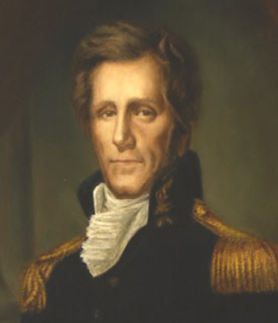
Part IV: The Era of Corruption, 1817-1829
    Chapter 10: Erecting the American System: The Monetary Infrastructure
      The Panic of 1819
      Andrew Jackson, Martin Van Buren, Thomas Hart Benton, and James K. Polk versus Henry Clay, Daniel Webster, John Quincy Adams, Nicholas Biddle, and John Marshall
Jackson: We must stop the central bank’s “attendant evils and corruption.”

Slide 14
Part IV: The Era of Corruption, 1817-1829
    Chapter 11: Erecting the American System: Sectional Fissures
      The Tariff of 1824
        Clay’s “the master spirit of the age” was Napoleon Bonaparte!
        The Tariff of 1828
          Manufacturer Abbott Lawrence exulted it would “keep the South and West in debt to New England the next hundred years.”
          The General Survey Act of 1824

Slide 15
Part IV: The Era of Corruption, 1817-1829
    Chapter 12: The Culmination of the American System: Enlarging the Empire
      Adams–Onís Treaty acquired Florida and assumed merchant losses
        Historians: bailout “marked unprecedented American underwriting of private commercial losses.”
Clay and Adams scheme to get Cuba

Slide 16
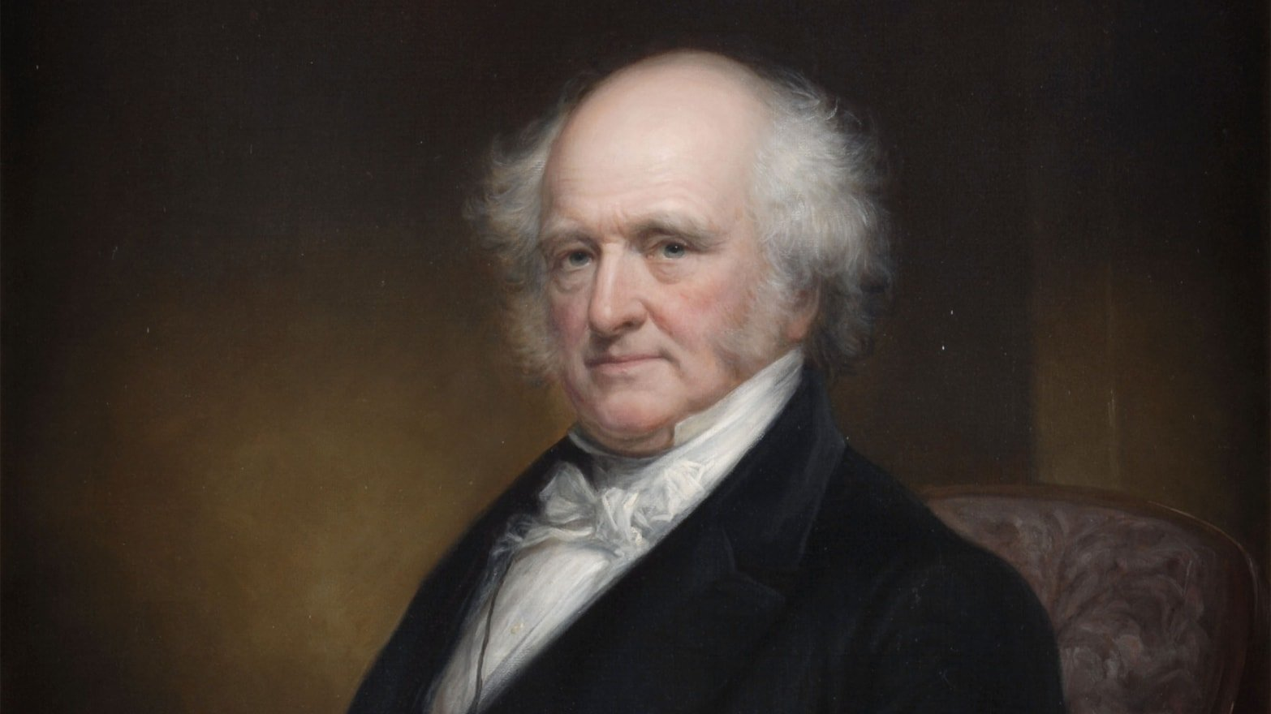
Part IV: The Era of Corruption, 1817-1829
Chapter 13: The Jacksonian Revolution and the Defeat of the National Republicans
  The Corrupt Bargain of 1825
    Jackson: “The Judas of the West has closed the contract, and received the thirty pieces of silver. His end will be the same.”
    The Revolution of 1828
Van Buren: “If Gen Jackson & his friends will put his election on old party grounds . . . our success when achieved will be worth something.”

Slide 17
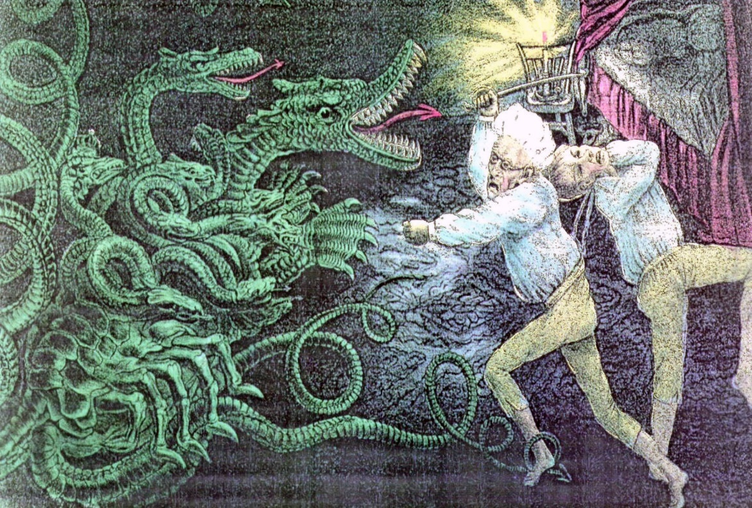
Part V: The Failed Jacksonian Revolution, 1829-1849
  Chapter 14: Dismantling the American System: Decentralizing Money
    Jackson vetoes the Second Bank of the United States’ early recharter
    Jackson: “the hydra of corruption is only scotched, not dead.”

Slide 18
Part V: The Failed Jacksonian Revolution, 1829-1849
  Chapter 15: Dismantling the American System: A Laissez-Faire Economy
    Walker Tariff of 1846
      The Cincinnati Enquirer: “The simultaneous triumph of free trade in the United States and Great Britain . . . is the greatest event of our age.”
    Maysville Road veto, paying off the national debt, Rivers and Harbors veto, general incorporation laws

Slide 19
Part V: The Failed Jacksonian Revolution, 1829-1849
Chapter 16: Resurrecting the American System: The Growth of Imperialism
  Texas annexation
    Debt holders (Biddle!), land speculators, and slave interests
    Van Buren and Benton split with Jackson and Polk
      Rothbard: “this tragic split in the Democratic Party” cost the organization “its libertarian conscience and drive”
    The Mexican War for the California ports

Slide 20
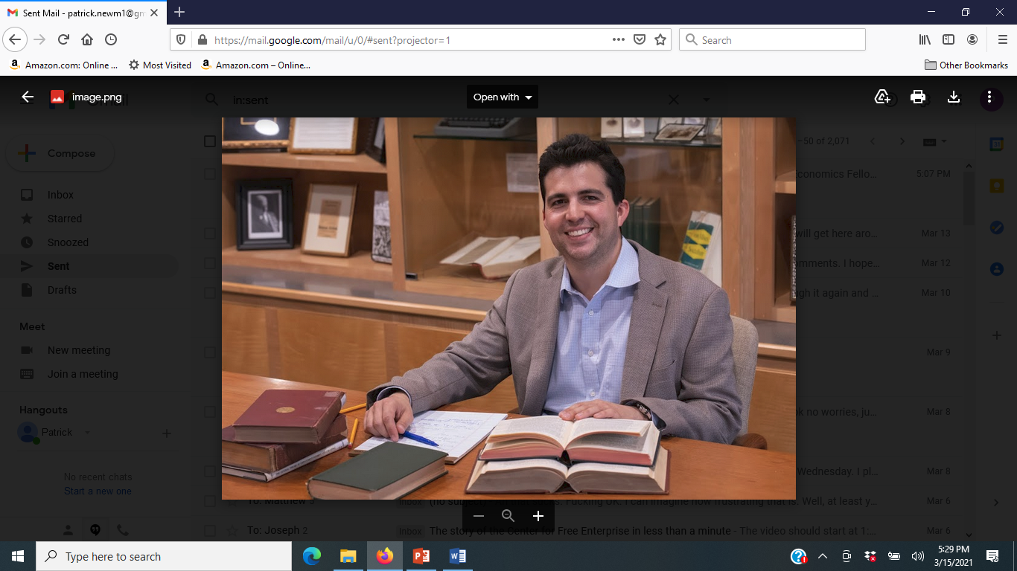
In conclusion
Cronyism will be great, although I can’t promise anything
You should buy the book when it comes out in October
  Perfect for Thanksgiving, Christmas, and Valentine’s Day gifts

