Slide 1
Banking
Dr. Patrick Newman
2021 Mises University

Slide 2
What’s this presentation about, and why should I care?
Why banks exist
The differences between loan banking and deposit banking
How deposit banking affects the money supply
  How competition (free banking) limits credit expansion
    Adverse clearing mechanism
How central banking affects the money supply
  The money multiplier process

Slide 3
Money (a brief review)
What you previously learned today
  Money originated on the market
  Money solves the double coincidence of wants and facilitates economic calculation
  Marginal utility theory can be applied to money
  The supply of money and the demand for money determines its purchasing power
  The purchasing power is an array of prices and cannot be aggregated into a price level

Slide 4
What is banking?
Money: a generally accepted medium of exchange
  “Money Proper”: a commodity (gold and silver) or irredeemable by decree (dollar bills)
Bank: an institution that facilitate loans and/or issue money substitutes to money proper
  The first function is called loan banking
  The second function is called deposit banking

Slide 5
Why does banking exist?
  Deposit banking exists because gold and silver coins are cumbersome and can be easily stolen
    Bank notes are easier to carry (small transactions)
    Bank deposits (checkbooks) can be precisely divided and require verification
    Loan banking exists because financial intermediation lowers the costs of finding borrowers and lenders

Slide 6
Simple loan banking
T-account
Suppose Patrick Newman decreases his spending on consumer goods by $10,000 and starts a bank with these savings
  Gold standard
  We will talk more about savings later
Newman Bank
Assets | Equity + Liabilities
Gold $10,000 | Equity $10,000
$10,000 | $10,000

Slide 7
Simple loan banking
Suppose the Newman bank then makes a $9,000 loan to Chipotle for one year
Important: the money supply has not changed. All that happened was a change in cash balances.
Newman Bank
Assets | Equity + Liabilities
Gold $1000 IOU from Chipotle $9,000 | Equity $10,000
$10,000 | $10,000

Slide 8
Complex loan banking
Suppose the Newman Bank borrows $5,000 in gold from Ludwig in the form of Certificate of Deposit. The Newman Bank then makes a $5,000 loan to the Mises Institute
The money supply remains constant. Why? Because certificates of deposit are not money substitutes. Ludwig relinquishes his ability to spend the money. Another change in cash balances
Newman Bank
Assets | Equity + Liabilities
Gold $1000 IOU from Chipotle $9,000 IOU from Mises Institute $5,000 | Equity $10,000 Liabilities COD to Ludwig $5,000
$15,000 | $15,000

Slide 9
Deposit banking
The situation is different with deposit banking
  Suppose Bob deposits $10,000 of gold at the Newman Bank
    The checking deposit is a money substitute. Bob can spend it or redeem it for the money proper
    Bob can also convert it into bank notes
    The money supply has not changed (yet). Bob has only changed the composition of his cash balance
Newman Bank
Assets | Equity + Liabilities
Gold Reserves $10,000 | Liabilities Notes or deposits to Bob $10,000
$10,000 | $10,000

Slide 10
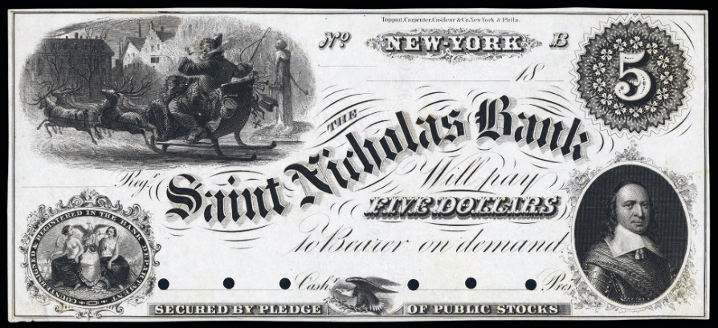
Bank notes
THE SAINT NICHOLAS BANK WILL PAY FIVE DOLLARS (1/4TH OZ OF GOLD) TO THE BEARER ON DEMAND

Slide 11
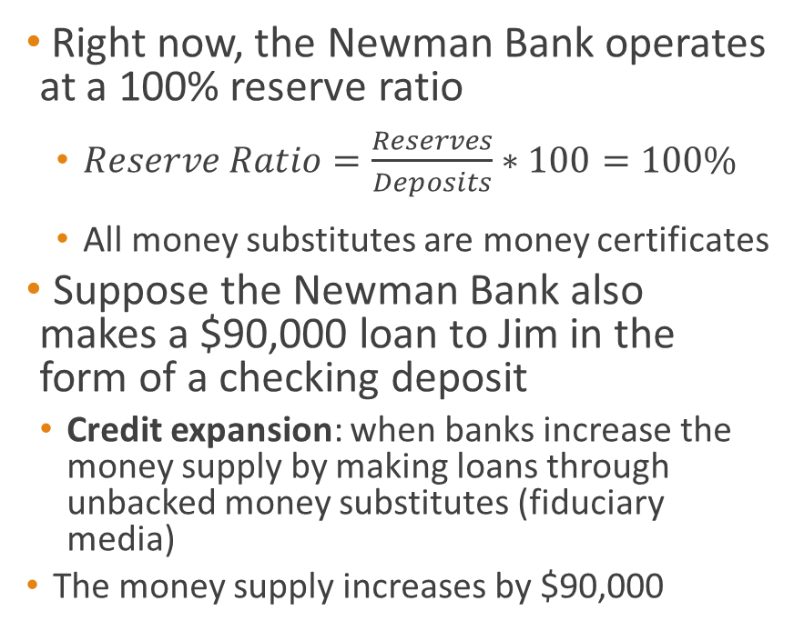
Deposit banking
Right now, the Newman Bank operates at a 100% reserve ratio
  $Reserve Ratio=\frac{Reserves}{Deposits}∗100=100\%$
  All money substitutes are money certificates
  Suppose the Newman Bank also makes a $90,000 loan to Jim in the form of a checking deposit
    Credit expansion: when banks increase the money supply by making loans through unbacked money substitutes (fiduciary media)
    The money supply increases by $90,000
Newman Bank
Assets | Equity + Liabilities
Gold Reserves $10,000 IOU from Jim $90,000 | Liabilities Deposit to Bob $10,000 Deposit to Jim $90,000
$100,000 | $100,000

Slide 12
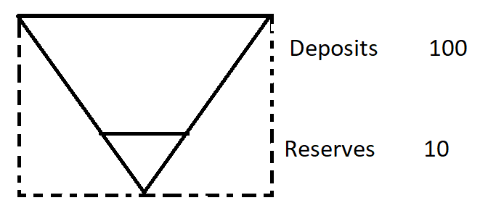
Fractional reserve banking
The Newman Bank is operating at a 10% fractional reserve ratio
The Newman Bank cannot meet all potential withdrawals, but estimates that it will never have to
  Liquid: enough reserves to meet all current withdrawals
  Illiquid: not enough reserves to meet all current withdrawals

Slide 13

Bank competition
Neoclassical economists: if deposit banks can engage in credit expansion and increase the money supply, they will do so endlessly. The free market fails to prevent “wildcat banks”!
Austrians: free banking and competition will limit credit expansion!
  The Adverse Clearing Mechanism: when an overexpansion of a bank’s deposits leads to an outflow of reserves

Slide 14
Bank competition
If the Newman Bank made the $90,000 loan to Jim, it would quickly go out of business
Why? Jim will spend his loan at ACE Hardware, which belongs to a different bank (The Bank of Salerno). And Joseph Salerno will present the check to Patrick Newman for redemption in gold
  The owners of each bank are friends, but they are not that good of friends

Slide 15
Free banking
  Vigorous competition prevents banks from engaging in excessive credit expansion. It will be limited by increases in the money proper (e.g., gold)
Wait! What if banks joined together and formed a cartel to coordinate credit expansion?
  It would fail because of internal and external pressure

Slide 16

Central banking
A (modern) central bank has five characteristics
  Monopoly on note issuance
  Banker’s bank
  Regulator (e.g., reserve requirements)
  Lender of last resort
  Conductor of monetary policy
Central banking strengthens bank cartels because it can increase the supply of bank reserves and can block out entry

Slide 17
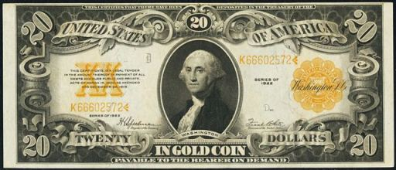
Federal reserve notes (1922)
$20 IN GOLD COIN (1 OZ.) PAYABLE TO THE BEARER ON DEMAND

Slide 18

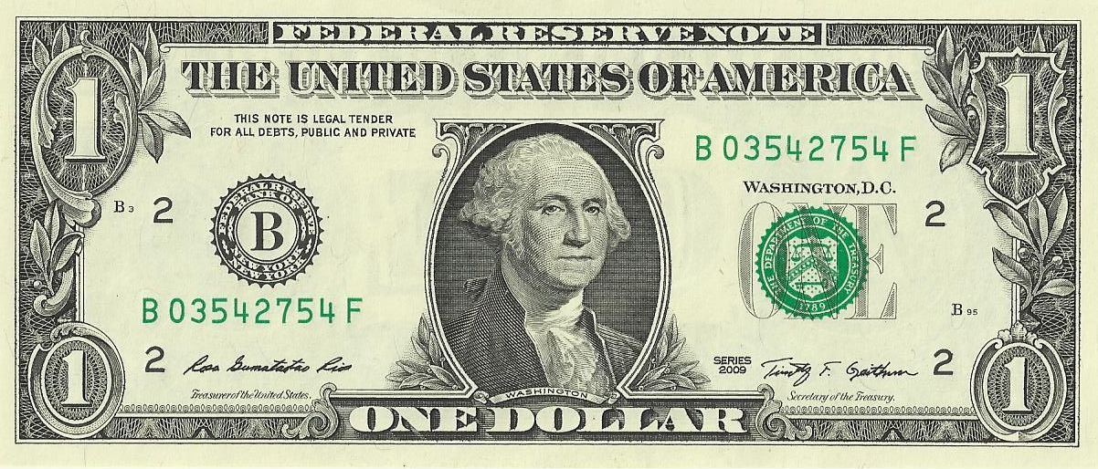
After we went off the gold standard

Slide 19
Central bank monetary policy
The modern central bank has four main tools it can use to conduct monetary policy
  Open market operations
  Discount window
  Reserve requirements
  Interest on excess reserves
  Lets look at open market operations, and the money multiplier: the process of how banks increase the money supply when they engage in credit expansion

Slide 20
Open market operations explained
The Fed writes a $1000 check to bond dealers Jones & Co. in New York City. It “prints money out of thin air”
The bond dealers deposit this check at the Newman Bank
The Newman Bank deposits it at the Federal Reserve (not shown)
Newman Bank
Assets | Equity + Liabilities
Reserves $1000 | Liabilities Deposit to Jones & Co. $1000
$1000 | $1000

Slide 21
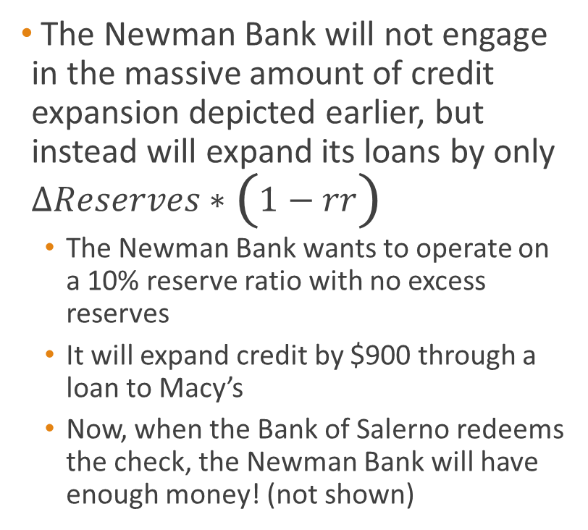
Open market operations explained
The Newman Bank will not engage in the massive amount of credit expansion depicted earlier, but instead will expand its loans by only $∆Reserves∗\left(1−rr\right)$
  The Newman Bank wants to operate on a 10% reserve ratio with no excess reserves
  It will expand credit by $900 through a loan to Macy’s
  Now, when the Bank of Salerno redeems the check, the Newman Bank will have enough money! (not shown)
Newman Bank
Assets | Equity + Liabilities
Reserves $1000 IOU from Macy’s $900 | Liabilities Deposit to Jones & Co. $1000 Deposit to Macy’s $900
$1900 | $1900

Slide 22
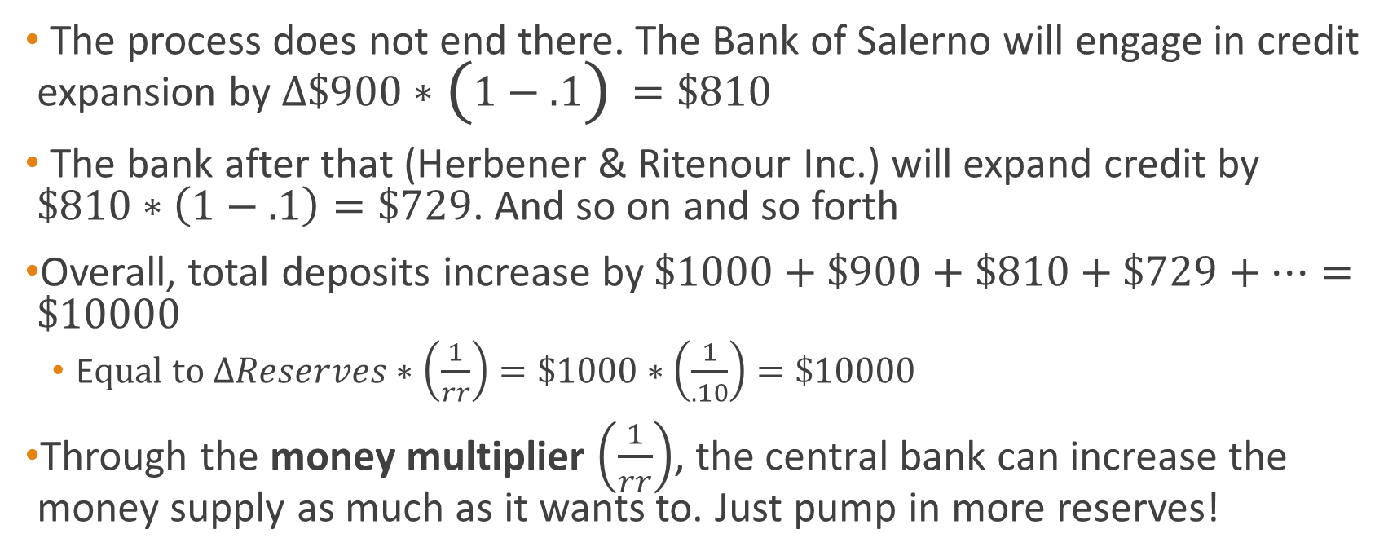
Open market operations explained
The process does not end there. The Bank of Salerno will engage in credit expansion by $∆\$900∗\left(1−.1\right)=\$810$
The bank after that (Herbener & Ritenour Inc.) will expand credit by $\$810∗\left(1−.1\right)=\$729$. And so on and so forth
Overall, total deposits increase by $\$1000+\$900+\$810+\$729+…=\$10000$
  E$qual to ∆Reserves∗\left(\frac{1}{rr}\right)=\$1000∗\left(\frac{1}{.10}\right)=\$10000$
Through the money multiplier $\left(\frac{1}{rr}\right)$, the central bank can increase the money supply as much as it wants to. Just pump in more reserves!

Slide 23
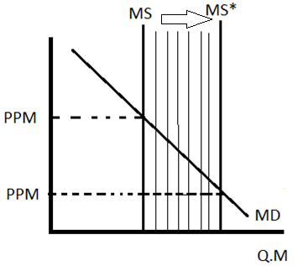
The monetary transmission mechanism
With each new loan from credit expansion, the money supply increases. It is injected into the economy at a specific point, raising prices and changing production unevenly

Slide 24
Topics for further analysis
How do changes in savings and changes in credit expansion affect market interest rates?
  What is an interest rate?
  How do increases in savings (from loan banking) and increases in credit expansion affect the structure of production?
    What is a structure of production?
    To learn the Austrians’ answers to these questions, you will have to stick around and listen to
      My talk on Austrian Capital Theory
      Dr. Herbener’s talk on The Theory of Interest
      Dr. Jonathan Newman’s talk on The Austrian Theory of the Business Cycle

Slide 25
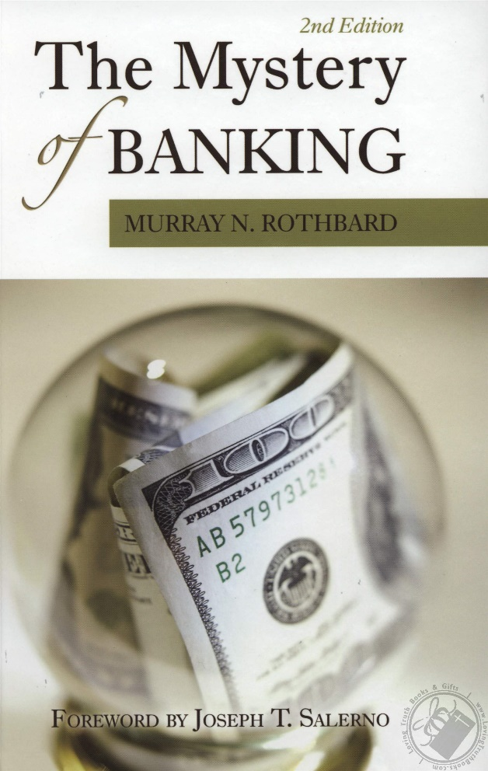
Thanks for listening!
For more, read Murray Rothbard’s The Mystery of Banking (2008 [1983])
See everyone in fifteen minutes!

