Slide 1

Robert P. Murphy
Mises University 2021

Slide 2
OUTLINE
A) US Commodity Money History
B) Do Textbooks Get Bank Credit-Creation Backwards?
C) Fed's Balance Sheet
D) Redefinition of M1
E) Abolition of Reserve Requirements

Slide 3
US Commodity Money History
➔ Constitution through Civil War, USG only issued gold and silver coins for USD (banks issued paper notes).
➔ Coinage Act of 1792 defined USD as either 371.25 grains of silver or 24.75 grains of gold (15:1).
➔ Gresham's Law
➔ William Jennings Bryan: "free coinage of silver"

Slide 4
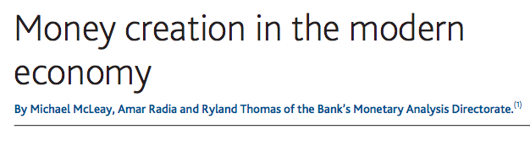
Do Textbooks Get It Backwards?

Slide 5
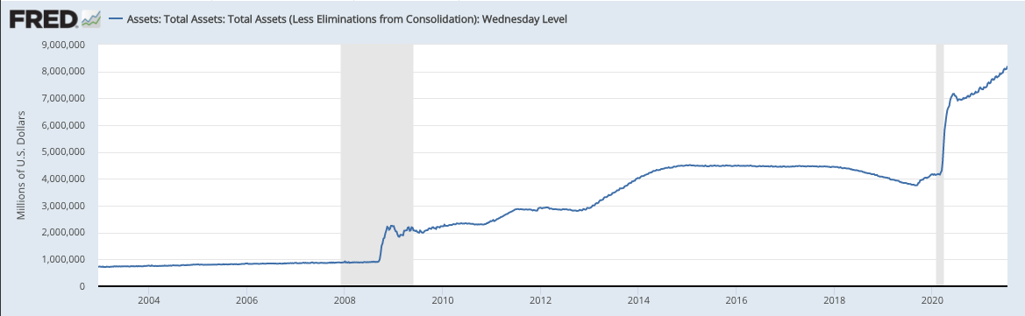
Fed's Balance Sheet

Slide 6
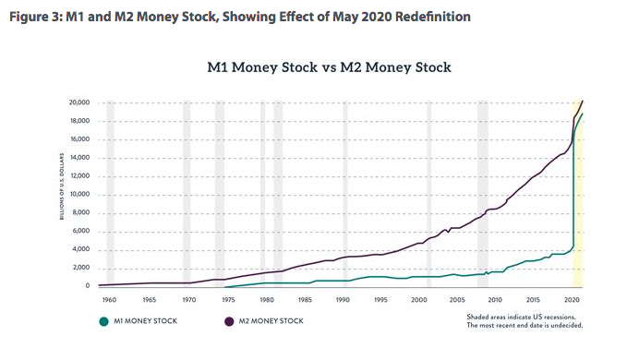
Redefinition of M1

Slide 7
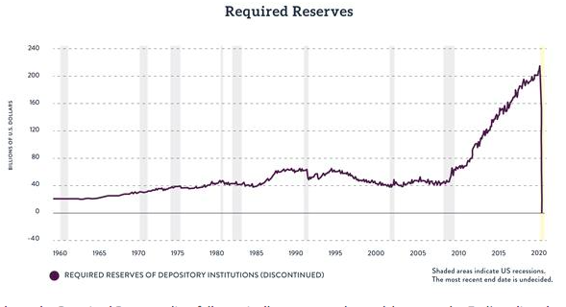
Abolition of Reserve Requirements

Slide 8
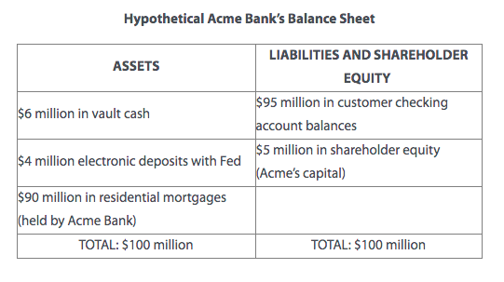
Capital vs. Reserve Requirements
➔ For 10%, need $9.5m in reserves ($500k in excess).
➔ But capital : assets only 5% (less than Basel's 8%).

