Slide 1
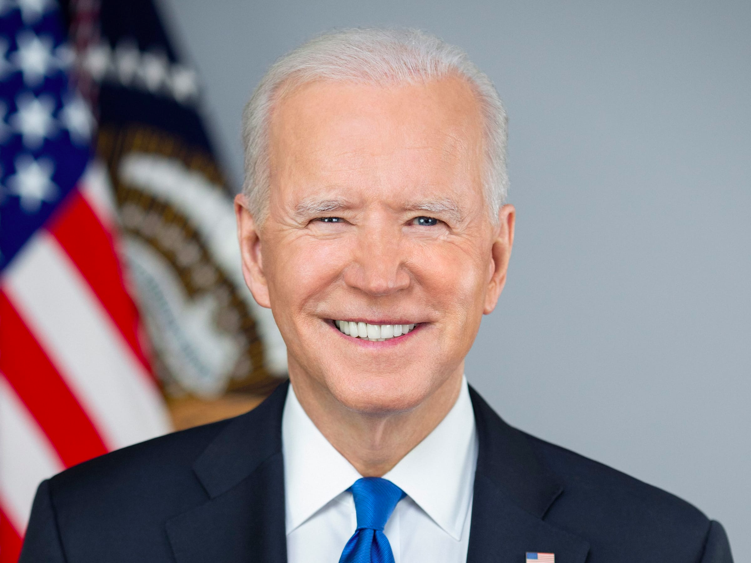
Bidenomics
Robert P. Murphy
Mises University 2021

Slide 2
OUTLINE
A) Climate Change
B) Unemployment Insurance Extension
C) Stimulus / Infrastructure
D) Executive Order on Competition

Slide 3
Biden Admin's Climate Agenda
➔ Re-enter Paris Agreement
➔ Hosted "Leaders Summit on Climate " in April
➔ Canceled Keystone XL Pipeline

Slide 4
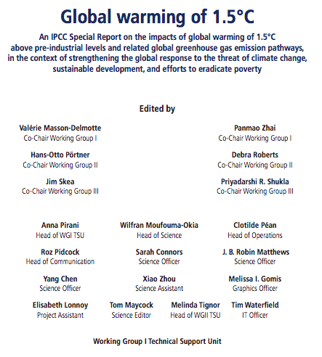
DIGRESSION:
PROBLEMS WITH

Slide 5
Unemployment Insurance
➔ Typically handled at state level, replacing portion of worker's wage.
➔ CARES Act gave $600/wk federal supplement, March 2020, originally through July 2020.
➔ $300/wk authorized in Dec 2020, Biden extended through Sept. 2021.

Slide 6
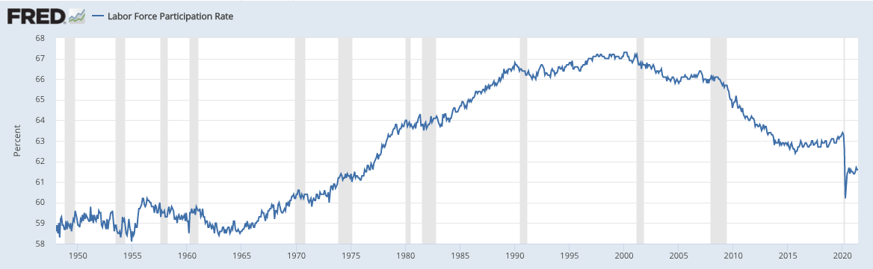

Slide 7
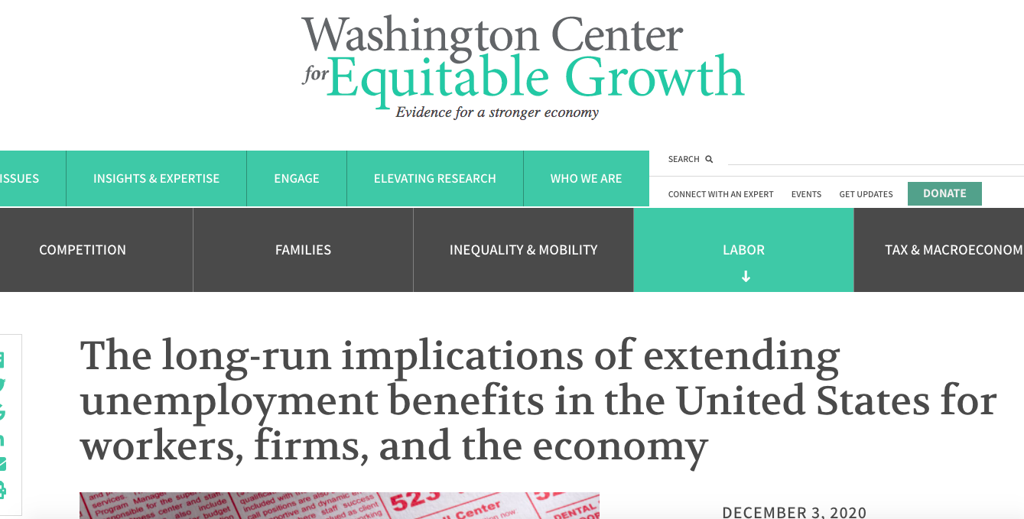

Slide 8
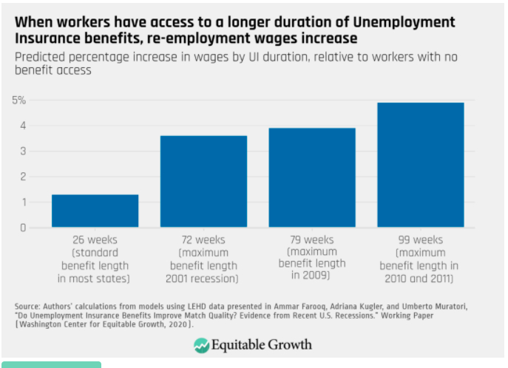

Slide 9
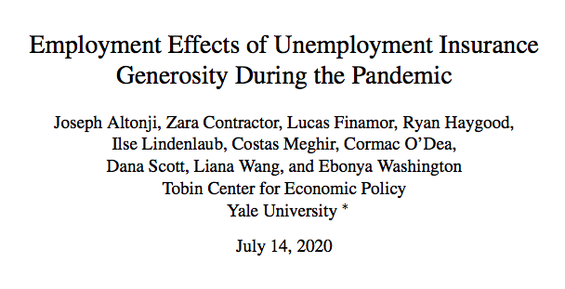

Slide 10
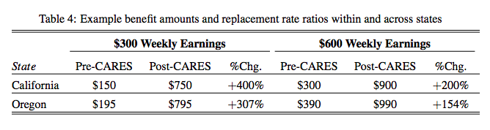

Slide 11
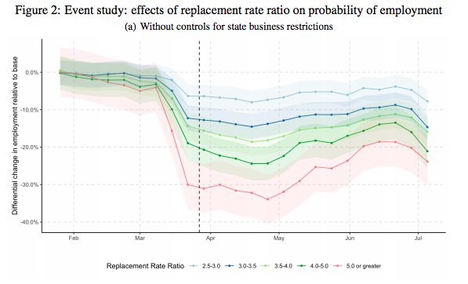

Slide 12
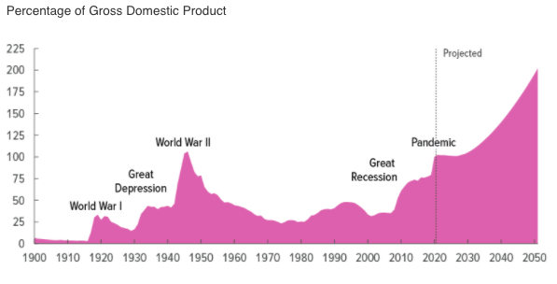
Stimulus / Infrastructure

Slide 13
Executive Order on Competition
➔ Occupational Licensing Reform
➔ Patent "Abuse" (pharma)
➔ Non-Compete Clauses: Suppress Wages?

