Slide 1
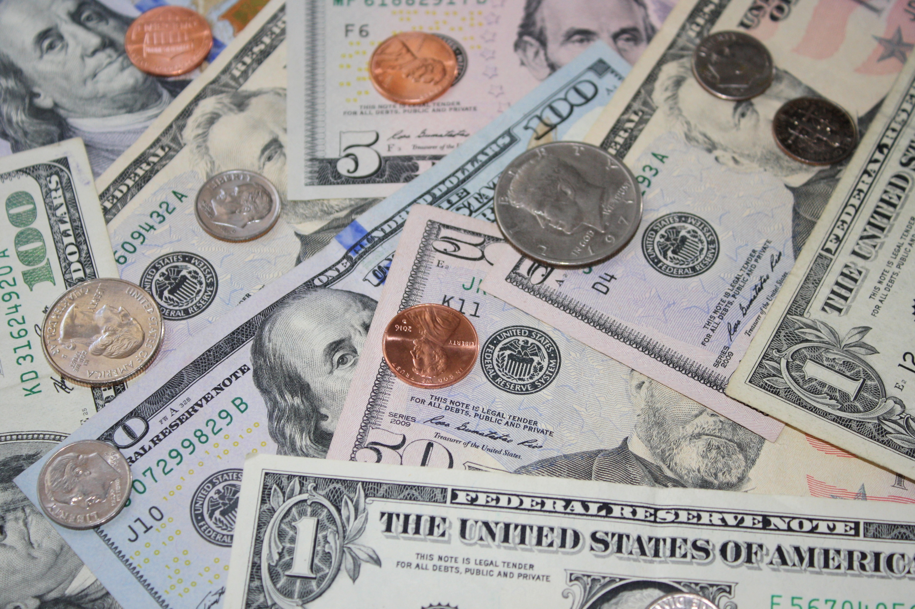
Money
Sandra Klein
Mises U 2022
sandy@mises.org

Slide 2
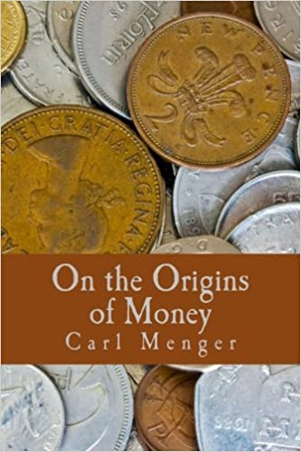
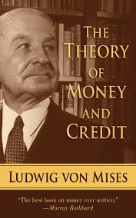
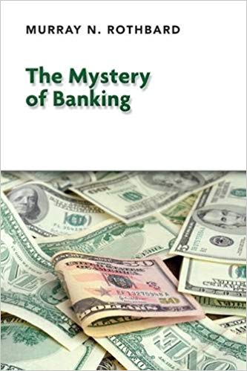

Slide 3
Setting the stage for money
Larger civilization beyond a few families
Specialization and exchange vs. self-sufficiency
Limitations of barter: indivisibilities and double coincidence of wants requirement

Slide 4



Slide 5
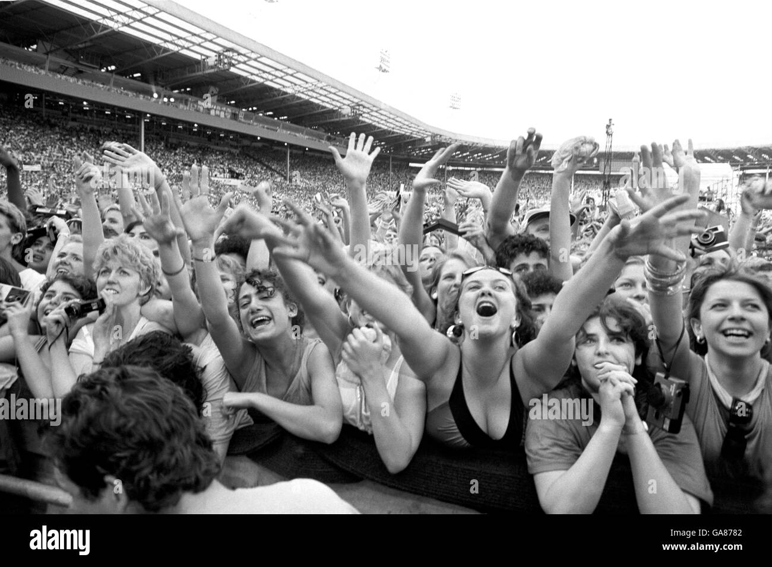

Slide 6
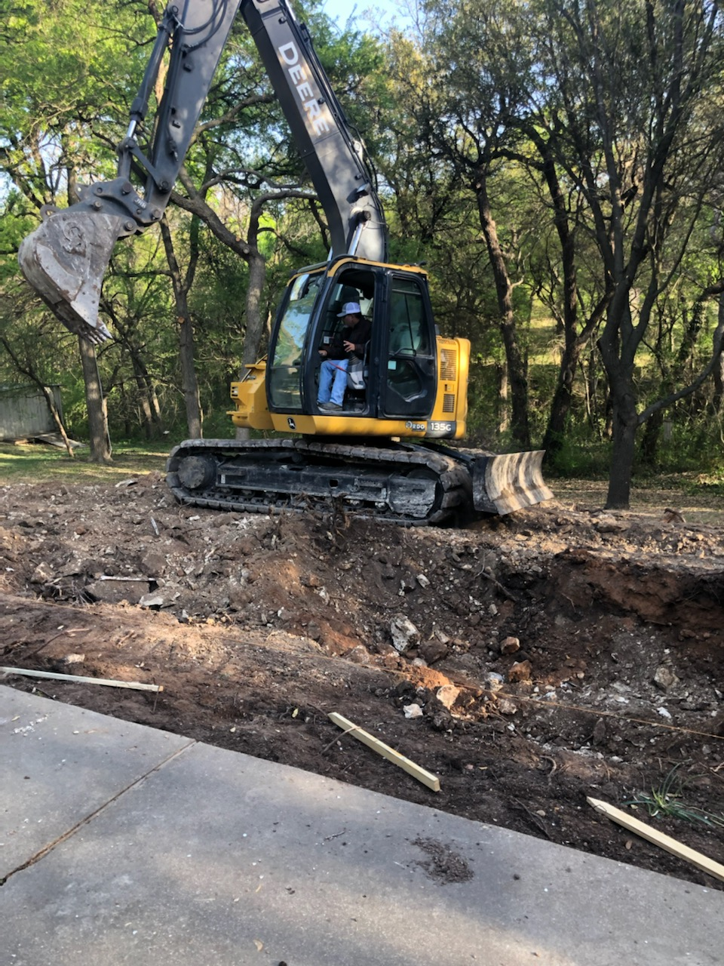

Slide 7


Slide 9

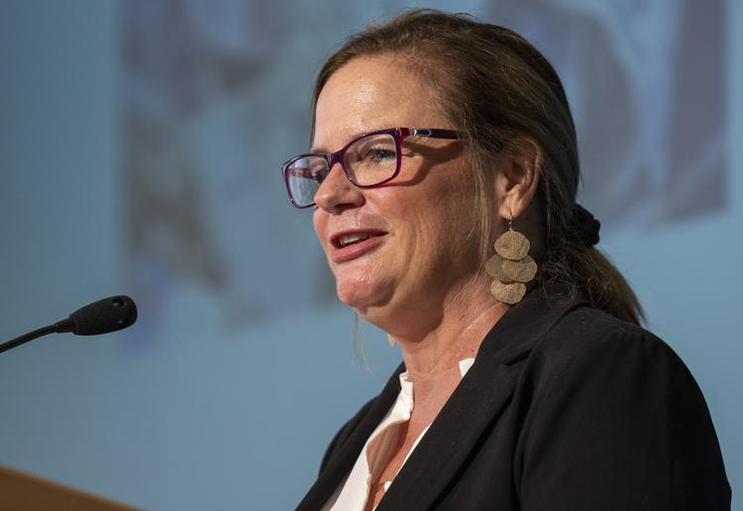

Slide 10
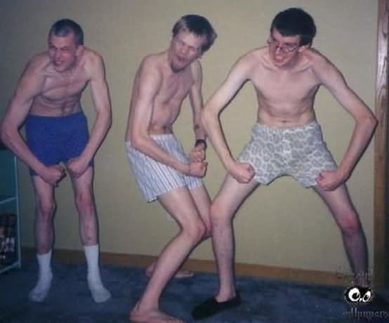
Left to right:
Salerno, Gordon, and Klein under double coincidence of wants requirement

Slide 11
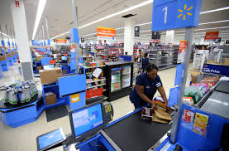
1,000 goods under barter: 499,500 prices
An average Wal-Mart store carries over
120,000 goods.
“[Money] becomes more necessary as division of labor increases and wants become more refined.” Mises, Theory of Money and Credit, p. 43

Slide 12
Emergence of indirect exchange
The more saleable a good, the more easily its owner can exchange it other goods at some “price.”
Goods have different degrees of saleability.
Trade for a good not desired, so long as it is more saleable than the good given up.
The demand for the more saleable good has a new component, not just for consumption but also for use in exchange.

Slide 13
A good medium of exchange should be
Divisible
Durable
Transportable
Scarce
Fungible

Slide 14
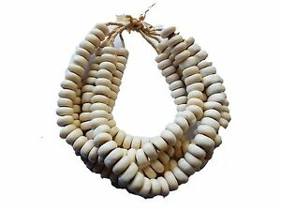
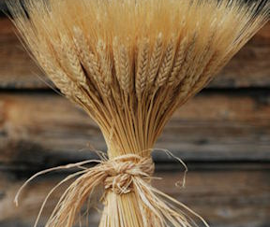
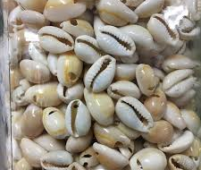
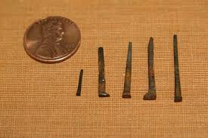
Early media of exchange

Slide 15
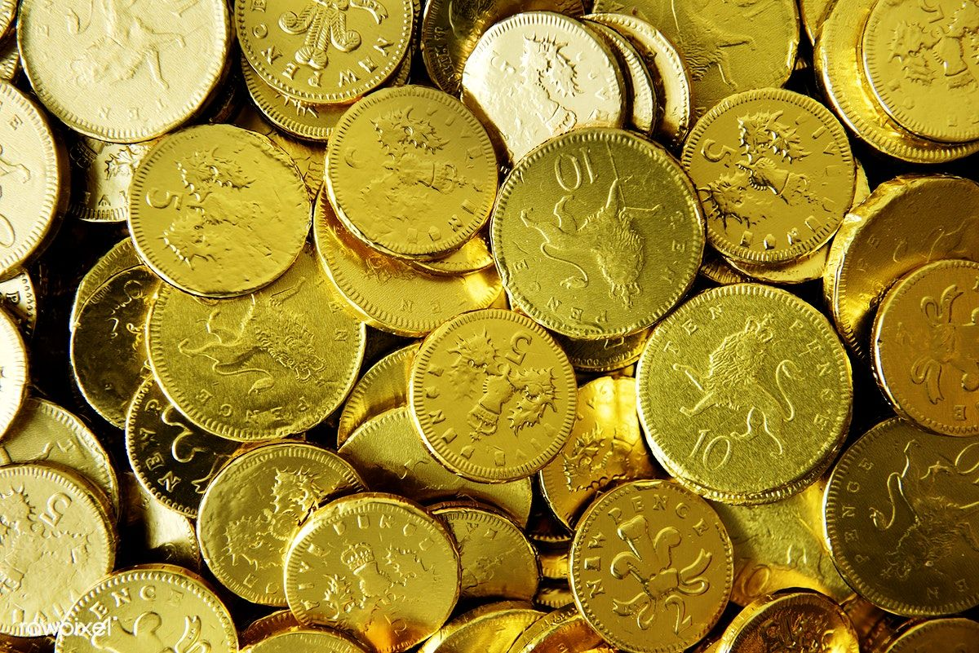
The market’s chosen medium of exchange

Slide 16
Hence it is also clear that nothing may have been so favorable to the genesis of a medium of exchange as the acceptance, on the part of the most discerning and capable economic subjects, for their own economic gain, and over a considerable period of time, of eminently saleable goods in preference to all others.
Menger, On the Origins of Money, p. 37

Slide 18
Benefits of money
All goods priced in money (1,000 goods, 1,000 prices)
Elaborate structure of production
Rational economic calculation
Easy comparison of value
Gaming desktop computer costs 1 ounce of gold
new Ford Escape costs 20 ounces of gold
The Ford is worth 20 gaming computers

Slide 19
Commodity money
Sold by units of weight
Units of weight are convertible into each other
1 pound = 16 ounces
1 ounce = 28.35 grams
Names of currency were names for weights of a commodity:
American money was dollars
French money was francs
German money was marcs
“Price of gold was fixed at $20.”

Slide 20
Exchange rates made easy
The dollar was defined as 1/20 of a gold ounce.
The pound sterling was the name given for ¼ of a gold ounce.
1/4 ounce of gold = 5/20 ounce of gold
1£ = $5

Slide 22
Purchasing Power of Money (PPM)
The purchasing power (or “price”) of the dollar is the inverse or reciprocal of the overall price level.
$1 1/150 laptop
$1 1 pack of gum
$1 1/30,000 of a car

Slide 23
The value of money in exchange
Increase in supply of money ➔ its value in exchange falls ➔ prices rise
Decrease in supply of money ➔ its value in exchange rises ➔prices fall
Increase in demand for money ➔ its value in exchange rises ➔ prices fall
Decrease in demand for money ➔ its value in exchange falls ➔prices rise

Slide 24
The optimal supply of money
Any supply of money is just as good as any other through adjustments in the PPM.
The Angel Gabriel model shows an increase in money supply confers no social benefit.
Counterfeiters and early spenders benefit at the expense of late spenders.
Under a gold standard, the only way to increase M is through mining gold.

Slide 25
We would not expect money to be . . .
Paper
National
Under the control of any entity

