Slide 1
Entrepreneurship
Peter G. Klein
Mises University
2021
@petergklein
#MisesU

Slide 2


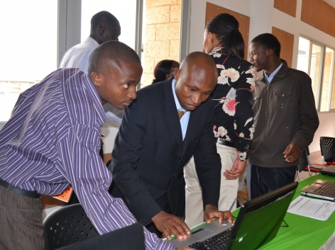


Slide 3
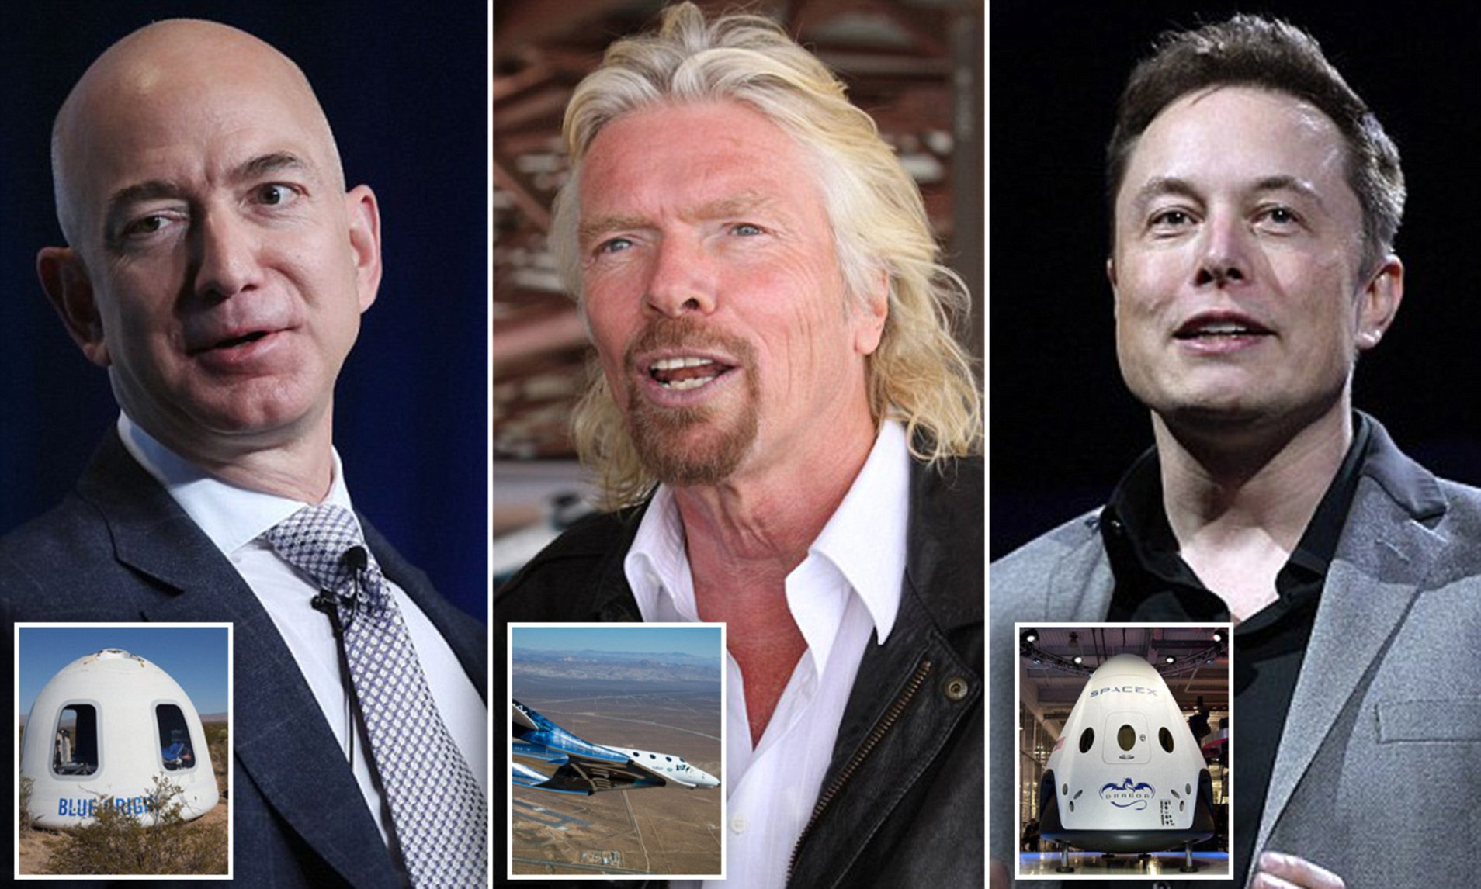

Slide 4
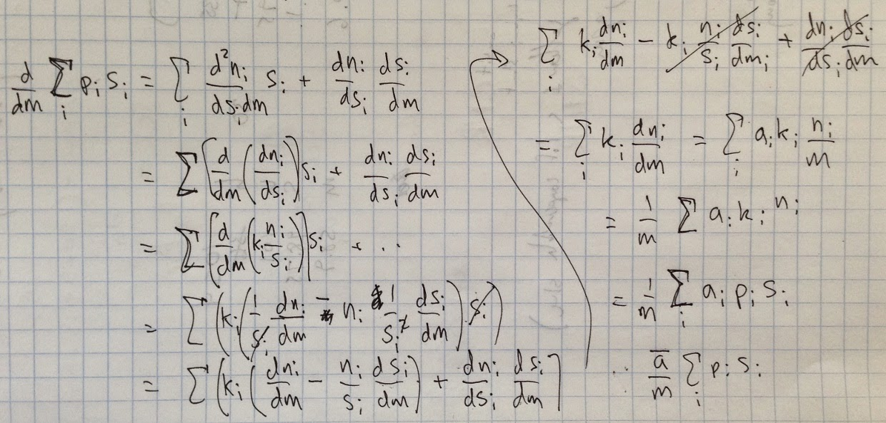

Slide 5
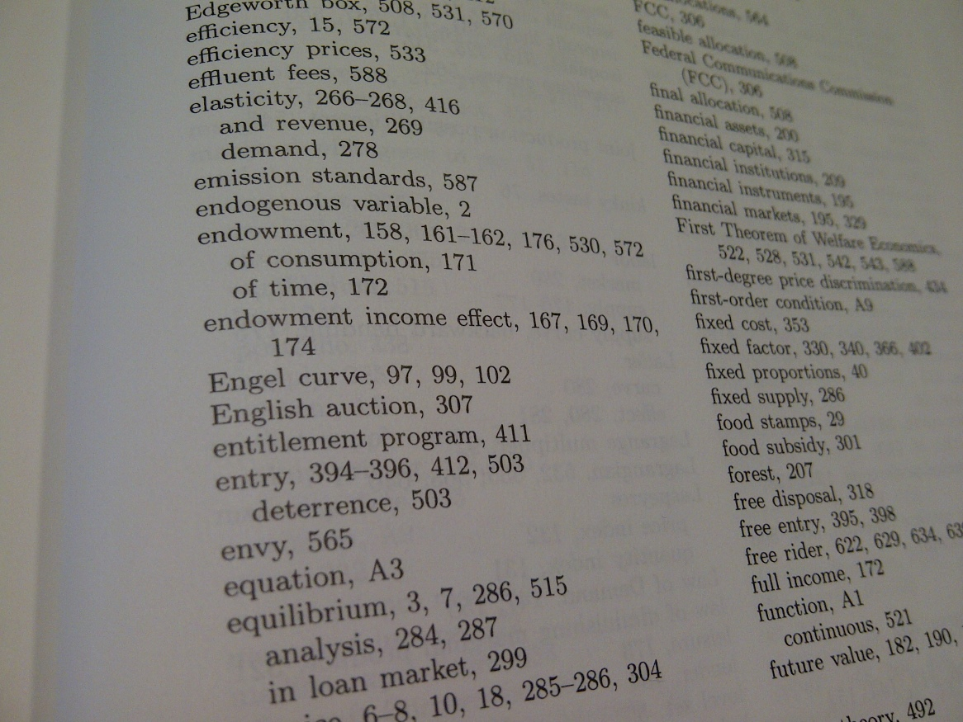

Slide 6
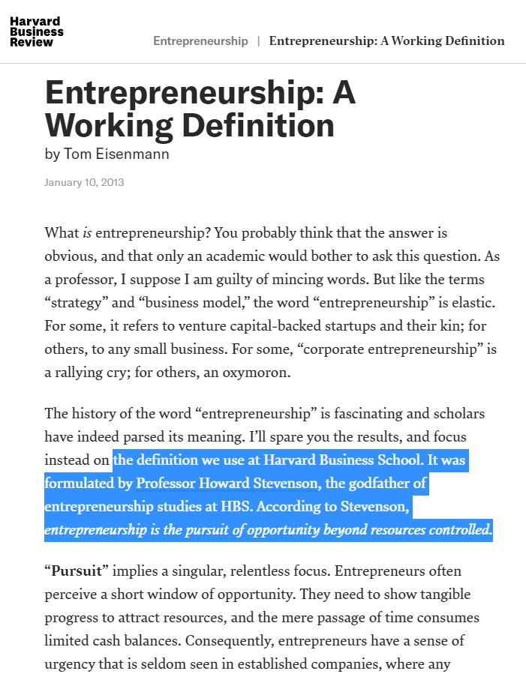
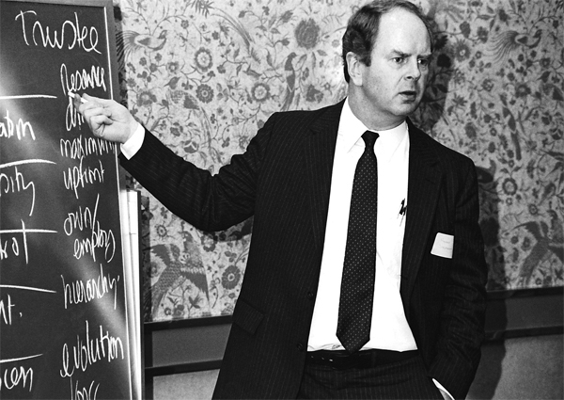

Slide 7
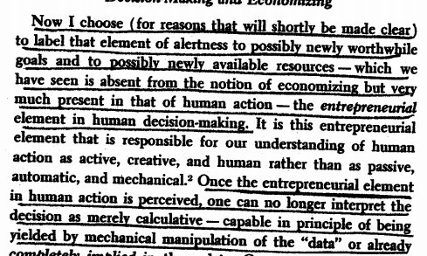

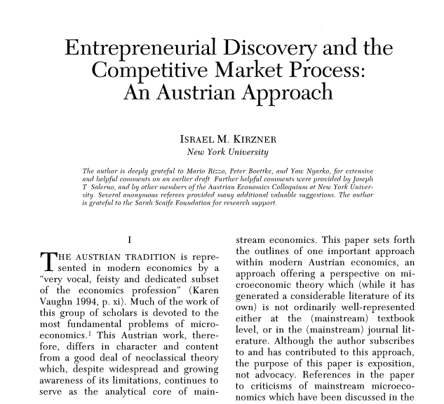

Slide 8
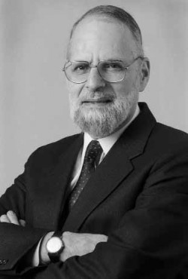
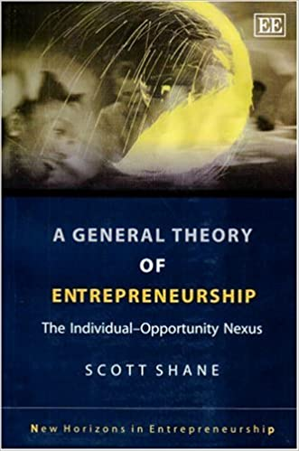
The opportunity-discovery approach
Entrepreneurship as alertness to profit opportunities
  Contrast with mechanistic notions of search and optimization
  Emphasis on serendipitous discovery, without antecedents
  Separation of entrepreneurship and resource ownership (pure entrepreneur owns no capital)
  Claim that discovery, not investment, drives the market process
In applied work, connections to passion, charisma, focus, boldness

Slide 9
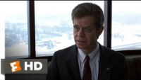

Slide 10
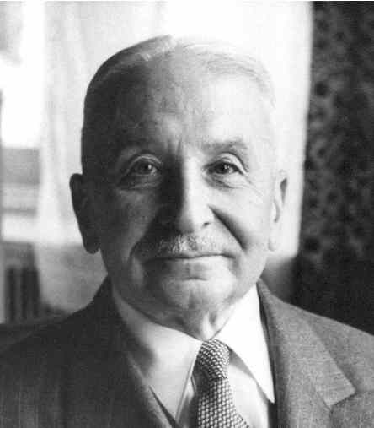
[I]t is impossible to eliminate the entrepreneur
from the picture of a market economy. The
various complementary factors of production
cannot come together spontaneously. They
need to be combined by the purposive efforts
of men aiming at certain ends and motivated
by the urge to improve their state of satisfaction. In eliminating the entrepreneur one eliminates the driving force of the whole market system. — Human Action, p. 248.
Entrepreneurship as a general feature of the market economy
Not just self-employment, startups, tech firms

Slide 11
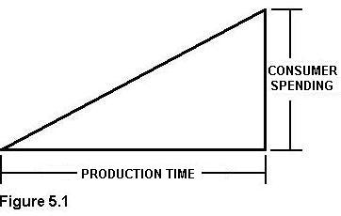
Austrian production theory
Inputs and outputs (means and ends)
  Original factors, intermediate goods, and final goods
  Typically, many possible factor combinations!
Time
Imputation
  Marginal product
  Marginal revenue product

Slide 12
Entrepreneurial profit and loss
In equilibrium (Mises’s and Rothbard’s evenly rotating economy)
  Each factor earns its discounted marginal revenue product.
  Owner-managers of firms earn implicit wages.
  Capitalists earn interest.
Outside the evenly rotating economy?
  Entrepreneurs compete for factors, based on their knowledge and beliefs about
    The present: technology, productive capabilities, resource availability
    The future: consumer demand, institutional conditions, competitor actions
  Results: profit and loss

Slide 13
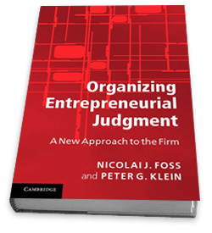
Conceptualizing entrepreneurship
Entrepreneurship in the broad sense: bearing uncertainty
  “The term entrepreneur as used by [economic] theory means: acting man exclusively seen from the aspect of the uncertainty inherent in every action” (Mises, 1949).
  Uncertainty (case probability) versus risk (class probability)
Entrepreneurship in the narrow (commercial) sense: combining and recombining productive factors in pursuit of money profit
  “We are living in a world of unexpected change; hence capital combinations . . . will be ever changing, will be dissolved
  and reformed. In this activity, we find the real
  function of the entrepreneur” (Lachmann, 1956).
  Requires resource ownership.
  Knight, Mises, Klein call this judgment.
The market selection process

Slide 14
Objective conditions
of reality
Past prices
Scientific and technical knowledge
Imagined future
Entrepreneur’s subjective attributes
Preferences
Beliefs about the future
Interpretation of the past and present data
learning
Actual future
Outcomes
(profit and
loss)
Action
selection

Slide 15

Mises’s entrepreneur-promoter
A special class of entrepreneur
  Economics “also calls entrepreneurs those who are especially eager to
  profit from adjusting production to the expected changes in conditions,
  those who have more initiative, more venturesomeness, and a quicker eye than the crowd, the pushing and promoting pioneers of economic improvement” (Mises, 1949, p. 255).
  Mises’s suggested term for these: promoter
Characteristics of the promoter
  Invests large amounts of financial or physical capital
  Is particularly alert to profit opportunities
  Exhibits creativity and leadership
  A more loosely defined, historically contingent
  concept than the pure, functional entrepreneur

Slide 16
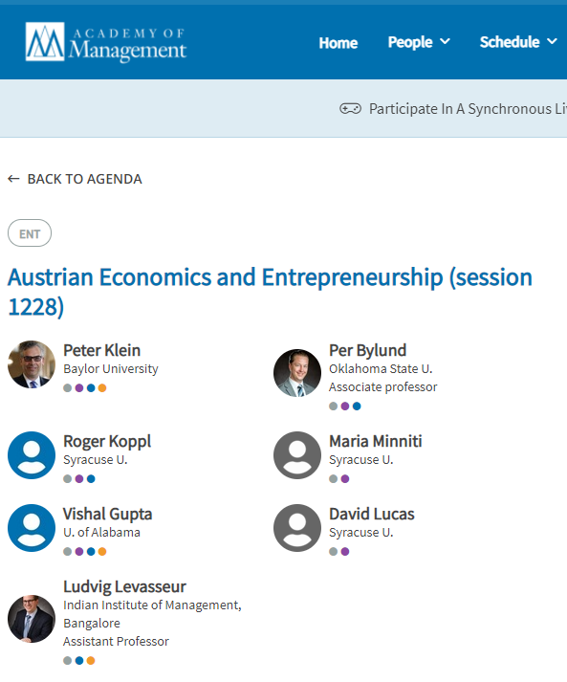

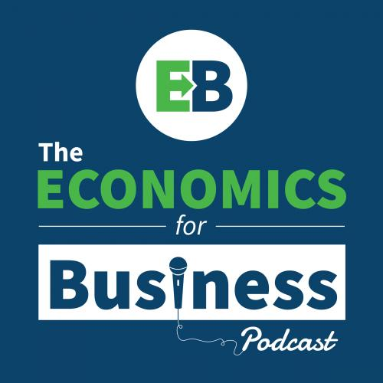
Austrian economics and contemporary entrepreneurship theory
Huge growth in entrepreneurship research and education.
Mainstream entrepreneurship research is very Austrian friendly.
Outstanding issues
  Conceptualizing entrepreneurship
  (self-employment, firm growth,
  innovation)
  Entrepreneurship and firm performance
  Entrepreneurship and economic growth
  Public policy toward entrepreneurship

