Slide 1
The Economics (and Politics) of Data Privacy
Peter G. Klein
Mises University
2020
@petergklein
#MisesU

Slide 2
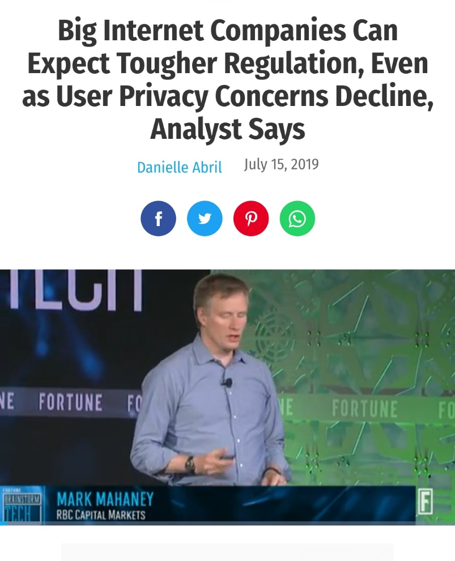
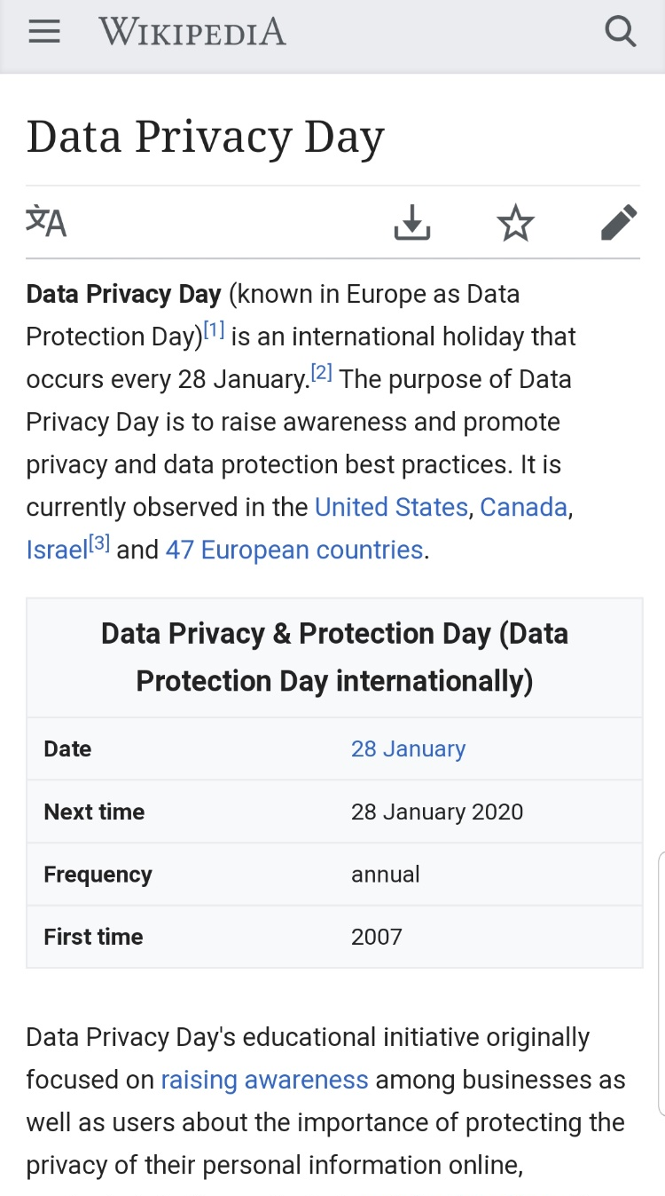
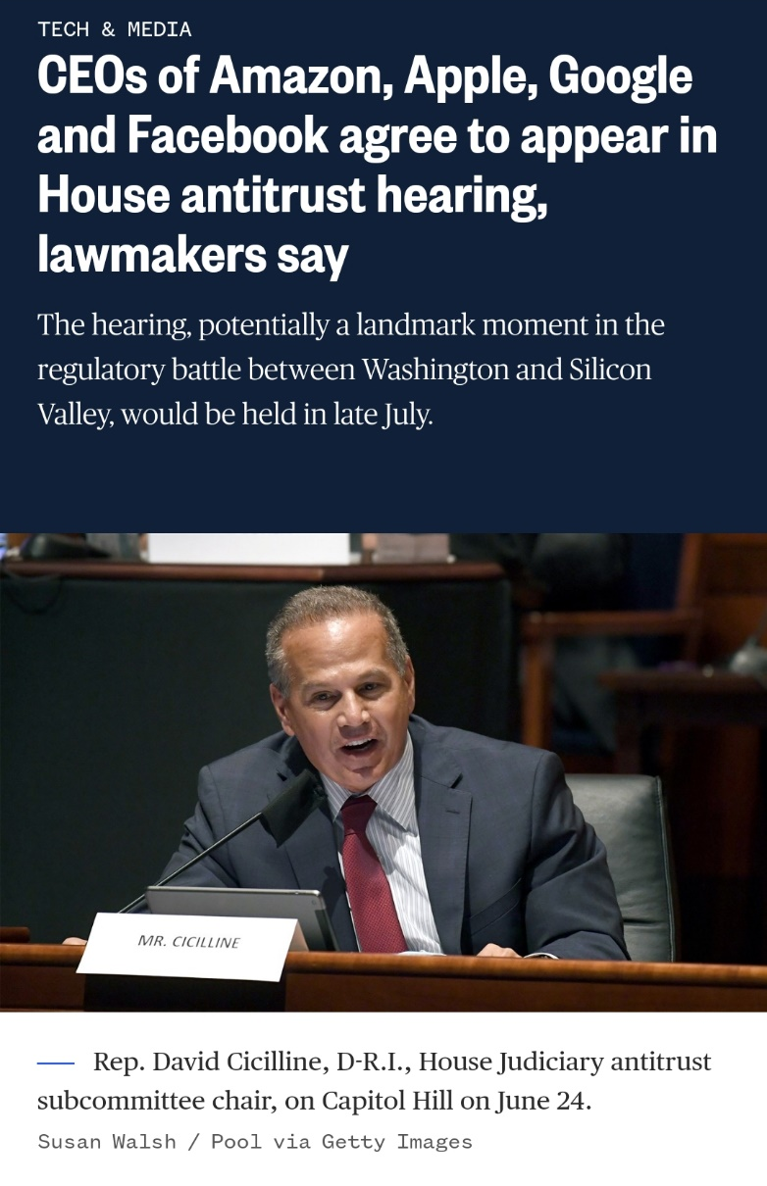

Slide 3
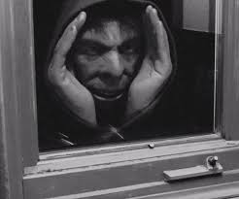



Slide 4



If a thing is to become a good, or in other words, if it is to acquire goods-character, all four of the following prerequisites must be simultaneously present:
A human need.
Such properties as render the thing capable of being brought into a causal connection with the satisfaction of this need.
Human knowledge of this causal connection.
If a thing is to become a good, or in other words, if it is to acquire goods-character, all four of the following prerequisites must be
simultaneously present:
A human need.
Such properties as render the thing capable of being brought into a causal connection with the satisfaction of this need.
Human knowledge of this causal connection.
Command of the thing sufficient to direct it to the satisfaction of the need.
Only when all four of these prerequisites are present simultaneously can a thing become a good.
Emphasis on discrete, marginal units that can be bought and sold in markets.

Slide 5
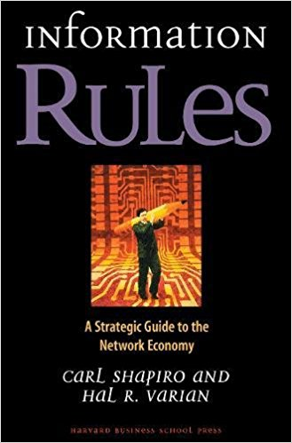


Is privacy an economic good?
Analogy with information goods
  Books, movies, communications infrastructure, consultants, training programs….
“Privacy” goods
  Sunglasses, disguises, locks, window shades, fences, land….
  Encryption, cookie blockers, BleachBit
Privacy goods and services can be analyzed just like other economic goods.
  Supply and demand, technological change, regulation, taxes and subsidies, etc.

Slide 6





The market for privacy
Entrepreneurs offer bundled services that come with varying degrees of privacy protection.
  Encrypted or regular emails, chats, voice and video calls
  Browsers that block cookies or not
  Social media sites, search engines, etc. that store information or not
Demonstrated preference suggests that consumers are not willing to pay much for privacy, on the margin!

Slide 7
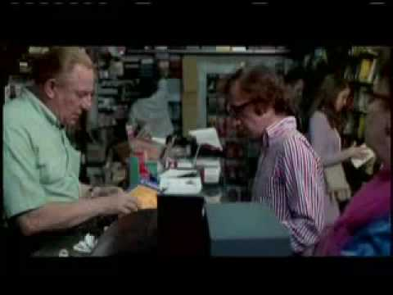
Empirical issues
De facto, lots of privacy today
Huge efficiency gains from matching
on buyer and seller characteristics
  Sharing platforms
  Dating sites
Cost savings from electronic storage
and sharing of private information
  Medical records
  Credit histories
Not much evidence for price discrimination based on consumers’ private information (Aquisti et al., “Economics of Privacy,” JEL, 2016)

Slide 8
Privacy regulation
Proposed rules
  Mandatory privacy protection (bans on third-party access)
  Mandatory data portability (you “own” your data)
  Stiffer (FTC) penalties for data breaches (Yahoo, Uber, Equifax, Marriot, Target, Sony PlayStation, Facebook, JPMorgan Chase)
    Legislative remedies or common law?
Benefits and costs
  Could make services more valuable — but market can figure this out.
  Increases cost of service provision, so providers must find other ways of monetizing the service.
    More frequent/intrusive advertising
    User fees
  Example of GDPR – annoying, and helps incumbents!

Slide 9
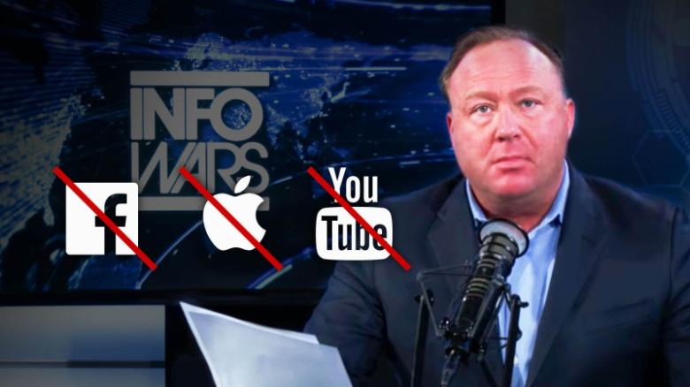
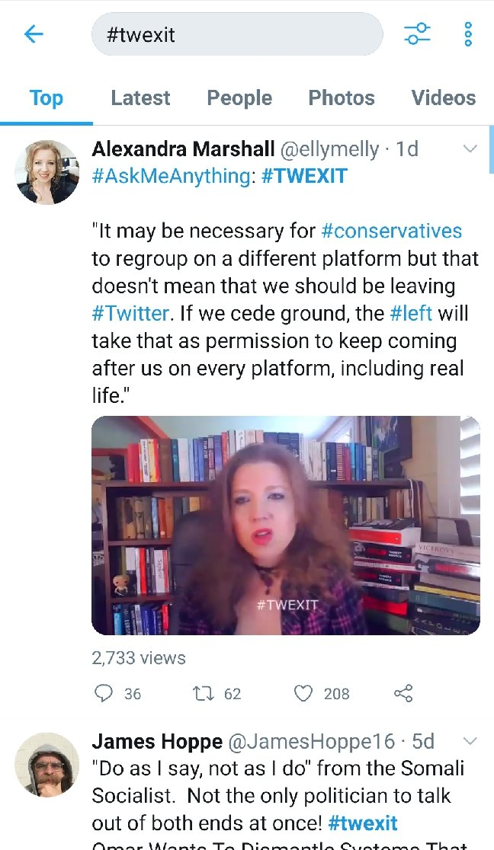
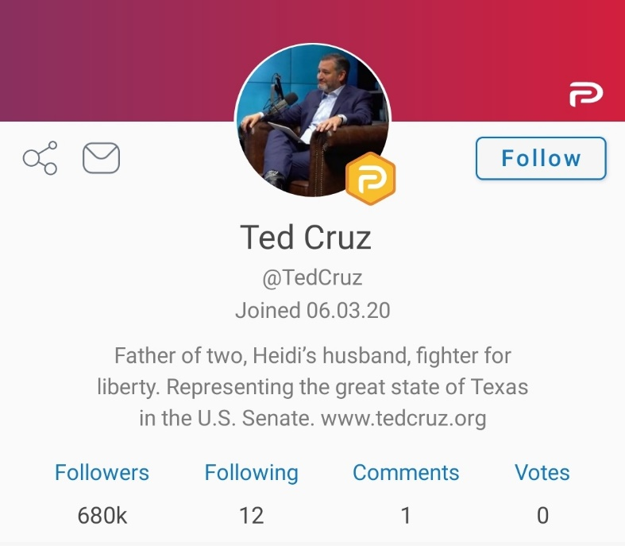
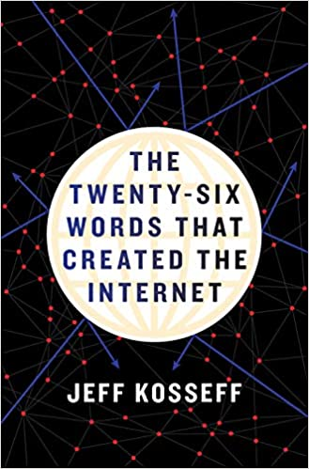

The problem of Section 230
Concerns about social media platforms and content neutrality
Communications Decency Act (1996)
CDA Section 230
  Common-law distinction between publishers and common carriers
  230: online
  platforms immune
  from liability, even
  if they monitor,
  curate, and edit

Slide 10
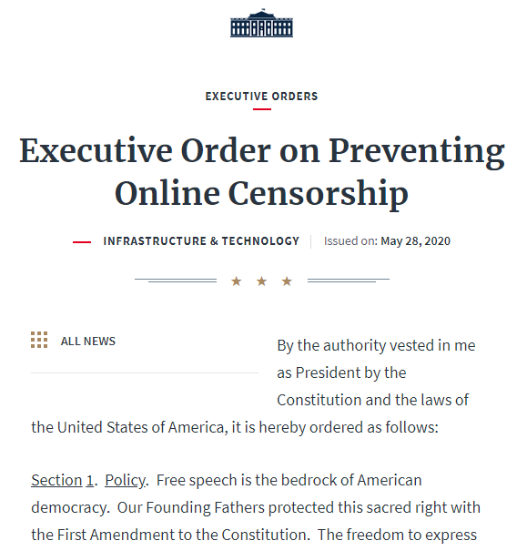
Section 230 reform?
Mainstream positions
  Social conservatives: revise sec. 230,
  treat social media platforms as
  regulated public utilities, required to
  maintain neutrality (cf. “net neutrality”)
  EFF/Techdirt/libertarian view: private
  firms can do what they like.
My position
  Sec. 230 not needed – common law better than legislation. Enforce contractual agreements/ToS between platforms and users.
  If that hurts platforms, so what?
  Avoid all attempts at viewpoint neutrality regulation.
  Remove government-created entry barriers for new entrants (no CDA, GDPR, etc.).

Slide 11

Legal and political concepts of privacy
Can information be owned?
  Libertarian literature on intellectual property
  You own your computer, you have legal rights to the data transmission or storage services you’ve contracted for.
  But you don’t “own” your data.
Privacy relates to other people’s knowledge about you.
  You can respect someone’s privacy or not.
  But you can’t steal someone’s privacy!

