Slide 1
Banking
Mises university 2020
Jonathan newman

Slide 2
Money - recap
Money – generally accepted medium of exchange.
Money originates in an unhampered market economy.
Mises showed that subjective utility and marginal utility theory apply to money.
Money allows for economic calculation and a massive expansion of the scope of the division of labor.

Slide 3
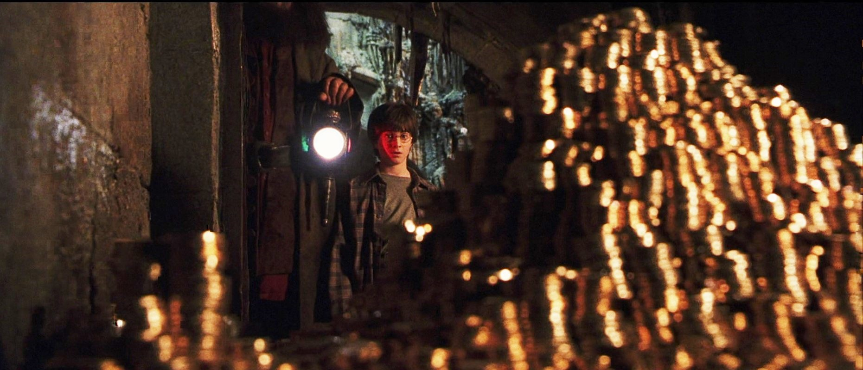

Banking – two functions

Slide 4
Deposit banking
Bank receives deposits and issues money certificates.
  Since money is homogeneous, customers may not care to receive the same coins.
  Customers expect redemption at par on demand.
  If any bearer can redeem and the notes are generally trusted, the money certificates may be used as money and become money substitutes.
  None of the operations of deposit banking result in a change in the stock of money or the supply of credit.
Assets |  | Liabilities
Reserve | $100 | Deposit | $100

Slide 5
Loan banking
Banks act as financial intermediaries between savers and borrowers.
This can be profitable by offering savers a lower rate than what borrowers pay.
  Banks specialize in investigating the potential borrowers/projects and in designing and administering the loan arrangements.
  Does not require leverage. Time structure of the funds from savers can match the loans extended to borrowers.
Assets |  | Liabilities
1 year loan | $100 | 1 year CD | $100
5 year loan | $500 | 5 year CD | $500

Slide 6
Fractional Reserve Banking
Banks can engage in “profitable hanky-panky” (Rothbard, The Case Against the Fed) by issuing fiduciary media and creating credit.
Instead of keeping 100% of deposits in reserve, banks create new loans with unbacked deposits.
Bank is now illiquid (mismatch of time structure of assets and liabilities).
Bank does not bear the opportunity cost of the created funds.
This activity is not regulated by profit/loss, but may be moderated by independent banks in competition.
Assets |  | Liabilities
Reserve | $100 | Deposits | $1000
Loan | $900

Slide 7

Money multiplier
Fractional reserve banking leads to an increase in the supply of money.
1st Bank of Auburn
Assets |  | Liabilities
Reserve | $100 | Deposits | $1000
Loan | $900
2nd Bank of Auburn
Assets |  | Liabilities
Reserve | $90 | Deposits | $900
Loan | $810
Step | 1 | 2 | 3 | … | ∞
MS | $1000 | $1900 | $2710 | … | $10,000
3rd Bank of Auburn
Assets |  | Liabilities
Reserve | $81 | Deposits | $810
Loan | $729
$$MM=\frac{1}{RR}=\frac{1}{0.1}=10$$

Slide 8
Summary and Criticism
Full reserves (100%)
Fractional reserves
Bank runs are not a problem.
Money production is subject to profit/loss.
Credit markets function normally.
Critics of this system say that we miss out on a lot of lending and investment because banks can’t extend credit beyond what depositors have put in the banking system.
Critics also say that a central bank would have virtually no ability to exercise control over the money supply.
Bank runs are a problem.
Money supply grows without profit/loss check.
Credit markets no longer reflect time preferences.
Critics say that bank runs are an inherent risk and they can lead to full-blown financial crises.
Critics also say that the increase in credit leads to malinvestment and overconsumption, i.e., a business cycle.

Slide 9
Development of central banking
One bank cannot issue too much fiduciary media because the holders of that bank’s notes (e.g., other banks) will seek to redeem them. This can easily bankrupt the overextended bank.
If all the banks issue the same amount of fiduciary media, even at high and increasing rates, no individual bank is at risk per se. Each bank’s overextension is matched by all the other banks’ overextension and they cancel each other out.
Banks may seek to cartelize or have a central coordinator so that they can evenly issue fiduciary media this way. Banks and their customers may want a “lender of last resort” to moderate banking crises, too.
The answer, then, is a central bank.

Slide 10
Federal Reserve
Conducts monetary policy.
Bank for the private banks.
Bank for the Federal Government.
The Fed conducts monetary policy on a day-to-day basis primarily through open market operations: buying and selling government bonds.
  The government always has a ready buyer of debt.
  The Fed collects interest and remits all in excess of operating needs back to Treasury.

Slide 11
Federal Reserve System’s Balance Sheet – July 1, 2020
Assets (billions of $) |  | Liabilities (billions of $)
Government bonds | $6,976 | Currency | $1,967
Gold | $11 | Treasury deposits | $1,658
Everything else | $76 | Bank deposits | $3,438
 | $7,063 |  | $7,063

Slide 12
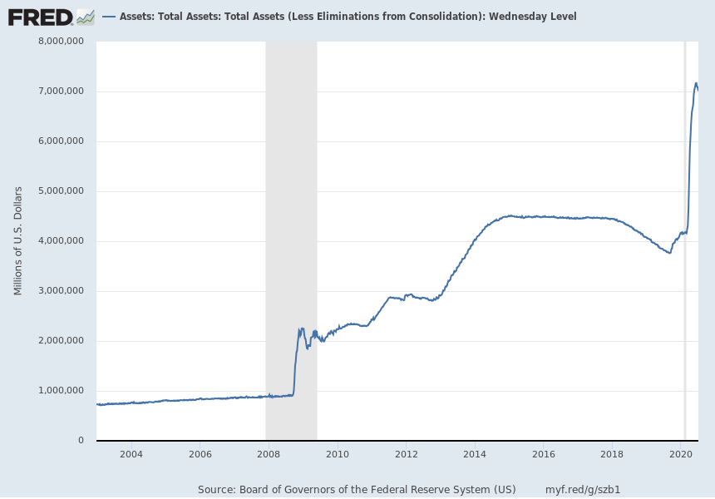
Federal Reserve: Total Assets

Slide 13
Federal Reserve System’s Balance Sheet – changes since July 3, 2019
Assets (billions of $) |  | Liabilities (billions of $)
Government bonds | + $3,194 | Currency | + $222
Gold | ± $0 | Treasury deposits | + $1,412
Everything else | ± $0 | Bank deposits | + $1,560
 | + $3,194 |  | + $3,194

Slide 14
Federal Reserve System’s Balance Sheet – changes since July 3, 2019
Assets (% change) |  | Liabilities (% change)
Government bonds | + 45% | Currency | + 11%
Gold | ± 0% | Treasury deposits | + 85%
Everything else | ± 0% | Bank deposits | + 45%
 | + 45% |  | + 45%

Slide 15
Central banking + Fractional Reserve Banking
Central bank buys government bonds with new money.
Private banks issue new loans to reestablish desired reserve ratio.
Federal Reserve
Assets |  | Liabilities
Government Bonds | $1,000 | Reserves | $1,000
FRB System
Assets |  | Liabilities
Reserves | $1,000 | Deposits | $10,000
Loans | $8,000
Government Bonds | $1,000

Slide 16
Central banking + Fractional Reserve Banking
Central bank buys government bonds with new money.
Private banks issue new loans to reestablish desired reserve ratio.
Federal Reserve
Assets |  | Liabilities
Government Bonds | $1,000 + $1,000 | Reserves | $1,000 + $1,000
FRB System
Assets |  | Liabilities
Reserves | $1,000 + $1,000 | Deposits | $10,000
Loans | $8,000
Government Bonds | $1,000 - $1,000

Slide 17
Central banking + Fractional Reserve Banking
Central bank buys government bonds with new money.
Private banks issue new loans to reestablish desired reserve ratio.
Federal Reserve
Assets |  | Liabilities
Government Bonds | $2,000 | Reserves | $2,000
FRB System
Assets |  | Liabilities
Reserves | $2,000 | Deposits | $10,000
Loans | $8,000
Government Bonds | $0

Slide 18
Central banking + Fractional Reserve Banking
Central bank buys government bonds with new money.
Private banks issue new loans to reestablish desired reserve ratio.
Federal Reserve
Assets |  | Liabilities
Government Bonds | $2,000 | Reserves | $2,000
FRB System
Assets |  | Liabilities
Reserves | $2,000 | Deposits | $10,000 + $10,000
Loans | $8,000
Government Bonds | $0

Slide 19
Central banking + Fractional Reserve Banking
Central bank buys government bonds with new money.
Private banks issue new loans to reestablish desired reserve ratio.
Federal Reserve
Assets |  | Liabilities
Government Bonds | $2,000 | Reserves | $2,000
FRB System
Assets |  | Liabilities
Reserves | $2,000 | Deposits | $20,000
Loans | $8,000
Government Bonds | $0

Slide 20
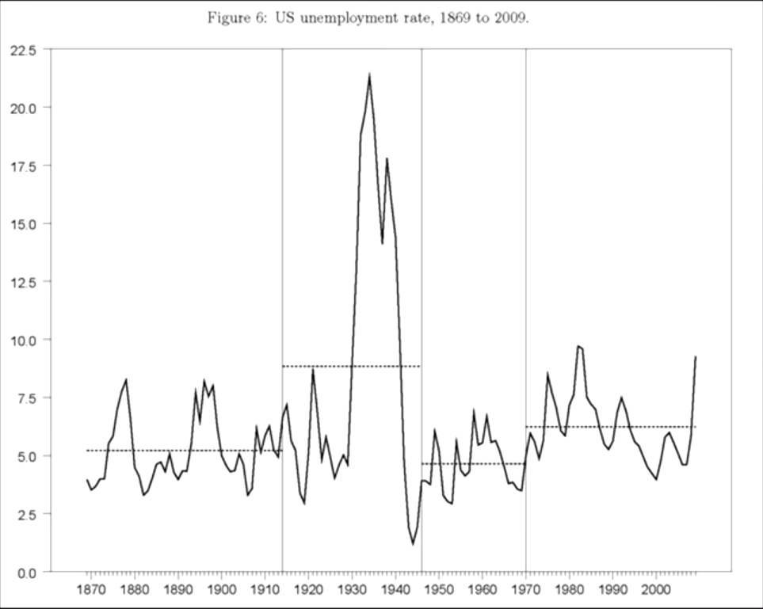
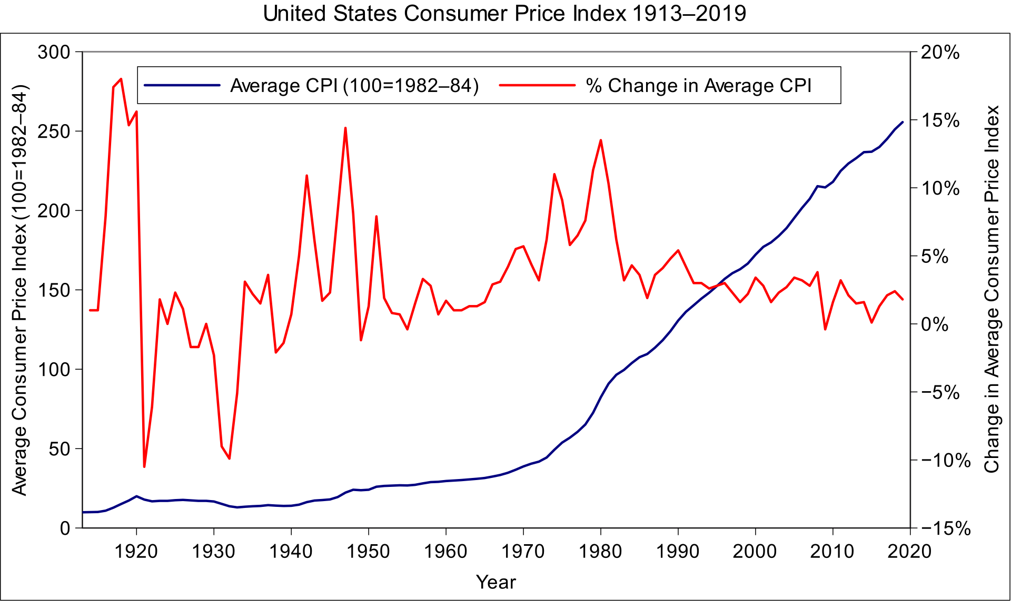
Results
US Dept of Labor
Selgin, “A Century of Failure” (2010)

Slide 21
Recommended reading
Beginner
  What Has Government Done to Our Money? – Rothbard
  The Case Against the Fed – Rothbard
  What You Should Know About Inflation – Hazlitt
Intermediate
  Understanding Money Mechanics – Murphy (forthcoming)
  The Mystery of Banking – Rothbard
  The Tragedy of the Euro - Bagus
Advanced
  The Theory of Money & Credit – Mises
  A History of Money and Banking in the US - Rothbard

