Slide 1
The Austrian Theory of the Business Cycle
Jonathan Newman
Mises University 2021

Slide 2
Mises’s analogy
“The whole entrepreneurial class is, as it were, in the position of a master-builder whose task it is to erect a building out of a limited supply of building materials. If this man overestimates the quantity of the available supply, he drafts a plan for the execution of which the means at his disposal are not sufficient. He oversizes the groundwork and the foundations and only discovers later in the progress of the construction that he lacks the material needed for the completion of the structure. It is obvious that our master-builder's fault was not overinvestment, but an inappropriate employment of the means at his disposal.”
Human Action, p. 557

Slide 3
What is a business cycle?
What it is not: Business fluctuations
  Changes happen all the time in the market economy (production, consumption, preferences, resources)
  Entrepreneurs have the task of dealing with and anticipating these changes by putting resources on the line to satisfy consumer demands.

Slide 4
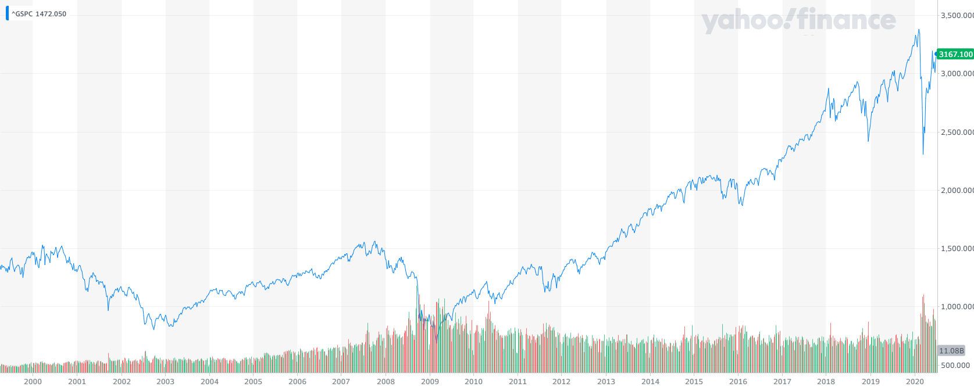
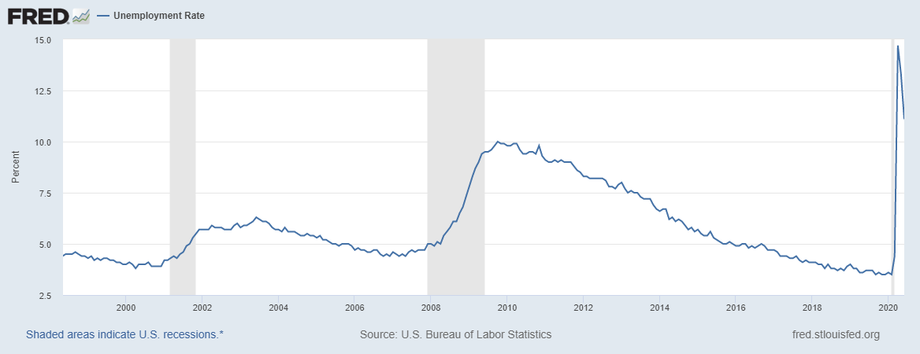
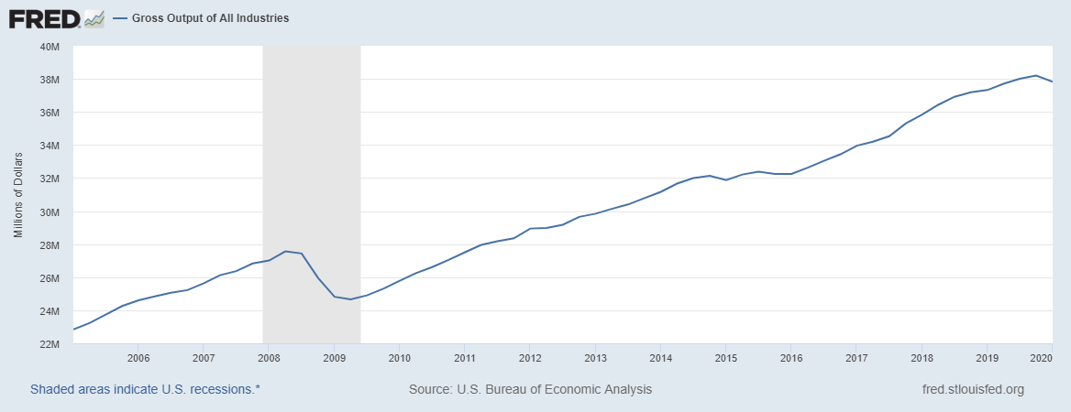
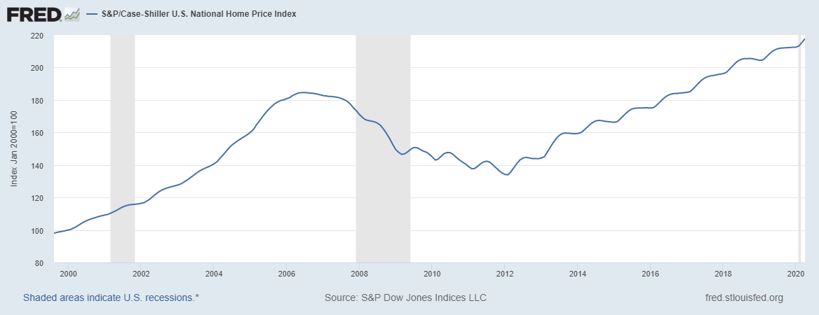
What is a business cycle?
General boom and general bust
We see patterns in economic data like this:

Slide 5
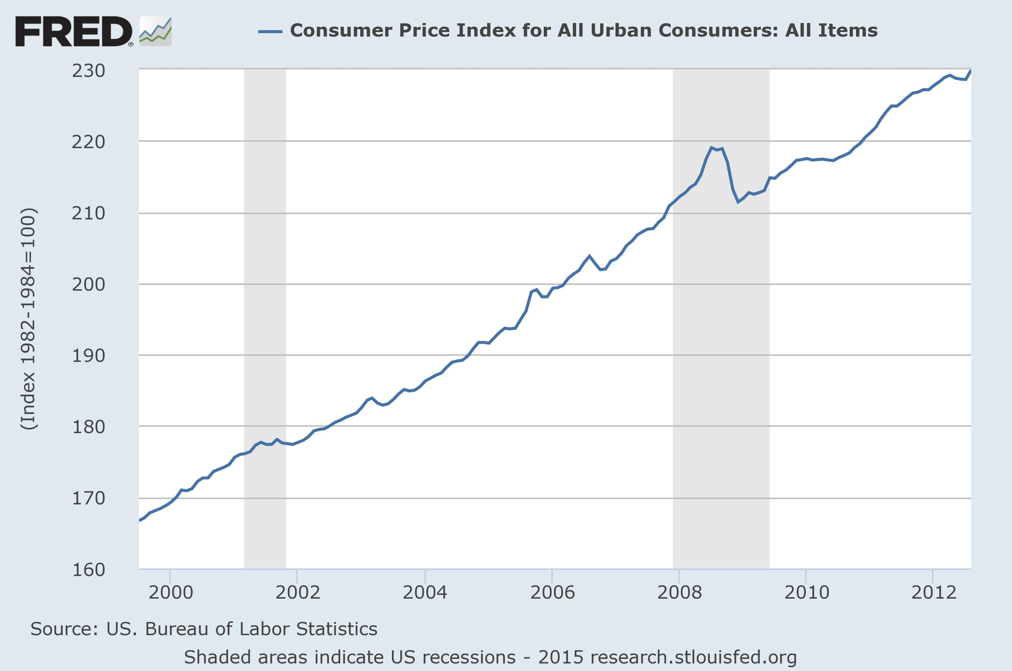
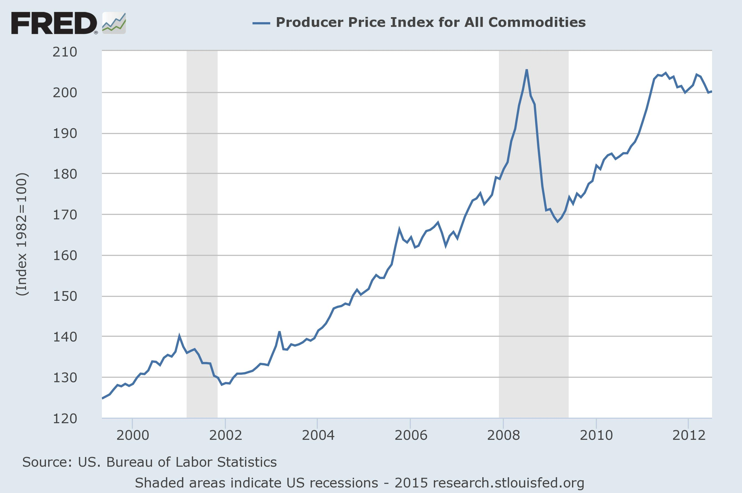
What is a business cycle?
General boom and general bust
Consumer prices vs. factor prices
  Rothbard, America’s Great Depression, p. 9: “capital-goods industries fluctuate more widely than do the consumer-goods industries”

Slide 6
What is a business cycle?
General boom and general bust
Theory must account for these phenomena:
  The “shape” or stages of the cycle: boom then bust
  The cluster of entrepreneurial errors
  The more dramatic fluctuations in capital-goods industries compared to consumer-goods industries
Suspects:
  Money
  Credit

Slide 7
Outline
Structure of production
Time preference and interest
Sustainable growth
Unsustainable growth
Overconsumption and malinvestment

Slide 8
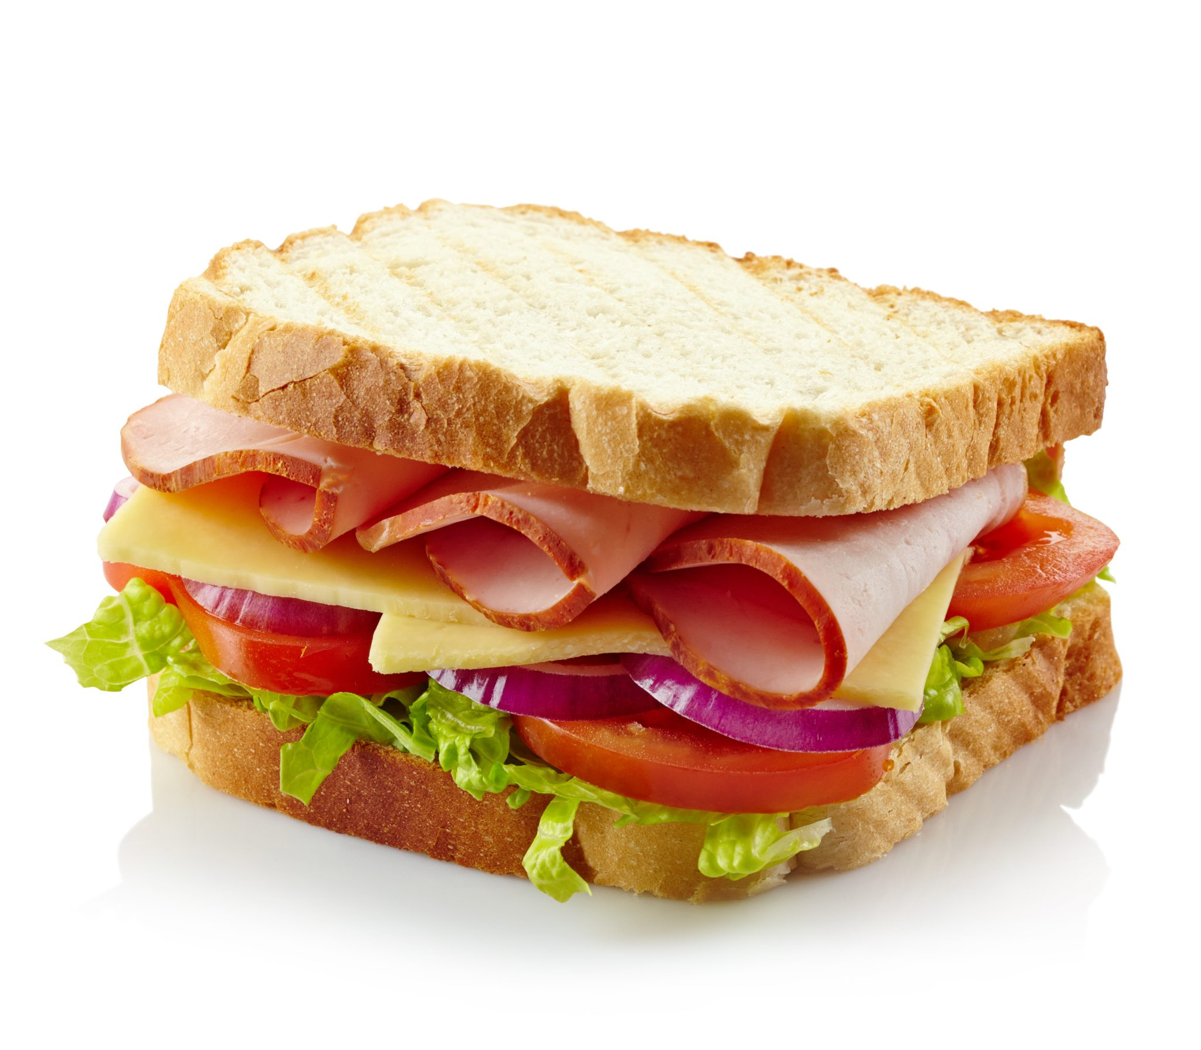

Slide 9
Labor
Land
Big metal machines
Labor
Metal mining
Land
Refrigerator
Knives
Oven
Land
Land
Labor
Oil refining
Fencing
Big metal machines
Labor
Land
Butcher
Bakery
Farming
Land
Flour
Labor
Metal refining
Labor
Plastic
Manufacturing
Ham
Bread
Lettuce
Metal manufacturing
Land
Labor
Labor
Ham Sandwich
Tomato
Big metal machines
Oil drilling
Labor
Labor
Land
Lumberyard
Land
Plate
Mayo
Coops
Land
Table/chairs
Chainsaws
Chicken Farm
Furniture Manufacturer
Paper Mill
Land
Land
Big metal machines
Labor
Labor
Tools
Land
Labor

Slide 10
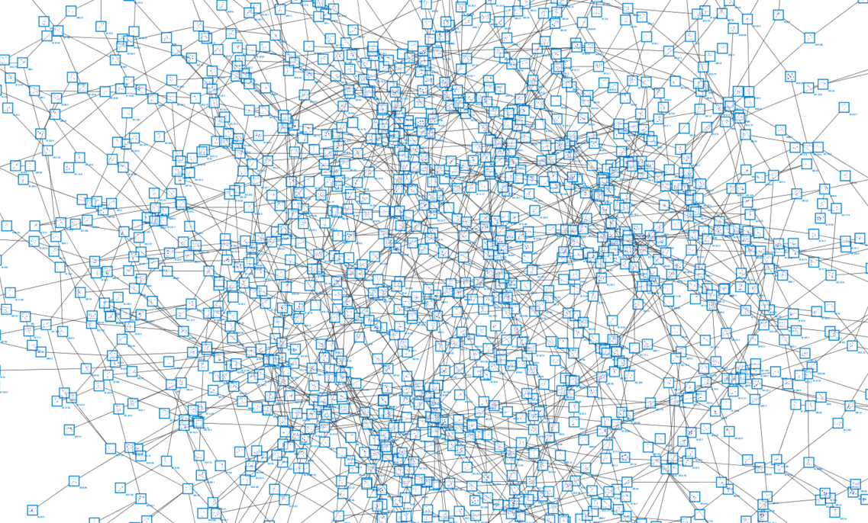

Slide 11
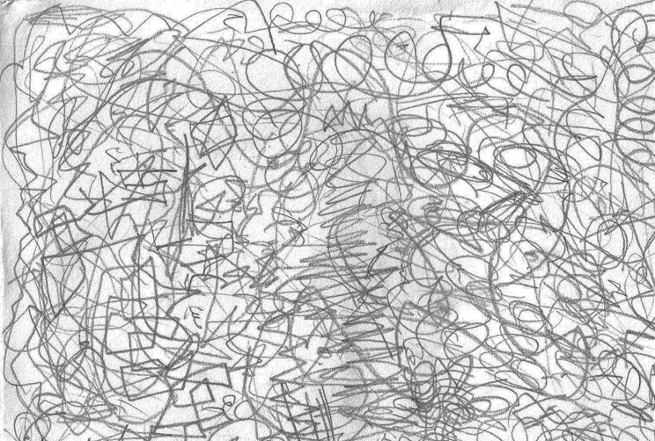

Slide 12
Labor
Land
Big metal machines
Labor
Metal mining
Land
Refrigerator
Knives
Oven
Land
Land
Labor
Oil refining
Fencing
Big metal machines
Labor
Land
Butcher
Bakery
Farming
Land
Flour
Labor
Metal refining
Labor
Plastic
Manufacturing
Ham
Bread
Lettuce
Metal manufacturing
Land
Labor
Labor
Ham Sandwich
Tomato
Big metal machines
Oil drilling
Labor
Labor
Land
Lumberyard
Land
Plate
Mayo
Coops
Land
Table/chairs
Chainsaws
Chicken Farm
Furniture Manufacturer
Paper Mill
Land
Land
Big metal machines
Labor
Labor
Tools
Land
Labor

Slide 13
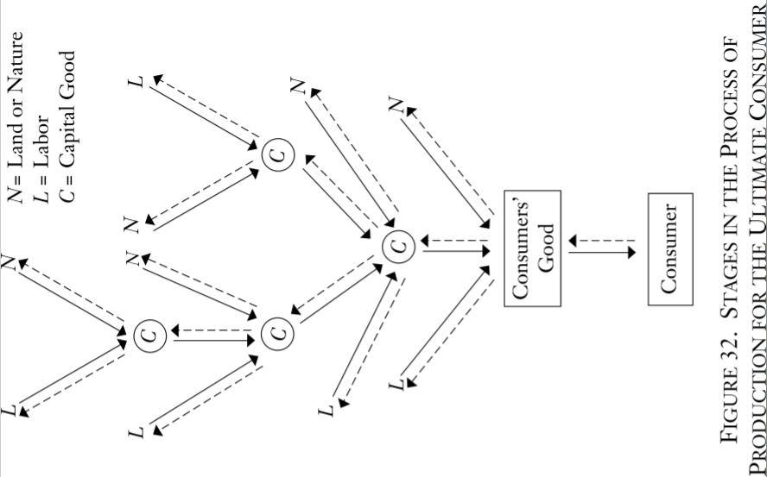

Slide 14
Structure of Production
 |  |  |  |  | $
 |  |  |  | $ | $
 |  |  | $ | $ | $
 |  | $ | $ | $ | $
 | $ | $ | $ | $ | $
$ | $ | $ | $ | $ | $
In the ERE, the only remaining price spread between stages is interest.

Slide 15
Time preference
We all prefer a given satisfaction sooner rather than later.
Variety of rates of time preference, so there is an opportunity to trade.
interest
rate
David
$1200 F
$1000 P
$1100 F
:
$1000 F
S
Jeff
$1100 F
$1000 P
$1050 F
:
$1000 F
D
loans

Slide 16
Consumption
Investment
interest
rate
S
D
loans

Slide 17
Consumption
Investment
interest
rate
S
D
loans

Slide 18
Consumption
Investment
interest
rate
S
D
loans

Slide 19
Consumption
Replace/maintain
net
Replace/maintain
Investment
interest
rate
S
D
loans

Slide 20
Consumption
Investment
interest
rate
S
w
S
w
S
D
D
D
L
L
loans

Slide 21
Consumption
Tradeoff b/t consumption and investment
Hayekian Triangle
Investment
interest
rate
S
w
S
w
S
Loan market
D
D
D
L
L
loans
Stage-specific labor markets

Slide 22
Consumption
Investment
interest
rate
S
w
S
w
S
D
D
D
L
L
loans

Slide 23
Consumption
Investment
interest
rate
S
S’
w
S
w
S
D
D
D
L
L
loans

Slide 24
Consumption
Investment
interest
rate
S
S’
w
S
w
S
D
D
D
L
L
loans

Slide 25
Consumption
Investment
interest
rate
S
S’
w
S
w
S
D
D
D
L
L
loans

Slide 26
Consumption
Investment
interest
rate
S
S’
w
S
w
S
D
D’
D
D’
D
L
L
loans

Slide 27
Consumption
Investment
interest
rate
S
S’
w
S
w
S
D
D’
D
D’
D
L
L
loans

Slide 28
Increase in savings, summary
Saving involves freeing up resources for production.
In credit markets, saved funds are made available to entrepreneurs to purchase factors of production.
New, longer lines of production are started, which is in line with consumers’ time preferences.
The additional investment (in excess of what is required for maintaining/replacing existing capital stock) pays off with an expanded set of resources in the future, i.e., economic growth.

Slide 29
Artificial credit expansion
Consumption
Investment
interest
rate
S
w
S
w
S
D
D
D
L
L
loans

Slide 30
Artificial credit expansion
Consumption
Investment
interest
rate
S
w
w
S+∆M
S
S
D
D
D
L
L
loans
∆M

Slide 31
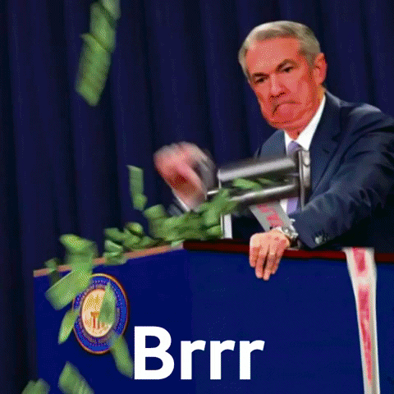
Artificial credit expansion
Consumption
Investment
interest
rate
S
w
w
S+∆M
S
S
D
D
D
L
L
loans
∆M

Slide 32
Artificial credit expansion
Consumption
Investment
interest
rate
S
w
w
S+∆M
S
S
D
D
D
L
L
loans
∆M

Slide 33
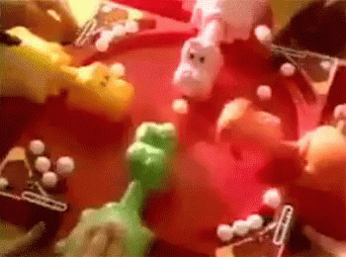
Artificial credit expansion
Consumption
Investment
interest
rate
S
w
w
S+∆M
S
S
D
D
D
L
L
loans
∆M

Slide 34
Artificial credit expansion
Consumption
Investment
interest
rate
S
w
w
S+∆M
S
S
D
D
D
L
L
loans
∆M

Slide 35
Artificial credit expansion
Consumption
Investment
interest
rate
S
w
w
S+∆M
S
S
D
D
D
L
L
loans
∆M

Slide 36
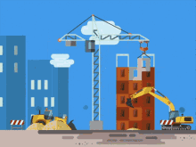

Artificial credit expansion
Consumption
Investment
interest
rate
S
w
w
S+∆M
S
S
D
D
D
L
L
loans
∆M

Slide 37
Artificial credit expansion
Consumption
Investment
interest
rate
S
w
w
S+∆M
S
S
D
D’
D
D’
D
L
L
loans
∆M

Slide 38

Artificial credit expansion
Consumption
Investment
interest
rate
S
w
w
S+∆M
S
S
D
D’
D
D’
D
L
L
loans
∆M

Slide 39
Artificial credit expansion
Consumption
Investment
interest
rate
S
w
w
S+∆M
S
S
D
D’
D
D’
D
L
L
loans
∆M

Slide 40
Artificial credit expansion
Consumption
Investment
interest
rate
S
w
w
S+∆M
S
S
D
D’
D
D’
D
L
L
loans
∆M

Slide 41
Artificial credit expansion
Newly created money enters the economy through credit markets and represents an increased supply of loanable funds
  Interest rate falls, but not because of a decrease in time preference
  At the lower interest rate, saving decreases
  Consumption and borrowing increase
  Firms take the new funds and invest in new, longer lines of production
  Factor prices are bid up across the board. Wages increase, employment increases, consumption increases, investment spending increases.
  In short, we have a general boom.

Slide 42
Artificial credit expansion causes overconsumption and malinvestment
Overconsumption - consumers did not show they preferred future output to present output, in fact, they decreased saving at the lower interest rate.
The credit expansion does not represent an increase in real resources available for consumption or investment.
  Factors of production become increasingly scarce
  Prices are bid up higher than entrepreneurs expected
  Costs increase, expected profits turn into losses
  Projects are abandoned
Malinvestment - entrepreneurs were led to believe consumers had saved, real resources were available for production, and that longer, more capital-intensive production would be profitable.

Slide 43
The Bust
Firms attempt to liquidate malinvested capital.
Wages decrease and workers are laid off.
Credit markets dry up.
Prices readjust to reflect consumer demands.
The bust is a recovery phase as people try to find profitable uses for land, labor, and capital.

Slide 44
Lessons learned
If you look at highly aggregated data, you misdiagnose the problem and give bad solutions.
“Before we can meaningfully ask what might go wrong, we should first understand how things could ever go right.” – Hayek
Sustainable production is based on a real reallocation of resources away from consumption, i.e., real savings.
Unsustainable booms are caused by artificial increases in credit. Recessions are the time when we fix the mistakes of the past.

Slide 45
Recommended Reading
Beginner
  Meltdown – Woods
  The Austrian Theory of the Trade Cycle and Other Essays – Ebeling (ed.)
Intermediate
  America’s Great Depression – Rothbard
  The Causes of the Economic Crisis – Mises
Advanced
  Time and Money – Garrison
  “A Reformulation of Austrian Business Cycle Theory in Light of the Financial Crisis” (QJAE) – Salerno

