Slide 1
Austrian Alternatives to Conventional Economic Statistics
Jonathan Newman
Mises University 2021

Slide 2
Essential reading
Murray Rothbard (1956). “Toward a Reconstruction of Utility and Welfare Economics.” In Economic Controversies, pp. 289-333.
Roderick Long (2006). “Realism and abstraction in economics: Aristotle and Mises versus Friedman.” Quarterly Journal of Austrian Economics, 9(3), 3-23.
Ludwig von Mises. Human Action, pp. 347-354.
Hans-Hermann Hoppe (2013). “Is Research Based on Causal Scientific Principles Possible in the Social Sciences?” In The Economics and Ethics of Private Property, pp. 295-304.
Murray Rothbard (1961). “Statistics: Achilles’s Heel of Government.” In Economic Controversies, pp. 427-431
Murray Rothbard (1978). “Austrian Definitions of the Supply of Money.” In New Directions in Austrian Economics. 143-156.

Slide 3
Misesian distinction
Theory
History
Pertains to all choices ever made by anybody
“Particulars” of choices not relevant
Specific motivations not relevant
Not falsifiable by experience/observation
No constant relationships
Goal: explain cause and effect, explain the real world
Examples: Human Action, Mises; Man, Economy, and State, Rothbard
Application of theory to the past
“Particulars” may be identified
Motivations may be guessed
Open to interpretation
Still no constant relationships, but statistical correlations may be identified for a specific time period
Examples: America’s Great Depression, Rothbard; Crisis and Leviathan, Higgs

Slide 4
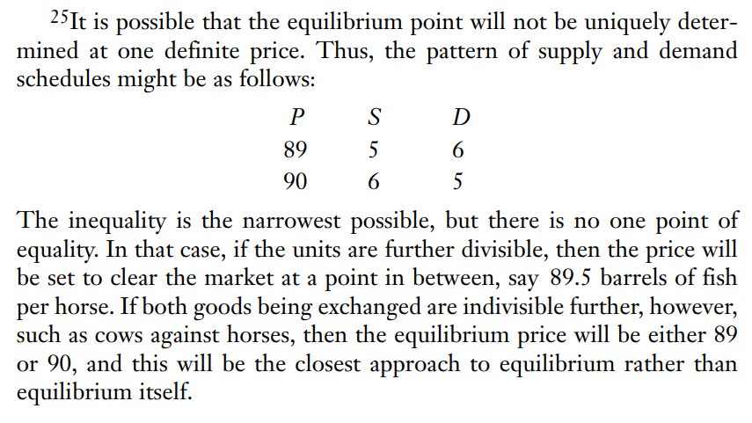
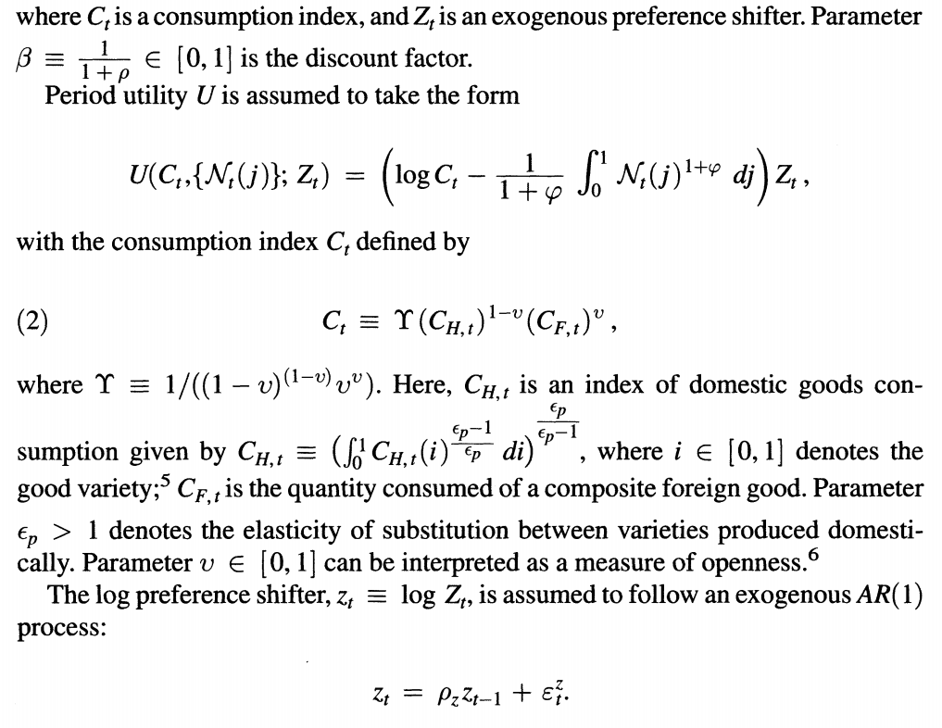
Method
Austrian Economics
Mainstream
Logical deduction
Ex: Rothbard, MES, p. 116
Mathematical models and statistics
Ex: Vol. 106, No. 12, AER, p. 3832.
Notes:
Galí, J., & Monacelli, T. (2016). Understanding the Gains from Wage Flexibility: The Exchange Rate Connection. The American Economic Review, 106(12), 3829-3868. Retrieved from http://www.jstor.org/stable/24911362

Slide 5
Rothbard on Method
“Therefore, atoms and stones can be investigated, their courses charted, and their paths plotted and predicted, at least in principle, to the minutest quantitative detail. People cannot; every day, people learn, adopt new values and goals, and change their minds; people cannot be slotted and predicted as can objects without minds or without the capacity to learn and choose.” – Rothbard, preface to Mises’s Theory and History
“The use of statistics and quantitative data may try to mask this fact [impossible to test economic theory], but their seeming precision is only grounded on historical events that are not homogeneous in any sense. Each historical event is a complex, unique resultant of many causal factors. Since it is unique, it cannot be used for a positivistic test, and since it is unique it cannot be combined with other events in the form of statistical correlations and achieve any meaningful result.” – Rothbard, preface to Mises’s Theory and History

Slide 6
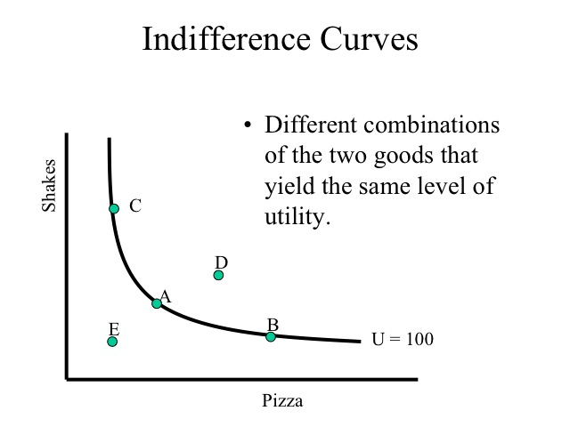
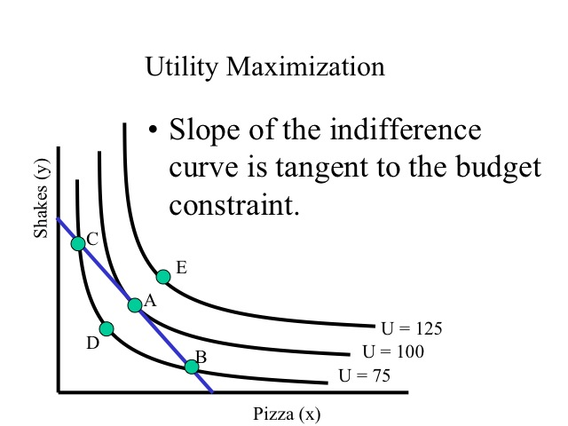

Mainstream Microeconomics
Individual agents select bundles of goods to consume to maximize their utility.
The goods are continuous and utility is given by a mathematical function.
  Ex: $U\left(X,Y\right)=X^{α}Y^{β}$
Choices are constrained by a budget: $M=P_{X}X+P_{Y}Y$
Agents solve a constrained optimization problem: maximize utility constrained by a budget.

Slide 7
Causal-realist economics
Individuals act to bring about a preferred state.
Preference can only be demonstrated in action.
Action is the use of means for a purpose: the attainment of an end.
In action, less important ends are forgone to attain more important ends.

Slide 8
Immediate observations
The two approaches have very different goals:
  Mainstream: model behavior to make good predictions
  Causal-realist: explain and understand real-world phenomena
Consumer behavior is explained in very different ways:
  Mainstream: consumers use (or act as if they use) math to make decisions.
  Causal-realist: consumers make qualitative judgments based on subjective preferences
The elements are conceived in very different ways:
  Mainstream: continuous goods are consumed to achieve a certain level of utility (cardinal)
  Causal-realist: discrete goods are consumed to attain a certain ordinally-ranked end
The scope of the consumer’s knowledge is very different:
  Mainstream: the consumer knows and considers all possible bundles
  Causal-realist: the consumer only necessarily considers the end attained and the highest-ranked end forgone

Slide 9


Slide 10
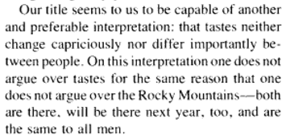
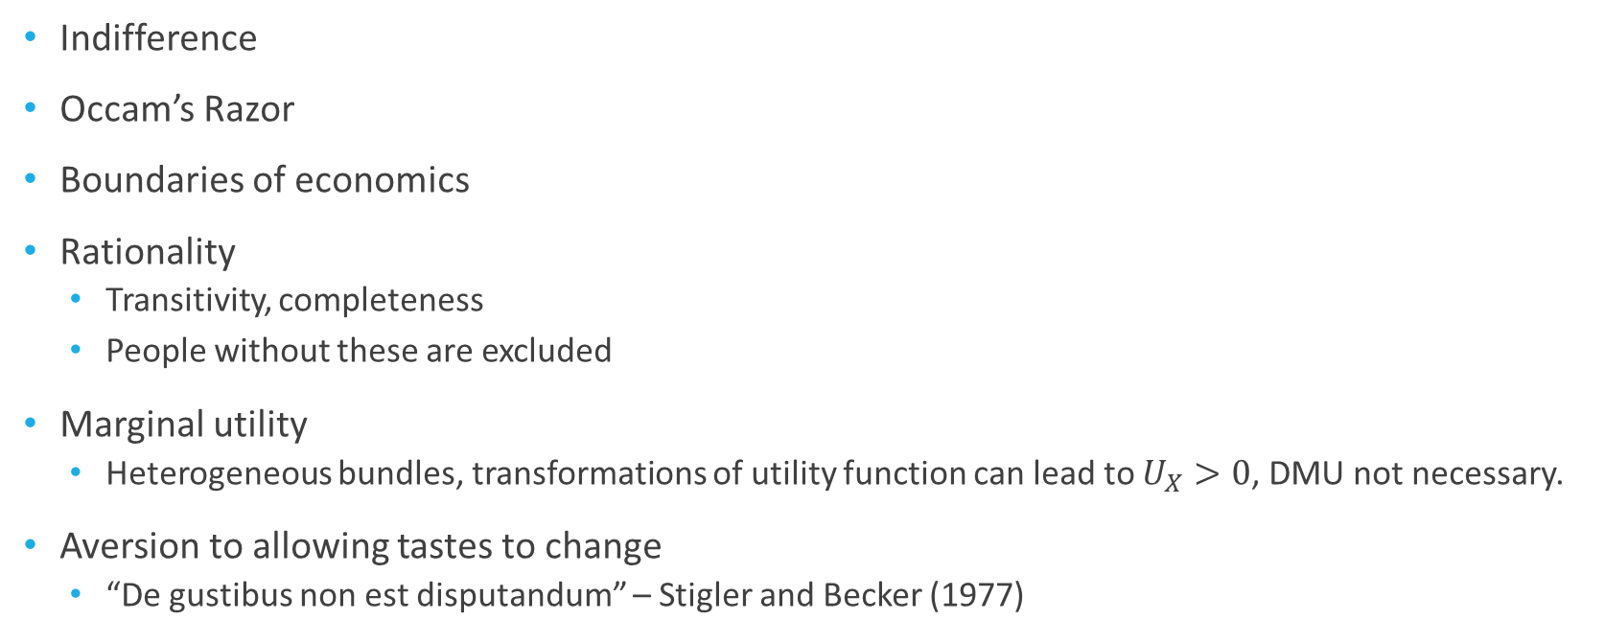
Problems with the mainstream approach
Indifference
Occam’s Razor
Boundaries of economics
Rationality
  Transitivity, completeness
  People without these are excluded
Marginal utility
  Heterogeneous bundles, transformations of utility function can lead to $U_{X}>0$, DMU not necessary.
Aversion to allowing tastes to change
  “De gustibus non est disputandum” – Stigler and Becker (1977)

Slide 11
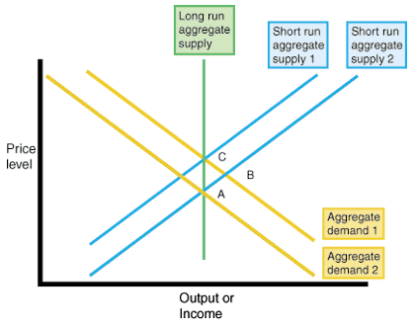
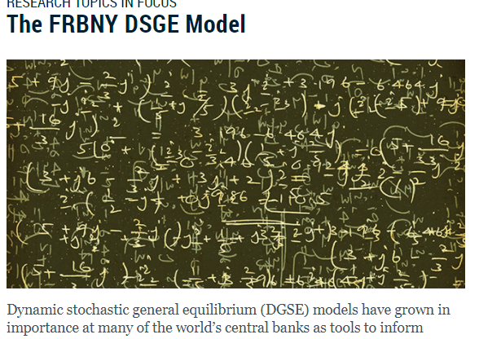
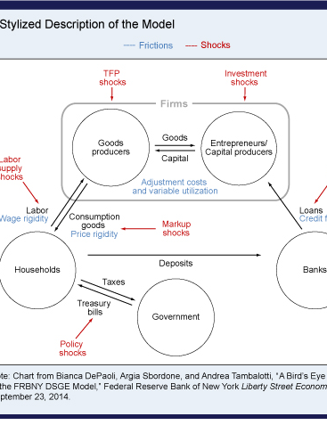
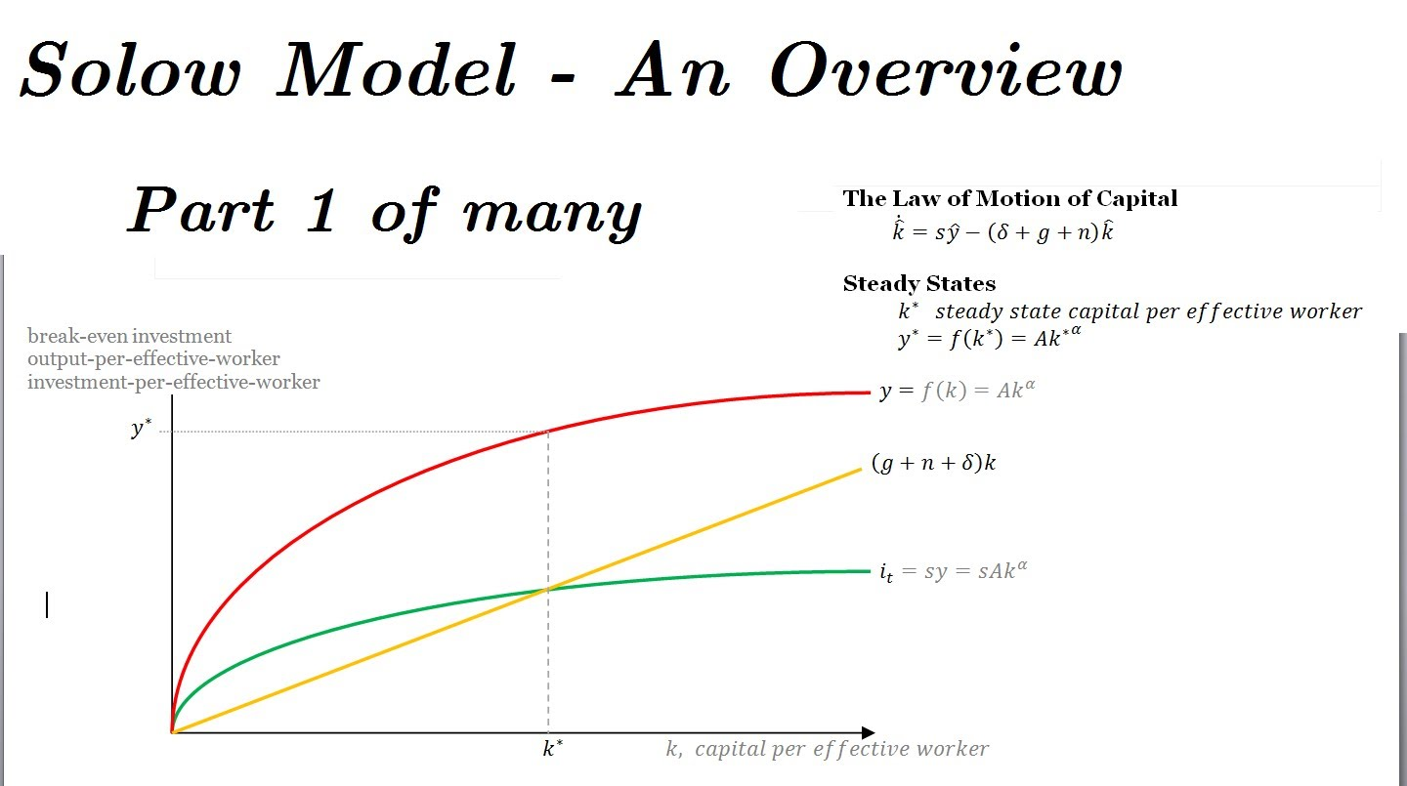
Mainstream Macroeconomics
AS/AD
Economic growth models
  Solow, Endogenous
DSGE models
  Real Business Cycle theory
  New Keynesian

Slide 12
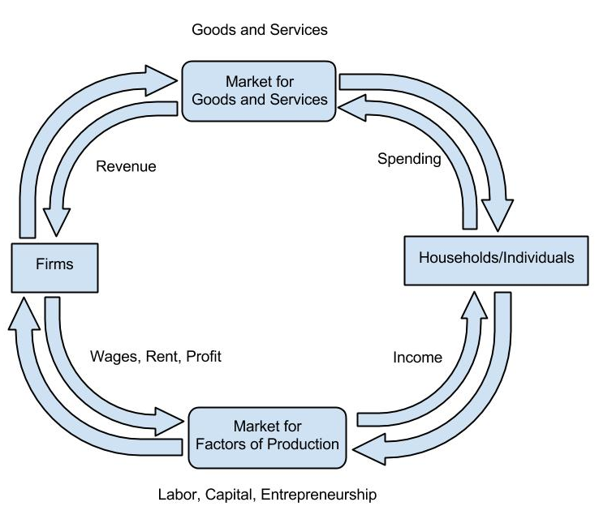
Circular Flow Model

Slide 13
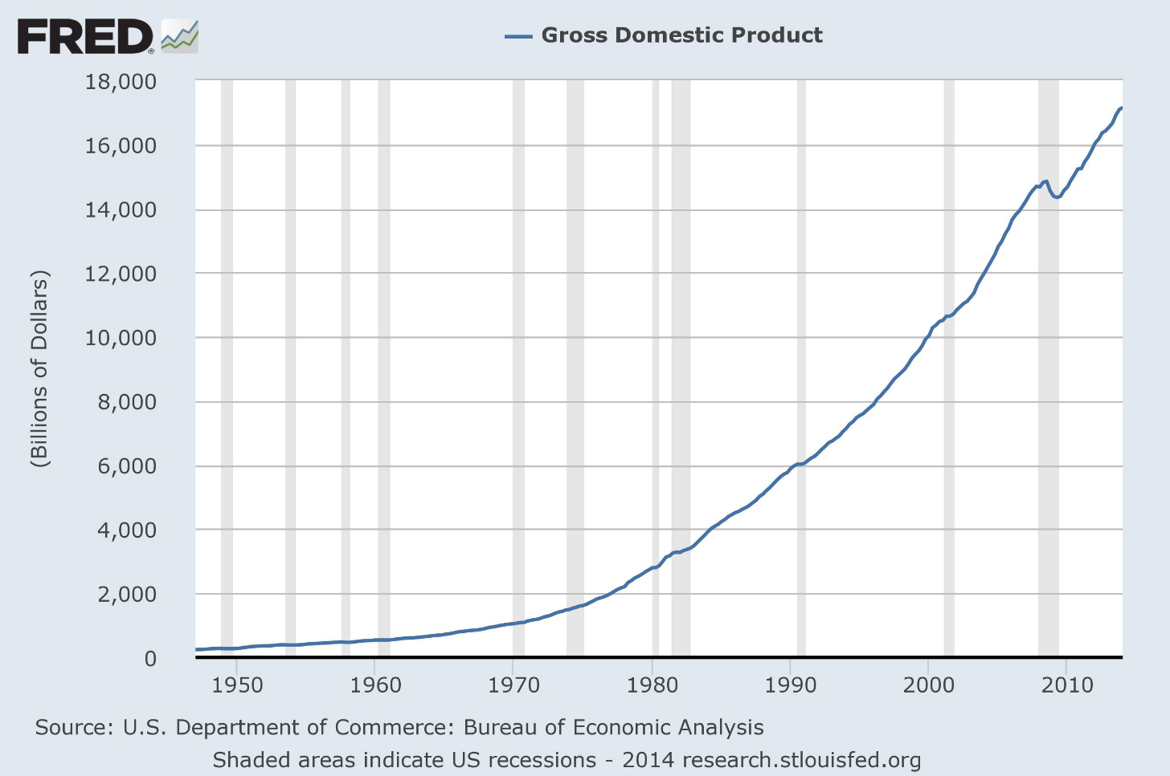
Gross Domestic Product
The market value of all final goods and services produced within a country over a given time period
  Prices are used as a common denominator
  No intermediate goods are counted
  Only domestic production is counted
  It is measured for a specific time period (flow variable)
  Y = C + I + G + X - M

Slide 14
Issues with GDP
1. Household production is ignored. Sometimes we make goods for our own personal use (e.g., low level home improvement) or perform services for ourselves (e.g., mowing our own lawn).
2. Black market transactions are difficult to measure. The production of illegal goods and services is technically a part of total output, but doesn’t get counted in GDP.
3. GDP/capita is not the best measure of overall well-being, even though it is used that way sometimes.
4. Leisure is valuable, but not counted in GDP because it isn’t produced and traded. Sometimes we choose not to produce because we value the alternative, like retiring or even relaxing on the weekend. GDP would decrease for these reasons, even though we are getting what we want.

Slide 15
Issues with GDP (cont.)
5. The stuff inside GDP is heterogeneous and unequally distributed throughout the population. GDP just tells you the total dollar amount, but cannot tell you anything about income distribution, wealth distribution, growth potential, size of the government, etc.
6. Consumption is exaggerated and international trade is understated.
7. Government expenditures are categorically different than the other components. Without market prices and the profit and loss test, there is no way to measure what the government produces. All government expenditures are also made possible by taking from the private economy.
Notes:
“Consumer spending turns out to represent only about 30% of total economic activity (GDE), not 70% as constantly reported.” (Skousen)
Suppose Country A is composed of vegetarians whose sole occupation is to raise pigs. Each year they export all $1 trillion of them to their carnivorous neighbors in Country B. The meat-lovers, in contrast, do nothing but grow apples ($1 trillion per year) to sell to their vegetarian neighbors in Country A.
Further suppose that in each country, there is no investment (neither gross nor net). Each year, consumers in each country spend $1 trillion on food. There is no government.
So GDP = C + I + G + Nx = $1 trillion + $0 + $0 + ($1 trillion – $1 trillion) = $1 trillion.
(Murphy)

Slide 16
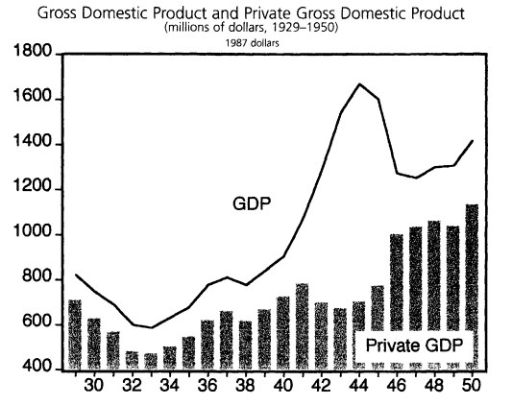
Higgs and GDP
Government expenditures are removed from GDP to make Private Gross Domestic Product.
Reveals what real people actually experienced in the war economy.
Robert Higgs, “Wartime Prosperity? A Reassessment of the U.S. Economy in the 1940s,” Journal of Economic History, March 1992, pp.49-52.

Slide 17
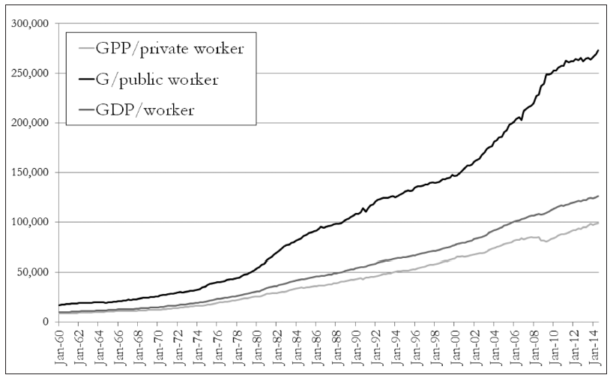
Howden on per capita statistics
“In some sense the growth in private income has lagged that of the greater average, and has performed far worse than its public counterpart. Not only that, but the volatility in the growth of private income has also been far more pronounced than in the public sector. Recessions are far more damaging to private workers.”
Notes:
https://www.mises.ca/unintended-consequences/

Slide 18
Rothbard’s Private Product Remaining
In the pleasant but illusory world of “national product statistics,” government expenditures on goods and services constitute an addition to the nation’s product. Actually, since government’s revenue, in contrast to all other institutions, is coerced from the taxpayers rather than paid voluntarily, it is far more realistic to regard all government expenditures as a depredation upon, rather than an addition to, the national product. In fact, either government expenditures or receipts, whichever is the higher, may be regarded as the burden on private national product, and subtraction of the former figure from Gross Private Product (GPP) will yield an estimate of the private product left in private hands. The ratio of government depredation (government expenditures or receipts, whichever is the higher) over Gross Private Product yields the approximate percentage of government depredation of the private product of the economy. (America’s Great Depression, p. 253—254)

Slide 19
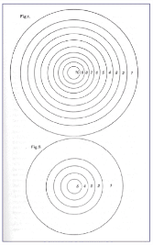
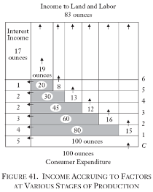
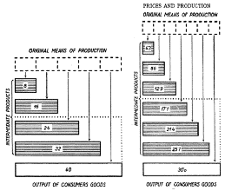
Austrian Macroeconomics
Böhm-Bawerk
Hayek
Rothbard

Slide 20
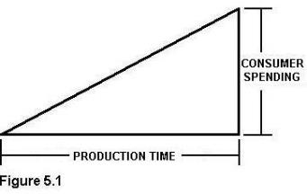
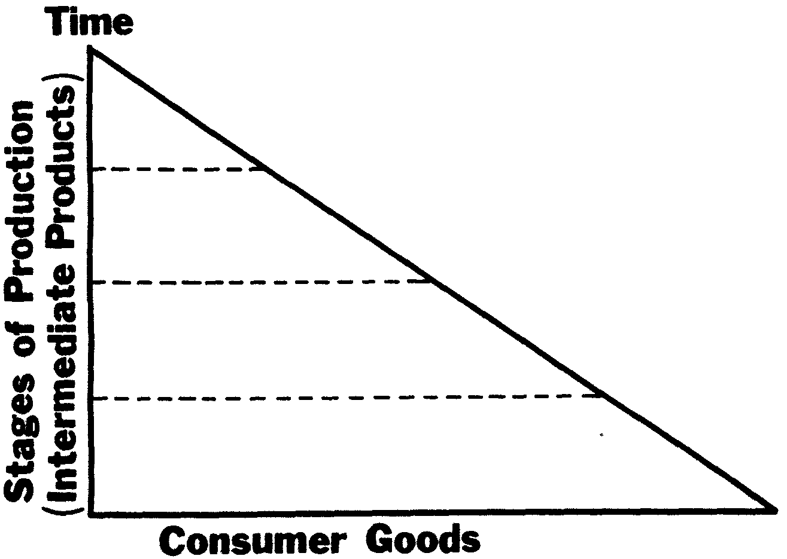
Austrian Macroeconomics
Böhm-Bawerk
Hayek
Rothbard
Garrison

Slide 21
Austrian Macroeconomics

Slide 22
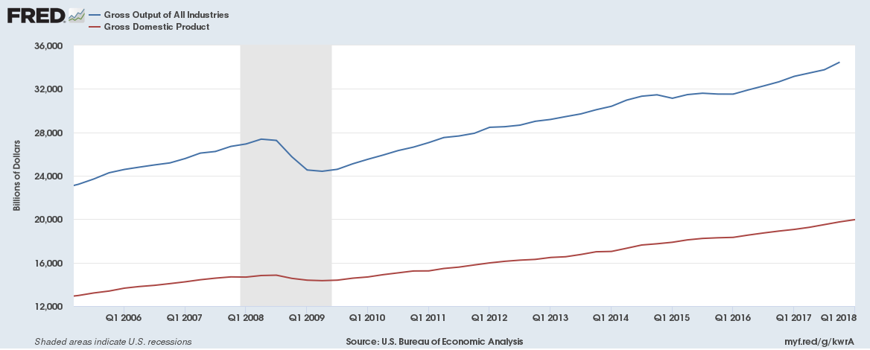
Gross Output
GDP only counts final goods and services, which excludes the very large amount of spending in the earlier stages of production. Consumption spending looks very big and important in GDP calculations, but when we look at all expenditures in the economy, we see the real size and importance of production.
Murray Rothbard and Mark Skousen advocate for a measure of Gross Output or Gross Domestic Expenditure to that end.
In 2014, the BEA began releasing Gross Output figures.

Slide 23
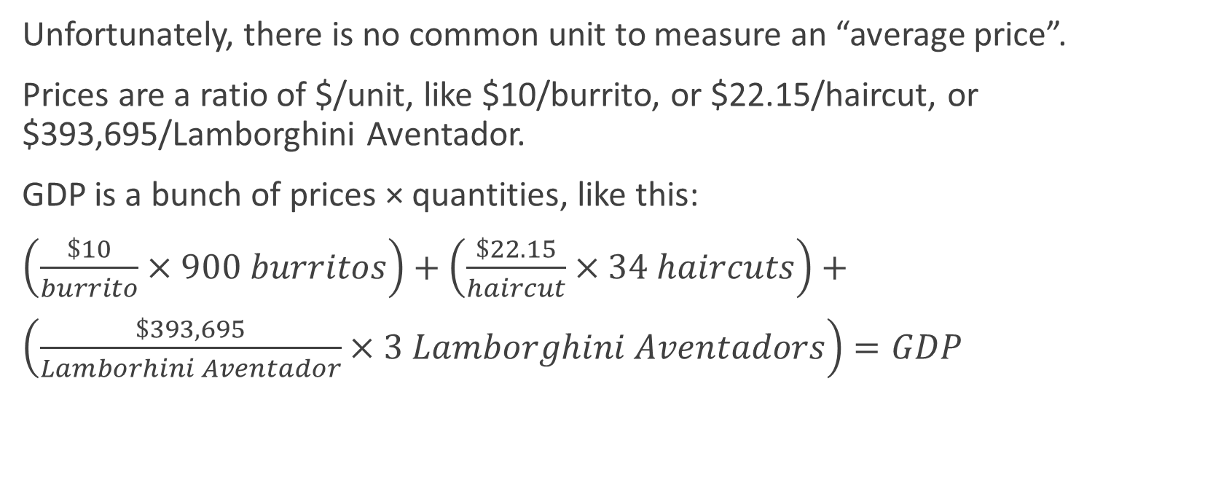
The Price Level
Unfortunately, there is no common unit to measure an “average price”.
Prices are a ratio of $/unit, like $10/burrito, or $22.15/haircut, or $393,695/Lamborghini Aventador.
GDP is a bunch of prices × quantities, like this:
$\left(\frac{\$10}{burrito}×900 burritos\right)+\left(\frac{\$22.15}{haircut}×34 haircuts\right)+$
$\left(\frac{\$393,695}{Lamborhini Aventador}×3 Lamborghini Aventadors\right)=GDP$

Slide 24
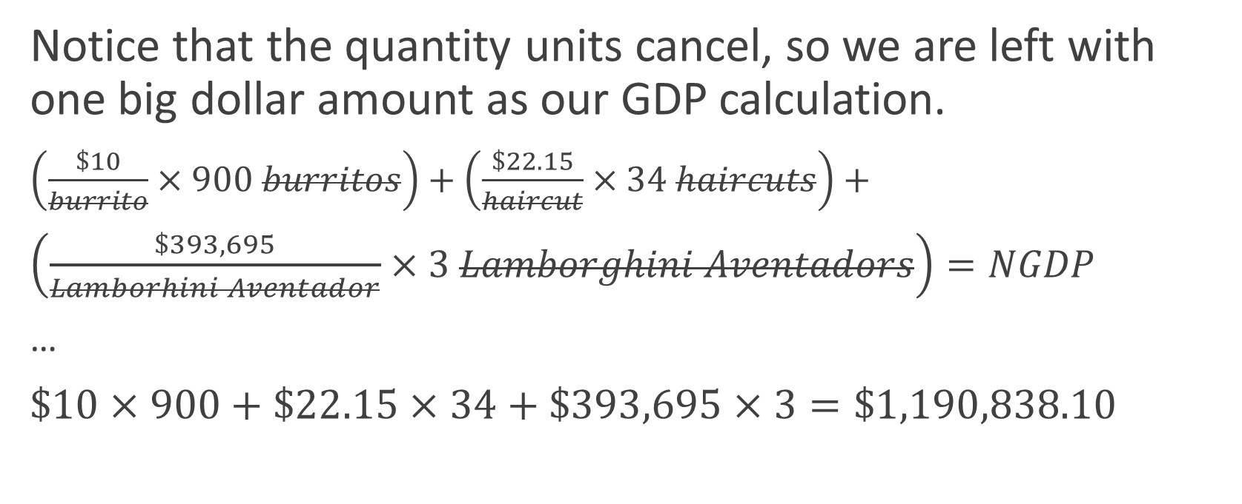
On units
Notice that the quantity units cancel, so we are left with one big dollar amount as our GDP calculation.
$\left(\frac{\$10}{burrito}×900 burritos\right)+\left(\frac{\$22.15}{haircut}×34 haircuts\right)+$
$\left(\frac{\$393,695}{Lamborhini Aventador}×3 Lamborghini Aventadors\right)=NGDP$
…
$\$10×900+\$22.15×34+\$393,695×3=\$1,190,838.10$

Slide 25

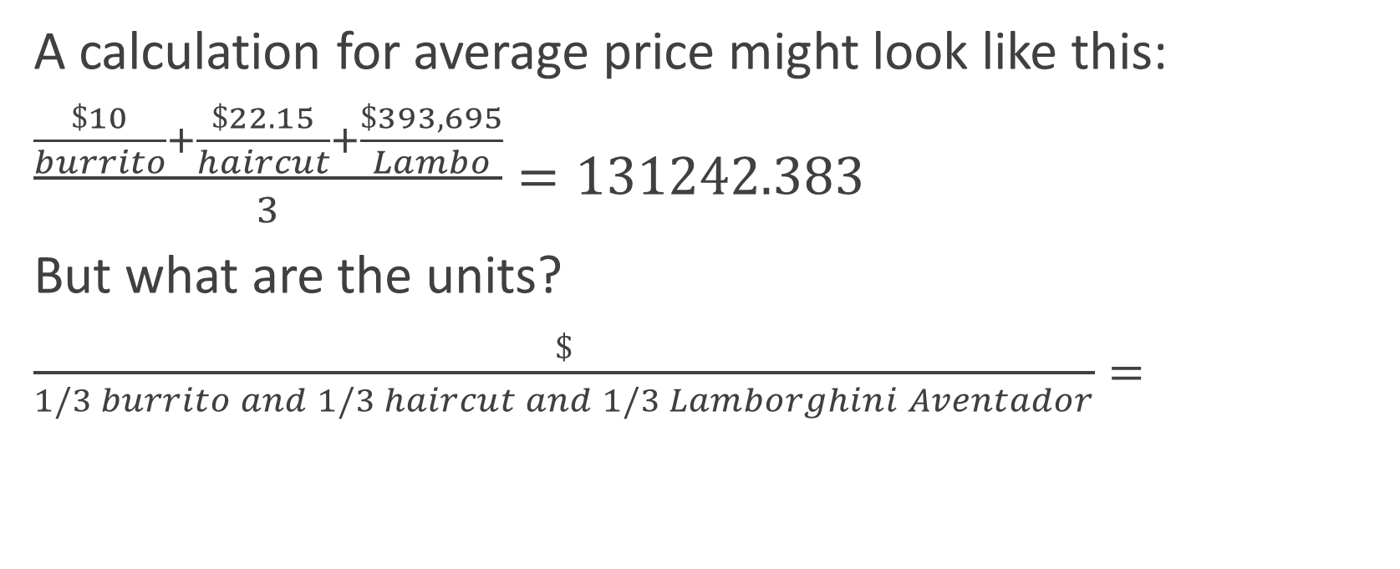
The Price Level
A calculation for average price might look like this:
$\frac{\frac{\$10}{burrito}+\frac{\$22.15}{haircut}+\frac{\$393,695}{Lambo}}{3}=131242.383$
But what are the units?
$\frac{\$}{1/3 burrito and 1/3 haircut and 1/3 Lamborghini Aventador}=$
$$nonsense$$

Slide 26
Consumer Price Index
Therefore an indexing method is used, so that the common unit is the total price of a basket of goods in some arbitrarily chosen base year.
Suppose we had a basket of goods that contained 50 burritos, 9 haircuts, and 2 Lamborghini Aventadors. We could measure the price of this basket and compare it to the price of the same basket, but in a different year.

Slide 27
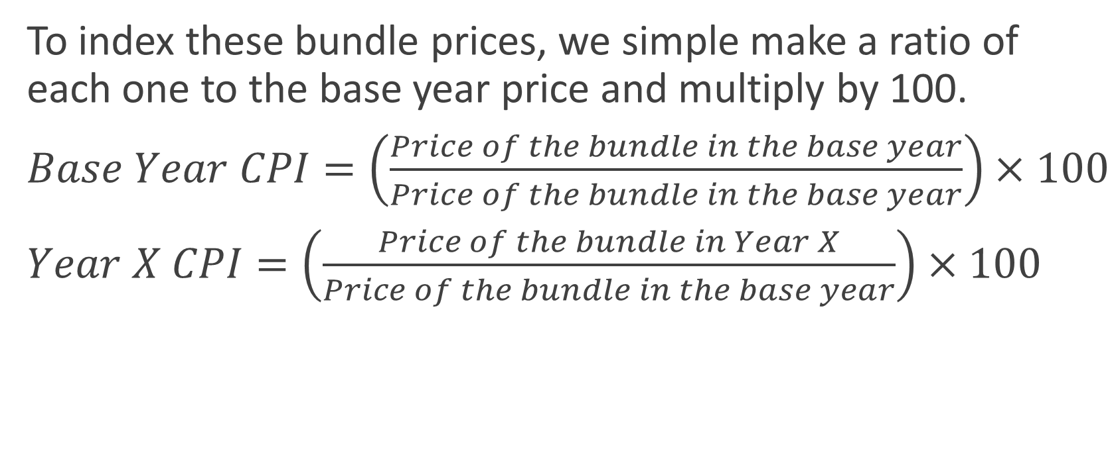
Consumer Price Index
To index these bundle prices, we simple make a ratio of each one to the base year price and multiply by 100.
$Base Year CPI=\left(\frac{Price of the bundle in the base year}{Price of the bundle in the base year}\right)×100$
$Year X CPI=\left(\frac{Price of the bundle in Year X}{Price of the bundle in the base year}\right)×100$

Slide 28
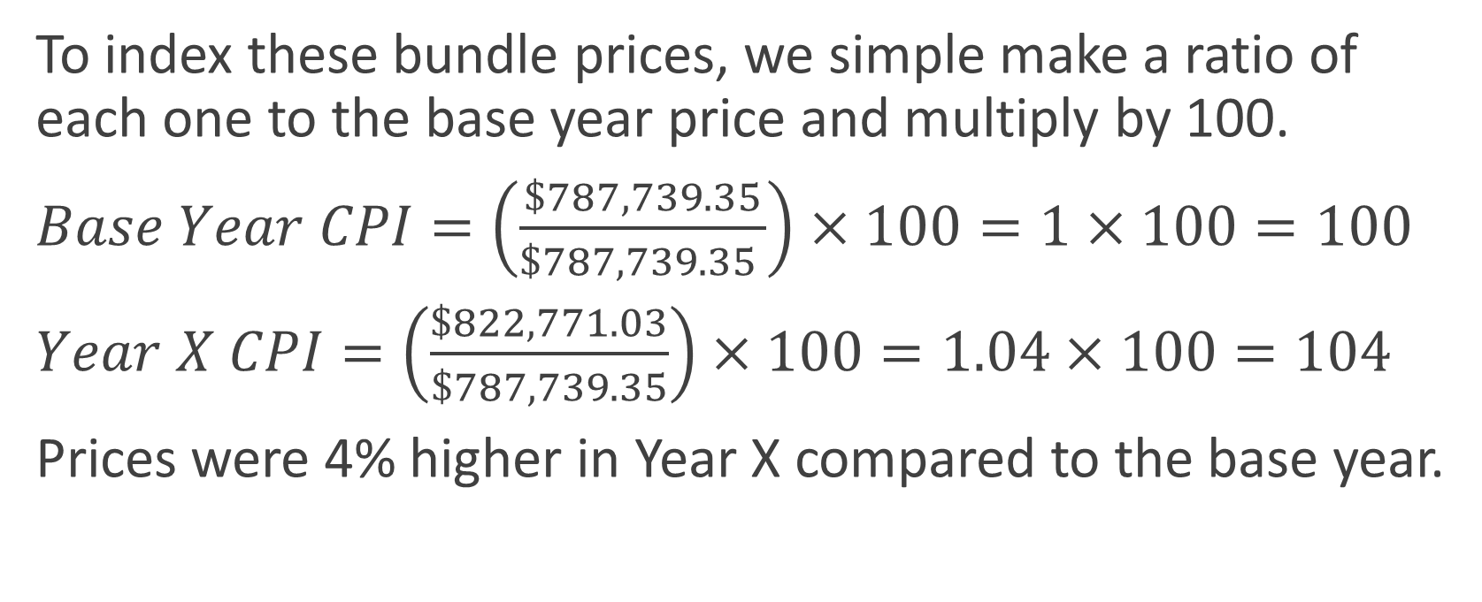
Consumer Price Index
To index these bundle prices, we simple make a ratio of each one to the base year price and multiply by 100.
$Base Year CPI=\left(\frac{\$787,739.35}{\$787,739.35 }\right)×100=1×100=100$
$Year X CPI=\left(\frac{\$822,771.03}{\$787,739.35}\right)×100=1.04×100=104$
Prices were 4% higher in Year X compared to the base year.

Slide 29
Issues with CPI
1. Even with the indexing, there is still an apples and oranges problem, especially when looking at changes in CPI year to year.
2. CPI hides relative prices and Cantillon effects.
3. There’s no such thing as the price level (as one number) in economic theory.
“This contention rests on the myth that some sort of general purchasing power of money or some sort of price level exists on a plane apart from specific prices in specific transactions. As we have seen, this is purely fallacious. There is no “price level,” and there is no way that the exchange-value of money is manifested except in specific purchases of goods, i.e., specific prices.” (Rothbard, MES)

Slide 30
Money Supply Measures
M1 | M2 | M3
notes and coins, traveler’s checks, demand deposits, and other checkable deposits | adds savings deposits, time deposits, and money market accounts | adds large time deposits, institutional money market funds, short-term repurchase and other larger liquid assets
The Austrian True Money Supply measure is M2 minus traveler’s checks, time deposits, and money market mutual fund shares (MMDAs are ok). US Savings Bonds (at discounted immediate redemption value), the cash surrender value of life insurance policies, and US Treasury and government deposits at the Federal Reserve are added. Present-for-future goods transactions should be excluded from money supply measures because they are credit transfers and are not redeemable at par on demand. Some time deposits are redeemable before maturity at a discount, and the discounted value may be included in the money supply.
The condition for inclusion in the money supply is each person’s subjective estimate of what is redeemable at par on demand.
LIQUIDITY
Notes:
Unlike a check drawn on a demand deposit or MMDA, therefore, an MMMF draft does not simply represent a direct transfer of current claims to currency, but a dual order to the fund's manager to sell a specified portion of the shareowner's asset holdings and then to transfer the monetary proceeds to a third party named on the check.I9 Note that the payment process is not finally completed until the payee receives money, typically in the form of a credit to his demand deposit.“ (Salerno)

Slide 31
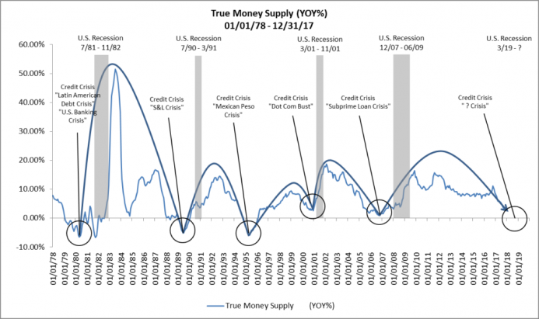
Change in TMS

Slide 32


Slide 33
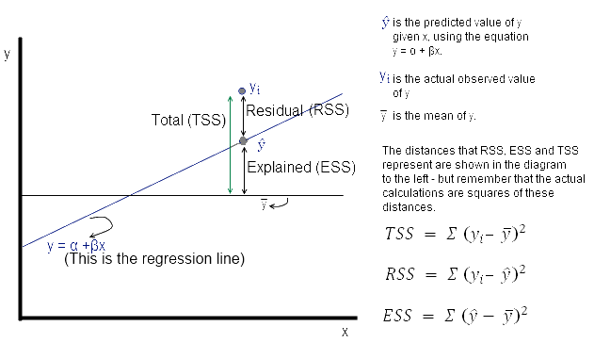
Econometrics
Models from micro and macro are rearranged into a form that can be estimated by regression
Real-world data are plugged in and estimated parameters come out
The estimated slopes give the “effect” of one variable on the dependent variable.

Slide 34
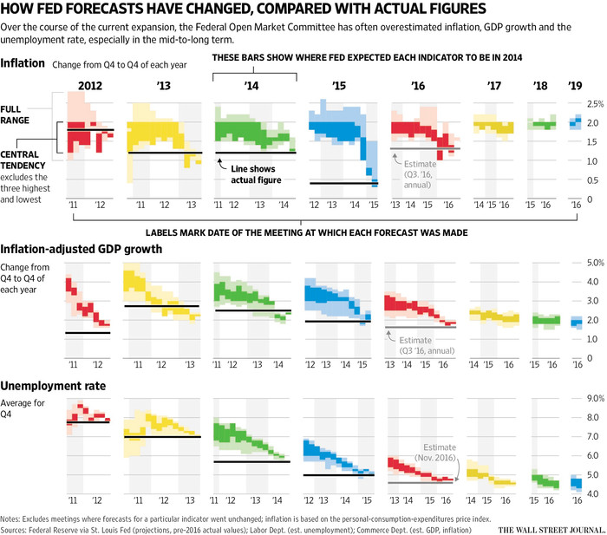
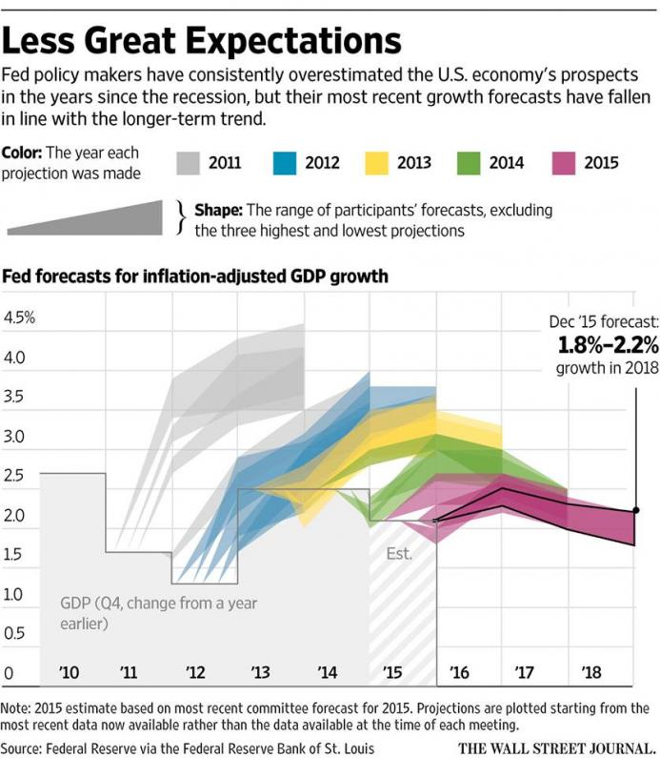
Fed forecasts

Slide 35
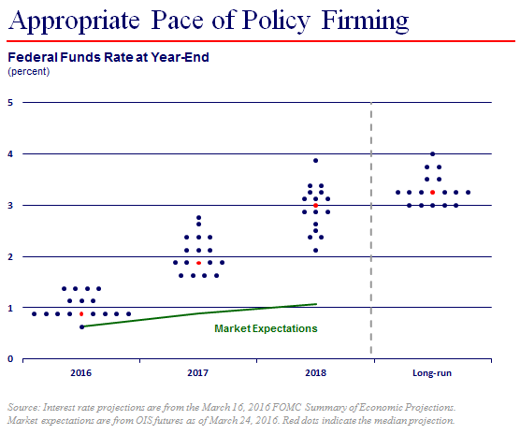
Fed forecasts (cont.)

Slide 36
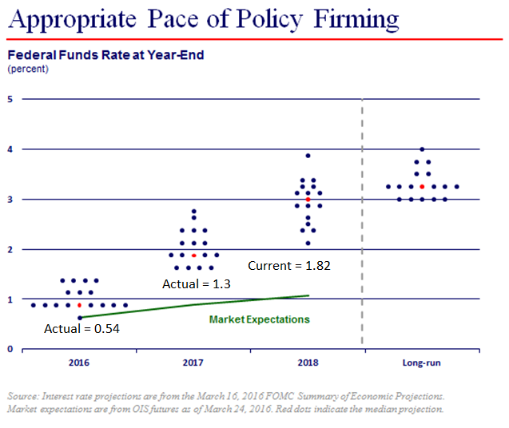
Fed forecasts (cont.)

Slide 37
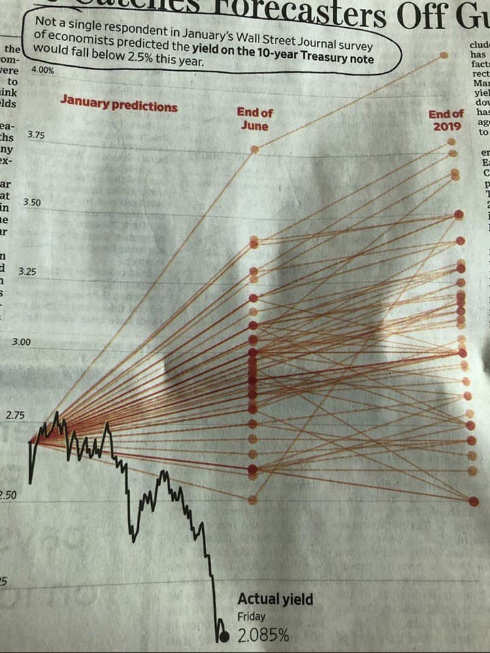

Slide 38
Fraying at the top
“There’s no question that mainstream academic macroeconomics failed pretty spectacularly in 2008. It didn’t just fail to predict the crisis -- most models, including Nobel Prize-winning ones, didn’t even admit the possibility of a crisis. The vast majority of theories didn’t even include a financial sector..” – Noah Smith, Bloomberg View
“Presenting a model is like doing a card trick. Everybody knows that there will be some sleight of hand. There is no intent to deceive because no one takes it seriously.” – Paul Romer, Chief Economist and Senior Vice President of the World Bank, NYU prof, Stanford prof
"(My view is that) real business cycle models of the type urged on us by Prescott have nothing to do with the business cycle phenomena observed in the United States or other capitalist economies." – Larry Summers, former Vice President of Development Economics and Chief Economist of the World Bank, US Treasury official under Clinton, former President of Harvard University

Slide 39
Fraying at the top
“I do not think that the currently popular DSGE models pass the smell test.” – Robert Solow
“New classical and new Keynesian research has had little impact on practical macroeconomists who are charged with [...] policy. [...] From the standpoint of macroeconomic engineering, the work of the past several decades looks like an unfortunate wrong turn.” – Greg Mankiw
“Why does an economy have business cycles? Why do asset prices move around so much? At this stage, macroeconomics has little to offer by way of answers to these questions. The difficulty in macroeconomics is that virtually every variable is endogenous, but the macroeconomy has to be hit by some kind of exogenously specified shocks if the endogenous variables are to move.” – Narayana Kocherlakota, President of the Federal Reserve Bank of Minneapolis

Slide 40
Austrians predict the financial crisis
Sean Corrigan’s December 3, 2002 interview:
“But both Freddie and Fannie are doing everything possible to encourage more debt. They have online mortgage applications. You can even get an online appraisal of your house.
There is a subterranean literature on the fringes of the mainstream press about how the appraisal process in home loans has been corrupted in this boom. The appraiser is paid if the loan goes through. Therefore, the potential borrower or purchaser or even the vendor can prod the appraiser to give a higher evaluation, just to get the deal done. Even with the inflation in prices that we’ve seen, it’s worse than it looks because the house values aren’t there in the first place.”
And Mark Thornton in 2004:
“Given the government’s encouragement of lax lending practices, home prices could crash, bankruptcies would increase, and financial companies, including the government-sponsored mortgage companies, might require another taxpayer bailout.”

Slide 41
Conclusions
The Austrian approach is focused on understanding real-world cause and effect. Mainstream economists like to use mathematical models of consumer behavior, firm behavior, macroeconomic phenomena, etc.
Mises and Rothbard present a unified and systematic, but bounded, science of economics.
The differences between the Austrian school and the mainstream begin at the most fundamental level: method (logic vs. mathematical models and empiricism) and the goal of economic science (understanding vs. prediction).
Conventional economic statistics like GDP, CPI, and M have serious issues, but some of these issues may be solved. Some issues cannot be solved, especially when it comes to the way the statistics are used and interpreted.
Good theory leads to better statistics and better predictions.

