Slide 1
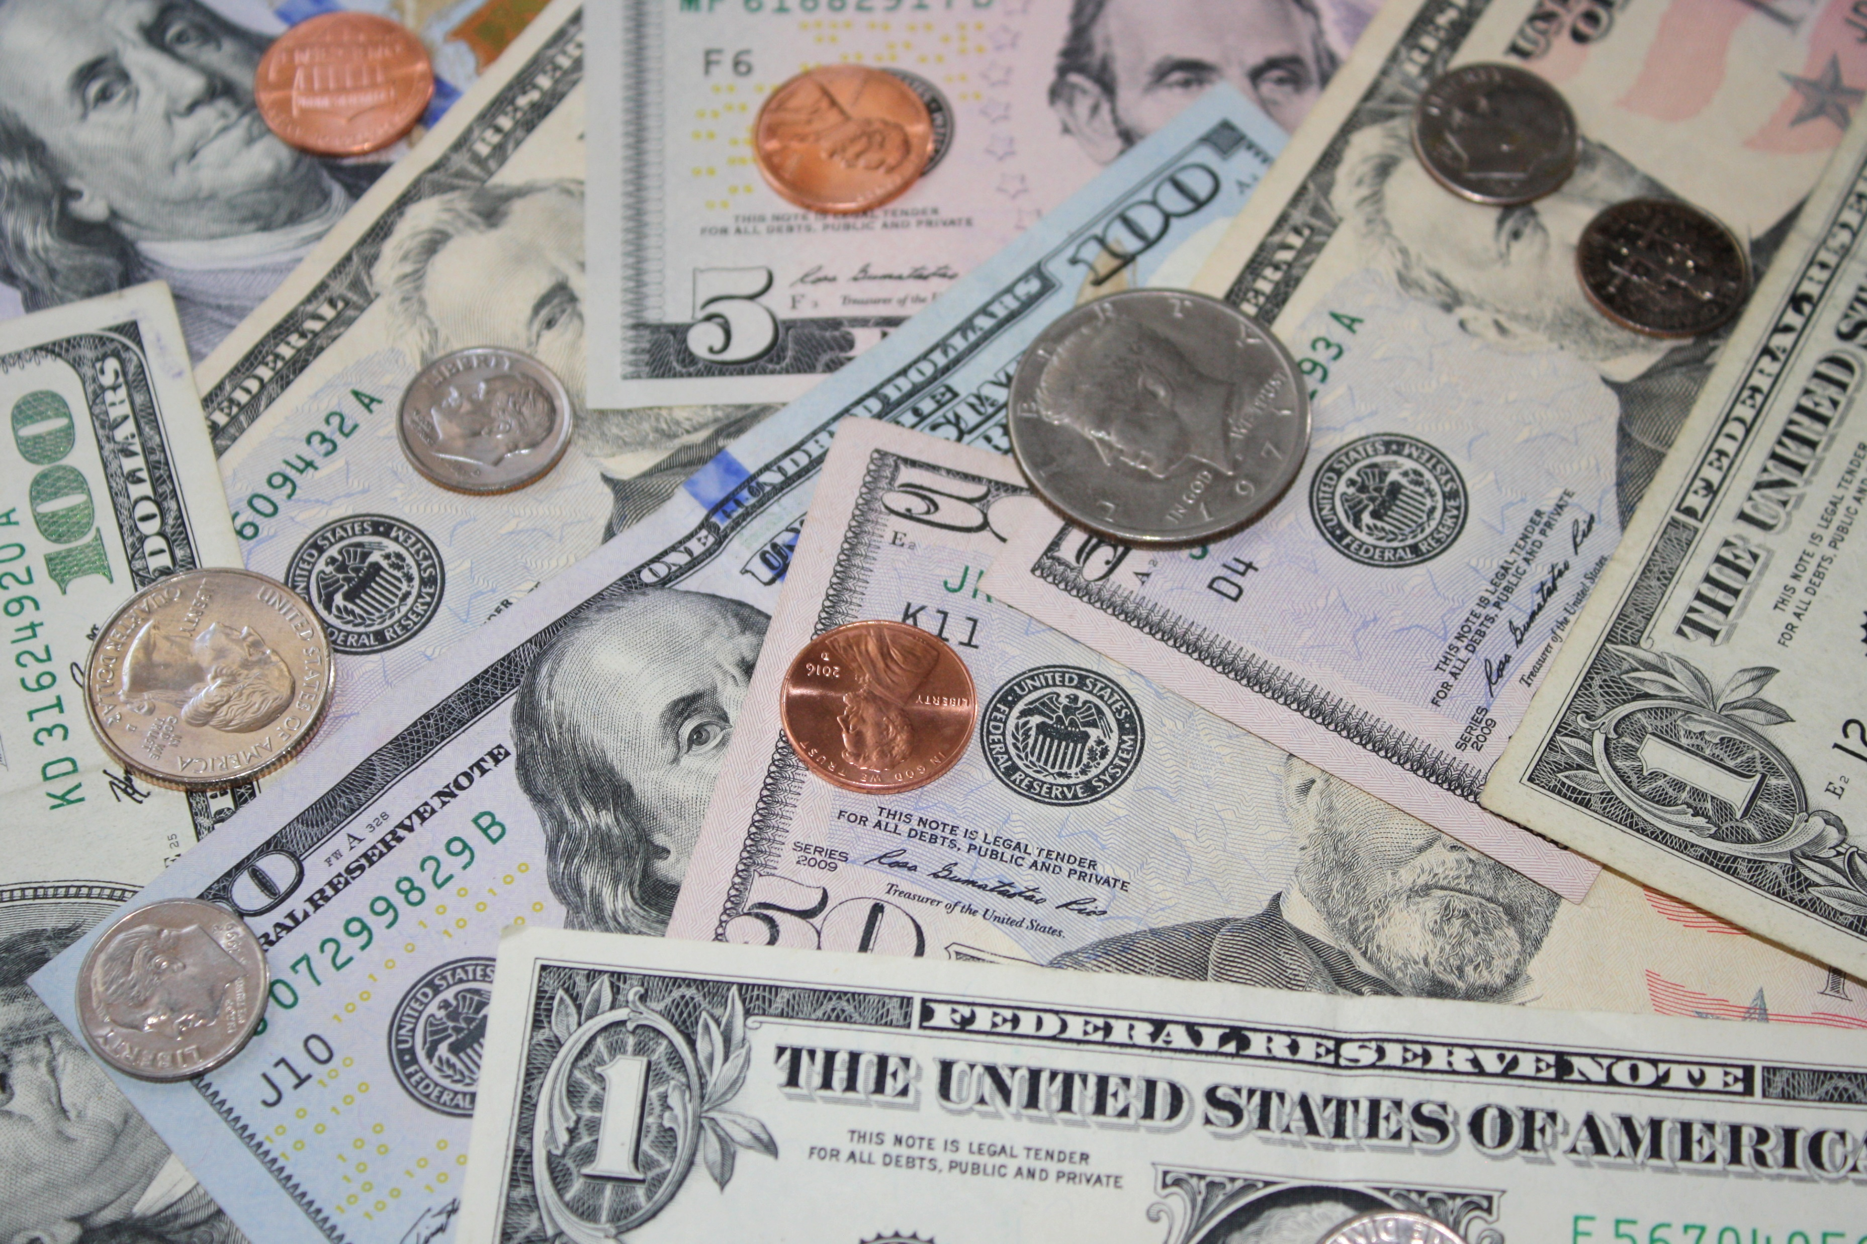
Money
Sandy Klein
Mises U 2026
sandy@mises.org

Slide 2
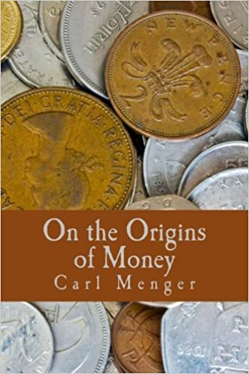
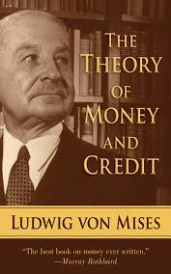
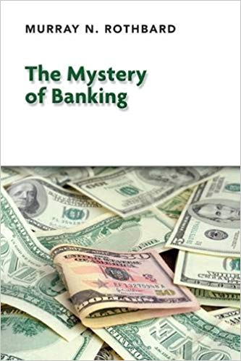

Slide 3
Setting the stage for money
Larger civilization beyond a few families
Specialization and exchange vs. self-sufficiency
Limitations of barter: indivisibilities and double coincidence of wants requirement

Slide 4


Slide 5


Slide 7


Slide 9
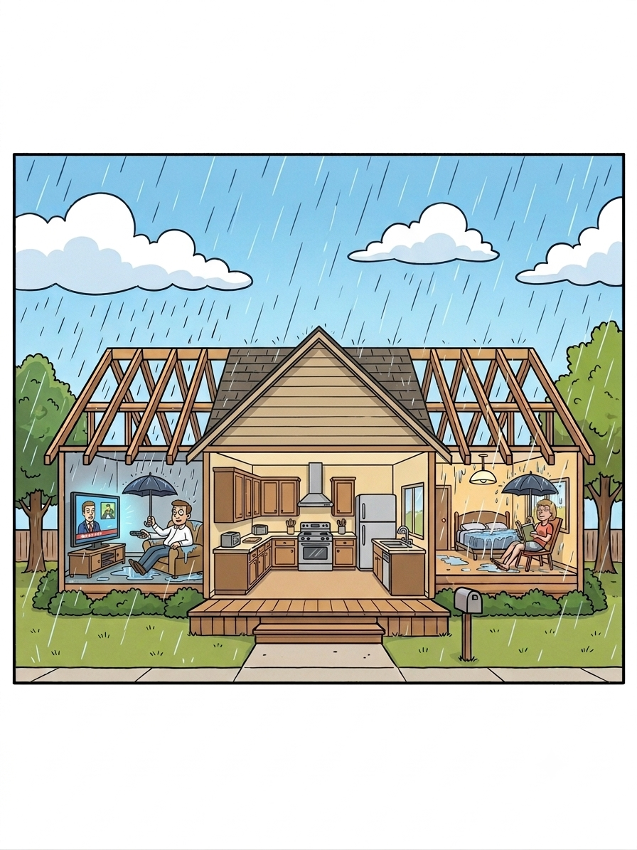
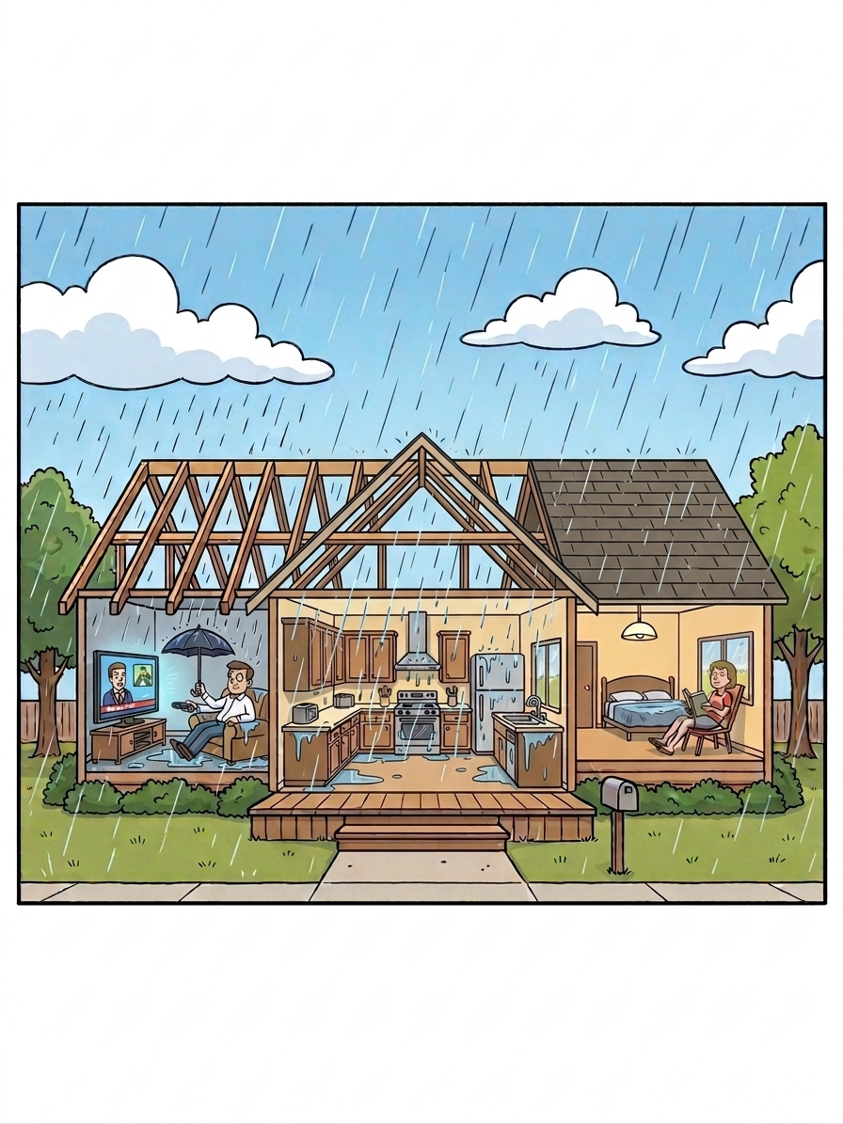
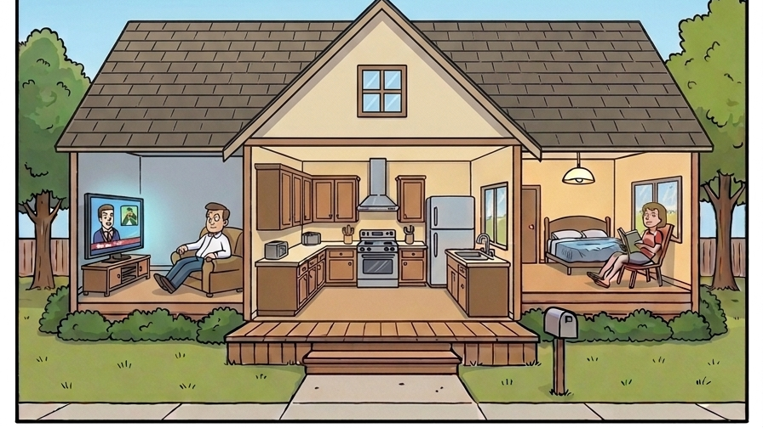

Slide 11


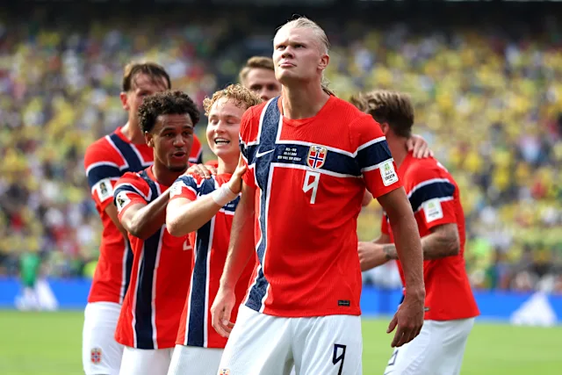

Slide 13
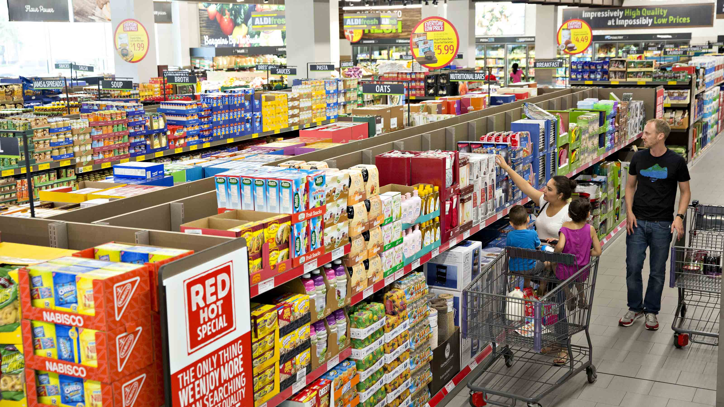
Barter: Each good is priced against every other good.
“[Money] becomes more necessary as the division of labor increases.” Ludwig von Mises
Theory of Money and Credit, p. 43
Store | Number of items | Number of prices
Circle K | 550 | 151,325
Kroger | 45,000 | 1 million
Wal-Mart | 120,000 | 7.2 million

Slide 14
Emergence of indirect exchange
The more saleable a good, the more easily its owner can exchange it for other goods at some “price.”
Goods have different degrees of saleability.
Trade for a good not desired, so long as it is more saleable than the good given up.
The demand for the more saleable good has a new component, not just for consumption but also for use in exchange.

Slide 15
A good medium of exchange should be
Divisible
Durable
Transportable
Scarce
Fungible

Slide 16
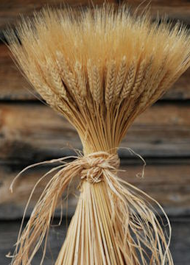
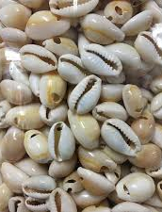
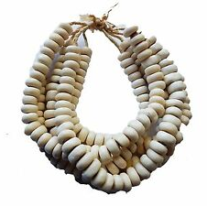
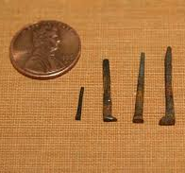
Early media of exchange

Slide 17
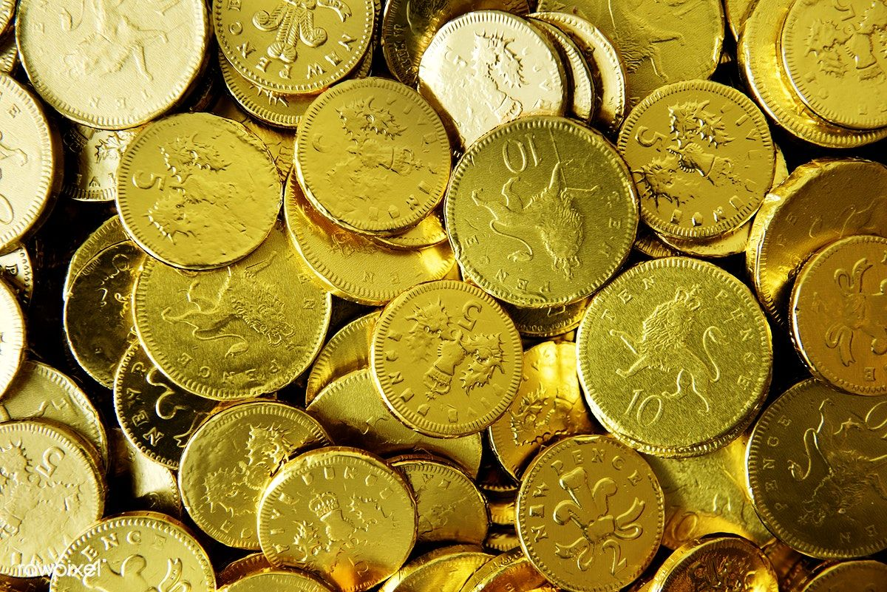
The market’s chosen medium of exchange

Slide 18
Hence it is also clear that nothing may have been so favorable to the genesis of a medium of exchange as the acceptance, on the part of the most discerning and capable economic subjects, for their own economic gain, and over a considerable period of time, of eminently saleable goods in preference to all others.
Menger, On the Origins of Money, p. 37

Slide 20
Benefits of money
All goods priced in money (1,000 goods, 1,000 prices)
Elaborate structure of production
Rational economic calculation
Easy comparison of values
  Commercial espresso machine costs 1 ounce of gold
  BMW 3 series costs 12 ounces of gold
  The BMW is worth about 12 commercial espresso machines

Slide 21
Commodity money
Sold by units of weight
Units of weight are convertible into each other
  1 pound = 16 ounces
  1 ounce = 28.35 grams
Names of currency were names for weights of a commodity:
  American money was dollars
  French money was francs
  German money was marks
“The price of gold was fixed at $20.”

Slide 22
The dollar was defined as 1/20 of a gold ounce.
The pound sterling was the name given for ¼ of a gold ounce.
1/4 ounce of gold = 5/20 ounce of gold
1£ = $5
Exchange rates made easy

Slide 24
Purchasing Power of Money (PPM)
The purchasing power (or “price”) of the dollar is the inverse or reciprocal of the overall price level.
$1 1/10 moonwalk lesson
$1 1/50 steak dinner
$1 1/250,000 a 2BR condo in Auburn

Slide 25
The value of money in exchange
Increase in supply of money ➔ its value in exchange falls ➔ prices rise
Decrease in supply of money ➔ its value in exchange rises ➔prices fall
Increase in demand for money ➔ its value in exchange rises ➔ prices fall
Decrease in demand for money ➔ its value in exchange falls ➔prices rise

Slide 26
The optimal supply of money
Any supply of money is just as good as any other through adjustments in the PPM.
The Angel Gabriel model shows an increase in money supply confers no social benefit.
Counterfeiters and early spenders benefit at the expense of late spenders.
Under a gold standard, the only way to increase M is through mining gold.

Slide 27
We would not expect money to be . . .
Paper
National
Under the control of any entity

