Slide 1
The Division of Labor and Social Order
Mises University
Auburn, Alabama

Slide 2
Relevant Literature
Plato, The Republic
Adam Smith, The Wealth of Nations
David Ricardo, On the Principles of Political Economy and Taxation
Ludwig von Mises, Human Action
Murray Rothbard, “Freedom, Inequality, Primitivism, and the Division of Labor”

Slide 3
Contrasting Views
Rather than seeing conflict as an anomaly, it is concluded that conflict is an essential and inherent component of the social relations found in capitalism.
– Herb Thompsom, “Conflict and the Social Relations of Capitalism”
The greater productivity of work under the division of labor is a unifying influence. It leads men to regard each other as comrades in a joint struggle for welfare, rather than as competitors in a struggle for existence. It makes friends out of enemies, peace out of war, society out of individuals.”
–Ludwig von Mises, Socialism

Slide 4
Modes of Production
Direct Use Production:
  Self-sufficiency.
  Direct correspondence between what people want and what they produce.
Production for Exchange
  Oriented to what can be sold in a market
  Market division of labor

Slide 5

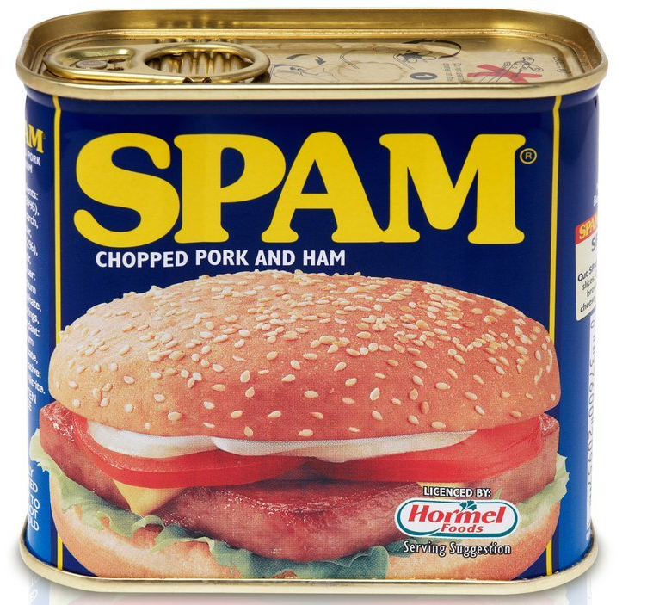
The Division of Labor
Specialization according to efficiency
Specialization: Each person produces a particular good or set of goods in excess of his personal consumption
Efficient producer has lowest opportunity cost of production

Slide 6
The Division of Labor
 | Production Possibilities |  | Opportunity Cost |  | Proficiency | Efficiency
 | Mangoes | Beef | Mangoes | Beef
Groucho: | 300 or 600 |  | 2 B | ½ M | Both Goods | Mangoes
Harpo: | 100 or 400 |  | 4 B | ¼ M | None | Beef
Who has absolute advantage in what? Groucho is more proficient in producing both goods.
Who has the comparative advantage in producing mangoes?
  How much does it cost Groucho to produce 1 mango? 2 lb. of beef
  How much does it cost Harpo to produce 1 mango? 4 lb. of beef
Who has a lower opportunity cost producing mangoes? Groucho

Slide 7
The Division of Labor
 | Production Possibilities |  | Opportunity Cost |  | Proficiency | Efficiency
 | Mangoes | Beef | Mangoes | Beef
Groucho: | 300 or 600 |  | 2 B | ½ M | Both Goods | Mangoes
Harpo: | 100 or 400 |  | 4 B | ¼ M | None | Beef
Who has the comparative advantage in producing beef?
  How much does it cost Groucho to produce 1 lb. of beef? ½ mango
  How much does it cost Harpo to produce 1 lb. of beef? ¼ mango
Who has a lower opportunity cost producing beef? Harpo

Slide 8
The Division of Labor
 | Production for Direct Use
 | Groucho |  | Harpo | Total
Mangoes | 150 |  | 50 | 200
Beef (lbs.) | 300 |  | 200 | 500
 | Production According to Efficiency
 | Groucho | Harpo |  | Total | Gain
Mangoes | 225 | 0 |  | 225 | 25
Beef (lbs.) | 150 | 400 |  | 550 | 50
Production Gains

Slide 9
Differences in Efficiency
What accounts for the differences in relative costs of production for different people?
  Differences in suitability of natural resources
  Differences in given capital stock
  Differences in skill or desirability of labor

Slide 10
The Division of Labor
The Law of Association
  Each factor of production is efficient in some line of production
  Applies not only to nations, but to each person
  Applies not only to labor, but also to land and capital goods
  Implication: Employment can expand indefinitely

Slide 11
The Fundamental Social Phenomenon
Mises: “The fundamental social phenomenon is the division of labor and its counterpart human cooperation.”
  Been with us since the beginning of human history
  The great impetus for the formation of society
    People form and move to certain communities so they can integrate with that region ’s division of labor.
    Society is only possible because of the greater productivity of the division of labor and of people's recognition of this fact.

Slide 12
The Division of Labor and Social Order
Allowed mankind to escape a Darwinian struggle for survival.
  “The greater productivity of work under the division of labor is a unifying influence. It leads men to regard each other as comrades in a joint struggle for welfare, rather than as competitors in a struggle for existence. It makes friends out of enemies, peace out of war, society out of individuals.”
  –Ludwig von Mises, Socialism
  Integrates world into an economic order.

Slide 13
Private Property a Necessity
Must be able to exchange what we produce.
Government intervention impedes division of labor.
Exchange requires private property.
Hence, to enjoy the benefits of the division of labor, society must have private property.

Slide 14
Economic Calculation
Coordination of economic order requires economic calculation.
  Requires market monetary prices.
  Economic Calculation requires medium of exchange.
  Requires prices be determined by process of voluntary exchange.
  Requires private property
  Requires sound money
Social order made possible by the market division of labor is itself possible only in a social order based on private property.

