Slide 1
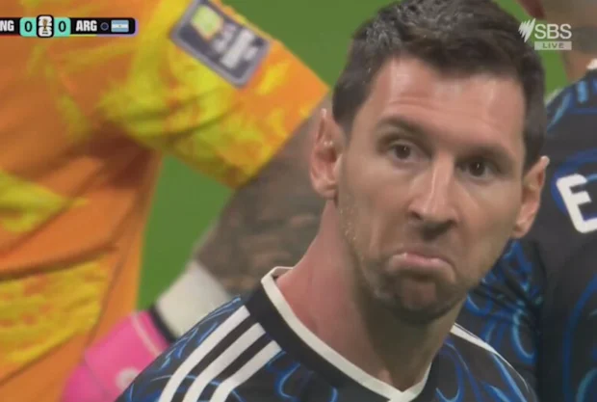
Entrepreneurship
Peter G. Klein
Mises University 2026
@petergklein
#MisesU

Slide 2

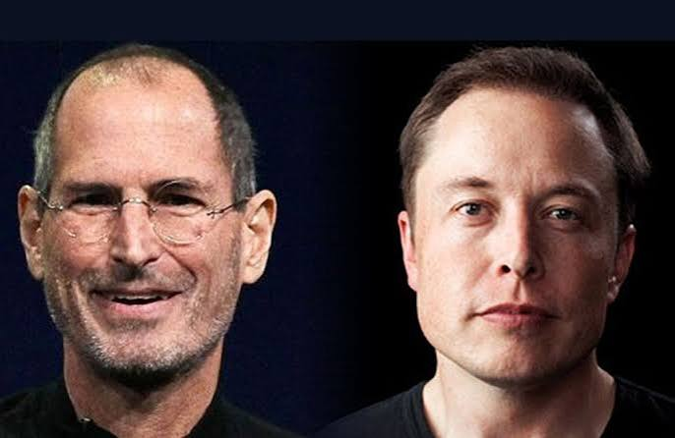
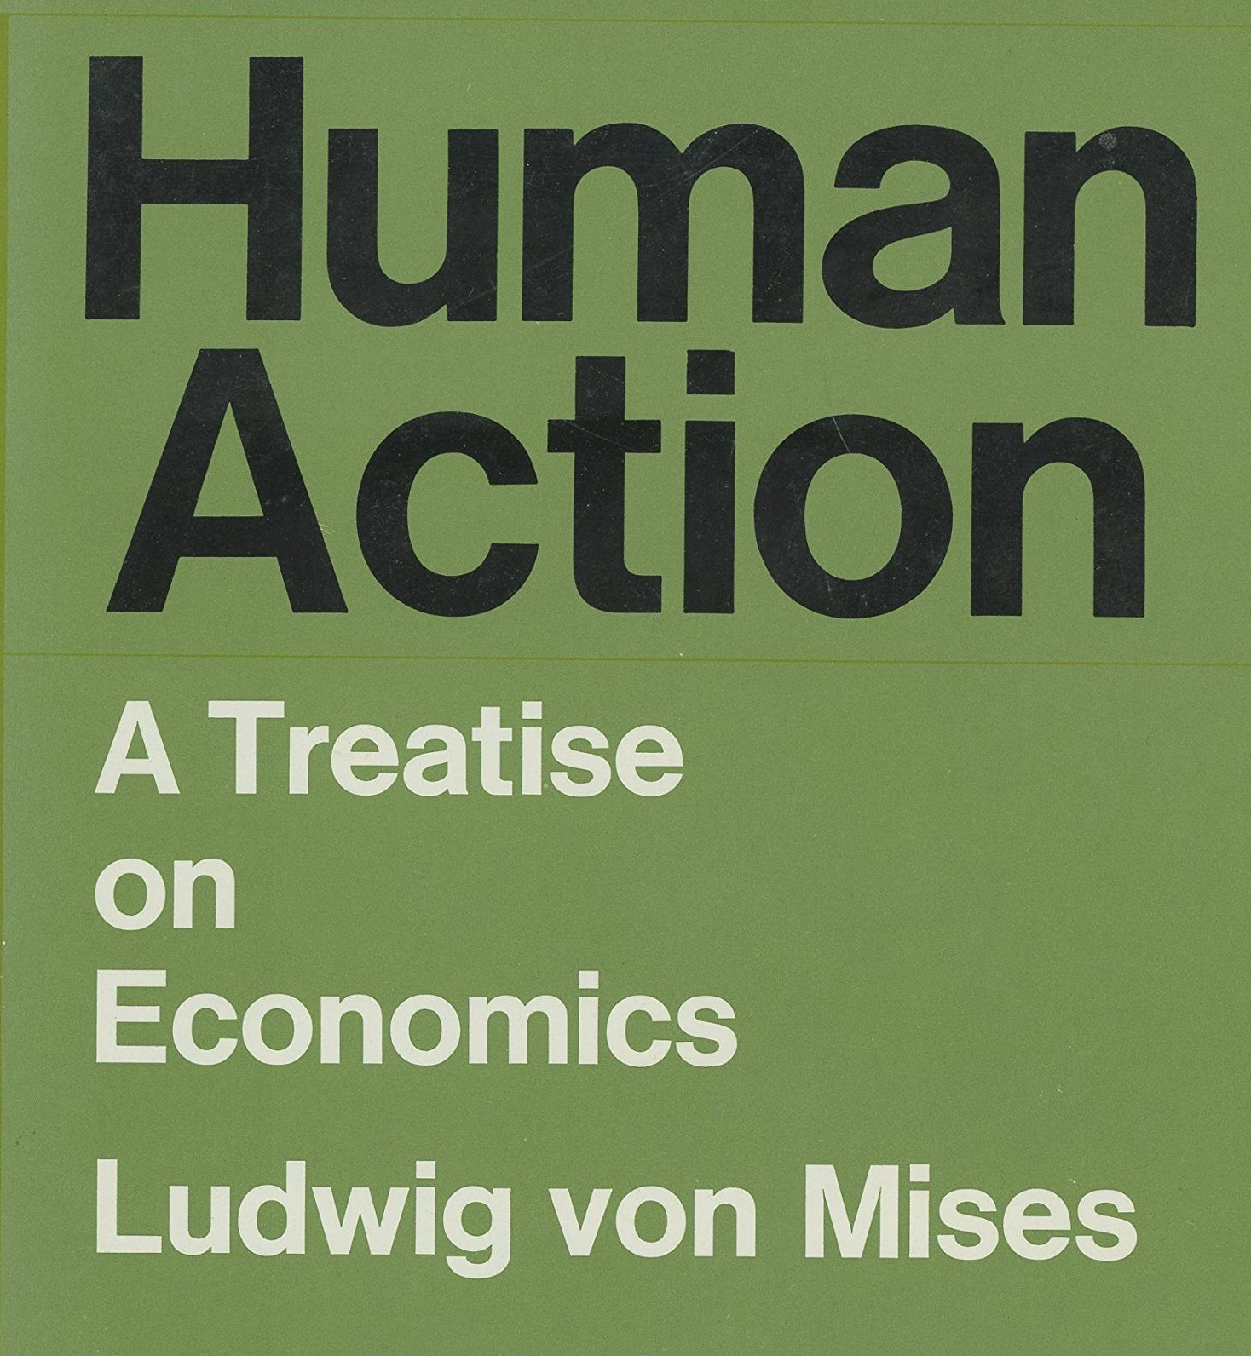
Mainstream views on entrepreneurship
Popular culture
  Bold, charismatic, creative individuals who introduce
  new products and services, who grow and scale
  startups, who transform industries
Mainstream economics
  Applied labor economics (self-employment), financial economics
  (venture capital), innovation (patenting)
Business schools
  Study of self-employment, startups, small business, family firms
  Largely aimed at training students to be better entrepreneurs
Austrian economics
  Positive, descriptive analysis of a specific type of human action and the central role it plays in the economy and society

Slide 3
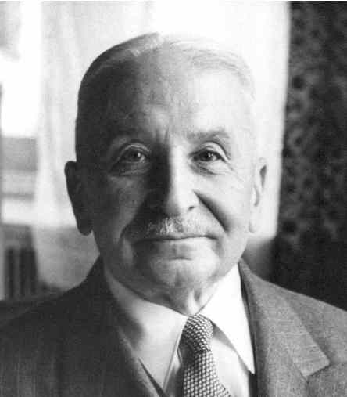
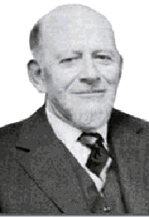
Entrepreneurship and its role in the economy and society
Entrepreneurship in the broad sense: bearing uncertainty
  “The term entrepreneur as used by [economic] theory means: acting man exclusively seen from the aspect of the uncertainty inherent in every action” (Mises, 1949).
Entrepreneurship in the narrow (commercial) sense: combining and recombining productive factors in pursuit of money profit
  “We are living in a world of unexpected change; hence capital combinations . . . will be ever changing, will be dissolved and reformed. In this activity, we find the real function of the entrepreneur” (Lachmann, 1956).
  Monetary (cardinal) revenues and costs
  Monetary profit and loss

Slide 4
Why entrepreneurship matters
“[I]t is impossible to eliminate the entrepreneur from the picture of a market economy. The various complementary factors of production cannot come together spontaneously. They need to be combined by the purposive efforts of men aiming at certain ends and motivated by the urge to improve their state of satisfaction. In eliminating the entrepreneur one eliminates the driving force of the whole market system” (Mises, 1949, p. 248).
Entrepreneurship as a general feature of the market economy
Not just self-employment, startups, tech firms
A praxeological category, not a personality trait

Slide 5


Austrian production theory
Inputs and outputs (means and ends)
  Original factors (land and labor), intermediate goods (capital goods), and final goods
  Typically, many possible factor combinations!
  Austrian capital theory (Cwik, tomorrow)
Time
Uncertainty
Imputation
  Marginal product
  Marginal revenue product

Slide 6
More details on imputation
Discounted marginal revenue product: money revenue attributed (“imputed”) to one unit of a factor, holding other factors constant, discounted by social rate of time preference (i.e., pure rate of interest)
  Establishes entrepreneur’s maximum willingness to pay for one unit of a factor.
Given competitive bidding by entrepreneurs, and absent uncertainty about future market conditions (Mises and Rothbard’s “evenly rotating economy”), the price of a factor will tend to equal its DMRP.
  The business owner’s money revenue just covers his money costs (including implicit interest and the opportunity cost of his own labor). No residual!
What about uncertainty?
Notes:
Isolable – value of the factor’s service can be appraised separately from those of the other factors
Specific factors – can only be used in one production process [largely ignored by mainstream production theory, which treats factor categories as schmoo]
Note that DMRP gives the maximum willingness to pay on the part of factor users; the actual price will depend on supply conditions as well [bargaining]

Slide 7






What about uncertainty?
Understanding uncertainty
  Not the same as probabilistic risk (Frank Knight, Richard von Mises)
  Future cannot be modeled mathematically—future can only be
  anticipated using tacit knowledge and understanding, judgment,
  intuition, gut feeling, heuristics
Entrepreneurial action under uncertainty
  Entrepreneurs compete for factors, based on their knowledge and beliefs about
    The present: technology, productive capabilities, resource availability
    The future: consumer demand, institutional conditions, competitor actions
    Actual DMRPs will only be revealed in the future.
  Results: profit and loss

Slide 8

The social function of profit
“If [entrepreneurs] fail to produce in the cheapest and best possible
way those commodities which the consumers are asking for most
urgently, they suffer losses and are finally eliminated from their
entrepreneurial position. Other men who know better how to serve
the consumers replace them” (Mises, 1951, p. 7).
  Not the same as the “convergence toward equilibrium”
“[T]he profit-maker is allocating factors where they had been undervalued as compared to the consumers’ desires. The greater a man’s profit has been, the more praiseworthy his role, for then the greater is the maladjustment that he alone has uncovered and is combatting. The greater a man’s losses, the more blameworthy he is, for the greater has been his contribution to maladjustment” (Rothbard, 1962, p. 515).

Slide 9

What profit is not
Interest
  Interest: reward for foregoing consumption
  Profit: reward for successfully bearing uncertainty
Accounting income
  Accounting income includes profit, interest, and the entrepreneur’s implicit wage.
  Economic concept of profit as a functional category, not a line item on the income statement
An automatic “return to capital”
A markup over production costs

Slide 10
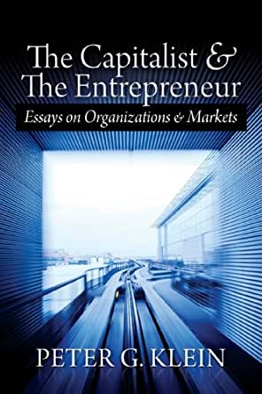
Entrepreneurship as judgment
Judgment: decision-making under uncertainty without a formal model or decision rule (intuition, gut feeling, Verstehen)
  “[T]he real entrepreneur is a speculator, a man eager to utilize his opinion about the future structure of the market for business operations promising profits. This specific anticipative understanding of the conditions of the uncertain future defies any rules and systematization. It can be neither taught nor learned. . . . [The entrepreneur] sees the past and the present as other people do; but he judges the future in a different way” (Mises, 1949, p. 585).
Judgment is manifest in ownership (Mises’s capitalist-entrepreneur”).
  Entrepreneur must own capital (taxi vs Uber drivers).
  Buying or renting factors (capital goods) in the present, deploying them in pursuit of profit in the (uncertain) future.

Slide 11
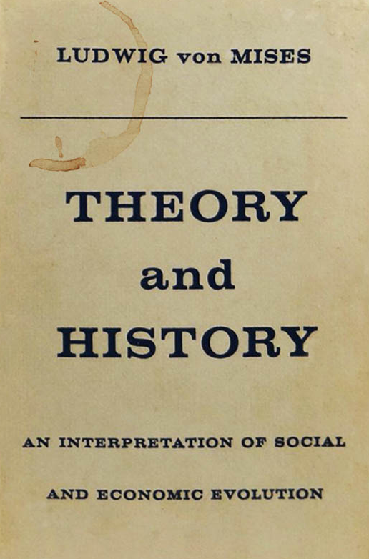
How do entrepreneurs think?
Opportunity-discovery view (based on a misreading of Israel Kirzner): Entrepreneurs have a flash of insight, then pursue opportunities without regard to resources currently at hand
Bricolage/effectuation view: Entrepreneurs use what they have, without a goal in mind
Theory-based view / “scientific method”: Entrepreneurs (should) think like scientists, formulating and testing hypotheses, revising beliefs using Bayesian updating (“naïve Popperianism”)
Austrian view: entrepreneurs as “historians of the future” (Mises)
  Praxeology: logical, deductive, general theory of human action
  Thymology: qualitative, interpretive study of choices made by specific human actors (thymos = soul, spirit, heart)
  History: empirical reconstruction of past actions and their meaning in context, using both praxeology and thymology
  Techniques used by the historian of the future: motivational projection, empathic understanding, future-oriented typification, scenario analysis, counterfactuals, analogy, institutional imagination

