Slide 1
Banking
Jonathan Newman
Notes:
ID=d924773e-9a16-4d6d-9803-8cb819e99682
Recipe=text_billboard
Type=TextOnly
Variant=0
FamilyID=AccentBoxWalbaum_Zero

Slide 2


Slide 3

Mises’s Typology of Money
Money in the broader sense
  Money in the narrower sense
    Commodity money
    Credit money
    Fiat money
  Money substitutes
    Fiduciary media
    Money certificates

Slide 4
What is a checking account?
Bank 1
Bank 2
Bank 3
“Available balance: The amount of money in your account that you can use right now.”
“You can use your debit card at participating merchants to: Purchase goods and services.”
“Our deposit relationship with you is that of debtor and creditor.”
Deposited money is “your money.”
“Your account’s available balance is our most current record of the amount of money in your account available for your use or withdrawal.”
“Each co-owner has complete control over all of the funds in the account.”
🚩

Slide 5
“Promises, promises”
Bank 1
Bank 2
Bank 3
Noninterest bearing deposits: $620.4 billion
Reserves: $343.3 billion
Difference: $277.1 billion
Loans: $1,397 billion
Noninterest bearing deposits: $532 billion
Reserves: $231.8 billion
Difference: $300.2 billion
Loans: $1,172 billion
Noninterest bearing deposits: $365.4 billion
Reserves: $174.2 billion
Difference: $191.2 billion
Loans: $972.4 billion

Slide 6
What’s going on here?
Banks call money in your checking account your money. They say it is available for withdrawal and purchases at par on demand. They say you have complete control over it.
Banks do not keep all deposits backed by reserves. Instead, they make loans to Uncle Sam, businesses, and consumers.

Slide 7
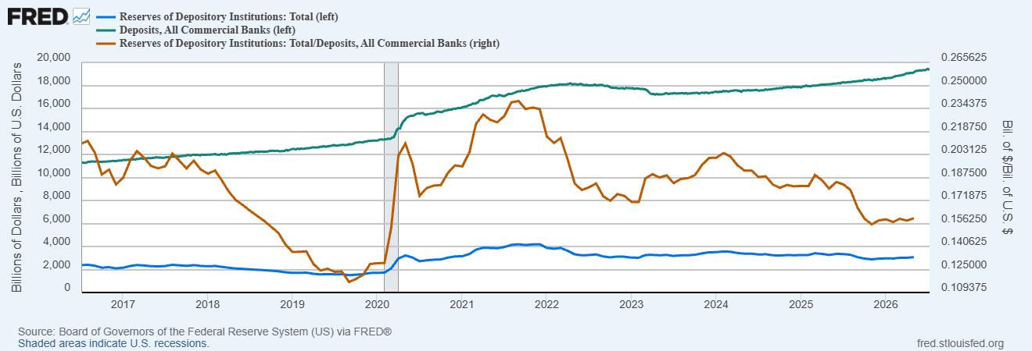

Slide 8
Two functions:
Deposit banking
Loan banking
Bank is a “money warehouse.”
“As in the case of any warehouse, the depositor placed his goods on deposit or in trust at the warehouse, and in return received a ticket (or warehouse receipt) stating that he could redeem his goods whenever he presented the ticket at the warehouse.” (MoB, p. 85)
Bank is a financial intermediary.
The bank is “borrowing money from some (in addition to investing the savings of the owners) and lending money to others.” (MoB, p. 82)

Slide 9
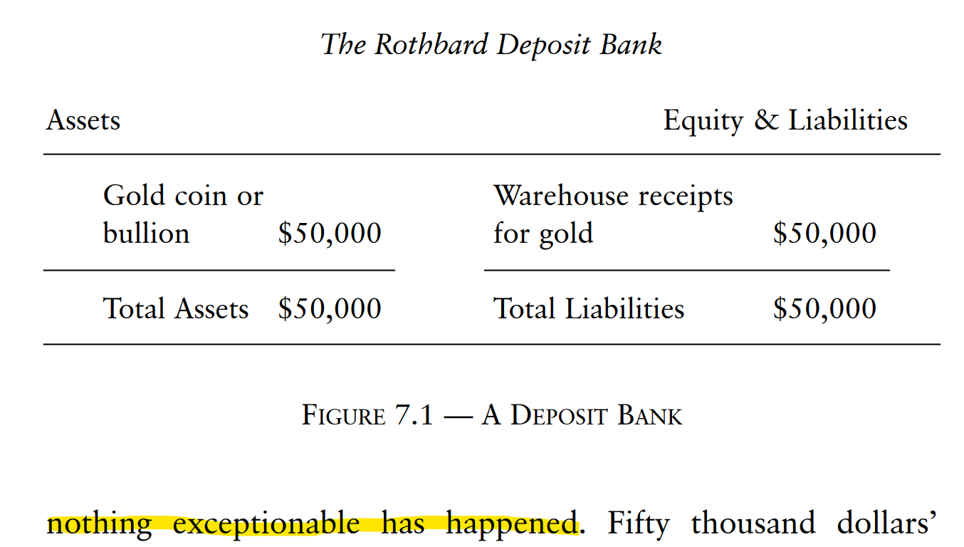
Pure Deposit Banking

Slide 10
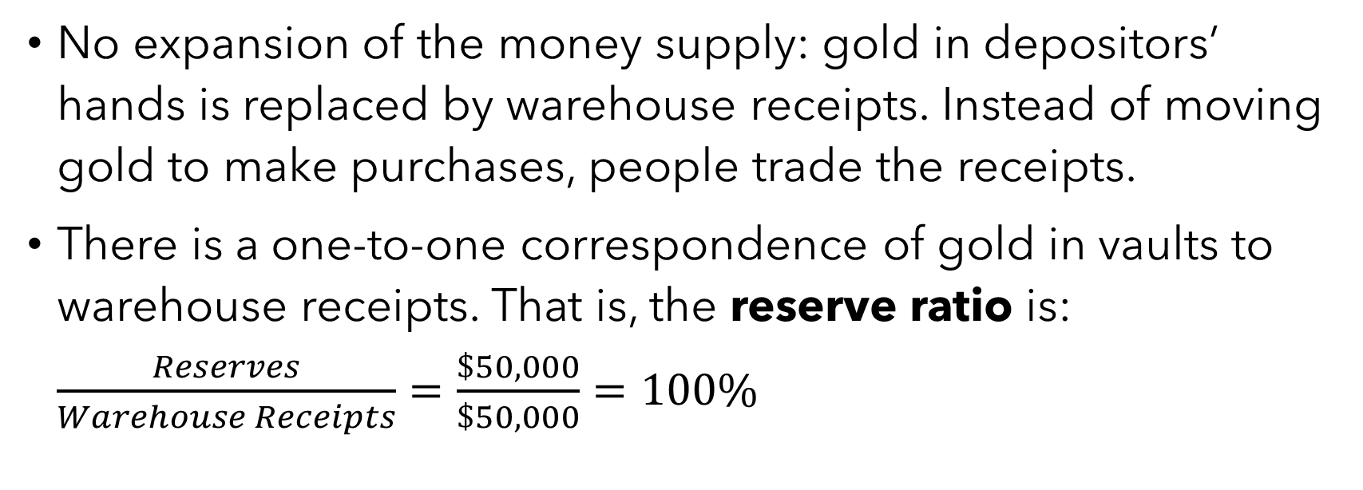
Pure Deposit Banking
No expansion of the money supply: gold in depositors’ hands is replaced by warehouse receipts. Instead of moving gold to make purchases, people trade the receipts.
There is a one-to-one correspondence of gold in vaults to warehouse receipts. That is, the reserve ratio is: $\frac{Reserves}{Warehouse Receipts}=\frac{\$50,000}{\$50,000}=100\%$

Slide 11
Pure Deposit Banking

Slide 12
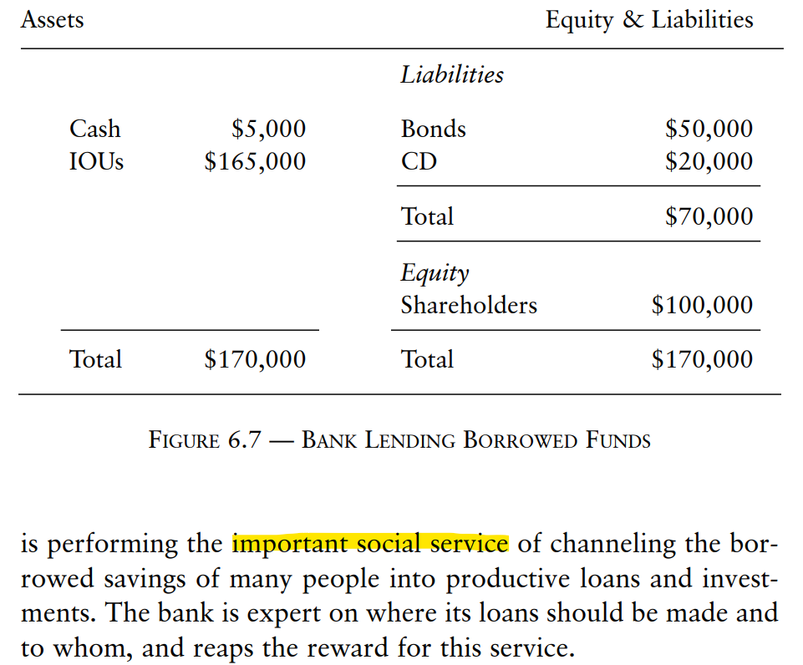
Pure Loan Banking

Slide 13
Pure Loan Banking
No expansion of the money supply: owners invest and creditors lend money to the bank and then that money is lent to borrowers.
The bank earns money by borrowing at lower rates than it lends. Ex: offers CDs at 10% and lends at 15%.
“If its administrative expenses of operation are, say, 2%, it is able to make a 3% profit on the entire transaction.”

Slide 14
Pure Loan Banking
Assets |  | Liabilities
1 year loan | $10,000 | 1 year CD | $10,000
3 year loan | $20,000 | 3 year CD | $20,000
5 year loan | $40,000 | 5 year CD | $40,000
No maturity mismatching required.

Slide 15
Fractional Reserve Banking
“The irresistible temptation now emerges for the goldsmith or other deposit banker to commit fraud and inflation: to engage, in short, in fractional reserve banking, where total cash reserves are lower, by some fraction, than the warehouse receipts outstanding.” (MoB, p. 96)
New subtype of money: the unbacked money substitute, i.e., FIDUCIARY MEDIA.

Slide 16
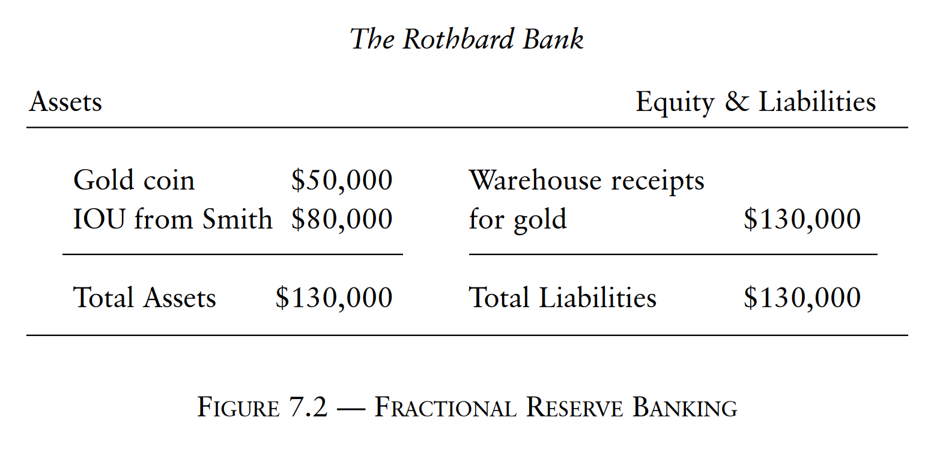
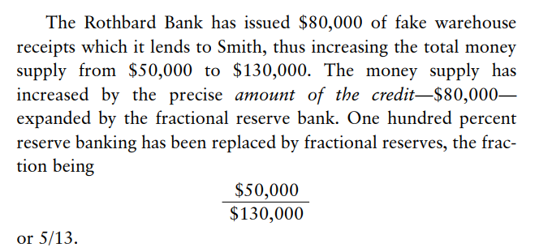
Fractional Reserve Banking

Slide 17
Fractional Reserve Banking
“In short, the deposit banker has suddenly become a loan banker; the difference is that he is not taking his own savings or borrowing in order to lend to consumers or investors. Instead he is taking someone else’s money and lending it out at the same time that the depositor thinks his money is still available for him to redeem. Or rather, and even worse, the banker issues fake warehouse receipts and lends them out as if they were real warehouse receipts represented by cash.” (MoB, p. 96)

Slide 18


Reserve Ratios and Money Multipliers
Fractional reserve banking leads to an increase in the supply of money.
1st Bank of Auburn
Assets |  | Liabilities
Res. | $100 | Dep. | $1000
Loan | $900
2nd Bank of Auburn
Assets |  | Liabilities
Res. | $90 | Dep. | $900
Loan | $810
3rd Bank of Auburn
Assets |  | Liabilities
Res. | $81 | Dep. | $810
Loan | $729
Step | 1 | 2 | 3 | … | ∞
MS | $1000 | $1900 | $2710 | … | $10,000
$$MM=\frac{1}{RR}=\frac{1}{0.1}=10$$

Slide 19
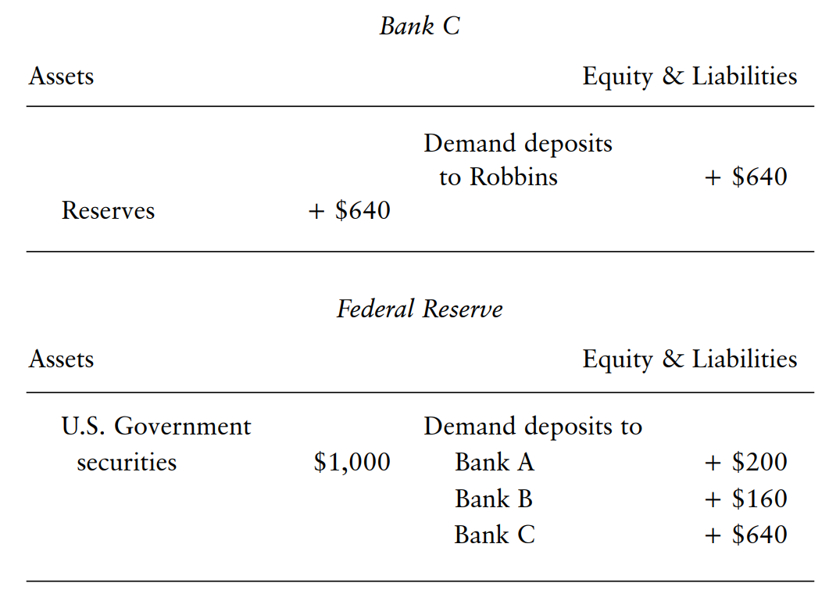
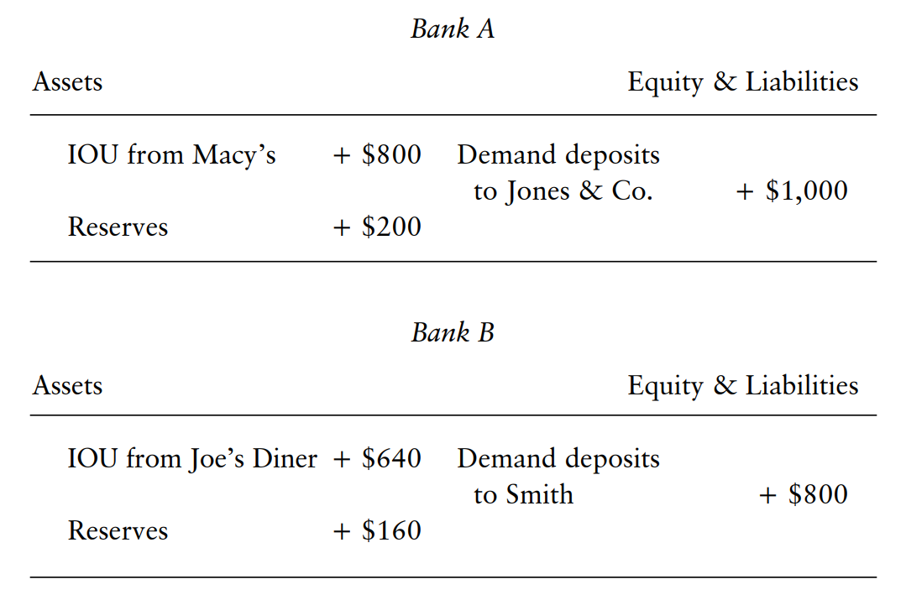
$1000 + $800 + $640 + … = $5000

Slide 20
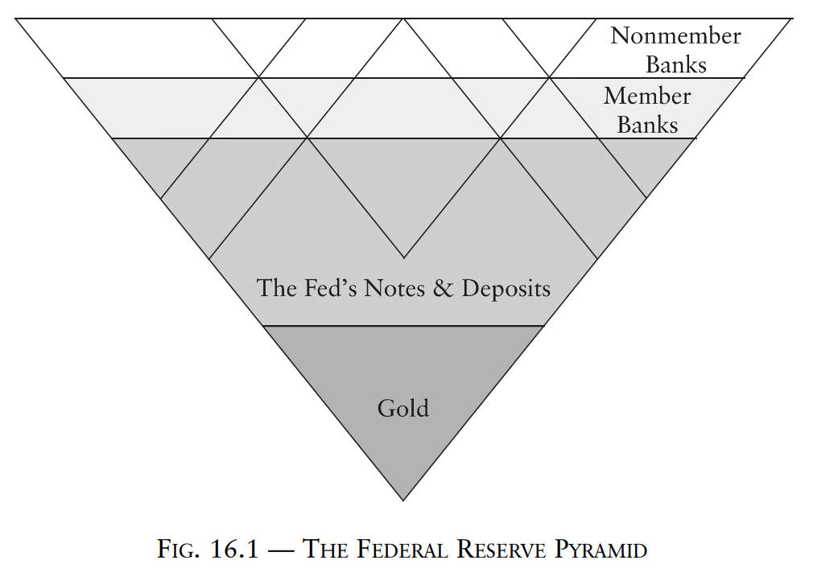

Slide 21


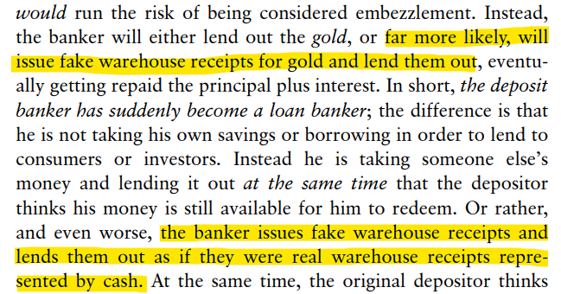
“It’s loan-deposit, not deposit-loan!!1”
Now watch this putt.

Slide 22

credit creation
an
intermediary
whatever helps me justify my hatred of Rothbard

Slide 23
The Whole Elephant
Individual fractional reserve banks create money/credit ex nihilo.
Banks intermediate real savings to the extent that they use funds that have actually been relinquished by savers. (But putting money in a checking account is not the same as saving.)
To see the money multiplier, you have to follow multiple steps.

Slide 24
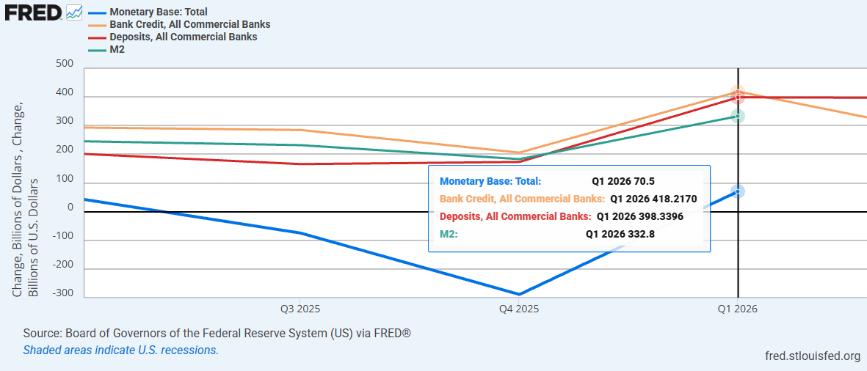

Slide 25
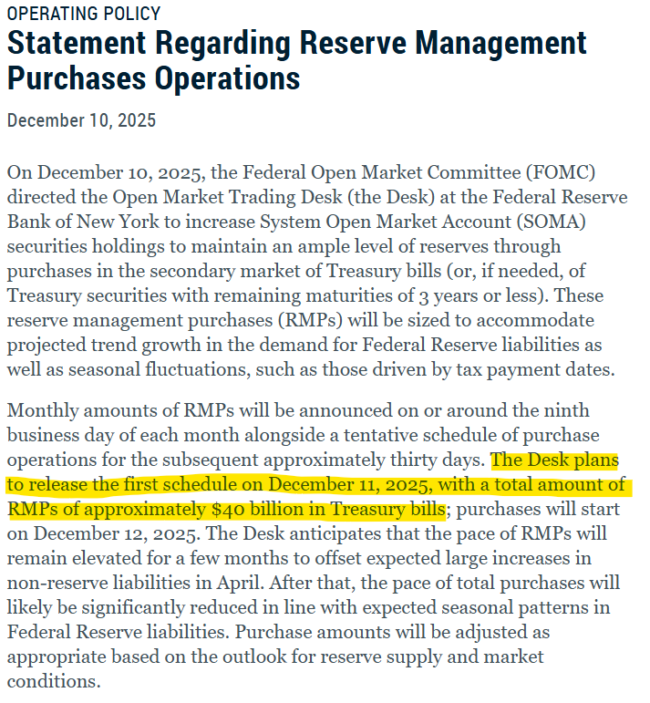
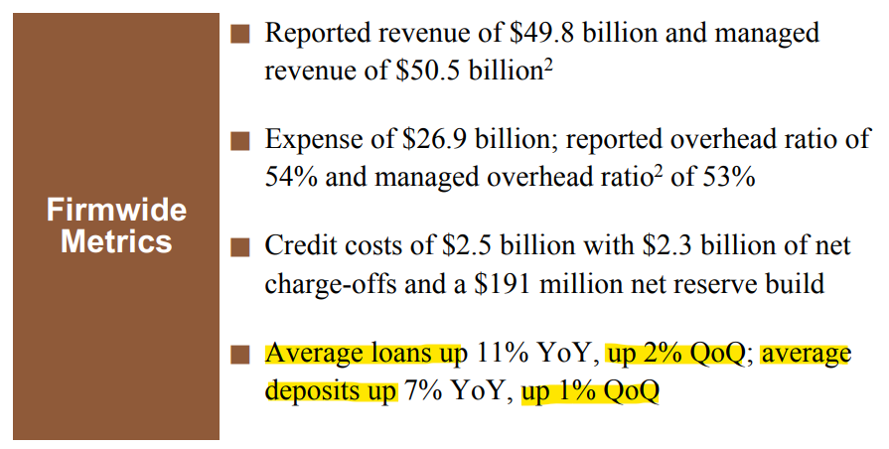


Q4 2025 to Q1 2026
The monetary base increased by $70.5B.
  Primary dealers (e.g., JPM, BoA, Citi, etc.) sell Treasuries to the Fed. The Fed buys with new reserves.
Flush with new reserves, these primary dealers expand credit by creating deposits. Bank credit expanded $418.2B. Deposits expanded $398.3B.
$$≈\$30 billion$$
$$≈\$26 billion$$

Slide 26



Real world multipliers
$\frac{∆M2}{∆MB}=\frac{\$332.8 billion}{\$70.5 billion}=4.72$
$\frac{∆Bank Credit}{∆MB}=\frac{\$418.2 billion}{\$70.5 billion}=5.93$
$\frac{∆Deposits}{∆MB}=\frac{\$398.3 billion}{\$70.5 billion}=5.65$
$$RR≈17\%$$

Slide 27
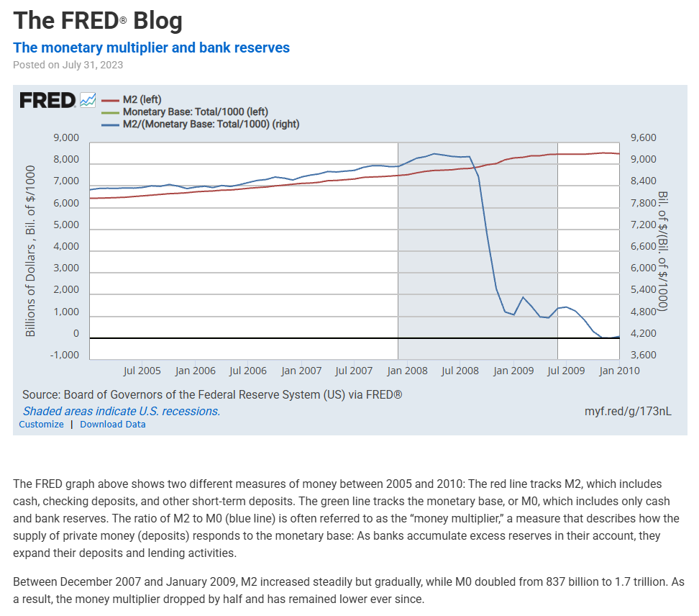
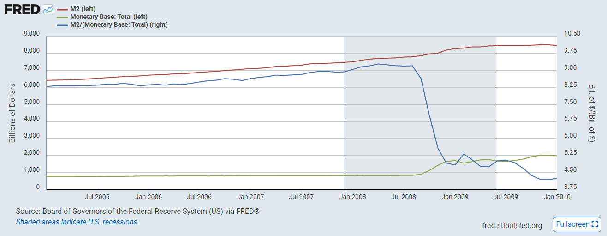



Slide 28
Central Banking + Fractional Reserve Banking
Fractional reserve banks are subject to runs.
Bank competition also limits how much fiduciary media individual banks can issue.
This creates an incentive to cartelize under a central bank, which ensures proportional expansion and provides a lender of last resort.
This does not solve the inherent problems of fractional reserve banking, but institutionalizes them and shifts the costs to taxpayers/money holders.

