Slide 1
Tariffs v Free Trade
Mises University 2026

Slide 2
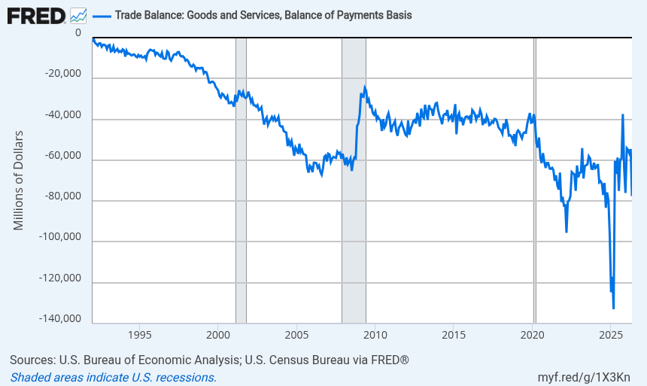
“Look at the deficits we have” Pres. D. Trump

Slide 3
Tariffs v Free Trade
Mises University 2026

Slide 4
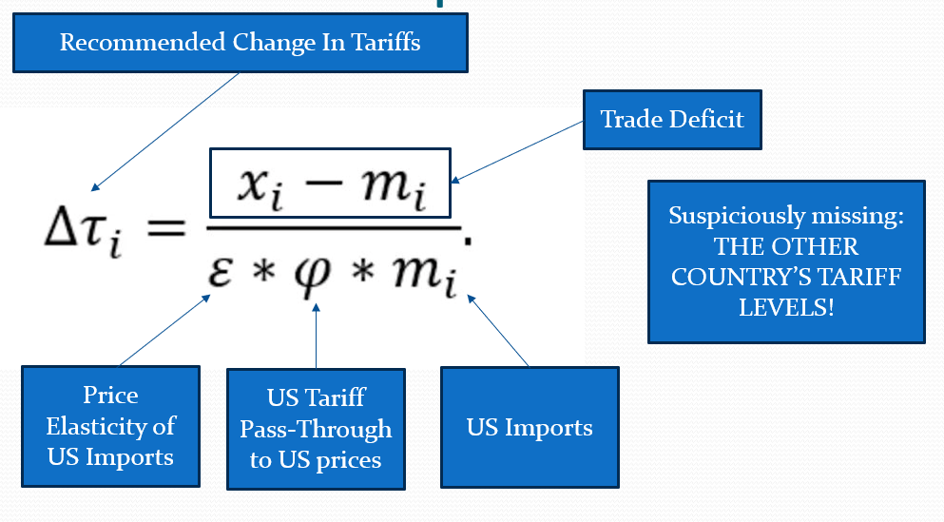
US Trade Rep’s Tariff Equation

Slide 5

US Trade Rep’s Tariff Equation (rewritten)
$Δτ_{i} ∗φ ∗ε ∗m_{i}=x_{i}−m_{i}$
First term = change in tariffs
First term * Second term = % change in prices from tariff pass-through
First term * Second term * third term = % change in imports based on % change in prices
Left-hand-side: $ change in imports from the increase in tariffs

Slide 6
Tariffs v Free Trade
Mises University 2026

