Slide 1

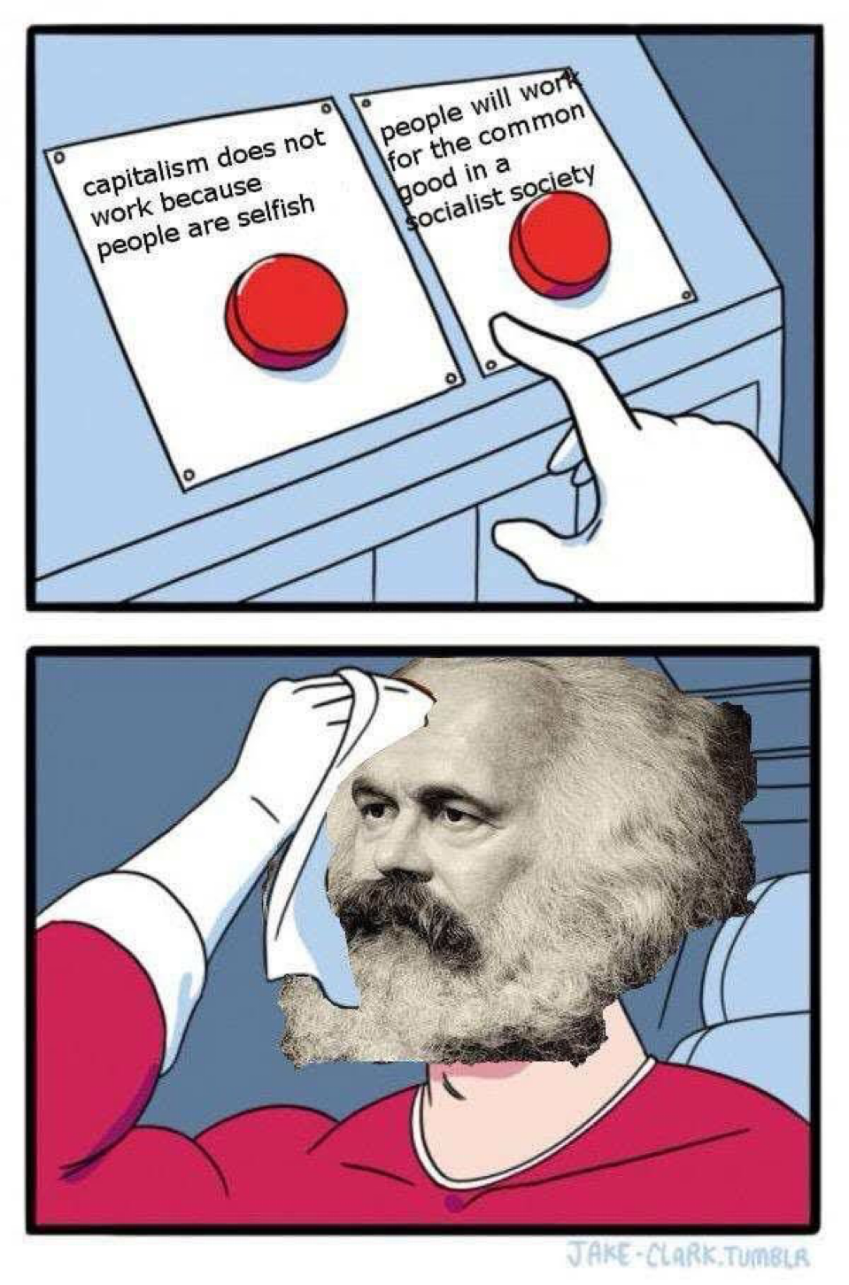

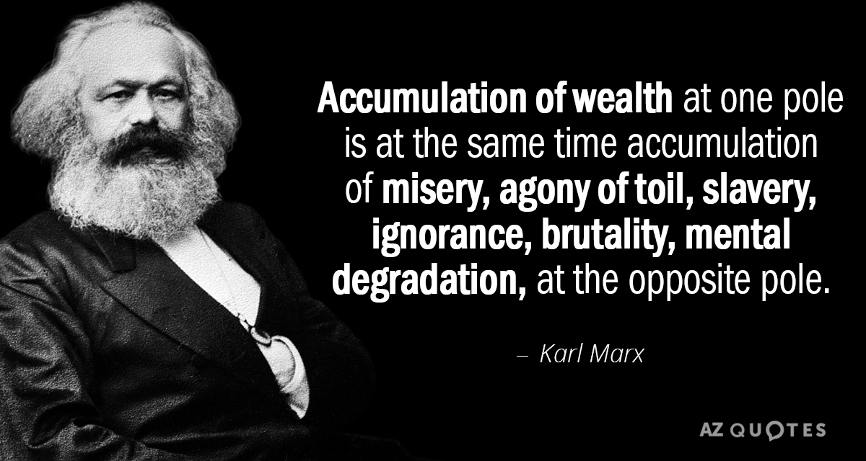
Common Objections to Capitalism
Who will build the roads?
www.davidicke.com/
Who will keep big business accountable?
Mises University 2025
Timothy D. Terrell
Notes:
[see Gramm, Ekelund, Early]
https://www.cato.org/sites/cato.org/files/serials/files/regulation/2014/10/regulationv37n3-9.pdf

Slide 2
What Is “Capitalism”?
What is capitalism?
Objections to capitalism
Not “crony capitalism”
“Free markets” might be a preferable term in some ways—no ambiguity.
The rich get richer and the poor get poorer
Socialism works in Europe!
Capitalism puts profits ahead of people
Capitalism leaves people without medical care
Capitalism won’t make socially important investments
Capitalism is racist and sexist

Slide 3
1. “The Rich Get Richer and the Poor Get Poorer”
“Today, of Americans officially designated as ‘poor,’ 99 percent have electricity, running water, flush toilets, and a refrigerator; 95 per cent have a television, 88 per cent a telephone, 71 per cent a car and 70 per cent air conditioning. Cornelius Vanderbilt had none of these.”
--Matt Ridley, The Rational Optimist
Wealth is not a fixed amount
Free markets have broadly increased living standards, not just for the “rich”
  98% of US adults own a cell phone, and for 91%, it’s a smartphone (2024, Pew).
Notes:
Increased specialization and international division of labor, increasing the “superstar” effect
Increased immigration
High earners tend to marry each other more than they once did
…It is a fact that the hatred of capitalism originated not with the masses, not among the workers themselves, but among the landed aristocracy—the gentry, the nobility, of England and the European continent. They blamed capitalism for something that was not very pleasant for them: at the beginning of the nineteenth century, the higher wages paid by industry to its workers forced the landed gentry to pay equally higher wages to their agricultural workers. The aristocracy attacked the industries by criticizing the standard of living of the masses of the workers.
The famous old story, repeated hundreds of times, that the factories employed women and children and that these women and children, before they were working in factories, had lived under satisfactory conditions, is one of the greatest falsehoods of history. The mothers who worked in the factories had nothing to cook with; they did not leave their homes and their kitchens to go into the factories, they went into factories because they had no kitchens, and if they had a kitchen they had no food to cook in those kitchens. And the children did not come from comfortable nurseries. They were starving and dying. And all the talk about the so-called unspeakable horror of early capitalism can be refuted by a single statistic: precisely in these years in which British capitalism developed, precisely in the age called the Industrial Revolution in England, in the years from 1760 to 1830, precisely in those years the population of England doubled, which means that hundreds or thousands of children—who would have died in preceding times—survived and grew to become men and women.

Slide 4
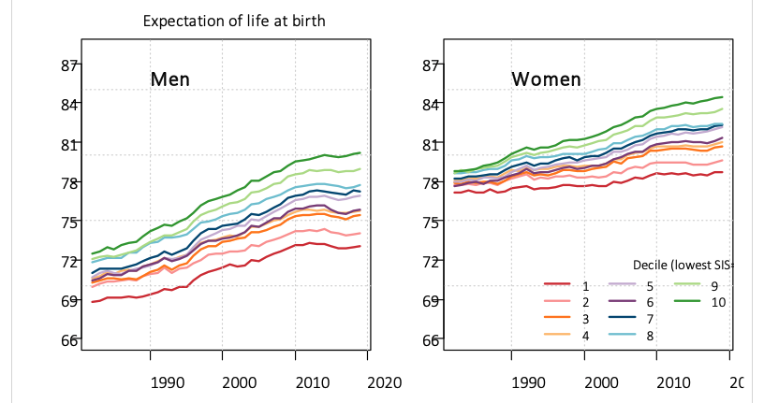
(in years) by socioeconomic decile for each sex, 1982–2019
Barbieri (2022): https://www.soa.org/globalassets/assets/files/resources/research-report/2020/mort-socioeconomic-cat-report.pdf

Slide 5





Things Are Getting Better…
Before the Industrial Revolution, the typical homes “had formidable drawbacks; they rotted from alternations of wet and dry, harbored a menagerie of mice, rats, hornets, wasps, spiders and birds; and above all they caught fire.” (Frances and Joseph Gies, cited in Gramm and Boudreaux, The Triumph of Economic Freedom: Debunking the Seven Great Myths of Capitalism)
Does anyone want to trade lives with someone in the top 0.1% in 1900?
  No antibiotics
  Primitive anesthesia and surgical techniques
  No mechanical air conditioning or refrigeration
  Slow travel and expensive, limited communication
  No TV or radio
Notes:
“An entire generation, which is now becoming one of the largest electorates in America, came of age and never saw American prosperity. I have never seen that, or experienced it, really, in my adult life.”
-- Alexandria Ocasio-Cortez, 2019
https://time.com/5555437/alexandria-ocasio-cortez-profile/
Overall life expectancy in the US in 1900 was 47.3 years.

Slide 6
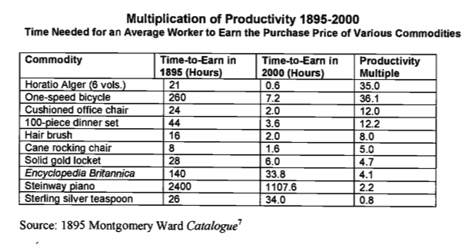
J. Bradford DeLong, 2000. “Cornucopia: The Pace of Economic Growth in the Twentieth Century.“ https://www.nber.org/system/files/working_papers/w7602/w7602.pdf

Slide 7
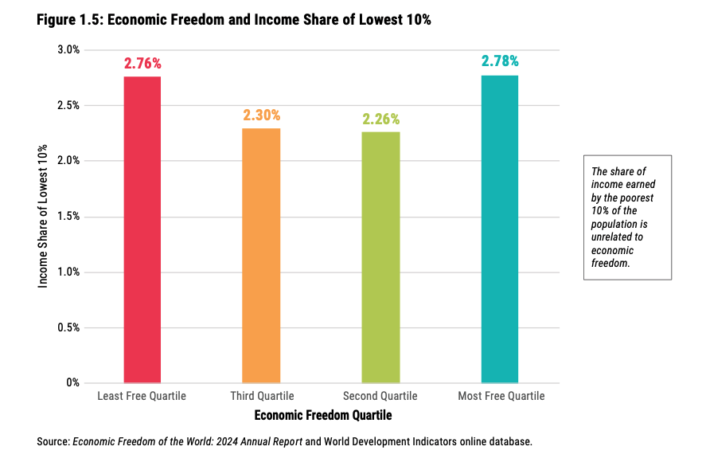

Slide 8
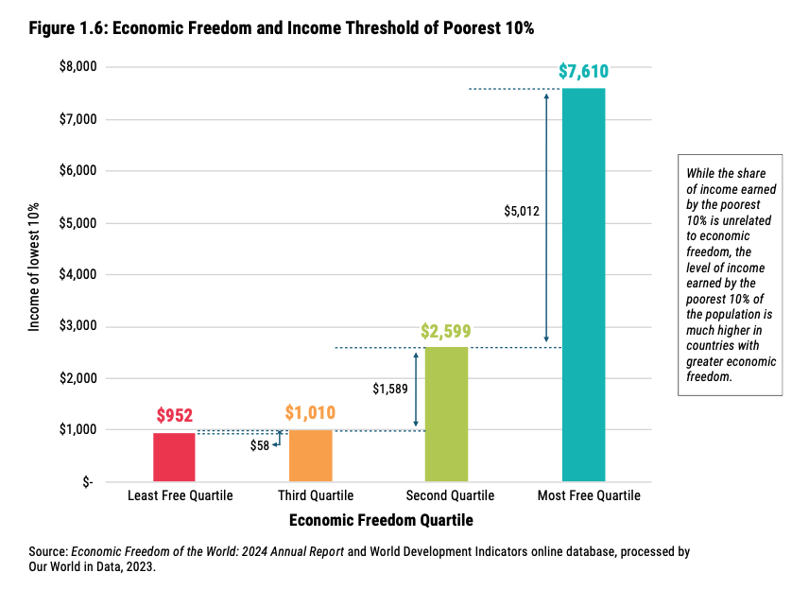
https://www.fraserinstitute.org/sites/default/files/2024-10/economic-freedom-of-the-world-2024.pdf

Slide 9
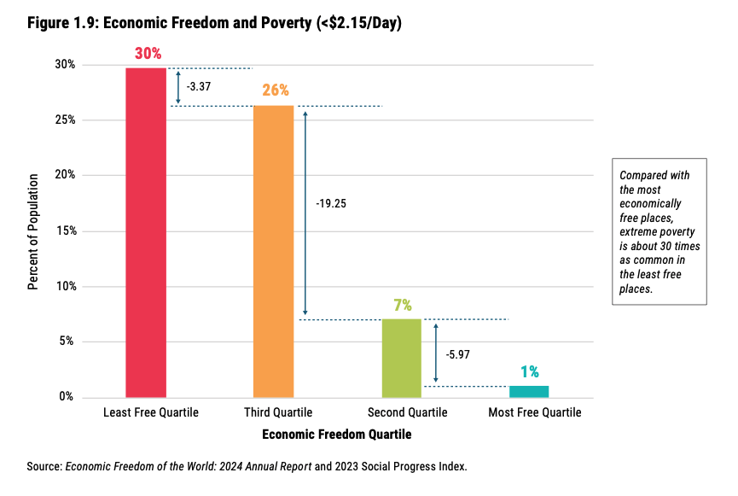
https://www.fraserinstitute.org/sites/default/files/2024-10/economic-freedom-of-the-world-2024.pdf

Slide 10
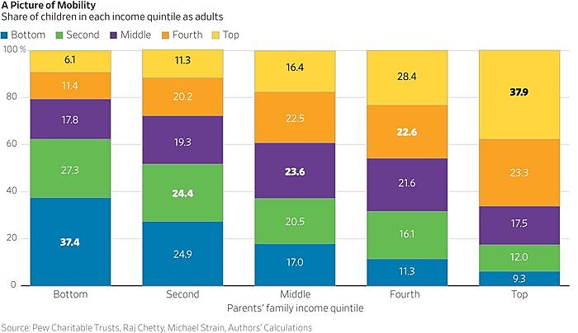
Income Mobility Matters
Source: John F. Early and Phil Gramm, 2023.
https://www.cato.org/commentary/upward-mobility-alive-well-america

Slide 11
Note that this is only relative mobility. But “the vast majority of adult children had higher real incomes than their parents.”
Source: John F. Early and Phil Gramm, 2023.
https://www.cato.org/commentary/upward-mobility-alive-well-america

Slide 12
After adjusting for inflation, “Only 28% of children reared in the bottom quintile had adult incomes that would put them in the bottom childhood quintile, and 26% rose all the way to the childhood top quintile.” -- Early and Gramm (2023)
Source: John F. Early and Phil Gramm, 2023.
https://www.cato.org/commentary/upward-mobility-alive-well-america
Notes:
Among the highest-income Americans, there is a lot of “churn.” A study of the top 400 highest income taxpayers in 15 tax years from the 1990s and early 2000s (https://taxfoundation.org/blog/irs-report-shows-rich-are-not-monolithic/) showed that over 15 tax years, only 2% of these high-income people appeared in the list every year, and only 27 percent appear more than once.

Slide 13
More inequality?
But…
Increased specialization and international division of labor, increasing the “superstar” effect
Increased immigration
High earners tend to marry each other more than they once did
IQ score spreads are shrinking as low scores rise
British aristocrats were 6 inches taller than average in 1800; today they are less than 2 inches taller
Some data from Matt Ridley, The Rational Optimist
Notes:
Also higher effective tax rates when considering lost welfare benefits

Slide 14
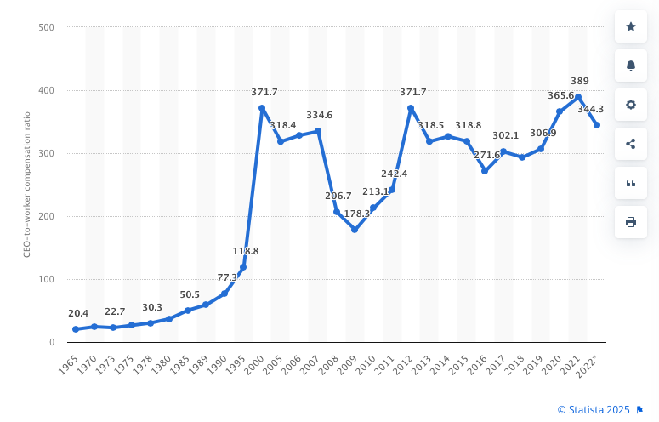
Aggregated CEO-to-Worker Compensation Ratio for the 350 Largest Publicly Owned Companies in the US from 1965 to 2022
https://www.statista.com/statistics/261463/ceo-to-worker-compensation-ratio-of-top-firms-in-the-us/
Old fallacy: compensation is a fixed “pot,” out of which CEOs and other workers must be paid—so more for the CEO means less for everybody else.
Notes:
Some problems: the average size of the “350 Largest Publicly Owned Companies” has increased, so it’s easier to understand why CEO compensation might have increased as well. Gabaix and Landier (2008): “The sixfold increase of CEO pay between 1980 and 2003 can be fully attributed to the six-fold increase in market capitalization of large US companies during that period.” https://xgabaix.scholars.harvard.edu/sites/g/files/omnuum7761/files/xgabaix/files/why_has_ceo_pay_increased.pdf
See Matt Palumbo, June 6, 2015 https://mises.org/library/myth-ceo-pay-and-greed

Slide 15
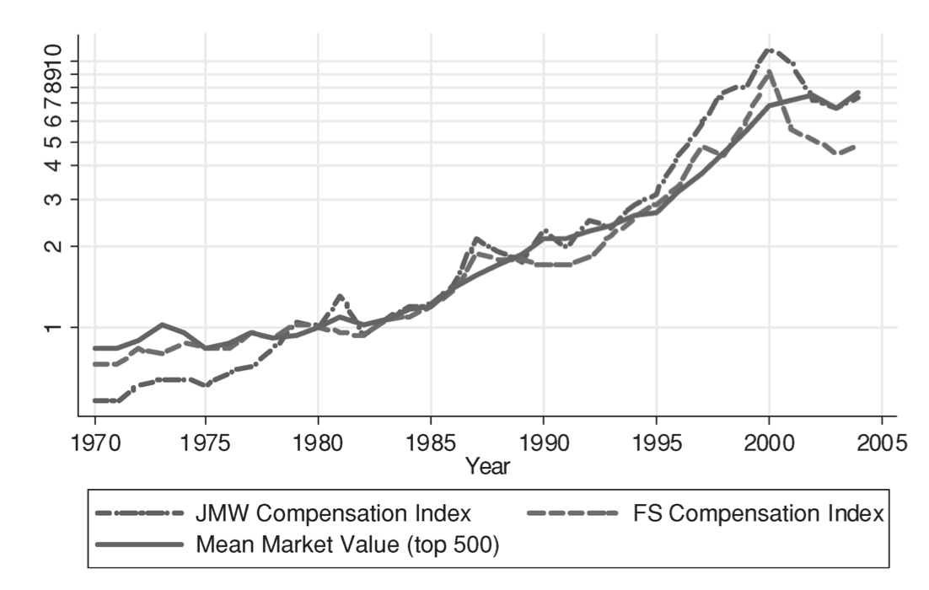
Xavier Gabaix and Augustin Landier, “Why Has CEO Pay Increased So Much?” Quarterly Journal of Economics, Feb. 2008; vol. 123, no. 1: 49–100. Fig. 1.
https://www.jstor.org/stable/25098894?seq=2

Slide 16


Piketty and Inequality
Thomas Piketty (Capital in the Twenty-First Century, 2013) “alerted Americans to a body of research that had been developed over more than a decade, showing both income and wealth growing sharply more unequal around the world.” (Britton-Purdy [2015])
Piketty worried about an “endless inegalitarian spiral” where people like “landlords and oil well owners… could easily come to own everything that can be owned… once and for all.”
  Rothbard showed why this can’t happen—a single big firm or cartel of firms could not refer to external markets and therefore could not calculate rationally.
Britton-Purdy, Jedediah (2015). “Wealth and Democracy,” Nomos 58: 235–260.

Slide 17
Concentration of Wealth
Louis Rouanet: “The major flaw of Piketty’s book is that he explains inequality not by starting from consumers’ choice but by starting from capital ownership.”
“For Piketty, the rate of return on capital is a mythical stream of income which depends not upon ownership abilities but on how much capital you own.”
“On the unhampered market, the rich can accumulate more wealth only if he is efficient to the task of allocating capital, for the benefit of all.”
Louis Rouanet, “Piketty Is Wrong: Markets Don’t Concentrate Wealth,” https://mises.org/mises-wire/piketty-wrong-markets-dont-concentrate-wealth

Slide 18
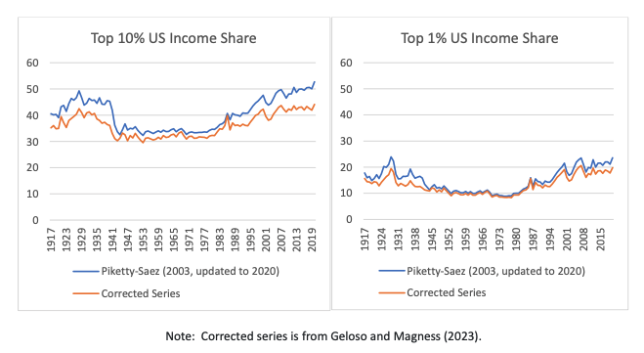
How Much Has Inequality Really Been Rising?

Slide 19
“Taken in sum, the century-long level of top income distribution is lower than what Piketty-Saez claim, but the Piketty-Saez series also tends to exaggerate inequality with greater severity at both ends of the U-curve.” (Magness, 2024)
”A larger downward revision is almost certainly warranted, but also remains more difficult to estimate due to limitations in available data.” (Magness, 2024)
Magness, Phillip, “The Problems with Piketty's Data” (August 13, 2024). SSRN: https://ssrn.com/abstract=4924917 or http://dx.doi.org/10.2139/ssrn.4924917
Geloso, Vincent, and Phillip Magness, “A Methodologically Consistent Measure of Income Inequality in the United States, 1917 to 2020.” (August 5, 2023). GMU Working Paper in Economics No. 23-30, SSRN: https://ssrn.com/abstract=4532761 or http://dx.doi.org/10.2139/ssrn.4532761

Slide 20
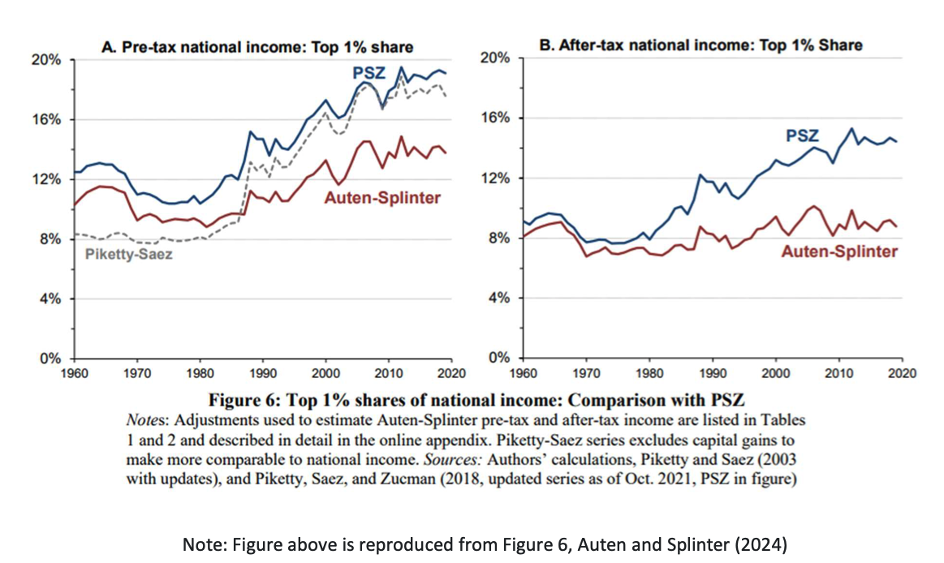
Auten, G., and D. Splinter. 2024. “Income Inequality in the United States: Using Tax Data to Measure Long-Term Trends.” Journal of Political Economy, 132–37.
Notes:
“The Auten-Splinter series makes a specific effort to account for the 1986 tax code changes, as well as other trends that have affected the distribution of income over time such as changing marriage rates and a number of assumptions about unreported tax evasion. Their series only extends back to 1960 due to its reliance on IRS micro-file sampling, which is not available in earlier years. …While the new series shows an increase in top income concentration since the 1980s, the depicted rise is substantially more subdued than Piketty-Saez or their own broader DINA series.”
“Of equal significance, Auten and Splinter are able to capture the effects of transfer payments and after-tax income levels. …The claimed rise in top income concentrations dissipates. In fact, the after-tax income distribution of the top 1% as of 2018 has barely moved from where it sat in the mid-1960s.” (Magness 2024)

Slide 21
How Much Has Inequality Really Been Rising?
There is “a tendency in the PSZ literature to adopt discretionary data construction choices as well as accounting errors that tilt in a non-random direction. Almost all of their accounting differences with Geloso et al. (2022) and Geloso-Magness (2023) have the effect of exaggerating income inequality at the two tails of the U, whereas almost all of their imputation differences with Auten-Splinter (2023) have the effect of increasing the magnitude and pace of rising inequality after 1980.” (Magness 2024)
Notes:
Which is an academic way of saying they’re partisan hacks who twisted the data to serve their ends.

Slide 22
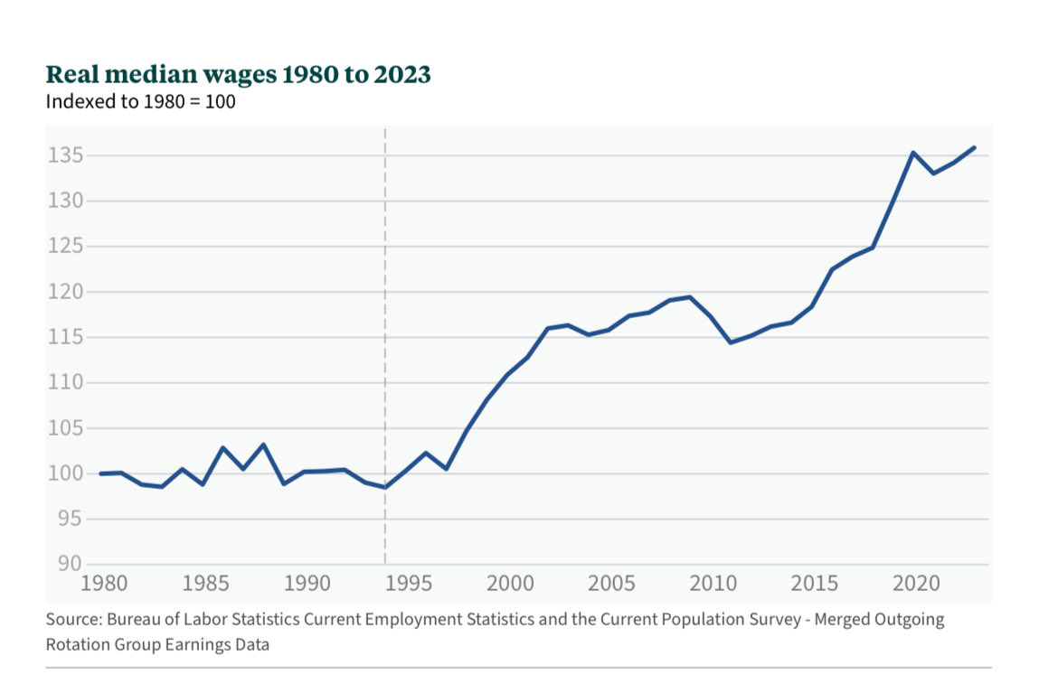

Slide 23
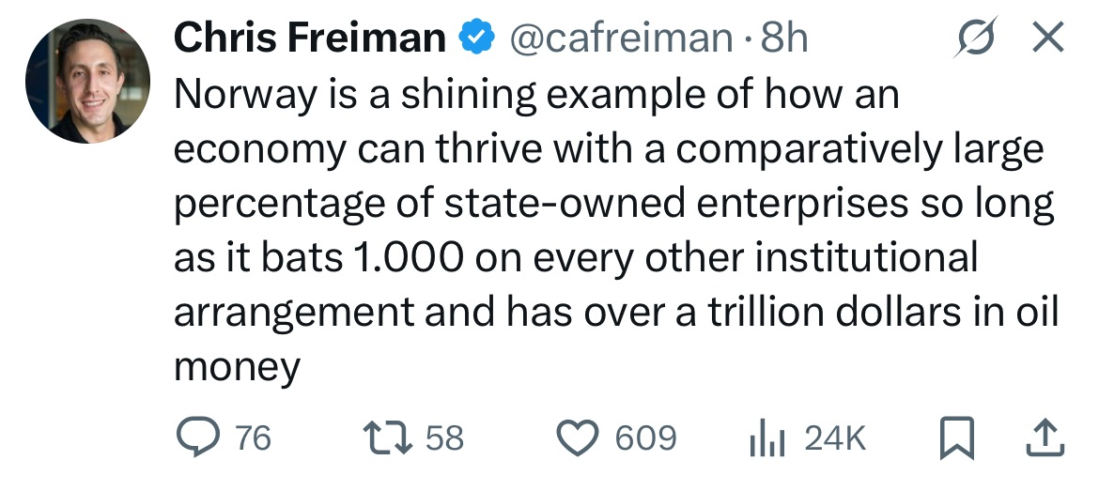
2. “Socialism Works in Europe”
Economic Freedom of the World Ranking (2023 annual report; 2021 data)
Top 30 Nations
  Singapore
  Hong Kong SAR, China
  Switzerland
  New Zealand
  United States
  Ireland
  Denmark
  Australia
  United Kingdom
  Canada
  Taiwan
  Estonia (tied for 12th)
  Lithuania (tied for 12th)
  Iceland
  Luxembourg (tied for 15th)
Mauritius (tied for 15th)
Czechia
Finland
Sweden
Japan
Costa Rica (tied for 21st)
Netherlands (tied for 21st
Germany (tied for 23rd)
Malta (tied for 23rd)
Georgia (tied for 25th)
Latvia (tied for 25th)
Romania
Austria
Norway
Chile
Notes:
The Netherlands, and Denmark (another “socialist” nation) are ranked #21, and 7, respectively. This puts them well within the top quartile of economic freedom (the US ranks #5). Their socialism “works” relative to many other countries because they are less consistent with it. It’s diluted with a large measure of important other freedoms.
US score: 8.14. Netherlands: 7.76. Denmark: 8.10. The Netherlands ranks:
#8 on the legal system and property rights
#58 on the monetary system, and
#14 on freedom to trade internationally.
The Netherlands rank very low (154, out of 165 countries!) on size of government. Denmark is #143. In economic freedom terms, that means their government is large—they have a large welfare state. But this is offset by the salutary effects of the other areas of relative freedom.
The US, by comparison, ranks:
#18 on the legal system and property rights
#31 on the monetary system, and
#45 on freedom to trade internationally.
So I think it is a bit inappropriate to say that socialism “works” in the Netherlands. The Netherlands are a reasonably nice place to live largely because socialism in some dimensions has been mixed with a large quantity of economic freedom in other dimensions. And likewise for the US—but our socialism looks different.

Slide 24
2. “Socialism Works in Europe”
Economic Freedom of the World Ranking (2023 annual report; 2021 data)
Bottom 30 Nations
  Mauritania
  Cameroon
  Somalia
  Comoros
  Guinea
  Guinea-Bissau
  Suriname
  Iraq
  Arab Republic of Egypt
  Ethiopia
  Guyana
  Gabon
  Burundi
  Angola
  Dem. Rep. of the Congo (tied for 150th)
Eswatini (tied for 150th)
Myanmar (tied for 150th)
Chad
Lebanon
Central African Republic
Republic of the Congo
Algeria
Argentina
Libya (tied for 160th)
Islamic Republic of Iran (tied for 160th)
Republic of Yemen
Sudan
Syrian Arab Republic
Zimbabwe
Venezuela

Slide 25
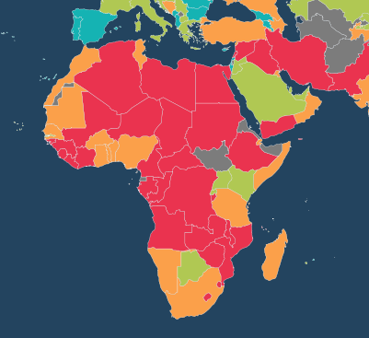
2. “Socialism Works in Europe”
Economic Freedom of the World Ranking (2023 annual report; 2021 data)
Bottom 30 Nations
  Mauritania
  Cameroon
  Somalia
  Comoros
  Guinea
  Guinea-Bissau
  Suriname
  Iraq
  Arab Republic of Egypt
  Ethiopia
  Guyana
  Gabon
  Burundi
  Angola
  Dem. Rep. of the Congo (tied for 150th)
Eswatini (tied for 150th)
Myanmar (tied for 150th)
Chad
Lebanon
Central African Republic
Republic of the Congo
Algeria
Argentina
Libya (tied for 160th)
Islamic Republic of Iran (tied for 160th)
Republic of Yemen
Sudan
Syrian Arab Republic
Zimbabwe
Venezuela
“Africa is poor because she is not free”
–George Ayittey
Notes:
20 of the bottom 30 are African. George Ayittey, Ghanaian economist and president of the Free Africa Foundation: “Africa is poor because she is not free.”

Slide 26
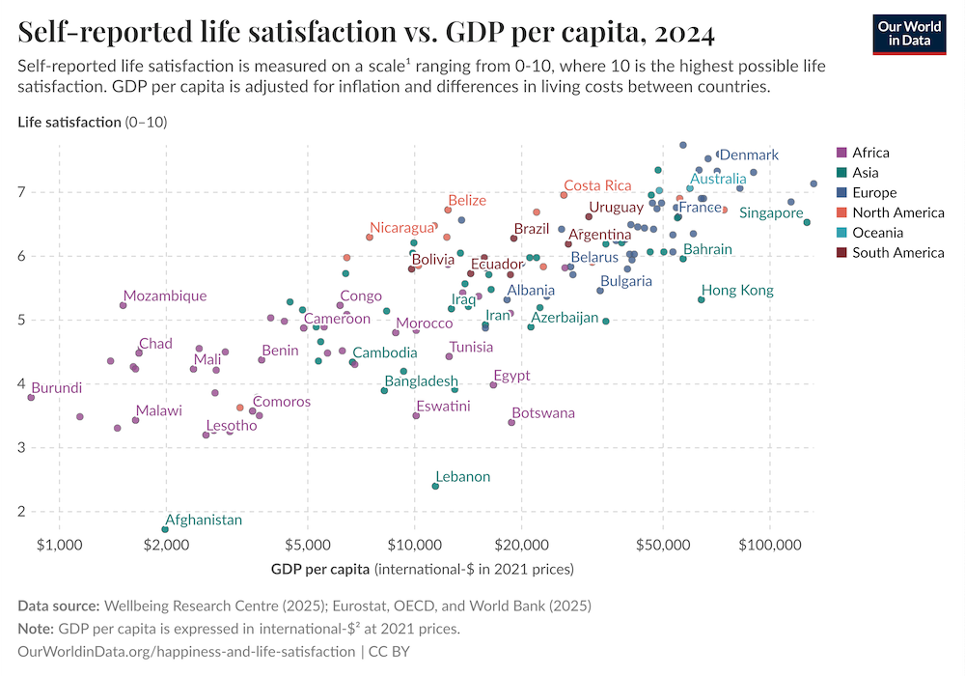
Notes:
1974 Richard Easterlin study – “Easterlin paradox”
Two 2008 studies show that the paradox doesn’t exist.
“Rich people are happier than poor people; rich countries have happier people than poor countries; and people get happier as they get richer. The earlier study simply had samples too small to find significant differences.” Ridley, Matt (2010-06-10). The Rational Optimist (P.S.) (p. 26). HarperCollins e-books. Kindle Edition.

Slide 27
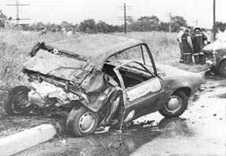
3. “Capitalism Puts Profits Ahead of People”
Misunderstanding of profits
“Nirvana fallacy”
A complex mythology has developed around the idea that firms must be “held accountable” by government, or they will sacrifice customers for short-term gain.
aworldofprogress.com
Notes:
Profits are not exploitation. They have an important social function. The information profits and losses provide is essential to resolving social problems. Rothbard:
“A man earns profits only if he has, by superior foresight and judgment, uncovered a maladjustment—specifically an undervaluation of certain factors by the market. By stepping into this situation and gaining the profit, he calls everyone’s attention to that maladjustment and sets forces into motion that eventually eliminate it. If we must condemn anyone, it should not be the profit-making entrepreneur, but the one that has suffered losses. For losses are a sign that he has added further to a maladjustment, through allocating factors where they were overvalued as compared to the consumers’ desire for their product.” (MES 1993 p. 468)

Slide 28
Love Canal
Love Canal was a 3,000 foot long trench from a failed canal project from the 1800s) on the outskirts of Niagara Falls, New York. In the 1920s it was turned into a dumping ground for toxic waste. The clay soil and the clay cover placed over the waste protected against leakage.
Privately owned companies—but also the US Army and the city government—dumped toxic waste into the canal.*
In 1953, the city government, warned by then-owner Hooker Chemical of what had been buried in the canal, paid $1 for the property to build a school, under threat of eminent domain.
*See https://reason.com/1981/02/01/love-canal/
Notes:
Further reading: https://atlassociety.org/commentary/commentary-blog/6273-toxic-waste-at-love-canal-who-really-cares-about-the-environment

Slide 29
Love Canal
Eric Zuesse* pointed out that Hooker took great pains to point out to the local government that the land had been filled with chemical waste products, and escorted school board officials to the property and made eight test borings in their presence to confirm the presence of chemicals. Borings over the site turned up chemicals; on the sides of the canal, there were none.
*See https://reason.com/1981/02/01/love-canal/
Notes:
Further reading: https://atlassociety.org/commentary/commentary-blog/6273-toxic-waste-at-love-canal-who-really-cares-about-the-environment

Slide 30
Love Canal
Hooker Chemical placed an explicit warning in the deed that the land had been filled with chemical waste, and tried to have additional special provisions placed in the deed, e.g., requiring that the land ”be used for park purposes only.” When the school board tried to sell land to a developer in 1957, Hooker Chemical objected.
*See https://reason.com/1981/02/01/love-canal/
Notes:
Rick Stroup:
Only when the waste site was taken over by local government... was the site mistreated in ways that led to chemical leakage. The government decision makers lacked personal or corporate liability for their decisions. They built a school on part of the site, removed part of the protective clay cap to use as fill dirt for another school site, and sold off the remaining part of the Love Canal site to a developer without warning him of the dangers as Hooker had warned them. The local government also punched holes in the impermeable clay walls to build water lines and a highway. This allowed the toxic wastes to escape when rainwater, no longer kept out by the partially removed clay cap, washed them through the gaps created in the walls.
Further reading: https://atlassociety.org/commentary/commentary-blog/6273-toxic-waste-at-love-canal-who-really-cares-about-the-environment

Slide 31
Love Canal
People living near the canal complained for decades about odors and foul-smelling substances emanating from the soil. The city government’s response was to cover up the offending toxins with more soil. In 1976, the city finally hired a private firm to investigate, and toxic residues were found in homes and storm drains. The city responded only by installing window fans in a few homes.*
In 1978 the New York State Department of Health got involved and limited evacuations were begun. A homeowners’ association was founded to combat government recalcitrance.*
*http://chej.org/wp-content/uploads/Love-Canal-Factpack-PUB-001.pdf
Notes:
Rick Stroup:
Only when the waste site was taken over by local government... was the site mistreated in ways that led to chemical leakage. The government decision makers lacked personal or corporate liability for their decisions. They built a school on part of the site, removed part of the protective clay cap to use as fill dirt for another school site, and sold off the remaining part of the Love Canal site to a developer without warning him of the dangers as Hooker had warned them. The local government also punched holes in the impermeable clay walls to build water lines and a highway. This allowed the toxic wastes to escape when rainwater, no longer kept out by the partially removed clay cap, washed them through the gaps created in the walls.
The Love Canal episode led to Senator Al Gore’s 1980 CERCLA law (”Superfund”) which required firms to pay for cleanup of toxic waste sites, even if they were only “potentially responsible.” Hooker Chemical was hit with massive lawsuits.* *https://www.econlib.org/library/Enc/FreeMarketEnvironmentalism.html
Further reading: https://atlassociety.org/commentary/commentary-blog/6273-toxic-waste-at-love-canal-who-really-cares-about-the-environment

Slide 32

737 MAX
In 2018 and 2019, within a six month period, two Boeing 737 MAX aircraft crashed after experiencing controllability problems.
The root cause, as it turns out, was FAA regulation.
The FAA sets qualification requirements on pilots—pilots that qualify on an airplane of a certain ”type” by the FAA’s definition don’t have to re-qualify on each variant in that type.

Slide 33
737 MAX
There was, therefore, a strong incentive for Boeing to keep the MAX similar enough to the original 737 (which dates to 1964) to satisfy the FAA that it was the same “type.”
Handling characteristics couldn’t change, though the new engines meant extra lift when climbing steeply.
This restricted the extent to which Boeing could modify the basic aircraft, even though the old airframe design was not well-suited to the new engines.
See https://www.theverge.com/2019/5/2/18518176/boeing-737-max-crash-problems-human-error-mcas-faa

Slide 34

MAX Failure
A software fix was devised to push the nose down in steep climbs (MCAS), to offset the handling differences in the new variant.
FAA review did not catch the possible problem with MCAS, even though the FAA had a 30 page list of differences between the MAX and the other 737s.
Image: https://www.theverge.com/2019/5/2/18518176/boeing-737-max-crash-problems-human-error-mcas-faa

Slide 35

Product Safety without Regulation
Courts (tort law)
User reviews
Private certification (e.g., UL)
Brand names/reputation
Insurance companies
  Have an incentive to monitor manufacturers because they don’t want to pay out for product failures
Notes:
In at least some cases, firms take better care of their customers than the customers would if left to their own devices.
“Fish and shellfish that are both caught and eaten by the same person pose more health risks than commercially sold seafood. Although recreational fishers tend to ignore warnings about hazardous chemicals in certain waters, commercial fishers voluntarily avoid contaminated areas. Also, in handling the catch, commercial fishers pay greater attention to sanitation than do recreational fishers” (Yasuda, Independent Review, Fall 2010, p. 213)
There are private means of certifying sellers and product quality. We don’t know what they all might look like.
eBay → system of rating transactions and providing people with a detailed reputation that is certified and adheres to that person for as long as they continue to make transactions on the site. Like a “credit rating” for person-to-person anonymous transactions.
Market incentives don’t lead to a perfect world in which nothing ever goes wrong (recall Nirvana fallacy). But they are far more likely to generate beneficial outcomes than government.

Slide 36

4. “Capitalism Leaves People without Medical Care”

Slide 37
Medical Licensure
In the late 1800s, the US had the highest number of physicians, per capita, in the world.
In 1904, the AMA began a concerted effort to reduce the number of medical students, claiming that this would increase medical quality.
In 1910, Abraham Flexner published a report for the Carnegie Foundation on US and Canadian medical education.
The report suggested closure of most medical schools (155 to 31), homogenization of education in medical schools, approval of any new medical school by the state government, and additional state licensure regulation.

Slide 38

Drug Suppression
”Costs include patient harm from delayed access as well as research and development (R&D) opportunities foregone by drug developers whose capital is consumed by fulfilling the demands of FDA clinical trials. According to [Mary] Ruwart, at least half of pharmaceutical innovations get shelved because the cost to take a drug through the regulatory testing process makes those drugs uneconomic for drug developers to pursue.
”Even with very conservative assumptions, Ruwart found the years of life lost due to FDA clinical demands is in the millions.”
Bartley J. Madden, Free to Choose Medicine, 3rd ed. (2018), p. 6.

Slide 39

Information Suppression
“In the early 1980s, several reports in medical journals indicated that the B vitamin, folic acid, taken early in pregnancy could prevent a number of birth defect. … Folic acid would have to go through the expensive drug development process if the manufacturers wished to advertise its benefits to young women.
“… Had U.S. folic acid manufacturers been permitted to advertise … [we] might have seen an increase in supplementation in the United States—and a decline in birth defects. Instead, approximately 10,000 American babies were born with deformities more horrific than thalidomide.”
Mary Ruwart, Death by Regulation: How We Were Robbed of a Golden Age of Health and How We Can Reclaim It, quoted in Bartley J. Madden, Free to Choose Medicine, 3rd ed., 2018, p. 6.
This Photo by Unknown Author is licensed under CC BY-SA
Notes:
--Mary Ruwart, Death by Regulation: How We Were Robbed of a Golden Age of Health and How We Can Reclaim It, quoted in Bartley J. Madden, Free to Choose Medicine, 3rd ed., 2018, p. 6.

Slide 40

“Mylan holds a patent on a type of design that meets specific legal requirements foisted upon schools for auto-injectors. Mylan therefore exploits this. Also, the FDA is reportedly barring competing companies that do manage to meet the same technical requirements by recalling their offerings based on higher standards than set for EpiPen, or by asking them to undergo more arbitrary testing before true consideration is offered.
“Taking this information into account, it becomes pretty clear pretty quickly that FDA regulations customized to Mylan’s already-established brand and design is causing a monopoly to form around the company’s offering. Thus far the competing companies to Mylan have been given excuse after excuse as to why their products can’t see equal footing in the market. It’s essentially a rigged game – cronyism, to be exact.”
http://thelibertarianrepublic.com/epipen-monopoly-hint-not-runaway-capitalism/

Slide 41
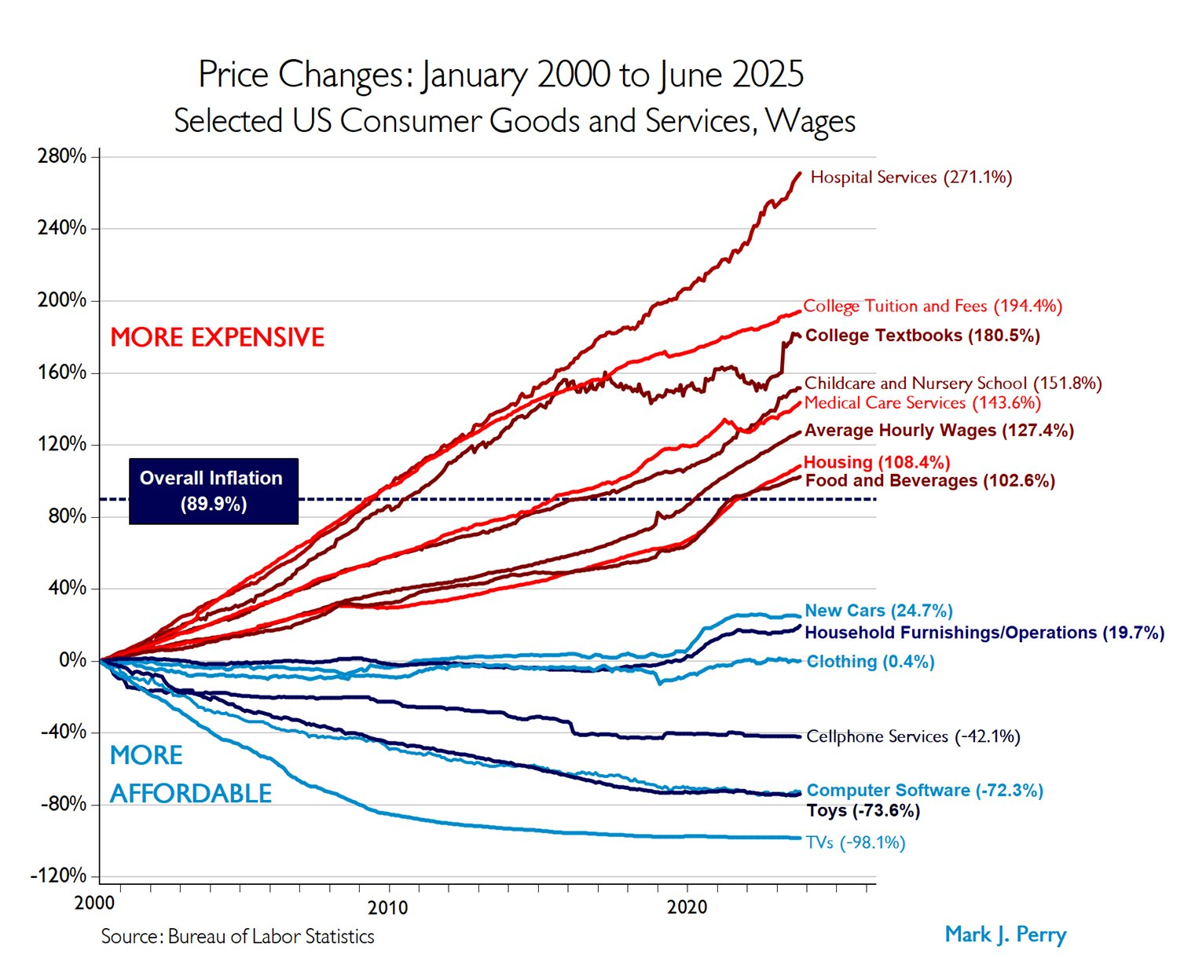

Slide 42

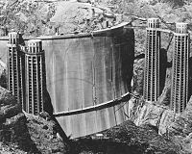
5. “Capitalism Won’t Make Socially Important Investments”
Unmuseum.org
mises.org
nationalreview.com
http://en.wikipedia.org/wiki/Hoover_Dam
Notes:
Wright brothers wrote to US government mentioning that their invention could be used for scouting and message carrying, and were ignored—a form letter was sent in response. Their competitor (Langley, of the Smithsonian), was heavily funded ($50,000 or more) by the US government, but that ended in utter failure, nearly downing their test pilot in the Potomac. Wilbur and Orville Wright were entirely self-funded and spent around $1,000 on materials and travel during their research.
Calculation problem
What’s an “important project”?
“The research, new technologies, and discoveries that might have been products of the space-shuttle program exist in the shadow of other research, technologies, and discoveries that might have been produced with the resources had they remained in the private sector.”
Political variables – costs and benefits are determined by politicians and bureaucrats who have their own goals.
Space Shuttle
Cost projection: $118 per pound to orbit
Actual: $27,000 per pound to orbit.
Projected cheap turnaround allowing flights every few weeks
Actual: Many months of overhauls between flights at a cost of $1.5 billion
My article in Mises Daily, 2011:
Bill Anderson: "we have no evidence that the space program has created on its own any of the new technologies that make our material lives better; instead, the program has utilized existing technologies.

Slide 43
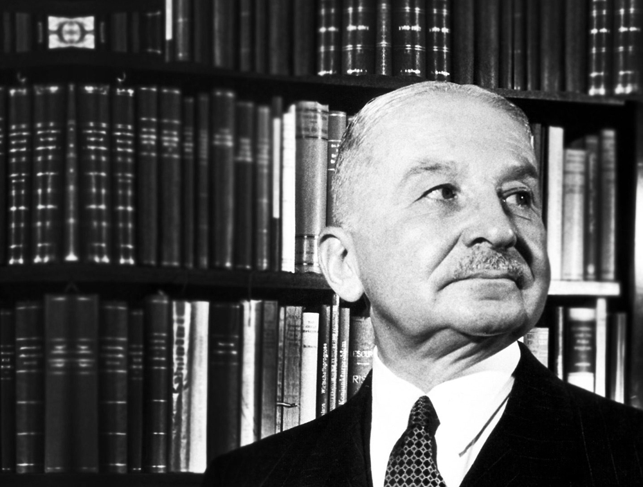
Technology and Economic Progress
“…people ascribe all improvements in economic conditions to the progress of the natural sciences and technology. …As they see it, the unprecedented technological improvements of the last two hundred years were not caused or furthered by the economic policies of the age. They were not an achievement of classical liberalism, free trade, laissez faire and capitalism. They will therefore go on under any other system of society’s economic organization.”
-- Ludwig von Mises, The Anti-Capitalistic Mentality, p. 22.

Slide 44
6. “Capitalism Is Racist and Sexist”
metrojacksonville.com
Notes:
In a free society, people are allowed to have whatever tastes and preferences they like. But ignoring productivity in order to favor one group or another may come at a cost. In contrast, government intervention can shield people from the real economic consequences of their views.
Illustration of price controls encouraging landlord racism
Employers have an incentive to hire on the basis of ability, and customers have the incentive to take a good deal no matter what the race of the person selling. Store owners have an incentive to sell to anyone.
These two articles show why this theory is correct – “The enemies of Jim Crow” by Jeff Jacoby (via Cafe Hayek), and “The Economics and Politics of Discrimination” by George Leef.
Jacoby writes-
Far from craving the authority to relegate blacks to the back of buses and streetcars, for example, the owners of municipal transportation systems actively resisted segregation. They did so not out of some lofty commitment to racial equality or integration, but for economic reasons: Segregation hurt their bottom line. It drove up their expenses by requiring them – as the manager of Houston’s streetcar company complained to city councilors in 1904 – “to haul around a good deal of empty space that is assigned to the colored people and not available to both races.” In many cities, segregation also provoked blacks to boycott streetcars, cutting sharply into the companies’ profit.
In a notable study published in the Journal of Economic History, economist Jennifer Roback showed that in one Southern city after another, private transit companies tried to scuttle segregation laws or simply ignored them.
Thus in Jacksonville, Fla., a 1901 ordinance requiring black passengers to be segregated went unenforced until 1905, when the state Legislature mandated segregation statewide. The new statute “was passed by the Legislature much against the will of the streetcar companies,” reported the Florida Times-Union. So well-known was the companies’ hostility to segregation that when a group of black citizens challenged the law in court, their attorney felt compelled to deny being “in cahoots with the railroad lines in Jacksonville.”
And Leef-
…First, the Jim Crow laws of the states of the South specified that certain jobs in industry could be done only by white workers. But if the industrialists were intent upon discriminating, why did this preference have to be enacted into law? The answer is that to preserve the status of the white worker, there had to be a legal restraint upon employers. In the absence of the law, competition from nondiscriminating employers would have urged all to hire and promote blacks and whites on the basis of economic value, not race.
…The reason for the adoption of the policy of Apartheid in the 1930s was that white workers were incensed that so many blacks were being hired and were competing with them in pay and promotions. Therefore, they persuaded the government to restrict the better-paying jobs to whites only. Once more, we see that business was the enemy of discrimination, government the cause.
Caplan and Stringham:
Unregulated markets will be neither generically "discriminatory" nor “non-discriminatory”; some forms thrive while others wither.
Caplan and Stringham: http://www.google.com/url?sa=t&source=web&cd=5&ved=0CCoQFjAE&url=http%3A%2F%2Fmises.org%2Fjournals%2Fscholar%2Fstringham.pdf&ei=_-ZNTOehGYT48Ab8i8GNDA&usg=AFQjCNGp5Dq9o22z0rfwJdpo-QyV1poNyg p. 10

Slide 45
The Anti-Capitalistic Mentality
“The most passionate detractors of capitalism are those who reject it on account of its alleged injustice.
…Nature is not bountiful but stingy. It has restricted the supply of all things indispensable for the preservation of human life. … Men, cooperating under the system of the division of labor, have created all the wealth which the daydreamers consider as a free gift of nature.”
-- Ludwig von Mises, The Anti-Capitalistic Mentality, p. 49.
Notes:
Declaring that one has a “right” to a quantity of a good or service assumes that there will be a quantity available and that all that is necessary is to divide it appropriately. But goods and services are not just manna from heaven.
Poverty is the natural state, and the key is to think about what social institutions move us away from that state rather than thinking of wealth as a fixed pie just waiting to be sliced up and shared.
Maybe next year I’ll do a talk on the pernicious idea of “social justice.”

Slide 46



Additional Resources
timothyterrell.net
terrelltd@wofford.edu
@timothyterrell

