Slide 1
THE BIRTH OF THE AUSTRIAN SCHOOL
Mises University 2025
Joseph T. Salerno

Slide 2
The Marginalist Revolution
The simultaneous and independent discovery of the principle of “marginal utility” by three different economists (1871-1874).
Who were the marginalist revolutionaries?
    Carl Menger (Austria), The Principles of Economics 1871
    William Stanley Jevons (Great Britain), The Theory of Political Economy 1871
    Leon Walras, (Switz.) Elements of Pure Economics 1874

Slide 3
Marginal Utility
Marginal Utility (Grenznutzen—Friedrich von Wieser, Menger’s student)
Final Utility (Jevons)
Rarété (Walras)

Slide 4
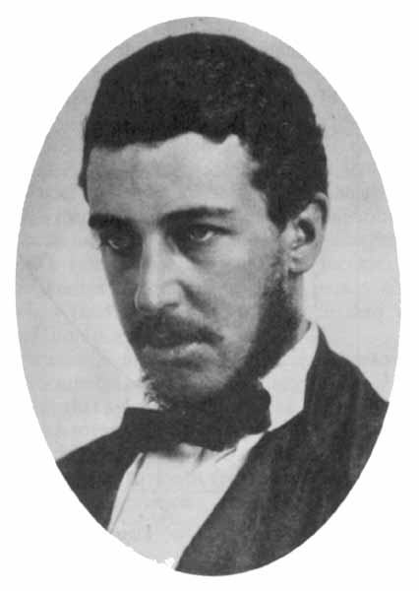
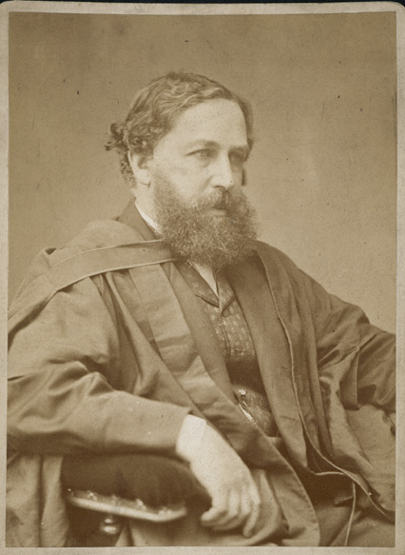
William Stanley Jevons

Slide 5
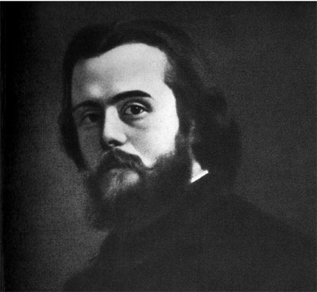
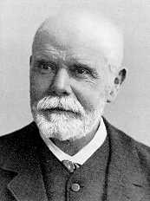
Leon Walras

Slide 6
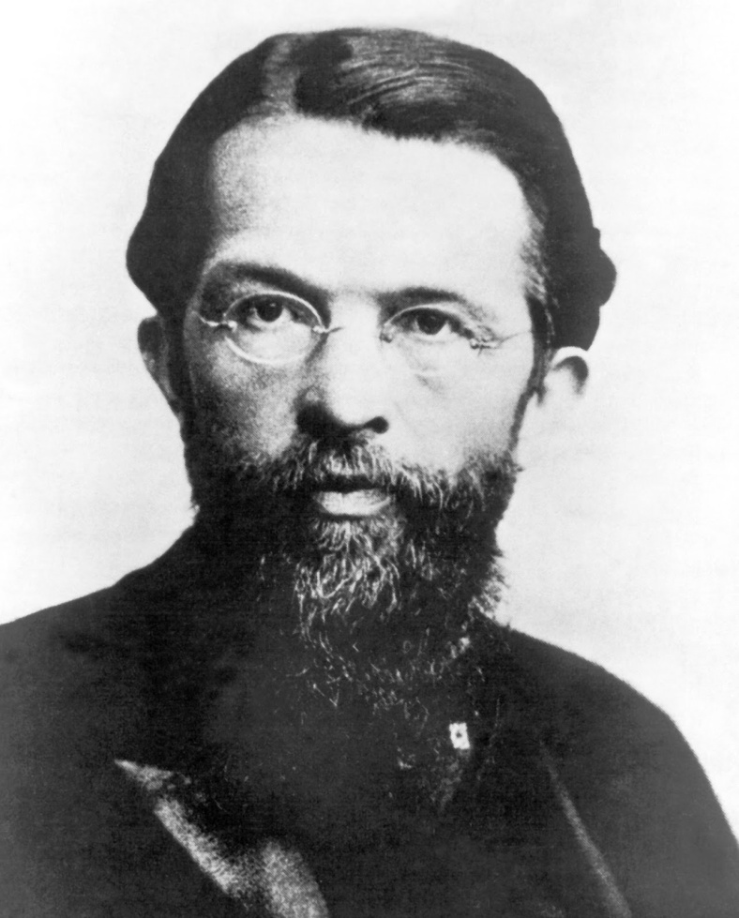
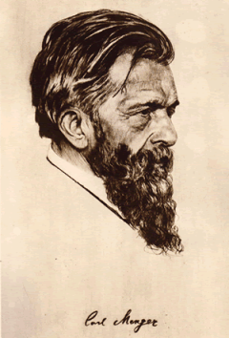
Carl Menger

Slide 7
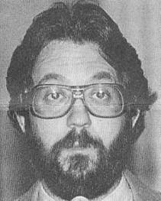
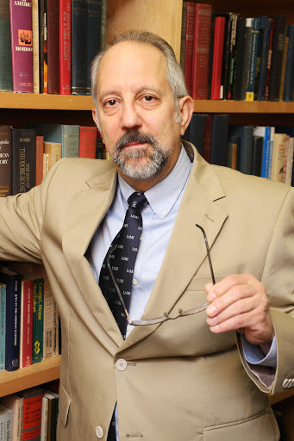
Notable Modern Austrian

Slide 8
Menger versus Jevons and Walras
Jevons and Walras viewed utility as a quantity of satisfaction received from goods, which could be added up and compared between individuals.
Menger viewed utility as the result of an individual actor’s judgment about the importance of concrete goods in satisfying his wants and improving his or her well-being.
For Menger utilities or satisfactions are ranked when choosing:
  1st bottle of water
  2nd can of Coke
  3rd granola bar

Slide 9
Menger’s Achievement
Menger discovered much more than the principle of marginal utility—he developed an entire system of economics based on subjective value and individual choice.
Menger was creative genius. He drew on many different influences but his vision of the economy as the systematic outcome of humans striving to satisfy their wants was unique and revolutionary.

Slide 10
Menger: Founder of the Austrian School
Joseph Schumpeter: “Menger is nobody’s pupil and what he created stands . . . . Menger’s theory of value, price, and distribution is the best we have up to now [1926].”
Ludwig von Mises: “What is known as the Austrian School of Economics started in 1871 when Carl Menger published a slender volume under the title [Principles of Economics].... Until the end of the Seventies there was no ‘Austrian School.’ There was only Carl Menger.”

Slide 11
Menger: Founder of the Austrian School
F. A. Hayek said the Austrian school’s “fundamental ideas belong fully and wholly to Carl Menger. . . . [W]hat is common to the members of the Austrian school, what constitutes their peculiarity and provided the foundations for their later contributions, is their acceptance of the teaching of Carl Menger.”

Slide 12
Classical Economics 1776-1871
David Hume, Essays on Economics (1750s)
Adam Smith, The Wealth of Nations (1776)
David Ricardo, Principles of Political Economy (1817)

Slide 13
Contributions of Classical School
Prices are not arbitrary or random. They are determined by universal and unchangeable laws (the law of supply and demand).
These prices are used by business owners to calculate profits and losses and to decide what and how much to produce.
Profits encourage businesses to increase supply of a profitable good and lure new businesses to enter the industry; losses drive businesses to reduce supply of an unprofitable good or to cease production altogether and exit the industry.
In the long run, the adjustment of supply causes profits and losses to disappear and prices to equal costs of production.

Slide 14
The Main Flaw in Classical Economics
It attempted to explain values and prices in terms of broad and abstract classes of goods, e.g., bread, diamonds, milk, coal, iron, cotton, beef, etc.
But human beings value and exchange concrete units of goods like 1 gallon of milk, 1 lb. of beef, 2 carats of diamonds, 3 pairs of shoes, etc.
This led the classical economists to become bogged down in the “paradox of value” or the “diamond-water paradox.”

Slide 15
The Paradox of Value
Diamonds have a very high “exchange value” but a very low “use value” in everyday life. They have a high price on the market but serve as mere ornamentation or as a conspicuous display of wealth and therefore satisfy trivial human wants.
Water has a relatively low “exchange value” but a very high “use value.” It has a low market price but is indispensable in sustaining human life itself and therefore serves extremely important wants.

Slide 16

Diamonds and Water
A London jeweler paid $46,158,674 at auction for this 24.78-carat "fancy intense pink" diamond in 2010.

Slide 17
The Erroneous Solution of the Classical Economists
Economics is not concerned with explaining use value; it is only concerned with explaining exchange value or price.
Therefore, diamonds are much more expensive than water because it costs more money to produce a carat of diamonds than a gallon of water.
The classical economists thus adopted a cost-of-production theory of value and price and focused on the businessman as the central actor in the economy, and the consumer dropped out of the picture.
Classical economics was about the acquisition and accumulation of wealth by businessmen not about the satisfaction of consumer wants.

Slide 18
Menger’s Aim: A Realistic Price Theory
“I have devoted special attention to the investigation of the causal connections between economic phenomena involving products and the corresponding agents of production, not only for the purpose of establishing a price theory based on reality and placing all price phenomena . . . together under one unified point of view. . . .” (Menger, Principles of Economics, 19)

Slide 19
Causal-Realist Economics
Menger began the causal-realist tradition in economics followed by modern Austrians.
Economic theory is the investigation of the causes of prices, wage rates, rents and interest actually paid on real markets.

Slide 20
So What Is Economics All About?
“Man himself is the beginning and the end of every economy”
“Our science is the theory of a human being’s ability to deal with his wants.”
“All things are subject to the law of cause and effect.” (The very first sentence of Menger’s Principles)

Slide 21
Menger on Action and Causation
Menger recognized that every action embodies both subjective and objective elements related by cause and effect.
ends → means → realization
man → external world → subsistence
wants → goods → satisfaction
All action begins in the human mind, uses elements of the objective world, and ends in the mind.

Slide 22
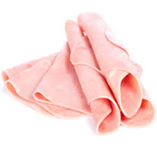
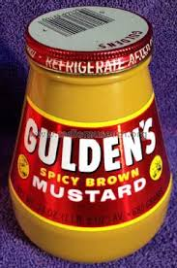


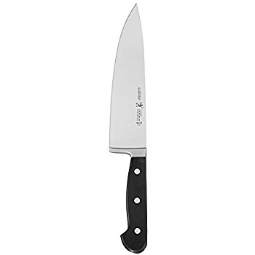


Subjective and Objective Elements of Action

Slide 23
Menger’s Theory of a Good
A human need.
A thing is capable of being brought into causal connection with the satisfaction of the need.
Human knowledge of this causal connection.
Command of the thing sufficient to direct it to the satisfaction of the need. [ownership or control]
Mises’s correction: 2, 3. 2’. The belief that a thing has the capacity to cause the satisfaction of a human need
What makes something an economic good? An economic good is a good whose quantity is insufficient to satisfy all the human wants for it. It is scarce.

Slide 24
Menger and Economizing
Scarcity →Choice → Ranking of Wants → Economizing Goods
Economizing: using scarce goods to satisfy only the most important or highly ranked wants.
Mengerian “economizing man” (consumers) versus classical “economic man” (business owners and managers)

Slide 25
Value and the Law of Marginal Utility
The value of a good is determined by its “marginal utility,” that is, the satisfaction from the least important or lowest ranked end served by the available supply of the good.
Therefore: as the supply of a good possessed by an individual increases, its marginal utility and, therefore, its value decreases.

Slide 26
Crusoe’s Value Scale for Sacks of Wheat
1st bread to sustain life
2nd bread to sustain health
3rd seed for next harvest
4th feed for goats (milk, cheese, meat, etc)
5th to make whiskey vodka
6th feed for pet parrot
7th . . . .
etc.

Slide 27
Short Quiz
Farmer’s Value Scale for Horses (3) and Cattle (2)
1st H1 for plowing (wheat)
2nd H2 for plowing (increase productivity)
3rd C1 for milk
4th C2 for beef
5th H3 for recreational riding
Which animal is more valuable to the farmer, a horse or a cow?

Slide 28
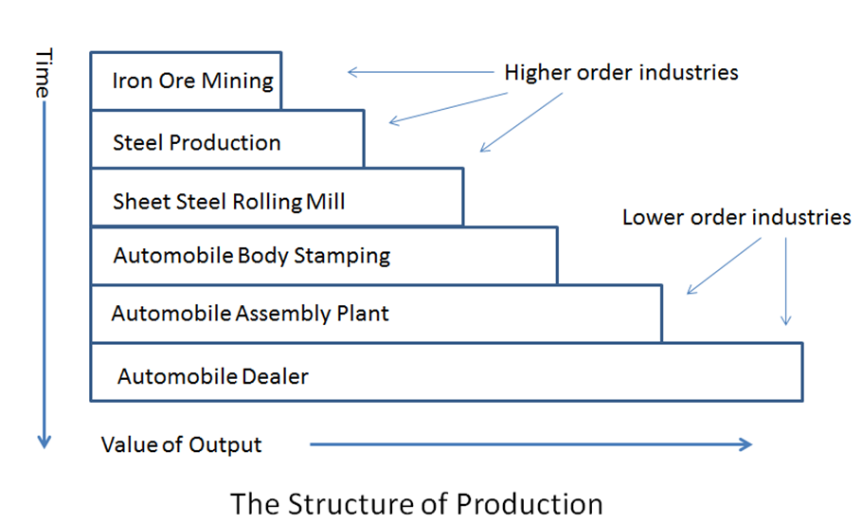
The Orders of Goods and the Production Structure

Slide 29
Menger’s Law of Imputation
The value of the means is determined by the value of the ends or wants they serve.
Value is imputed “backwards” from consumer value judgments of the services of the consumer good in satisfying wants to the consumer good itself to higher-order goods (capital goods).
The subjective value of transportation services determines the value of the car and gasoline which determines the value of steel, robot assembly machinery, oil wells, drilling equipment etc.

Slide 30
Causality, Production, and Value Imputation
Production
higher 5th Farm Tools
4th Wheat
3rd Flour
2nd Bread (Wholesale)
lower 1st Bread (Retail)
Value Consumer

Slide 31
Analysis of Exchange
A B
(HORSE) (COW)
COW HORSE
SELLER BUYER
($70,000) (BMW 5 series)
BMW 5 series $70,000

Slide 32
Analysis of Exchange
Goods exchanged are not equal in value.
Double inequality of value—both parties value the good they are receiving more highly than the good they are giving in exchange. Reverse valuations of goods cause exchange.
Exchange increases the utility or welfare of both parties without leaving anyone worse off. Starting point of Austrian welfare economics.

Slide 33
The Law of Marginal Productivity
Production Function for Wheat
1000 W = 90 L + 2 H + 1 P + 40 A + 500 F
  W = wheat (bushels); L = labor (days); H = horses
  P = plow; A = land (acres); F = fertilizer (cwt.)
What is the value of a 100 lb. sack of fertilizer?

Slide 34
Menger’s Solution
How much would the total product decrease if a unit of the factor of production was subtracted from the process of production?
Answer:
  assume ΔF = - 100 → ΔW = - 75
  then marginal product of 100 F = 75 W;
  therefore value of marginal product of 100 F = marginal utility (value) of 75 W to the farmer

