Slide 1
Growth Versus Prosperity
Mises University
Auburn, Alabama

Slide 2
Modern Development Economics
Culmination of historical process incorporating many factors:
The “Golden Age of Keynesianism” (1948–73).
The Marshall Plan
National income statistics documenting economic inequalities
Creation of international aid agencies (UN, IMF, and WB)
Development of “gap theory” of the “poverty trap”

Slide 3
Modern Growth Theories
Suffer from Same Problems as Modern Macro in General
Excessive Aggregation
Mathematics
Assume efficient coordination
Superficial analysis of change over time

Slide 4
Modern Growth Theories
Harrod–Domar Model
Simple Keynesian Cross framework: Y = C + I
Growth rate = savings rate/capital-to-output ratio – depreciation
Key Conclusion: positive relationship between rate of savings and investment and the rate of growth

Slide 5
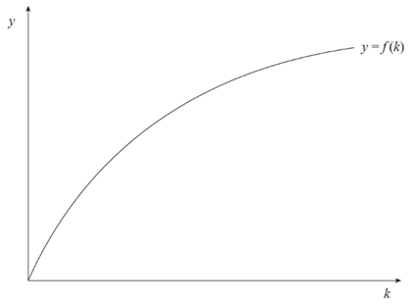
Modern Growth Theories
Neoclassical Growth Model:
Production constraint: Y_{t} = A_{t}F(K_{t})
  Y = Output
  K = Capital
  A = Productivity shift factor: Often assumed to represent technology.

Slide 6
Modern Growth Theories
Diminishing Returns to Capital:
Increased capital investment eventually will yield maximum output.
Model predicted there would be convergence between MDCs and LDCs.

Slide 7
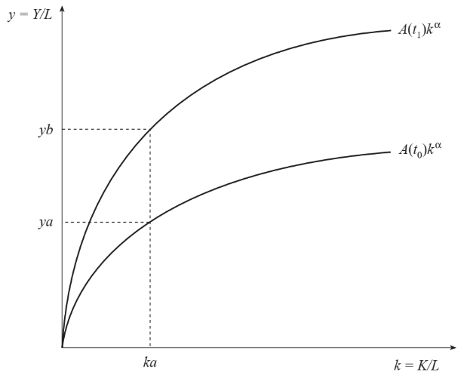
Modern Growth Theories
Diminishing Returns to Capital:
Increased capital investment eventually will yield maximum output.
Model predicted there would be convergence between MDCs and LDCs.
Continued economic expansion requires increased technology.

Slide 8
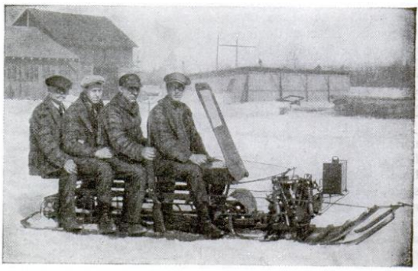
Modern Growth Theories
Endogenous Growth Model:
Diminishing marginal returns to capital are offset by increases in technology
Key Assumption: There are technological spillovers

Slide 9
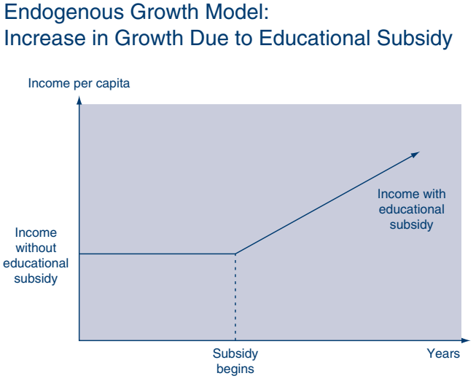
Modern Growth Theories
Endogenous Growth Model:
Raising the level of capital can lead to ever-increasing growth rates.
Implies that subsidies to research universities are conducive to sustainable economic growth.
Source: David M. Gould & Roy J. Ruffin, “What Determines Economic Growth?

Slide 10
Modern Growth Theory: Critique
Aggregation led to focusing on increasing inputs perceived as homogenous.
Math Models:
Good at describing equilibrium conditions; bad at describing dynamic economic order
Economic efficiency becomes simple technical engineering problem of constrained maximization.
National Income Accounting contributes to bias of planning and focusing on inputs and growth of output rather than on economic progress

Slide 11
Recommended Literature
Foundational: Menger, Bohm-Bawerk, Mises, and Rothbard
Espinosa, Victor I. (2020) ‘Epistemological Problems of Development Economics’, Procesos de Mercado: Revista Europea de Econnomía Política, XVII (1), 55–93.
Holcombe, Randall. (2007) Entrepreneurship and Economic Progress
Huerta de Soto, Jesus. (2006) Money, Bank Credit, and Economic Cycles, Chapter 5
_______. (2009) The Theory of Dynamic Efficiency.
Ritenour, Shawn (2023) The Economics of Prosperity: Rethinking Economic Growth and Development
Shenoy, Sudha. (2007) ‘Investment Chains through History or an Historian's Outline of Development, Using Goods of Ever Higher Orders’, Indian Journal of Economics and Business, Special Issue, 185-215.
_______. (2010) Towards a Theoretical Framework for British and International Economic History: Early Modern England. A Case Study.

Slide 12
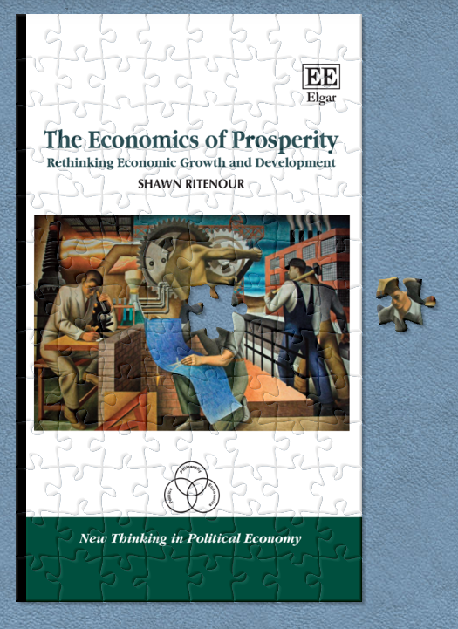

Economics of Prosperity
Analysis: Breaking complex substance into smaller parts to gain better understanding of it.
Synthesis: putting the pieces back together again in a new or different whole.

Slide 13
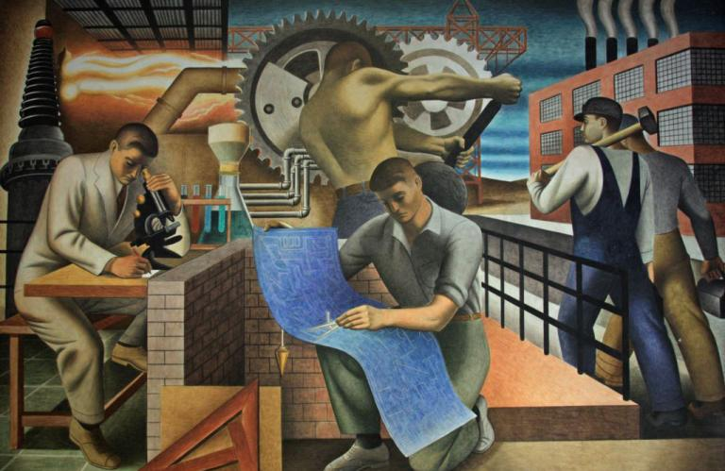
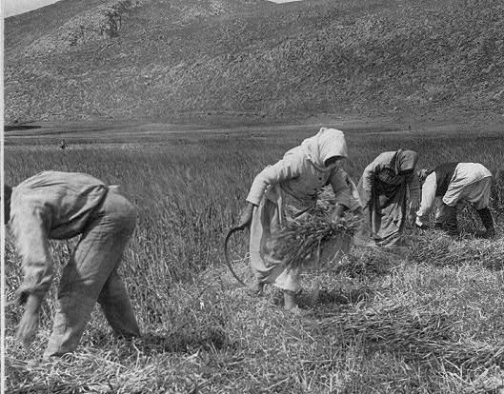
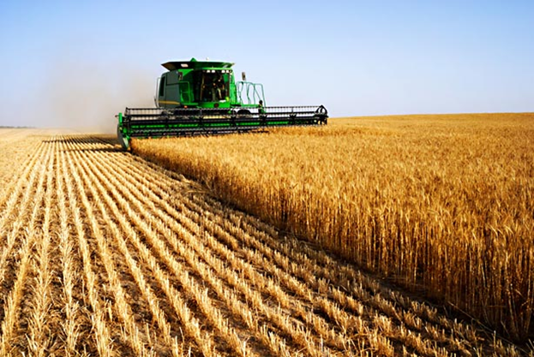
Vehicles of Prosperity
Market division of labor
Capital Accumulation

Slide 14
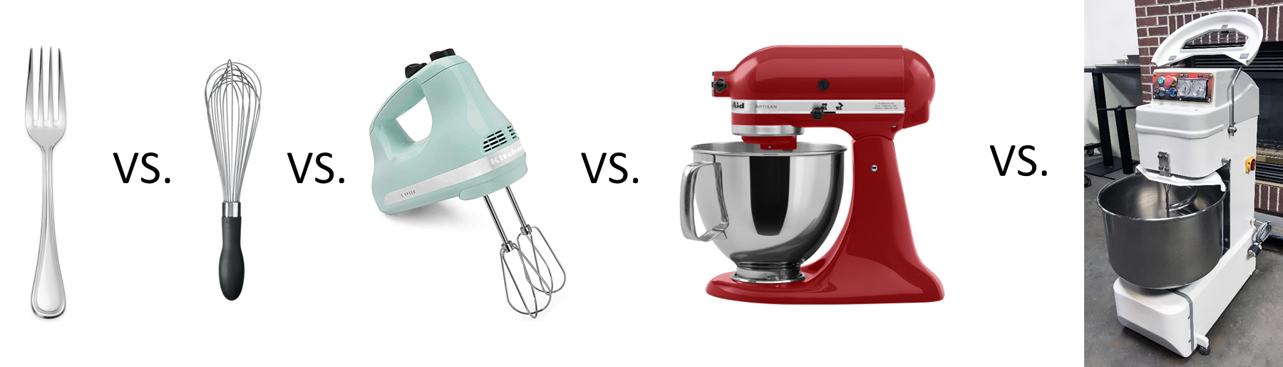
Vehicles of Prosperity
Technological Improvement

Slide 15

Vehicles of Prosperity
Entrepreneurship

Slide 16

Entrepreneurship
Many margins:
Product
Capital Investment
Technology
Economic calculation is crucial

Slide 17
Economic Progress
Process of Dynamic Efficiency
The happy consequence of a highly developed division of labor, taking advantage of an increasing capital stock embodying better technology, wisely invested by entrepreneurs.

Slide 18


Economic Institutions
Enablers of Economic Progress

