Slide 1
Tariffs versus Free Trade
Dr. Patrick Newman
Mises University 2025

Slide 2
What’s this presentation about, and why should you care?
Tariffs and international restrictions are once again prominent in economics and politics
Laissez faire works, government intervention does not
  Free trade is just another aspect of the free market economy
  Protective tariffs fail to achieve what their advocates say they will do

Slide 3
What do our terms mean?
Free trade: unrestricted movement of consumer goods and factors of production across nations’ borders
Tariffs: taxes on the sale of foreign goods. This causes
    domestic consumers to buy more from home, which stimulates domestic production
    foreign producers to reduce supply, which reduces overall production
Notes:
Q: Do domestic producers restrict their own supply? Or is it that they want to restrict overall supply so their domestic supply commands a higher nominal price without the foreign product competition. Clarify.

Slide 4
Free trade, properly understood
Free trade is the free market applied to the world economy
  Entrepreneurs use economic calculation to figure out what goods to produce, how they should be produced, and where they should be produced
  The profit and loss signal encourages the allocation of factors to where consumers most highly value them

Slide 5
Free trade, properly understood
Free trade increases the productivity of factors and decreases the prices of consumer goods
Tariffs distort production, they misallocate factors away from more highly valued uses to less highly valued uses

Slide 6
Don’t take my word for it
“Under a system of completely free trade, capital and labor would be employed wherever conditions are most favorable for production. . . .
Protective tariffs can accomplish only one thing: to prevent production from being carried on where the natural and social conditions are most favorable for it and to cause it to be carried on instead where conditions are worse.
The outcome of protectionism is, therefore, always a reduction in the productivity of human labor.”
Ludwig von Mises, Liberalism (1927)

Slide 7
US tariffs over the past two hundred years

Slide 8
Argument #1: protect jobs and industry
Tariffs cause US citizens to buy American
  This stimulates jobs and production in the US
“If we want to bring manufacturing back, we need tariffs!”
Notes:
Q: Chart looks more like correlation: higher tariffs, high manufacturing jobs. How explain away?

Slide 9
Argument #1: protect jobs and industry
Reality: tariffs only protect some jobs and some industries at the expense of others
  Tariffs on inputs raise the costs of many businesses
  Tariffs reduce the incomes of foreigners, causing them to buy fewer US exports
  Both reduce employment and production in the affected industries

Slide 10
Argument #1: protect jobs and industry
“But it's impossible to compete with foreign made production. They pay their workers slave wages!”
What matters to entrepreneurs are not absolute wages, but wages relative to productivity
  Value of output produced by average US worker is ~6x more than worker in India or China
  Manufacturing will stay in the US if justified by workers’ productivity!

Slide 11
Argument #1: protect jobs and industry
“Okay. So why has manufacturing left the US since WWII?”
  Unsustainable—other countries’ manufacturing would eventually bounce back
  US has moved past manufacturing and into services
  Taxes and regulations reduced the profitability of manufacturing in the US
    Higher effective corporate income tax rates
    Environmental Protection Agency (1970)
    Occupational Health and Safety Administration (1971)
    Government protected unions

Slide 12
Argument #1: protect jobs and industry
“So, what’s the solution?”
Answer: to bring back manufacturing, make it profitable!
  Cut taxes to encourage investment
  Cut regulations to encourage innovation
  Cut government spending to lower borrowing costs

Slide 13
Argument #2: the other side doesn’t play fair
“Free trade works, but only if both nations do it”
  Foreign competitors may undercut US producers (dumping); or foreign nations may enact tariffs, artificially lower the value of their currency, provide subsidies, enact capital controls, etc.
  Price competition is an integral part of the marketplace!
  Responding to foreign interventions with tariffs hurts the domestic country
Notes:
Q: What of non-tariff trade barriers, e.g., subsidies, capital controls, etc?

Slide 14
Argument #2: the other side doesn’t play fair
Philadelphia Free Trade Convention of 1831:
Free trade “tends most thoroughly to develop the moral and physical energies of each nation, and to apply them to those objects to which they are best adapted.
The proposition must be equally true in relation to each nation, whatever may be the policy adopted by others.
The nation which resorts to a restrictive policy, legislates to her own disadvantage, by interfering with the natural and most profitable employment of capital.”
Notes:
Q: Typo?

Slide 15
Argument #3: the trade deficit “crisis”
Trade Deficit: imports exceed exports

Slide 16
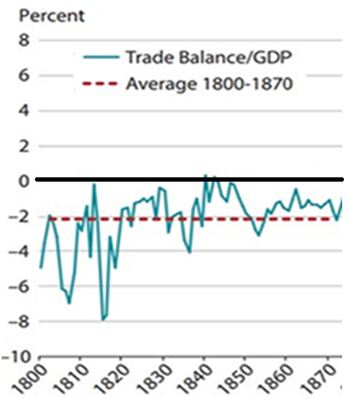
Argument #3: the trade deficit “crisis”
A trade deficit per se is not good or bad for economic growth
  What is causing the trade deficit? What does the trade deficit consist of?
Importing more capital goods leads to more production!

Slide 17
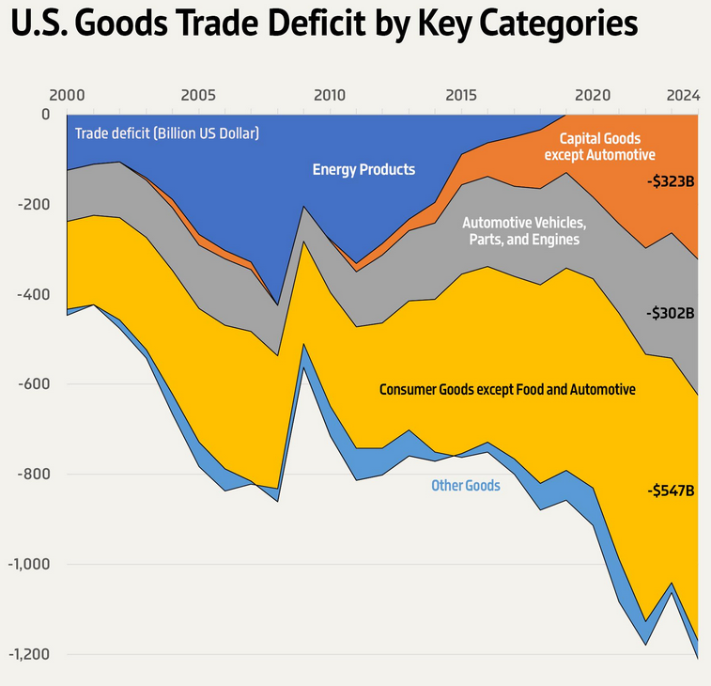
Argument #3: the trade deficit “crisis”
2000s US trade deficit largely composed of consumer goods
  Consumer dissaving decreases economic growth, but isn’t “bad” per se
    But it is when caused by monetary and regulatory policies

Slide 18

Argument #4: national defense
  “Even Adam Smith said this!”
  Modern day: prevents us from being dependent on Russia and China for strategic inputs
  Setting aside questions of foreign policy, is this a good argument?
Notes:
Q: What is the Adam Smith quote?

Slide 19
Argument #4: national defense
Are tariffs actually needed?
  In 2018, used to justify tariffs on steel
    Only 3% of US steel services defense needs. And only 11% of steel imports come from Russia and China
  In 2025, proposed because concerns about Chinese dominance in rare minerals like gallium and lithium
    The US has large sources of these minerals, but environmental regulations impede utilization

Slide 20
Argument #4: national defense
Would tariffs actually be effective?
  Tariffs can hurt national defense by increasing prices of inputs
    E.g., tariffs on allies like South Korea, Taiwan, and Vietnam raise prices of imported semiconductors, servers, and other data center components
  A more effective policy is to stockpile essential imports
  Couldn’t tariffs be abused?
    Isn’t food essential to national defense? And military clothing?

Slide 21
Argument #5: replace income tax revenue
Proposed by the Trump administration
Face value, good proposal! Income taxes should be replaced with tariffs because they are less invasive, distortionary, and opaque
Very important caveat: this requires massive spending cuts. What happened to the $2 trillion in promised DOGE spending cuts?
  Revenue raised from tariffs could be around $200 billion, nowhere close to $2.4 trillion in income tax revenue
Notes:
Q: Add to less invasive, less distorationary, more transparent?

Slide 22
Argument #5: replace income tax revenue

Slide 23
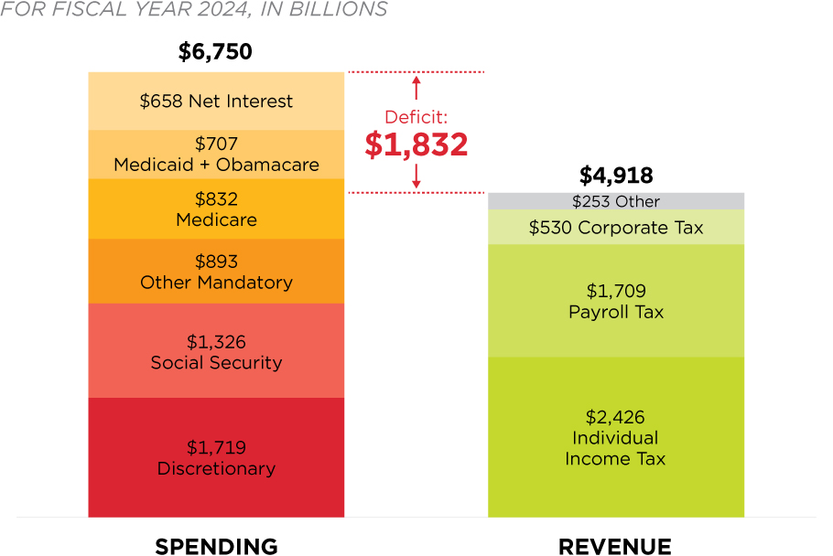
Argument #5: replace income tax revenue

Slide 24
Argument #6: cronyism
Tariffs are a form of cronyism: policies that benefit special interests at the expense of the public
  They please certain special interests (businesses and unions), certain swing state voters, and give certain politicians more power, all at the expense of the public
This is the best argument for tariffs, because it is the only one that is true
    The problem is, no one ever publicly advocates for cronyism!

Slide 25
Conclusion
Adopting free trade is like any other free market policy
  It enables entrepreneurs to allocate scarce factors of production to the uses most highly valued by society
  It facilitates the Invisible Hand
Protective tariffs distort the market and lead to an inefficient allocation

