Slide 1
Austrian Capital Theory
Dr. Patrick Newman
Mises University 2025

Slide 2
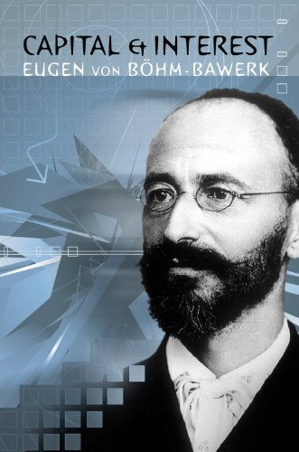
What’s this presentation about, and why should I care?
You will learn about capital theory:
    The study of mankind’s network of produced factors of production and what causes it to change
    Emphasizes the production structure, specificity, time, savings, and roundaboutness

Slide 3
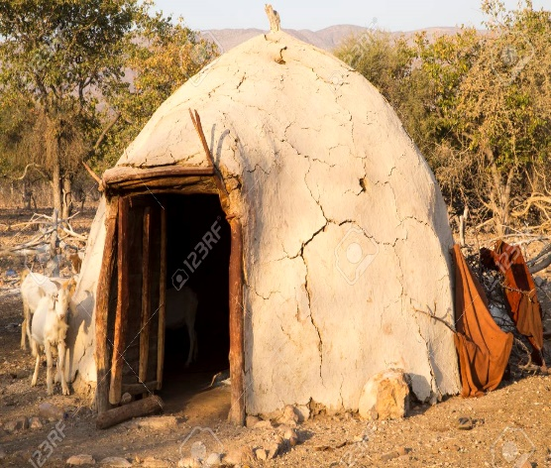
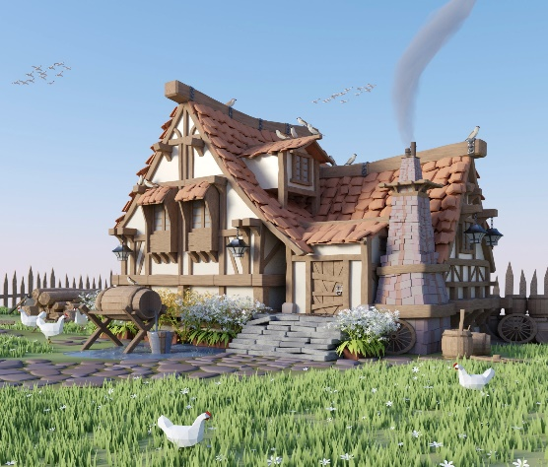
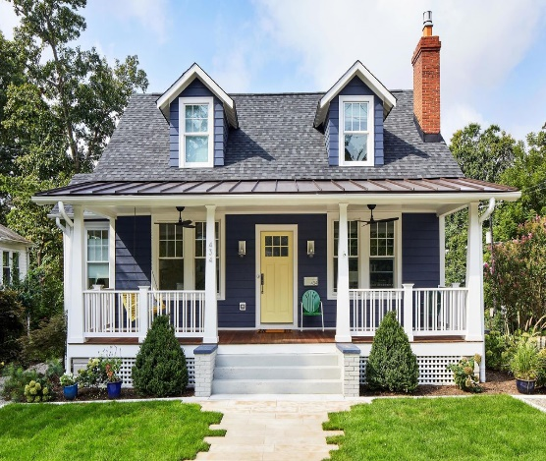
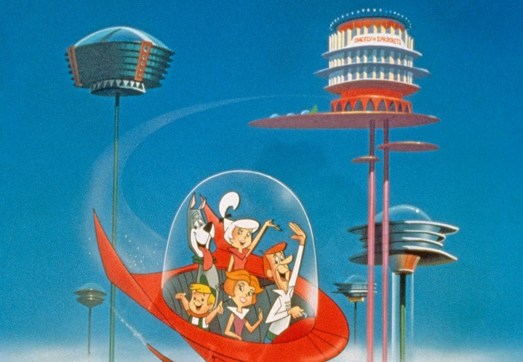
All this “stuff”—that’s what makes humans unique!
Standards of living have risen from barbarism to the modern level because of an increasingly intricate structure of capital goods
  Beavers are still making dams, but humans have moved past huts!

Slide 4
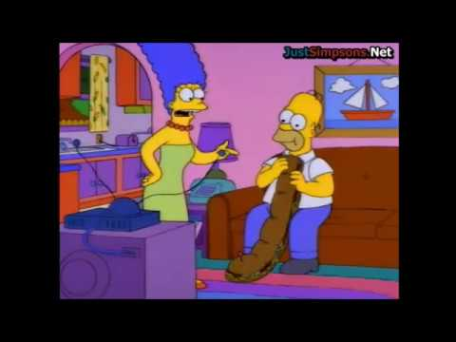
What are capital goods?
We know from praxeology that humans act: they use means to achieve ends
  Say you are hungry. You buy food at the grocery store. Then you make a sandwich. Finally, you eat the sandwich

Slide 5
What are capital goods?
    The finished sandwich is a good of the first order, i.e., a consumer good
    The sandwich made in the kitchen is a good of the second order
    Ingredients are goods of the third order
    Second to nth order goods are known as higher order goods

Slide 6
What are capital goods?
    Taken together, we have the structure of production for a sandwich!
            Higher order goods → consumer good
    The production of each good makes up a separate stage of production

Slide 7
What are capital goods?
Four factors of production:
  Labor: humans, “produced” by other humans
  Land: nature-given resources and the space we stand on
  Capital goods: produced materials made from labor, land, and other capital goods
  Technology: recipes to produce capital goods or consumer goods

Slide 8
Some important notes
    Land and labor are called the original factors of production
    Different capital goods cannot be added together—you need money prices for that!
    Factors differ in terms of their specificity. They are heterogeneous
        They can be used to make a variety of goods. Some more, some less

Slide 9

Let’s start from the beginning: Crusoe economics
Robinson Crusoe is stuck on a desert island with some supplies from his ship, and he is hungry
He can satisfy his hunger by picking berries (consumption)
  Suppose this takes ten hours
  He can also produce capital goods (a bow and arrow) to hunt animals
      Leads to more consumption, but requires thirty hours

Slide 10
Crusoe’s structure of production
Fortunately, Crusoe recovered a knife and twine from his ship
  Suppose there are three stages in the bow-and-arrow production structure
    Gather the right wood and sticks
    Use knife to sharpen wood into a bow and sticks into arrows
    Add notches to bow and tie twine to them

Slide 11
Crusoe’s structure of production
    How can Crusoe make the bow and arrow and not starve?
    He must save (restrict present consumption) in order to invest (build capital goods)
      This involves time preference (Dr. Herbener’s lecture)
      For two weeks, Crusoe reduces his consumption of berries and accumulates them
      Crusoe then eats his berries while making his bow and arrow over a thirty-hour hour period
      After producing his bow and arrow, Crusoe can finally increase his future consumption

Slide 12
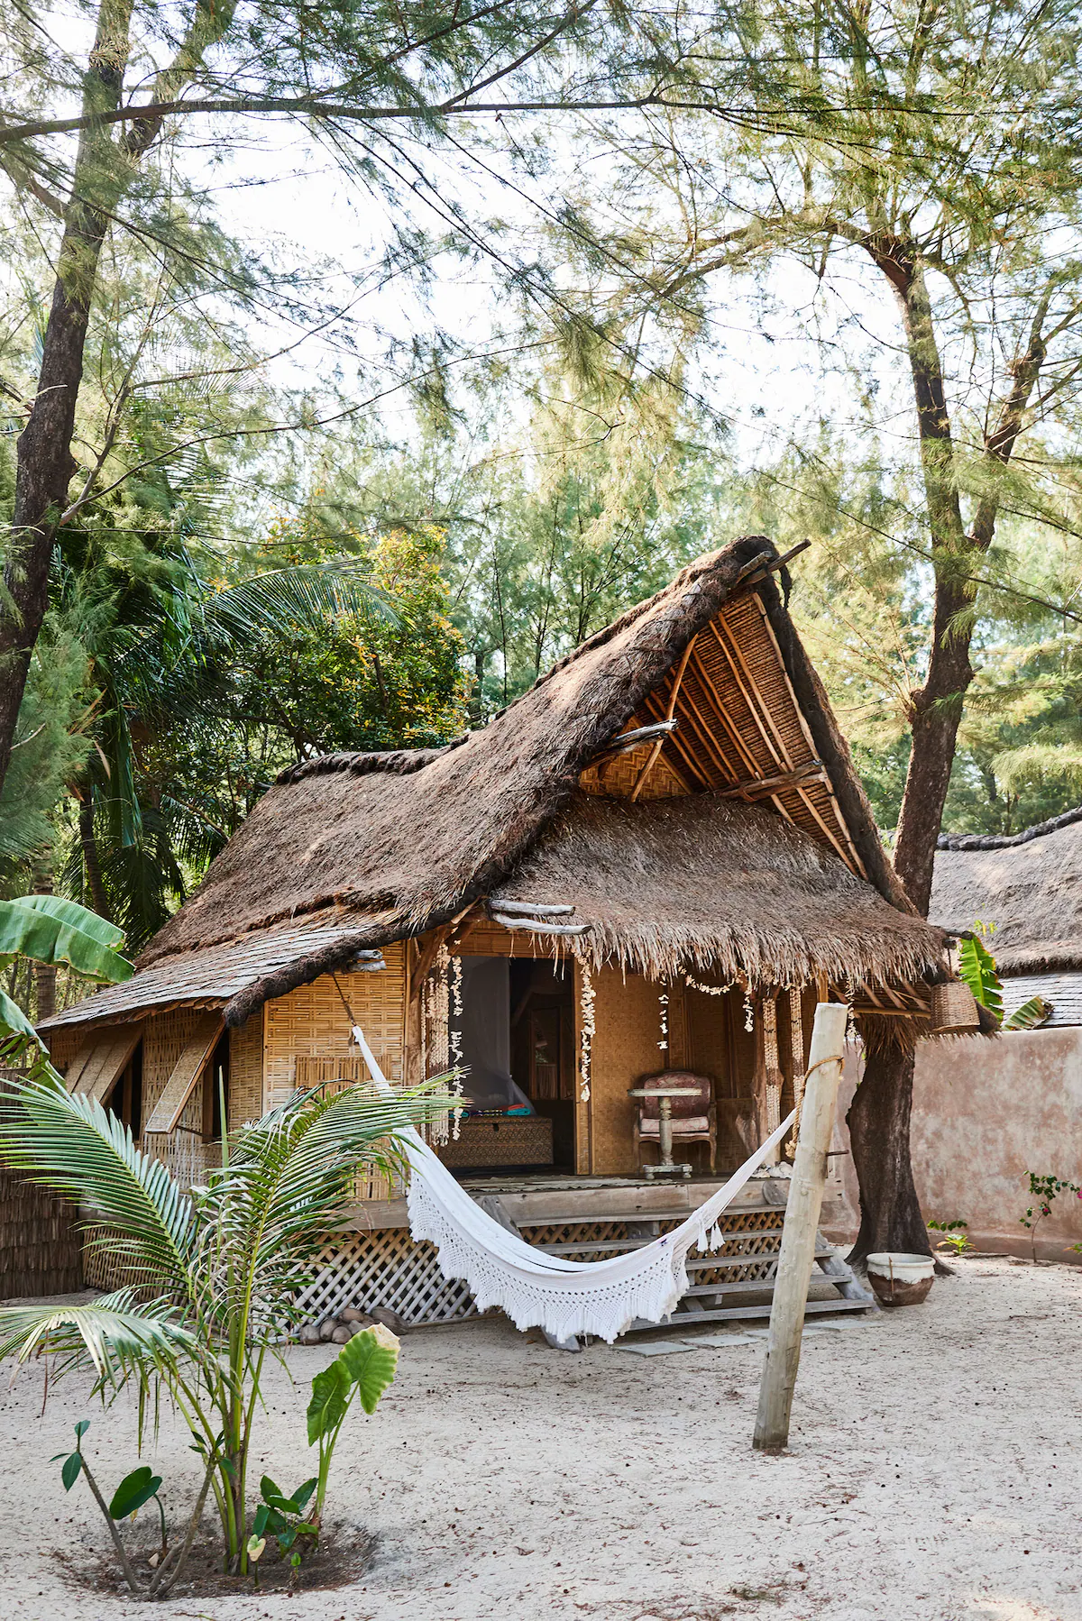
Crusoe grows his structure of production
Crusoe can continue to save berries to create more capital goods and further increase his future consumption
  He could improve the bow, add heads to arrows, build a net and spear to catch fish, etc.
  Investment always takes more time
    Adds more stages of production and lengthens the structure of production

Slide 13
Crusoe’s structure of production
    The more productive structures (i.e., those that lead to greater increases in consumption) take more time and have more stages
      These are known as roundabout production processes
      Time preferences are the ultimate limit on roundaboutness
      As individuals save more and adopt more roundabout production processes, human civilization advances

Slide 14
What have we learned from our simple Crusoe thought experiment?
There is a structure of production to produce any given good
Factors of production differ in terms of their specificity
The creation of capital goods requires savings and time
Increases in future consumption requires longer processes

Slide 15
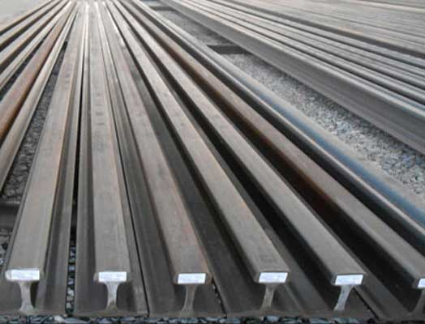
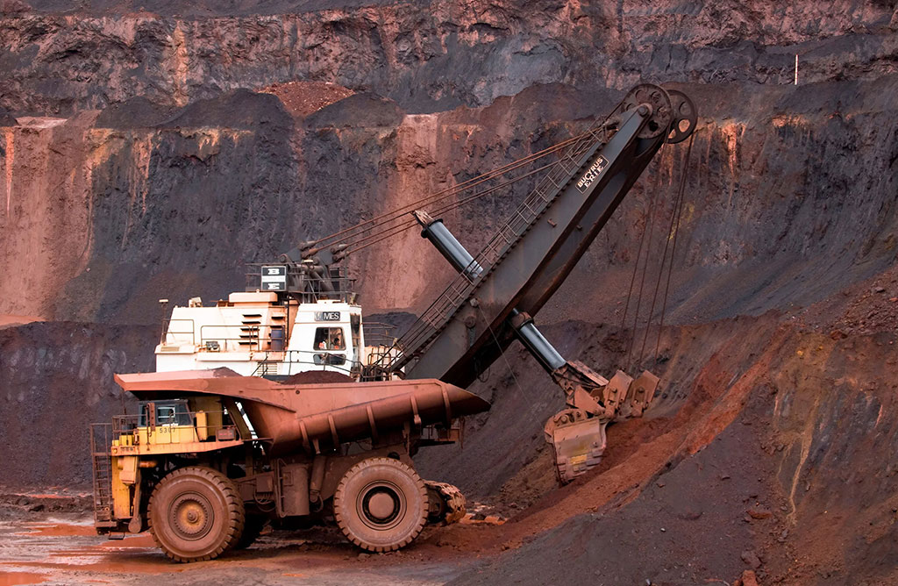
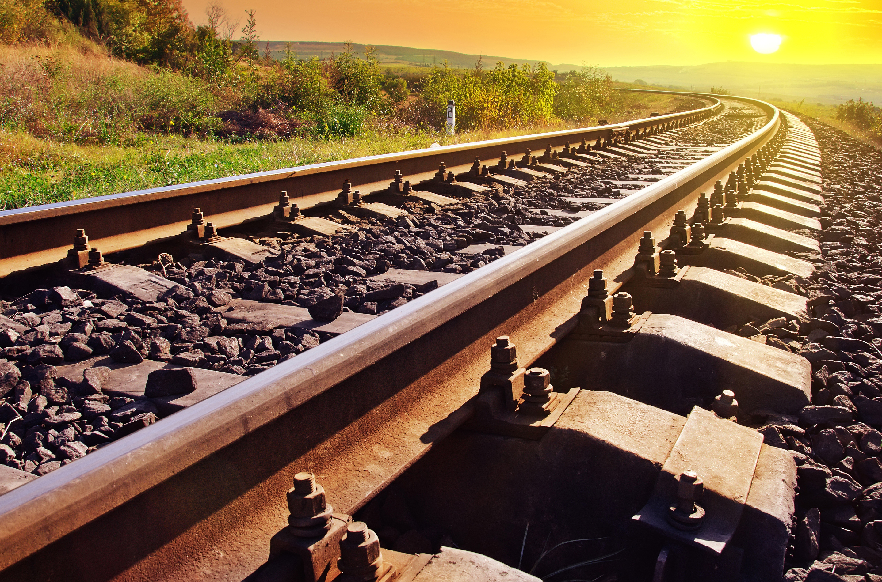
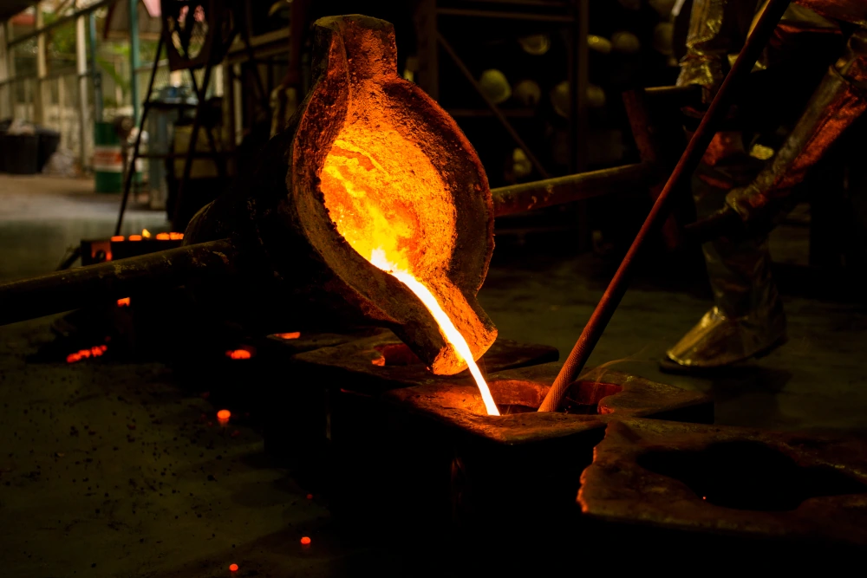
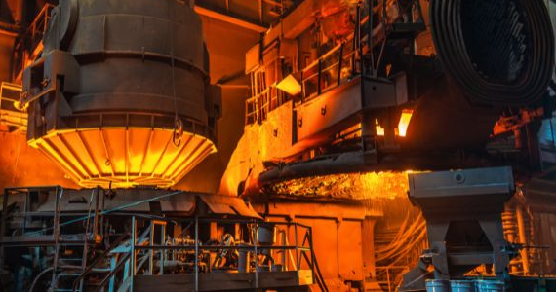
Now let’s look at the modern economy
Capital goods are produced by different individuals and exchanged for money
E.g., the structure of production for steel rails
    Mine ore, coal, and limestone
    Smelt ore into iron
    Refine iron into steel
    Shape steel into rails
    Lay rails to make a railroad

Slide 16

Enter the capitalist
At each stage of the rail making process, capitalists save money and invest
  They have lower time preferences than their workers
A capitalist purchases factors to create capital goods that they will sell
    For their saving, the capitalist earns interest

Slide 17
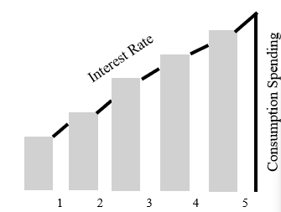
The overall structure of production
We can simplify the economy with five stages:
  Mining/harvesting raw materials
  Refining raw materials
  Manufacturing goods
  Packaging and distributing goods
  Preparing consumer goods

Slide 18
The overall structure of production
  The lower order stages are those stages that lead to consumer goods in the near future
  The higher order stages are those stages that lead to consumer goods in the remote future
    More higher orders means a greater payoff. But also means more waiting!

Slide 19
Changes in the structure
Capitalists increasing their savings is the main reason for economic growth
  This leads to additional higher order stages, which lengthens the structure of production
  More capital goods leads to more consumer goods or better quality consumer goods

Slide 20
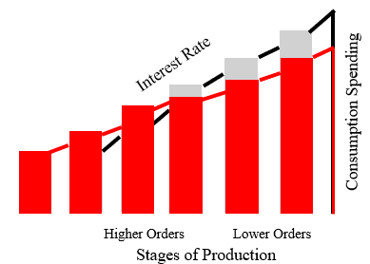
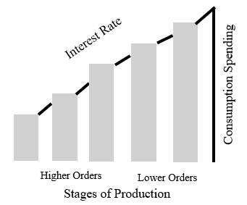
Changes in the structure

Slide 21
Significance of Austrian capital theory
Capital goods are heterogeneous. The structure of production is a latticework of capital goods, not a blob
Time is a crucial part of any production process, production is not instantaneous
Savings, not technology, is the most important ingredient for economic growth

Slide 22
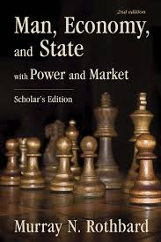
Thanks for listening!
See everyone again in the afternoon!

