Slide 1
Entrepreneurship
Peter G. Klein
Mises University
2025
@petergklein
#MisesU

Slide 2
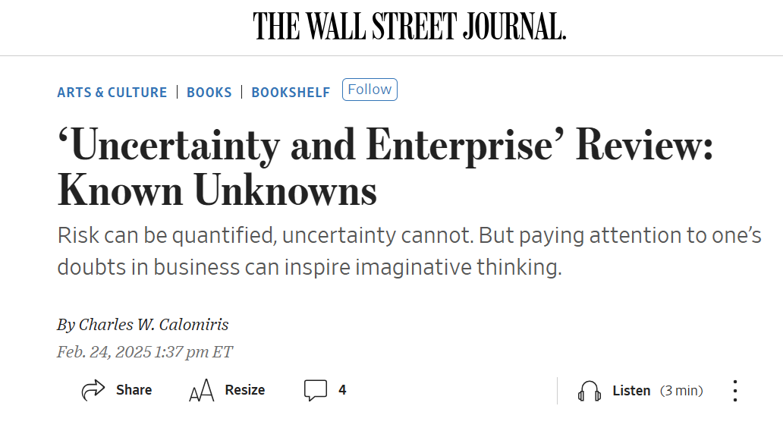
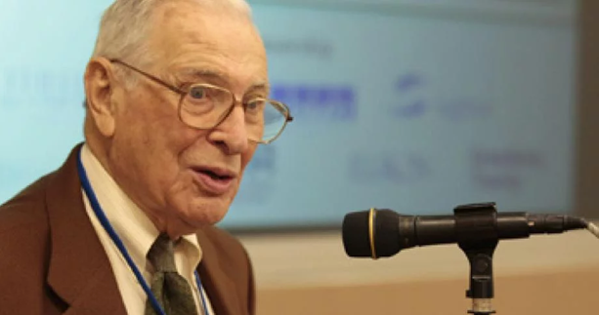
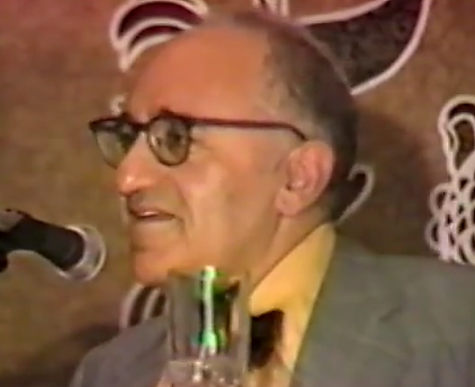
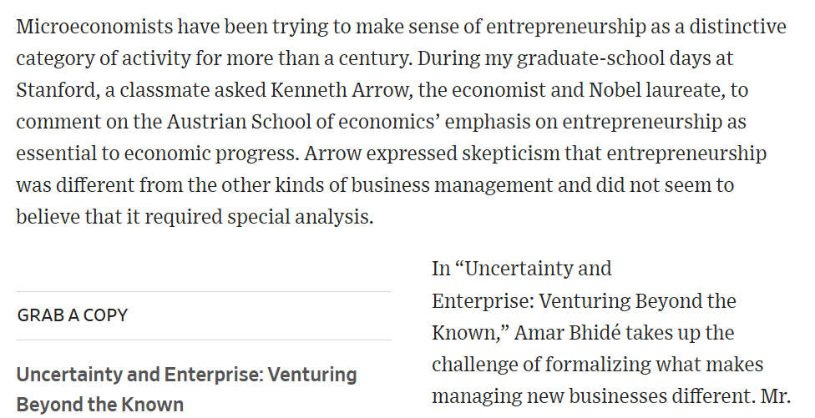

Dofflemyer Lecture Series, 1992

Slide 3

What is entrepreneurship?
Is entrepreneurship “different from other kinds of business
management” and does it require “special analysis”?
Mainstream view
  Entrepreneurship is a kind of labor service (e.g., starting or growing a business, managing a small enterprise, developing and introducing new products)
  Analyzed like any other factor of production: supplied up to the point where DMRP = w.
  Could also refer to a personality type for some workers/managers (creativity, initiative, perseverance, confidence)
Austrian view
  Entrepreneurship is judgmental decision-making under uncertainty.
  A specific type of human action — not labor (including management, business creation, inspirational leadership).

Slide 4
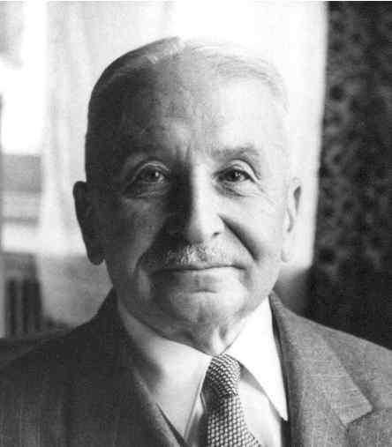
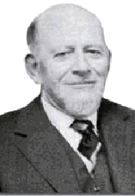
Thinking about entrepreneurship
Entrepreneurship in the broad sense: bearing uncertainty
  “The term entrepreneur as used by [economic] theory means: acting man exclusively seen from the aspect of the uncertainty inherent in every action” (Mises, 1949).
Entrepreneurship in the narrow (commercial) sense: combining and recombining productive factors in pursuit of money profit
  “We are living in a world of unexpected change; hence capital combinations . . . will be ever changing, will be dissolved and reformed. In this activity, we find the real function of the entrepreneur” (Lachmann, 1956).
  Monetary (cardinal) revenues and costs
  Monetary profit and loss

Slide 5
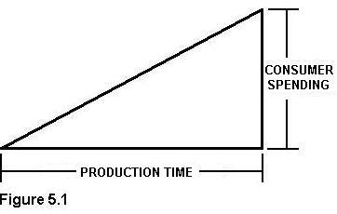
Why entrepreneurship matters
“[I]t is impossible to eliminate the entrepreneur from the picture of a market economy. The various complementary factors of production cannot come together spontaneously. They need to be combined by the purposive efforts of men aiming at certain ends and motivated by the urge to improve their state of satisfaction. In eliminating the entrepreneur one eliminates the driving force of the whole market system” (Mises, 1949, p. 248).
Austrian production theory
  Inputs and outputs
  Capital and stages of production (Newman, tomorrow)
  Imputation
  Need for economic calculation (Salerno, tomorrow)

Slide 6
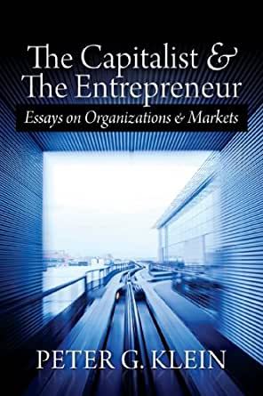
Entrepreneurship as judgment
Judgment: decision-making under uncertainty without a formal model or decision rule (intuition, gut feeling, Verstehen)
  “[T]he real entrepreneur is a speculator, a man eager to utilize his opinion about the future structure of the market for business operations promising profits. This specific anticipative understanding of the conditions of the uncertain future defies any rules and systematization. It can be neither taught nor learned. . . . [The entrepreneur] sees the past and the present as other people do; but he judges the future in a different way” (Mises, 1949, p. 585).
Judgment is manifest in ownership (Mises’s capitalist-
entrepreneur”).
  Entrepreneur must own capital (taxi vs Uber drivers).
  Buying or renting factors (capital goods) in the present, deploying them in pursuit of profit in the (uncertain) future.
  This is hard because capital goods are diverse.

Slide 7

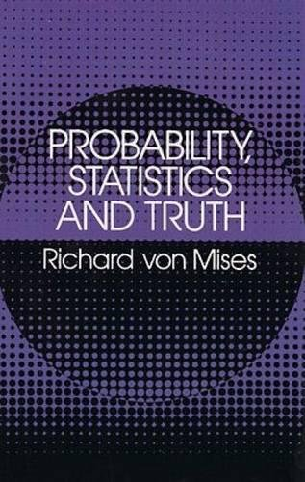
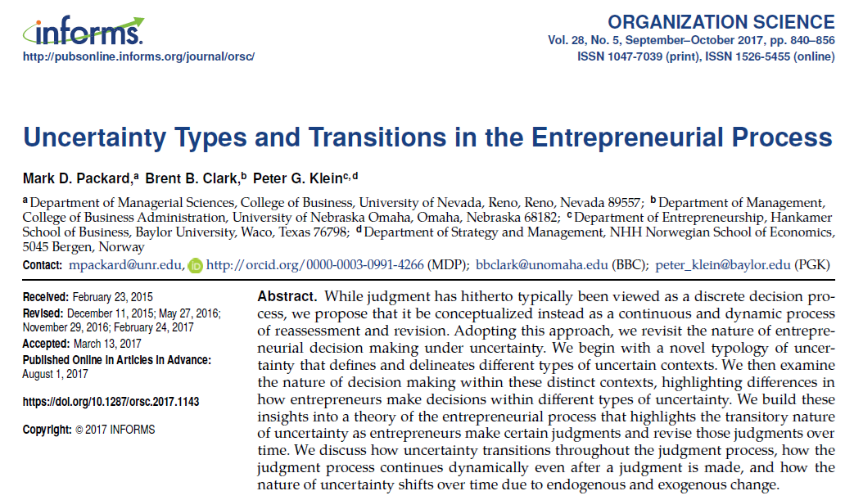
Conceptualizing uncertainty
Uncertainty versus risk (Knight, 1921)
Subjective probabilities (Keynes, 1921)
  Neoclassical economics approach (with Bayesian updating)
  Finance notion of ambiguity
Case versus class probability (R. von Mises, 1928)
  Note on subjectivity

Slide 8
Entrepreneurial profit and loss
In equilibrium (Mises’s and Rothbard’s evenly rotating economy)
  Each factor earns its discounted marginal revenue product (DMRP).
  Owner-managers of firms earn implicit wages based on opportunity cost.
  Capitalists earn interest based on time preference.
Outside the evenly rotating economy?
  Entrepreneurs compete for factors, based on their knowledge and beliefs about
    The present: technology, productive capabilities, resource availability
    The future: consumer demand, institutional conditions, competitor actions
    Actual DMRPs will only be revealed in the future.
  Results: profit and loss

Slide 9

Entrepreneurship and the market process 1/
“If [entrepreneurs] fail to produce in the cheapest and best possible
way those commodities which the consumers are asking for most
urgently, they suffer losses and are finally eliminated from their
entrepreneurial position. Other men who know better how to serve
the consumers replace them” (Mises, 1951, p. 7).
  Not the same as the “convergence toward equilibrium”
“[T]he profit-maker is allocating factors where they had been undervalued as compared to the consumers’ desires. The greater a man’s profit has been, the more praiseworthy his role, for then the greater is the maladjustment that he alone has uncovered and is combatting. The greater a man’s losses, the more blameworthy he is, for the greater has been his contribution to maladjustment” (Rothbard, 1962, p. 515).

Slide 10

Entrepreneurship and the market process 2/
“Of course, we should not be too hard on the bumbling loser. He receives his penalty in the form of losses. These losses drive him from his poor role in production. If he is a consistent loser wherever he enters the production process, he is driven out of the entrepreneurial role altogether. He returns to the job of wage earner. In fact, the market tends to reward its efficient entrepreneurs and penalize its inefficient ones proportionately. In this way, consistently provident entrepreneurs see their capital and resources growing, while consistently imprudent ones find their resources dwindling. The former play a larger and larger role in the production process; the latter are forced to abandon entrepreneurship altogether” (Rothbard, 1962, pp. 515-16).

Slide 11
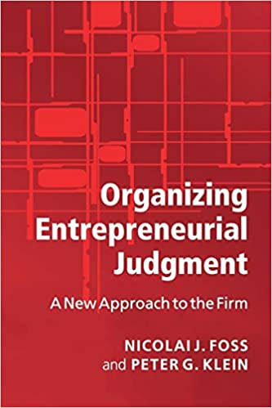
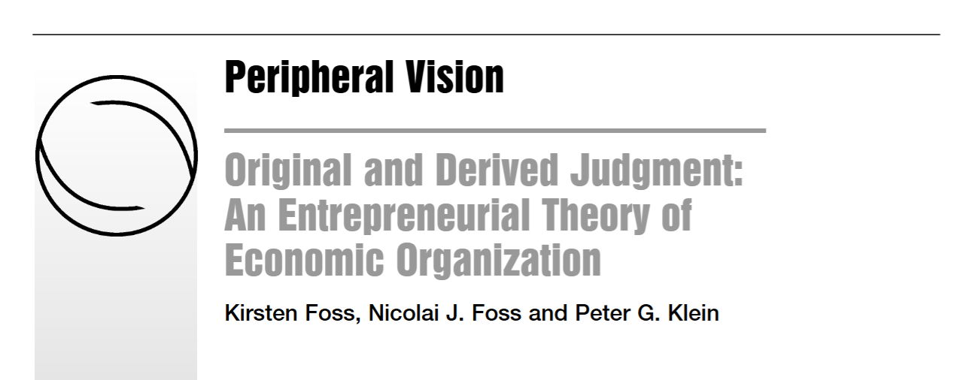
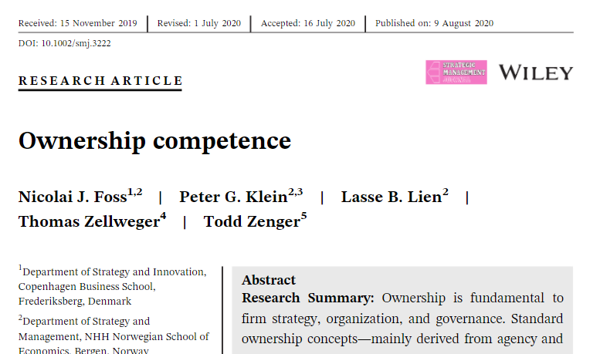
Entrepreneurial judgment and ownership
Judgment under uncertainty manifest in ownership.
Ownership as residual decision-making
  Proximate decision-making can be delegated to non-owner managers.
  Implications for the theory of the firm (who decides what, how are employees monitored and evaluated)
Owners differ in their ability (“ownership competence”)

Slide 12

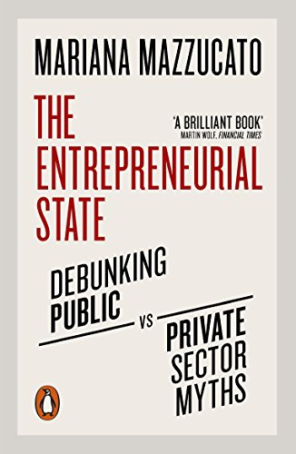

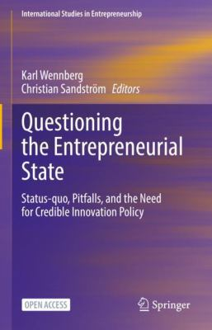
Can non-market actors be entrepreneurial?
Entrepreneurship versus “entrepreneur-like” behavior
Objectives, incentives, performance evaluation
Judgment and ultimate responsibility

