Slide 1
The Division of Labor and Social Order
Jonathan Newman
Notes:
ID=d924773e-9a16-4d6d-9803-8cb819e99682
Recipe=text_billboard
Type=TextOnly
Variant=0
FamilyID=AccentBoxWalbaum_Zero

Slide 2

Definitions
Division of labor – individuals specialize in particular tasks with the intent to trade
Social order – the institutions that permit, inhibit, or prohibit private property and the resultant harmony (or disharmony) of interests
“Society is division of labor and combination of labor.” – Mises, Human Action, p. 143

Slide 3
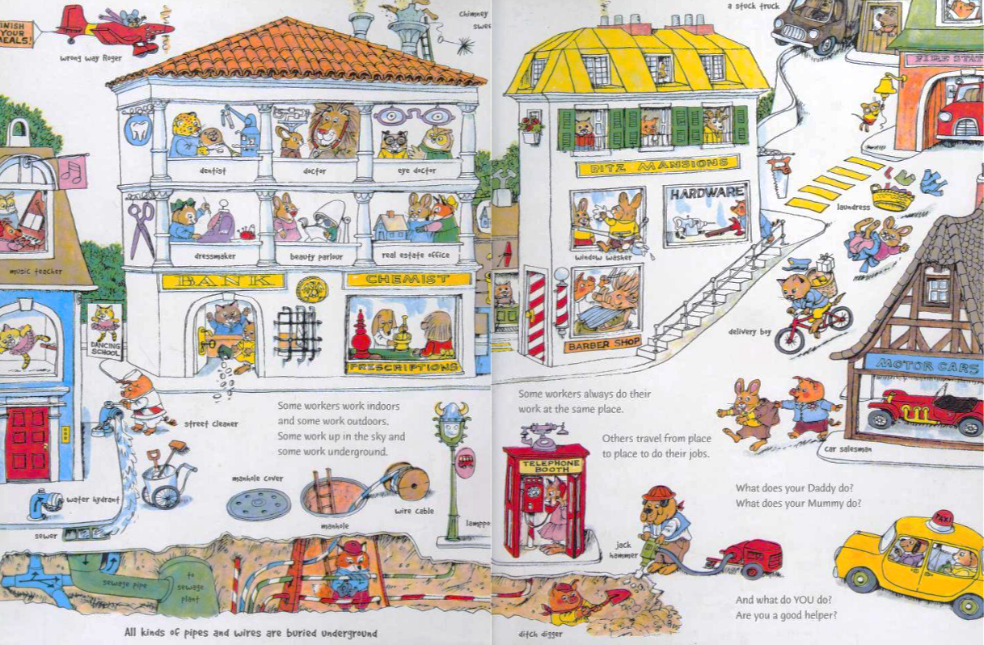

Slide 4
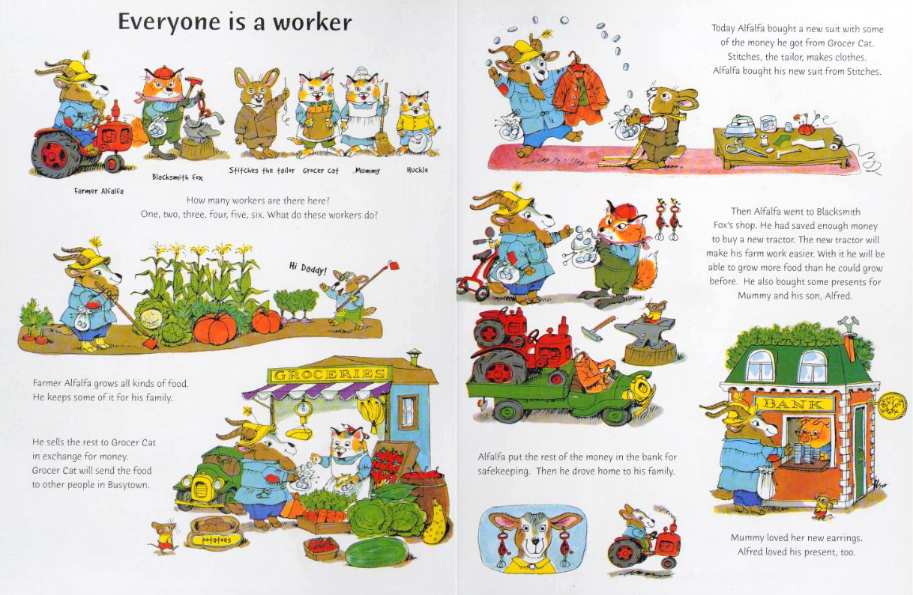

Slide 5
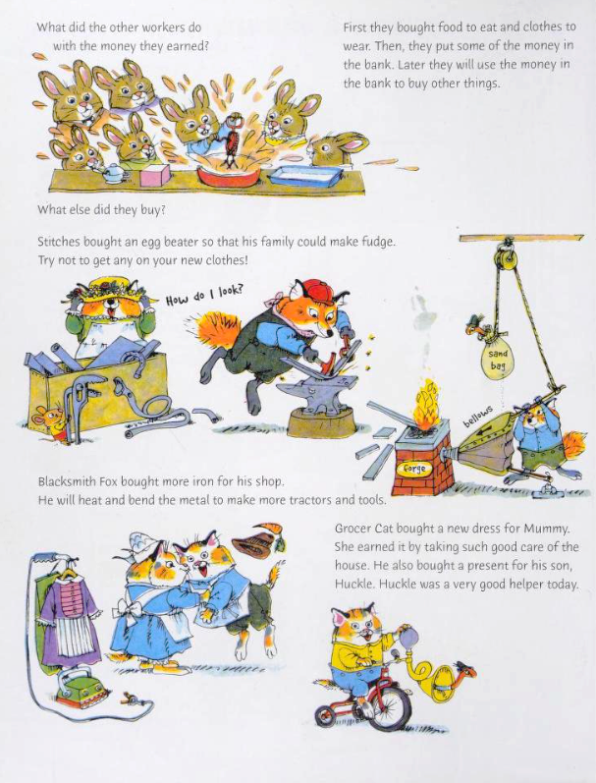
Scarry, Richard. 2005. What Do People Do All Day? London: HarperCollins. Originally published by Random House in 1968.

Slide 6
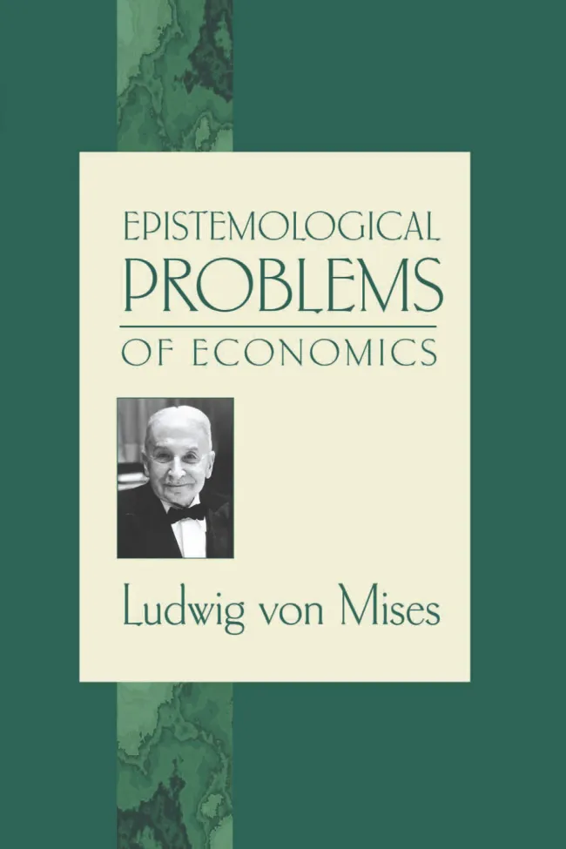
Division of labor → Society
“We owe the origin and development of human society and, consequently, of culture and civilization, to the fact that work performed under the division of labor is more productive than when performed in isolation.” – Mises, Epistemological Problems of Economics, p. 110

Slide 7
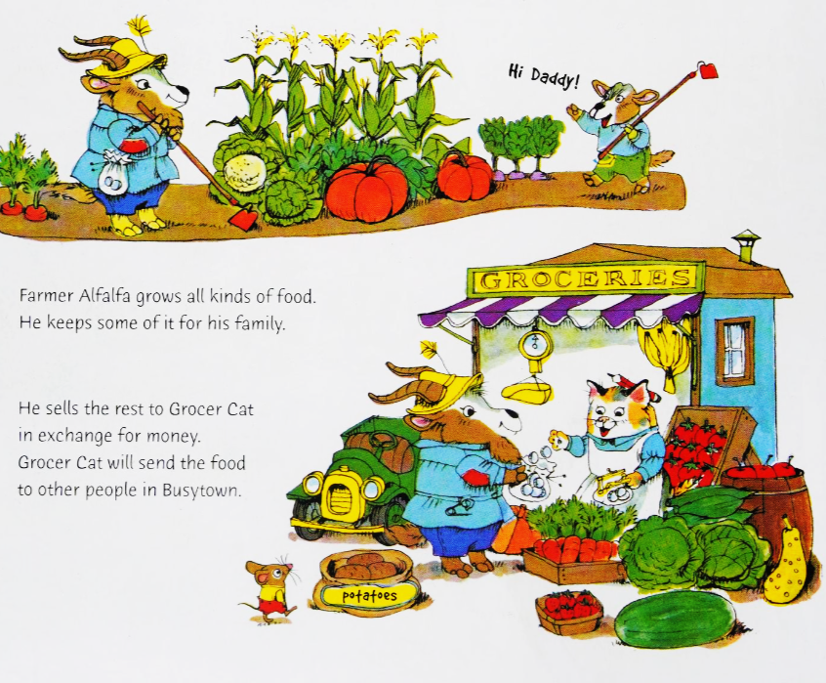
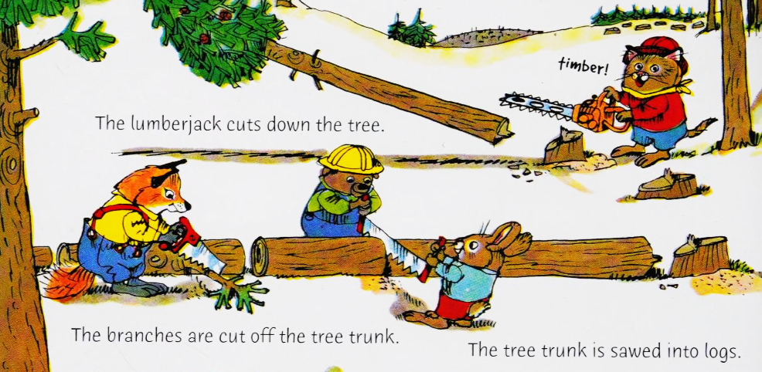
Division vs. Combination of Labor
Division of labor
Combination of labor

Slide 8
Labor
Land
Big metal machines
Labor
Metal mining
Land
Refrigerator
Knives
Oven
Land
Land
Labor
Oil refining
Fencing
Big metal machines
Labor
Land
Butcher
Bakery
Farming
Land
Flour
Labor
Metal refining
Labor
Plastic
Manufacturing
Ham
Bread
Lettuce
Metal manufacturing
Land
Labor
Labor
Ham Sandwich
Tomato
Big metal machines
Oil drilling
Labor
Labor
Land
Lumberyard
Land
Plate
Mayo
Coops
Land
Table/chairs
Chainsaws
Chicken Farm
Furniture Manufacturer
Paper Mill
Land
Land
Big metal machines
Labor
Labor
Tools
Land
Labor

Slide 9
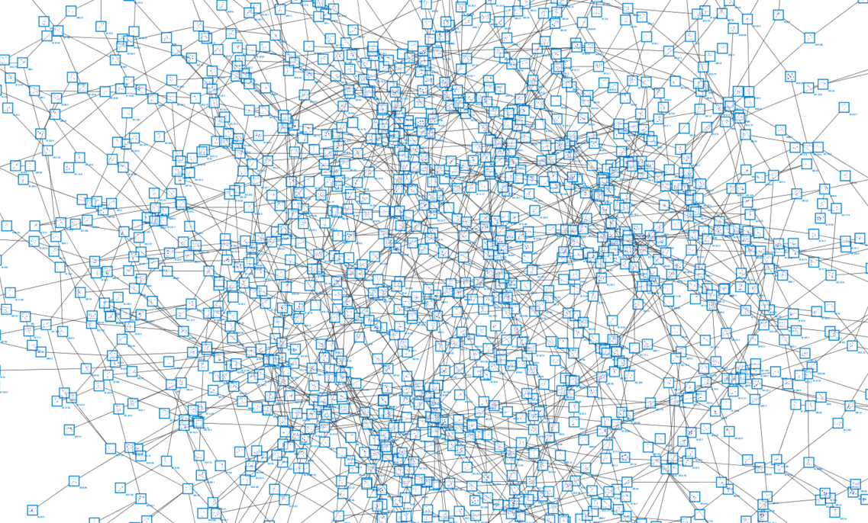

Slide 10
Labor
Land
Big metal machines
Labor
Metal mining
Land
Refrigerator
Knives
Oven
Land
Land
Labor
Oil refining
Fencing
Big metal machines
Labor
Land
Butcher
Bakery
Farming
Land
Flour
Labor
Metal refining
Labor
Plastic
Manufacturing
Ham
Bread
Lettuce
Metal manufacturing
Land
Labor
Labor
Ham Sandwich
Tomato
Big metal machines
Oil drilling
Labor
Labor
Land
Lumberyard
Land
Plate
Mayo
Coops
Land
Table/chairs
Chainsaws
Chicken Farm
Furniture Manufacturer
Paper Mill
Land
Land
Big metal machines
Labor
Labor
Tools
Land
Labor

Slide 11
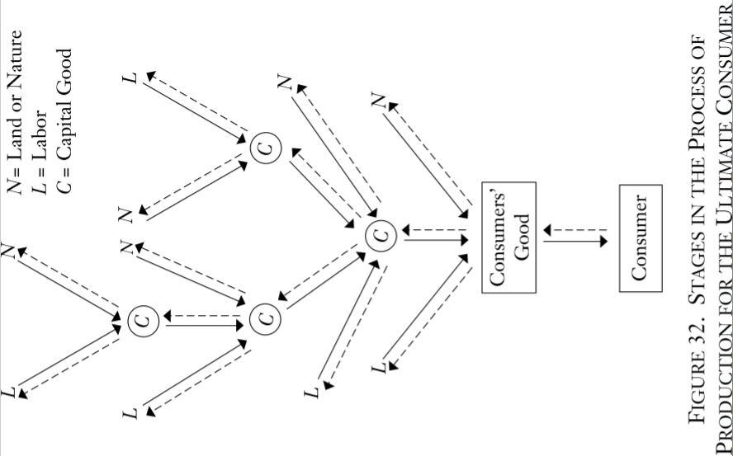

Slide 12
Why is the division of labor more productive?
Coconuts
In isolation, we can only consume what we produce.
Suppose Crusoe can collect two coconuts per hour or catch half a fish per hour.
After eight hours…
16
8
2
4
Fish

Slide 13
Why is the division of labor more productive?
Coconuts
Suppose Friday can collect half a coconut per hour or catch two fish per hour.
After eight hours…
4
2
8
16
Fish

Slide 14
Why is the division of labor more productive?
Coconuts
Coconuts
16
8
4
2
2
4
8
16
Fish
Fish

Slide 15


Why is the division of labor more productive?
Coconuts
Coconuts
16
8
4
2
2
4
8
16
Fish
Fish

Slide 16
Why is the division of labor more productive?
Coconuts
Coconuts
16
🤯
9
8
7
4
2
8
2
4
7
9
16
Fish
Fish

Slide 17
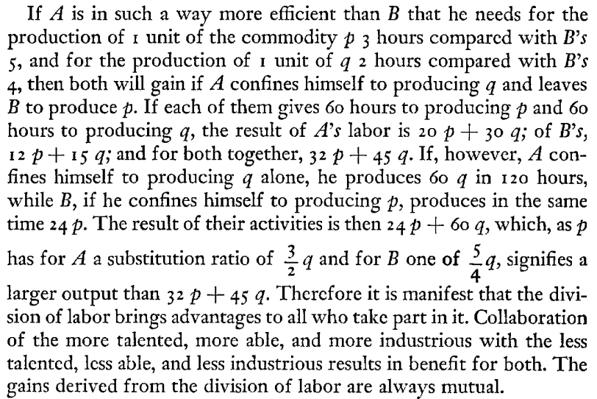
Law of Association

Slide 18
“Mises, what do you mean?”
Two people: A and B. Two goods: p and q.
A can produce 1 p in 3 hours. For B, it takes 5 hours. A can produce 1 unit of q in 2 hours. For B, it takes 4.
Isolation: With 120 hours split evenly between p and q, A can produce 20 p and 30 q. B can produce 12 p and 15 q. Total production is 32 p and 45 q.
Division of labor: A only produces q and B only produces p. Total production is 24p and 60 q.
The “substitution ratio” for A is 2p:3q; for B it’s 4p:5q, which “signifies a larger output.”

Slide 19
“I still don’t get it.”
It’s easier to see the gains by having A partially specialize in q.
Ex: A allocates 93 hours to q and 27 hours to p. A produces 46.5q and 9p. Add to B’s production of p (24 units). Total production is 33p and 46.5q, greater than their isolated production of 32 p and 45 q.

Slide 20
How does the law of association work?
The law of association says that everyone has a spot in the division of labor, even those who are less productive.
The reason it works is because the gains from trade come from the differences in production tradeoffs, not absolute productivity.
B has the comparative advantage in p because
  A: 2p/3q = 4p/6q < B: 4p/5q. (Costs A 6q to make 4 p. Only 5q for B.)
If you flip the fractions, the inequality sign flips too:
  A: 3q/2p > 5q/4p. A has the comparative advantage in q.

Slide 21
The Importance of the Law of Association
“The law of association makes us comprehend the tendencies which resulted in the progressive intensification of human cooperation. We conceive what incentive induced people not to consider themselves simply as rivals in a struggle for the appropriation of the limited supply of means of subsistence made available by nature. We realize what has impelled them and permanently impels them to consort with one another for the sake of cooperation. Every step forward on the way to a more developed mode of the division of labor serves the interests of all participants.” – Mises, Human Action, p. 159

Slide 22
Economic Calculation
“Monetary calculation is the guiding star of action under the social system of division of labor.” – Mises, Human Action, p. 230
The prospective monetary income in various employments provides an incentive to each individual to specialize in his comparative advantage.

Slide 23
Other critics of economic calculation fail to realize that it is a method available only to people acting in the economic system of the division of labor in a social order based upon private ownership of the means of production.
Mises, Human Action, p. 217

Slide 24



Example: Bob’s Employment Opportunities
$1,000
$2,000
$5 million
Boxer
Actor in Marvel films
Singer

Slide 25



Social Order
If based on private property, economic calculation is possible and the full benefits of the division of labor can be extended to all who participate.
If private property is inhibited or prohibited, economic calculation is distorted or made impossible, and the benefits of the division of labor are curtailed or eradicated.

Slide 26

The marvelous civilization of antiquity perished because it did not adjust its moral code and its legal system to the requirements of the market economy. A social order is doomed if the actions which its normal functioning requires are rejected by the standards of morality, are declared illegal by the laws of the country, and are prosecuted as criminal by the courts and the police. The Roman Empire crumbled to dust because it lacked the spirit of liberalism and free enterprise. The policy of interventionism and its political corollary, the Führer principle, decomposed the mighty empire as they will by necessity always disintegrate and destroy any social entity.
Mises, Human Action, p. 763

Slide 27
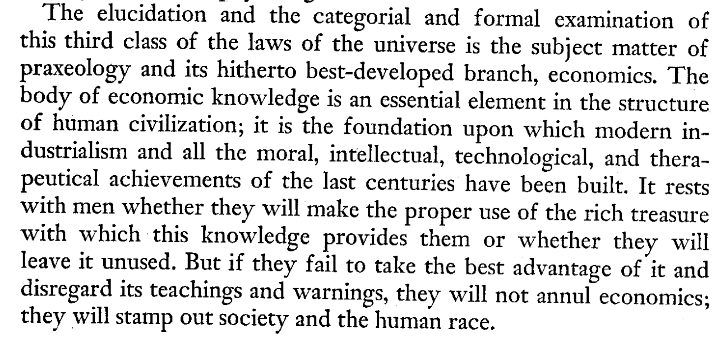
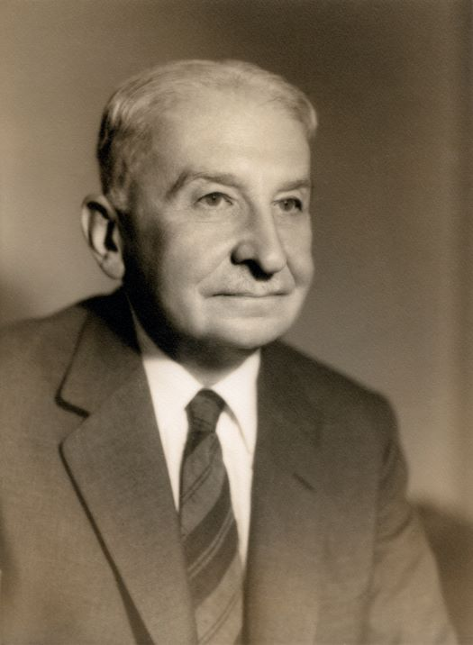
Mises, Human Action, p. 881

