Slide 1

Bureaucrats in the
Deep State
Tate Fegley
Mises University 2023

Slide 2
Defining the Deep State
There are a number of ways to define the “Deep State,” none of which are free from debate.
What I don’t mean:
  A “conspiracy theory” about a clandestine network of members of the intelligence agencies, working in conjunction with high-level financial and industrial entities, to exercise power alongside or within the elected US government, that ”might” exist a la Wikipedia
What I do mean:
  Bureaucrats that operate with de facto electoral unaccountability
  Especially, but not necessarily limited to, the national security-oriented agencies that operate in secrecy
  Agencies whose leaders and policies are not much affected by changes in the White House or Congress

Slide 3
Profit Management
The manager has a readily identifiable metric of whether an enterprise or division is being managed well: is it making a profit?

Slide 4

Bureaucratic Management
Key characteristic: it is not operated on the basis of profit and loss.
“The objectives of public administration cannot be measured in money terms and cannot be checked by accountancy methods. Take a nationwide police system like the FBI. There is no yardstick available that could establish whether the expenses incurred by one of its regional or local branches were not excessive.”
  - Mises, Bureaucracy, p. 38

Slide 5

The Ideal Protective State
Property rights are well-defined, and the purpose of government is to protect and enforce these rights from internal and external threats.
The state does through the operation of police, courts, and the national security state, which includes the military.
This model is also characterized by the existence of effective mechanisms allowing citizens to directly monitor, reward, or punish politicians for their actions.

Slide 6
Operation of the Ideal Protective State
Elected politicians engage in protective activities only when it is in the interests of citizens.
In doing so, elected officials employ, monitor, and reward or punish bureaucrats who serve as value-added inputs in the production of security.
There is symmetric information between the citizen and political actors.
There is no room for political opportunism, waste, fraud, corruption or abuses of power because political actors are assumed to be ideal civil servants.

Slide 7
Voters
Elected Officials
Bureaucrats
Media

Slide 8
The Actual State
Principal-agent problems
Limited effectiveness of voting
Rationally ignorant voters
Vote-seeking politicians
Special-interests
The lack of economic calculation makes it impossible to determine whether bureaucratic outputs were value-added

Slide 9
The Limits of the Voting Booth
Citizens often lack the incentive to acquire the information necessary to monitor, reward, and punish elected officials.
Since they are not fully informed, political actors have the incentive to use propaganda to influence what information is available to voters and how it is framed.
There is substantial time between federal elections.
  Those who voted for George W. Bush in 2000 could not have anticipated 9/11 and the response to it. By the 2004 election, changes to the national security apparatus would be very hard to reverse, even if voters wanted it.

Slide 10
Special Interests
E.g. the “military-industrial-congressional complex,” (MICC) which refers to the interlinkages between the government’s military apparatus, Congress, and private industry
Concentrated benefits and dispersed costs
Members of the MICC have the incentive to attempt to shape public opinion and government policy to inflate national security threats relative to their actual potential for harm

Slide 11
Voters
Elected Officials
Bureaucrats
Deep State
Disinformation
Insert personnel
Censorship
Media
Notes:
Censorship:
FBI directly involved “most massive attack on free speech in American history”
Hunter Biden Laptop
Lab leak theory
Effectiveness of masks, lockdowns, and vaccines
Speech about election integrity

Slide 12
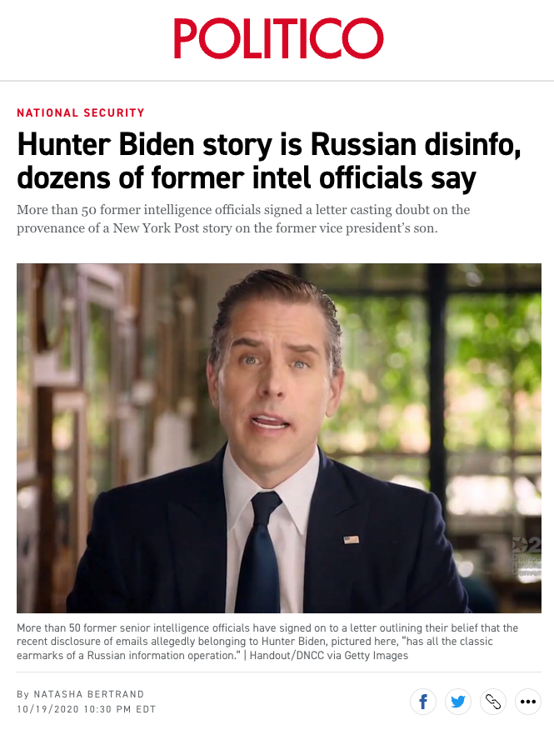
Disinformation
Notes:
Worth noting is that Natasha Bertrand has reliably trumpeted everything fed to her by intelligence officials, including the Christopher Steele dossier.

Slide 13
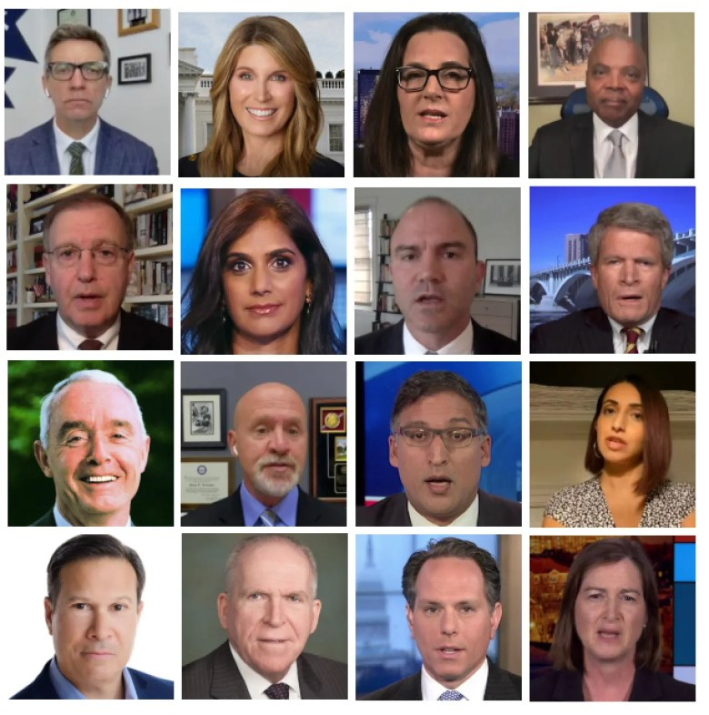
Insert Personnel
Talking heads at MSNBC from CIA, FBI, DEA, DOJ, US Army
Notes:
From top left: Watts, Wallace, Vance, Twitty, Rosenberg, Rangappa, Rhodes, Painter, McCaffrey, Kirschner, Kaytal, Haq, Figliuzzi, Brennan, Bash, McQuade
John Brennan, former Director of the CIA, now senior intelligence analyst at MSNBC
Frank Figliuzzi, former Assistant Director of Counterintelligence at the FBI
Asha Rangappa, former Special Agent for the FBI, specializing in counterintelligence
Nicolle Wallace, former Communications Director for George W. Bush
Jeremy Bash, former Chief of Staff of the CIA
Clint Watts, former FBI counterintelligence agent and MSNBC national security analyst
Chuck Rosenberg, former Acting DEA administrator and senior FBI official
Nayyera Haq, former Senior Director of the White House
Richard Painter, former Chief Ethics lawyer in the George W. Bush White House
Neal Kaytal, former Acting Solicitor General of the United States
Ben Rhodes, former National Security Advisor to Barack Obama
Barry McCaffrey, former U.S. Army General and Drug Czar, security analyst for NBC and MSNBC
Stephen Twitty, former Lieutenant General of the U.S. Army
Joyce Vance, former U.S. Attorney
Barbara McQuade, former U.S. Attorney
Glenn Kirschner, former Assistant U.S. Attorney

Slide 14
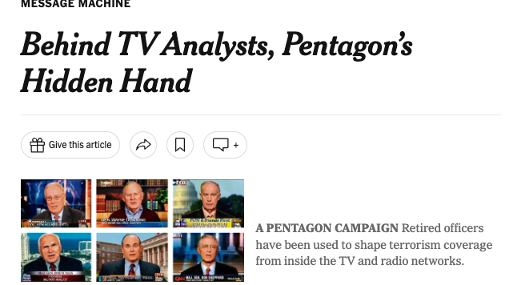

Slide 15
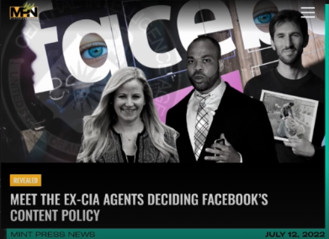

Slide 16
Voters
Elected Officials
Bureaucrats
Investigate and intimidate dissidents
Manufacture plots/entrapment
Six ways from Sunday
Deep State
Disinformation
Insert personnel
Censorship
Media

Slide 17
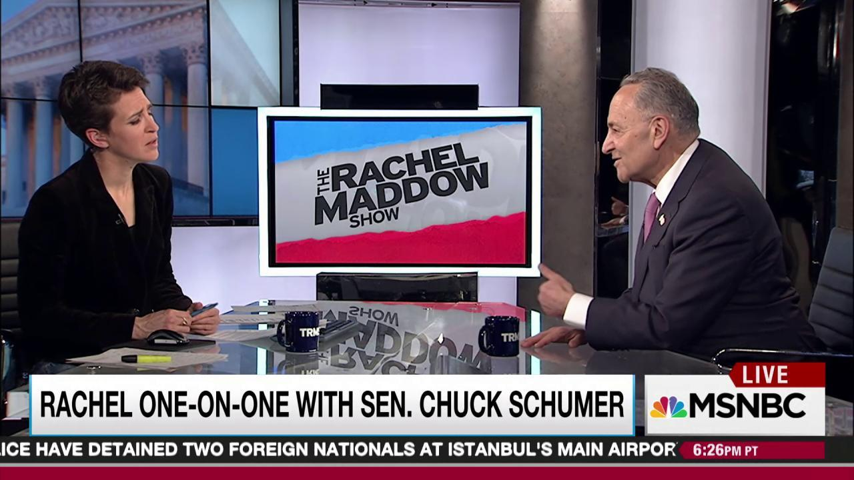
“Let me tell you, you take on the intelligence community, they have six ways from Sunday at getting back at you.”
Notes:
What might this include?
Opening a false investigation about you
Leaking disinformation to the media
Malicious prosecution
Selective prosecution

Slide 18
Voters
Elected Officials
Bureaucrats
Investigate and intimidate dissidents
Manufacture plots/entrapment
Six ways from Sunday
Lie with impunity/hide information
Deep State
Disinformation
Insert personnel
Censorship
Media

Slide 19
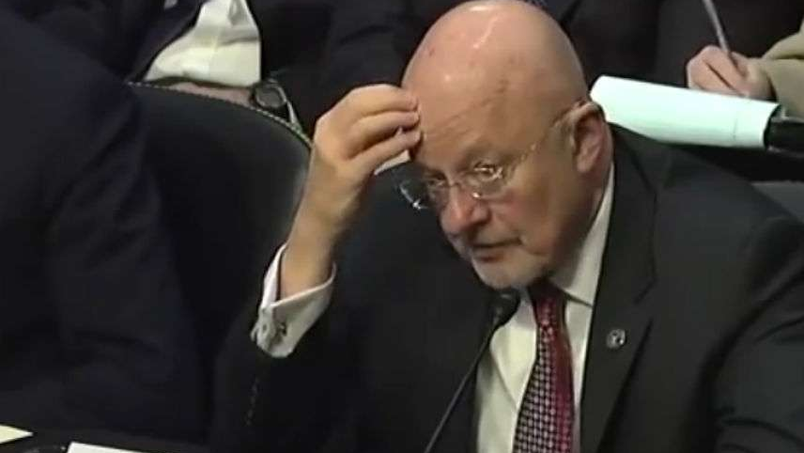
Former Director of National Intelligence James Clapper
Notes:
National intelligence director James Clapper in 2013 lied under oath — with impunity — to Congress about the existence of the the Deep State's mass surveillance programs. And, by the way, he is employed by CNN.
Hilarious side note: Natasha Bertrand, who published the Politico article about the intelligence officials claiming the Hunter Biden laptop story was Russian disinfo, was also hired by CNN. So she’s co-workers now with Clapper, and Clapper accused her of having “deliberately distorted” the letter that he cosigned.

Slide 20
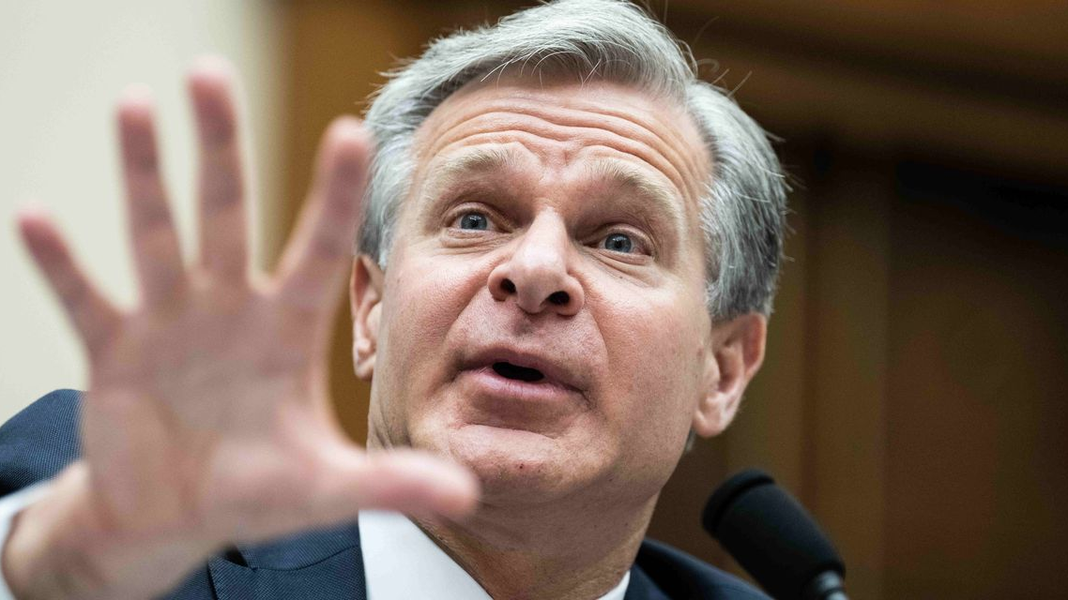
FBI Director Christopher Wray
Notes:
Brought to testify before the House Judiciary Committee on July 12 regarding, among other things, how the FBI is coercing Big Tech to censor the political speech of Americans online. He mainly evaded questions and feigned ignorance about such things as how many FBI informants and undercover agents were among the crowd on Jan. 6. If this isn’t a lie, it’s sheer incompetency, but he will likely face no consequences.

Slide 21
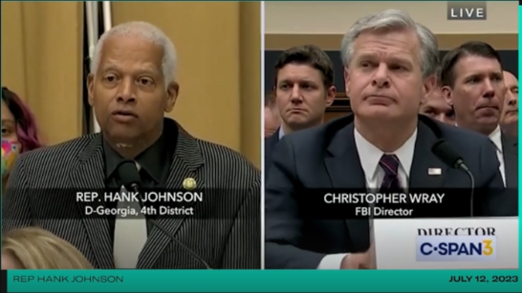
Notes:
Director Wray, are you aware that MAGA Republicans have repeatedly called for the FBI to be defunded?...Can you briefly describe for us what the effect would be on our national security or domestic tranquility if the FBI were defunded or dismantled?”

Slide 22
Voters
Elected Officials
Bureaucrats
Fail to prosecute misconduct
Investigate and intimidate dissidents
Manufacture plots/entrapment
Six ways from Sunday
Lie with impunity/hide information
Deep State
Disinformation
Insert personnel
Censorship
Media

Slide 23
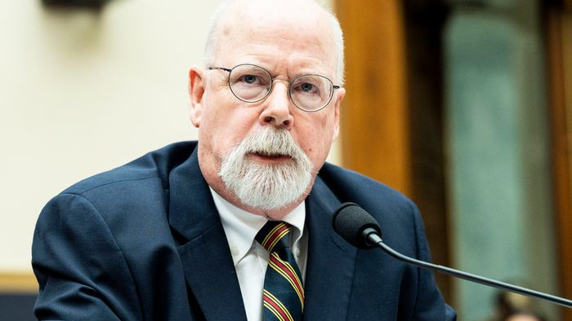
Special Counsel John Durham
Notes:
The FBI did not have an adequate basis on which to launch Crossfire Hurricane
Failed to examine all available exculpatory evidence
Continued the investigation even when case agents were unable to verify evidence
Did not interview key witnesses
Individuals abused their authority under FISA

Slide 24
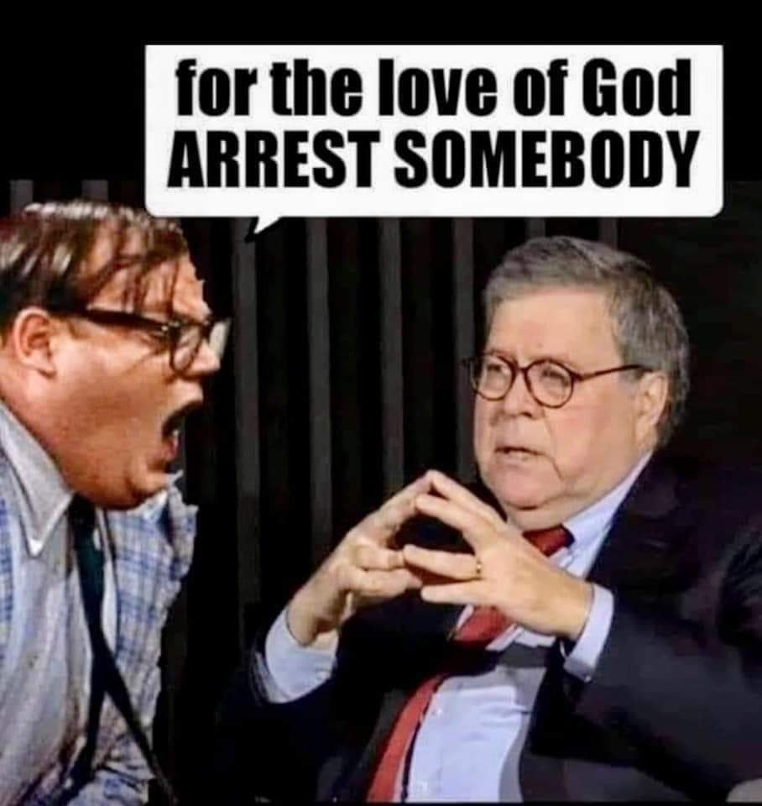
Notes:
Attorney General Bill Barr

Slide 25
Voters
Elected Officials
Bureaucrats
Fail to prosecute misconduct
Investigate and intimidate dissidents
Manufacture plots/entrapment
Six ways from Sunday
Lie with impunity/hide information
Deep State
Disinformation
Insert personnel
Censorship
Media
Notes:
I don’t want to make it seem like it’s exclusively antagonism between the Deep State and elected officials – and we should think of neither group as a unified source – as there are clearly mutually beneficial arrangements.
This is not at all meant to be exhaustive of the dynamics at work, but highlights some of the ways in which the idealized model of democratically holding bureaucrats accountable breaks down.

Slide 26
Some concluding thoughts
What might be done (from a Misesian perspective)
  Defund the Deep State?
  Reduce the role of the state
Notes:
“The two pillars of democratic government are the primacy of the law and the budget…The administration, in a democratic community, is not only bound by law but also by the budget. Democratic control is budgetary control. The people’s representatives have the keys of the treasury. Not a penny must be spent without the consent of parliament.” Mises, Bureaucracy, p. 34-35
“The emergence of a large class of such men dependent on the government became a serious menace to the maintenance of constitutional institutions.” p. 45
“Representative democracy cannot subsist if a great part of the voters are on the government payroll. If the members of parliament no longer consider themselves mandatories of the taxpayers but deputies of those receiving salaries, wages, subsidies, doles, and other benefits from the treasury, democracy is done for.” p. 66

