Slide 1

Explore And Realize
(and keep exploring)
How Austrian entrepreneurs generate value on the path to business success.
Explore
Realize
Based on E4B Podcast
#143
with
Professor Per Bylund

Slide 2

Entrepreneurs generate new value for customers.
Value is the benefit gained by customers – whether B2B or B2C - in the experience of a consumption activity. Value is subjective: a feeling that’s entirely real but not measurable.
Most companies do not understand the concept of subjective value. Therefore, this understanding is advantageous for Austrian entrepreneurs
All the time, customers are learning what new value they want, and entrepreneurs are learning how to help them.

Slide 3
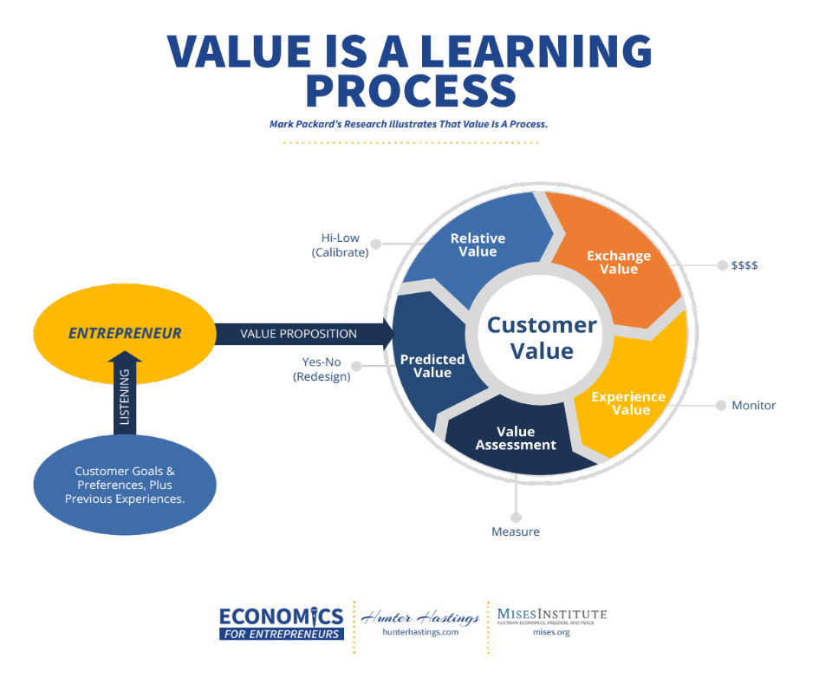
Customers engage in learning what they want…... entrepreneurs learn with them.
Customers aim at relief of felt unease – they can’t articulate what they want, they can only express dissatisfaction: “Things would be better if…..”, “I wish there was………”.
Value is a learning process for customers – what’s available to them, how well does it fit their preferences, is it better than alternatives (including doing nothing). They can’t know what generates a valuable experience – that’s in the future.
Entrepreneurs observe them during the learning process, help where they can with information, including pricing, and try to keep up with the learning process of each individual customer.
Listen to Dr. Mark Packard discuss the Value Learning Process

Slide 4
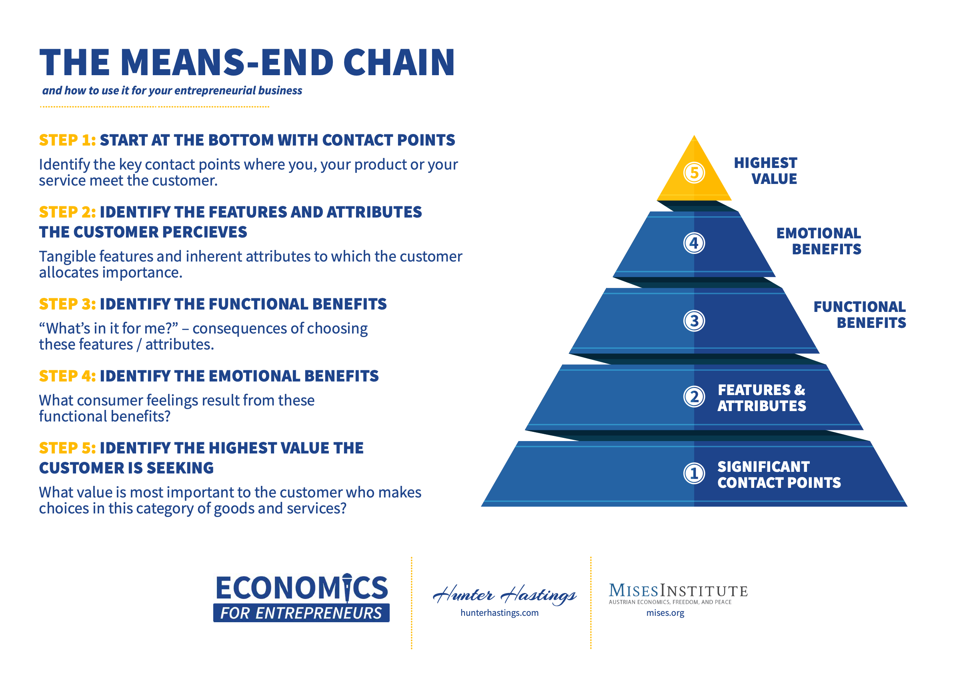
The needs pyramid tool helps entrepreneurs identify customer goals based on their highest need.
Customers unconsciously adhere to a pyramid of values, and their choices are consistent with the pursuit of their highest subjectively-identified value.
THE NEEDS PYRAMID
For example, Nike’s “Just Do It” rallying cry pertains to a highest value of a sense of achievement in life. Benefits and features such as performance, comfort, appearance and affordability are contributive to the customer’s experience of achievement.
Entrepreneurs can reconstruct this pyramid to identify “the strongest route to the top” – the best way to help customers to experience the highest value they seek.
Trini Amador on the role of values in business

Slide 5
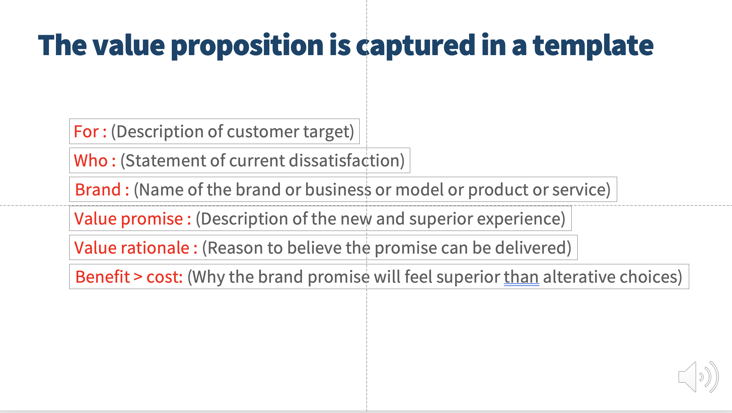
To generate customer learning, entrepreneurs offer dynamic value propositions for a better future.
Customers create value. Entrepreneurs facilitate their value experience. The remove every barrier – knowledge barrier, emotional barrier, price-value perception barrier, decision barrier, choice barrier – in order to generate a purchase and subsequent value experience
Value Proposition Template
A critical step is the value proposition: the promise to the customer that the entrepreneur understands them and their preferences sufficiently to offer them the best possible solution.
Value propositions are refined and made stronger and more fitting over time based on customer feedback – from research, from trials and from actual consumption experiences.
Learn more about Value Proposition Design

Slide 6

Customers lead the way on a weaving path, entrepreneurs humbly follow through continuous change.
The customer’s search for value is non-linear. Value uncertainty applies to the customer as well as the entrepreneur.
There are continuous changes in the customer’s environment – new experiences, new offerings from competing entrepreneurs, new influences on willingness to pay, new perspectives on preferences.
Entrepreneurs can inform and try to persuade, but, ultimately, they are followers, observing the customer’s progress, interacting where possible, and quickly adapting and responding to customer discovery..

Slide 7

No planning – value generation through adaptively fitting in to the customer’s value system.
Traditional business methods, as taught at business schools, favor control, planning, efficiency and the elimination of waste. These concepts are inapplicable to entrepreneurial value generation.
Imagination, creativity and adaptation represent the more appropriate approach to discover value.
Fitting in to the customer’s value system is the best perspective for the entrepreneur. Customers assemble and integrate resources and services within their own value system. Entrepreneurs who can fit in and contribute new value are welcomed.

Slide 8
Value realization takes place when the customer completes the learning journey and chooses a value proposition.
As customers learn what they want, and as they accept the help of the entrepreneur by considering new value propositions, they move towards a value exchange that precedes their value experience (which occurs in or after consumption).
If the value experience is appraised positively (i.e. met the customer’s expectations), we can say that value is realized. Value realization for the consumer is a valuable experience; for the entrepreneur it’s the observation of that experience, and the signals that result from it (including cash flow from exchange).
Explore
Realize
Both cash flow and observations of the customer’s experience are feedback mechanisms to which the entrepreneur can further adapt. Exploration never stops.

Slide 9
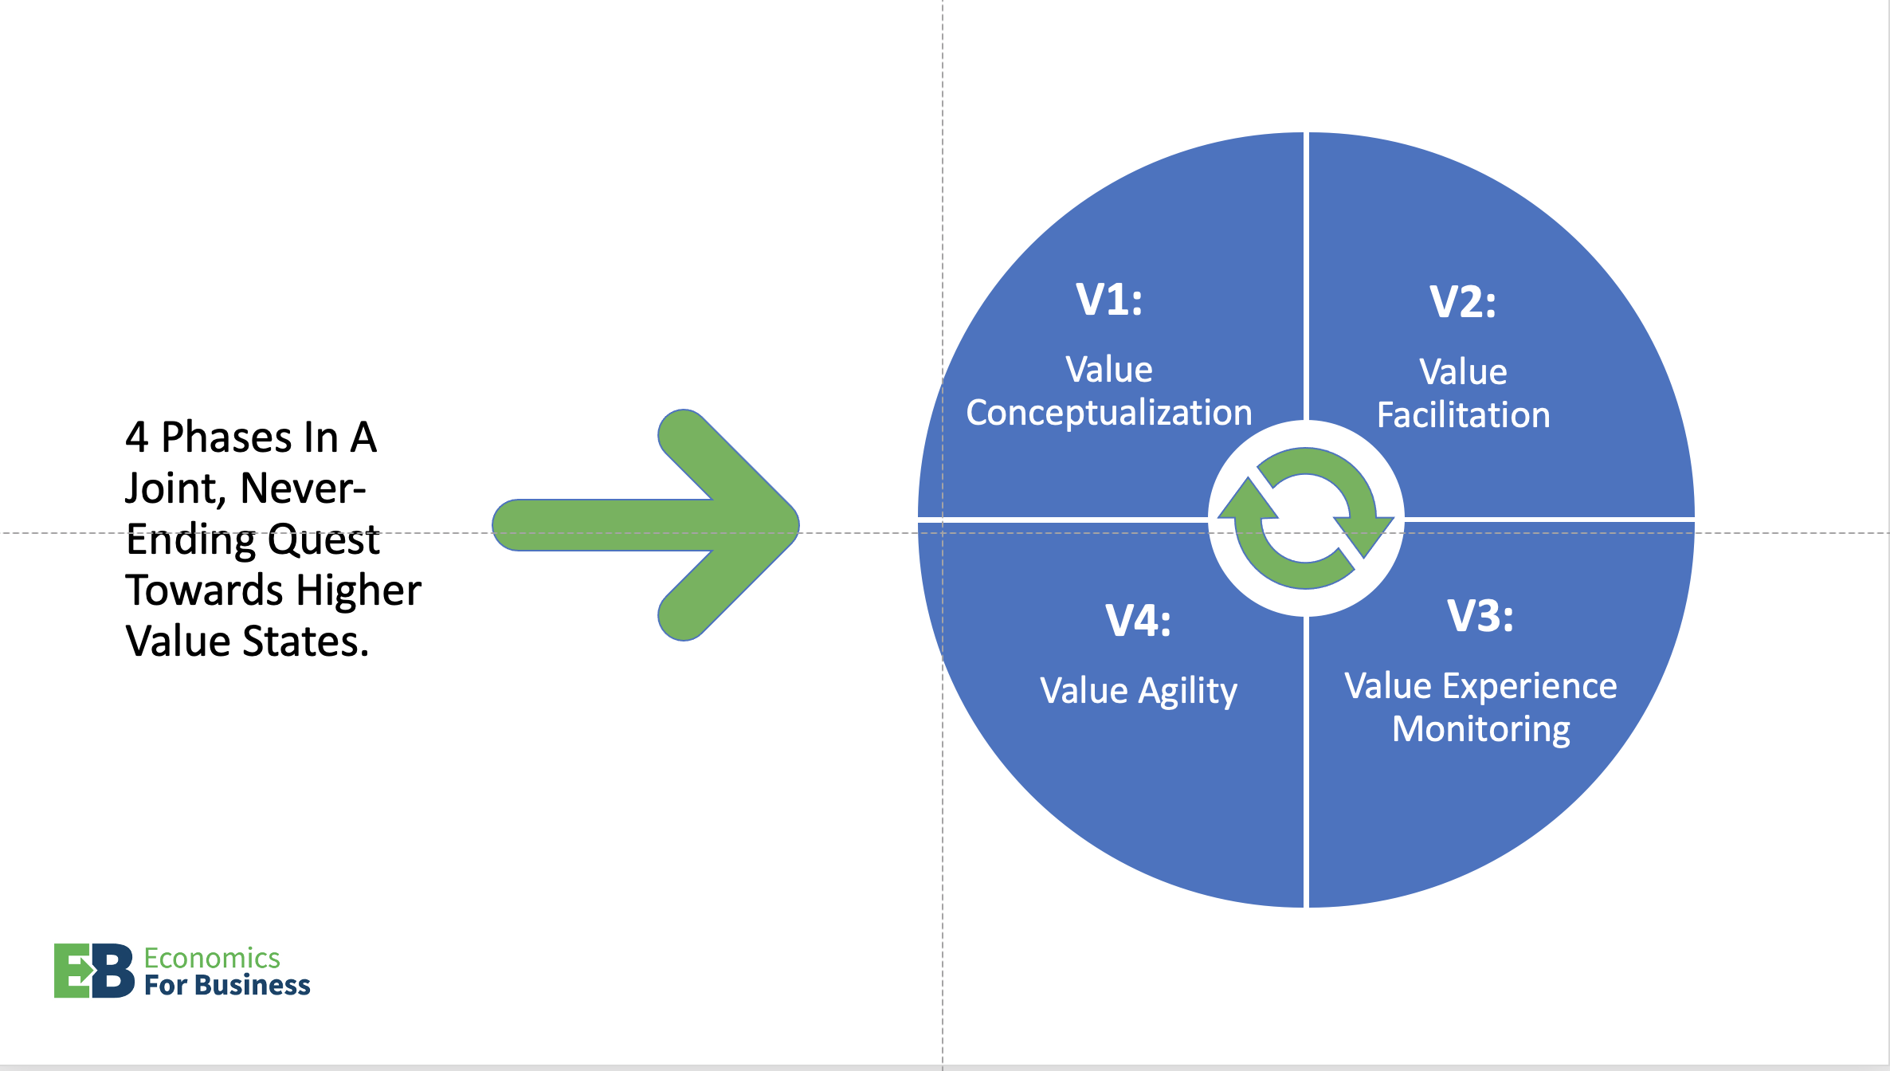
The entrepreneurial experience is a flow, constantly making adjustments in a demonstration of value agility.
The flow of entrepreneurship can be visualized in the four quadrants of the Austrian business model.
Entrepreneurship is a continuous progression through the quadrants – value conceptualization, value facilitation, value experience, and value agility.
Value agility is the adaptation to the feedback from the customer reflecting their consumption experience and their appraisal of that experience compared to their expectations, to alternatives and to any new information they are receiving in the marketplace. From the feedback, the entrepreneur conceptualizes potential new future value.
See the 4V’s Business Model video

Slide 10

Value is an emergent property of this flow; the entrepreneur is always exploring.
An entrepreneurial project is initiated as a search for value – what experience will the customer value and will the entrepreneur be able to generate it?
Explore
Realize
Explore
Realize
Exploration progresses with continuous feedback from potential customers, absorbed as adaptive changes in the value proposition from the entrepreneur.
Explore
Realize
If the customer anticipates value sufficiently to make a purchase, the entrepreneur can use this feedback to expand the value proposition – repeat sales, more customers, added features, lower prices, faster delivery, etc.
Explore
Realize
The entrepreneur never stops exploring, both to expand realized value and to initiate new explorations for new value. An entrepreneurial value portfolio may include several explorations at different stages of the value generation cycle.
Explore
Realize
Explore
Realize
Time

Slide 11
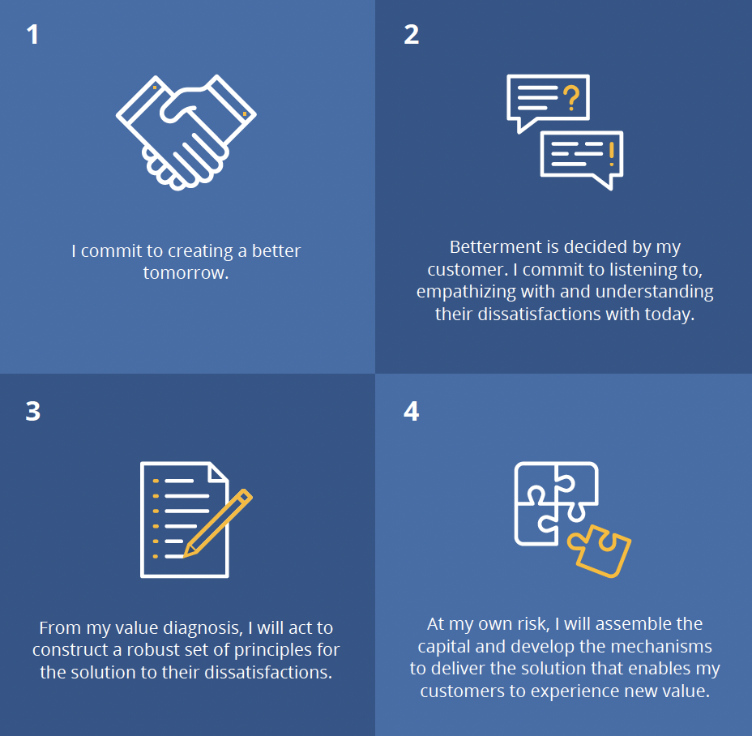
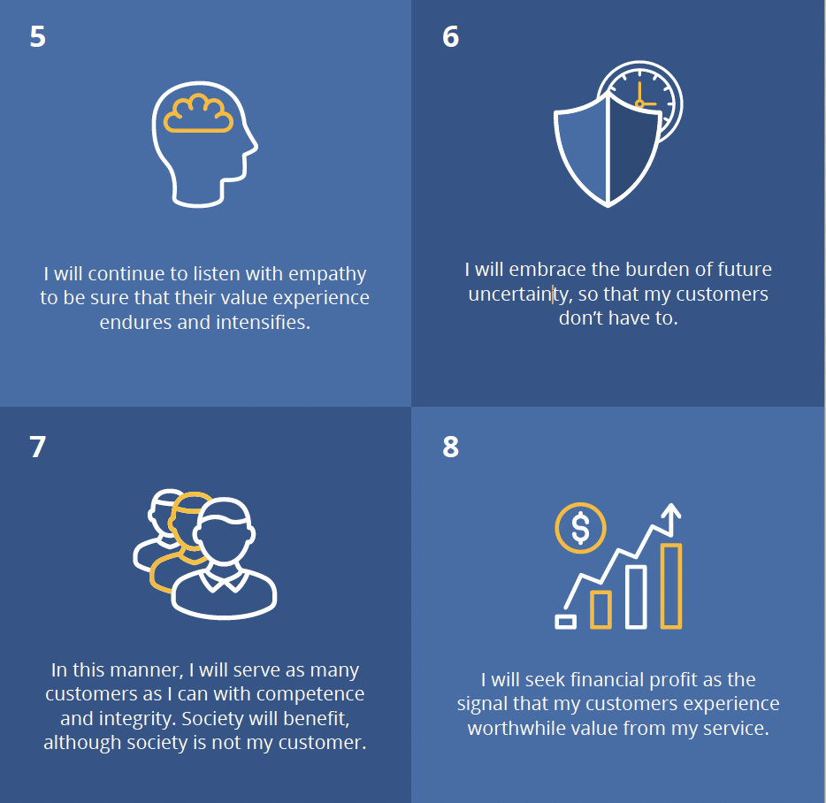
The entrepreneurial ethic is service.
THE ENTREPRENEURIAL ETHIC
Entrepreneurs create the future – a better future for their customers and themselves. What drives them?
The underlying ethic is service.
Entrepreneurs can reconstruct this pyramid to identify “the strongest route to the top” – the best way to help customers to experience the highest value they seek.
For a fuller exposition of the entrepreneurial ethic click here

Slide 12

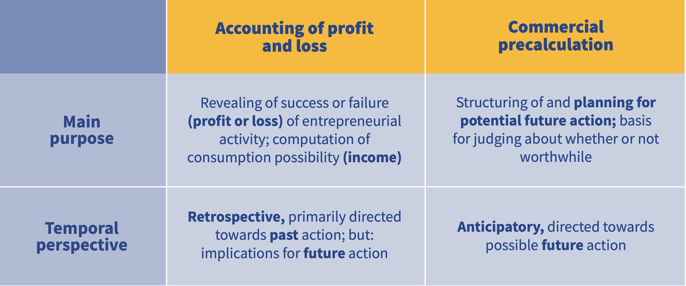
Profit is the result of choosing the right costs for the value generated; cash flow is the market signal of customer content.
Entrepreneurs imagine the value they will generate for customers and estimate the customer’s willingness to pay in a value exchange, measured in dollars.
Then, entrepreneurs choose the costs they are willing to incur to deliver the imagined customer value.
The costs that can be captured in P&L accounting can be compiled and the total should be less than the dollars generated by customer revenues over a specific period of time. The difference is accounting profit.
Accounting is a subjective tool – entrepreneurs make it fit their business purpose.
Find more on entrepreneurial accounting

Slide 13
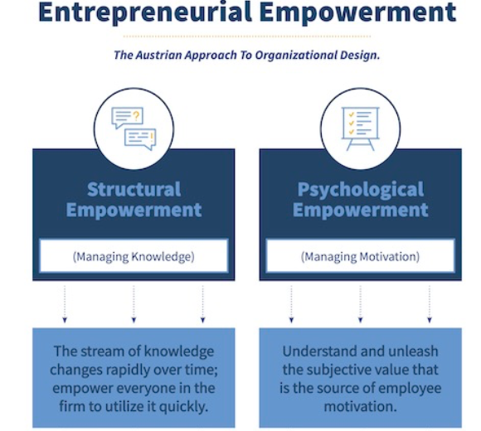
The goal of firm organization is to liberate the value generation capabilities of all employees. Don’t copy others.
Organizational design for entrepreneurial value generation is an open field, full of choices for innovative businesses.
The first principle is don’t copy: don’t copy another business’s design or one that is recommended in a business book or by a 3rd party.
The guiding principle is entrepreneurial empowerment: liberating the value generation capabilities of every employee.
Find more on entrepreneurial empowerment

