Slide 1


Which way, western man?

Slide 2

Caveats
No rules?
Some rules?
Subjective/temporal/geographic.
My biases.

Slide 3
The
Challenge
Build a serviceable professional wardrobe for school and work.
Spend less than $2,000, over 1-3 years.
Create a cohesive foundation for a lifetime of dressing well at (relatively) low cost.
Improve career/romantic prospects.

Slide 4
The Rules
Fit is not everything. Without it you have nothing.
Spend 2X as much, buy ½ as much.
Focus on cost per wear.
Simplicity is key.
Skin tone and body type- what looks good on you?
Do the work.

Slide 5
The Hierarchy
Shoes/belts.
Out to in.
Outerwear.
Suits/sportscoats.
Furnishings.
Everything else/casual wear.

Slide 6
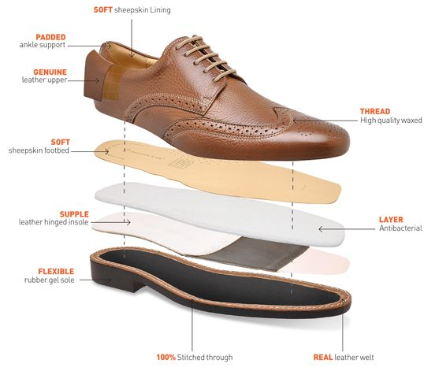
Shoes
Must be Goodyear welted, i.e. resoleable.
Basic distinction: Oxford vs. Derby/Blucher vs. slip on.
Lasts.
3 must haves.
Brands: Allen Edmonds, Alden, Church’s, Loake, Herring, Crockett & Jones, Peal & Co., Carmina, Meermin.

Slide 7
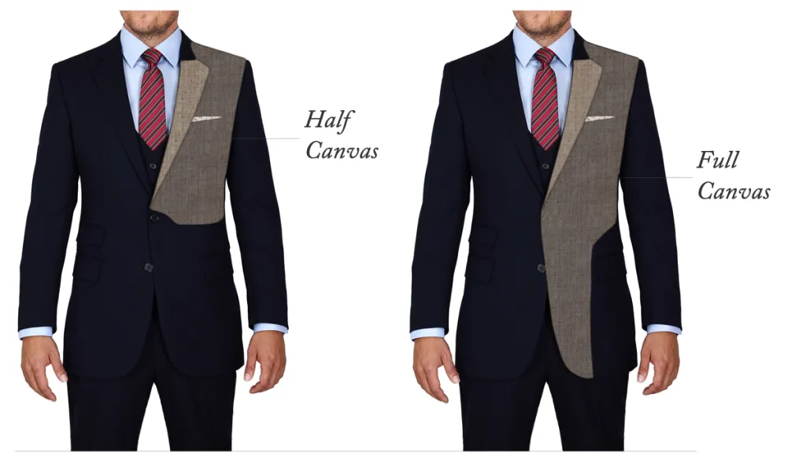
Suits
Must be at least half-canvassed.
Grey, navy. Avoid aggressive stripes, checks, & patterns.
Shoulders/length.
2 buttons primarily.
Single or double vent.
No black!
Not too skinny!

Slide 8
Furnishings: Shirts &
Ties
Shirts: all cotton
Non-iron is OK.
Length.
Brooks, Tyrwhitt, Ike Behar, David Donahue.
Ties: all silk.
Tie width.
Jewelry?

Slide 9
Strategy
&
Resources
Ebay, but tactical: search notifications, apps.
Styleforum classifieds.
Allen Edmonds shoe bank/factory stores allenedmonds.com/shoebank.
Amazon Basics.
Local consignment/thrifting.
Nordstrom Rack, Saks Off5th, Brooks sales, Tyrwhitt sales.
Used luxe sites: TheRealReal, Poshmark, Tailored Consignment.
KirbyAllison.com.
GentlemansGazette.com.

