Slide 1
Austrian Economics in Business
Per Bylund
School of Entrepreneurship
Oklahoma State University
per.bylund@okstate.edu

Slide 2
The firm in economics
Y = AL^{α}K^{β}
inputs
K, L
Y = P*Q
outputs
where:
Y = total production (the real value of all goods produced)
L = labor input (the total number of person-hours worked)
K = capital input (a measure of all machinery, equipment, and buildings; the value of capital input divided by the price of capital)
A = total factor productivity
α and β are the output elasticities of capital and labor, respectively. These values are constants determined by available technology.
Q = number of goods produced
P* = equilibrium price for the good

Slide 3
The firm in equilibrium
No entrepreneur
No management
No heterogeneity
No organization
No differentiation

Slide 4
The firm in business admin
The entrepreneur starts the firm
The manager runs the firm
Firms seek unique, valuable resources
Firms develop specific capabilities
Firms seek differentiation for above-normal profits and competitive advantage

Slide 5
The firm in business admin
Entrepreneurship
  How to start a firm
  Who starts a firm, when and why
  No place in mainstream economics; “expunged”
Strategy
  How to position the firm (wrt industry forces)
  Seeks sustained competitive advantage
  Economics flipped upside-down
Management
  Directs and organizes human resources
  Psychology, motivation, organizational structure
Managerial economics
  Maximize by finding MC=P

Slide 6
Where Austrians stand
Entrepreneurial production
Opportunities are possibilities to better satisfy (future) consumer wants
Economic goods as means to satisfy wants (Salerno yesterday)

Slide 7
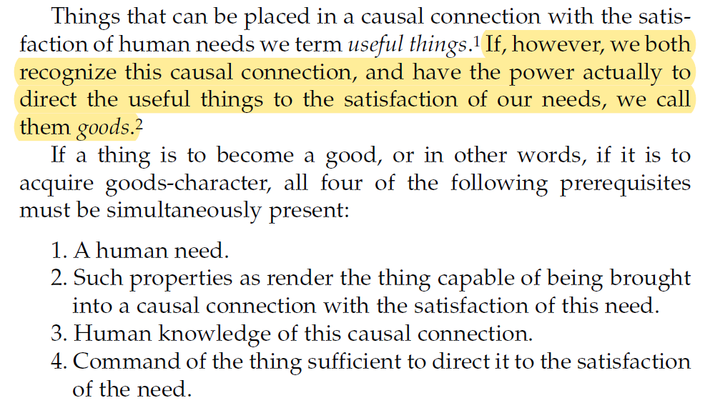
Economic ‘good’
Menger, Principles of Economics, p. 52

Slide 8
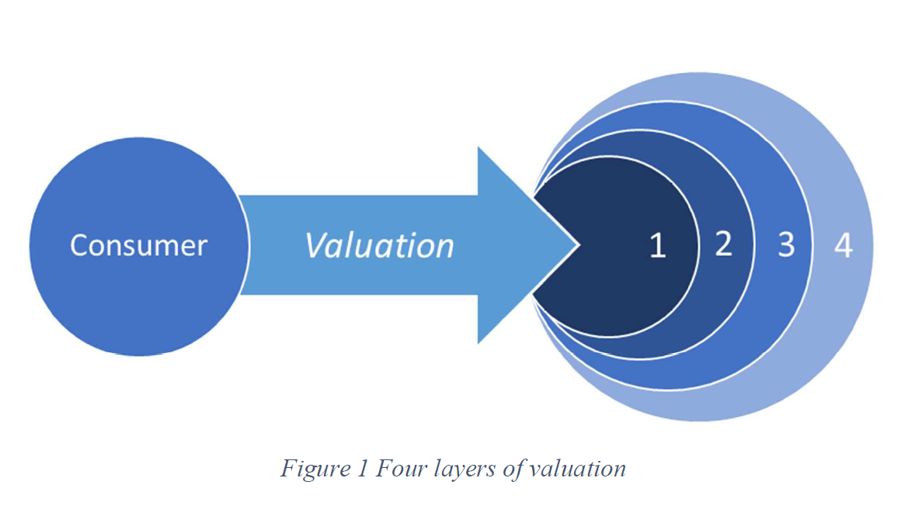
The consumer’s value calculus
Satisfaction from using the good (expected)
Other goods satisfying the same want
Other goods satisfying other wants
Expectations of (better) future goods
Bylund, unpublished manuscript

Slide 9
Where Austrians stand
Entrepreneurial production
Opportunities are speculations of how to better satisfy (future) consumer wants
Economic goods as means to satisfy wants
Production precedes consumption

Slide 10
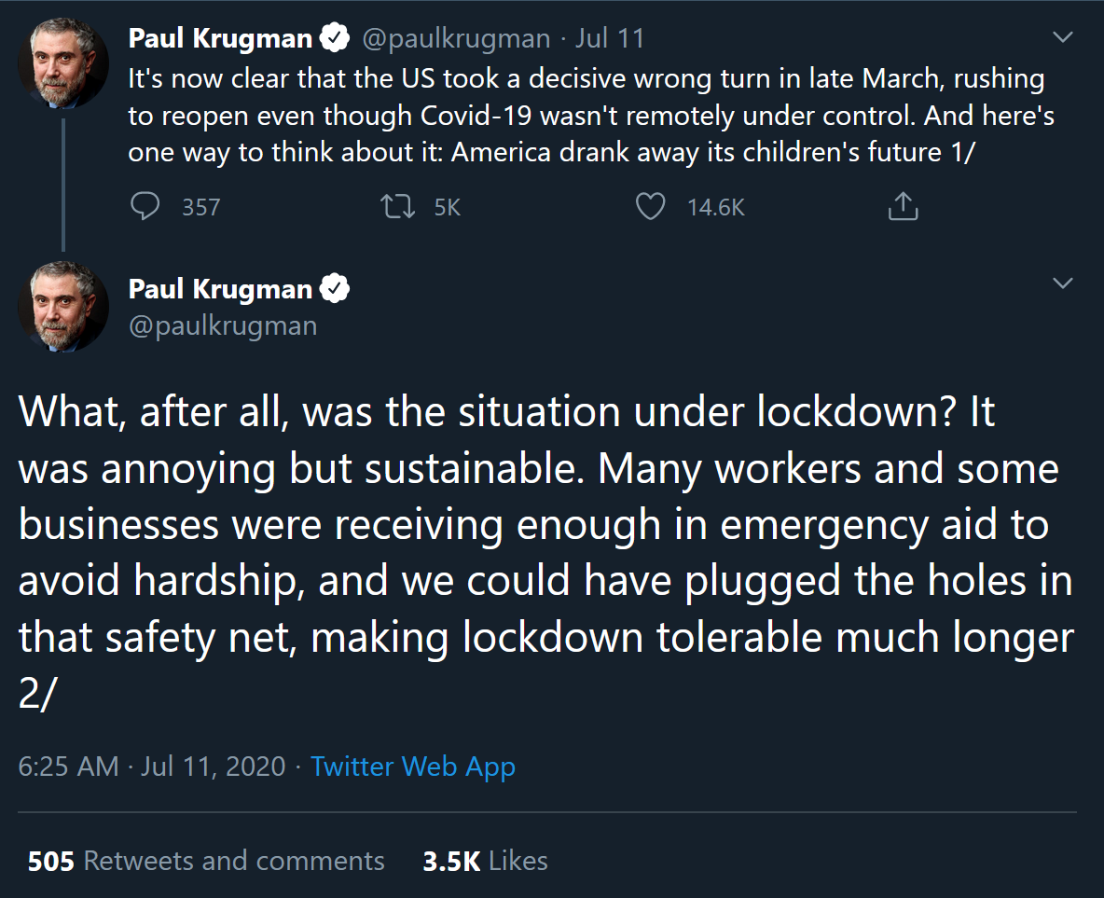
Not so Austrian
Paul Krugman, blogger and former economist

Slide 11
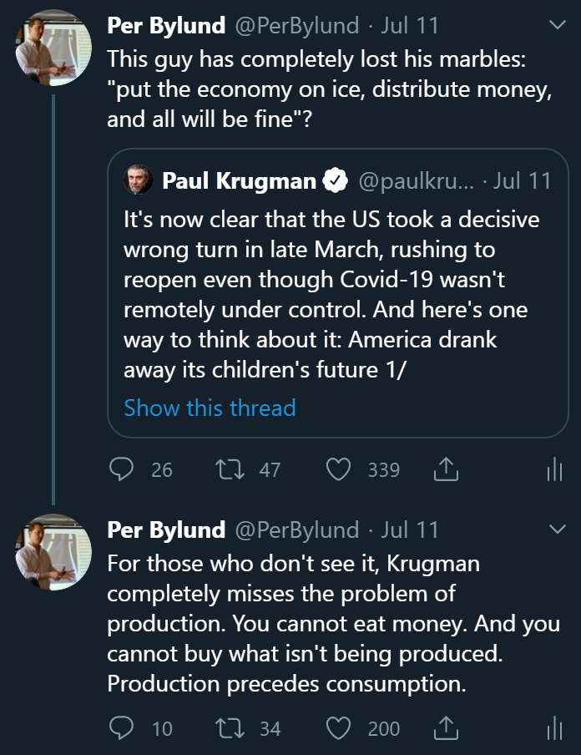
Austrian

Slide 12
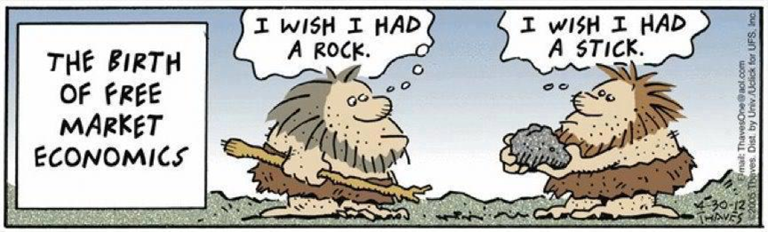
The main issue for business
Produce goods to facilitate consumption
Profit from facilitating value

Slide 13
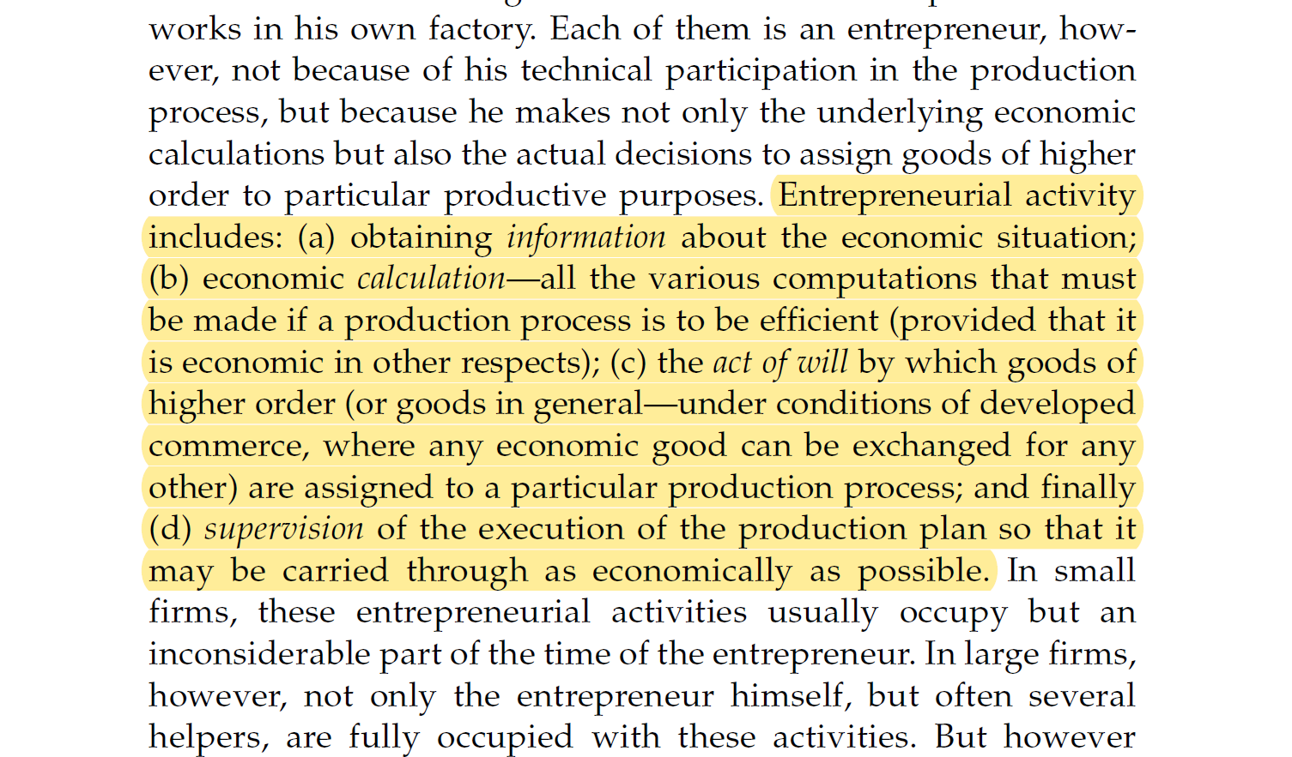
Entrepreneurial production
Menger, Principles of Economics, p. 160

Slide 14
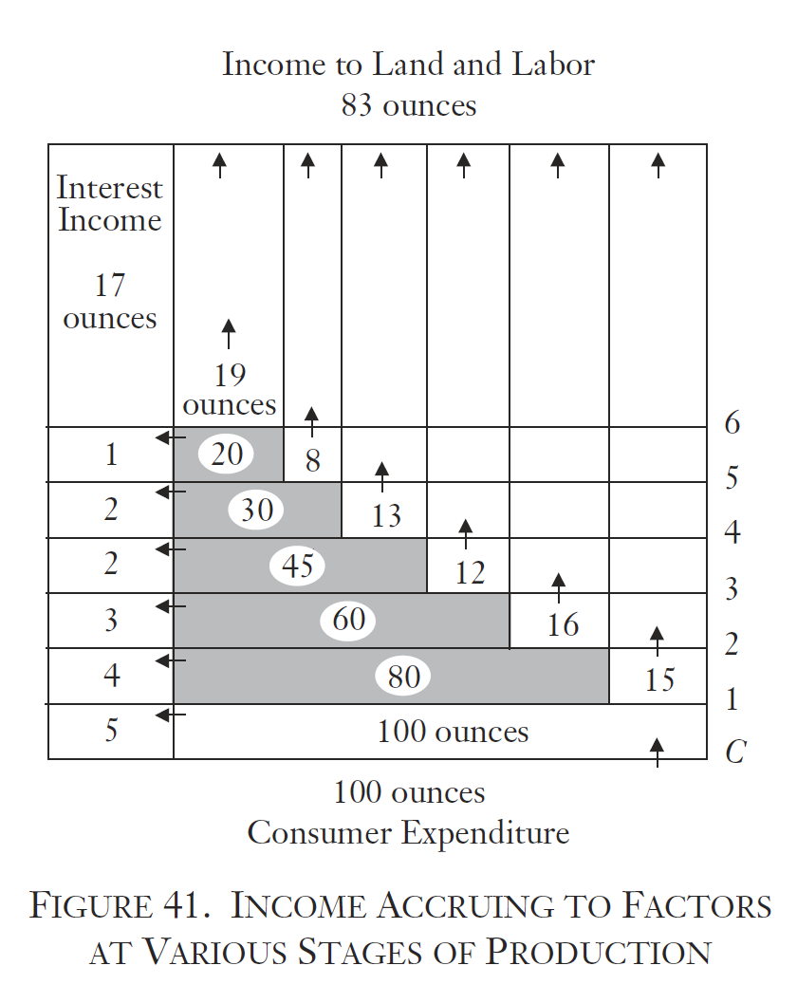
Entrepreneurial production
Rothbard, Man, Economy & State, p. 369

Slide 15
Entrepreneurial production
Entrepreneurial imagination
Speculative investment

Slide 16
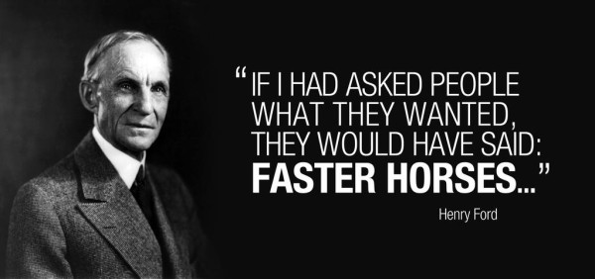
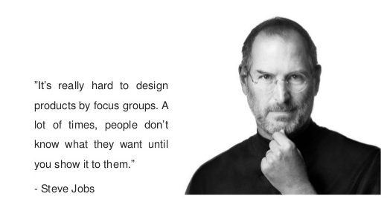
Entrepreneurial production

Slide 17
Entrepreneurial production
Entrepreneurial imagination
Speculative investment
Production takes time
Uncertain future market conditions (Klein yesterday)
  Other entrepreneurial undertakings change the consumer’s value calculus
Economic calculation through market prices
  But not within the firm

Slide 18
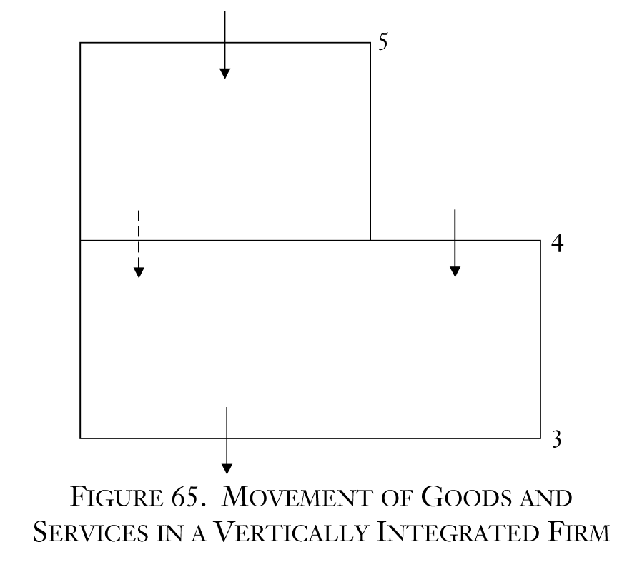
The firm to Austrians
Rothbard, Man, Economy & State, p. 610

Slide 19
The firm in Austrian economics
Entrepreneurs’ means for producing
Decentralized production of means to satisfy ends
Consumer sovereignty

Slide 20
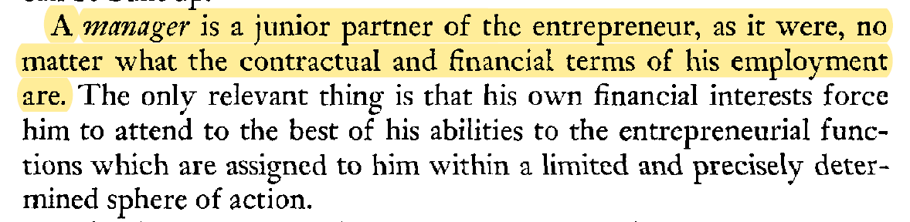
The firm to Austrians
The firm is the entrepreneur’s creation
The manager works for the entrepreneur
Mises, Human Action, p. 301

Slide 21

The firm to Austrians
The firm is the entrepreneur’s creation
The manager works for the entrepreneur
‘Islands of specialization’
  New production structure
  Beyond what the market can coordinate

Slide 22
From theory to practice
Trained economists are semi-useless
  Equilibrium doesn’t apply
Most entrepreneurs fail most of the time
  Often because they are not Austrians
Successful businesses create the future
  Actively pursue consumer satisfaction
Experienced entrepreneurs are Austrians
  Develop gut feel through trial-and-error
  Lack explanation (theory) and terminology

Slide 23
The Austrian business
Begins and ends with the consumer
  Consumer sovereignty
  Value in satisfaction through consumption
  Focus on value of the entire experience
Selling price is a part of the bundle for sale
  Low enough to offer ‘profit’ for the consumer
  Ultimately a function of consumer value
  Cost-plus pricing

Slide 24
The Austrian business
Prefer market prices
  Focus on the core value facilitation
  Outsource functions when (as soon as) possible
Main tasks of the entrepreneur
  Imagine how to satisfy consumers
  Choose lowest cost for profit

Slide 25
The Austrian business
The entrepreneur answers one question
  How can I best serve consumers?
Management answers only two questions
  How can we strengthen our value proposition to the consumer?
  How can we operate more effectively (increase the price-cost difference)?

Slide 26

More on Austrians and business
The Economics 4 Entrepreneurs podcast. Find it at e4epod.com
Free e-book Mises.org/E4B_eBook
Forthcoming special issue of the Quarterly Journal of Austrian Economics on entrepreneurship

