Slide 1
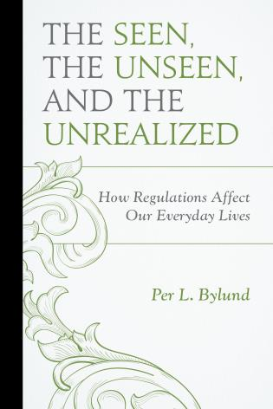

The Seen, the Unseen, and the Unrealized
🍐
Per Bylund
School of Entrepreneurship
Oklahoma State University
per.bylund@okstate.edu
@PerBylund

Slide 2
The ‘Seen’
“Between a good and a bad economist this constitutes the whole difference — the one takes account of the visible effect; the other takes account both of the effects which are seen, and also of those which it is necessary to foresee. Now this difference is enormous, for it almost always happens that when the immediate consequence is favourable, the ultimate consequences are fatal, and the converse. Hence it follows that the bad economist pursues a small present good, which will be followed by a great evil to come, while the true economist pursues a great good to come, — at the risk of a small present evil.”
Frédéric Bastiat

Slide 3
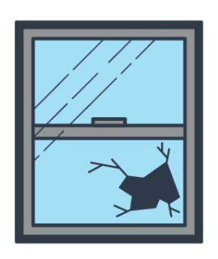
The ‘Unseen’
The ‘broken window’ fallacy of Bastiat (Hazlitt)
  “Have you ever witnessed the anger of the good shopkeeper, James B., when his careless son happened to break a square of glass?”
The downside has an upside – and vice versa
  Opportunity cost
  The shopkeeper’s loss is the glazier’s gain
It’s not a zero-sum game
  The glazier gains because the shopkeeper loses
  But the shoemaker does not gain because the shopkeeper loses

Slide 4
Bastiat’s analysis
Voluntary exchange is maintained
  Actions comply with value scale
Static view
  No process, no cumulative effects
Adds the counterfactual necessary to analyze the economic impact of an event
  ‘Either-or’ analysis

Slide 5
Bastiat’s analysis cont’d
Shopkeeper’s value scale
Before After
So: shopkeeper loses the window, but still pursues the highest valued end attainable for the six francs
…
Windowpane | ✔️
Shoes | ➖
…
Naughty boy
…
Windowpane | ➖
Shoes | ➖
…

Slide 6

Large-scale destruction
Assume bombs dropped over Dresden with massive property damage, but no deaths (a miracle!)
Before After
As the bombing stops, people get busy rebuilding
  More economic ‘activity’, what Krugman calls ‘growth’
…
Buildings | ✔️
Other stuff | ➖
…
Big boy
…
Buildings | ➖
Other stuff | ➖
…

Slide 7
Large-scale destruction cont’d
The higher demand for construction materials causes prices to increase
  Construction materials are shifted into Dresden from lower-priced regions in pursuit of profits
  Increased production in existing supply chains
  In other words: the market works as expected
Disaster relief offered by private citizens, charitable and for-profit organizations, maybe government
Dresdeners have suffered a loss, but they still pursue their highest valued attainable ends

Slide 8
Economics of destruction
Temporary loss/setback
  Loss of existing wealth (window, Dresden)
  Prices and actions adjust to the new situation
  Resources are reallocated to their better uses
Despite the exogenous shock (destruction), the market order remains intact
  Actors pursue their highest valued attainable ends
  A temporary setback (loss), followed by the (new) maximizing trajectory

Slide 9
But let’s look at regulations
Restrictions (costs imposed) on actions
  Prohibition on specified actions (bans)
  Prohibition on actions unless complying with specific mandates (licensing, zoning, building codes etc.)
Effective regulations restrict actions that are formally, physically, and economically feasible
Thus: Regulations are not destruction, but destructive

Slide 10
Regulations: value scale analysis
Assume the CDC issues a touchscreen ban to stop the spread of some disease

Slide 11

Dr. Anthony “iPad” Fauci

Slide 12
Regulations: value scale analysis
Assume the CDC issues a touchscreen ban to stop the spread of some disease
This is the effect on some user’s value scale:
No regulation Touchscreen ban
…
iPod Touch | ✔️
Walkman | ➖
Portable radio | ➖
…
…
iPod Touch | ❌
Walkman | ✔️
Portable radio | ➖
…

Slide 13
Regulations: value scale analysis
Note the implication: this is not a one-time loss
  Reality is unchanged – the economy’s ability to satisfy this want remains
The option is lost
  Someone to replace a broken device cannot
  Someone frequently updating their device cannot
Actors can’t pursue their highest valued attainable ends
  Every time a choice is made where the touchscreen option had been valued higher constitutes a loss
The economy is not static, it is a process – restrictions have long-term consequences

Slide 14
Regulations: production analysis
Producers are prohibited from selling touchscreens, so they will exit or shift production elsewhere
  Relative consumer wants, there is under-production in touchscreens and devices using touchscreens
Investments are instead made elsewhere: non-touchscreen devices, television sets, etc.
  Relative consumer wants, there is over-production in other lines of production
In sum, the production structure is distorted, malinvestments abound

Slide 15
So far, no big surprises
Regulations distort the production structure
Regulations cause value losses (lost options)
So, what about the “unrealized”?

Slide 16



Innovation is (r)evolutionary
iPod iPhone iPad
Innovations are cumulative, so where capital investments are made matters: they determine (facilitate) what entrepreneurs can do
Process perspective: effects in the unfolding market
Time

Slide 17
Implications of touchscreen ban
No continued innovation using touchscreens to satisfy consumer wants
Resources reallocated toward other (lesser) value production
Relevant knowledge and competencies will not be developed, generated, accumulated
Jobs, expertise, organizations will not be created
  They may be created elsewhere (a further distortion)
Add-on and next-stage investments/firms/jobs will never see the light of day

Slide 18
The issue of the “Unrealized”
Neither seen nor unseen, but what never comes to be because of regulations
  The products, investments, jobs, and opportunities that would have existed were it not for artificial restrictions
Where the market would be, structurally, from a consumer satisfaction perspective
  “options that would have been available had the economy not been distorted” (p. 162)
Regulations do away with products but, more importantly, also jobs/careers, production possibilities, and value-creative trajectories

Slide 19
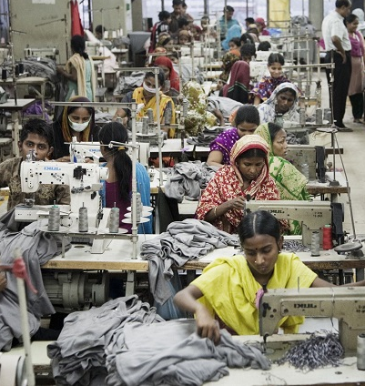
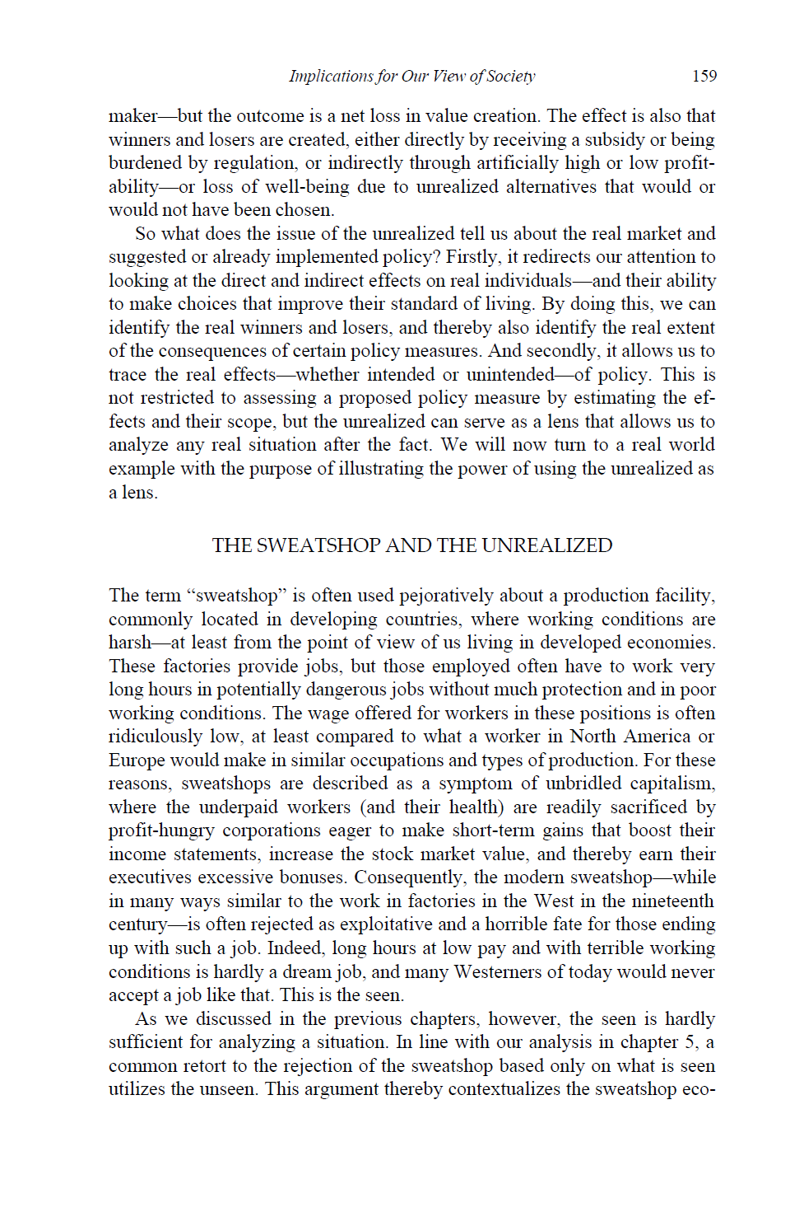
Analyzing the Unrealized
Sweatshops

Slide 20
Analyzing the Unrealized
“…the fact that there are no economic limitations … means the market is mature enough to support this type of production [sweatshops]. We can therefore conclude that the standard of living in the village would likely have been at par with that which is offered through employment in the sweatshop. In other words, the poverty experienced by the villagers is to a significant extent artificial, as is Rashid’s choice situation when he chooses between the comparatively high-paying job in the sweatshop and toiling in the fields or weaving baskets by hand.” (p. 163)

Slide 21
The ‘Unrealized’ summarized
Effect on entrepreneurs
  Cannot pursue creating goods and services they expect will best satisfy consumers’ wants
  Cannot make the most highly valued investment
    May choose to not invest at all
    May choose to invest elsewhere, thereby distorting the production structure
This means lower standard of living
  Fewer and worse options for consumers
  Fewer and lower-pay jobs for workers
  Production structure not aligned with consumer value

Slide 22
Read more
The Seen, the Unseen, and the Unrealized: How Regulations Affect Our Everyday Lives
  https://store.mises.org/The-Seen-the-Unseen-and-the-Unrealized-P11174.aspx

