Slide 1

How Entrepreneurs
Built the World
Per Bylund
School of Entrepreneurship
Oklahoma State University
per.bylund@okstate.edu
@PerBylund

Slide 2
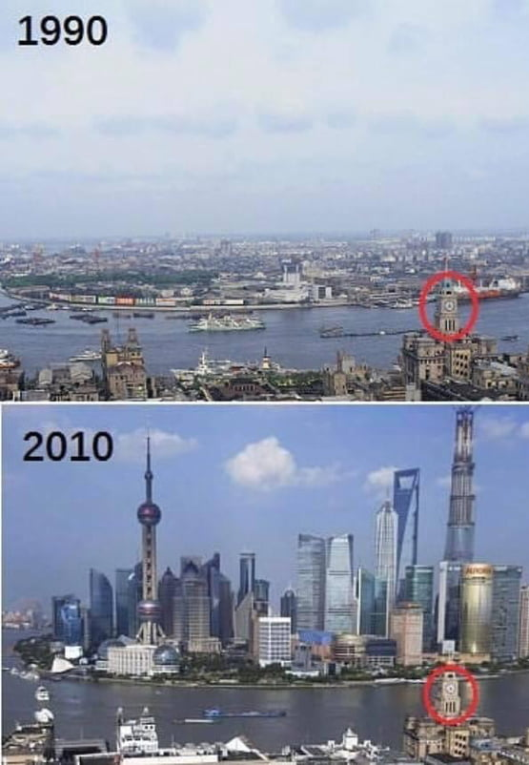
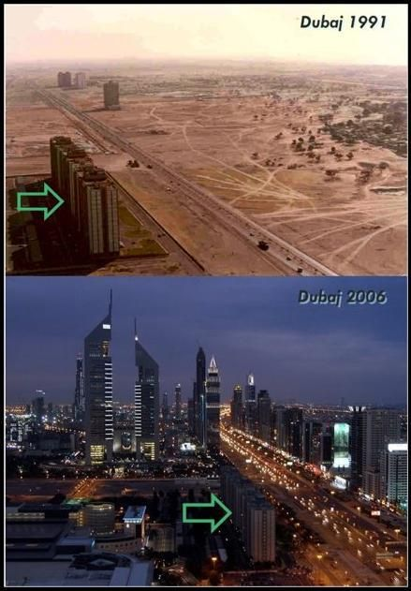
Shanghai

Slide 3

The real story
Entrepreneurship
Capital accumulation
Market exchange
E.g., Hong Kong
Not state planning, investment,
regulations

Slide 4
Entrepreneurship
Speculator bearing uncertainty (Klein on Monday)
Uncertainty-bearing is part of any action
The narrower case: the entrepreneur-promoter

Slide 5
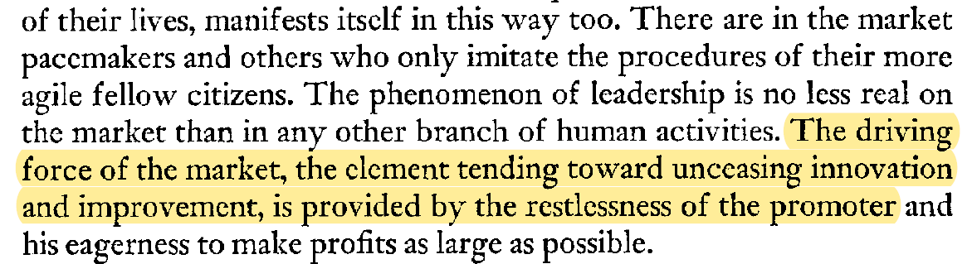
The driving force
The entrepreneur-promoter
Mises, Human Action, p. 256

Slide 6
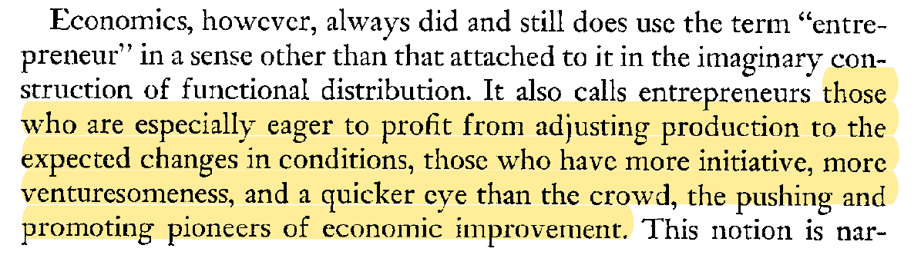
The driving force
The entrepreneur-promoter
Mises, Human Action, p. 255

Slide 7
The driving force
The entrepreneur-promoter (Mises)
  “unceasing innovation and improvement”
  “pioneers of economic improvement”

Slide 8
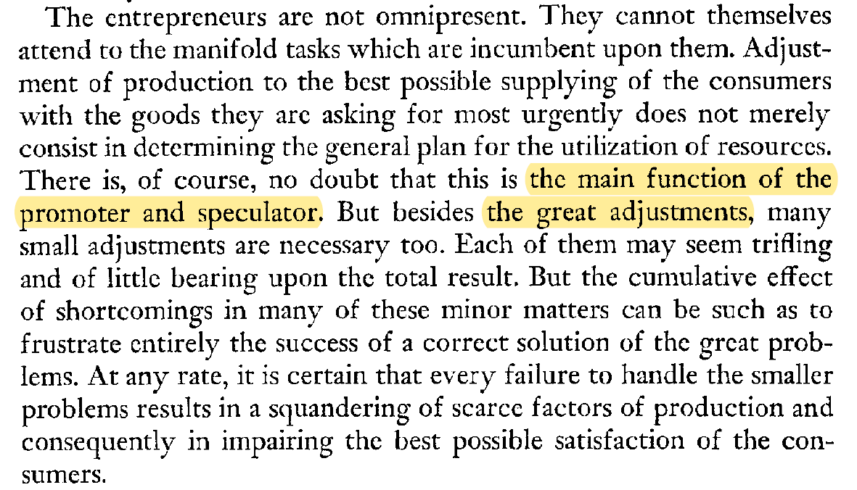
The driving force
Mises, Human Action, p. 300

Slide 9
The driving force
The entrepreneur-promoter (Mises)
  “unceasing innovation and improvement”
  “pioneers of economic improvement”
  “great adjustments” of production
Different from alertness (Kirzner), discovery (Hayek)
  Correcting ‘errors’ in the economic system
  Within-system (re)allocation

Slide 10
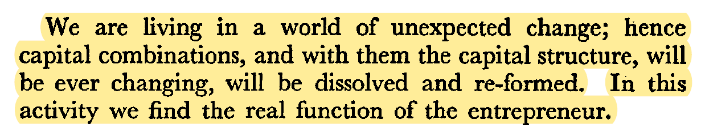
The driving force
Adjusting the capital structure
Lachmann, Capital and Its Structure, p. 13

Slide 11
The driving force
Adjusting the capital structure
  “dissolve and reform”
  Create, extend, and add to capital structure
Create, recreate, and direct productive capability
  Invention
  Innovation

Slide 12
Invention vs. innovation
Invention is the new idea
  New technology, technique, material, product
Innovation is the ‘bringing to market’
  New value proposition (business model, use, etc.)
Schumpeter, Theory of Economic Development

Slide 13

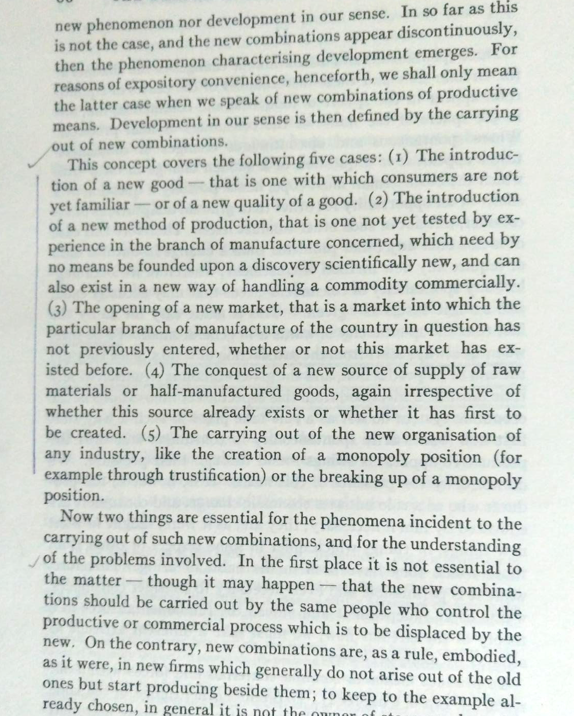
Disruptive innovations
New goods
New methods of production
New markets
New source of supply
New organization of industry
Schumpeter, Theory of
Economic Development, p. 66

Slide 14
What entrepreneurship does
Innovates “new combinations” of factors
  Facilitates consumer value by offering new means for satisfying wants
  Social savings rate determine the rate of innovations undertaken
Exercises judgment in dedicating resources to more highly valued uses (greater satisfaction)
  Imagination and empathy
Directs factors
  Earns the difference in value facilitation
  Raises the remuneration to factors (new and old)

Slide 15
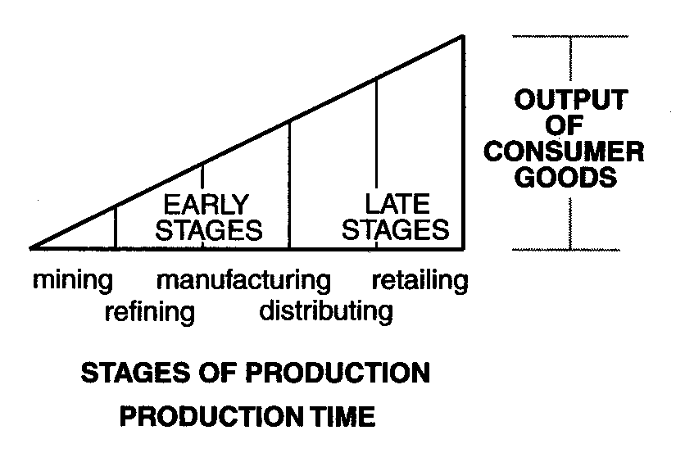
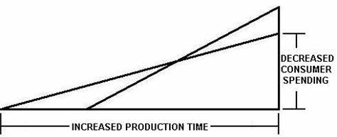
Effects of entrepreneurship
The ‘Hayekian’ triangle

Slide 16
Effects of entrepreneurship
Crusoe catches fish with his hands
  Labor
Crusoe makes a net to catch more fish
  Labor and capital
fish
fish
net

Slide 17
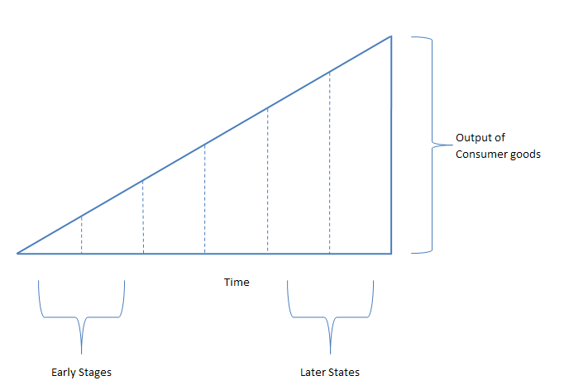
Effects of entrepreneurship

Slide 18
Effects of entrepreneurship

Slide 19
Effects of entrepreneurship
Production
Valuation
Land
Mining: Iron ore
Smelting: Iron
Manufacturing: Automobiles
Dealer: Automobiles
Consumer: Driving
Plant: Steel

Slide 20
Effects of entrepreneurship
Production
Valuation
Land
Mining: Iron ore
Smelting: Iron
Steel plant: Steel
Manufacturing: Automobiles
Dealer: Automobiles
Consumer: Driving

Slide 21
Effects of entrepreneurship

Slide 22
Effects of entrepreneurship
New way of producing things
Producing new things (lowest-stage)
New combinations

Slide 23
Effects of entrepreneurship

Slide 24

Limitations to entrepreneurial innovations
Incompatibility
  Must use compatible inputs
  Must produce compatible outputs
Incompleteness
  Must completely cover ‘distance’
  from inputs to outputs
  From t₁–t₂–t₃ to t₁–[t₂₁–t₂₂–t₂₃]–t₃
Pricelessness
  No market prices, no calculation
  Production beyond the extent of the market

Slide 25
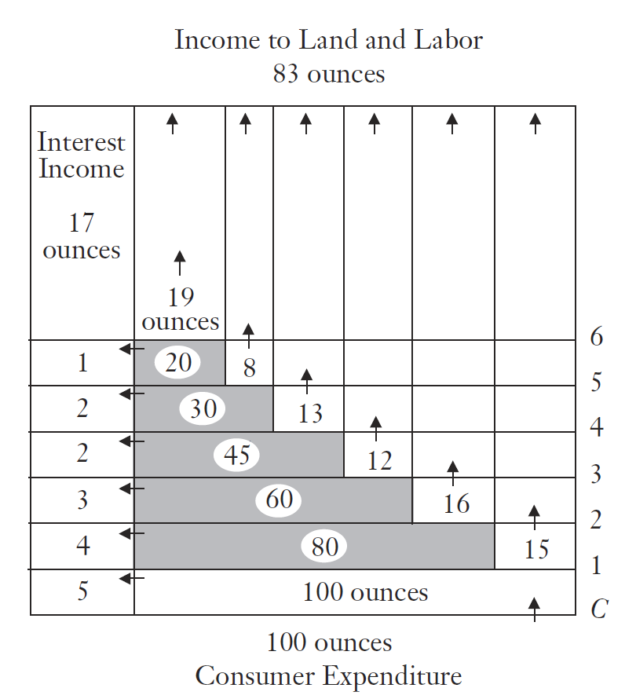

Slide 26
Entrepreneurship drives change
In production
  Great adjustments to production
  Dissolves and reforms the capital structure
  Creates new, ‘accumulates’ capital
  Increases throughput
In consumption
  Increases availability of valued goods
  Facilitates new value
  Drives social change

Slide 27
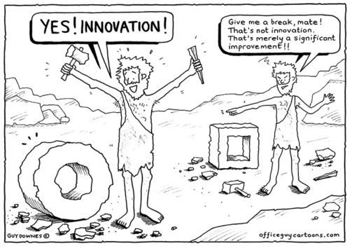
Entrepreneurial practice drives social change
Creative destruction
  The smartphone
  The wheel
Institutional change
  Uber vs. taxi
  Dark web
Transaction platforms
  Sharing economy
  Sears’ catalog

Slide 28
Entrepreneurial practice drives social change
Entrepreneurs imagine consumption opportunities that facilitate or engender new behavior

Slide 29
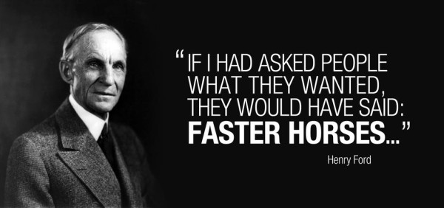
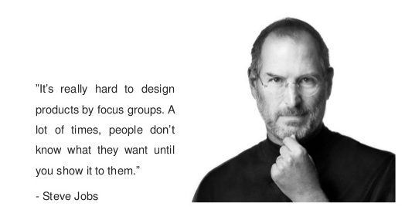
Entrepreneurial practice drives social change

Slide 30
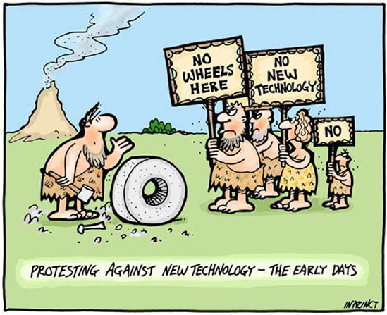
Entrepreneurial practice drives social change
Entrepreneurs imagine consumption opportunities that facilitate or engender new behavior
Entrepreneurs must entice
consumers to overcome
their skepticism, resistance
to newness
Entrepreneurs effectuate
change to society’s capital
structure, thus direct the
economy

Slide 31

Entrepreneurial practice drives social change
Entrepreneurs are in the business of creating our tomorrow

Slide 33
Read more
The Seen, the Unseen, and the Unrealized: How Regulations Affect Our Everyday Lives
  https://store.mises.org/The-Seen-the-Unseen-and-the-Unrealized-P11174.aspx
The Problem of Production: A New Theory of the Firm
  Hardback: https://store.mises.org/The-Problem-of-Production-Hardcover-P11173.aspx
  Paperback: https://store.mises.org/The-Problem-of-Production-A-New-Theory-of-the-Firm-P11172.aspx

