Slide 1

Firms, Managers, and Entrepreneurship
🍐
Per Bylund
School of Entrepreneurship
Oklahoma State University
per.bylund@okstate.edu
@PerBylund

Slide 2
A ‘curious’ perspective…
Entrepreneurs create business firms to produce new goods, anticipating to earn profits by serving consumers better than other entrepreneurs
Austrians assert that the business firm exists within and is part of the market process
To Austrians, the economic function of the business firm is to deal with and organize production

Slide 3
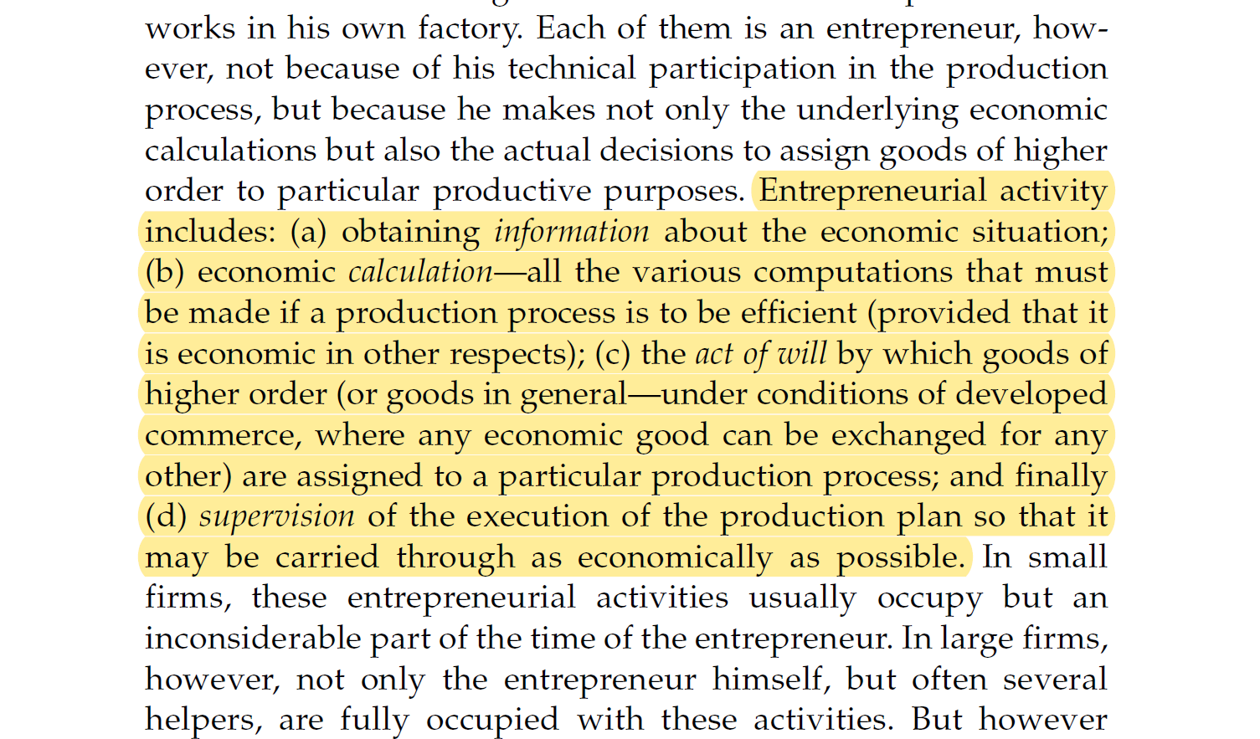
From the very beginning
Menger, Principles of Economics, p. 160

Slide 4
The economic problem is production
Economic goods are means to satisfy wants
  We produce goods to (better) satisfy (more) wants
  We economize on means to ‘maximize’ value
Production precedes consumption
  Most goods must be produced to be suitable means for satisfying wants
  In the market economy demand is constituted by supply
Entrepreneurship drives the market process
  Rivalrous entrepreneurial production
  Speculations of how to better satisfy (future) consumer wants

Slide 5
The main issue in economic production
Cost < Price < Value

Slide 6
The main issue in economic production
Cost < Price < Value
Production
Valuation

Slide 7
The main issue in economic production
Cost < Price < Value
Entrepreneur’s money profit
Consumer’s psychic profit

Slide 8
Entrepreneurship (per Mises)
Entrepreneurship in the broad sense
  Uncertainty-bearing aspect of every action (praxeological definition)
Entrepreneurship in market production
  Uncertainty-bearing regarding what consumers will value
  Division of intellectual labor lessens uncertainty (economic calculation argument)
The narrower case: the entrepreneur-promoter
  Innovative, disruptive entrepreneurship
    Imaginative production to better serve consumers
  The ‘driving force’ of the economy
    Causes progress/growth
    Contributes to uncertainty

Slide 9
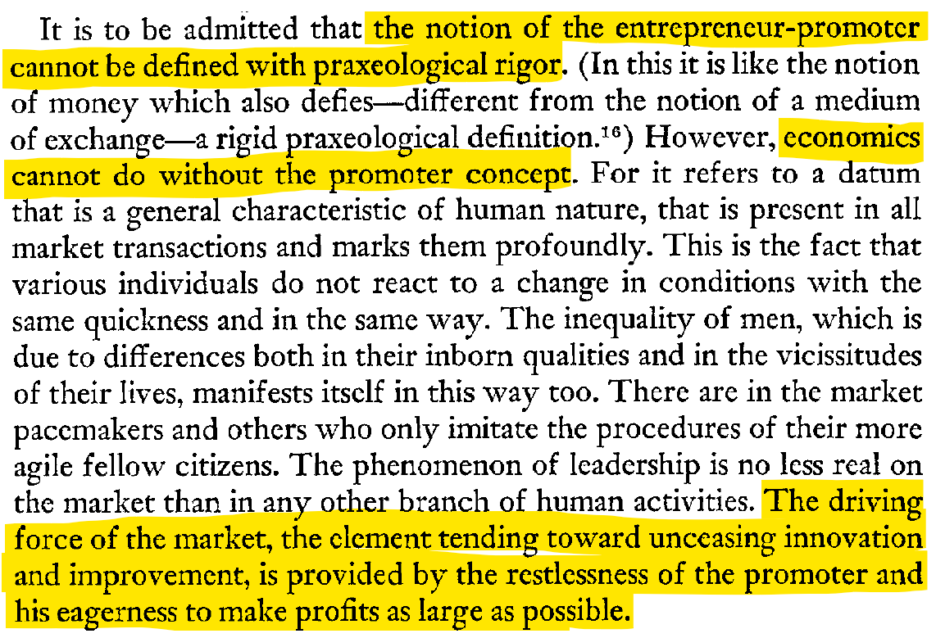
Mises, Human Action, p. 256

Slide 10
The driving force
The entrepreneur-promoter (Mises)
  “unceasing innovation and improvement”
  “pioneers of economic improvement”
  “great adjustments” of production
  Determines the structure of production (cf. Lachmann)
    Starts new productions (investment)
    Pulls the plug on existing productions (devestment)
Different from alertness (Kirzner), discovery (Hayek)
  Correcting ‘errors’ in the economic system
  Within-system (re)allocation

Slide 11
More on the promoter and market process
Bylund, PL. 2020. “Finding the Entrepreneur-Promoter: A Praxeological Inquiry,” Quarterly Journal of Austrian Economics, Vol. 23, Issue 3-4, pp. 355-389. https://doi.org/10.35297/qjae.01007
Bylund PL. 2022. “Entrepreneurship and the Market Process.” In Bylund PL, A Modern Guide to Austrian Economics, pp. 84-102. Northampton, MA: Edward Elgar Publishing. https://www.e-elgar.com/shop/usd/a-modern-guide-to-austrian-economics-9781789904390.html

Slide 12
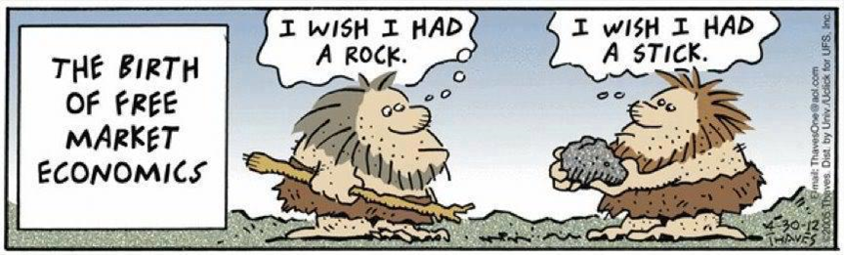
The main issue for business
Produce goods to facilitate consumption
Profit from facilitating value
Trade is not production

Slide 13
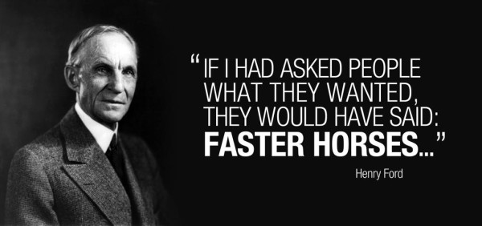
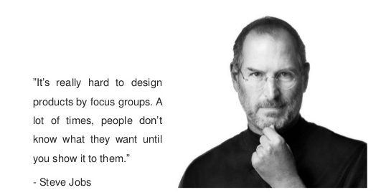
Entrepreneurial production

Slide 14
Entrepreneurial production
Entrepreneurial imagination
Speculative investment
Production takes time
Uncertain future market conditions
  Other entrepreneurial undertakings change the consumer’s value calculus

Slide 15
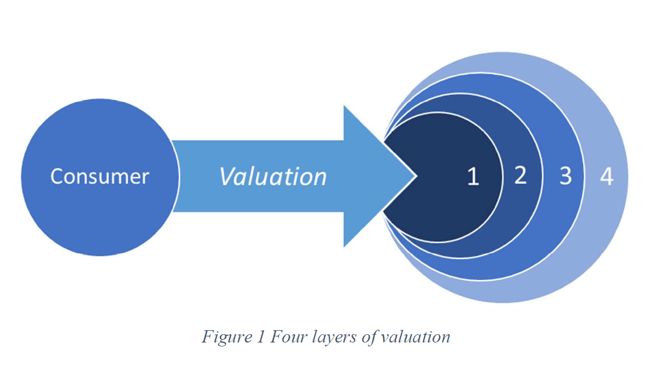
The consumer’s value calculus
Satisfaction from using the good (expected)
Other goods satisfying the same want
Other goods satisfying other wants
Expectations of (better) future goods
Bylund, unpublished manuscript

Slide 16
Entrepreneurial production
Entrepreneurial imagination
Speculative investment
Production takes time
Uncertain future market conditions
  Other entrepreneurial undertakings change the consumer’s value calculus
Economic calculation through market prices
  But not within the firm

Slide 17
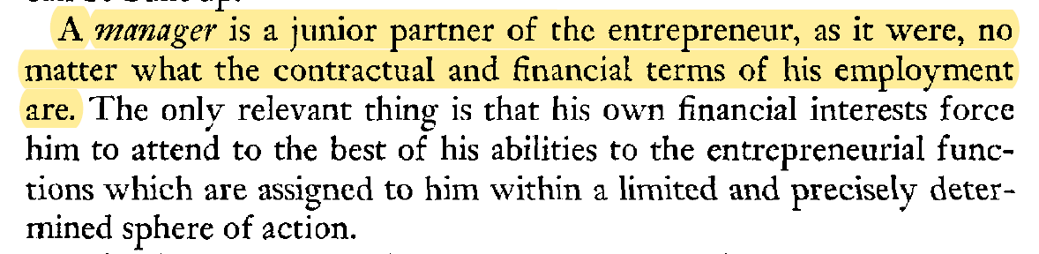
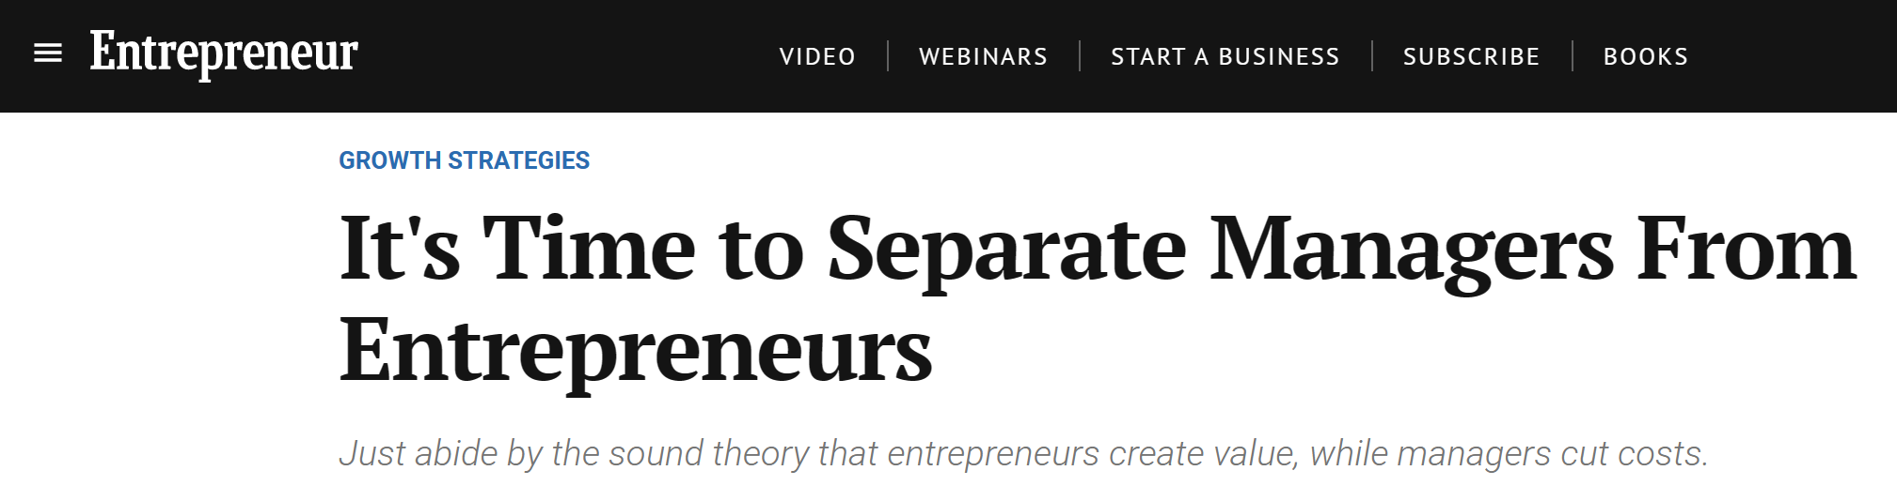
The firm to Austrians
The firm is the entrepreneur’s creation
  Purposefully created by dedicated resources toward producing good
  Value-oriented – cost structure chosen based on value
The manager works for the entrepreneur
Mises, Human Action, p. 301
https://www.entrepreneur.com/growing-a-business/its-time-to-separate-managers-from-entrepreneurs/343398

Slide 18
The firm to Austrians
The firm is the entrepreneur’s creation
  Purposefully created by dedicated resources toward producing good
  Value-oriented – cost structure chosen based on value
The manager works for the entrepreneur
  Focus: cost efficiency (cut costs/waste, streamline production)
    Reduce average cost of production
    Expand sales beyond initial market segment
  Economic function: extends the profitable life of the entrepreneur’s value creation (cost-effective production)

Slide 19
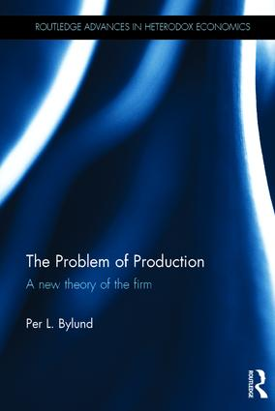
The firm to Austrians
‘Islands of specialization’
  Novel production structure of unknown value
    Expected/imagined to produce comparatively greater value
  Structure beyond what market contracts can coordinate
    Based on the entrepreneur’s imagination
    Uses different/more intense division of labor
  The vehicle by which entrepreneurs step ahead of and disrupt market production
    Incalculable priceless ‘chaos’ that will eventually be replaced by economizing market transactions

Slide 20




Firms, managers, and entrepreneurship
Product
1. imagines
Firm
2. creates
3. appoints/hires
5. assesses
Product
4. produces
Manager
Entrepreneur
Consumer(s)

Slide 21
The Austrian business in practice
Begins and ends with the consumer
  Consumer sovereignty
  Value in satisfaction through consumption
  Focus on value of the entire experience
Selling price is a part of the bundle for sale
  Low enough to offer ‘profit’ for the consumer
  Ultimately a function of consumer value
  Cost-plus pricing

Slide 22
The Austrian business in practice
Prefer market prices
  Focus on the core value facilitation
  Outsource functions when (as soon as) possible
Main tasks of the entrepreneur
  Imagine how to satisfy consumers – value first
  Bear uncertainty of speculative production investment

Slide 23
The Austrian business in practice
The entrepreneur answers one question
  How can I best serve consumers?
  (Alternative phrasing: What productions are of greatest value?)
Management answers two questions
  How can we strengthen the firm’s value proposition to the consumer?
  How can the firm operate more profitably (increase the price-cost difference)?

Slide 24
From theory to practice
Trained economists are semi-useless
  Equilibrium doesn’t apply
Most entrepreneurs fail most of the time
  Often because they are not Austrians
Successful businesses create the future
  Actively pursue consumer satisfaction
Experienced entrepreneurs are Austrians
  Develop gut feel through trial-and-error
  Lack explanation (theory) and terminology

Slide 25
Thank you

