Slide 1

Economic After Effects of Covid
🍐
Per Bylund
@PerBylund
Mises University | July 28, 2022

Slide 2
Pandemic downturn: Two sides of the story
The ‘actual’ virus/pandemic
  Loss of productivity due to sickness, fear (real and imagined), etc.
  Expected: downturn, swift return to ‘normal’

Slide 3

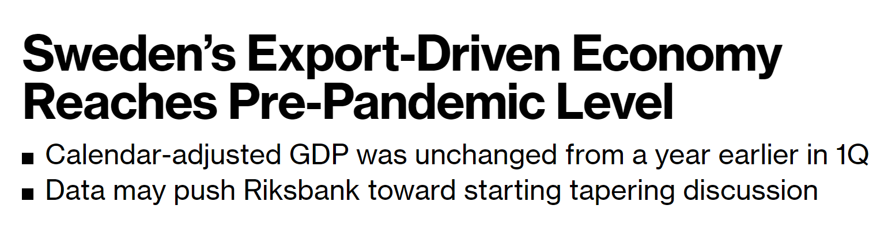
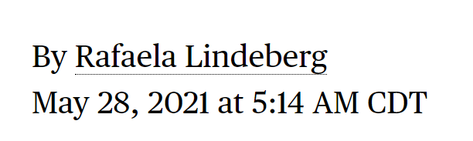

Slide 4
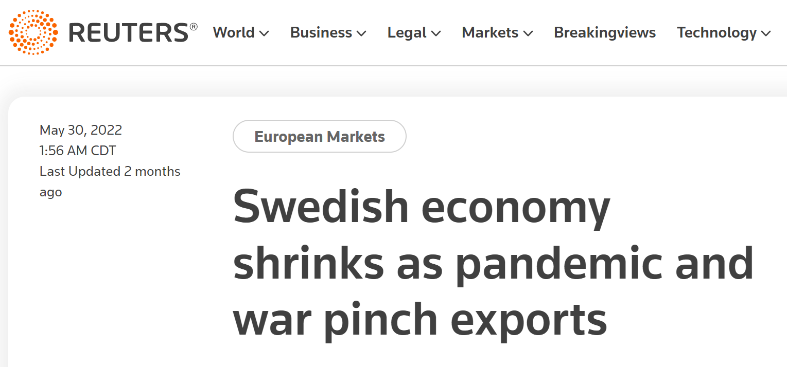

Slide 5
Pandemic downturn: Two sides of the story
The ‘actual’ virus/pandemic
  Loss of productivity due to sickness, fear (real and imagined), etc.
  Expected: downturn, swift return to ‘normal’
Technocratic economic management
  Lockdowns, stay-at-home orders, etc.
  Essential vs. non-essential businesses and workers
  Heavily subsidized inactivity and ample needs-based support
  = top-down planning of the economy

Slide 6
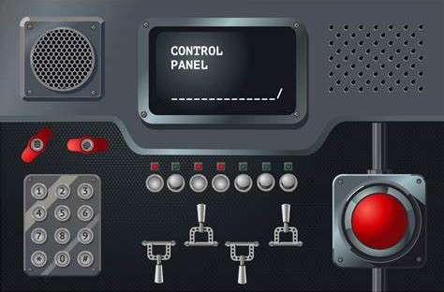

FOR THE ECONOMY

Slide 7


Slide 8
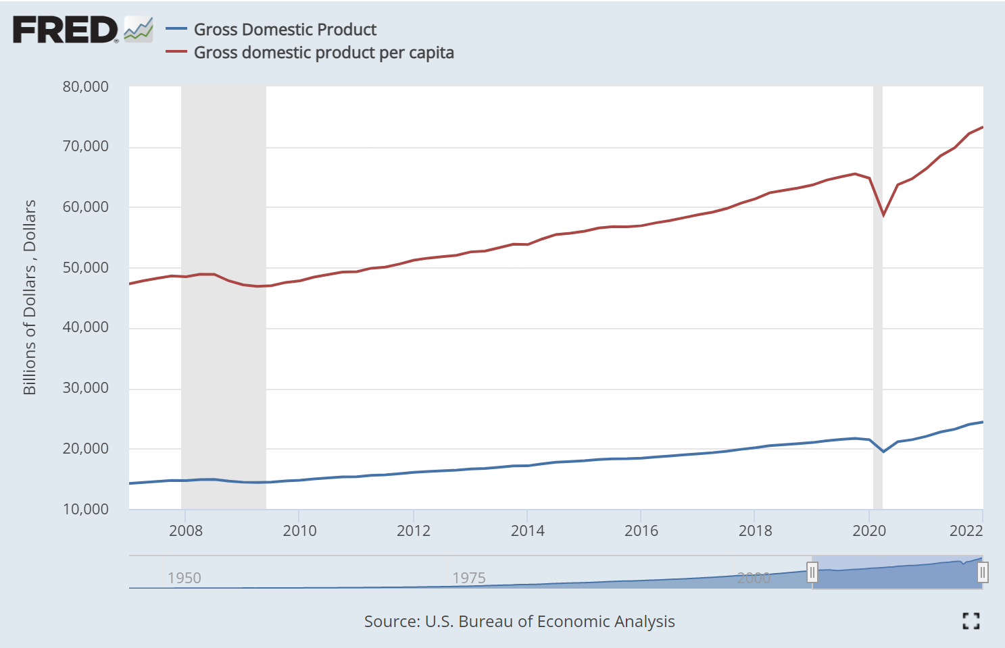
Effect on GDP
Federal Reserve Economic Data

Slide 9
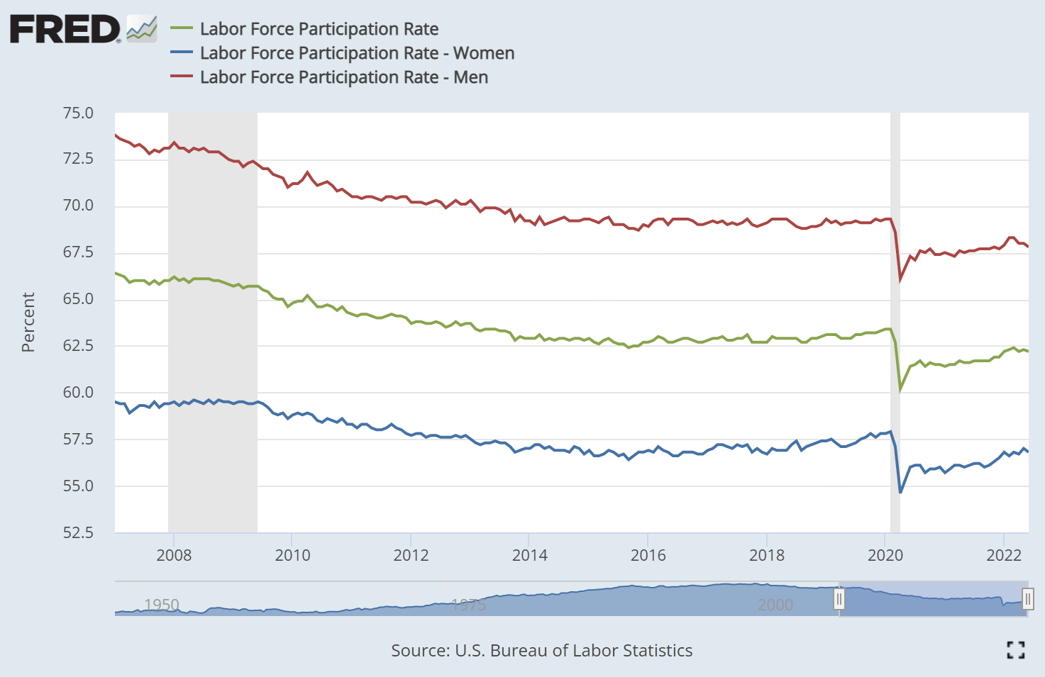
Effect on employment
Federal Reserve Economic Data

Slide 10
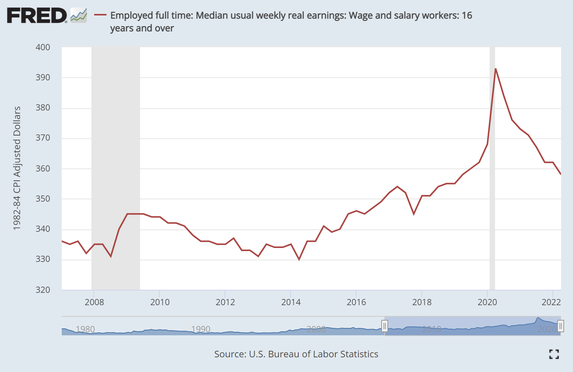
Effect on weekly earnings
Federal Reserve Economic Data

Slide 11

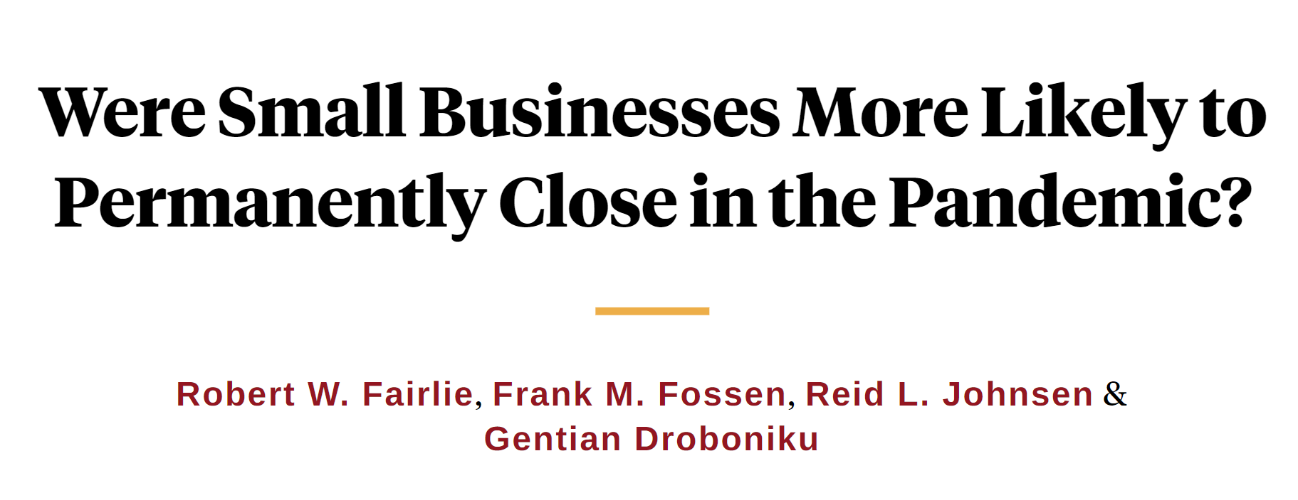

Slide 12
Greater effects of pandemic policy
Restructuring of employment and income
  Who gets to work vs. who is made dependent on government hand-outs

Slide 13
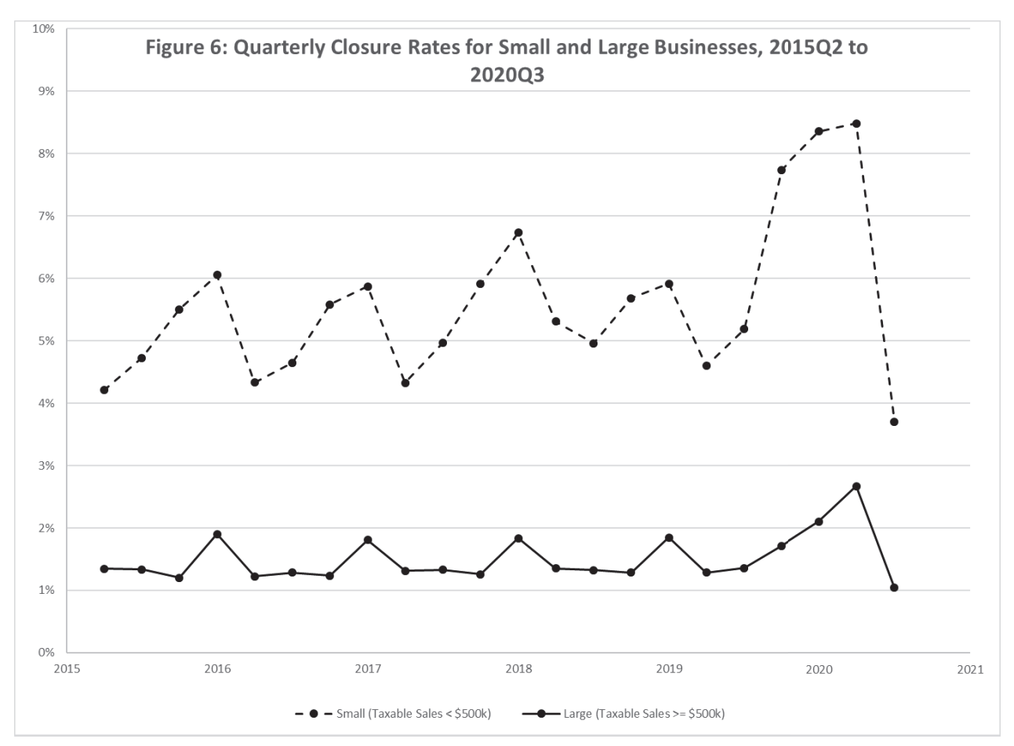
Small business death
"Were Small Businesses More Likely to Permanently Close in the Pandemic?" NBER Working Paper #30285 by Robert W. Fairlie, Frank M. Fossen, Reid L. Johnsen, and Gentian Droboniku

Slide 14
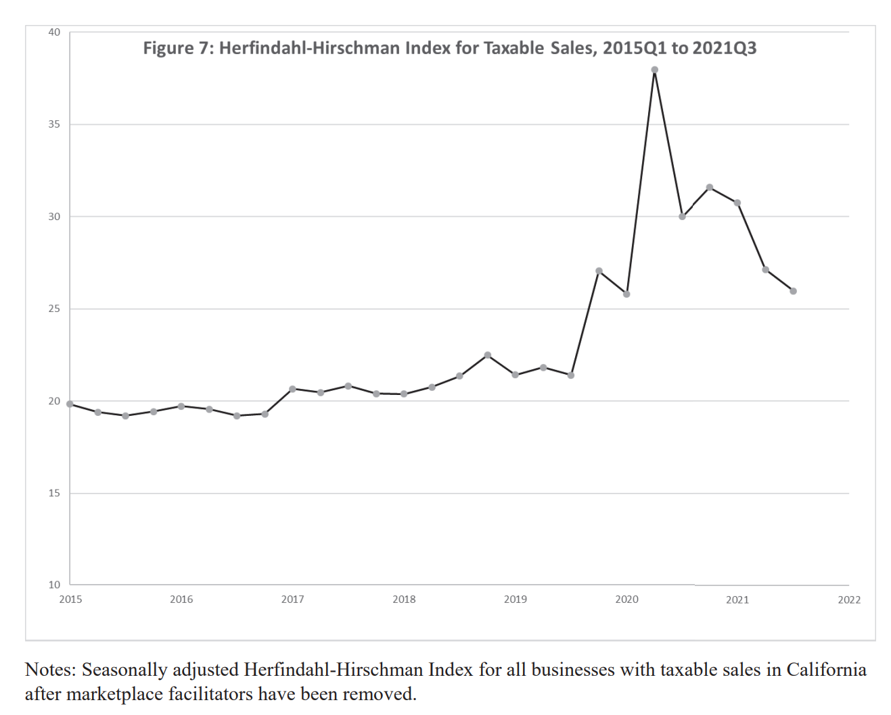
Market concentration
"Were Small Businesses More Likely to Permanently Close in the Pandemic?" NBER Working Paper #30285 by Robert W. Fairlie, Frank M. Fossen, Reid L. Johnsen, and Gentian Droboniku

Slide 15
Greater effects of pandemic policy
Restructuring of employment and income
  Who gets to work vs. who is made dependent on government hand-outs
Centralizing of market structure
  More big businesses, fewer small businesses
  Loss of entrepreneurship, gain of management

Slide 16
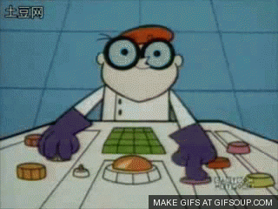
Dept of Central Economic Management

Slide 17
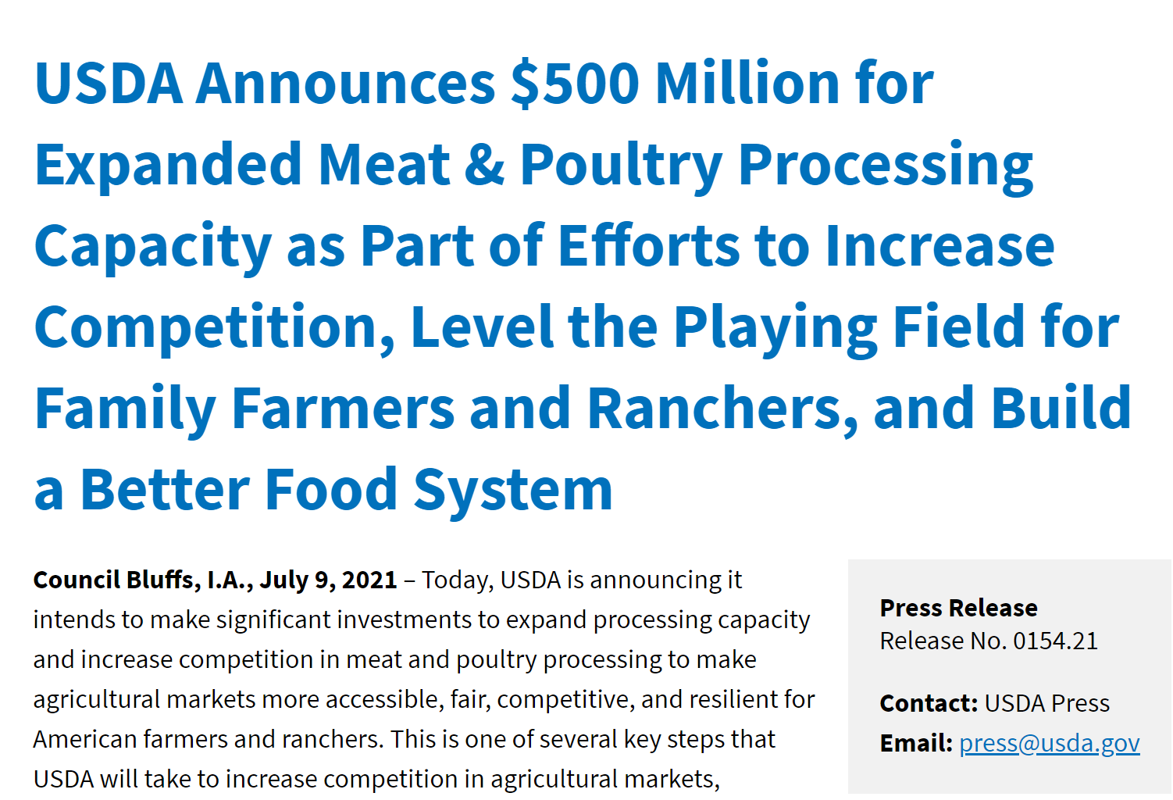
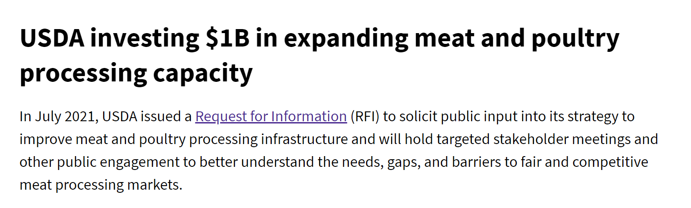
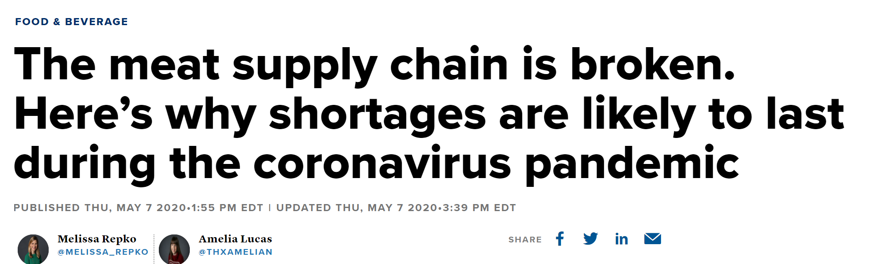
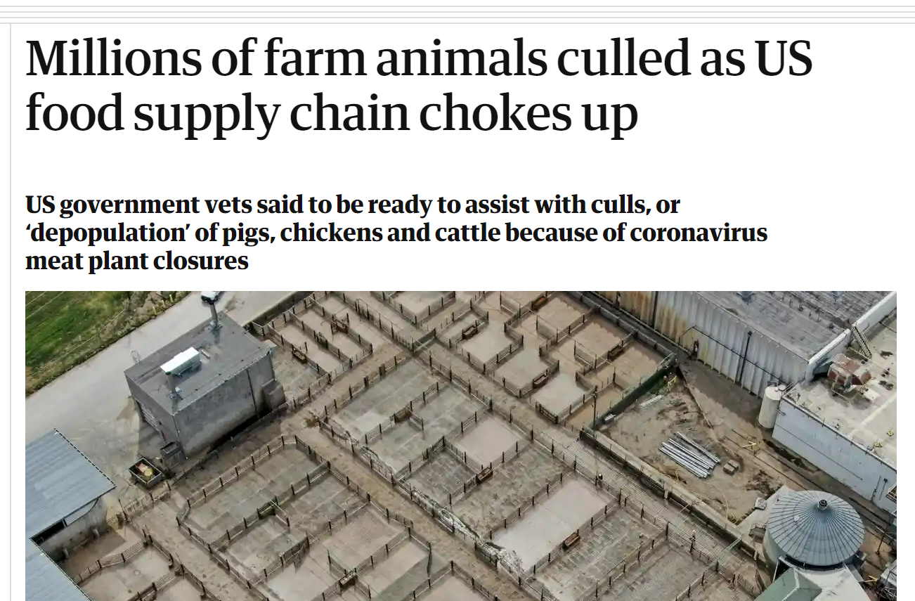
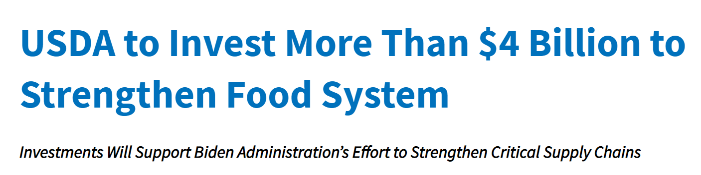

Slide 18


Slide 19
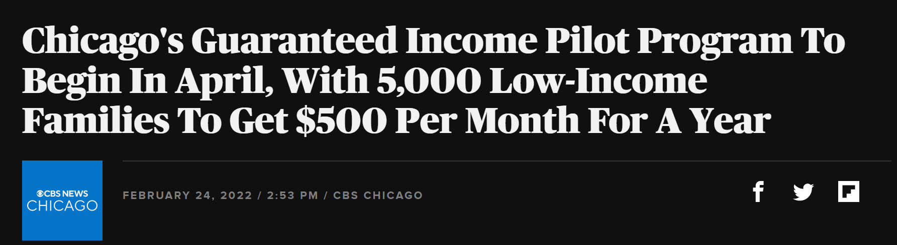
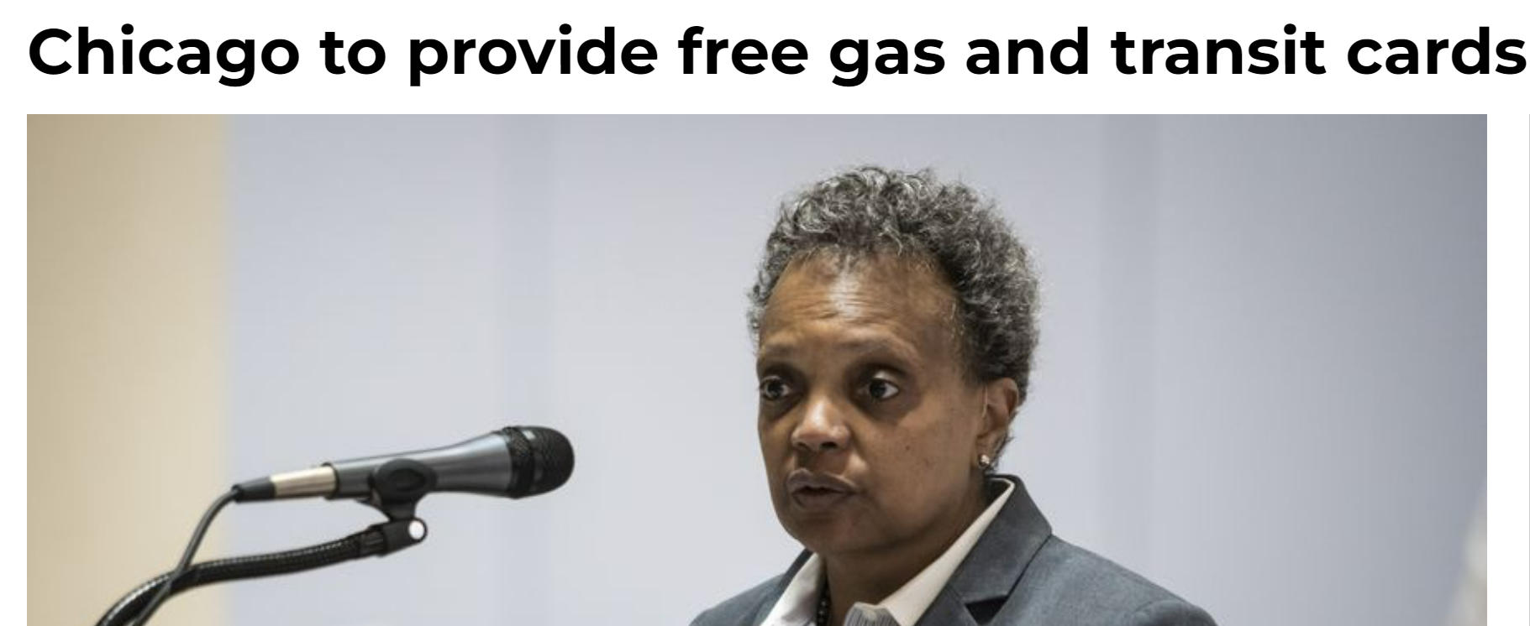

Slide 20
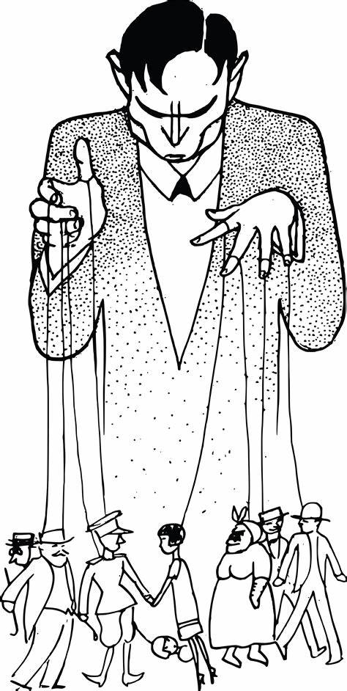
Greater effects of pandemic policy
Restructuring of employment and income
  Who gets to work vs. who is made dependent on government hand-outs
Centralizing of market structure
  More big businesses, fewer small
  Loss of entrepreneurship, gain of management
Making government the core economic player
  Director and funder of production
  Unrestricted ‘benevolent’ government (on every level)

Slide 21

What about the long-term?
The market process is cumulative
  What is was built based on what was
  What will be will be built on what is
  So: distortions set us on a different trajectory
Society is also cumulative
  (Society and the economy are the same.)

Slide 22
Is it all bad news?

Slide 23


Is there any good news?
‘Forced’ shift to distance work
Reconceptualization of the office--increased supply of inner-city apartments?
Development and adoption of delivery services

