Slide 1



The Rise of State-Controlled Medical Care
Timothy D. Terrell
Mises University 2023
/ @timothyterrell
timothyterrell.net
This Photo by Unknown Author is licensed under CC BY-NC
Notes:
Imke,
In your last discussion post, you wrote:
I am still in shock that the US has one of the highest maternal mortality rates (CDC, 2022a), a continuously declining life expectancy (CDC, 2022b) and overall increasing issues with access to health care. Most other Western nations are ahead of the US in that respect, despite the USA having the highest spending in these sectors (Klobucista, 2022). Part of this worse performance is due to lack of accessible healthcare and lack of available benefits despite Obama Care, as well as limited access to retirement funds for blue collar workers.
First, our life expectancy in the US has not been "continuously declining." Rather the opposite: https://www.census.gov/content/dam/Census/library/publications/2020/demo/p25-1145.pdf
A lot of the apparent disparity between the US and other countries is a) the result of factors outside the realm of medical care, such as differences in accident rates, and b) differences in how countries account for child mortality. I did some work on this several years ago and a lot of the apparent gap disappears once these factors are taken into account. The US has tremendous problems with its medical care system, but some of the comparisons are very misleading.
As for maternal mortality, I took a quick look at the statistics. The maternal mortality rates for women 40+ is much higher than for younger women, and the average age at birth has been increasing in the US, which means that more women are giving birth in that high-risk category. That's not necessarily an indictment of the medical care system, and probably not the result of economic constraints either, since women in their 40s tend to be better off financially than younger women. https://www.nbcnews.com/news/motherhood-deferred-us-median-age-giving-birth-hits-30-rcna27827 I have not done an international comparison, so that's a guess at what's driving the rise in maternal mortality in the US.
Dear Dr. Terrell,I am taking your "Economics of Medical Care" course through the Mises Institute. Thank you for doing it! I appreciate you putting this course together. A couple of comments.
CPT codes are owned by the AMA and largely code the visit or procedure performed by the physician. For example a 99213 is a is a mid-level follow-up office visit. a 44950 is a routine appendectomy. They were first published in 1966.
ICD-10-CM codes are diagnostic codes and were originally developed by the WHO as tools for primarily infectious diseases and for epidemiology purposes, not for coding as it relates to medical billing:
https://www.who.int/classifications/icd/en/HistoryOfICD.pdf
These codes go back to the 1920's. However, with the most recent revision to ICD-10, the number of codes dramatically expanded from about 15,000 to about 60,000.
Even prior to the 1990's, physicians were required to put a CPT 4 code (what they did) and an ICD code (why they did it/patient diagnosis) on the HCFA 1500 billing forms for all insurances.
DRG (diagnosis-related groups) were developed by the insurance industry and CMS to change payment on the hospital inpatient side from a fee-for-service billed charges to one of a global payment for the entire hospitalization based on the diagnosis (and perhaps co-diagnoses). For CMS (Medicare) this went into effect in 1983.
In 1992, CMS wanted to value physician work by attaching "resource based-relative value units" (RVU's) to the CPT 4 codes. These codes have three components: Physician work; Facility overhead; and Malpractice. These values are modified annual (sometimes more, sometimes less) and come out in the Federal Register.
I think the explosion in healthcare administration started with the DRG implementation and then expanded more with the RB-RVS system in 1992. Hospitals (where most of the money goes) really had to learn how to work within ("game") the DRG system in order to get paid. Hospital coding became a huge industry.
There are additional coding systems such as SNOMED for diagnoses (this came out of the pathology side of medicine) and LOINC (laboratory terminology used in EMRs).
I hope that helps a little.
Thanks again for your course.
Alan R. Ertle, MD, MPH, MBA
Bend, Oregon
medinfoco@aol.com

Slide 2

Part 1: Medical Licensure

Slide 3
Part 1: Medical Licensure
“Competition resulted not only in a proliferation of medical personnel but in the growth of heterodox theories arising in opposition to standard medical therapeutics.”
License to practice medicine in Connecticut, 1824. Source: http://doc1.med.yale.edu/historical/bicentennial/1810/midcentury.html
Ronald Hamowy, “The Early Development of Medical Licensing Laws in the United States, 1875-1900,” Journal of Libertarian Studies, vol. 3, no. 1 (1979)
Notes:
Hamowy points out that by the 1870s, mainstream medicine had reduced its dependence on bloodletting, arsenic, etc., and added botanical drugs along the lines suggested by an alternative school of thought, eclecticism.
Patrick Newman mentioned some of this in his lecture and I’ll just review a bit.

Slide 4
Medical Licensure
In the late 1800s, the US had the highest number of physicians, per capita, in the world.
In 1904, the AMA began a concerted effort to reduce the number of medical students, claiming that this would increase medical quality.
In 1910, Abraham Flexner published a report for the Carnegie Foundation on US and Canadian medical education.
The report suggested closure of most medical schools (155 to 31), homogenization of education in medical schools, approval of any new medical school by the state government, and additional state licensure regulation.

Slide 5
Medical Licensure
The AMA controls medical schools, state by state, through an accrediting body, the Liaison Committee on Medical Education. Licenses are granted only to graduates of these schools.
Prices of medical care shot up.
Schools of alternative medicine were almost all closed.
Changes arising from the Flexner report also led to fewer women and African Americans in medical education. Michel Accad observed that only 2 of 7 African American medical schools and only one women’s medical college survived the Flexnerian reforms.
See Dr. Michel Accad, http://alertandoriented.com/an-economic-history-of-the-american-health-care-system-part-1/

Slide 6
Part 2: The Food and Drug Administration

Slide 7

Part 2: The FDA
Started in 1906, as a result of the Pure Food and Drug Act, pushed by Theodore Roosevelt
Expansion of powers in 1938 with the Federal Food, Drug, and Cosmetic Act
1951: Durham-Humphrey Amendment established “prescription-only” category
1962: Kefauver-Harris Amendment—not just safety but efficacy required for approval
1984: Hatch-Waxman Act extended length of patents on new drugs, but eased post-patent pathway for generics
Notes:
The FDA creates barriers to entry for new drugs, which reduces competition for existing treatments.
The FDA doesn’t know the patients’ willingness to accept risk.
Costs can discourage new drugs (“drug loss”), costing lives.

Slide 8
The FDA’s “Drug Lag”
Septra:
  Five-year delay in introducing the antibiotic Septra to the US market
  Estimate by Nobel laureate George Hitchings that this delay cost 80,000 lives in the US.
Beta blockers:
  Lag in FDA approval may have cost 250,000 lives in the US.
Drug analyst Dale Gieringer:
“The benefits of FDA regulation relative to that in foreign countries could reasonably be put at some 5,000 casualties per decade or 10,000 per decade for worst-case scenarios. In comparison … the cost of FDA delay can be estimated at anywhere from 21,000 to 120,000 lives per decade.”
Miller, Benjamin, and North, The Economics of Public Issues, 18th ed. (2014), pp. 6, 7.
Doug Bandow, https://fee.org/articles/patients-and-doctors-vs-the-fda/

Slide 9
Drug Suppression
”According to [Mary] Ruwart, at least half of pharmaceutical innovations get shelved because the cost to take a drug through the regulatory testing process makes those drugs uneconomic for drug developers to pursue.
”Even with very conservative assumptions, Ruwart found the years of life lost due to FDA clinical demands is in the millions.”
Bartley J. Madden, Free to Choose Medicine, 3rd ed. (2018), p. 6.
Notes:
Costs include patient harm from delayed access as well as research and development (R&D) opportunities foregone by drug developers whose capital is consumed by fulfilling the demands of FDA clinical trials.

Slide 10

Information Suppression
“In the early 1980s, several reports in medical journals indicated that the B vitamin, folic acid, taken early in pregnancy could prevent a number of birth defect. … Folic acid would have to go through the expensive drug development process if the manufacturers wished to advertise its benefits to young women.
“… Had U.S. folic acid manufacturers been permitted to advertise … [we] might have seen an increase in supplementation in the United States—and a decline in birth defects. Instead, approximately 10,000 American babies were born with deformities more horrific than thalidomide.”
Mary Ruwart, Death by Regulation: How We Were Robbed of a Golden Age of Health and How We Can Reclaim It, quoted in Bartley J. Madden, Free to Choose Medicine, 3rd ed., 2018, p. 6.
This Photo by Unknown Author is licensed under CC BY-SA
Notes:
--Mary Ruwart, Death by Regulation: How We Were Robbed of a Golden Age of Health and How We Can Reclaim It, quoted in Bartley J. Madden, Free to Choose Medicine, 3rd ed., 2018, p. 6.

Slide 11
Information Suppression
“New drugs do consumers no good if they do not know about them. Advertising restrictions imposed by the FDA, therefore, prop up the profits of incumbent drug marketers at the expense of newcomers in the industry and of consumers.”
-- Tom DiLorenzo
http://mises.org/daily/3793

Slide 12

The FDA and COVID-19
The FDA stood in the way of developing new coronavirus tests.
Refusal to use a German test that was developed early in the pandemic
Private labs were prevented from developing tests
The CDC contributed to a shortage of tests with a senseless policy of distributing tests without regard to the size of local populations.
Notes:
“The federal government… botched the process for creating and administering coronavirus tests. Because SARS-CoV-2 is a new variant, a new test was needed to track its spread. German researchers developed one in mid-January, but the CDC decided not to use it, instead pressing ahead with the development of a separate test. When that test was released in late January, it proved faulty, and the FDA prevented private laboratories from developing tests of their own.”
“The CDC also distributed its few test kits equally to labs across the country, without regard to the size of local populations. The result was a dramatic shortage of valid tests in populous areas, which created the false impression that the number of cases in the U.S. was low. In early March, facilities in the U.S. had administered 3,099 tests. By comparison, South Korea, a much smaller country whose epidemic started the same day as ours, had administered 188,000.”
-- Charles Silver and David A. Hyman, National Review Online, April 14, 2020

Slide 13
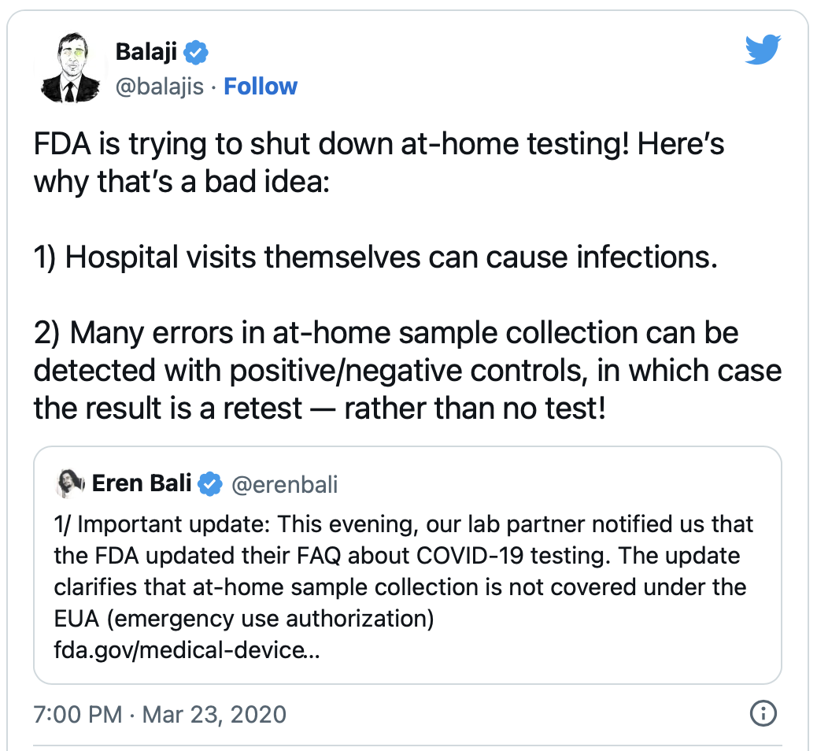
The FDA and COVID-19
Notes:
FDA Can't Stop Harassing Distillers Who Made Hand Sanitizer During the Pandemic
After 18 months of dealing with the FDA, some distillers are regretting making hand sanitizers at all.
JACOB GRIER | 8.8.2022 5:30 PM
https://reason.com/2022/08/08/fda-cant-stop-harassing-distillers-who-made-hand-sanitizer-during-the-pandemic/
Distillers "feel like it's been one thing after another," says Harris, referring to a surprise notice distilleries producing sanitizer received from the FDA in December 2020 informing them that they were obligated to pay a surprise $14,000 fee as registered drug production facilities. That fee was waived by the Department of Health and Human Services following reporting by Reason and other sources and vociferous public objections. The unexpected compliance costs some are facing now strike many as yet another undue burden. "No good deed goes unpunished" is a phrase that came up often in conversations with distillers.
The guidelines allowing beverage distillers to produce hand sanitizer when it was in short supply during the pandemic were intended to remove regulatory roadblocks, acknowledging that the emergency justified easing restrictions that make sense in normal times. Distillers saw making sanitizer as a way to stay afloat while helping their communities, but the lesson many are learning is that dealing with government regulation turns this into a mistake they would not repeat.
"At a point in time, I was so glad of sanitizer, and right now, I wish we'd never done it," says Lupo, who reports taking out a $45,000 loan to produce sanitizer at a very marginal profit. "I will not put myself on this same chopping block again."

Slide 14

Patents
“Expanding the scope of research beyond pharmaceutical drugs, a survey of R&D labs and company managers revealed that between 23 and 35 percent believe a patent is an effective way of getting a return on investment. At the same time, 51 percent believe trade secrets to be an effective way of ensuring returns.”
-- Nathan Nicolaisen, Mises Daily, 12/31/2013, https://mises.org/library/advancing- pharmaceutical-and-medical- technology-does-not-depend-patents
Notes:
US CDC survey: “of the ten most important medical discoveries of the twentieth century, none of them had anything to do with patents.”
-- Nathan Nicolaisen, Mises Daily, 12/31/2013, https://mises.org/library/advancing-pharmaceutical-and-medical-technology-does-not-depend-patents

Slide 15

Drug Costs
“Mylan holds a patent on a type of design that meets specific legal requirements foisted upon schools for auto-injectors. Mylan therefore exploits this. Also, the FDA is reportedly barring competing companies that do manage to meet the same technical requirements by recalling their offerings based on higher standards than set for EpiPen, or by asking them to undergo more arbitrary testing before true consideration is offered.
“Taking this information into account, it becomes pretty clear pretty quickly that FDA regulations customized to Mylan’s already-established brand and design is causing a monopoly to form around the company’s offering. Thus far the competing companies to Mylan have been given excuse after excuse as to why their products can’t see equal footing in the market. It’s essentially a rigged game – cronyism, to be exact.”
http://thelibertarianrepublic.com/epipen-monopoly-hint-not-runaway-capitalism/

Slide 16
Part 3: Medical Insurance

Slide 17

Part 3: Medical Insurance
Medical insurance received a big boost during World War II, when price and wage controls led employers to offer medical insurance to workers, which was not taxable.
The number of insured Americans grew from 10 million in 1940 to 80 million by 1950.
Third party payers (government or private insurance) create moral hazard effects that lead to regulation and rationing.
This Photo by Unknown Author is licensed under CC BY-NC-ND
Notes:
By 2019, only about 25 million Americans did not have health insurance of one kind or another.

Slide 18
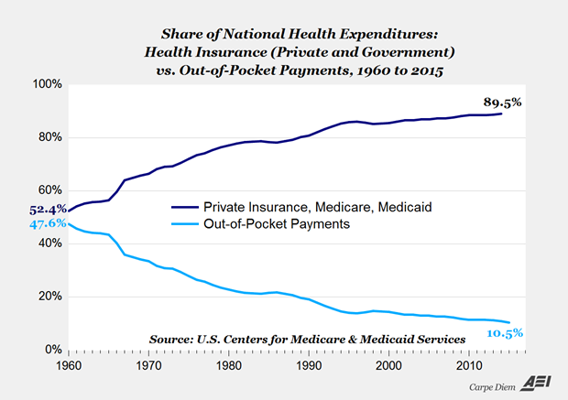
Source: Mark Perry, https://fee.org/articles/if-cosmetic-surgery-has-a-working-market-why-can-t-medical-care/

Slide 19
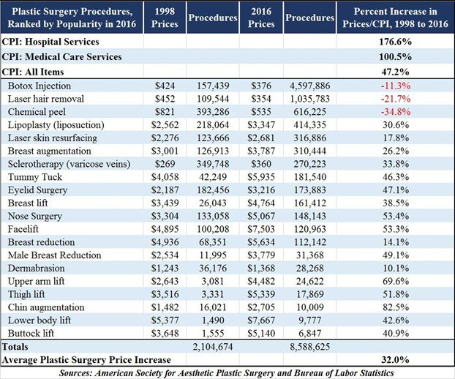
Source: Mark Perry, https://fee.org/articles/if-cosmetic-surgery-has-a-working-market-why-can-t-medical-care/

Slide 20
Rising Costs
“Studies have found that a fully insured population spends about 40-50 percent more than a population with a large deductible and their status is not measurably improved by the additional services (Manning et al. 1987).
Foy, Sciamanna, Kozak, and Filippone, “The Medical Care Cost Ratchet,” Cato Journal vol. 34, no. 1 (Winter 2014). https://pdfs.semanticscholar.org/38e1/efdd0dc26681e10b16141538c3310603b0e2.pdf

Slide 21
Rising Costs
“…[T]echnological change has indeed increased health care costs in many cases without significantly improving health outcomes. This has occurred because medical insurance in its current state discourages individuals from economizing health care decisions and incentivizes the adoption and overconsumption of services with progressively diminishing returns on investment.”
Foy, Sciamanna, Kozak, and Filippone, “The Medical Care Cost Ratchet,” Cato Journal vol. 34, no. 1 (Winter 2014). https://pdfs.semanticscholar.org/38e1/efdd0dc26681e10b16141538c3310603b0e2.pdf

Slide 22
Part 4A: Medicare, Medicaid

Slide 23

Medicare and Medicaid
Both programs were started in 1965 under Social Security Act amendments.
Medicaid is needs-based; Medicare is government medical insurance for the elderly (and for those of any age with end-stage renal disease).

Slide 24

Medicare Structure
Medicare has four parts: A, B, C, and D.
Parts A and B (“Original Medicare”) includes inpatient hospital and skilled nursing services (A) and physician and surgical services, ER, labs, tests, and some durable medical equipment (B).
Part A is mandatory for eligible individuals who receive Social Security.
Part B premiums increase with income, and if a person doesn’t sign up right away, there’s a hefty increase in all future premiums.
Part C is “Medicare Advantage,” which may offer extra coverage like vision, hearing, or dental.
Part D is a standalone prescription drug coverage program.
All are administered by private companies, under contract to the Center for Medicare and Medicaid Services (CMS).
Notes:
Part C was formalized in 1997.
Medicare Advantage has an out-of-pocket annual spend limit, which Parts A and B do not.
Many Medicare Advantage plans also integrate Part D-like drug coverage.
There is substantial competition among plans for market share (average of 21 different plans).
Costs have been lower, on average, than for Medicare recipients who are not on Part C.
Most people who sign up for Medicare today choose a Medicare Advantage plan.

Slide 25
Medicare Advantage
Image: https://cdn-images-1.medium.com/max/1200/1*XNyGgU1QvQSwi7fyQ3fFsA.png

Slide 26

Medicaid Results
“…Baicker et al. (2013) found that Medicaid coverage generated no significant improvements in health outcomes in the first two years, despite increased use of prescription drugs, office visits, preventive care services including mammograms, and annual spending per individual (by insurance plan) in excess of $1,100.
This Photo by Unknown Author is licensed under CC BY-NC

Slide 27
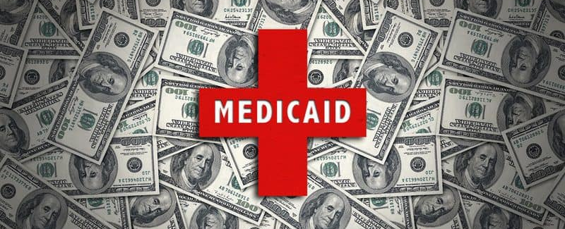
The Oregon Experiment
Oregon health insurance experiment:
  In 2008, Oregon expanded its Medicaid service by lottery. About 10,000 residents of the state were enrolled, and their medical service usage and health were compared to lottery “losers.”
  Health care service usage increased, but there was “no statistically significant impact on physical health measures.”
  Financial strain for the lottery “winners” decreased, as we might expect.
  Winners had lower rates of depression
This Photo by Unknown Author is licensed under CC BY-ND
Notes:
Ben Domenech, managing editor of Health Care News and fellow of the Heartland Institute, commentated that the moderate changes in depression found in the study from Medicaid could have been exceeded by having all of the patients adopt a pet, which significantly lowers depression and reduces the risk of heart disease, and also would have been far cheaper. He concluded, "So... you actually care about people being healthier and not just feeling less depressed, is to end Medicaid and simply give people the monetary value of the program to purchase a private health plan."^{[11]}

Slide 28
Part 4B: The Affordable Care Act
Notes:
“Patient Protection and Affordable Care Act” or “Obamacare” signed into law in 2010, with major provisions coming into force in 2014.
Main components:
Medicaid expansion
Insurers must cover all applicants, without regard to medical history, setting premiums based mostly on geographic location (“community rating”) and age, and not on gender and most pre-existing conditions.
Everyone must obtain health insurance, except those who are deemed unable to afford coverage and those religious groups that have obtained waivers. But individual mandate penalty has been $0 since 2019. Subsidies and state-based exchanges are to assist in finding health insurance.
Employers with 50 or more employees must provide coverage for employees working ≥30 hours a week, or face penalties.
Health insurance policies must cover certain services (“essential health benefits”) and not have any cap on annual or lifetime benefits for an individual.

Slide 29
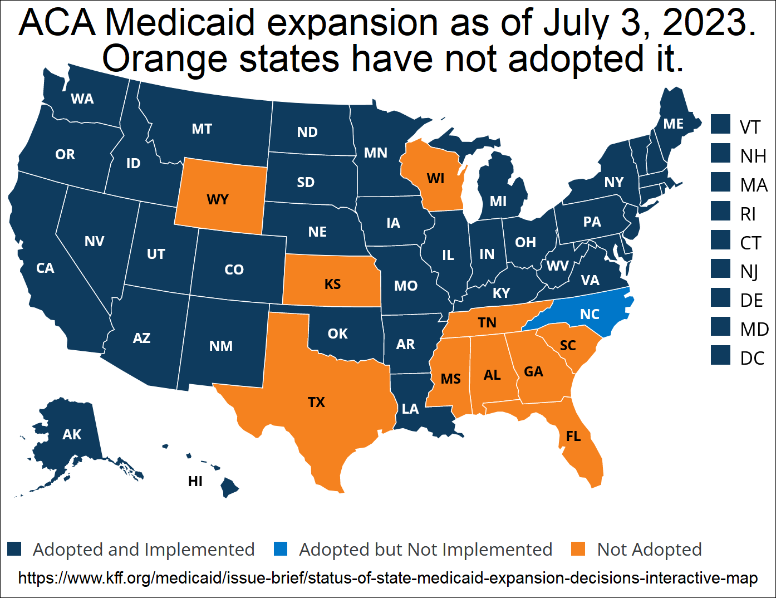

Slide 30
ACA
“On average, premiums in the individual market have doubled since the ACA went into effect.”
“These high premiums are not accompanied by low deductibles; indeed, the median deductible for a benchmark Silver plan in 2019 was $4,375.”
“In 2010, the CBO projected that 24 million Americans would enroll in the exchanges in 2019; the actual figure was closer to 9 million.” [In 2022, 14.5 million people signed up for Marketplace plans.]
-- Avik Roy, 2019 https://freopp.org/bringing-private-health-insurance-into-the-21st-century-d1df138f1f0c
Notes:
All must be required to get insurance, lest adverse selection result in the healthiest opting out
If insurance companies must insure everyone, even those who are very expensive to cover, they must be required to cover certain things and not refuse to cover pre-existing conditions.
Insurance would therefore be expensive, so subsidies were built in.
Unintended consequences:
Premiums rose (and are projected to rise substantially in 2022-23)
People chose to pay the penalty rather than sign up for insurance
Insurers pulled out of the exchanges, limiting options
Employers limited the number of ≥ 30-hour employees to stay under the 50-employee mark.

Slide 31
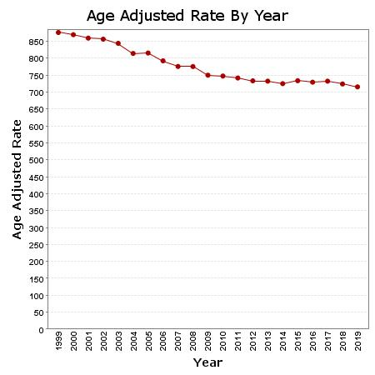
U.S. Age-Adjusted Mortality Rates per 100,000 (Annual)
Centers for Disease Control and Prevention, National Center for Health Statistics. Multiple Cause of Death on CDC WONDER Online Database. Accessed at http://wonder.cdc.gov/mcd-icd10.html on Jul 19, 2021.
Full expansion of insurance coverage under ACA: 2014
Notes:
Murphy: “And yet, we see the opposite. Although the ACA passed in 2010, the full expansion of insurance coverage didn’t kick in until 2014. So the relevant metric is to see what happened to (age-adjusted) mortality rates before and after 2014.”

Slide 32
Pre-Existing Conditions
Image: modernsurvivalblog.com
Notes:
Requiring an insurance company to take on certain payments without increasing premiums accordingly is forcing the insurance company to make a simple transfer—it is not insurance but a mandated payment.
Insurance companies would then have to raise premiums on others who do not have the pre-existing conditions.
These others now face not only the premium for covering risk, but an additional amount to be transferred to others in the insurance pool.
This will make insurance less attractive for those without pre-existing conditions, possibly inducing the healthiest to drop out. We are back to adverse selection, and therefore the mandate—which creates a forced transfer (“healthy tax”)
In a free market, how would pre-existing conditions be handled?
Insuring insurability (e.g., guaranteed renewability).
”Under the individual insurance that existed before Obamacare, beneficiaries… could buy guaranteed-renewable health insurance. If they developed a condition while insured, they could still buy health insurance at a premium that applied to the whole pool they were in when they originally bought insurance.” (David Henderson, https://fee.org/articles/why-pre-existing-conditions-should-be-left-to-the-market/)
Parents could buy ”insurability” insurance for their children, even unborn children.
Charity

Slide 33
Part 5 (?): Medicare for All

Slide 34
Part 5 (?): Medicare for All (M4A)
First-dollar coverage (no copays or deductibles)
Dental, vision, hearing—all covered
Payments to providers cut by >40% relative to private insurance payments
Image: https://thehill.com/homenews/senate/428430-bernie-sanders-to-deliver-his-own-state-of-the-union-response
Notes:
Basically what this does is double down on a system that is already failing, rather than admit that the market can handle medical care.

Slide 35
Medicare for All (M4A)
“M4A would add approximately $32.6 trillion to federal budget commitments during the first 10 years of its implementation (2022–2031).” (https://www.mercatus.org/publications/federal-fiscal-policy/costs-national-single-payer-healthcare-system)
Increases in federal medical care expenses would be about 10.7% of GDP in 2022, 12.7% in 2031, and higher thereafter.
Charles Blahous: “A doubling all currently projected federal and corporate income tax collections would be insufficient to finance the added federal costs of the plan.”

Slide 36
Medicare for All (M4A)
Under M4A, insurance companies would still be around, managing the system, as with Medicare Advantage and Medicaid managed-care contractors.
Cuts to medical providers of 40% would mean that many doctors would exit. Access to medical care would suffer.
M4A would outlaw private insurance that duplicates benefits offered by the government. Private insurance is common in Europe.
Notes:
“In addition to notoriously underestimated cost projections, Medicare underpayments to hospitals must be addressed. Hospitals receive 88 cents on the dollar from Medicare and 90 cents on the dollar from Medicaid for their expenditures on these patients…. Currently hospitals make up the shortfall with higher payments from private insurance—which will no longer exist [under M4A]. Slashing oft maligned CEO salaries would be a drop in the bucket. Hospital workers—unionized or otherwise—would not accept pay cuts.”
-- Marilyn Singleton, M.D., J.D.

Slide 37
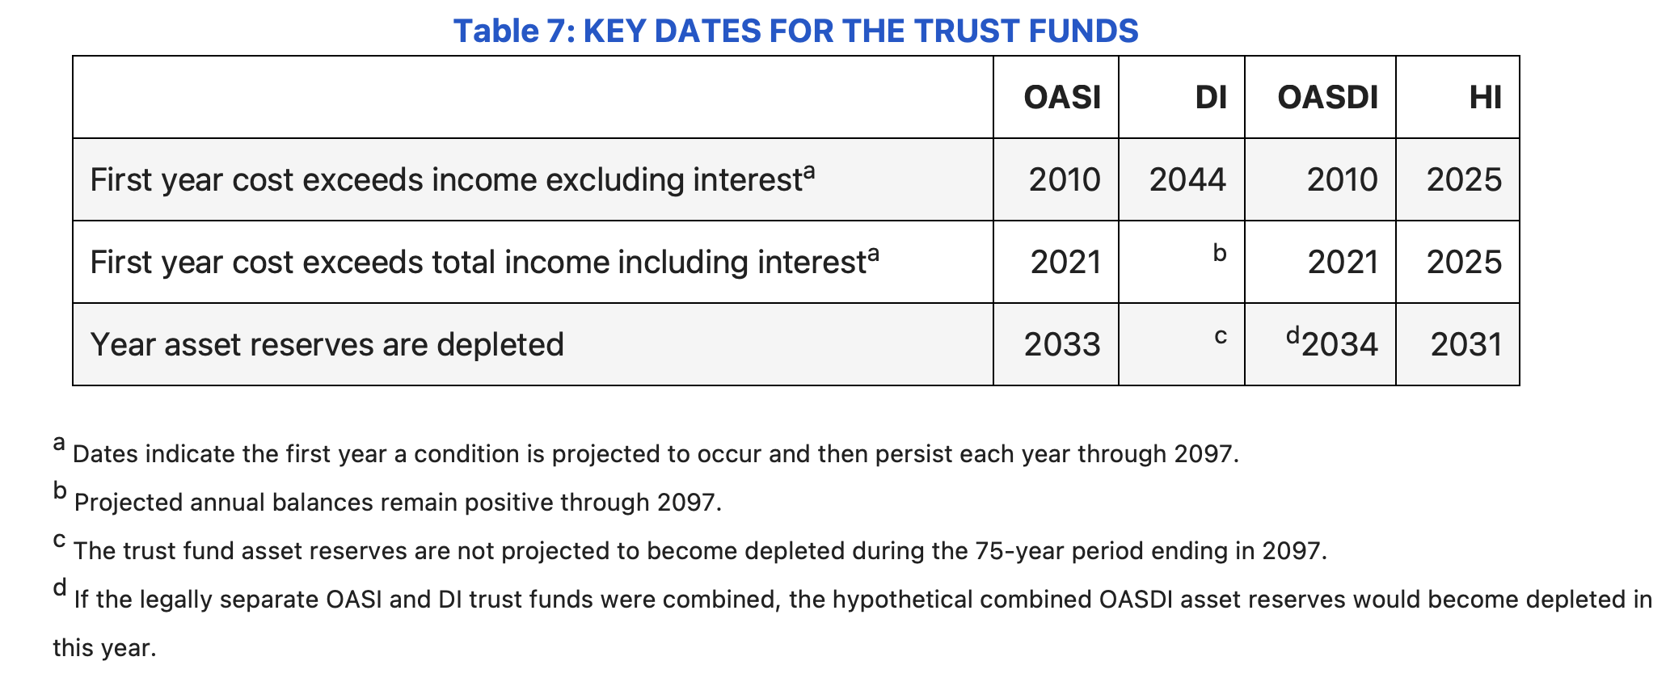
Financial Trouble Ahead
Source: 2023 Annual Report of the Social Security and Medicare Boards of Trustees:
https://www.ssa.gov/oact/TRSUM/
OASI: Old Age and Survivor’s Insurance
DI: Disability Insurance
OASDI: combined OASI and DI
HI: Hospital Insurance (Medicare Part A)

Slide 38
Additional Reading
Hamowy, Ronald. 1979. “The Early Development of Medical Licensing Laws in the United States, 1875-1900,” Journal of Libertarian Studies, vol. 3, no. 1 (1979)
Lewis, Hunter. 2018. “’FDA Approval’ Is a Monopolist’s Scheme to Limit Competition“ https://mises.org/power-market/fda-approval-monopolists-scheme-limit-competition
Madden, Bartley. 2018. Free to Choose Medicine, 3rd ed. Heartland Institute.
Terrell, Timothy D. 2021. “The False Promise of Free Medical Care.” In Freedom or Free Stuff… It’s Your Choice, ed. Rafael Acevedo. Miami: Econintech.

