Slide 1
The Dollar Crisis of 1861-1865
Greenbacks, Gold, and Confederate Dollars

Slide 2
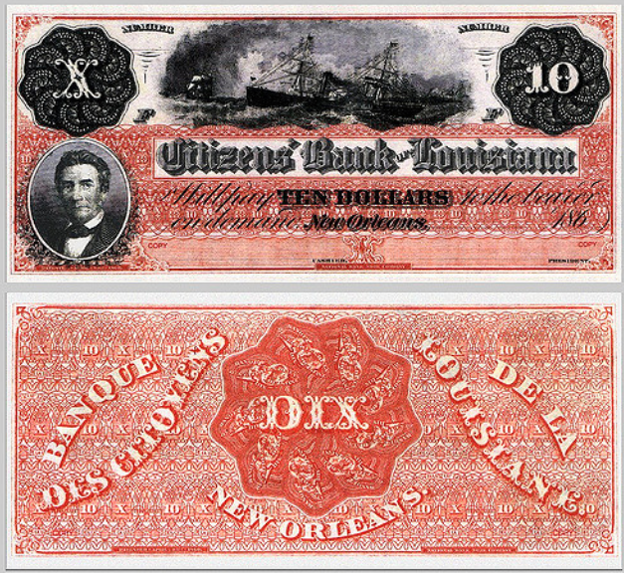
The “Dixie”
https://www.flickr.com/photos/11028408@N06/1071972675

Slide 3
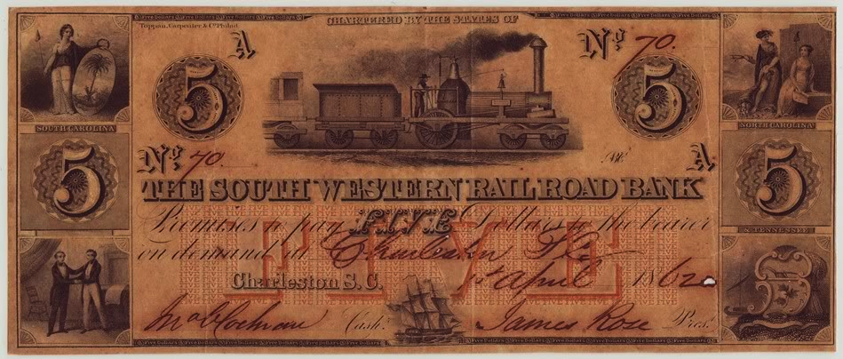
Free Banking
Early America: a gold and silver standard, with “free banking”
Free banking resulted in many different bank notes issued by banks and large firms
Notes:
Early America: a gold and silver standard, with “free banking”
Whigs under Henry Clay followed an economic policy platform called the “American System”
When the Whig Party collapsed, the platform was transferred to the Republican Party
Three main elements
Central banking and fiat money
Federally funded “internal improvements”
High protective tariffs
Free banking resulted in many different bank notes issued by banks and large firms

Slide 4
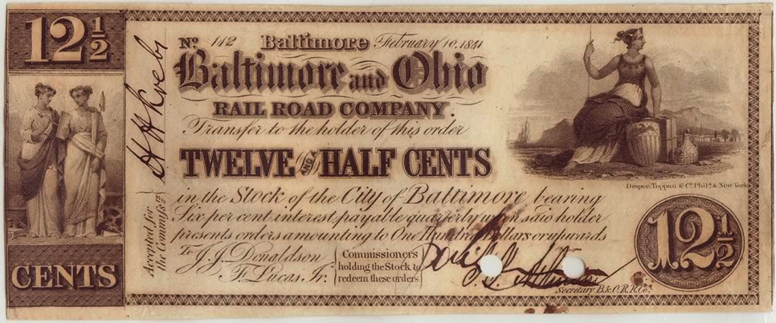
Railroad Currency - MD
http://webpages.charter.net/marlofan/RRnote2.htm

Slide 5
Railroad Currency – SC (1862)
http://webpages.charter.net/marlofan/RRnote2.htm

Slide 6
Free Banking
  “…overall, the combination of state charters and free banks led to one of the most stable and prosperous periods known in American financial history. …Contrary to the predictions of some, when money was taken out of the hands of the government and subjected to a private market, it produced a stable free-market money supply.” (Schweikart, The Entrepreneurial Adventure, p. 50)
Notes:
Banking tended to be more free in the South, with branch banking being permitted.
“During the Panic of 1857… the South—which had branch banking, as opposed to the single-unit banks in the North—had virtually no failures or suspensions” (Larry Schweikart, “The Non-Existent Frontier Bank Robbery,” p. 50)

Slide 7
Union War Finance
70% bond issues
18% taxes
  Revenue Act of Aug. 5, 1861
  Incomes > $800 taxed at 3%
  By the end of the war, the top income tax rate was 10% on all incomes over $5,000
  Income tax expired in 1872.
12% greenbacks
Clement Vallandigham
Image: https://mstartzman.pbworks.com/w/page/21899450/Clement%20L%20Vallandigham%20(4)

Slide 8
Union “United States Notes,” commonly called “greenbacks,” followed Legal Tender Act of Feb. 25, 1862.
More greenbacks under Legal Tender Act of July 11, 1862, many of which were to be small denominations ($1, $5).
Image: Public Domain, https://en.wikipedia.org/wiki/Greenback_(1860s_money)

Slide 9
Greenbacks were resisted by California and Oregon. The states ruled that greenbacks violated their state constitutions, and refused to accept them in taxes.
Image: Public Domain, https://en.wikipedia.org/wiki/Greenback_(1860s_money)

Slide 10
The low point for the greenback came in July 1864, when it took $2.64 in greenbacks to buy $1 of gold.
Image: Public Domain, https://en.wikipedia.org/wiki/Greenback_(1860s_money)

Slide 11
https://en.wikipedia.org/wiki/United_States_Note#/media/File:RunningtheMachine-LincAdmin.jpg

Slide 12
Postwar Greenbacks
Greenbacks circulated after the war, generally rising in value, and in 1879 were actually authorized for redemption in gold.
Greenbacks were used to influence the money supply until the Federal Reserve Act in 1913, which created Federal Reserve Notes for that purpose.
No United States Notes were issued into public circulation after January 21, 1971.

Slide 13
$100 United States Note (“greenback”), 1880 issue
Image: https://en.wikipedia.org/wiki/United_States_Note

Slide 14
$1 United States Note (“greenback”), 1928 issue
Image: https://en.wikipedia.org/wiki/United_States_Note

Slide 15
$100 United States Note (“greenback”), 1968 issue
As of 2012, $239 million in United States Notes were estimated to remain in circulation.
Image: https://en.wikipedia.org/wiki/United_States_Note

Slide 16
Confederate War Finance
Tariffs raised little money
The first year, the CSA collected 75% of its revenue from Treasury notes, <25% from bonds, and <2% from taxes. (http://www.taxhistory.org/www/website.nsf/Web/THM1861?OpenDocument)
Overall, about 35% of the CSA’s funds came from loans.
Many Confederate states borrowed, confiscated Northern property, and levied property taxes.

Slide 17
Confederate War Finance
The Confederate Treasury issued $1 million in notes in 1861 and $700 by 1863, producing a rapid inflation.
An unpopular income tax was levied in 1863, along with an 8% tax on inventories, excise taxes, license fees, a 10% wholesale profits tax, and a 10% tax on crops, payable in kind. (http://www.taxhistory.org/www/website.nsf/Web/THM1861?OpenDocument)
Notes:
Income over $1,000 was taxed at 1%, and 2% on income over $2,500. (http://www.civilwar.org/education/history/warfare-and-logistics/logistics/tax.html)
The Tax in Kind accounted for around half of total revenue (https://en.wikipedia.org/wiki/Confederate_war_finance)
In February 1864, a 5% tax on land and slaves was assessed.

Slide 18
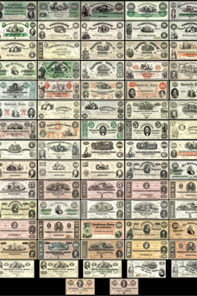
All 72 CSA Notes

Slide 19
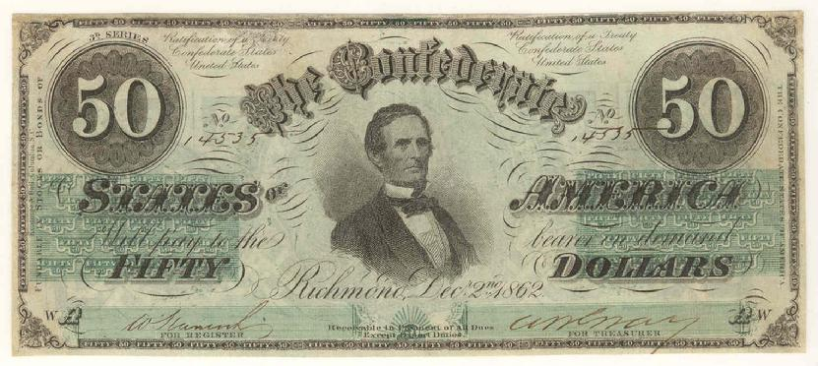
1862 - CSA

Slide 20
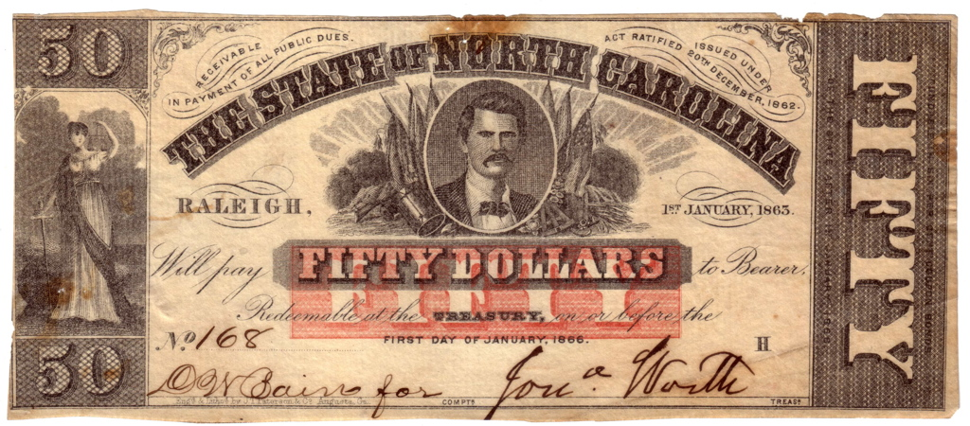
1863 - NC

Slide 21
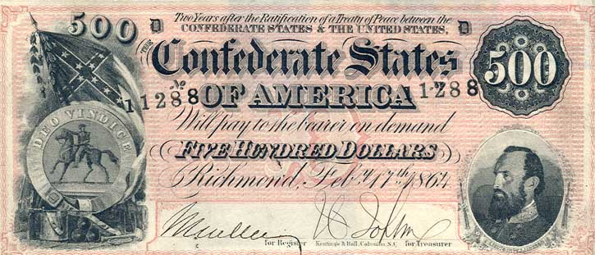
1864 - CSA

Slide 22
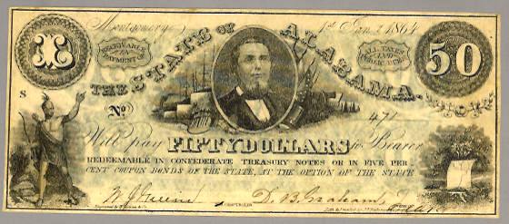
1864 - Alabama

Slide 23
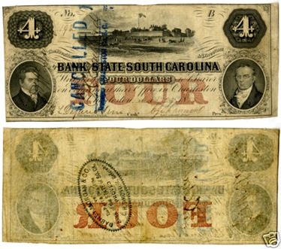
South Carolina

Slide 24
https://en.wikipedia.org/wiki/Confederate_war_finance

Slide 25
https://en.wikipedia.org/wiki/Confederate_war_finance

Slide 26
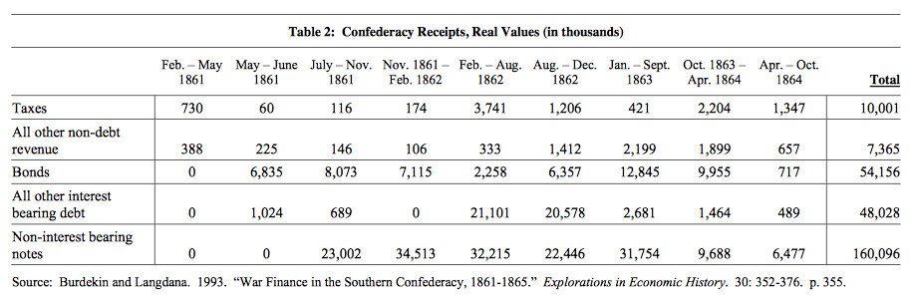
http://economics.yale.edu/sites/default/files/files/Workshops-Seminars/Economic-History/razaghian-050914.pdf

Slide 27
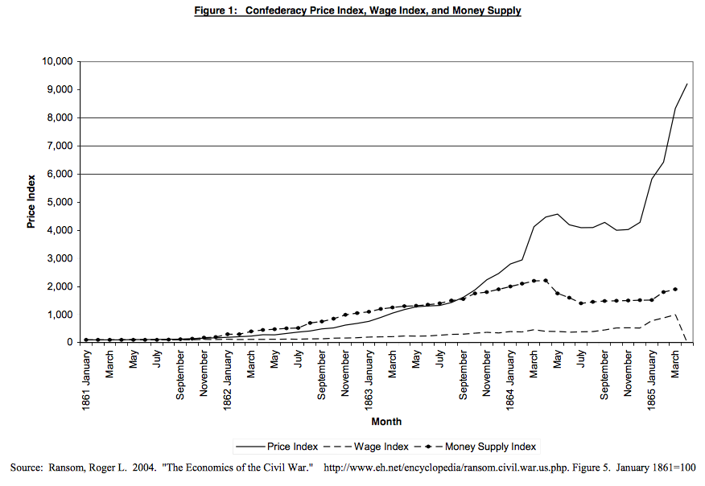
March 1865: Johnston retreat north
May 1864: Currency reform completed
Dec. 24, 1865: Savannah falls
Feb. 1864: Currency reform act
Sept. 2, 1864: Atlanta falls
July 1863: Gettysburg
Dec. 15-16, 1864: Hood destroyed at Battle of Nashville
May 1863: Chancellorsville
http://economics.yale.edu/sites/default/files/files/Workshops-Seminars/Economic-History/razaghian-050914.pdf

Slide 29
https://en.wikipedia.org/wiki/Confederate_war_finance

Slide 30
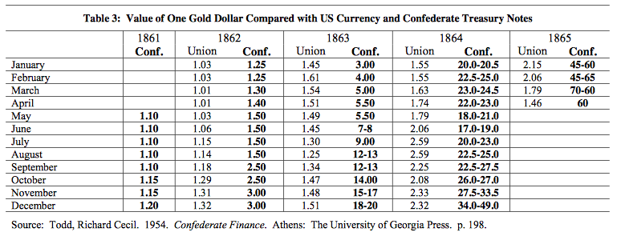
http://economics.yale.edu/sites/default/files/files/Workshops-Seminars/Economic-History/razaghian-050914.pdf

Slide 31
Union Counterfeits
Samuel Upham
Notes:
In March 1862, Samuel C. Upham, a Philadelphia shopkeeper, began selling perfect replicas (a.k.a. counterfeits) of Confederate currency.
Calling them “Mementos of the Rebellion,” he sold them for as little as 1½ cents on the dollar.
By April 1862, the notes were showing up in Richmond. Union troops also spent the notes liberally in occupied Virginia.

Slide 32
Image: Counterfeit CSA $5 note. https://www.annmarieackermann.com/paper-bullets-counterfeit-confederate-currency-civil-war/
Notes:
Confederates would have found it more difficult time counterfeiting Union greenbacks, since greenbacks were printed using high-quality engraving rather than the cheaper lithographic printing used by the CSA.

Slide 33
Counterfeit British banknote, from Operation Bernhard http://www.telegraph.co.uk/history/world-war-two/8029844/Nazi-fake-banknote-part-of-plan-to-ruin-British-economy.html

