Slide 1
Early Dollar Crises: Lessons for Today
Patrick Newman
Mises Institute Supporters Summit: The End of the Dollar Era

Slide 2
What’s this presentation about?
The Depression of the 1890s (1893-1897)
  Double-dip depression (1893-1894 and 1895-1896)
  Featured several runs on the dollar
  What caused this depression? Why was it so serious?
    Normal Austrian Business Cycle
    Expected threat of devaluation—currency crisis
  What relevance does this have for today?
    Any flight from the dollar will severely affect the U.S. economy

Slide 3
The National Banking Acts of 1863-1865
A central bank traditionally has a monopoly on note issuance and is a bankers’ bank
During the Civil War Congress created a quasi-central banking system of national banks
  National banks had a monopoly on bank note issuance (prohibitive tax on state bank notes)
  National and state banks could deposit reserves in central reserve city banks in New York City

Slide 4
The National Banking Acts of 1863-1865
Prior to the Civil War, there was freedom of entry in banking (Free Banking Era). But there were built-in fragilities
  Prohibitions on branch banking made banks more failure prone and concentrated their reserves in New York City
  Requirements for banks to guarantee the value of their bank notes by backing them with government bonds made note issuance inelastic

Slide 5
The National Banking Acts of 1863-1865
  The National Banking System aggravated these fragilities
    Prohibitions on branch banking continued
    Reserves increasingly concentrated in NYC
    National bank notes required to be insured with government bonds
    The pyramiding of reserves led to greater credit expansion and several credit induced booms (1870-1873, 1881-1884, 1886-1892, 1900-1907)
    When monetary conditions tightened and a prominent business failed the banking system imploded (panics of 1873, 1884, 1893, and 1907)

Slide 6
What else was going on?
The U.S. was on a de facto gold standard before the Civil War
  $1 dollar defined as 371.25 grains of silver or 23.2 grains of gold (1 grain of silver equal to .0625 grains of gold)
  Given that the market valued 1 grain of silver at .0633 grains of gold the U.S. Mint undervalued silver and overvalued gold
  Gresham’s Law: money overvalued by the government drives out money undervalued by the government
    People hoarded/sent silver abroad and used gold in transactions

Slide 7
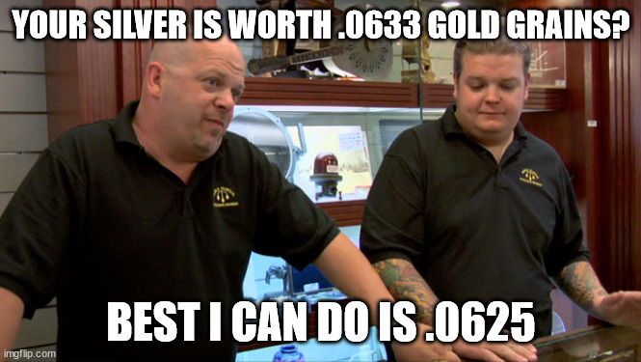
The U.S. Mint explained by Pawn Stars

Slide 8
What else was going on?
    In the 1870s European governments demonetize silver and new supplies of silver are discovered in the West
      1 grain of silver on the market can now only buy .055 grains of gold
      As a result, the U.S. officially demonetized silver in the mid-1870s
        This angered those who wanted silver coinage to increase the money supply

Slide 9
Did the Farmers have a right to be upset?
Historical myth argues that the farmers (“Populists”) suffered because money was scarce and the secular fall in prices increased the real value of their debt burdens
Did the farmers have a right to be upset? Yes and no
  Yes: national bank notes concentrated in the Northeast and national banks had high capital requirements. This limited farmers’ access to banking facilities
  No: deflation was expected, so the interest rates on agricultural loans adjusted downwards

Slide 10
But upset they were
Beginning in the late 1870s agrarians advocated the remonetizing silver at the old ratio (1 grain of silver equals .0625 grains of gold)!
  This would have undervalued gold and overvalued silver and put the U.S. on a de facto silver standard
Bland Allison Act (1878): Treasury must purchase $2 to $4 million silver each month and turn it into coins

Slide 11
Remonetization increased the risk of devaluation
If enough domestic and foreign investors redeemed their dollars and shipped their gold abroad the U.S. would have to suspend convertibility/adopt a silver standard = devaluation
The expectation of devaluation can lead to a capital flight wealthy domestic citizens and foreigners pull their money out of U.S. banks. Can be self-fulfilling
Capital flight results in reduced savings and higher interest rates and causes economic stagnation

Slide 12
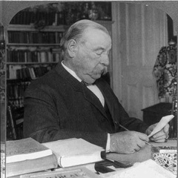
Politics in the 1880s
In the Northeast Democrats and Republicans were pro-gold
  Bourbon Democrats were the most pro-gold
  In the South and West Democrats and Republicans were pro-silver
    Populist Democrats were the most pro-silver
    Grover Cleveland (D, NY), president from 1885 to 1889, ardently pro-gold. This reassured domestic and foreign investors

Slide 13
Politics in the 1880s, cont.
The same could not be said about Cleveland’s successor Benjamin Harrison (R, IN), the president from 1889 to 1893
In the 1888 election Harrison campaigned on a bimetallic platform and as president admitted six new silver states (MT, ND, SD, WY, WA, ID)
In 1890 Republicans pass the protectionist McKinley Tariff and inflationist Sherman Silver Purchase Act
  Treasury doubled its purchases of silver

Slide 14
Investors grow very nervous
The Sherman Silver Purchase Act increases the chance of default
From 1890 to 1892 the nation’s gold stock declines 7% while the national banking system increases the money supply 18%!
March 1891: Treasury imposes a heavy fee on exporting gold bars
July 1892: Senate passes free coinage bill

Slide 15
The Panic of 1893 and the Depression of the 1890s
In early 1893 a panic hits the country
  Failure of the Philadelphia & Reading Railroad and the National Cordage Company
  Run on nation’s banks as citizens try to redeem bank money
    Healthy credit contraction and readjustment
  But there is also a run on the dollar and shipments of gold abroad. The Treasury’s gold stock declines by ~25% from late 1892 to mid-1893!
    Harmful decline in domestic savings

Slide 16
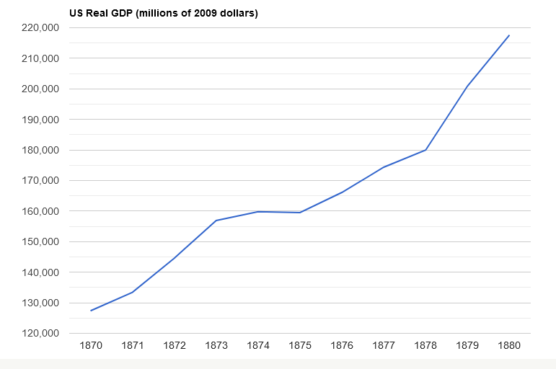
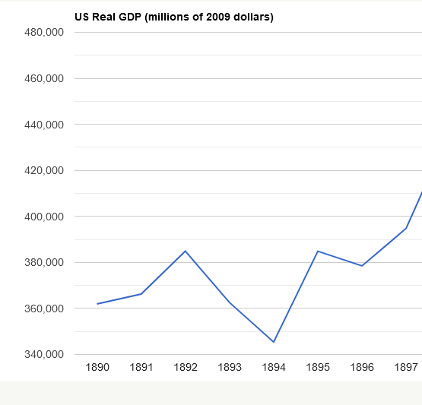
A Tale of Two Depressions

Slide 17
The Politics of the 1890s
Cleveland secures repeal of the Sherman Act in June
  From 1892 to 1893 the gold stock increases 2%
But repeal did not restore confidence and in 1894 gold starts to flow out again. From 1893 to 1895 gold stock declines 10%. Why?
  Populist Democrats took over the Democrat Party, increasing the likelihood of a bimetallic standard
  In early 1896 it appeared as though both presidential frontrunners would be pro-silver

Slide 18
McKinley becomes pro-gold and wins
In June 1896 investment banker J.P. Morgan & Co. secures a pro-gold plank in the Republican Party
In the fall of that year McKinley defeats Bryan and the gold standard is affirmed
  From 1895 to 1896 gold stock increases 16%!
  As investment returns to America recovery begins in 1897

Slide 19
What does this episode teach us?
Currency crises are extremely harmful to economic activity
When they are expected, domestic and foreign investors yank wealth out of the country, increasing the likelihood of default and a further reduction in savings
It is very hard to reassure investors without using contractionary monetary policy

Slide 20
What does this episode teach us?
Could a similar episode happen to the United States in the 2020s? Yes and no
No: we are obviously not on a gold or silver standard. Fiat! Nothing to suspend convertibility of
Yes: if investors expect the dollar to depreciate relative to other monies than they will convert their dollars into them and transfer their savings to other countries

Slide 21
Conclusion
The 1890s depression was caused by a credit induced boom aggravated by a currency crisis
This currency crisis was heavily linked to the political situation
Currency crises are extremely damaging

