Slide 1
US Dollar Hegemony and the Business Landscape
Peter G. Klein
Baylor University
@petergklein
October 2023

Slide 2


Slide 3


Slide 4


Slide 5


Slide 6
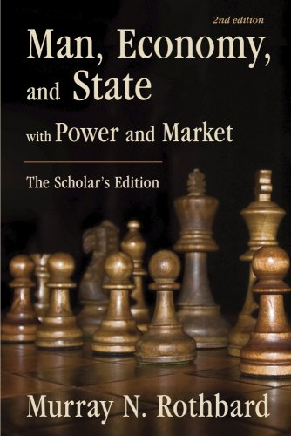
Production is ”the use by man of available elements of his environment as indirect means — as cooperating factors — to arrive eventually at a consumers’ good that he can use directly to arrive at his end.”
Transformation
Purposeful human action
Passage of time
Uncertainty
Need some planning tool for comparing
value of (present) means to value of (future) ends!

Slide 7
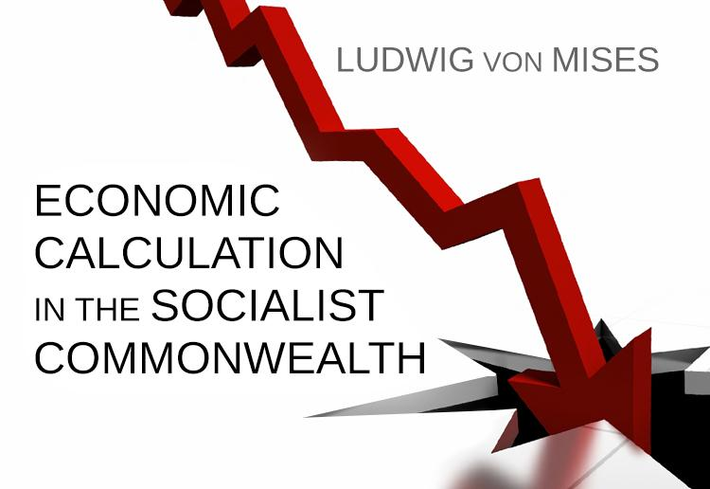

Slide 8
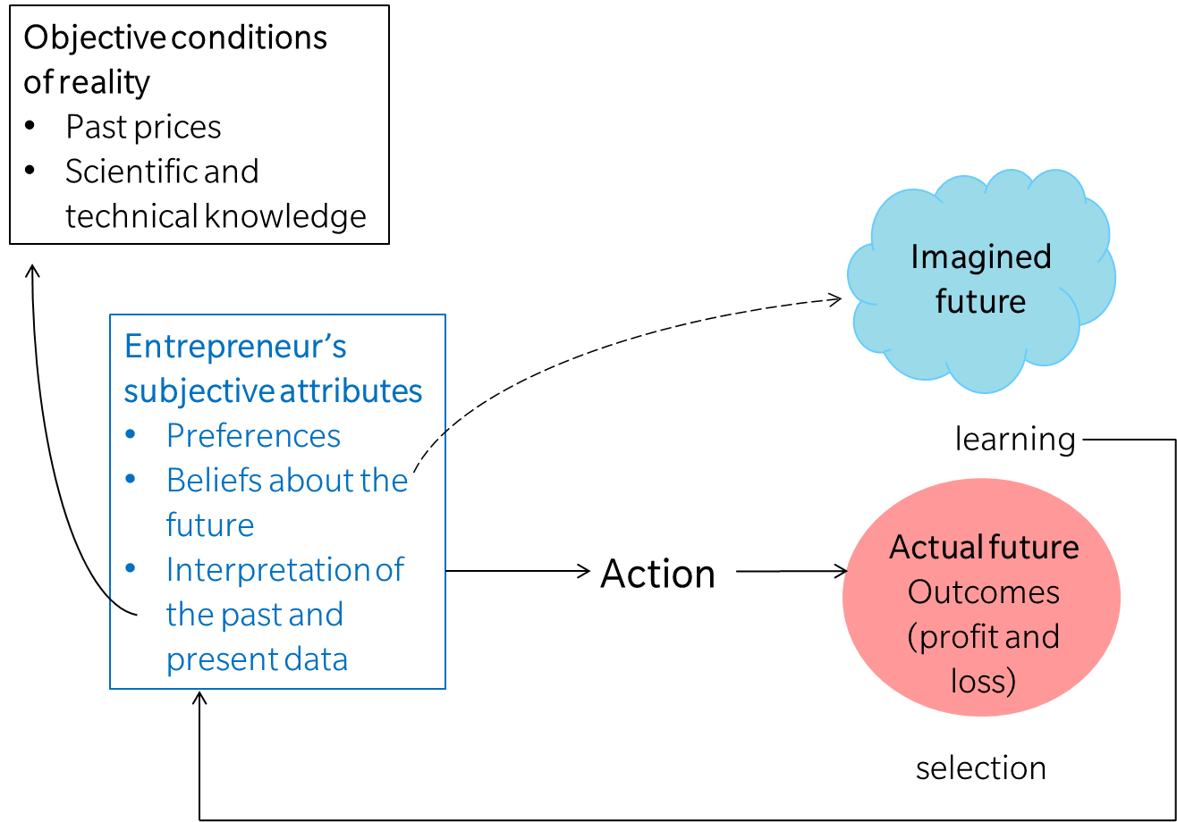


Slide 9
Building materials
Steel or titanium?
  Method 1
  1,000 tons steel
  500 hours labor
  Method 2
  800 tons titanium
  300 hours labor

Slide 10
Building materials
Steel or titanium?
  Method 1
  1,000 tons steel $50 per ton $50,000
  500 hours labor $20 per hour $10,000
  Total $60,000
  Method 2
  800 tons titanium $200 per ton $160,000
  300 hours labor $20 per hour $ 6,000
Total $166,000

Slide 11
Production method
Capital- or labor-intensive production?
  Method 1
  20 digging machines $1,000 each $20,000
  500 hours labor $20 per hour $10,000
  Total $30,000
  Method 2
  50 digging machines $1,000 each $50,000
  300 hours labor $20 per hour $ 6,000
  Total $56,000
Also
Estimating value of capital stock
How much to invest in particular capital goods
When to replace capital goods

Slide 12

Anticipating future prices
Production time
Consumer demand
Competitor reactions
Other conditions of the business or natural environment

Slide 13

How does all this work under central banking with fiat money?
Availability of cheap credit
Natural versus artificial interest rates
Changes in the value of money (nominal versus real prices)
Increases in relative price variability
Predicting what the monetary authority will do

Slide 14




Slide 15

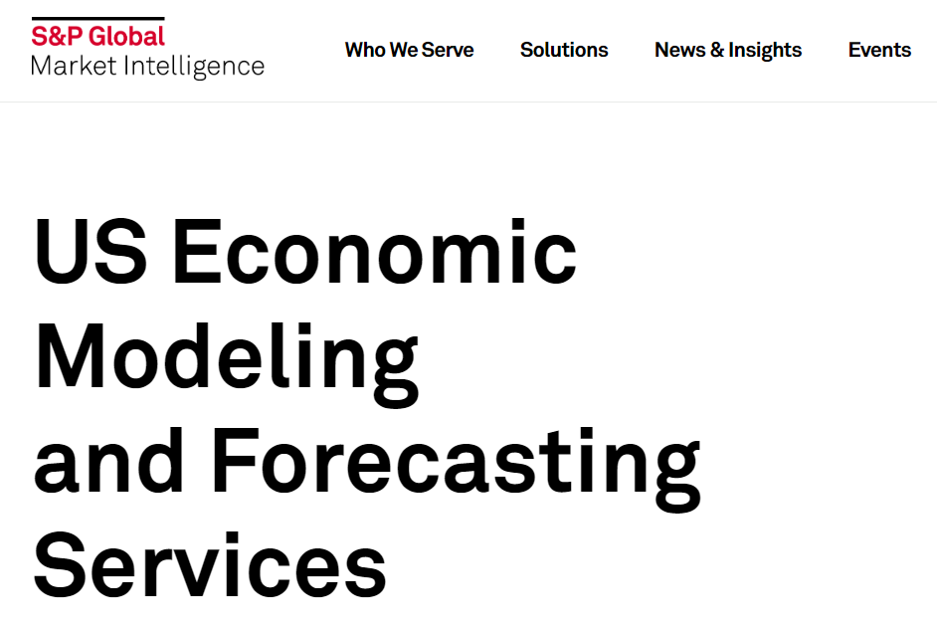




Slide 16
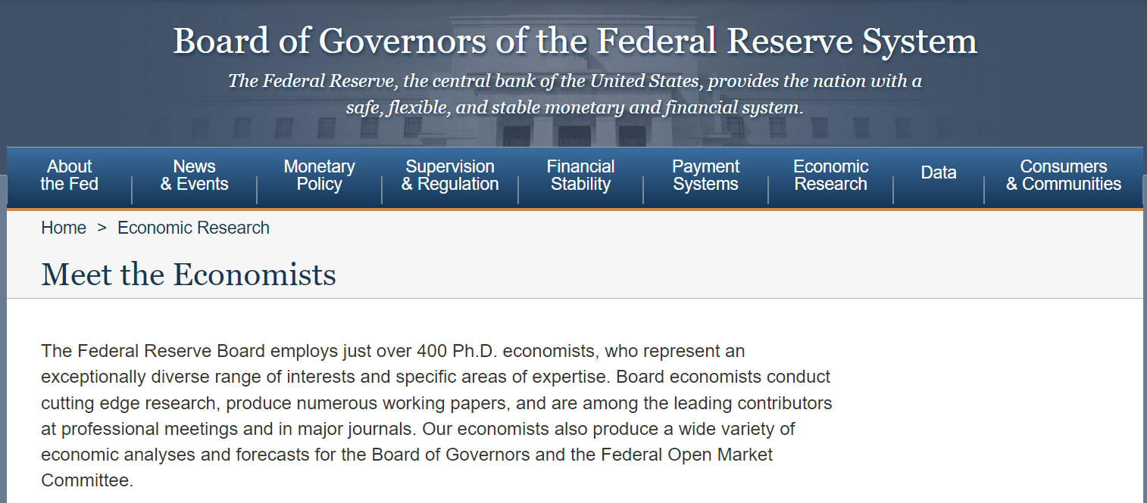

Slide 17
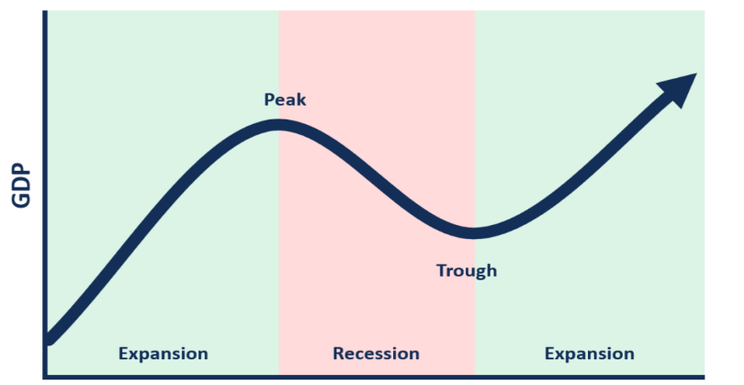

Effects of credit expansion
For the economy: creating the boom-bust cycle
  Malinvestment
For banks, firms, investors
  Artificially low interest rates + implicit
  government guarantees discourage lending
  to core customers and encourage investment
  in risker ventures.
  Low interest rates encourage entry by
  marginal entrepreneurs pursuing marginal
  projects.
  Even “good” entrepreneurs may take the money!

Slide 18

Zombie credit and zombie firms
High-quality entrepreneurs must devote resources to distinguishing themselves from low-quality entrepreneurs.
  Branding, marketing, high-end features
  Giving up decision rights to investors
Zombies bid up input prices, increasing the entrepreneur’s costs.
Presence (and inevitable failure) of zombies harms reputation of industries, technologies, sectors.

Slide 19
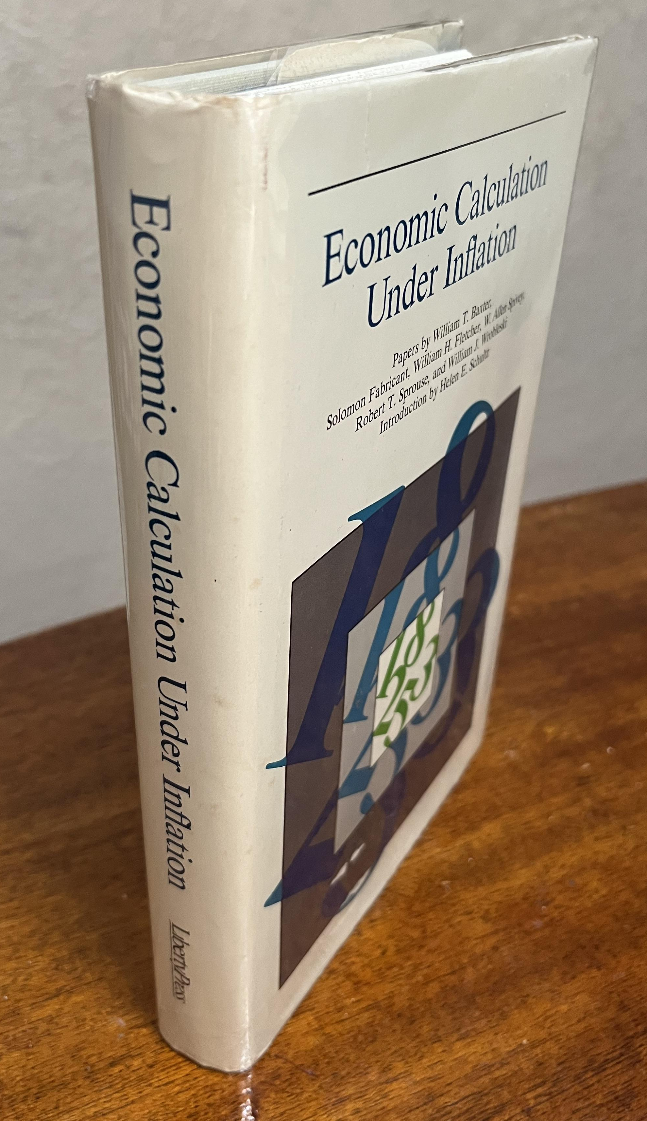
The entrepreneur’s problem
Accounting for changes in purchasing power over time in estimating future revenues, asset values, etc.
Anticipating other people’s expectations about future price changes (including factor suppliers)
The “signal-extraction” problem in interpreting changes in relative prices
Anticipating changes in import and export prices caused by monetary policy
Additional accounting, financial, and managerial complexities

Slide 20
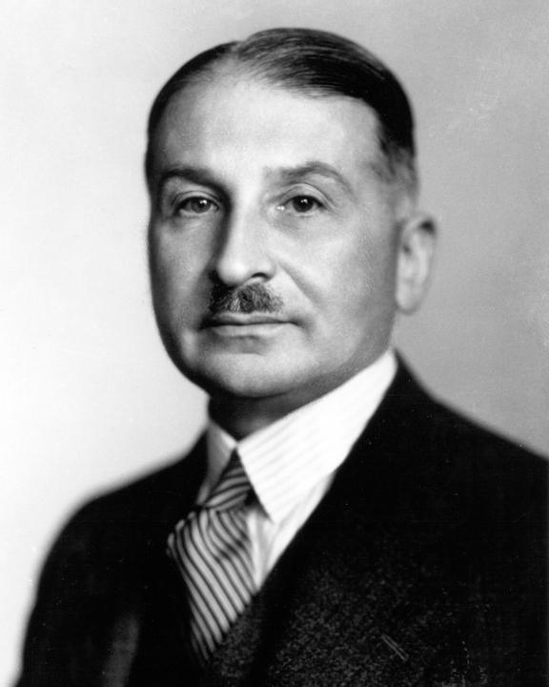
Does economic calculation require “stable” money?
Economic calculation does not require monetary stability in the sense in which this term
is used by the champions of the stabilization movement. . . What economic calculation
requires is a monetary system whose functioning is not sabotaged by government
interference.
For the sake of economic calculation all that is needed is to avoid great and abrupt fluctuations in the supply of money. Gold and, up to the middle of the nineteenth century, silver served very well all the purposes of economic calculation. Changes in the relation between the supply of and the demand for the precious metals and the resulting alterations in purchasing power went on so slowly that the entrepreneur's economic calculation could disregard them without going too far afield.
Precision is unattainable in economic calculation. . . . The planning businessman cannot help employing data concerning the unknown future; he deals with future prices and future costs of production. Accounting and bookkeeping in their endeavors to establish the result of past action are in the same position as far as they rely upon the estimation of fixed equipment, inventories, and receivables. In spite of all these uncertainties economic calculation can achieve its tasks.
— Mises, Human Action, chapter 12, section 5.

Slide 21

If the end of dollar hegemony means….
A monetary unit less subject to political control
Price changes that reflect changes in the value of commodity money, alone
Reduced scope for government intervention in the national and global economy
Fewer obstacles in the way of economic calculation by entrepreneurs
Then I say…

