Slide 1
Abundance, Generosity, and the State
Inquiry into Economic Principles
J.G. Hülsmann
13 October 2023
Mises Institute Supporter Summit

Slide 2
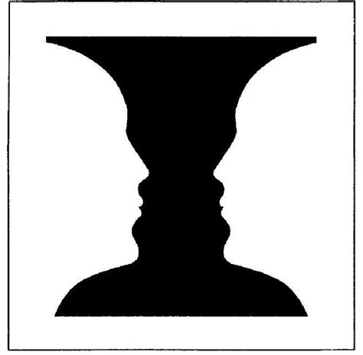
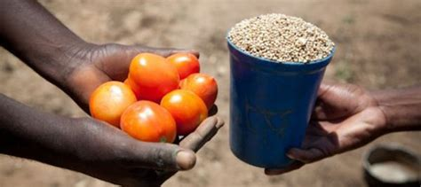
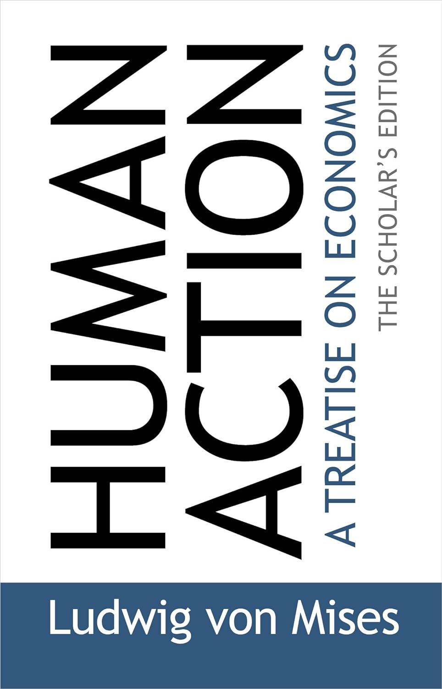
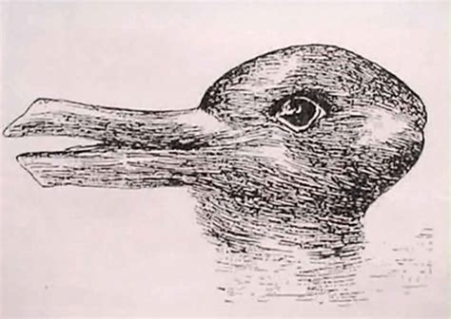

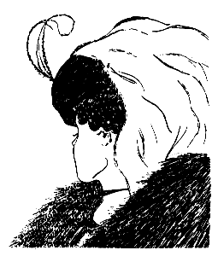

Slide 3
Benedict XVI, Caritas in Veritate (2009)
  “Charity in truth places man before the astonishing experience of gift. Gratuitousness is present in our lives in many different forms, which often go unrecognized because of a purely consumerist and utilitarian view of life.” (CV 34)
  “The great challenge before us […] is to demonstrate, in thinking and behaviour, not only that traditional principles of social ethics like transparency, honesty and responsibility cannot be ignored or attenuated, but also that in commercial relationships the principle of gratuitousness and the logic of gift as an expression of fraternity can and must find their place within normal economic activity.” (CV 36)

Slide 4
Reading from the Preface
Donations
  Gifts and other signs of devotion
  Donating as a category of human action
  Donations and the market economy
    Over-proportional growth and decline
    Inheritance
    Foundational virtues
Side-effect goods
  Side effects of leisure
  Cultural commons
  Ownership
  Examples
  Errors
  Technological progress
  Wealth effects of the pricing process
Interventionism and Gratuitous Goods
  Gifts by Fiat are False Gifts
  Impoverishing households
  Crowding out private welfare
  Fostering materialism
  Philanthro-cronyism
  Destruction of side-effect goods
Table of Contents
Preface & Introduction
PART ONE: THE NATURE OF GRATUITOUS GOODS
  1. Gratuitous Goods
  2. The Nature of Donations
  3. Motivations of Donations
  4. Reciprocations
PART TWO: GRATUITOUS GOODS IN A FREE ECONOMY
  5. The Economics of Donations
  6. Beneficial Side Effects of Human Action
  7. The Equivalence Postulate
  8. Natural Limits of Gratuitous Goods
PART THREE: GRATUITOUS GOODS AND THE STATE
  9. Interventionism
  10. The State as a Provider of Gratuitous Goods
  11. Haunted Donations
  12. Interventionism and Side-Effect Goods
Epilogue

Slide 5
Abundance, Generosity, and the State
Inquiry into Economic Principles
J.G. Hülsmann
13 October 2023
Mises Institute Supporter Summit

