Slide 1
Why This Time the
Dollar Faltered Has Been Different from the Last time
Supporters Summit
Mises Institute
October 12-14, 2023

Slide 2
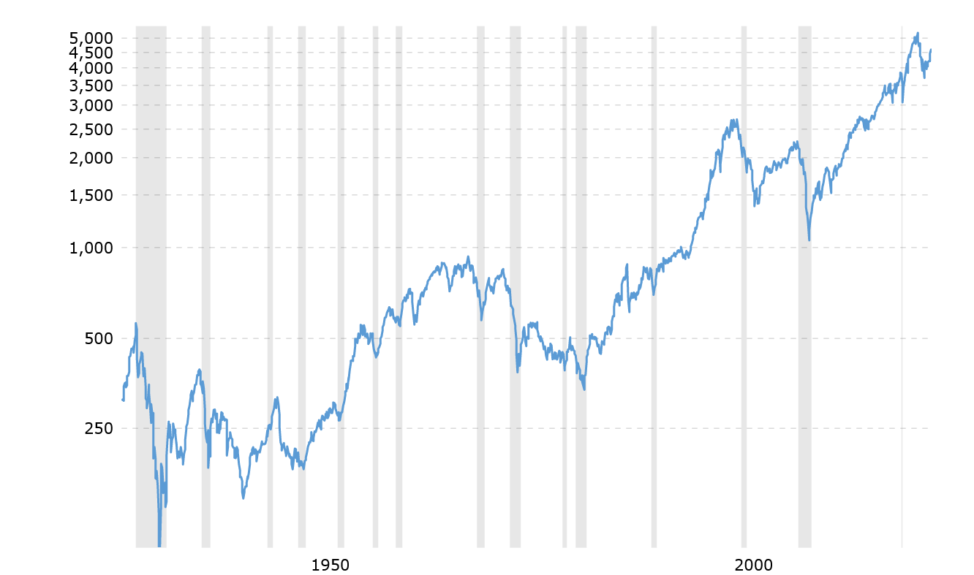
Real S&P 500 Index
Dec. ‘21
Aug. ‘00
Feb. ‘09
Jan. ‘66
June ‘82
June ‘49

Slide 3
Real S&P 500, Real Private Product Remaining
(annualized rate of change)

Slide 4
Real S&P 500, Real PPR, Consumer Price Index
(annualized rate of change)

Slide 5
Real S&P 500, Real PPR, CPI, True Money Supply
(annualized rate of change)

Slide 6
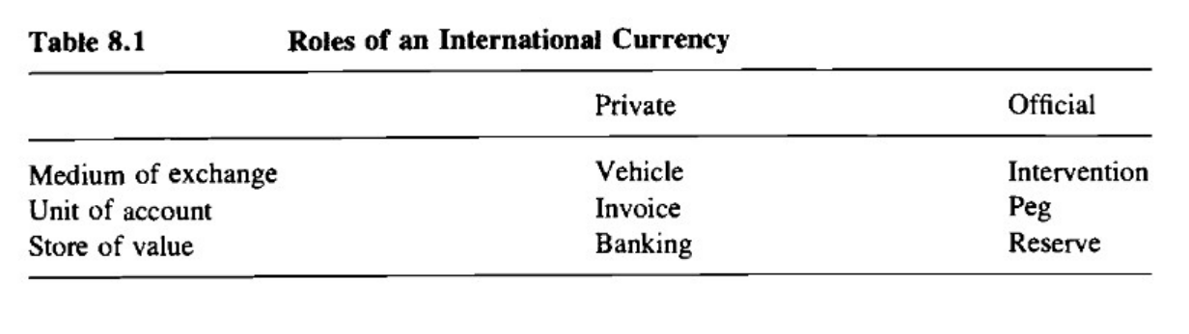
Paul Krugman, “The International Role of the Dollar: Theory and Prospect,” 1984
“The future of the United States monetary system is largely a political question; the future international role of the dollar is largely an economic one.”

Slide 7
Paul Krugman, “The International Role of the Dollar: Theory and Prospect,” 1984
Roles of an International Currency
Private Official
Medium of Exchange Vehicle Intervention
Unit of Account Invoice Peg
Store of Value Banking Reserve

Slide 8
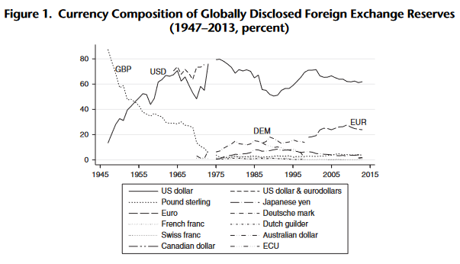
Barry Eichengreen, et al., “Stability or Upheaval? The Currency Composition of International Reserves in the Long Run,” (2014)

Slide 9
Currency Composition of Foreign Exchange Reserves
(percent)

Slide 10
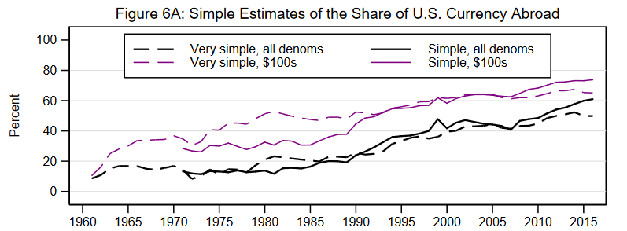
Ruth Judson, “The Death of Cash? Not So Fast: Demand for U.S. Currency at Home and Abroad, 1960-2016”

Slide 11
Foreign Holdings of U.S. Dollar Banknotes
(percent)

Slide 12
Foreign Exchange Turnover by Currency
(percent)

Slide 13
Share of Export Invoicing, 1999-2019
(average annual percentage)

Slide 14
Share of International and Foreign Currency Banking Claims, 1999-2020

Slide 15
Share of International and Foreign Currency Banking Liabilities, 1999-2020

Slide 16
Share of Foreign Exchange Debt Issuance, 1999-2021

