Slide 1
Austrian Capital Theory
Mises University
Auburn, Alabama

Slide 2
Relevant Literature
  Carl Menger, Principles of Economics
  Eugen von Böhm-Bawerk, Positive Theory of Capital
  Ludwig von Mises, Human Action
  F. A. Hayek, Prices and Production
  Murray Rothbard, Man, Economy, and State
  Roger W. Garrison, Time and Money
  Jesus Huerta de Soto, Money, Bank Credit, and Economic Cycles.

Slide 3
Capital Defined
Capital: The sum of the whole complex of goods destined for acquisition evaluated in money terms
The starting point of economic calculation.
Mises: “There is no such thing as an abstract or ideal 'capital that exists apart from concrete capital goods . . . capital is always embodied in definite capital goods and is affected by everything that happens with regard to them. The value of an amount of capital is a derivative of the value of the capital goods in which it is embodied” (Human Action, p. 500).

Slide 4
Capital Goods and Capital
Capital value of enterprise = sum of monetary value of assets minus its liabilities.
CVA= Sum of DMRPs over the course of the duration of serviceability of the capital good.
DMRP is MRP of capital good discounted by interest rate for a period of time.
MRP is MPP of capital good times anticipated P of the product.

Slide 5
Capital Goods and Capital
So capital value is affected by:
Productivity of the capital good.
Price of the product being produced.
Rate of time preference.
Duration of serviceability.

Slide 6
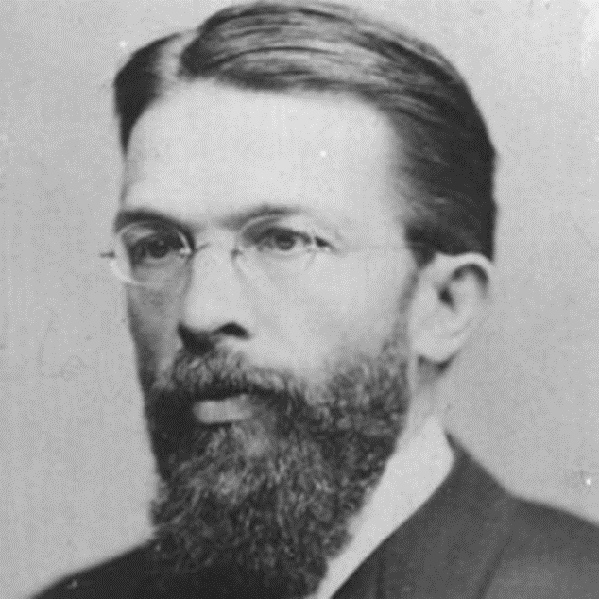
Interrelationship of Economic Goods
Consumer goods.
  Directly serviceable
  Goods of 1st order.
Higher order goods.
  Producer goods
  Indirectly serviceable.

Slide 7
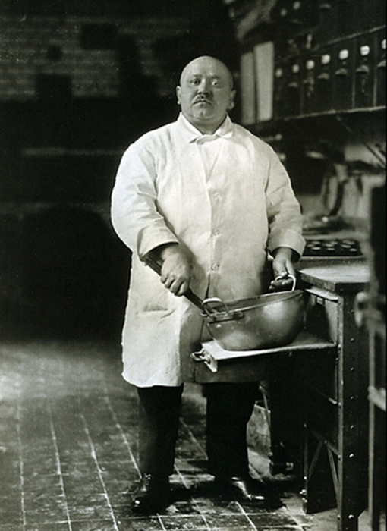
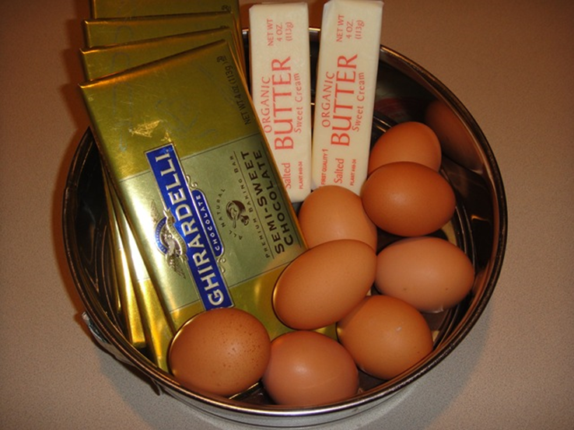


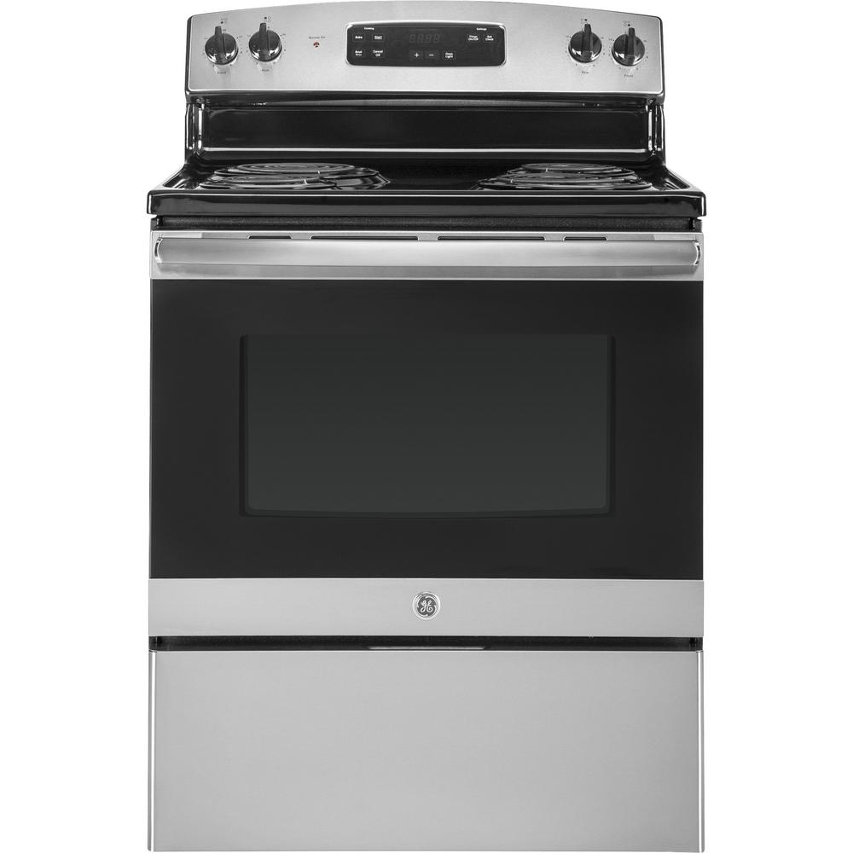

Structure of Production

Slide 8
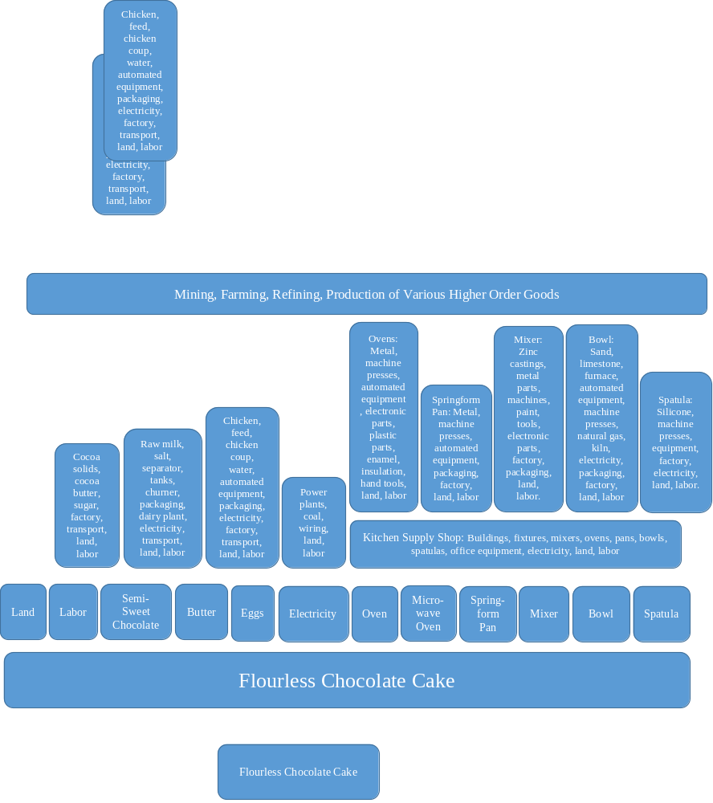

Slide 9
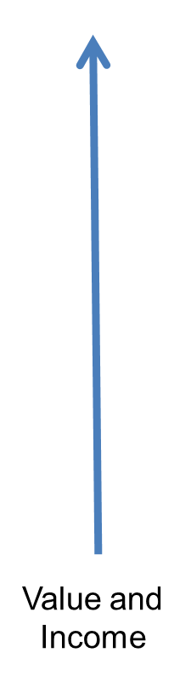
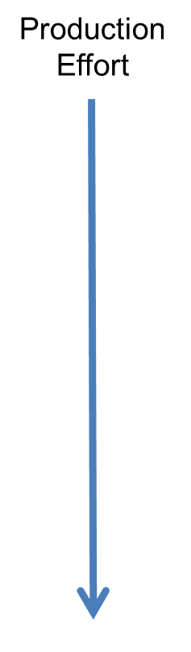

Slide 10

Benefits of Capital Goods
Using capital goods requires longer production processes
Ping Pong Table
Standing Mixer
  Saving: Restriction of consumption
  Investment: Transfer of resources to accumulation of capital goods

Slide 11

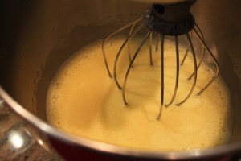
Benefits of Capital Goods
Increases productivity in two ways:
Increased productivity in tasks we can do without capital goods.
VS.

Slide 12
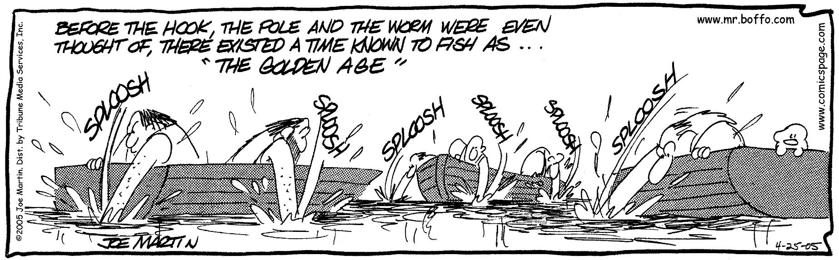
Benefits of Capital Goods
Increases productivity in two ways:
  Allows people to produce goods they otherwise could not obtain at all.
Advances people in time toward their objective in producing consumer good.

Slide 13
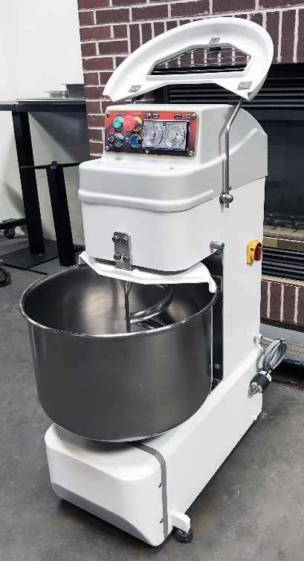



Choices about Capital Goods
VS.
VS.
VS.
VS.
More or less capital-intensive process

Slide 14

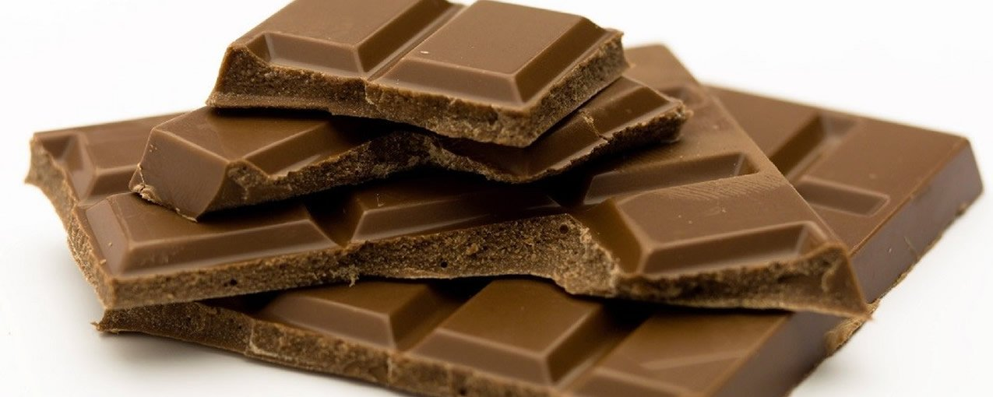

Choices about Capital Goods
VS.
VS.
Degree of specificity

Slide 15


Choices about Capital Goods
VS.
More or less durable

Slide 16
Capital Structure
Modern Macro vs. Austrian Economics
Modern Macro
Keynesian: Y = C + I + G + NX
Neo-classical: Y_{t} = A_{t}F(K_{t} L_{t},)
Homogenous Aggregates
Austrian
Concentric Circles: Böhm-Bawerk
Hayekian Triangle: Hayek, Rothbard, Garrison, Huerta de Soto
Vast interrelated, very complex structure of multi-stage production

Slide 17
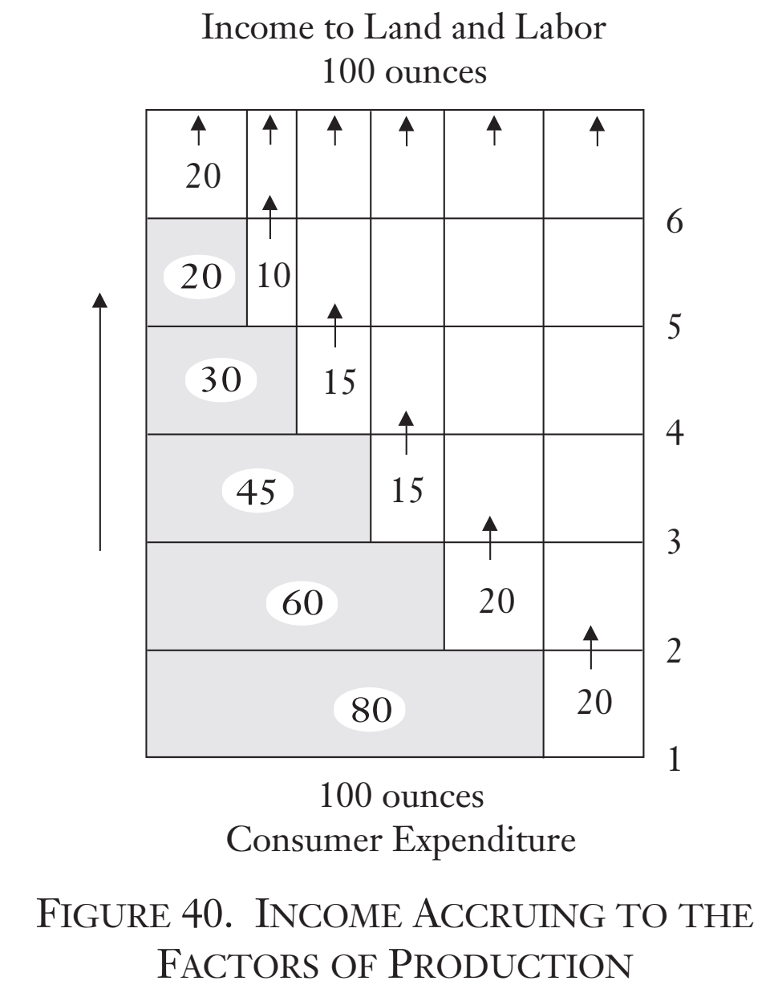
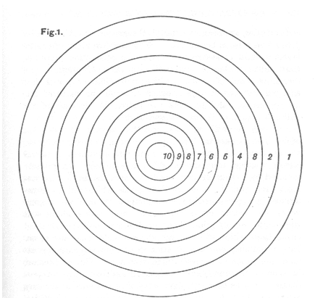
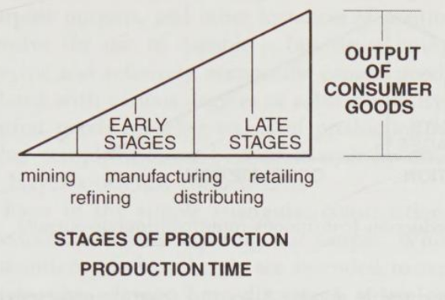
Capital Structure

Slide 18
Capital Structure
Production heavily weighted to production of capital goods.
Capitalist is laborers’ benefactor
The economic order is extremely complex

Slide 19
Calculation and Capital Allocation
Horizontally via profit and loss calculations
Inter-temporally via comparisons of rate of return and interest rate
Structure is flexible and can be changed
Stages | Rate of Return
Steel | 6%
Bolt | 5%
Mixer | 4%
Dessert Shop | 5%

