Slide 1
Why Murray Rothbard is a Great Economist
Dr. Patrick Newman

Slide 2
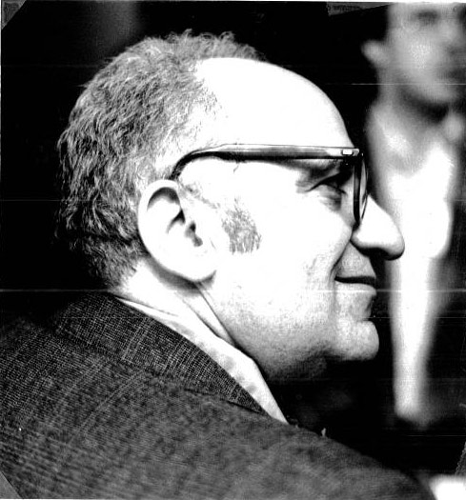
What’s this presentation about, and why should I care?
Brief biography of Rothbard and his important works
  Surveys some of his contributions to economics
  Explain why Rothbard is one of the greatest economists of all time

Slide 3
Murray Rothbard (1926-1995)
Graduated from Columbia University in 1945, PhD in 1956
  The Panic of 1819
Worked for The William F. Volker Fund and affiliate research organizations, 1950-1966
  Man, Economy, and State, America’s Great Depression, Conceived in Liberty
  Published in American Economic Review and Quarterly Journal of Economics

Slide 4
Murray Rothbard (1926-1995)
Economics Professor at the Brooklyn Polytechnic Institute, 1967-1986
  Spearheaded the Austrian Revival at South Royalton
  For a New Liberty, The Ethics of Liberty, The Progressive Era, The Mystery of Banking

Slide 5
Murray Rothbard (1926-1995)
  S.J. Hall Distinguished Professor of Economics at the University of Nevada Las Vegas, 1986-1995
  Academic vice president of the Ludwig von Mises Institute and editor of The Review of Austrian Economics
  An Austrian Perspective on the History of Economic Thought, The Case Against the Fed

Slide 6
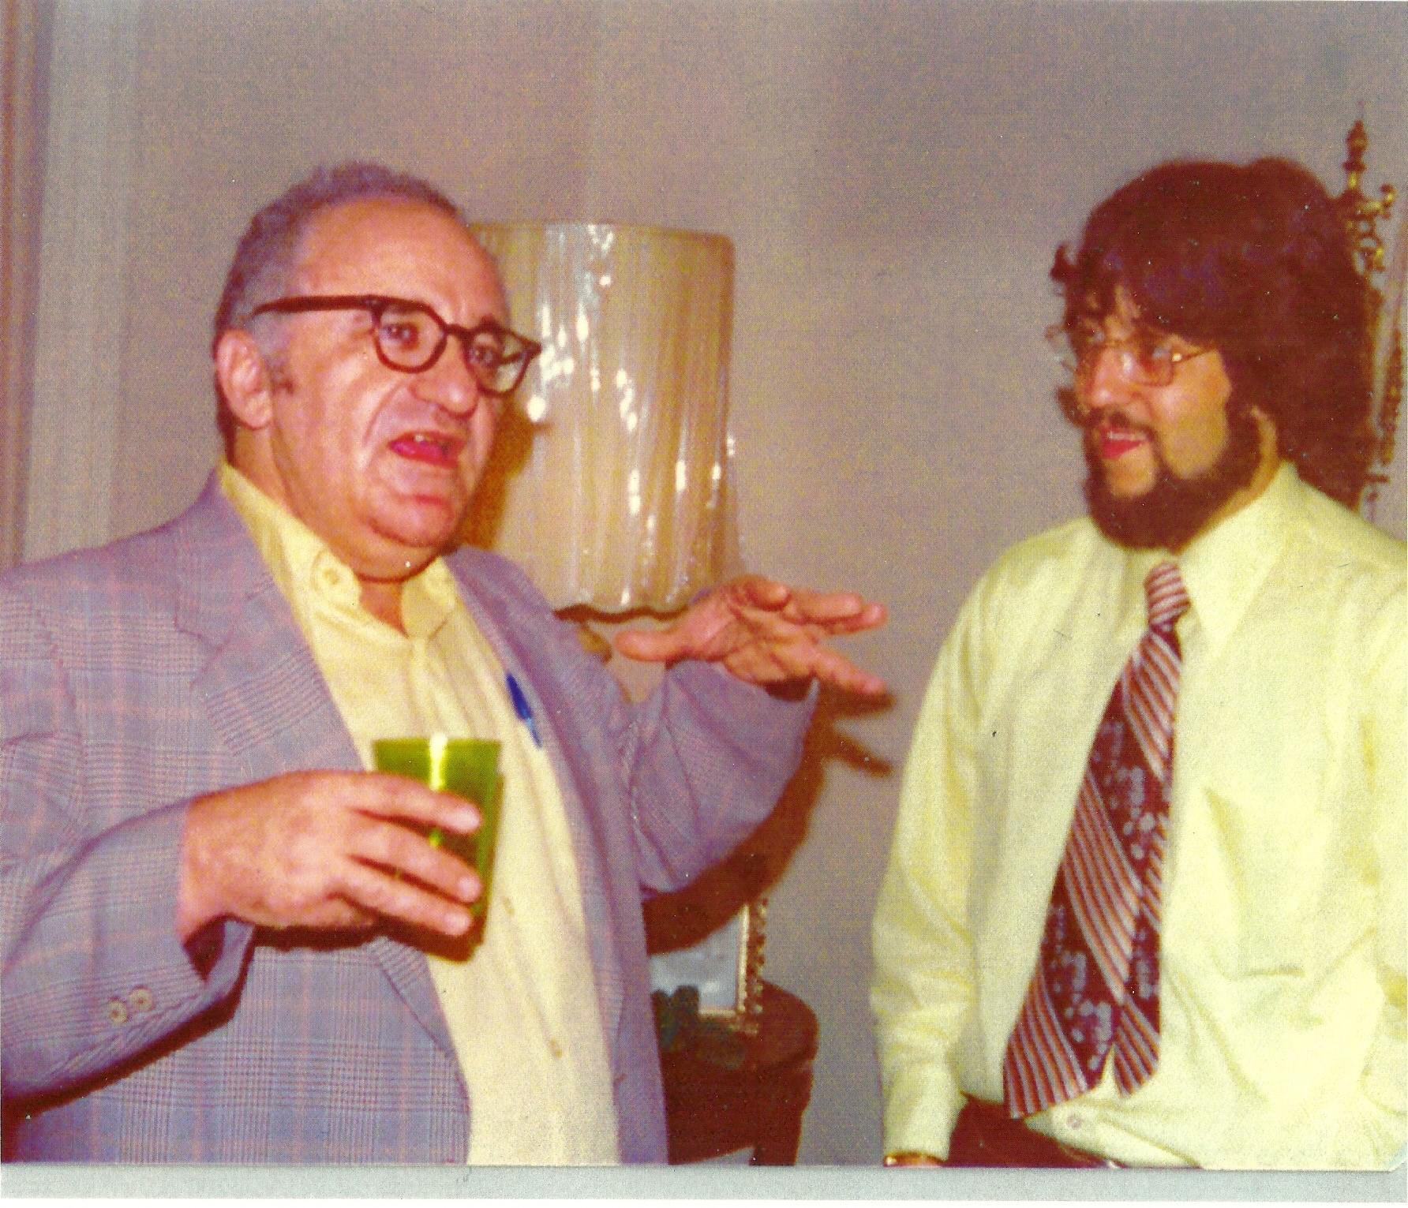
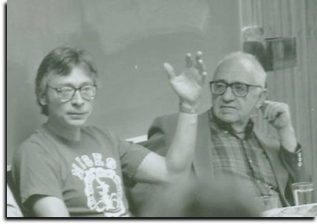
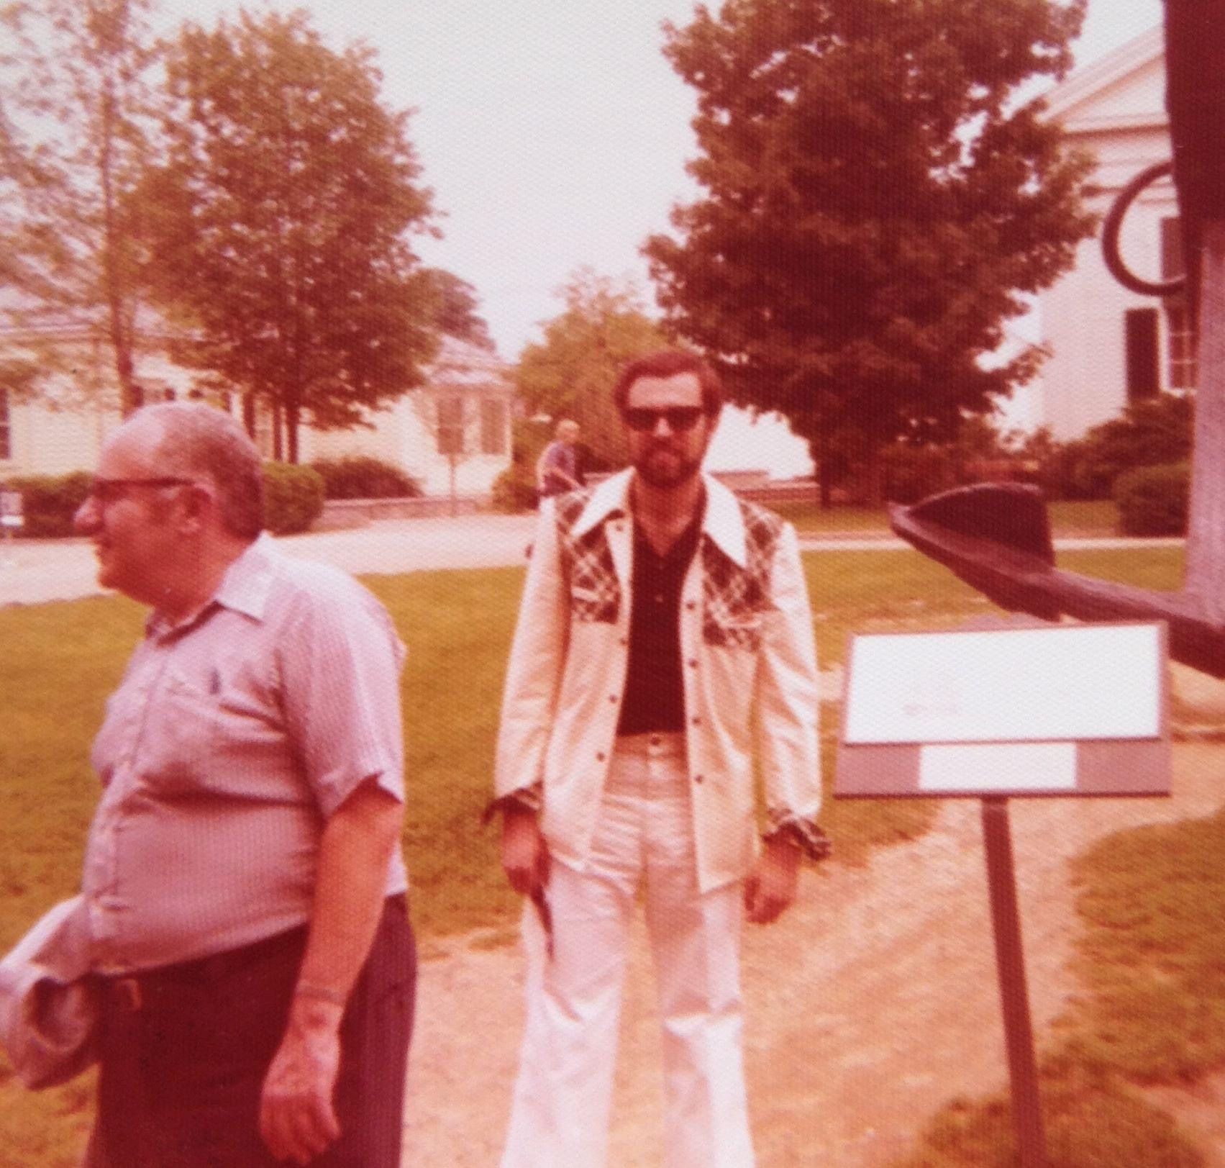
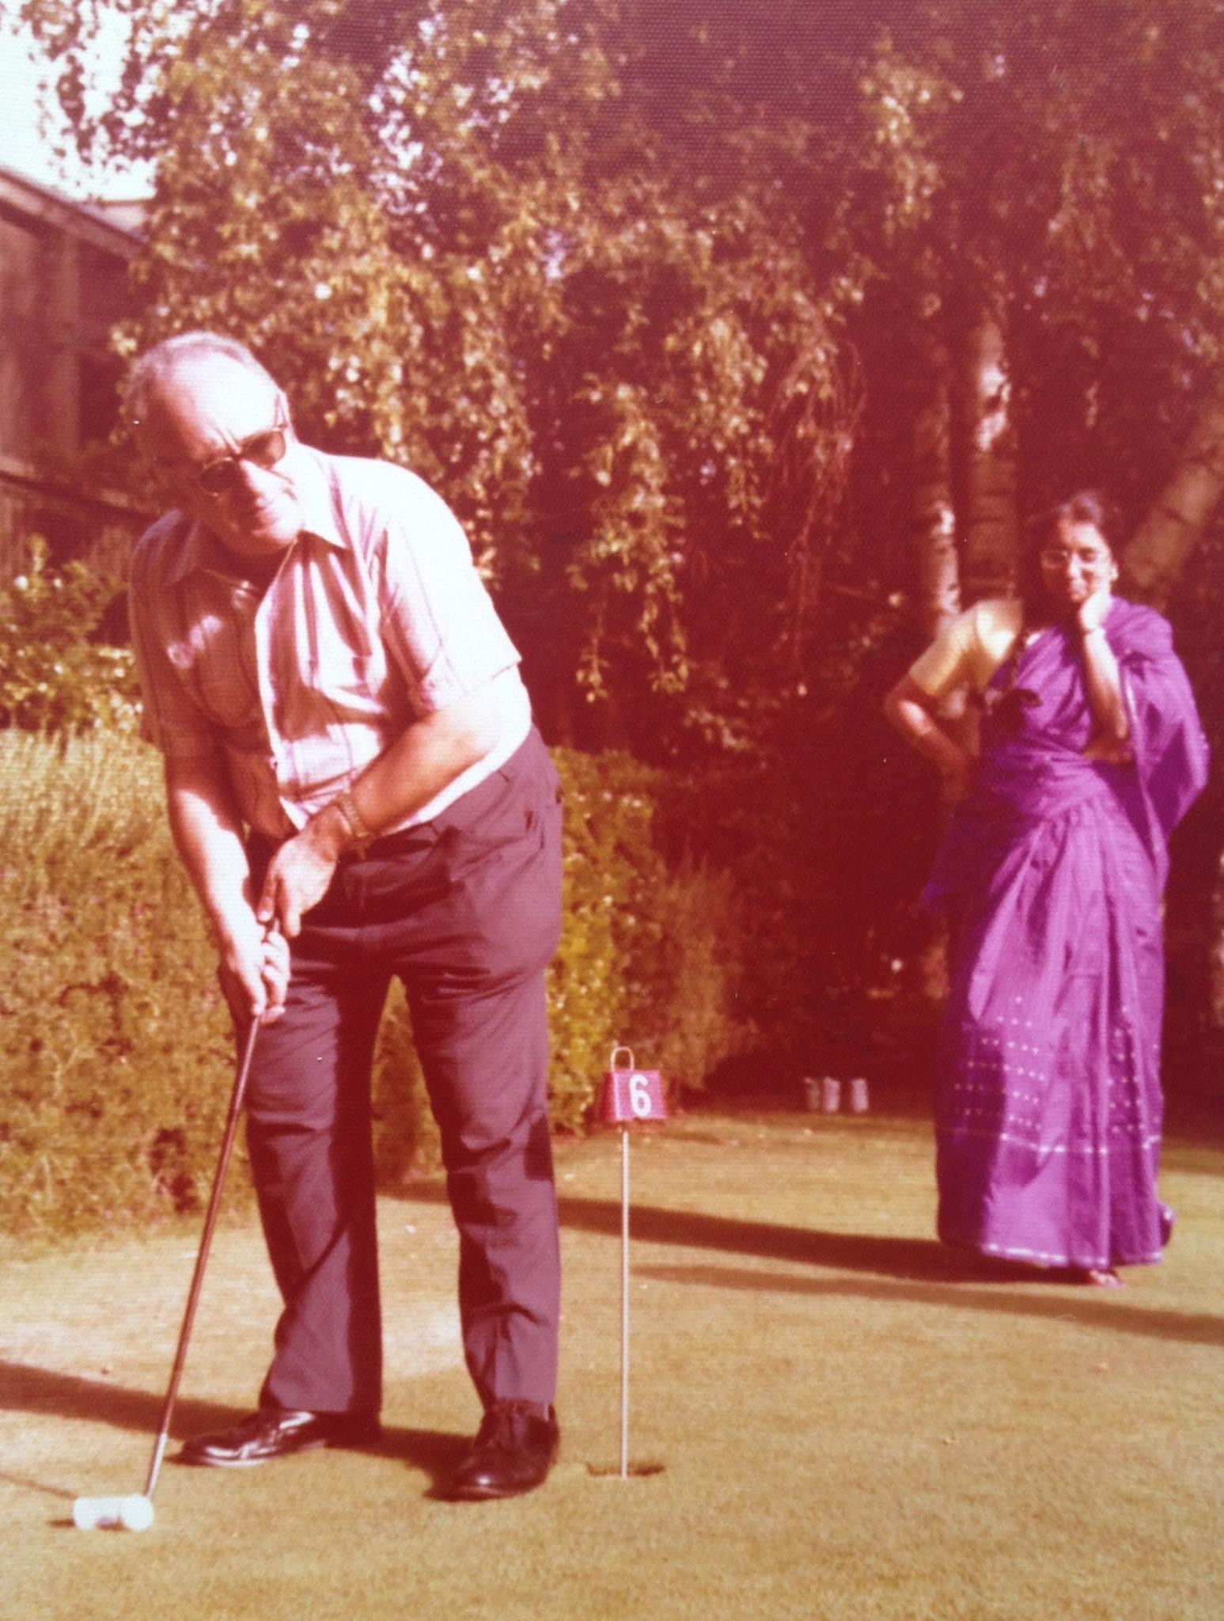
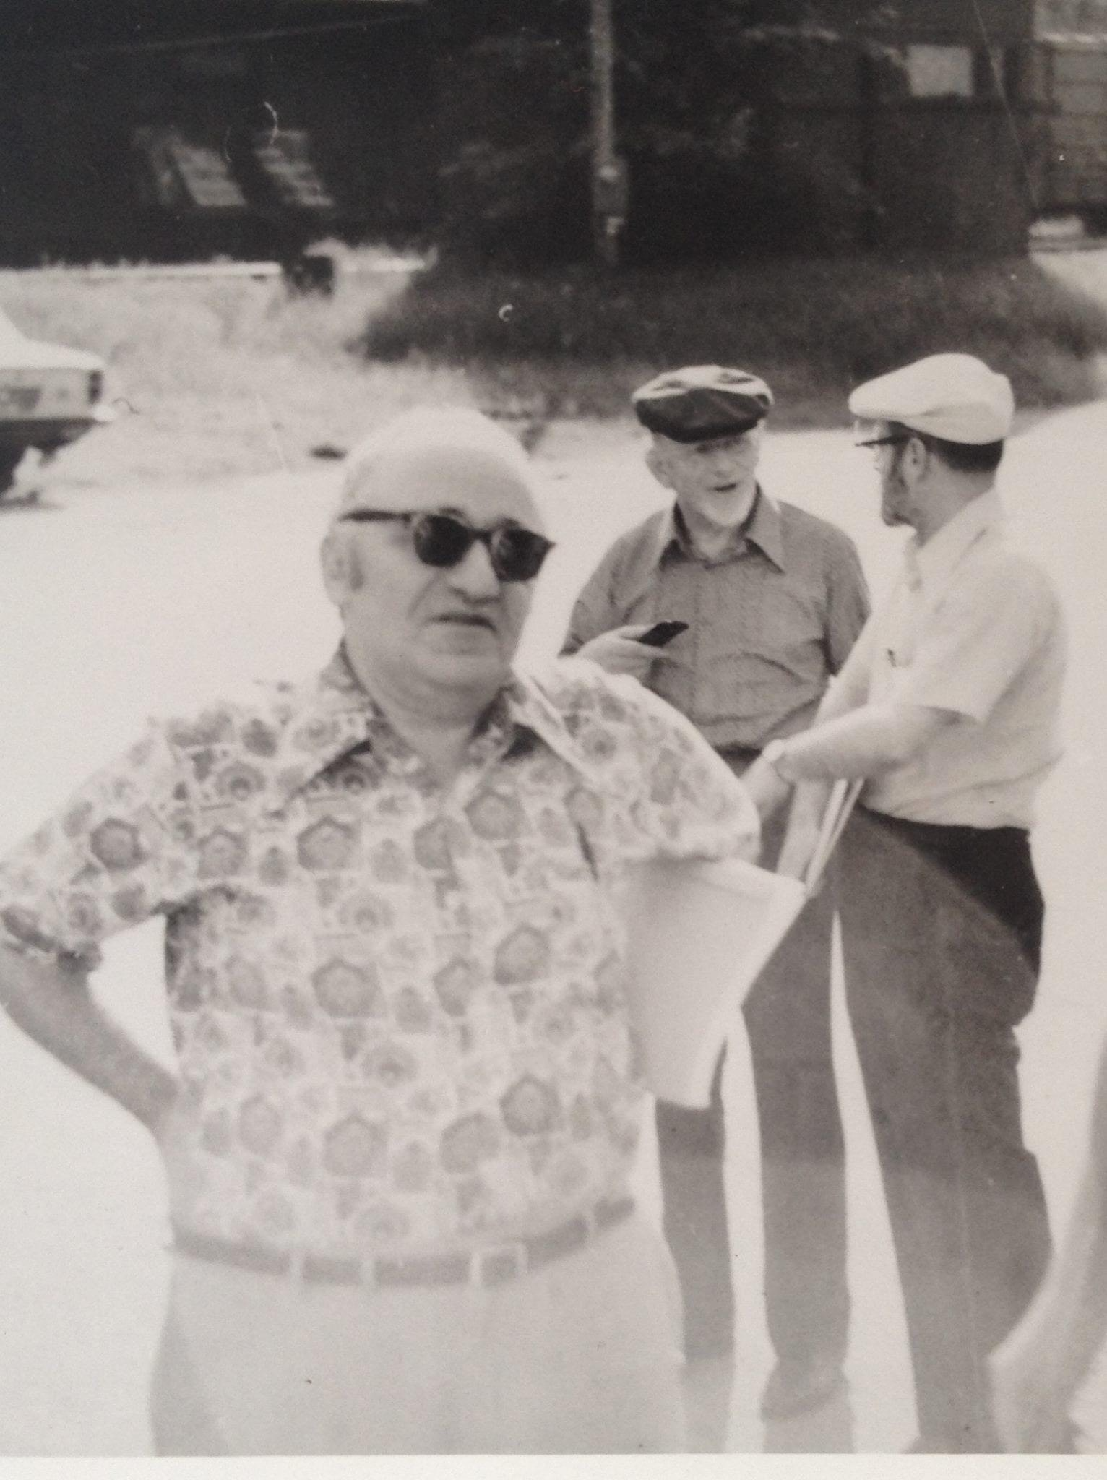
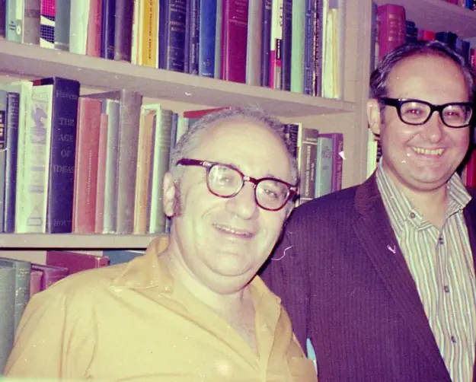
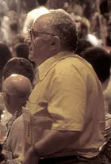
Rare photos of Rothbard

Slide 7
What are some of his (many) contributions?
Let’s sample his economics writings
Man, Economy, and State, Volumes I-III
  A towering treatise on Austrian economics
  Clarifies, refines, and advances the Misesian paradigm

Slide 8
Man, Economy, and State
Shows how the Law of Diminishing Marginal Utility leads to a downward sloping demand curve
  Implicit in Mises
Explains how equilibrium prices are reached in a world of uncertainty and speculative adjustment
  Step-by-step equilibration

Slide 9
Man, Economy, and State
Synthesizes the Mises-Fetter pure time preference theory of interest with the Wicksell-Hayek structure of production analysis
  Reunites these separated strands of Böhm-Bawerk

Slide 10
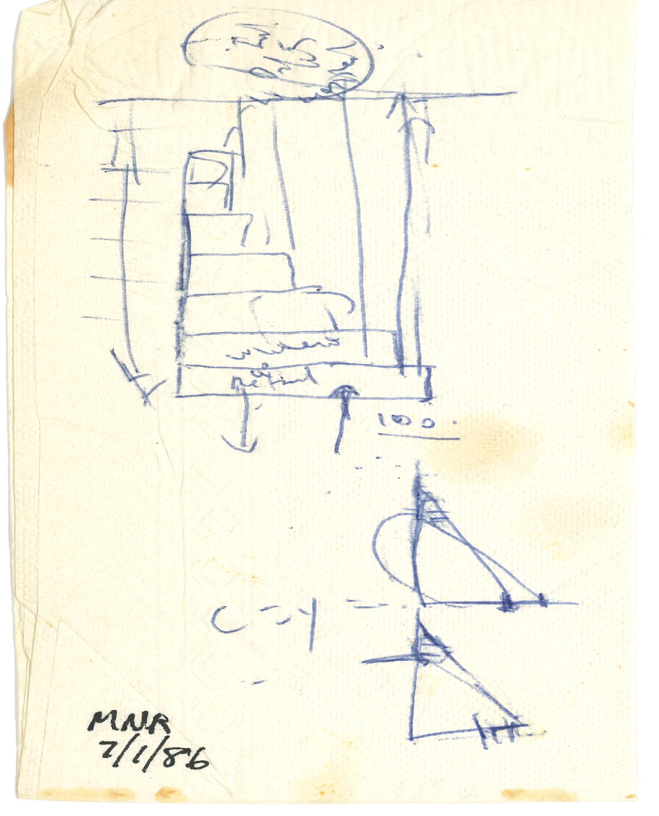
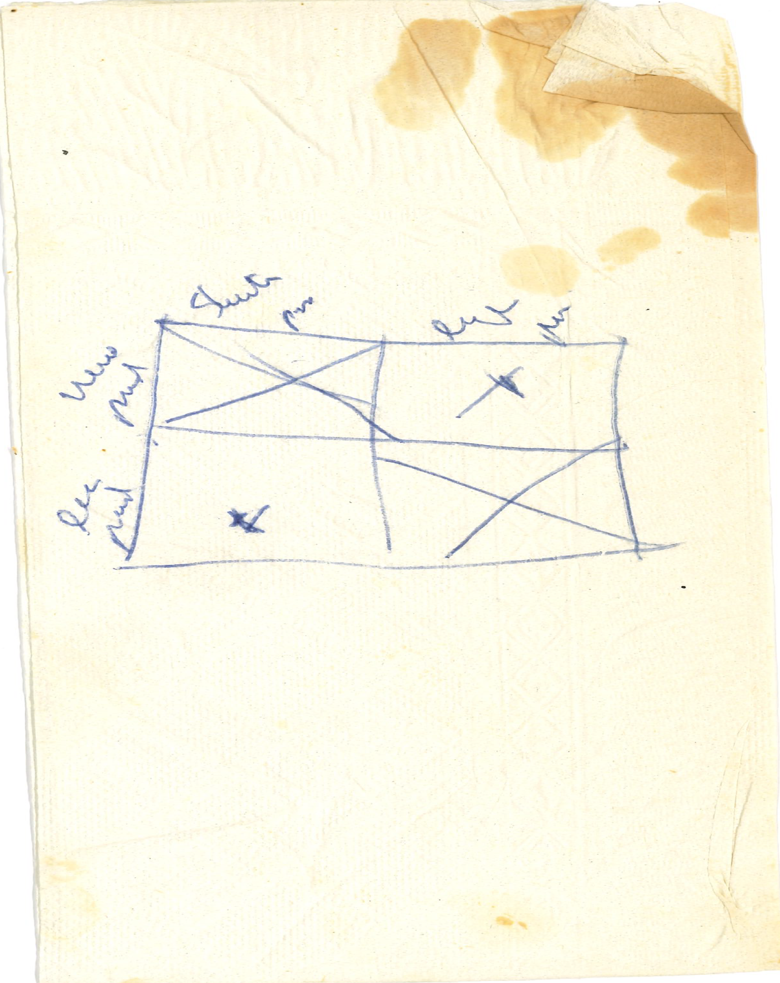
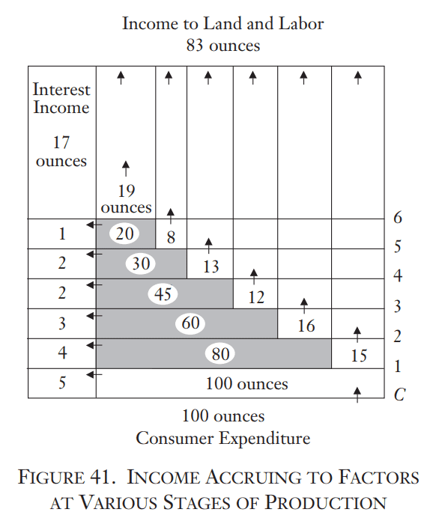

The Rothbard Napkin
Shorter processes
Longer processes
More productive
Less productive

Slide 11
Economic Controversies
A collection of essays published on method, history of thought, private property, taxation, and money
Gene Epstein: “Economic Controversies is probably the better way in. Man, Economy, and State can come a bit later.”

Slide 12
“Austrian Definitions of the Supply of Money”
What counts as a money substitute? That determines the proper definition of the money supply
Chicago School: whatever best correlates with nominal GDP
  Explanation versus prediction!
  Rothbard argues that savings deposits are economically identical to demand deposits
    Redeemable at par, can be converted into demand deposits

Slide 13
The Mystery of Banking
Rothbard’s sole textbook
Great introduction to monetary theory, the basics of banking, and the history of money and banking
  Outline for teaching a money and banking course

Slide 14
The Mystery of Banking and cronyism
Rothbard was a master historian in the Misesian tradition
Who benefits from monetary intervention? More specifically, which people benefited?
  Power elite analysis names names!

Slide 15
Take Mises’ word
April 5, 1956 to James Kennedy: “Rothbard is an extraordinarily talented young man, a keen thinker and an indefatigable worker. . . . I am fully convinced that he will one day be counted among the foremost economists. . . . I fully endorse what he says about these matters and I want merely to add that in my opinion nobody is better qualified to perform this job than Rothbard.”

Slide 16
Mises’ review of Man, Economy, and State
“Rothbard’s work [is] an epochal contribution to the general science of human action, praxeology, and its practically most important and up-to-now best elaborated part, economics. Henceforth all essential studies in these branches of knowledge will have to take full account of the theories and criticisms expounded by Dr. Rothbard.”

Slide 17
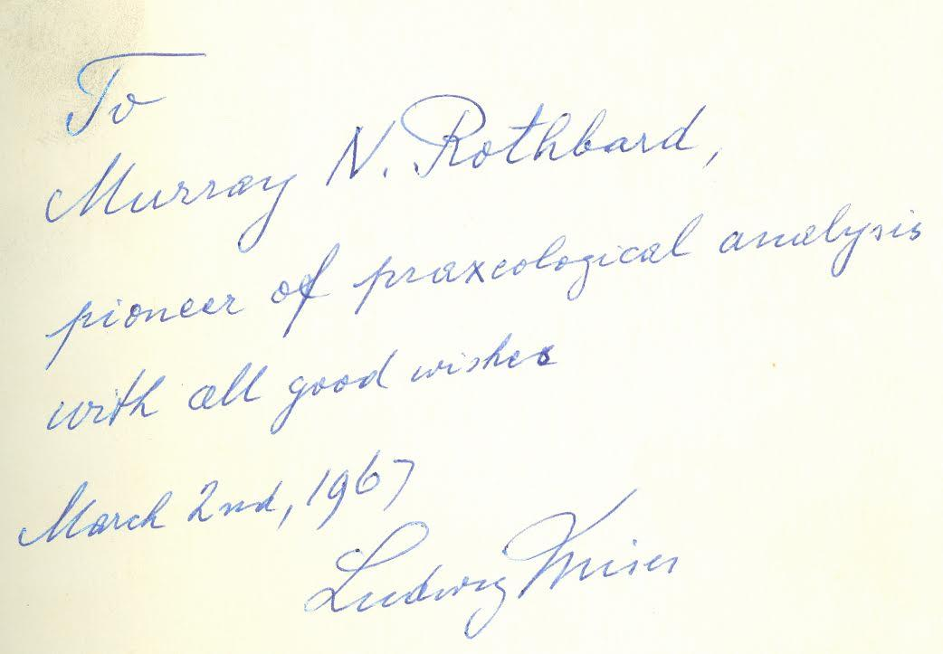
Is Rothbard a great economist?
12/6/62 to Louis Rougier “The proof of the cake is in the eating. I can only refer to the systematic exposition of the whole doctrine of praxeology in my book Human Action and nowadays in the brilliant book of a younger man, Murray N. Rothbard, Man, Economy, and State.”

Slide 18
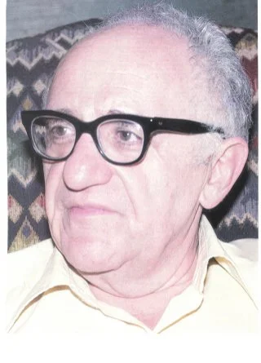
Conclusion
Rothbard is a great economist (period)
  Mises
  Rothbard
For more on Rothbard, read:
  David Gordon, The Essential Rothbard (2007)
  Joseph Salerno and Matt McCaffrey, The Rothbard Reader (2016)
  Joseph Salerno and Patrick Newman, The Making of a Misesian Economist (forthcoming)

