Slide 1
Cronyism in America
2022 Mises University
Dr. Patrick Newman

Slide 2
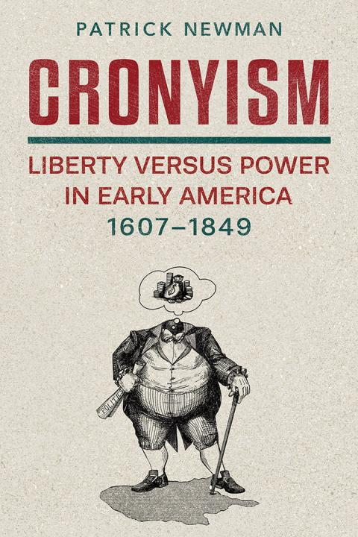
What’s this presentation about, and why should I care?
A case study from my book
  Understanding the past allows us to better understand the present
    Figure out patterns of cronyism
What is cronyism?
  Policies that benefit special interests at the public’s expense

Slide 3
Okay, but you still didn’t answer my question. What’s the case study on?
We live in a world of constant cronyism. Nothing seems to change, no matter the party or the people in power
Was it always like this? Is there any example we can find of cronyism going away? Can we learn from it
Yes. The story of Andrew Jackson and the Jacksonians’ fight against the Second Bank of the United States
  Reform through the executive

Slide 4
Let’s take it from the top
After the War of 1812, National Republicans in Congress establish the old Federalist program, which includes a central bank (1816)
The Second Bank of the United States special privileges:
  Twenty-year monopoly charter
  Treasury deposits money
  Government one-fifth ownership

Slide 5
The Era of Corruption (1817-1829)
  Intense corruption: directors illegally loan money to themselves without collateral. They bribe the bank president
  Very inflationary: the central bank expands its deposits by 57%, total money supply rises 25%
    Causes an unsustainable boom in farm improvements, land speculation, buildings, turnpikes, ships, slaves, and steamboats

Slide 6
The good times can’t last forever
Late 1818 the central bank suffers a gold outflow
  Adverse clearing mechanism!
It contracts credit, leading to the Panic of 1819
  People perceived a serious depression because prices collapsed 31%. But it was very mild
    1819-1824 nominal GDP per person declined 10%, real GDP per person increased 8%. Laissez faire!
    Regardless, the people were mad

Slide 7
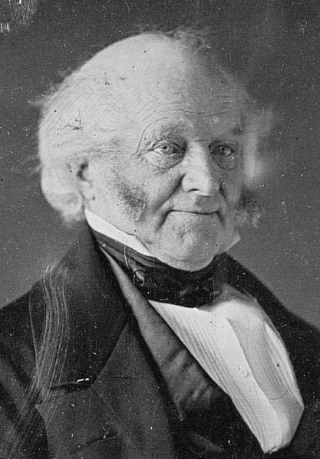
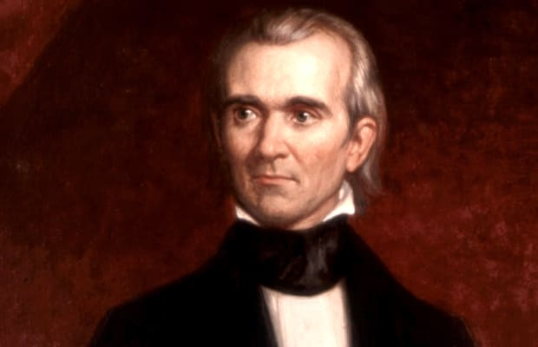
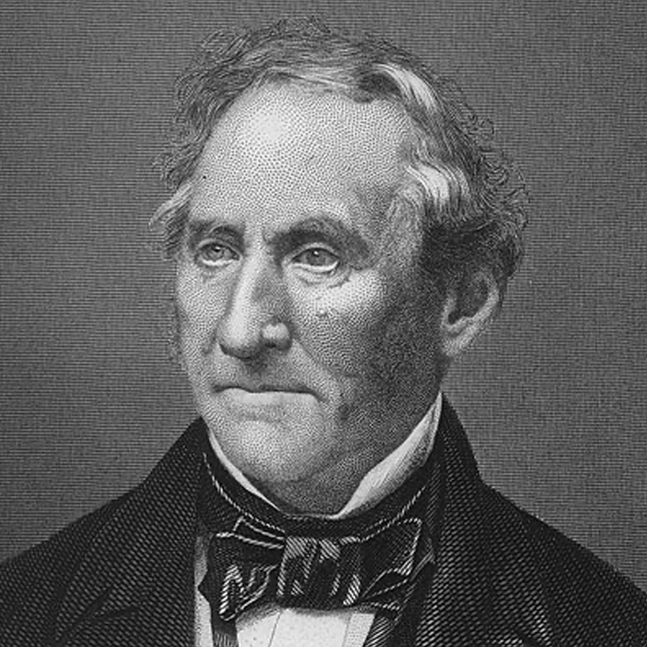
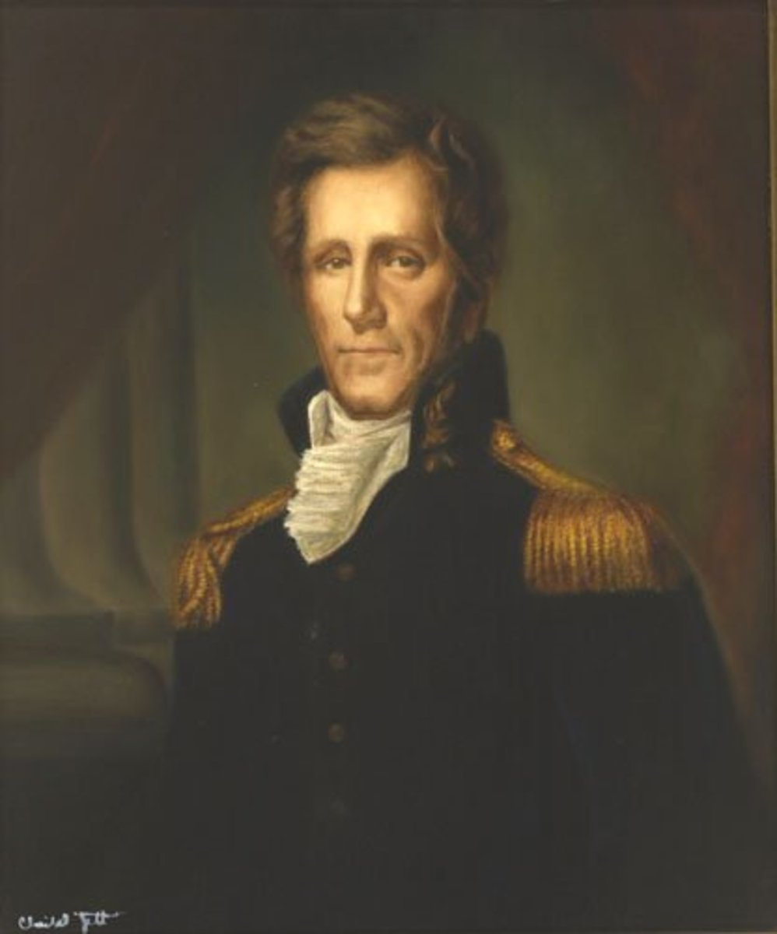
The Jacksonians: America’s unheralded libertarians
Post panic an increase in hard-money thought, influenced by newly translated European economists
  Jean-Baptiste Say’s book becomes a mainstream college textbook (imagine that!)
Politicians attack the central bank’s monopoly privileges

Slide 8
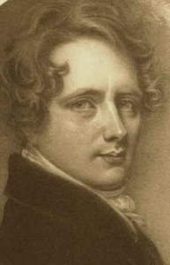
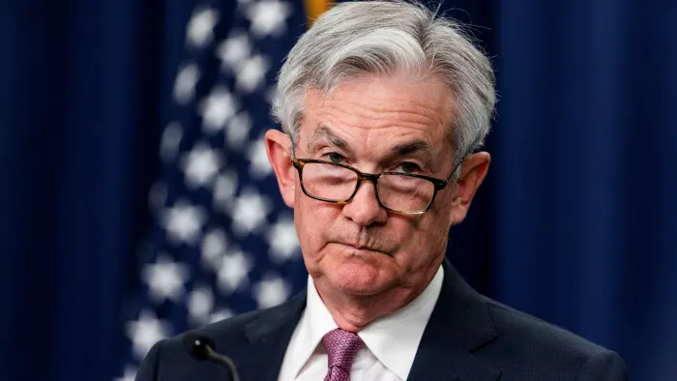
But the central bank has powerful friends
Recruited Hamiltonian intellectuals. Loaned money to periodicals in return for their support
  E.g. The National Intelligencer (The New York Times of the day)
New bank president Nicholas Biddle
  Wanted to nationalize the country’s money

Slide 9
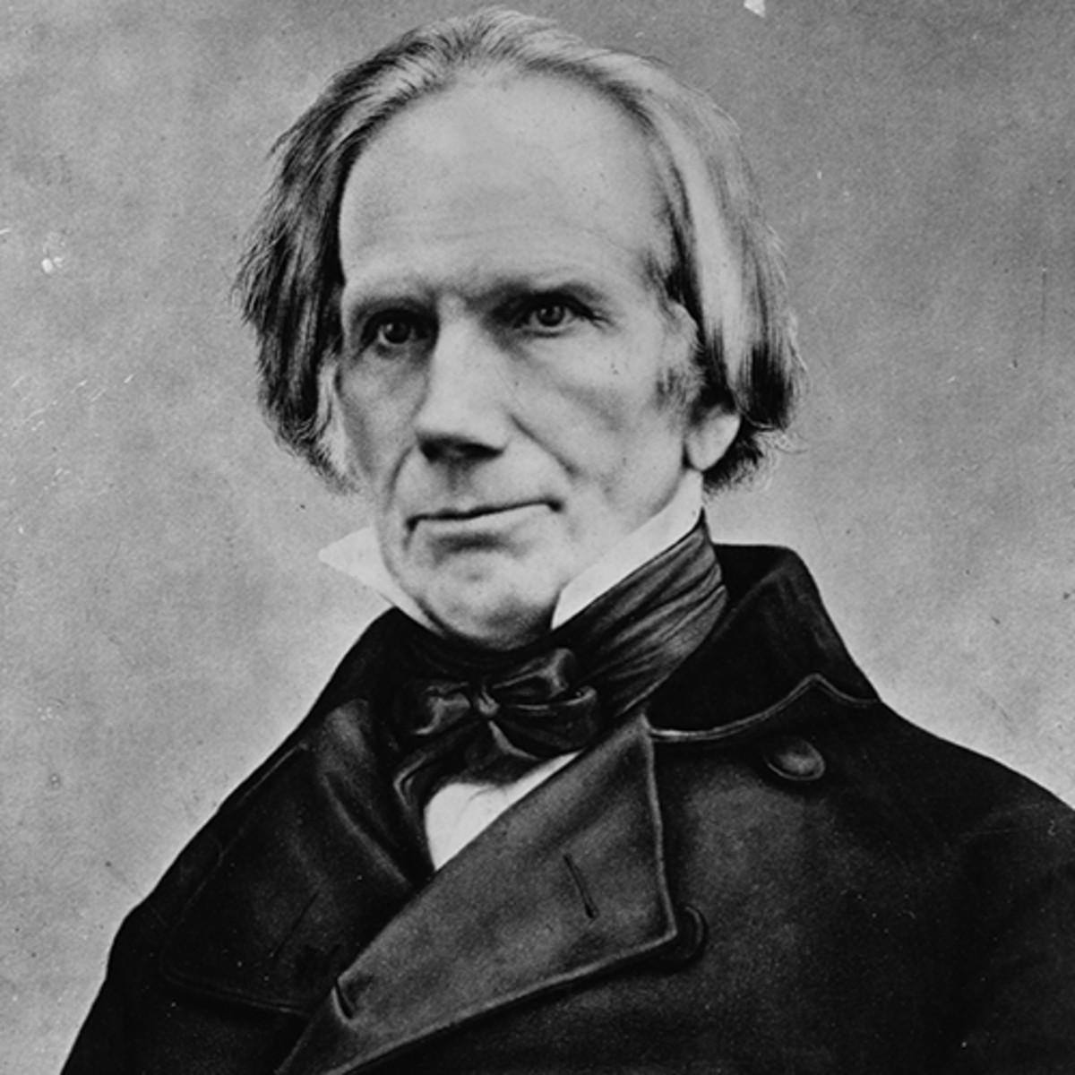
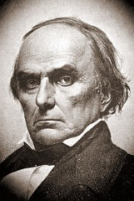
But the central bank has powerful friends
Loaned money to politicians Henry Clay and Daniel Webster
  Webster frequently wanted his retainer “renewed or refreshed as usual.”

Slide 10
The Corrupt Bargain of 1825
In 1824 Jackson defeats Secretary of State John Quincy Adams (a stockholder in the SBUS) in the popular and electoral vote
But Adams works with Speaker of the House Clay to steal the election
  Quid pro quo: Clay makes Adams president, Clay becomes Secretary of State
  Jackson fumed: “The Judas of the West has closed the contract, and received the thirty pieces of silver. His end will be the same.”

Slide 11
The Revolution of 1828
Van Buren creates the libertarian Democratic Party
  Makes Jackson the charismatic standard bearer
  Jackson and Van Buren fight congressional cronyism with the presidential veto
    Executive reform!
  Triumphantly, Jackson smashes Adams in the rematch. Does Jackson embark upon monetary reform?

Slide 12
The opening artillery fire
In 1829, economists William Gouge and Condy Raguet criticize the banking system as the “foundation of artificial inequality of wealth, and thereby, of artificial inequality of power.”
Jackson’s first congressional address declares the central bank’s existence “well questioned by a large portion of our fellow citizens.”
  This threatens its upcoming recharter in 1836
Biddle stunned. He had actually voted for Jackson (to mollify him)

Slide 13
The counterattack: propaganda and bribery
Biddle sends his congressional allies pro-central banking information
Enlists the academic American Quarterly Review, owned by a recipient of SBUS loans
Corrupts newspapers with money. E.g., gives the Courier and Enquirer a $15,000 loan
From 1829 to 1832 Biddle spends $50,000 to $100,000 on pamphlets, lent $100,000 to newspapers, and loaned congressmen $100,000 to $200,000

Slide 14
But the siege continues
In 1830 Jackson proposes a gold warehouse
  “a bank . . . without power to make loans . . . [and] though issuing no paper, would check the issues of the state banks by taking their notes . . . so long as they continue to be redeemed with specie.”
Senator Thomas Benton blasts the bank as a privileged monopoly unbecoming of a “confederacy of States.”

Slide 15
The nefarious Henry Clay steps in
Clay wants to defeat Jackson in the 1832 election
  His running mate was a former shareholder and director of the SBUS
  He urges Biddle to push for an early recharter before the election
    If Jackson vetoes, he will lose. If he doesn’t, he would still lose. A win-win!

Slide 16
The climax
The thoroughly bribed Congress passes the recharter bill in July. Biddle triumphantly appears and then hosts a party
But Jackson had long ago decided to veto the “corrupting monster.”

Slide 17
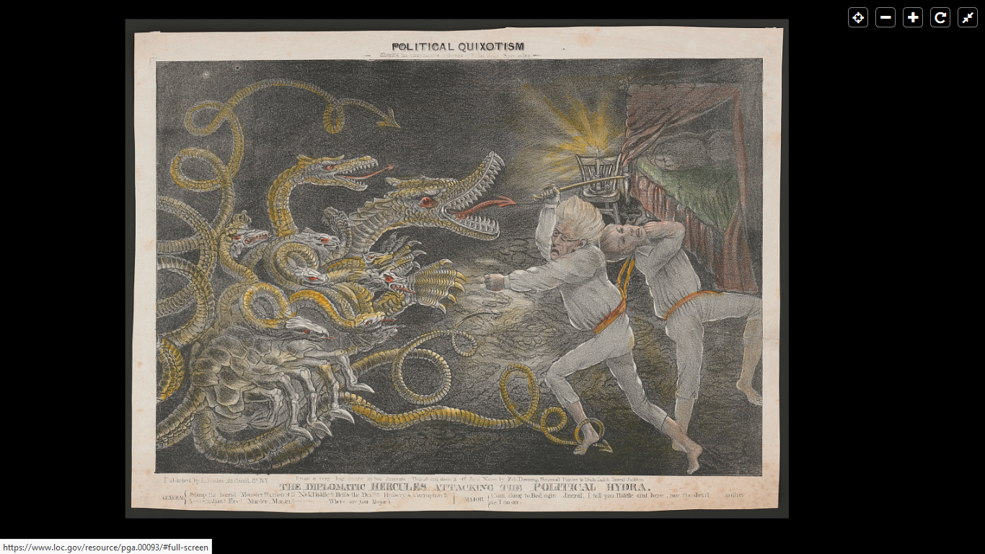
Liberty versus Power
Jackson to Van Buren: “the bank, Mr. Van Buren is trying to kill me, but I will kill it!”

Slide 18
Jackson’s veto was the best presidential reform against cronyism
Jackson transforms the presidential veto
When the “rich and the powerful” scheme to devise “artificial distinctions, to grant titles, gratuities, and exclusive privileges,” the public can “complain of the injustice.”
  Veto written by economist Amos Kendall
Donald Cole: “the veto is an attack on government privilege, not, as some have suggested, on capitalism.”

Slide 19
Jacksonian Veto
While Biddle described Jackson’s decision as “anarchy,” the president victoriously defeats Clay in the 1832 election
Van Buren writes to Jackson: “The idea of the establishment of any bank in any of the States, is, I take it, entirely done away with by the veto.”

Slide 20
Subsequent years
Jackson: “the hydra of corruption is only scotched, not dead.”
In 1833, Jackson removes the government’s deposits. The hydra officially loses its charter in 1836
In 1840, President Van Buren supports Jackson’s call to “separate the government from all banks”
  His Independent Treasury (1840) separates the federal government from banking by only accepting payments in specie

Slide 21
Conclusion
Andrew Jackson’s veto dealt a deadly blow to central banking in the United States
Using executive power has pitfalls, but seems to be the only effective way to enact reform
  Legislative bodies will always want the goodies, the executive can combat with vetoes

Slide 22
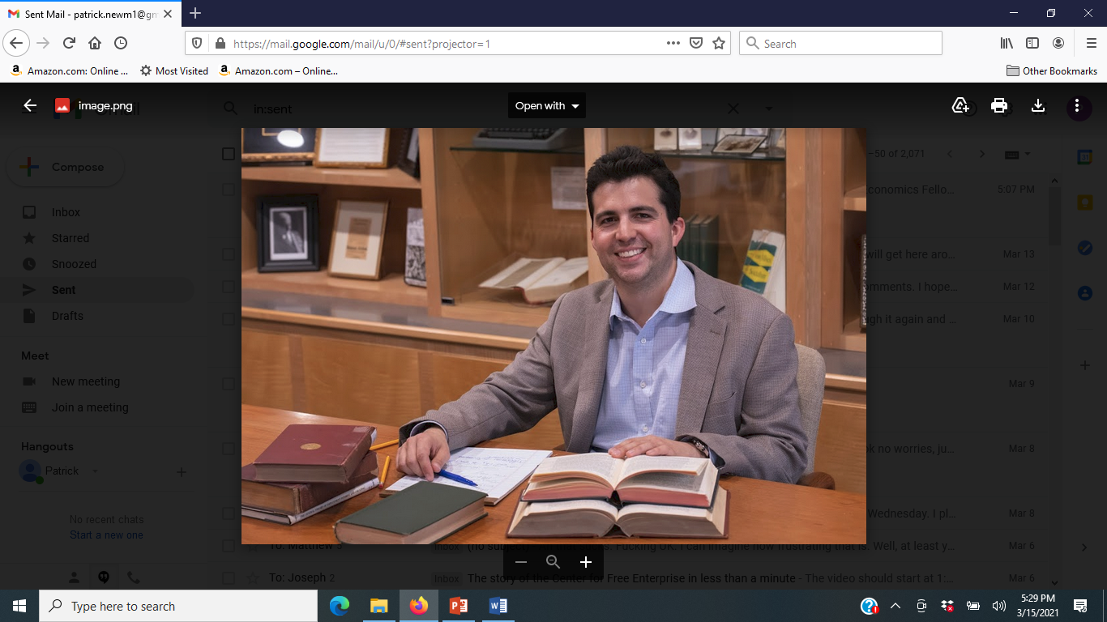
Conclusion
Cronyism is a must read for the origins of special-interest legislation
  Fantastic gift for Labor Day, Halloween, Thanksgiving, Christmas, and (especially) Valentine’s Day
  At the very least, it cures insomnia
  And is a very nice paperweight
  Stay tuned for the sequel!

