Slide 1
Banking
Dr. Patrick Newman
2022 Mises University

Slide 2
What’s this presentation about, and why should I care?
Why banks exist
The difference between loan banking and deposit banking
How deposit banking affects the money supply
  How free banking limits credit expansion
    Adverse clearing mechanism
How central banking affects the money supply
  The money multiplier process

Slide 3
What is money?
Money: a generally accepted medium of exchange
  Money proper:
    a commodity
    or paper made irredeemable by fiat
    Money substitute: a claim to a fixed amount of money proper
      Bank notes, bank deposits, etc.

Slide 4
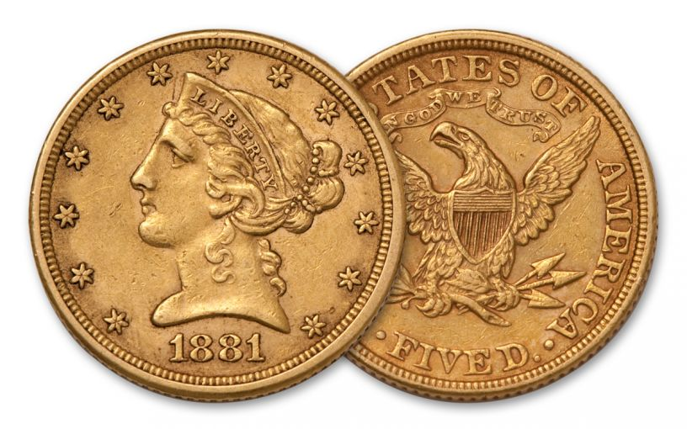
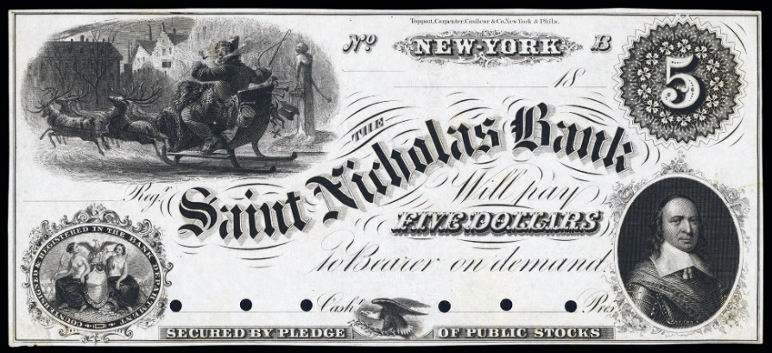
Under the gold standard
THE SAINT NICHOLAS BANK WILL PAY FIVE DOLLARS (1/4TH OZ. OF GOLD) TO THE BEARER ON DEMAND

Slide 5

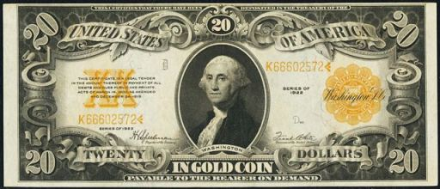
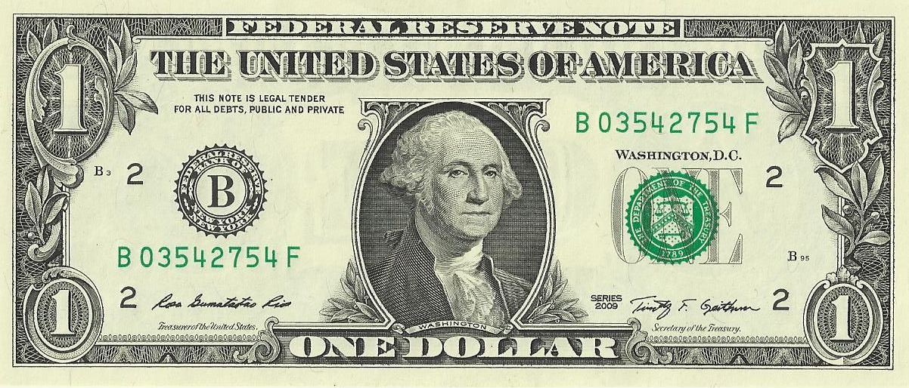

Under the Federal Reserve System
$20 IN GOLD COIN (1 OZ.) PAYABLE TO THE BEARER ON DEMAND

Slide 6
What is banking?
Bank: an institution that makes loans and/or issues money substitutes
  The first function is called loan banking
  The second function is called deposit banking

Slide 7
Why does banking exist?
  Loan banking exists because financial intermediation lowers the cost of finding borrowers and lenders
  Deposit banking exists because gold and silver coins are cumbersome and can be easily stolen
    Bank notes are easier to carry (small transactions)
    Debit cards can be precisely divided and require verification

Slide 8
Simple loan banking
Let’s assume we are on a gold standard
Suppose Patrick Newman decreases consumption by $10,000 and starts a bank with his savings
Newman Bank
Assets | Equity + Liabilities
Gold $10,000 | Equity $10,000
$10,000 | $10,000

Slide 9
Simple loan banking
Then the Newman bank makes a $9,000 loan to Jonathan for one year
Important: the money supply has not changed, only cash balances
Newman Bank
Assets | Equity + Liabilities
Gold $10,000 | Equity $10,000
$10,000 | $10,000
Newman Bank
Assets | Equity + Liabilities
Gold $1000 IOU from Jonathan $9,000 | Equity $10,000
$10,000 | $10,000

Slide 10
Complex loan banking
Suppose the Newman Bank borrows $5,000 from Ludwig in the form of a Certificate of Deposit
  CODs are not money substitutes. Ludwig can’t spend the money
  The Newman Bank then makes a $5,000 loan to the Mises Institute
The money supply remains constant
Newman Bank
Assets | Equity + Liabilities
Gold $1000 IOU from Jonathan $9,000 IOU from Mises Institute $5,000 | Equity $10,000 Liabilities COD to Ludwig $5,000
$15,000 | $15,000
Newman Bank
Assets | Equity + Liabilities
Gold $1000 IOU from Jonathan $9,000 | Equity $10,000
$10,000 | $10,000

Slide 11
It is different with deposit banking
  Let’s start over
  Suppose Bob deposits $10,000 of gold at the Newman Bank
    The deposit is a money substitute. Bob can spend it or redeem it for the money proper
    Bob can convert it into bank notes
    The money supply has not changed, only the composition of Bob’s cash balance
Newman Bank
Assets | Equity + Liabilities
Gold Reserves $10,000 | Liabilities Deposit to Bob $10,000
$10,000 | $10,000

Slide 12
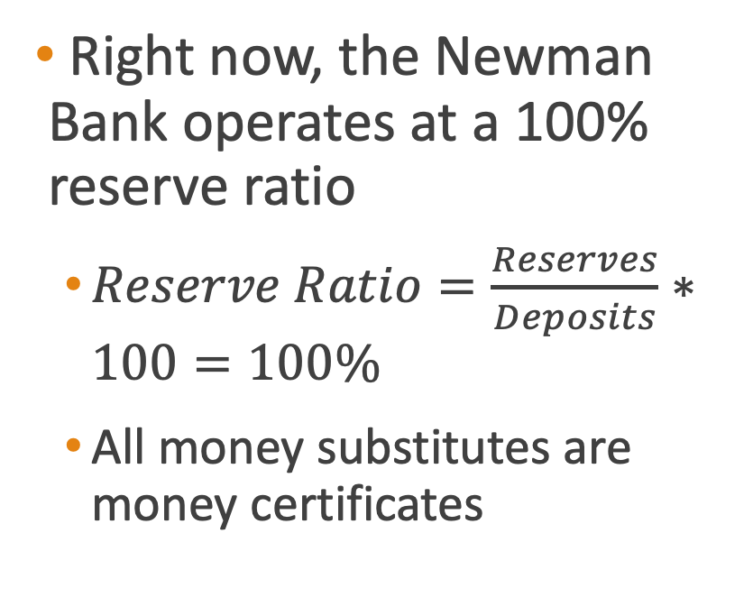
Deposit banking
Right now, the Newman Bank operates at a 100% reserve ratio
  $Reserve Ratio=\frac{Reserves}{Deposits}∗100=100\%$
  All money substitutes are money certificates
Newman Bank
Assets | Equity + Liabilities
Gold Reserves $10,000 | Liabilities Deposit to Bob $10,000
$10,000 | $10,000

Slide 13
Deposit banking
  Then the Newman Bank makes a $90,000 loan to Jim
    Credit expansion: increasing the money supply by making loans
  The money supply increases by $90,000
    $100,000 money substitutes. $10,000 are money certificates and $90,000 are fiduciary media
Newman Bank
Assets | Equity + Liabilities
Gold Reserves $10,000 | Liabilities Deposit to Bob $10,000
$10,000 | $10,000
Newman Bank
Assets | Equity + Liabilities
Gold Reserves $10,000 IOU from Jim $90,000 | Liabilities Deposit to Bob $10,000 Deposit to Jim $90,000
$100,000 | $100,000

Slide 14
Fractional reserve banking
The Newman Bank is operating at a 10% fractional reserve ratio
The Newman Bank cannot meet all potential withdrawals, but estimates that it will never have to
  Liquid: enough reserves to meet current withdrawals
  Illiquid: not enough reserves to meet current withdrawals

Slide 15

Wait a second
Mainstream economist: if banks can increase the money supply, they will do so endlessly
  The free market has allowed the Newman Bank to increase the money supply by $90,000 (out of thin air)!
  Wildcat banking!

Slide 16
Free Banking
Austrians: competition will limit credit expansion!
  The Adverse Clearing Mechanism: credit expansion causes an outflow of reserves

Slide 17
Bank competition
If the Newman Bank makes the $90,000 loan, it will go bankrupt
Why? Jim will spend his loan at ACE Hardware, which deposits the money at the Bank of Salerno
  The bank owners are friends, but not that good of friends
  Joseph Salerno will present the obligation to Patrick Newman for redemption in gold
  But the Newman Bank only has $10,000 in gold!

Slide 18
Free banking
  Competition severely limits credit expansion
  Wait! What if banks form a cartel to coordinate credit expansion?
  It would fail because of internal and external pressure

Slide 19
Central banking
A central bank has five characteristics
  Monopoly on note issuance (usually fiat money)
  Banker’s bank (holds bank reserves)
  Regulator (reserve requirements)
  Lender of last resort
  Conductor of monetary policy
Central banking strengthens bank cartels by easily increasing bank reserves

Slide 20
Central bank monetary policy
The modern central bank has four tools it uses to try to affect economic activity
  Open market operations
  Discount window
  Reserve requirements
  Interest on bank reserves
  Let’s look at open market operations and the money multiplier
    The step-by-step process of how credit expansion increases the money supply

Slide 21
Open market operations explained
The Fed writes a $1000 check to bond dealers Powell & Sons. It “prints money out of thin air”
Powell & Sons deposits at the Newman Bank
The Newman Bank deposits it at the Federal Reserve (not shown)
Newman Bank
Assets | Equity + Liabilities
Reserves $1000 | Liabilities Deposit to Powell & Sons $1000
$1000 | $1000

Slide 22
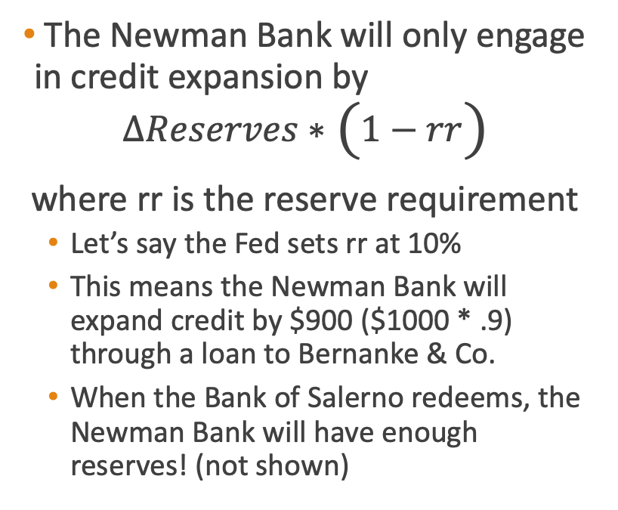
Open market operations explained
The Newman Bank will only engage in credit expansion by
$$∆Reserves∗\left(1−rr\right)$$
where rr is the reserve requirement
  Let’s say the Fed sets rr at 10%
  This means the Newman Bank will expand credit by $900 ($1000 * .9) through a loan to Bernanke & Co.
  When the Bank of Salerno redeems, the Newman Bank will have enough reserves! (not shown)
Newman Bank
Assets | Equity + Liabilities
Reserves $1000 | Liabilities Deposit to Powell & Sons $1000
$1000 | $1000
Newman Bank
Assets | Equity + Liabilities
Reserves $1000 IOU from Bernanke & Co. $900 | Liabilities Deposit to Powell & Sons $1000 Deposit to Bernanke & Co. $900
$1900 | $1900

Slide 23
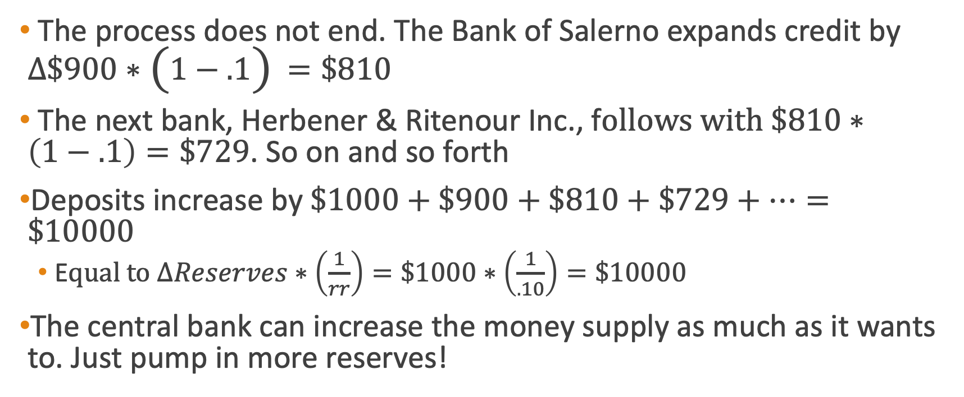
Open market operations explained
The process does not end. The Bank of Salerno expands credit by $∆\$900∗\left(1−.1\right)=\$810$
The next bank, Herbener & Ritenour Inc., f$ollows with \$810∗\left(1−.1\right)=\$729$. So on and so forth
Deposits increase by $\$1000+\$900+\$810+\$729+…=\$10000$
  E$qual to ∆Reserves∗\left(\frac{1}{rr}\right)=\$1000∗\left(\frac{1}{.10}\right)=\$10000$
The central bank can increase the money supply as much as it wants to. Just pump in more reserves!

Slide 24
The monetary transmission mechanism
With each new loan from credit expansion, the money supply increases
It is injected into the economy at a specific point, raising prices and changing production unevenly

Slide 25
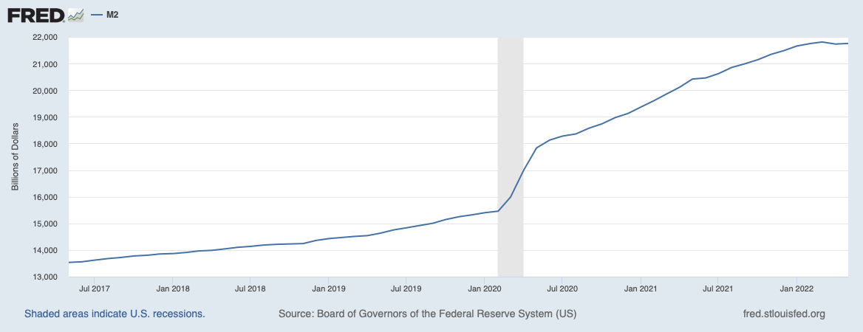


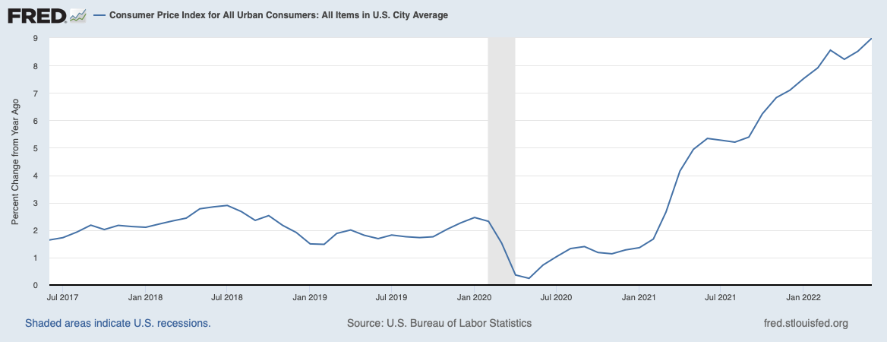
Don’t forget that prices go up!
>40%
>9%

Slide 26

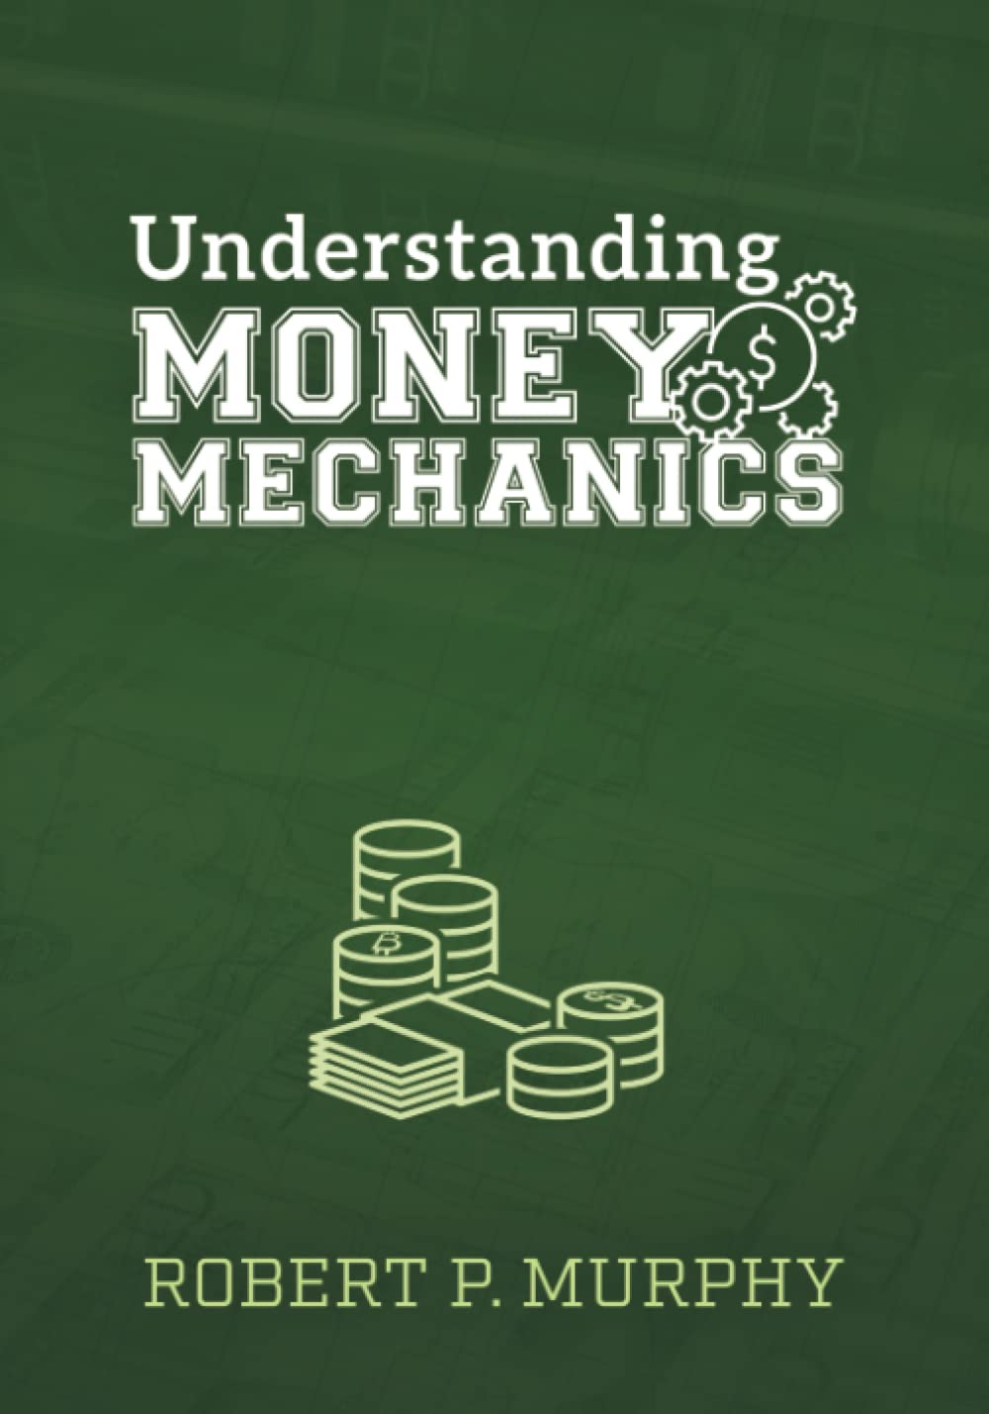
Thanks for listening!
For more, read Murray Rothbard’s The Mystery of Banking (2008) and Bob Murphy’s Understanding Money Mechanics (2021)

