Slide 1
Entrepreneurship
Peter G. Klein
Mises University
2023
@petergklein
#MisesU

Slide 2
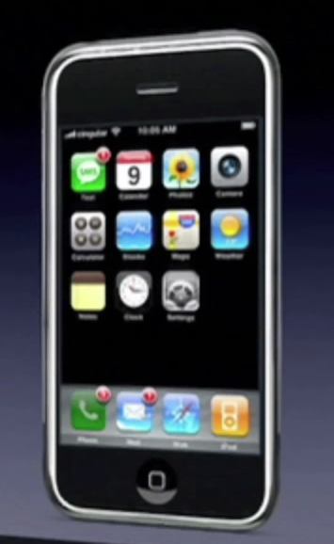
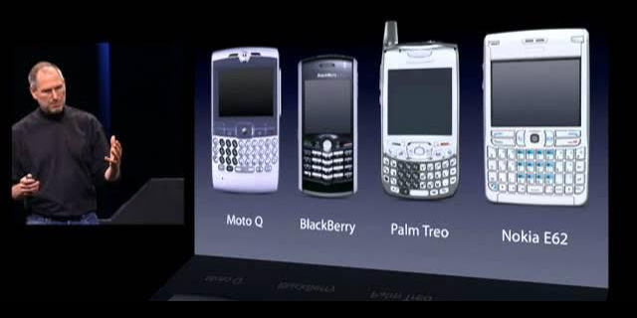
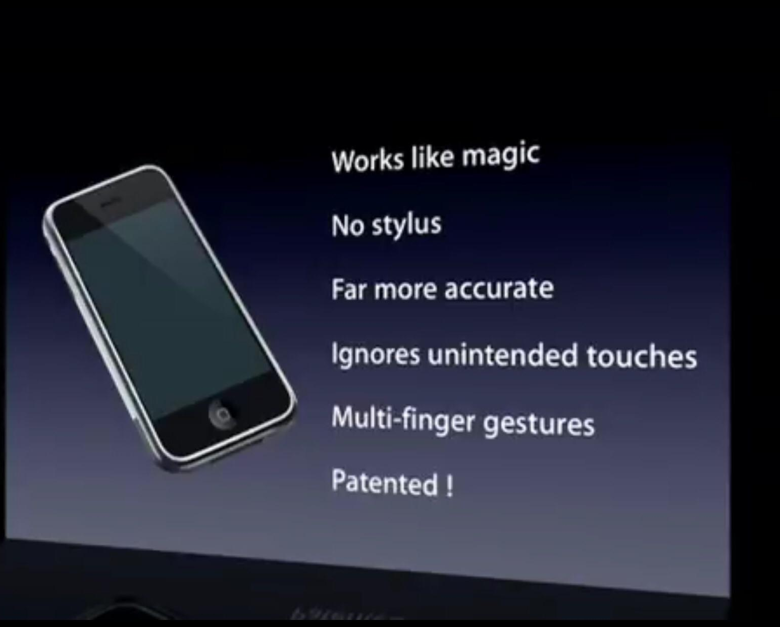
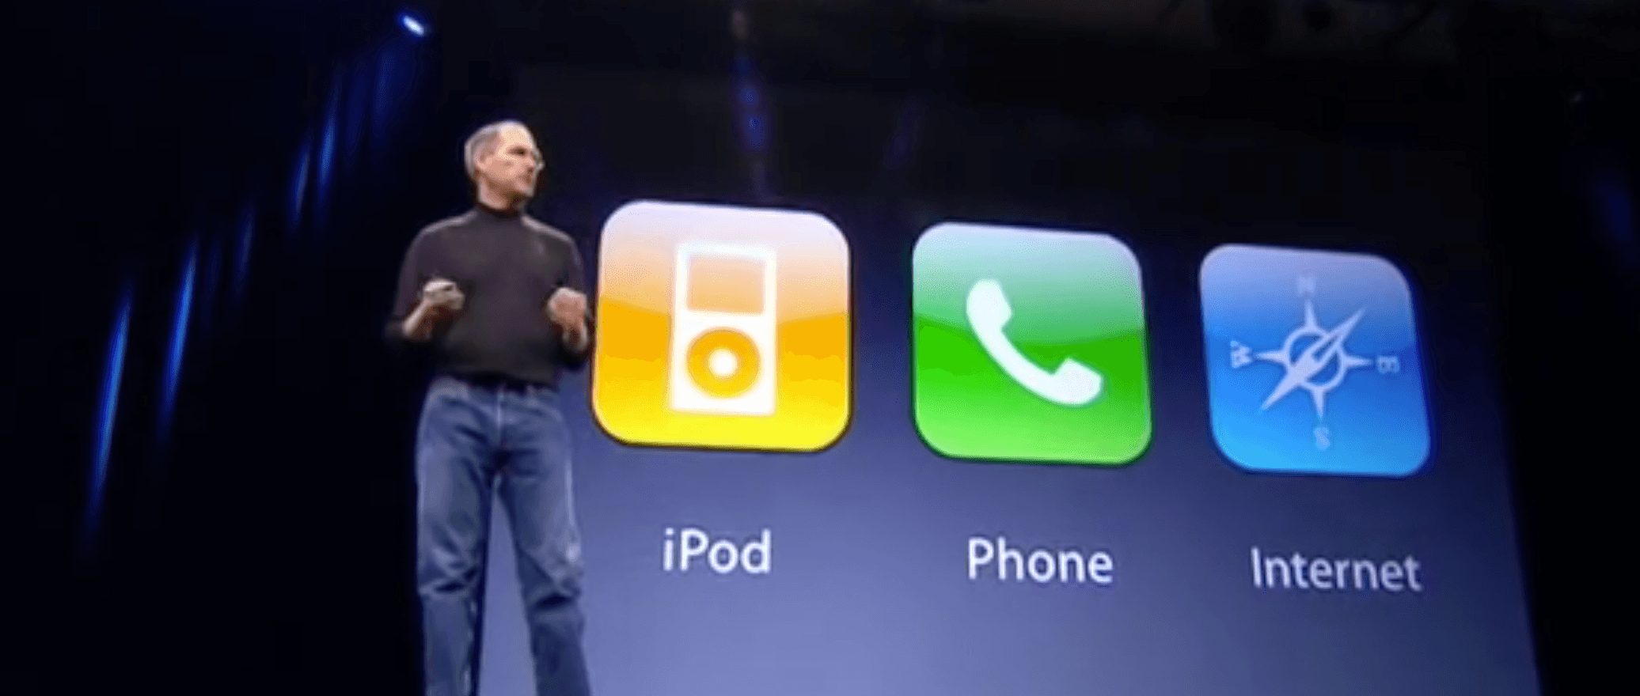

Slide 3


Slide 4


Slide 5




Slide 6
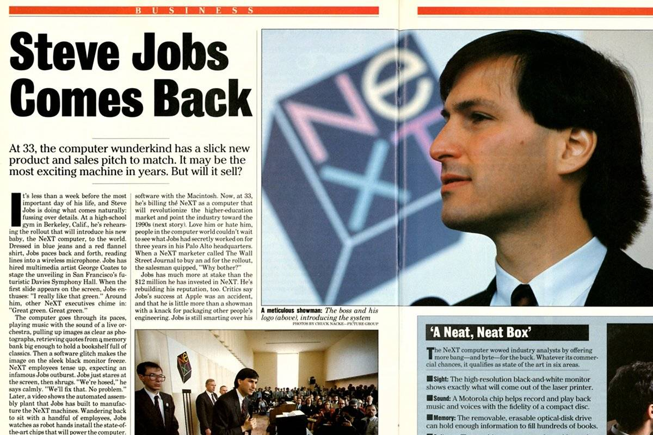


Slide 7
Uncertainty

Slide 8
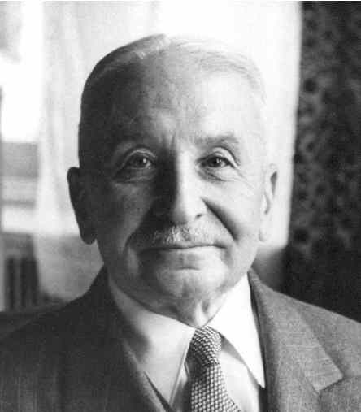
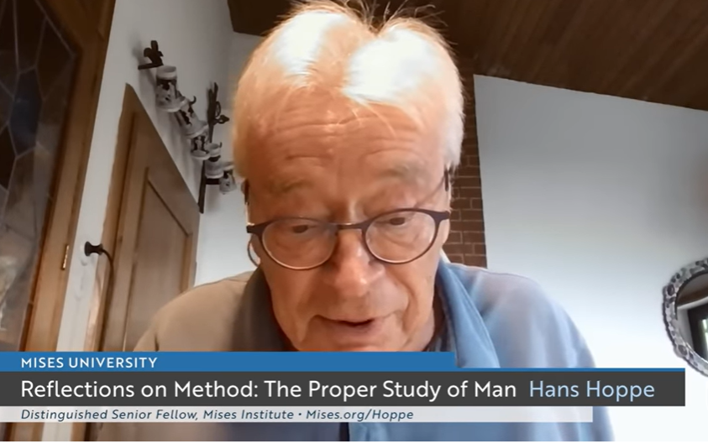
Thinking about entrepreneurship
Entrepreneurship in the broad sense: bearing uncertainty
  “The term entrepreneur as used by [economic] theory means: acting man exclusively seen from the aspect of the uncertainty inherent in every action” (Mises, 1949).
  “In using this term one must never forget that every action is embedded in the flux of time and therefore involves a speculation. The capitalists, the landowners, and the laborers are by
  necessity speculators. So is the consumer in providing
  for anticipated future needs. There’s many a slip ‘twixt
  cup and lip” (Mises, 1949).
  Subjective benefit and cost
  Subjective profit and loss

Slide 9
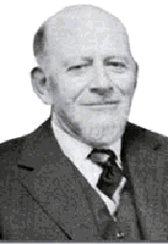
Thinking about entrepreneurship
Entrepreneurship in the broad sense: bearing uncertainty
  “The term entrepreneur as used by [economic] theory means: acting man exclusively seen from the aspect of the uncertainty inherent in every action” (Mises, 1949).
Entrepreneurship in the narrow (commercial) sense: combining and recombining productive factors in pursuit of money profit
  “We are living in a world of unexpected change; hence capital combinations . . . will be ever changing, will be dissolved and reformed. In this activity, we find the real function of the entrepreneur” (Lachmann, 1956).
  Monetary (cardinal) revenues and costs
  Monetary profit and loss

Slide 10

Why entrepreneurship matters
“[I]t is impossible to eliminate the entrepreneur from the picture of a market economy. The various complementary factors of production cannot come together spontaneously. They need to be combined by the purposive efforts of men aiming at certain ends and motivated by the urge to improve their state of satisfaction. In eliminating the entrepreneur one eliminates the driving force of the whole market system” (Mises, 1949, p. 248).

Slide 11
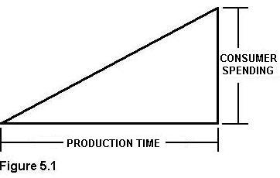
Why entrepreneurship matters
“[I]t is impossible to eliminate the entrepreneur from the picture of a market economy. The various complementary factors of production cannot come together spontaneously. They need to be combined by the purposive efforts of men aiming at certain ends and motivated by the urge to improve their state of satisfaction. In eliminating the entrepreneur one eliminates the driving force of the whole market system” (Mises, 1949, p. 248).
Austrian production theory
  Inputs and outputs
  Capital and stages of production (Ritenour, tomorrow)
  Imputation
  Need for economic calculation (Salerno, tomorrow)

Slide 12
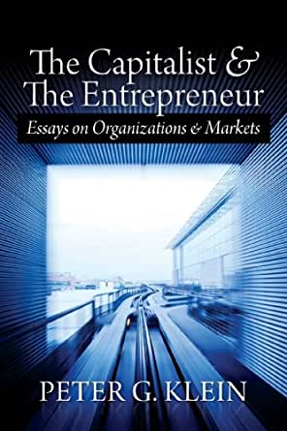
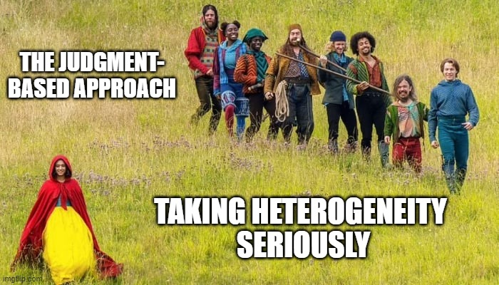
Entrepreneurship as judgment
Judgment: decision-making under uncertainty without a formal model or decision rule (intuition, gut feeling, Verstehen)
  “[T]he real entrepreneur is a speculator, a man eager to utilize his opinion about the future structure of the market for business operations promising profits. This specific anticipative understanding of the conditions of the uncertain future defies vany rules and systematization. It can be neither taught nor learned. . . . [The entrepreneur] sees the past and the present as other people do; but he judges the future in a different way” (Mises, 1949, p. 585).
Judgment is manifest in ownership (Mises’s capitalist-
entrepreneur”).
  Entrepreneur must own capital (taxi vs Uber drivers).
  Buying or renting factors (capital goods) in the present,
  deploying them in pursuit of profit in the (uncertain) future.
  This is hard because capital goods are diverse.

Slide 13
Entrepreneurial profit and loss
In equilibrium (Mises’s and Rothbard’s evenly rotating economy)
  Each factor earns its discounted marginal revenue product (DMRP).
  Owner-managers of firms earn implicit wages based on opportunity cost.
  Capitalists earn interest based on time preference.
Outside the evenly rotating economy?
  Entrepreneurs compete for factors, based on their knowledge and beliefs about
    The present: technology, productive capabilities, resource availability
    The future: consumer demand, institutional conditions, competitor actions
    Actual DMRPs will only be revealed in the future.
  Results: profit and loss

Slide 14
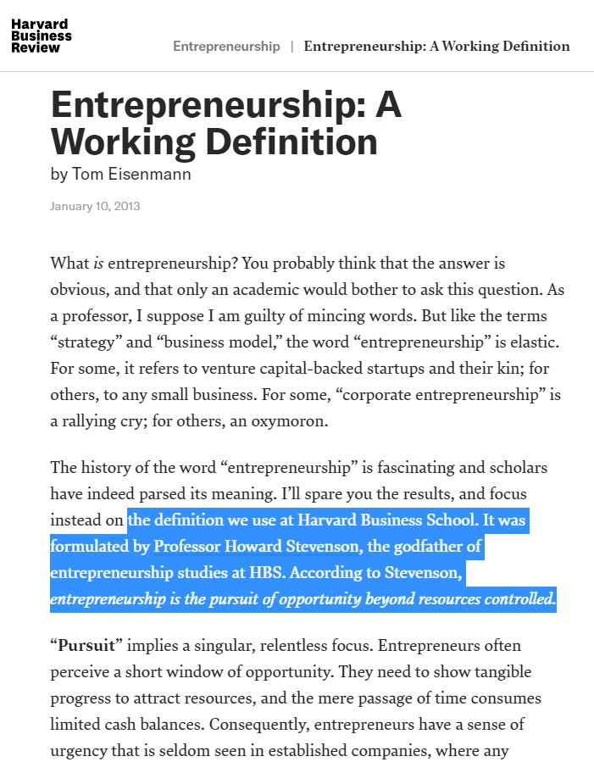
Other concepts of entrepreneurship
Personality traits (charisma, creativity, leadership, persistence)
Phenomena associated with startups, small business, tech
  Starting a business
  Managing a small business
  Starting and growing a particular type of business (small, tech, high-growth, VC-backed, with patents)
  Starting a business in a particular way (e.g., lean startup)
Pursuit of “opportunity”

Slide 15
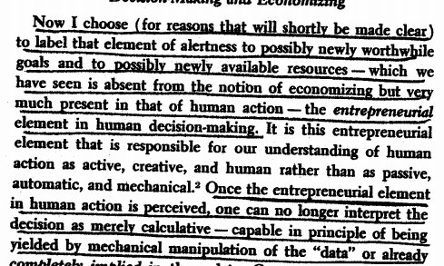

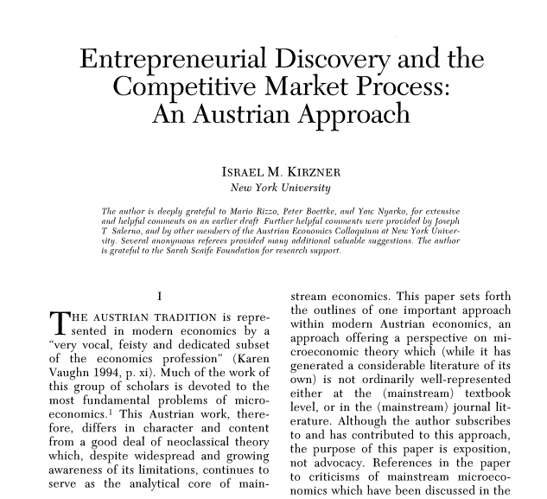

Slide 16
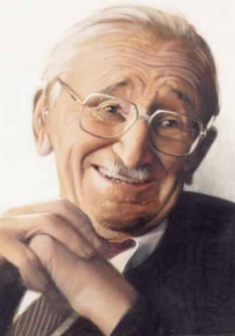
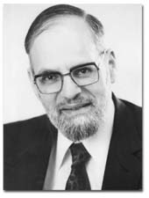
Problems with the discovery view
Hayek (1968): competition “is important primarily as a discovery procedure whereby entrepreneurs constantly search for unexploited opportunities that can also be taken advantage of by others.”
Kirzner (1973): entrepreneurship is alertness to “changing buying and selling possibilities,” “relevant new information,” and “potentially worthwhile goals hitherto unnoticed, as well as toward unnoticed potentially valuable, available resources.” The entrepreneur “notices [a] price discrepancy before others do.”
But
Entrepreneurs don’t discover, they create. Entrepreneurship looks to the future!
If profit comes from successful discovery, whither loss?
Under uncertainty, entrepreneurs must own capital.
For Mises, the “market process” is the profit-and-loss system, not convergence to equilibrium.

Slide 17
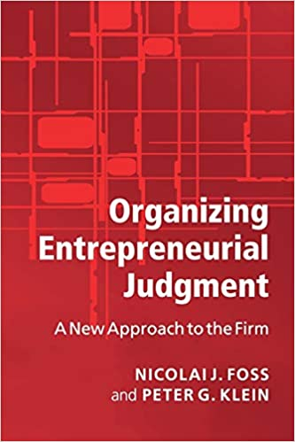
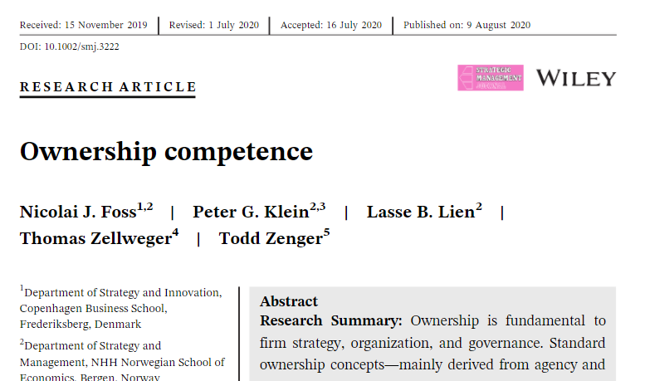
Entrepreneurial judgment and ownership
Judgement under uncertainty manifest in ownership.
Judgment can be exercised by individuals or groups.
  Joint ownership
  Organizations as nested hierarchies of judgment (Foss et al., 2007)
Ownership has a competence dimension, not just an incentive dimension.
  “People differ in their talents as owners. . . . Ownership
  ability includes attitude toward risk bearing, knowledge
  of different people’s productive abilities, foresight, and,
  of course, judgment” (Alchian, 1961).
  Owners vary with respect to
    Matching competence: what to own
    Governance competence: how to own
    Timing competence: when to own

Slide 18

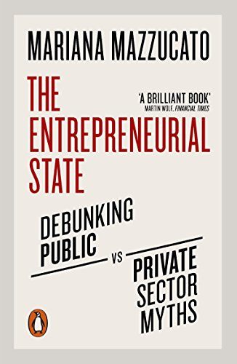

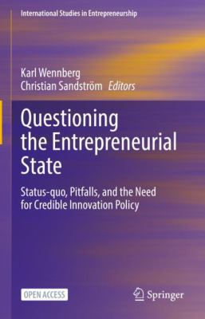
Can non-market actors be entrepreneurial?
Entrepreneurship versus “entrepreneur-like” behavior
Objectives, incentives, performance evaluation
Judgment and ultimate responsibility

